Slide 1
Lecture 7: Machine Translation, Sequence-to-Sequence and Attention
Presenter: Chu Đình Đức

Slide 2
Lecture Plan
Neural Machine Translation with Seq2Seq
Attention
Subword Models

Slide 3
1.1 Sequence-to-sequence Basics
Seq2Seq model is an end-to-end model made up of two RNNs
a encoder, which takes the model's input sequence as input and encodes it into a fixed-size "context vector", and
a decoder, which uses the context vector from above as a "seed" from which to generate an output sequence
Seq2Seq models are often referred to as "encoder-decoder models"

Slide 4
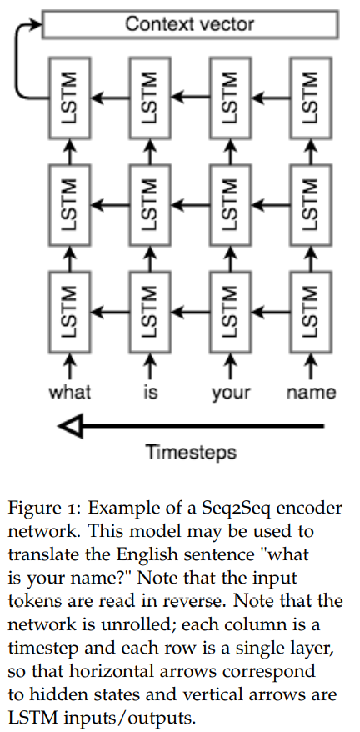
1.2 Seq2Seq architecture - encoder
Because it's so difficult to compress an arbitrary-length sequence into a single fixed-size vector, the encoder will usually consist of stacked LSTMs
Seq2Seq encoder will process the input sequence in reverse

Slide 5
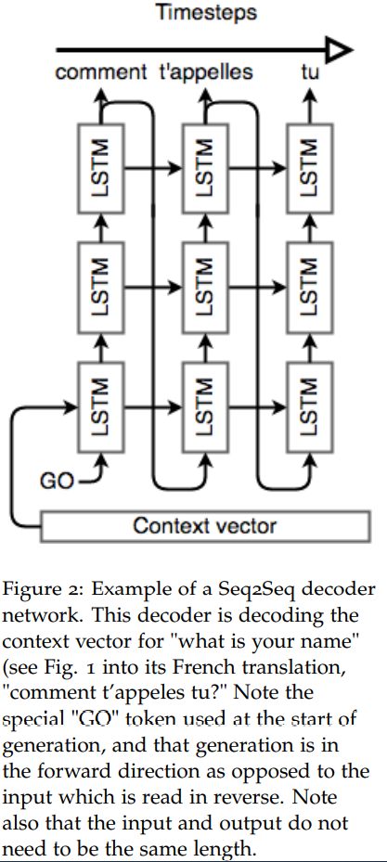
1.3 Seq2Seq architecture - decoder
An <GO> token is appended to the end of the input (there's also one at the end of the output)
Use softmax on the final layer's output to generate the output word, then pass that word into the first layer

Slide 6
1.4 Recap and Basic NMT Example
What a Seq2Seq model does in order to translate the English "what is your name" into the French "comment t'appelles tu"?
We start with 4 one-hot vectors for the input, then embed them into 4 dense vector representation
Encoder encodes 4 sequential vectors into a context vector
Using this context vector and <GO> as input of decoder
Decoder constructs "comment t'appelles tu" word by word (figure 2)

Slide 7
2.1 Motivation
Different parts of a sentence have different levels of signification
"the ball is on the field"
You primarily take note of the words "ball", "on" and "field"

Slide 8
2.2 Bahdanau et al. NMT model
Input: x₁, …, x_{n} that we want to translate
Output: y₁, …, y_{m} is target sentence
Encoder:
Let (h1, …, hn) be hidden vectors representing the input sentence. These vectors are the output of a BiLSTM for instance, and capture contextual representation of each word in the sentence

Slide 9

2.2 Bahdanau et al. NMT model
Decoder: we want to compute the hidden states s_{i}
s_{i-1} is the previous hidden vector
y_{i-1} is the generated word at the previous step
c_{i} is a context vector that capture the context from the original sentence that is relevant to the time step i of the decoder

Slide 10

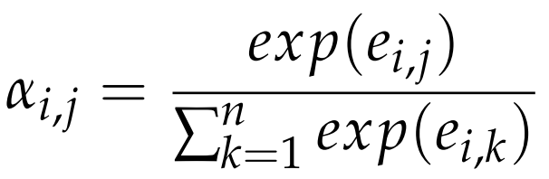
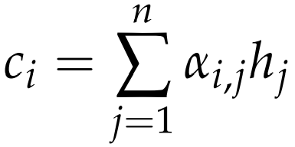
2.2 Bahdanau et al. NMT model
How to compute c_{i}?
For each hidden vector from the original sentence h_{j}, compute a score
Intuitively, this vector captures the relevant contextual information from original sentence for the i-th step of the decoder

Slide 11
2.3 Performance on long sentences
The major advantage of attention-based models is their ability to efficiently translate long sentences
As the size of the output grows, models that do not use attention will miss information and precision if they only use the final representation
Attention is a clever way to fix this issue and experiments indeed confirm the intuition

Slide 12
3.1 Word segmentation
Byte Pair Encoding
The essential idea is to start with a vocabulary of characters and keep extending the vocabulary with most frequent n-gram pairs in the dataset. Read more here
After the vocabulary is built, an NMT system with some seq2seq architecture can be directly trained on these word segments.
Notably, this method won top places in WMT 2016

Slide 13

3.2 Character-based model
For each word w with m characters, instead of storing a word embedding, this model iterates over all characters c₁, …, c_{m} to look up the character embeddings e₁, …, e_{m}
These characters embeddings are then fed into a biLSTM to get the final hidden states h_{f}, h_{b}. The final word embedding is

Slide 14
3.3 Hybrid NMT
Word-based Translation as a Backbone:
The core of the hybrid NMT is a deep LSTM encoder-decoder that translates at the word level
We maintain a vocabulary of size |V| per language and use <unk> to represent out of vocabulary words

Slide 15
3.3 Hybrid NMT
The twofold advantage of such a hybrid approach is that:
It is much faster and easier to train than character-based ones
At the same time, it never produces unknown words as in the case of word-based models
Word-based Translation as a Backbone
The core of hybrid NMT is a deep LSTM encoder-decoder that translates at the word level
We maintain a vocabulary of size |V| per language and use <unk> to represent out of vocabulary words

Slide 16
3.3 Hybrid NMT
Source Character-based Representation
In regular word-based NMT, a universal embedding for <unk> is used to represent all out-of-vocabulary words
This is problematic because it discards valuable information about the source words
Instead, we learn a deep LSTM model over characters of rare words, and use the final hidden state of the LSTM as the representation for the rare word

Slide 17
3.3 Hybrid NMT
Target Character-level Generation
General word-based NMT allows generation of <unk> in the target output. Instead, the goal here is to create a coherent framework that handles an unlimited output vocabulary
The solution is to have a separate deep LSTM that "translates" at the character level given the current word-level state. Note that the current word context is used to initialize the character-level encoder
The system is trained such that whenever the word-level NMT produces an <unk>, the character-level decoder is asked to recover the correct surface form of the unknown target word

Slide 18
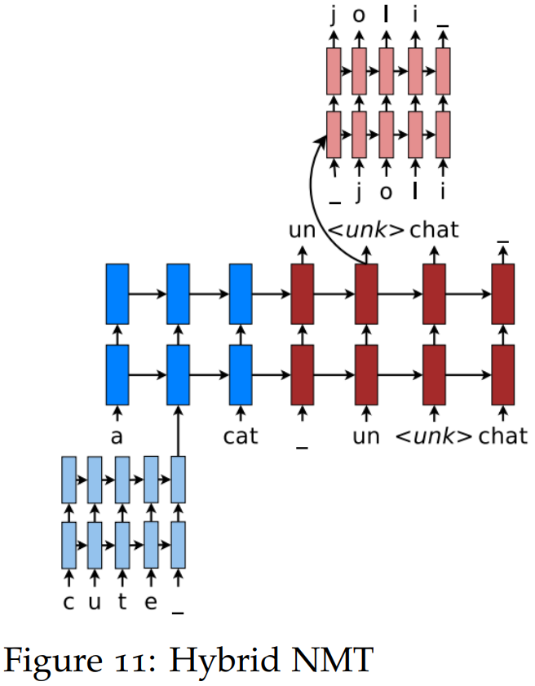
3.3 Hybrid NMT

Slide 19
THANK YOU!
Any questions

