Slide 1
Lecture 9: Transformers
Presenter: Chu Đình Đức

Slide 2
Lecture Plan
Impact of Transformers on NLP (and ML more broadly)
From Recurrence (RNNs) to Attention-Based NLP Model
Understanding the Transformer Model
Drawbacks and Variants of Transformers

Slide 3
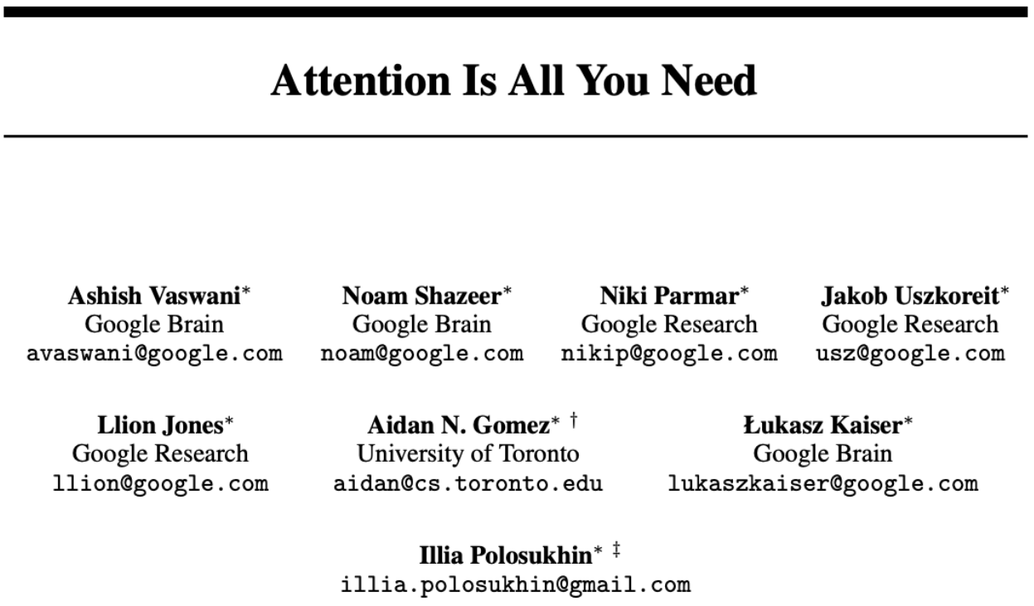
1. Impact of Transformers on NLP
We learn that attention dramatically improves the performance of RNN
Today, we will take this one step further and ask is attention all we need?

Slide 4
2. From RNNs to Attention-Based NLP Models
Issues with recurrent models
Linear interaction distance
Hard to learn long-distance dependencies (because gradient problems)
We already know sequential structure doesn't tell the whole story
Lack of parallelizability
Solution: (self) attention

Slide 5
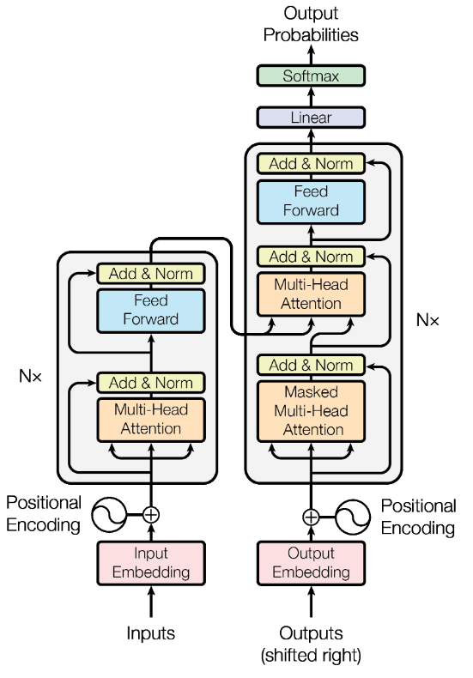
3. Understanding the Transformer Model

Slide 6
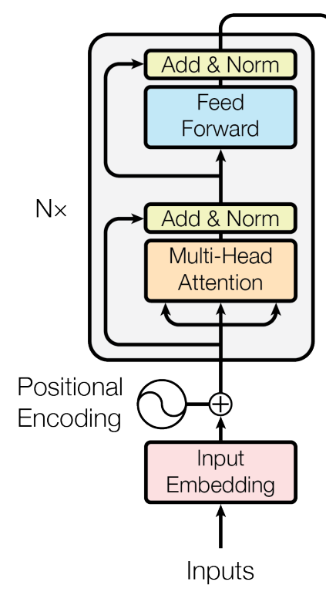
3.1 Encoder Conclusion
The encoder is composed of a stack of N = 6 identical layers. Each layer has two sub-layers. The first is a multi-head self-attention mechanism, and the second is a position-wise fully connected feed-forward network
We employ a residual connection around each of the two sub-layers, followed by layer normalization. That is, the output of each sub-layer is LayerNorm(x+Sublayer(x))

Slide 7
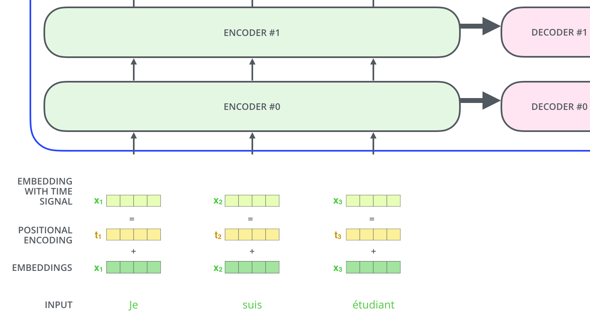
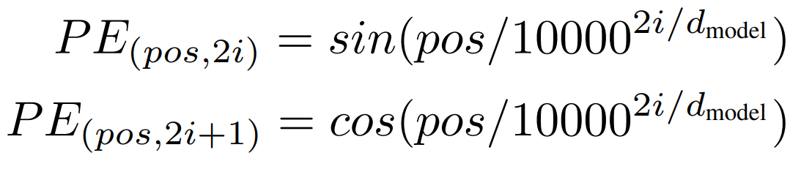
Positional Encoding
Since our model contains no recurrence (and no convolution), in order for the model to make use of the order of the sequence, we add "positional encoding" to the input embedding
The positional encodings have the same dimension d_{model} as the embeddings

Slide 8
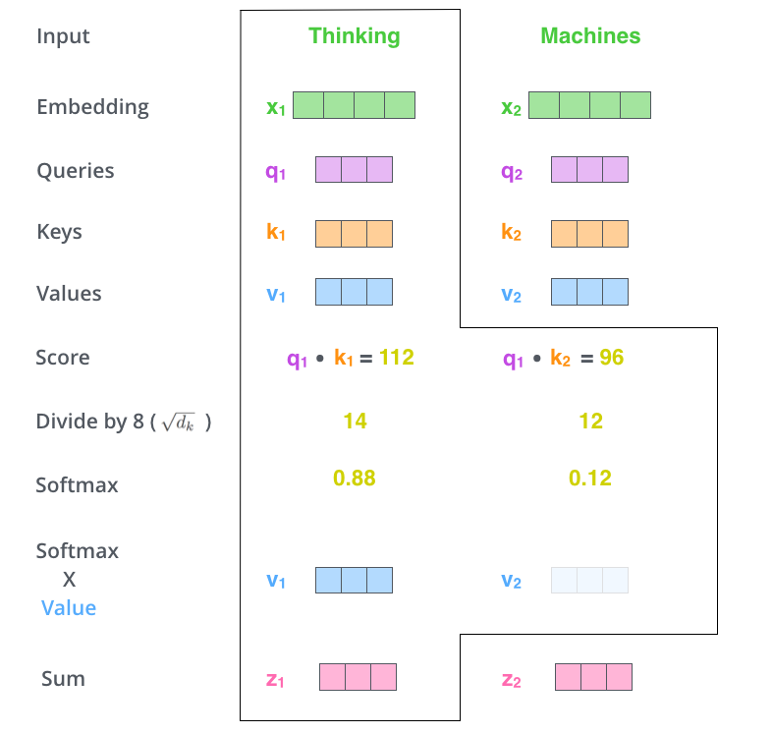
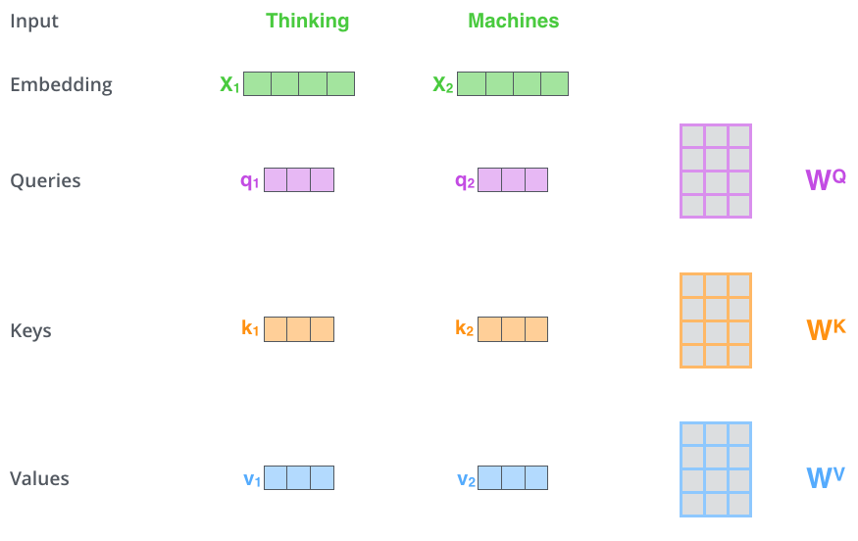
Scaled Dot-Product Attention

Slide 9
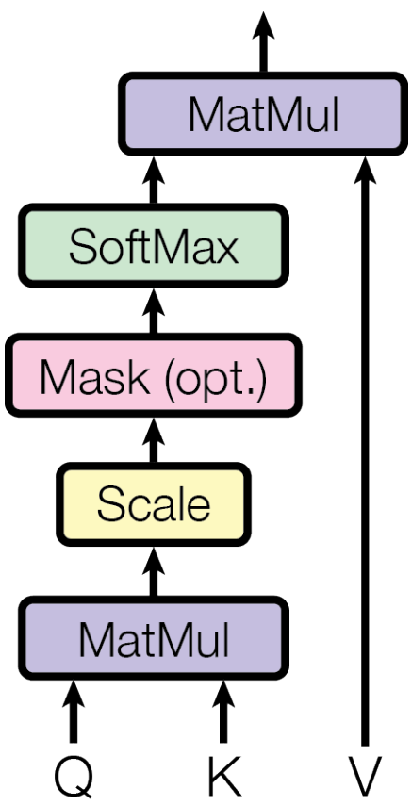
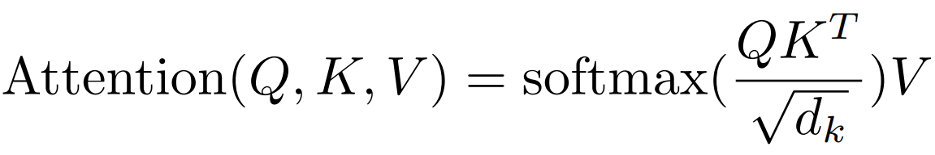
Scaled Dot-Product Attention
We call our particular attention "Scaled Dot-Product Attention"
The input consists of queries and keys of dimension d_{k}, and values of dimension d_{v}.
We compute the dot products of the query with all keys, divide each by sqrt(d_{k}), and apply a softmax function to obtain the weights on the values

Slide 10
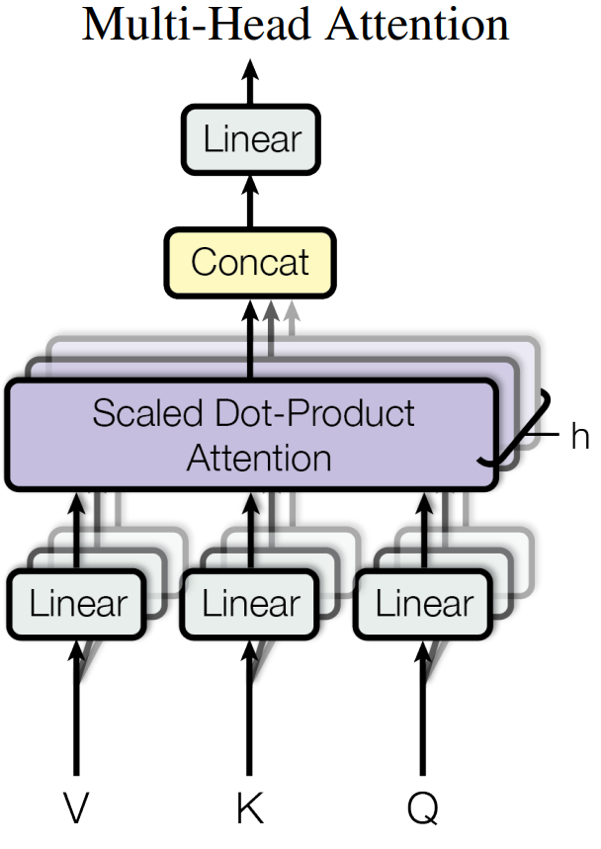
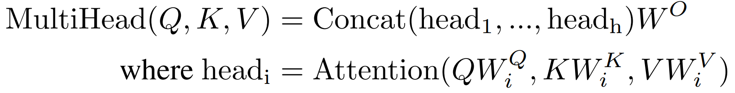
Multi-head Attention
Instead of performing a single attention, we found it beneficial to perform multi-head attention
Multi-head attention allows the model to jointly attend to information from different representation subspaces at different positions

Slide 11
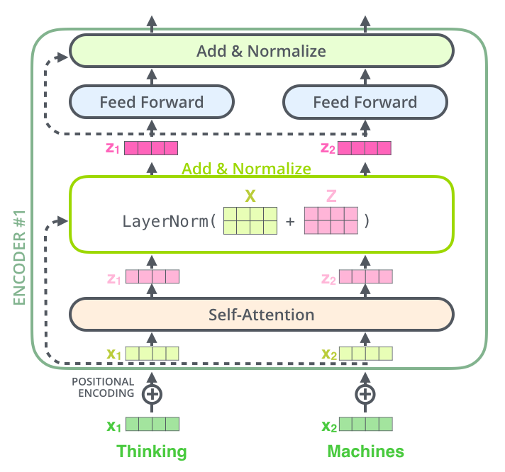
Add & Norm

Slide 12
Feed Forward
Each of the layers in our encoder and decoder contains a fully connected feed-forward network. This consists of two linear transformations with a ReLU activation in between
Add & Norm

Slide 13
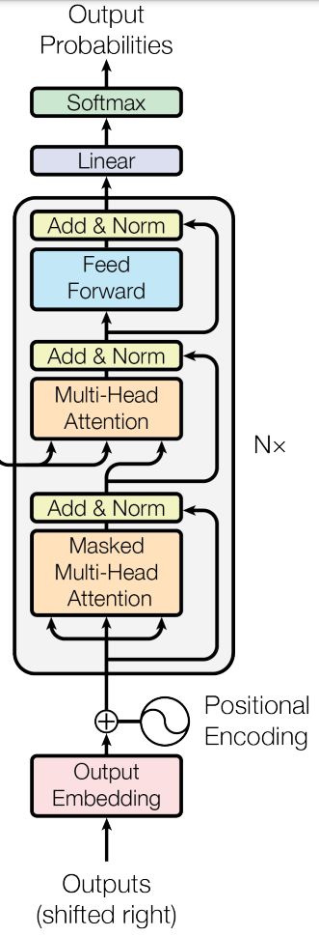
3.2 Decoder Conclusion
The decoder is also composed of a stack of N = 6 identical layers. In addition to the two sub-layers in each encoder layer, the decoder inserts a third sub-layer, which performs multi-head attention over the output of encoder stack
Similar to the encoder, we employ residual connections around each of the sub-layers, followed by layer normalization
We also modify the self-attention sub-layer in the decoder stack to prevent positions from attending to subsequent positions. This masking, combined with fact that the output embeddings are offset by one position, ensures that the predictions for position i can depend only on the known outputs at positions less than i

Slide 14
Outputs (Shifted right) - Decoder Input
Decoder 1: <s>
Decoder 2: <s> I
Decoder 3: <s> I am
Decoder 4: <s> I am a
Decoder 5: <s> I am a student --- STOP
Decoder 6:

Slide 15
Third Sub-layer Input
Output of the top encoder: z₁ z₂ z₃
z₁ z₂ z₃ mul W^{K} = k₁ k₂ k₃
z₁ z₂ z₃ mul W^{V} = v₁ v₂ v₃
Output of mask multi-head attention: zz₁ zz₂
zz₁ zz₂ mul W^{Q} = q₁ q₂
Self-attention with q k v
Multi-head attention

Slide 16
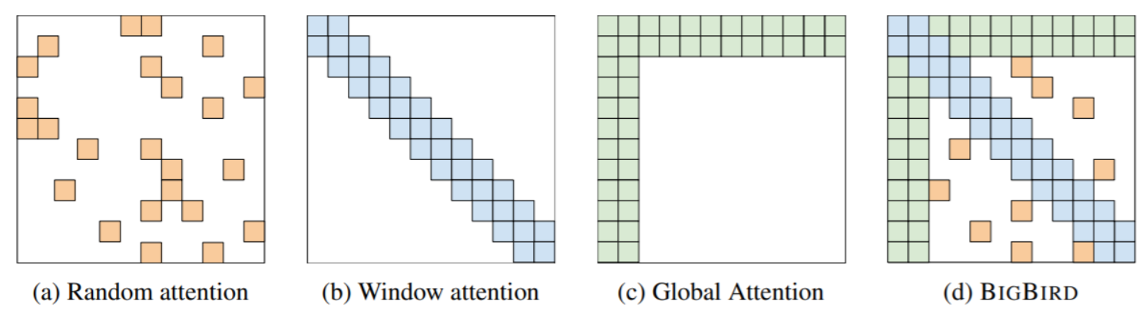
4. Drawbacks and Variants of Transformer
Quadratic compute in self-attention
Computing all pairs of interactions means our computation grows quadratically with the sequence length
For recurrent models, it only grew linearly
Key idea: replace all-pairs interactions with a family of other interactions, like local windows, looking at everything, and random interactions

Slide 17
THANK YOU
Any questions?

