Slide 1
Lecture 7: Machine Translation, Sequence-to-Sequence and Attention
Presenter: Chu Đình Đức

Slide 2
Lecture plan
Neural Machine Translation with Seq2Seq
Seq2Seq Basics
Seq2Seq Architecture – Encoder
Ses2Seq Architecture – Decoder

Slide 3
1.1 Seq2Seq Basics
A seq2seq model is an end-to-end model made up of 2 RNNs:
an encoder: takes the model's input sequence as input and encodes it into a fixed-size "context vector"
a decoder: uses the context vector from above as a "seed" from which to generate an output sequence
For this reason, seq2seq models are often referred to as "encoder-decoder models"

Slide 4
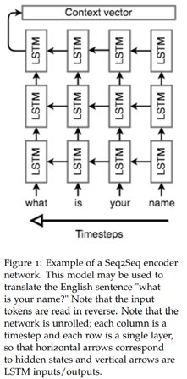
1.2 Seq2Seq Architecture - Encoder
The encoder network's job is to read the input sequence to our seq2seq model and generate a fixed-dimensional context vector c
Because it's so difficult to compress an arbitrary-length sequence into a single fixed-size vector (especially for difficult tasks like translation), the encoder will usually consist of stacked LSTMs
Seq2Seq encoder processes the input sequence in reverse: the last thing that encoder sees corresponds to the first thing that the model outputs, we're allowing the network to translate the first few words of the input as soon as it sees them, once it has the first few words translated correctly, it's much easier to go on to construct a correct sentence

Slide 5
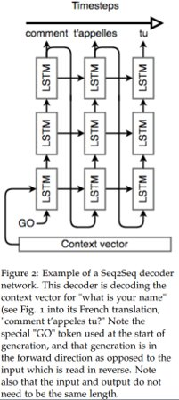
1.3 Seq2Seq Architecture - Decoder
We'll initialize the hidden state of our first with the context vector from encoder and pass in a <GO> token to signify the start of output generation
Then we'll run all three layers of LSTM, one after the other, following up with a softmax on the final layer's output to generate the output word. Then, we pass that word into the first layer, and repeat the generation

Slide 6
1.4 Recap
Note that there is no connection between the lengths of the input and output, any length input can be passed in and any length output can be generated
However, seq2seq models are known to lose effectiveness on very long inputs, a consequence of the practical limits of LSTMs
During backpropagation, the encoder's LSTM weights are updated so that it learns a better vector space representation for sentences, while the decoder's LSTM weights are trained to allow it to generate grammatically correct sentences that are relevant to the context vector

