Slide 1
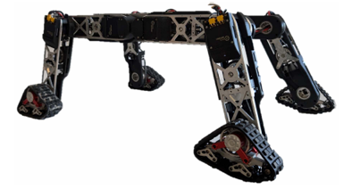

Tracked-legged Quadrupedal Robot Locomotion
Students:
Giacomo Tambellini
Duccio Petreni

Slide 2
Objectives
Modeling of Tracked Wheels for Resolving URDF Issues with Track Mechanisms
Locomotion of a Tracked-Legged Quadrupedal Robot

Slide 3


Proposed Solutions
Replacement of Tracked-Wheel Dynamics with a Simplified Model of Rotating Cylinders
Planning and Control via Reinforcement Learning
Isaac Sim +
Isaac Lab

Slide 4
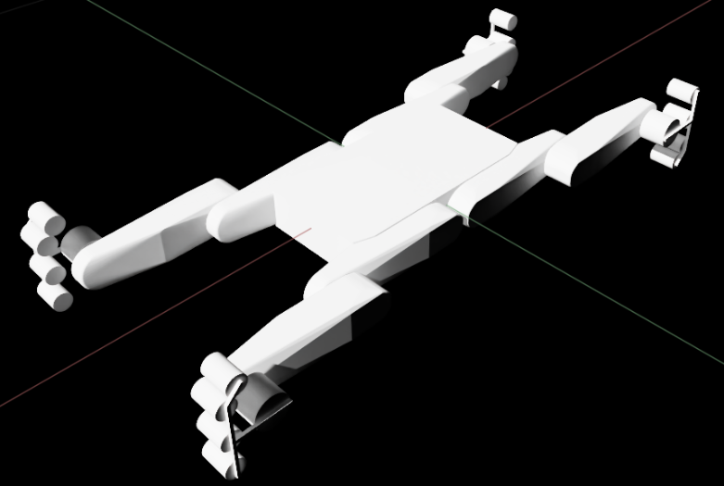
Modeling Tracked Wheels

