Slide 1
DEMONSTRATION OF
TYPES OF VIRUSES AND ITS MECHANISM

Slide 2
Group Member
Initial logic: Virus, EnvelopeVirus, NonEnvelopeVirus, VirusComponent, GetField, Screen class : Việt Dũng (20% idea), Đức (20% idea), Đình Dũng (20% idea), Doanh (40% : idea + implement).
Hoàng Đình Dũng – 20214882
Core class : Hav class (100%), Vesicle class (100%), Attack class (100%), HostCell class (50%), CellComponent class(50%)
GUI: 7 class Controller for Attack (each virus) (90%) , Fix code for StructureController class (10%)
Diagram: Controller class diagram
Report (writing, summarizing, and formatting)
Nguyễn Tiến Doanh – 20214881
Core Class: Covid class(100%), 2 Exception class (100%), HostCell class(50%), CellComponent class (50%)
GUI: MainScreenController, StructureController class (100%), fix code for AttackController class (10%)
Diagram: Use case diagram, (initial) general class diagram
Fixing and cleaning all code, code merging.
Nguyễn Việt Dũng – 20214883
Core class : Papilloma class (100%), Adeno class (100%)
Diagram: (final) general class diagram, detailed core class diagram
Report, slides
Đỗ Nghiêm Đức – 20214892
Core class : Influenza class (100%), Chikungunya class (100%)
Diagram: (final) general class diagram, detailed core class diagram
Report, slides

Slide 3

1. Introduction
Problem:
The rapid global spread of COVID-19 has underscored the critical importance of understanding viruses and their modes of infection. As the world faces the ongoing challenges of this pandemic, it becomes increasingly vital to grasp the basic knowledge of different types of viruses and their mechanisms of infection in order to develop effective prevention strategies. This report aims to provide an overview of the fundamental aspects of viruses, focusing on their basic structure and the methods by which they infect host cells. In this project, Java programming and JavaFX with GUI are the way we applied to create the virus application.

Slide 4
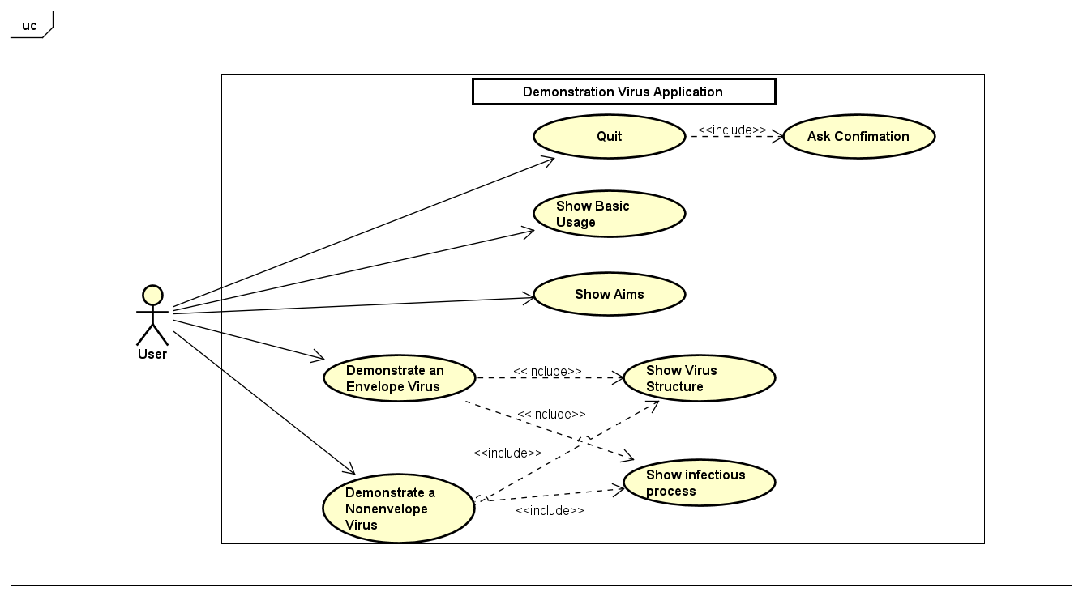
2. Use-case diagram

Slide 5
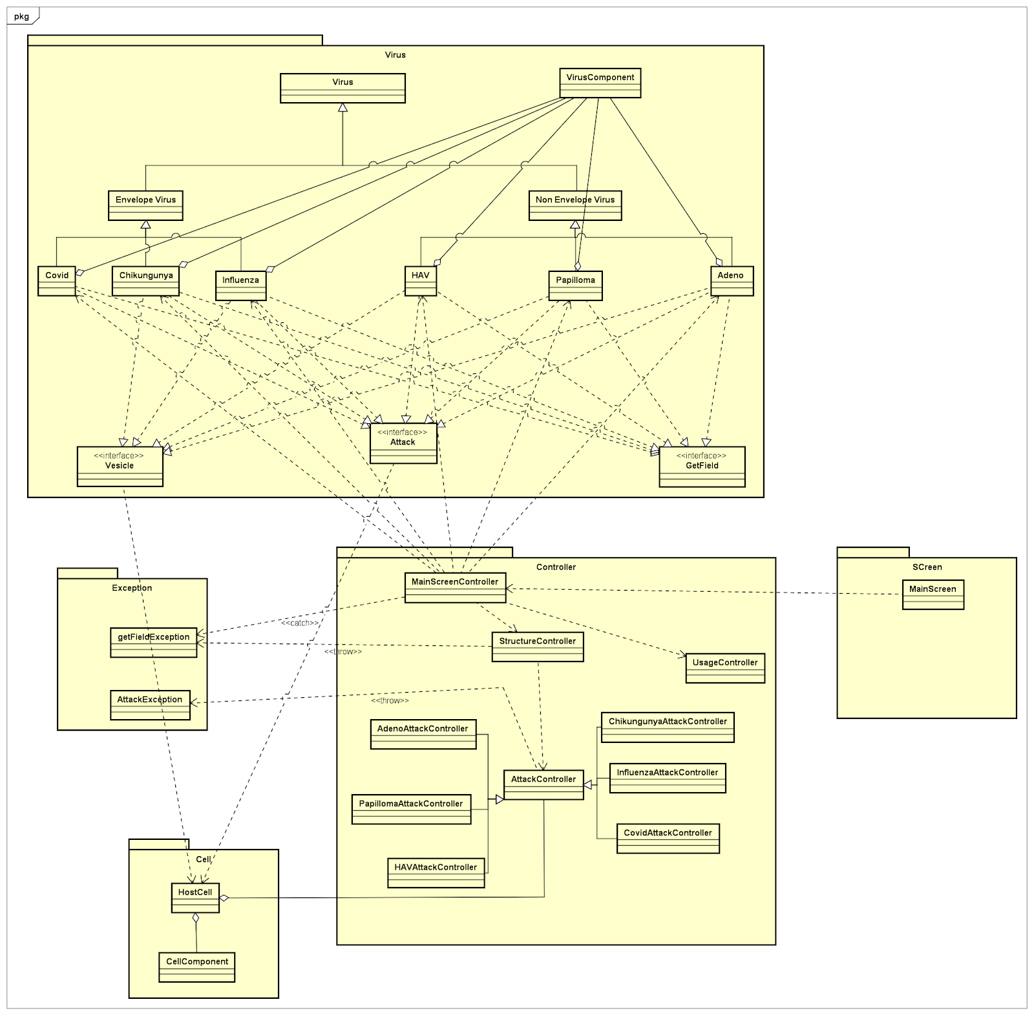
3. General class diagram

Slide 6
4. Detail class diagram

Slide 7
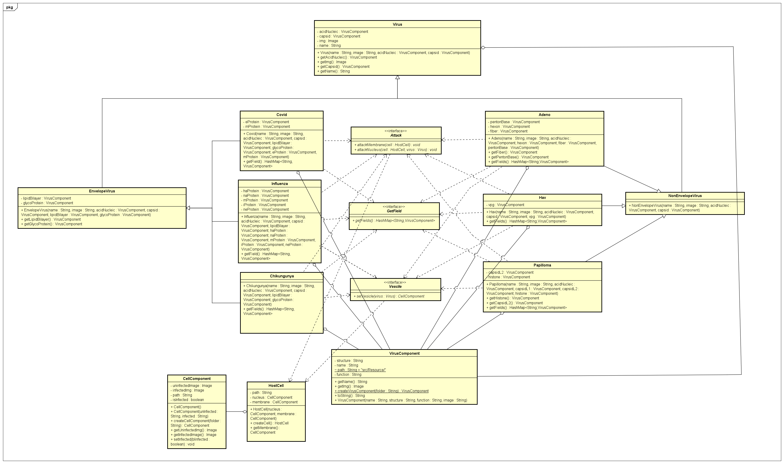
4.1. Virus diagram

Slide 8
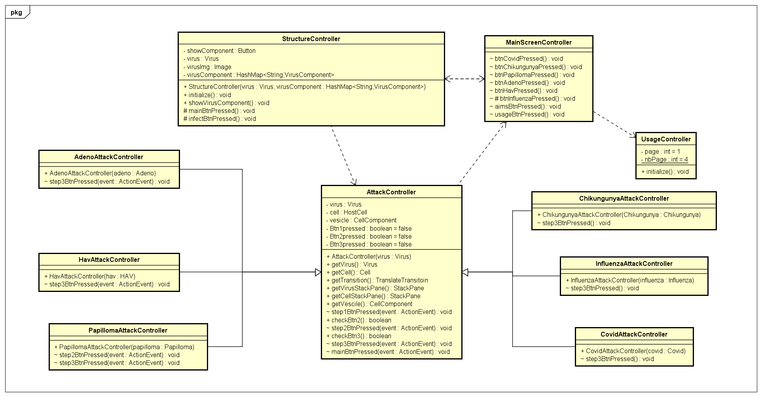
4.2. Controller diagram

Slide 9
5. Methods
There are 4 techniques of OOP which are used in this model :
Encapsulation
Private access modifiers protect sensitive information by restricting direct access from external sources. They encapsulate the data members and data methods of a class, ensuring they are kept together and accessible only within the class itself. By designating attributes as private, their visibility is limited to the class, promoting data encapsulation and preventing unauthorized access or modification. This enhances code organization, maintains data integrity, and enhances security.
For example: virus components are set to be private, so they are only accessed in the class Influenza.

Slide 10
5. Methods
2. Inheritance:
Within our Java project, we make use of inheritance to create a hierarchical structure among classes, enabling us to inherit properties and behaviors from a superclass and customize them in specialized subclasses.
For example, viruses inherited from EnvelopeVirus and NonEnvelopeVirus classes, so these viruses can inherit the attribute (lipidBilayer,…) and access to pubic method.
These two classes (NonEnvelopeVirus and EnvelopeVirus) also inherited from Virus class to get the basic structure of the virus (acid nucleic, capsid).
In addition, AttackController is inherited by each virus attack controller class to get some general point in attack process.

Slide 11
5. Methods
3. Abstraction:
The abstract class Virus is used as a blueprint for representing different types of viruses. By making Virus an abstract class, we prevent users from directly creating instances of Virus objects, as it serves as a generalization for all viruses and lacks concrete implementation details for specific virus types. Instead, it focuses on defining the essential characteristics shared by all viruses, such as image, name, capsid, and acid nucleic. This abstraction allows us to optimize the method structure and create a common interface for working with various virus types.
In addition, NonEnvelopeVirus and EnvelopeVirus class are also abstract classes for more or specialized implementations.
NonEnvelopeVirus is an abstract class that extends the Virus class, providing a more specialized implementation for viruses that do not have an envelope. EnvelopeVirus is another abstract class that extends the Virus class, specializing in viruses that possess an envelope.
Like NonEnvelopeVirus, EnvelopeVirus abstracts the common features (lipidBiLayer and glycoProtein) and functionalities of viruses with envelopes, allowing concrete subclasses to implement specific details for each type of enveloped virus.

Slide 12
5. Methods
4. Polymorphism:
By having each virus class implement the interfaces GetField, Vesicle, and Attack, we enable polymorphism in our code. Polymorphism allows us to treat objects of different virus types uniformly through their common interfaces, facilitating code modularity and reusability. For example with method overriding in the interface GetField, each virus class can provide its specific implementation for retrieving fields, making the code more flexible and adaptable to different virus behaviors.
. The way of applying polymorphism is that it enhances code modularity, reusability, and facilitates dependency injection and inversion of control principles.

Slide 13
6. Demo
https://www.youtube.com/watch?v=M_Aqb-m6ibU

Slide 14
7. References
https://stackoverflow.com/questions/40275951/static-method-that-returns-a-new-instance?fbclid=IwAR13dtc-93VPpAiC9j69lzqztNIzSACHU6usPDD7c6_UG1p2dfy1Uj6RzFM
https://stackoverflow.com/questions/21215299/loading-an-image-in-imageview-through-code?fbclid=IwAR0A6ftX0Eh6EpsZlvz_p3S9EVVWIx7YxmNVtZiqUzRVo0fntDVcEX2QiVQ
https://stackoverflow.com/questions/40097090/how-to-add-buttons-to-a-javafx-gui-via-the-controller-java-file-using-the-fxid?fbclid=IwAR1z1oO_vWOoty5JXFxMx_51IMcu9nKoZE_Imy-pBQHqZ9N2z_0qW9glbOo
https://www.youtube.com/watch?v=-WfyzkDodlI&list=PLhs1urmduZ2-4hFJxb2dgfWwcinNqEz0c&fbclid=IwAR1EYemH8VbpWcjnMheXCMTEl12ctccqBEWbakkbjH437ZTVe_YOhPWcJUw

Slide 15


