Slide 1
DEMONSTRATION OF
TYPES OF VIRUSES AND ITS MECHANISM

Slide 2
Group Member
Nguyen Tien Doanh 20214881
Do Nghiem Duc 20214892
Hoang Dinh Dung 20214882
Nguyen Viet Dung 20214883

Slide 3

1. Introduction
Problem:
The rapid global spread of COVID-19 has underscored the critical importance of understanding viruses and their modes of infection. As the world faces the ongoing challenges of this pandemic, it becomes increasingly vital to grasp the basic knowledge of different types of viruses and their mechanisms of infection in order to develop effective prevention strategies. This report aims to provide an overview of the fundamental aspects of viruses, focusing on their basic structure and the methods by which they infect host cells. In this project, Java programming and JavaFX with GUI are the way we applied to create the virus application.

Slide 4
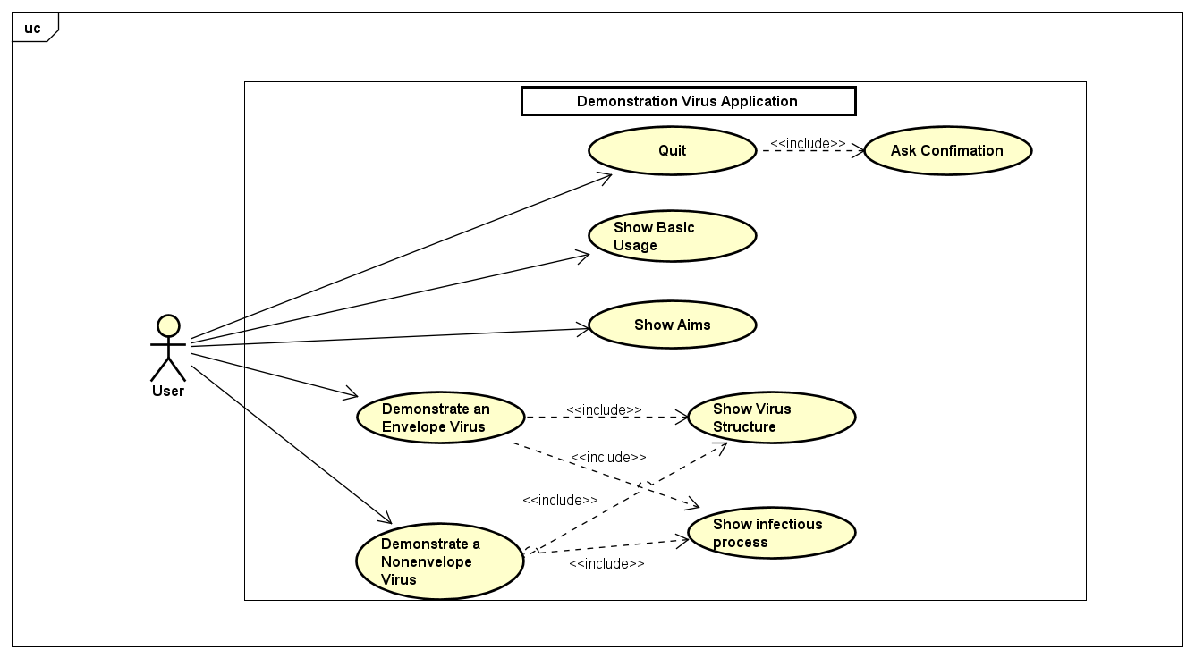
2. Use-case diagram

Slide 5
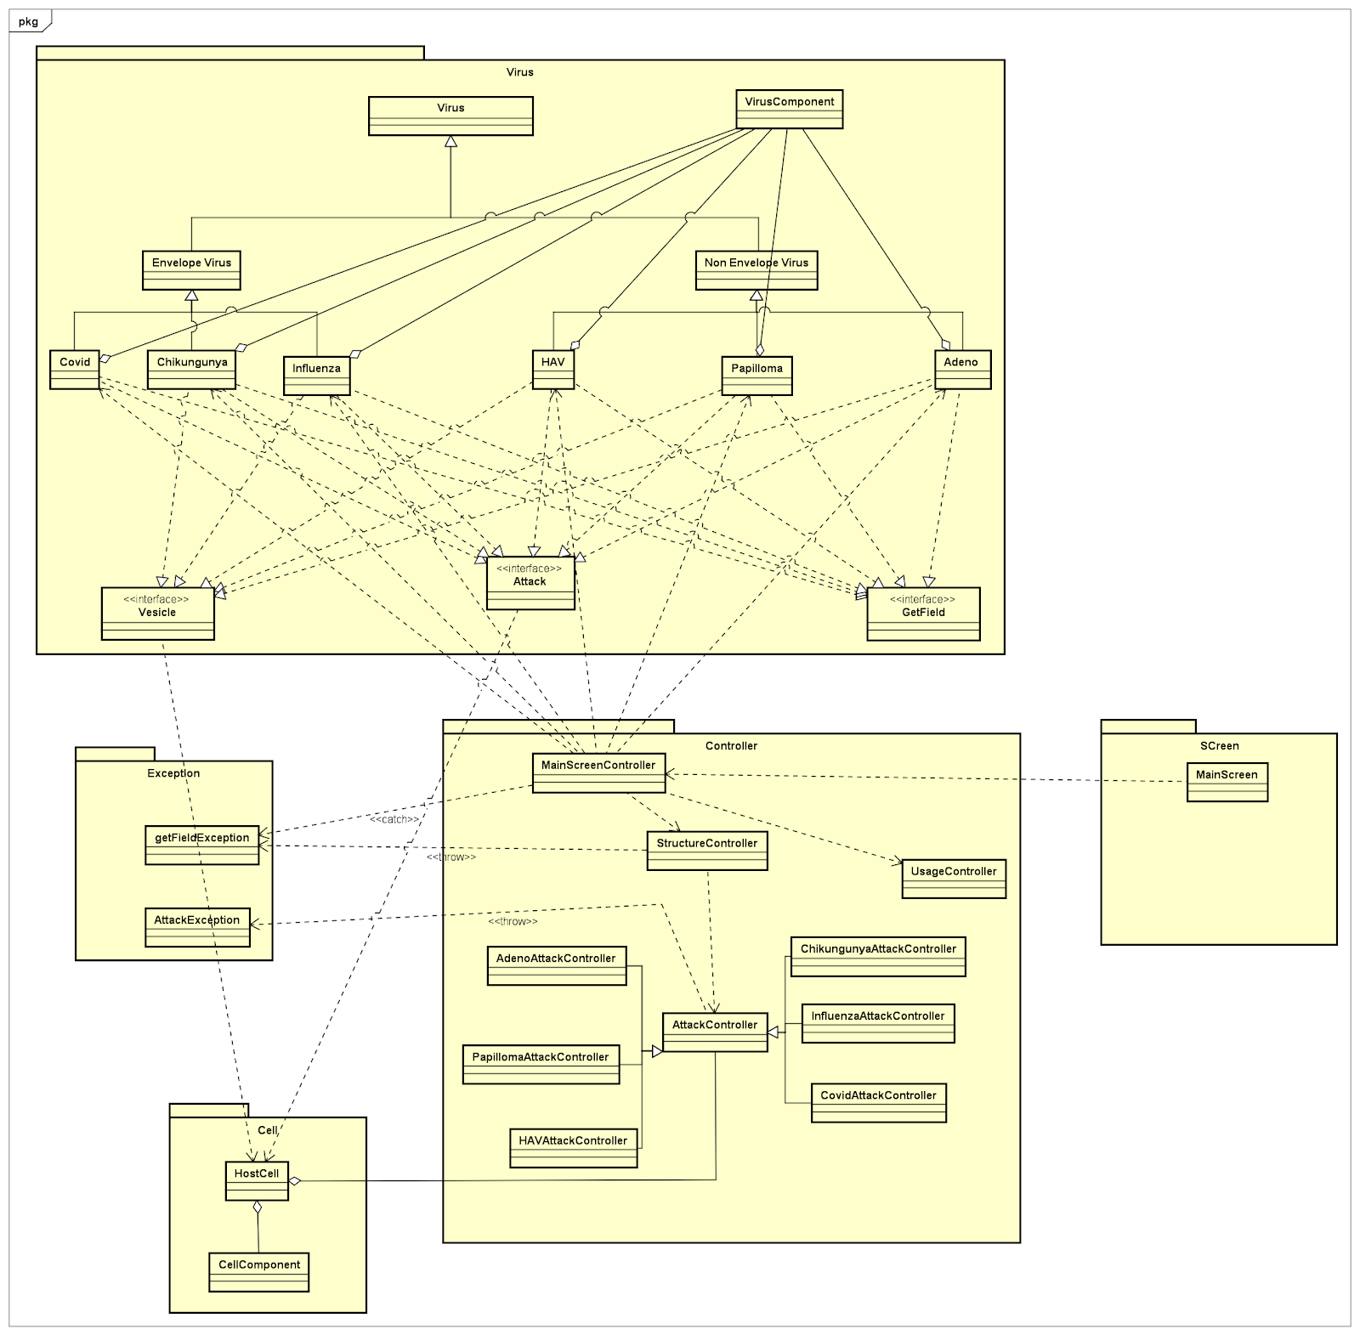
3. General class diagram

Slide 6
4. Detail class diagram

Slide 7
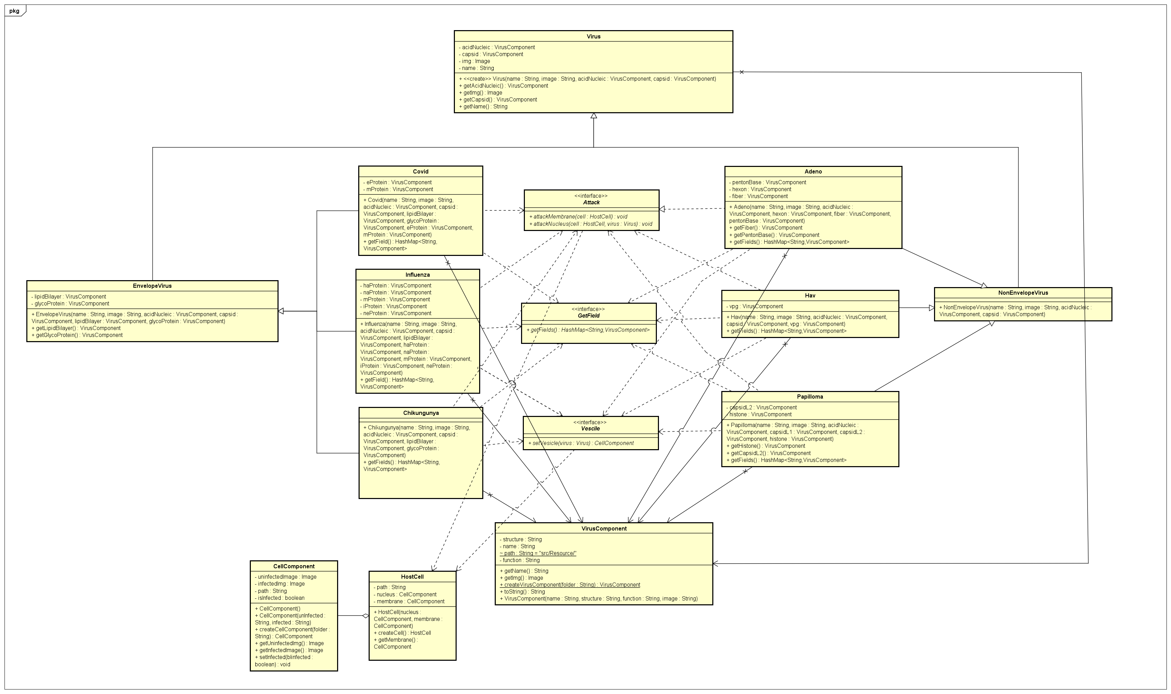
4.1. Virus diagram

Slide 8
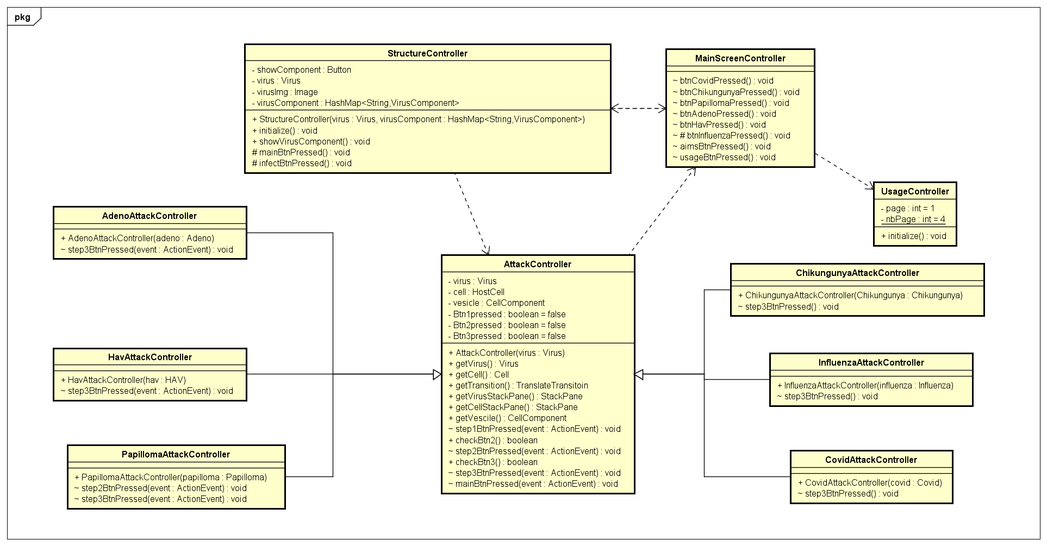
4.2. Controller diagram

Slide 9
5. Methods
There are 4 techniques of OOP which are used in this model :
Encapsulation
Private access modifiers protect sensitive information by restricting direct access from external sources. They encapsulate the data members and data methods of a class, ensuring they are kept together and accessible only within the class itself. By designating attributes as private, their visibility is limited to the class, promoting data encapsulation and preventing unauthorized access or modification. This enhances code organization, maintains data integrity, and enhances security.
For example: virus components are set to be private, so they are only accessed in the class Influenza.

Slide 10
5. Methods
2. Inheritance:
- Within our Java project, we make use of inheritance to create a hierarchical structure among classes, enabling me to inherit properties and behaviors from a superclass and customize them in specialized subclasses.
For example, viruses inherited from EnvelopeVirus and NonEnvelopeVirus classes. These two classes also inherited from Virus class. In addition, AttackController is inherited by each virus attack controller class to get some general point in attack process.

Slide 11
5. Methods
3. Abstraction:
Abstract class Virus is used to prevent creating any Object instance and optimize method structure and reduce the object to its essence so that only the necessary characteristics are exposed to the users. For example, Virus class generalize the general structure: image, name, capsid and acid nucleic.
In addition, NonEnvelopeVirus and EnvelopeVirus class are also abstract classes for more or specialized implementations.

Slide 12
5. Methods
4. Polymorphism:
It is expressed when each virus classes implements the interface GetField, Vesicle and Attack, then overide each method in the interfaces.
The way of applying polymorohism is that it enhances code modularity, reusability, and facilitates dependency injection and inversion of control principles.

Slide 13
6. Demo
https://www.youtube.com/watch?v=M_Aqb-m6ibU

Slide 14
7. References
https://stackoverflow.com/questions/40275951/static-method-that-returns-a-new-instance?fbclid=IwAR13dtc-93VPpAiC9j69lzqztNIzSACHU6usPDD7c6_UG1p2dfy1Uj6RzFM
https://stackoverflow.com/questions/21215299/loading-an-image-in-imageview-through-code?fbclid=IwAR0A6ftX0Eh6EpsZlvz_p3S9EVVWIx7YxmNVtZiqUzRVo0fntDVcEX2QiVQ
https://stackoverflow.com/questions/40097090/how-to-add-buttons-to-a-javafx-gui-via-the-controller-java-file-using-the-fxid?fbclid=IwAR1z1oO_vWOoty5JXFxMx_51IMcu9nKoZE_Imy-pBQHqZ9N2z_0qW9glbOo
https://www.youtube.com/watch?v=-WfyzkDodlI&list=PLhs1urmduZ2-4hFJxb2dgfWwcinNqEz0c&fbclid=IwAR1EYemH8VbpWcjnMheXCMTEl12ctccqBEWbakkbjH437ZTVe_YOhPWcJUw

Slide 15


