Slide 1

Final Project: Software Technology
Subject: Software Technology – Group 5
Lecturer: GV. Phạm Thái Kỳ Trung

Slide 2
List of Members
Bùi Đức Dũng - 518H0611
Trương Phúc Nguyên 520H0392

Slide 3
Introduction of project
The goal of this project is to create a function that makes it easy for accountants and agents to export and import goods. Allows accountants as well as agents to check the status of orders. Accountants can create Warehouse Receipts when the company imports goods and Develop a function for accountants to review the statistics of incoming goods, best-selling items, and sales revenue for each month.
Developing a B2C Website or a Mobile App to sell products to customers.

Slide 4
Accountant and Agent Import and export goods Requirements
1. Accountants shall be able to:
Create Goods Received when the company imports goods (a warehouse receipt will include many items).
Create Goods Delivery Note to deliver goods to agents (print delivery slips).
Update the status of orders as being transferred.
Update the payment status of agents.
View incoming/outgoing stock report, best-selling products and revenue report monthly.

Slide 5
Accountant and Agent Import and export goods Requirements
2. Agents shall be able to:
Place an order of items
Choose a payment method (Cash, bank transfer, Momo...).
See the status of their orders.

Slide 6
B2C website for customer Requirements
1. Customers can:
Register their own account
Save purchase history. (logged in)
Customers can track their order status. (pending/packaging/shipping/delivered) (logged in)
Place an order of items
Choose a payment method (Cash, bank transfer, Momo...).

Slide 7
B2C website for customer Requirements
2. Admin can:
View customer information
Edit customer information
Delete customer information
View customer cart information
View customer order history
Manage the order status of all customers(including pending/package/shipping/delivered)

Slide 8
Defining Use Case
User/Actor | User goal and resulting Use Case
Accountant | Login Logout Create Goods Received receipt Create Goods Delivery Note Update orders status Update payment status View report monthly

Slide 9
Defining Use Case
Agents | Place order Choose a payment method View orders status View purchase history Login Logout
Customers | Register account Login Logout View purchase history Place order View orders status Choose a payment method

Slide 10
Defining Use Case
Admin | View customer information Edit customer information Delete customer information View customer cart information View customer order history Manage order status
IT technical | Troubleshooting Developing application Maintenance

Slide 11
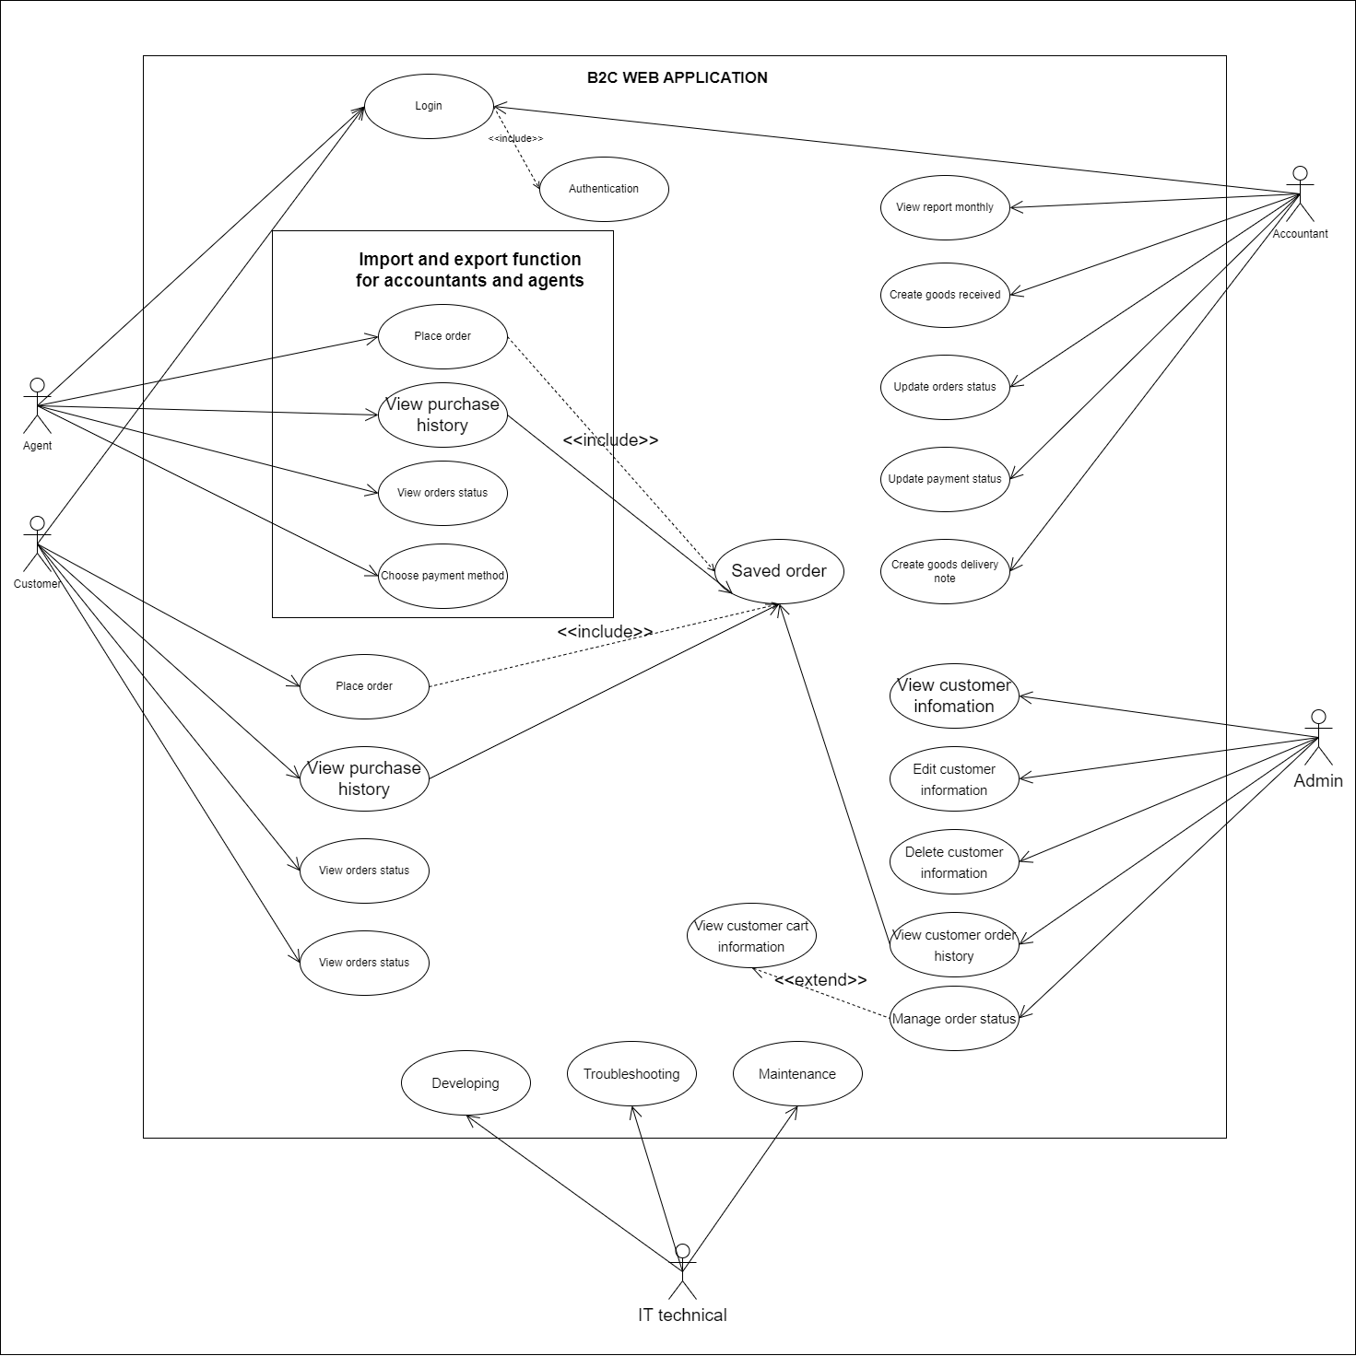
Business Use Case

Slide 12
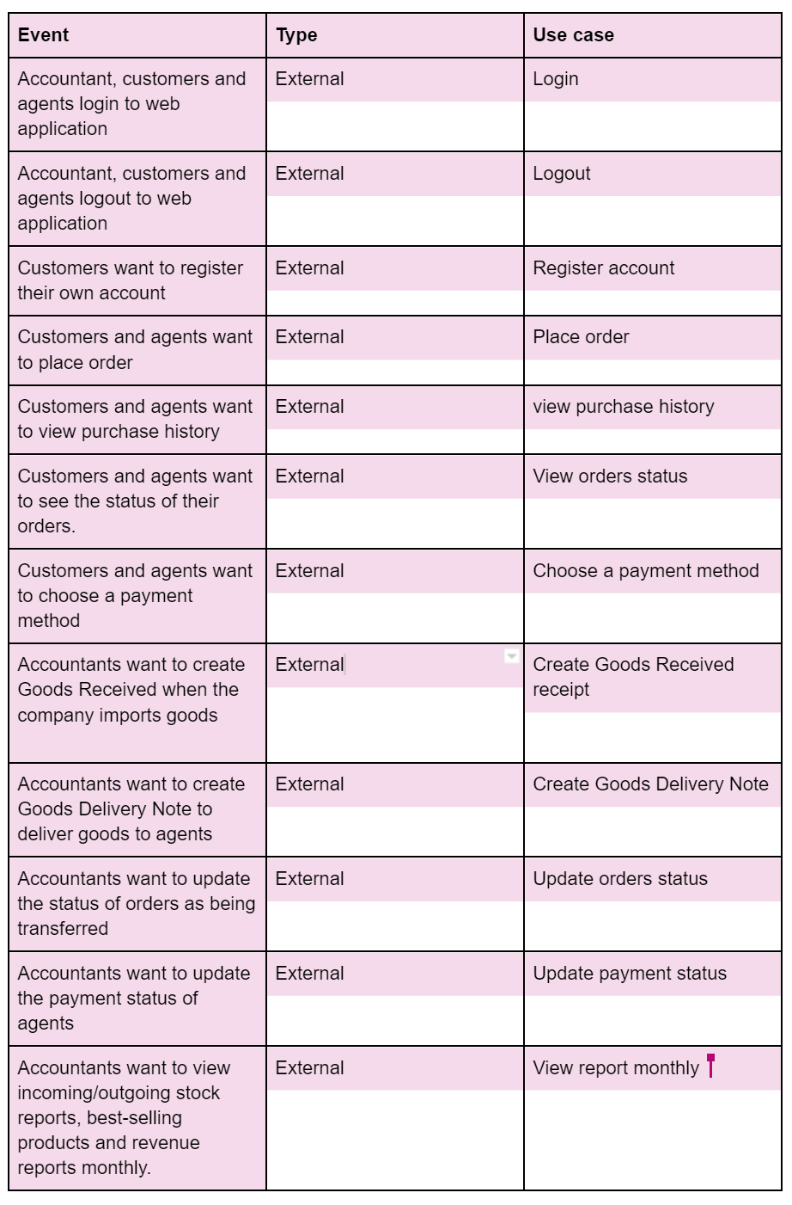
List of events

Slide 13
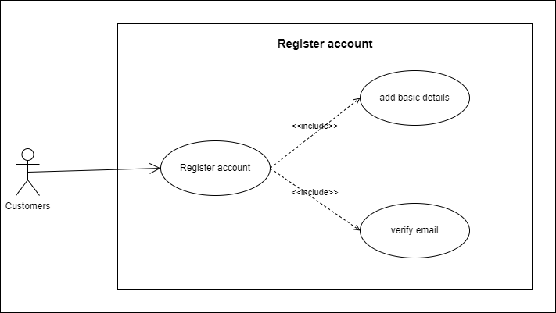
Register account Use Case
Register account – use case diagram

Slide 14
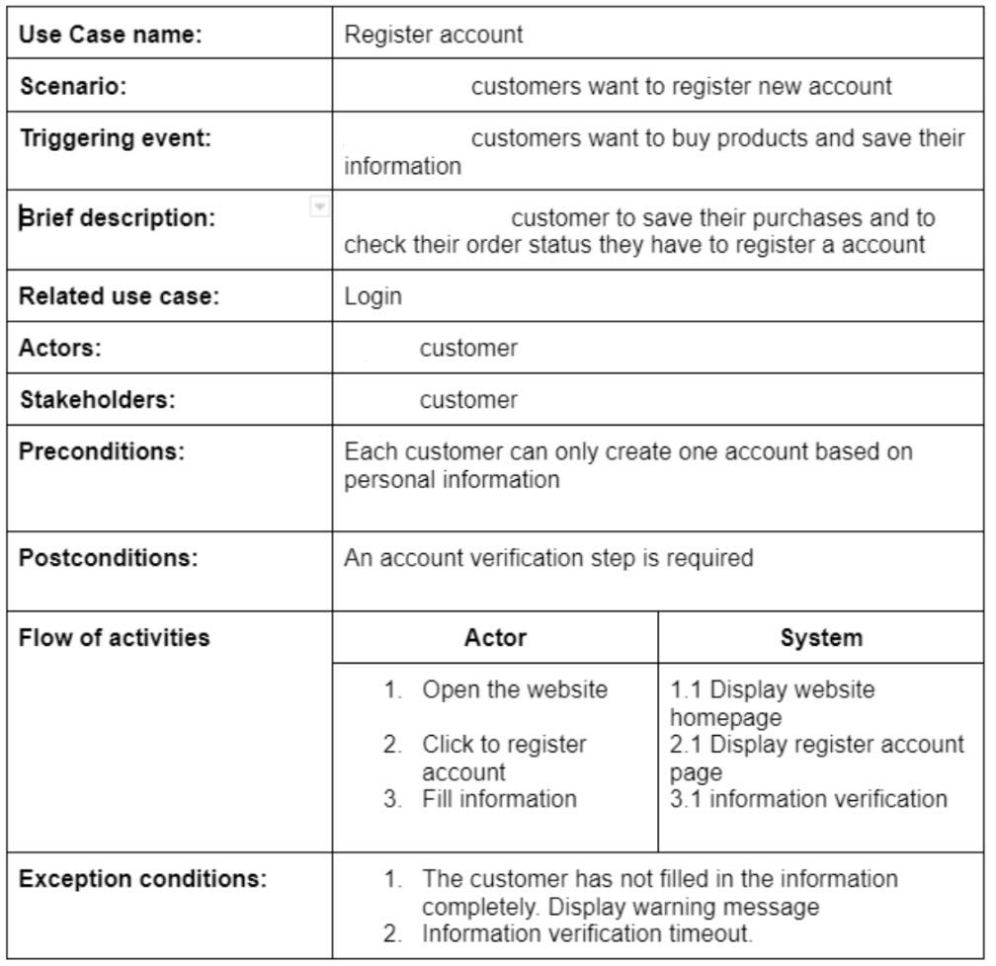
Register account Use Case

Slide 15
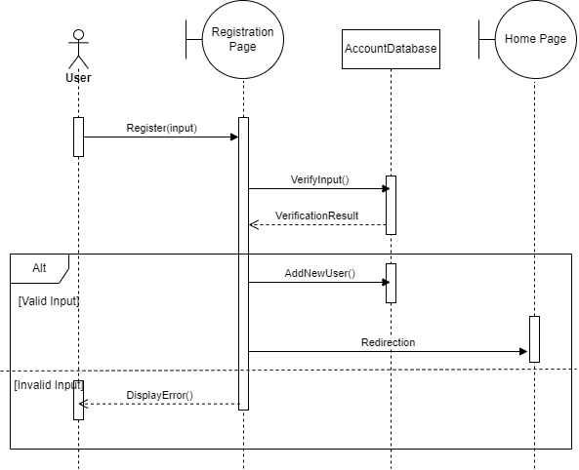
Register account Use Case
Register account– Sequence diagram

Slide 16
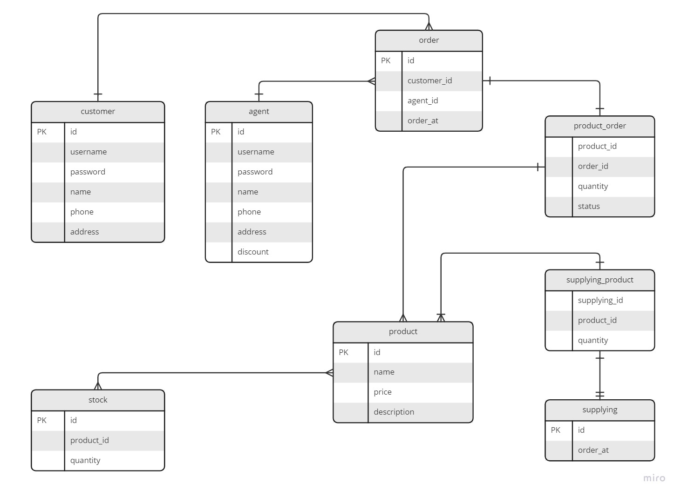
Database design

Slide 17
THE END
Thank you for watching our presentation

