Slide 1

Final Project: Analyzing and Designing Medical Monitoring Technology
Subject: Systems Analysis and Design – Group 2
Lecturer: GV. Phạm Thái Kỳ Trung

Slide 2
List of Members
Bùi Đức Dũng - 518H0611
Võ Nguyên Long - 519H0027

Slide 3
Introduction of Real-Time Continuous Glucose Monitoring
Portable and wearable medical monitoring devices.
Measures glucose level – records data periodically or continuously and transmitted via telephone, Internet connection, and wireless data transmission standards, such as Bluetooth.
The mobile app informs patient of high/low glucose level alerts, automatically transmit data and alerts to a central monitoring application.

Slide 4
Vision Statement
Developed a mobile application that will allow its users to monitor their medical data such as blood glucose level to be monitoring continuously in conjunction with the wristband monitoring instruments.

Slide 5
System Requirements
Monitor glucose levels
Immediately identify short-term and long-term medical dangers
Alert the patients and physician depending on glucose levels
Send monitoring device’s data to server
Receive monitoring device’s data from server
Allow patients to record notes
Enable physicians to send feedback to patients
Store physicians and patients responses in Health Record
Connect with Bluetooth wristband

Slide 6
Defining Use Case
User/Actor | User goal and resulting Use Case
Patients | Register account Login Read instruction View glucose level View health record Enter notes Share notes Send messages/alert Receive messages Logout

Slide 7
Defining Use Case
Physicians | Login View patient glucose level View patient health record Update patient health record Message patients Receive emergency messages Logout
Nurse/Phisician assistant | Login View patient glucose level View patient health record Message patients Receive patient's messages Logout

Slide 8
Defining Use Case
Healthcare provider | Access patient data Manage patient data Provide healthcare services
IT technical | Troubleshooting Developing application Maintenance

Slide 9
View Glucose Levels Use Case
Patients can view glucose levels current through the wristband or on mobile application.
Patients also want to be able to view glucose levels over various time periods, with a specific focus on time periods during which their glucose was within and outside of acceptable ranges.
Patients want to view their data in graphical view or an actual numbers

Slide 10
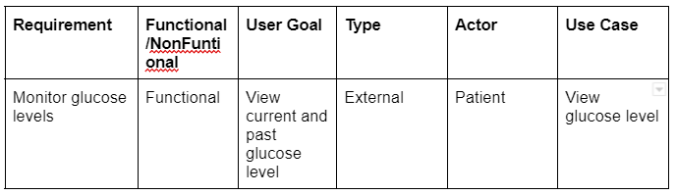
View Glucose Levels Use Case

Slide 11
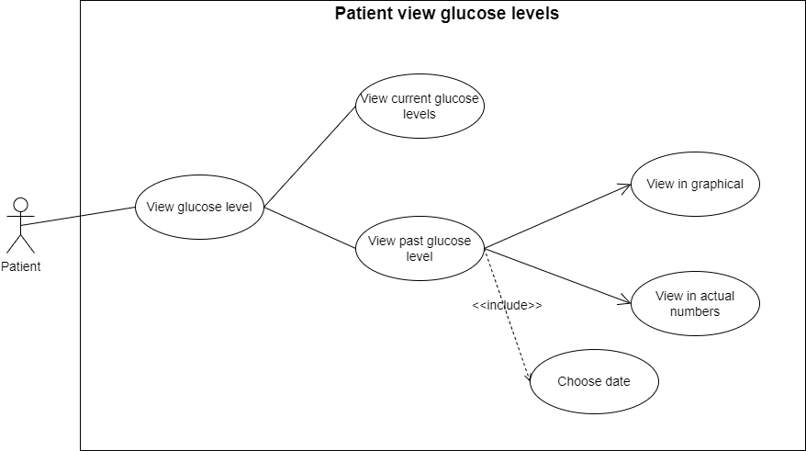
View Glucose Levels Use Case
View glucose levels – use case diagram

Slide 12
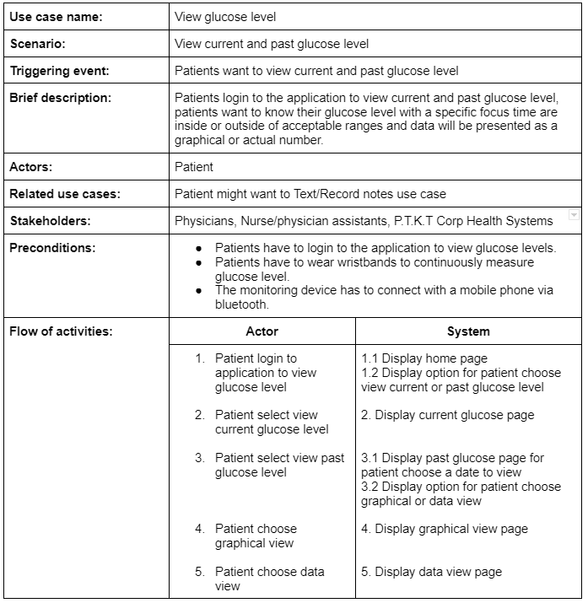
View Glucose Levels Use Case Description

Slide 13
View Glucose Levels Use Case
View glucose levels – UML Activity diagram

Slide 14
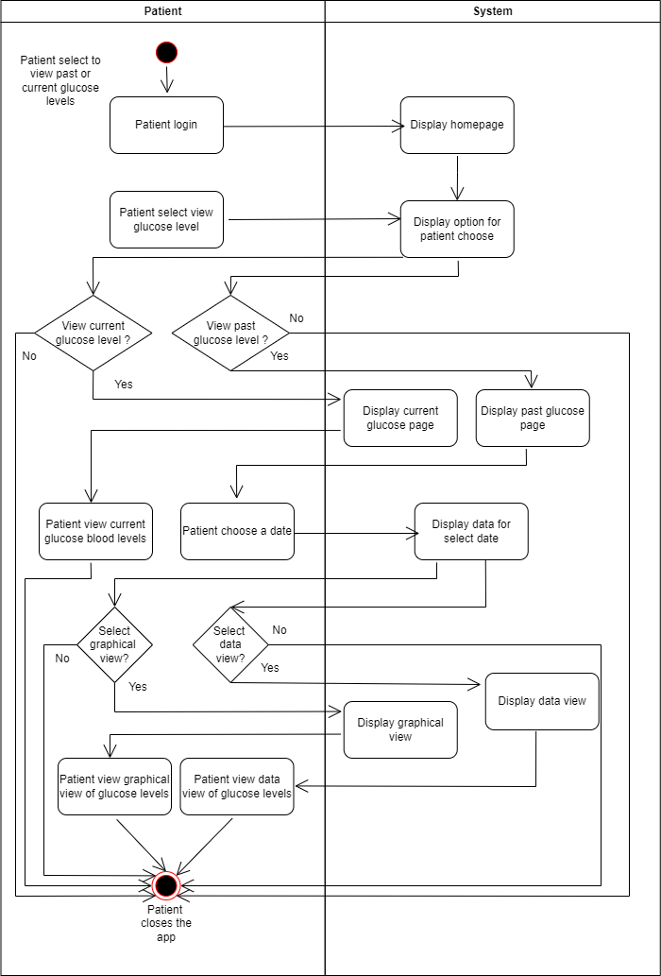

Slide 15
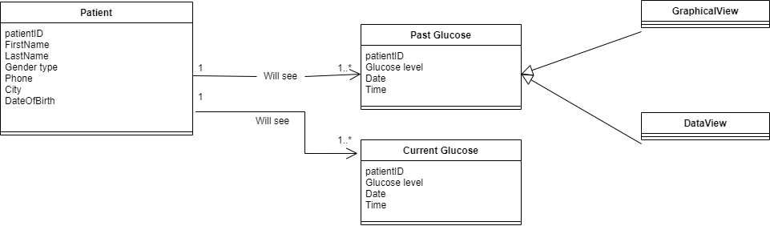
View Glucose Levels Use Case
View glucose levels – Domain model class diagram

Slide 16
View Glucose Levels Use Case
View glucose levels – Sequence diagram

Slide 17
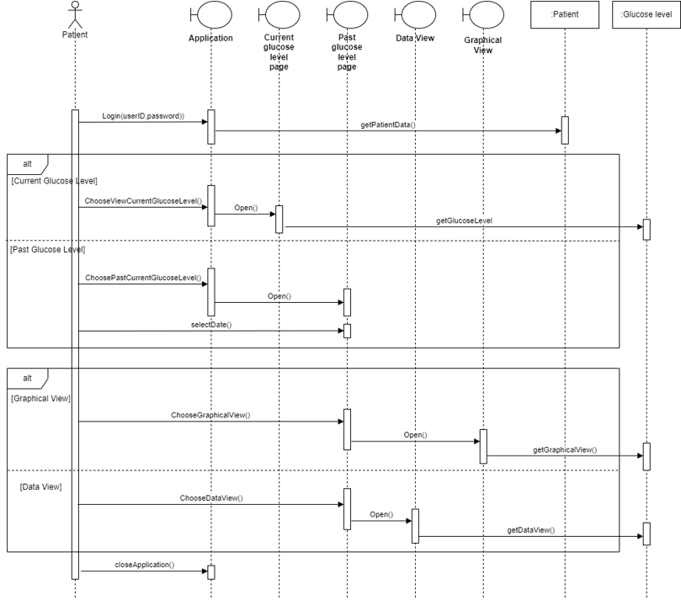

Slide 18
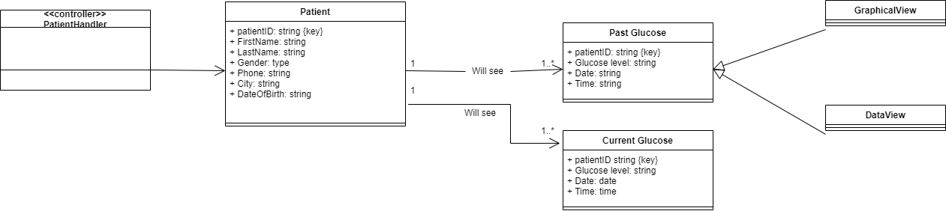
View Glucose Levels Use Case
View glucose levels – Domain design class diagram

Slide 19
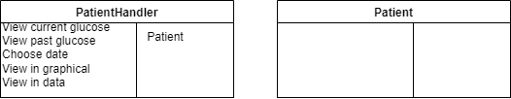
View Glucose Levels Use Case
View glucose levels – Controller

Slide 20
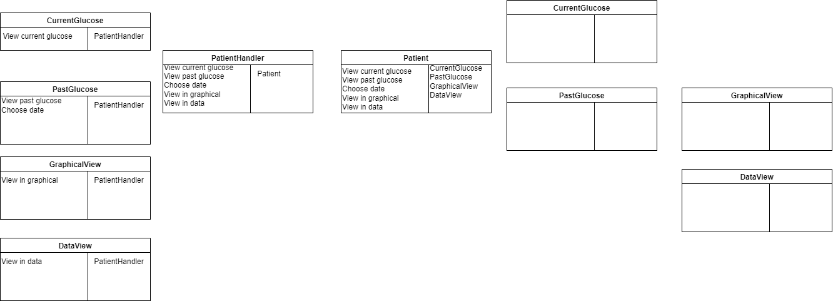
View Glucose Levels Use Case
View glucose levels – UI

Slide 21
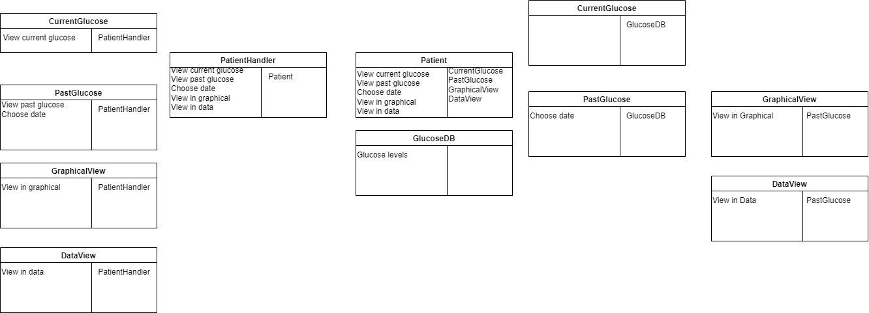
View Glucose Levels Use Case
View glucose levels – Data Access

Slide 22
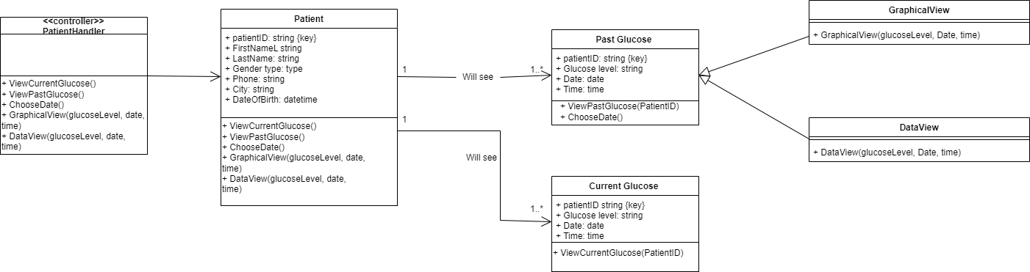
View Glucose Levels Use Case
View glucose levels – Domain design class diagram

Slide 23
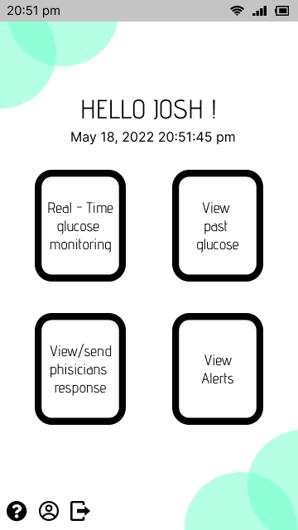
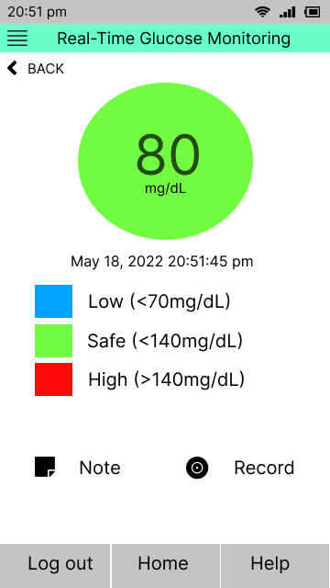
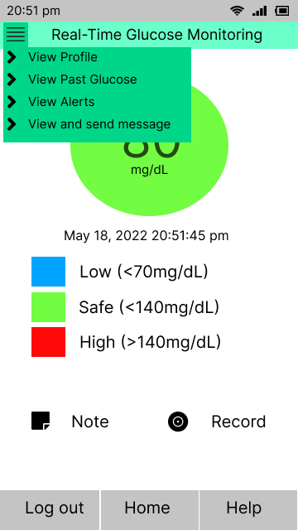
View Glucose Levels User Interface

Slide 24
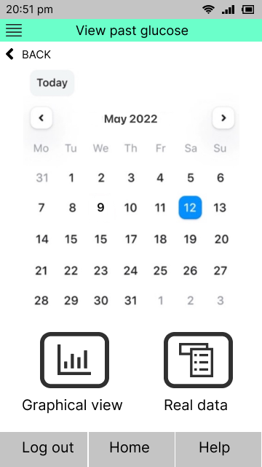
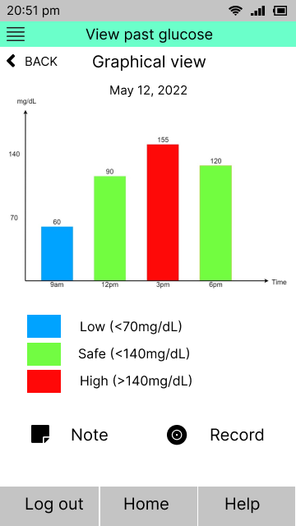
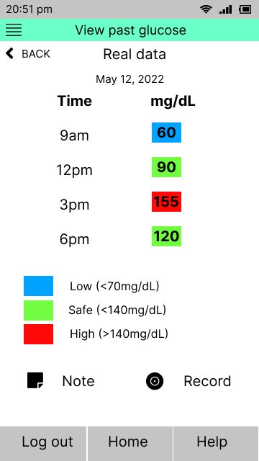
View Glucose Levels User Interface

Slide 25
THE END
Thank you for watching our presentation

