Slide 1

Final Project: Analyzing and Designing Medical Monitoring Technology
Subject: Systems Analysis and Design – Group 2
Lecturer: GV. Phạm Thái Kỳ Trung

Slide 2
List of Members
Bùi Đức Dũng - 518H0611
Võ Nguyên Long - 519H0027

Slide 3
Contents
Introduction
Vision statement
System requirements
Defining Use Case
Login Use Case – introduction
Login Use Case – Use case diagram
Login Use Case – Use case description
Login Use Case – Activity diagram
Login Use Case – Sequence diagram
Login Use Case – Domain class
Login Use Case – Controller
Login Use Case – UI - Data Access
Login Use Case – Design class
Login Use Case – User Interface

Slide 4
Introduction of Real-Time Continuous Glucose Monitoring
Portable and wearable medical monitoring devices.
Measures glucose level – records data periodically or continuously and transmitted via telephone, Internet connection, and wireless data transmission standards, such as Bluetooth.
The mobile app informs patient of high/low glucose level alerts, automatically transmit data and alerts to a central monitoring application.

Slide 5
Vision Statement
Developed a mobile application that will allow its users to monitor their medical data such as blood glucose level to be monitoring continuously in conjunction with the wristband monitoring instruments.

Slide 6
System Requirements
Monitor glucose levels
Immediately identify short-term and long-term medical dangers
Alert the patients and physician depending on glucose levels
Send monitoring device’s data to server
Receive monitoring device’s data from server
Allow patients to record notes
Enable physicians to communicate with patients
Store physicians and patients responses in Health Record
Connect with Bluetooth wristband

Slide 7
Defining Use Case
User/Actor | User goal and resulting Use Case
Patients | Register account Login Read instruction View glucose level View health record Enter notes Share notes Send messages/alert Receive messages Logout

Slide 8
Defining Use Case
Physicians | View patient glucose level View patient health record Update patient health record Message patients Receive emergency messages Logout
Nurse/Phisician assistant | View patient glucose level View patient health record Message patients Receive patient's messages Logout

Slide 9
Defining Use Case
Healthcare provider | Access patient data Manage patient data Provide healthcare services
IT technical | Troubleshooting Developing application Maintenance

Slide 10
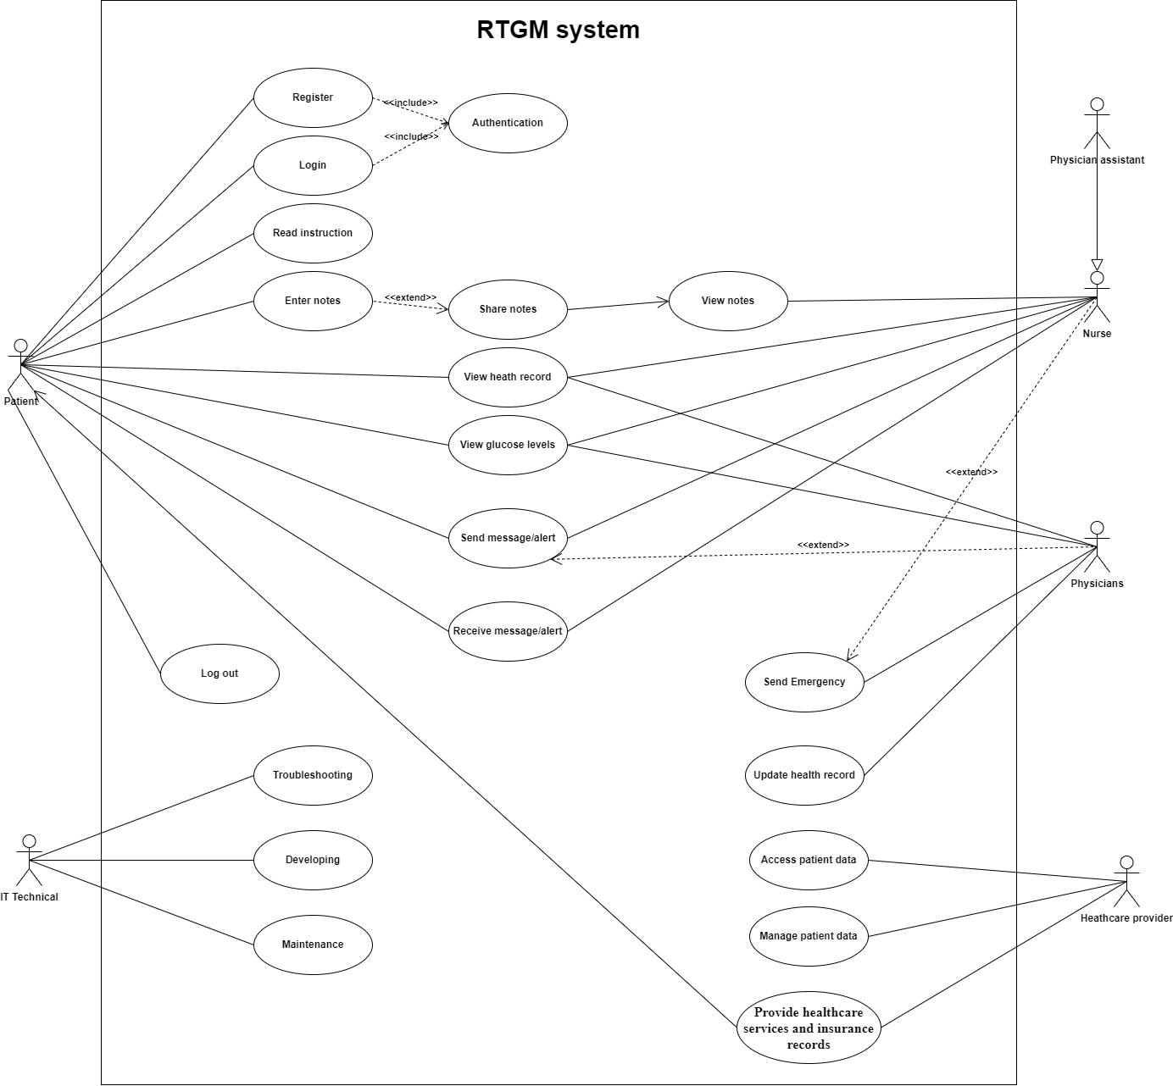
Defining Use Case

Slide 11
Login Use Case
Patients can login to application.
Patients can also get back their account though verify email.

Slide 12
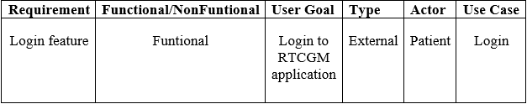
Login Use Case

Slide 13
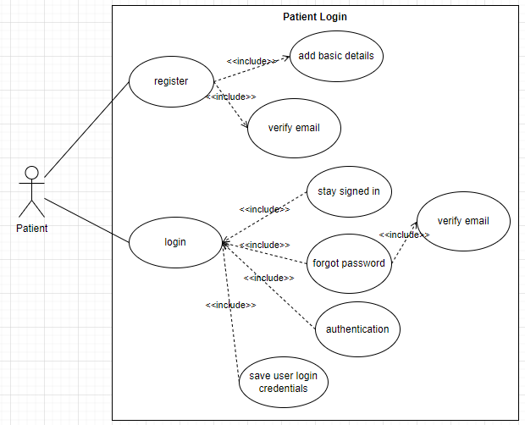
Login Use Case
Login – use case diagram

Slide 14
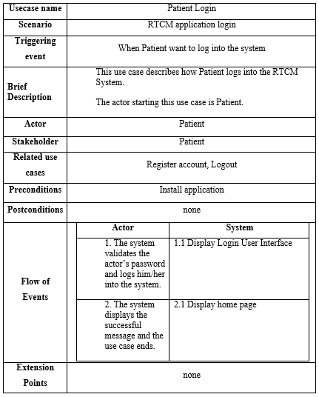
Login Use Case Description

Slide 15
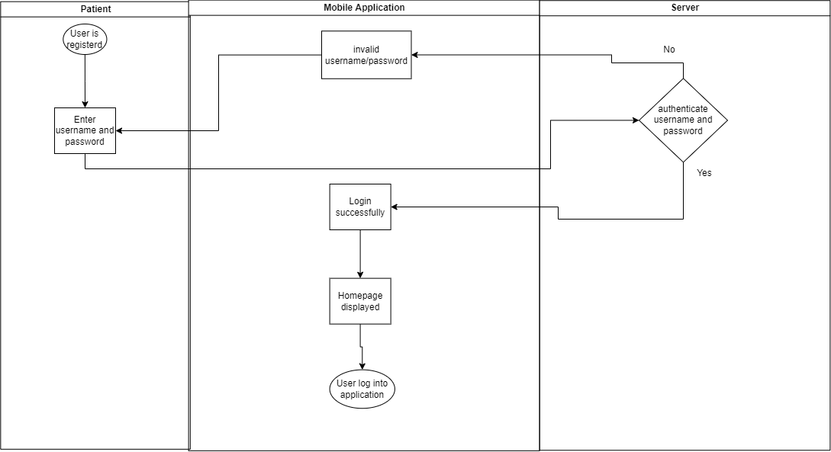
Login Use Case
Login – UML Activity diagram

Slide 16
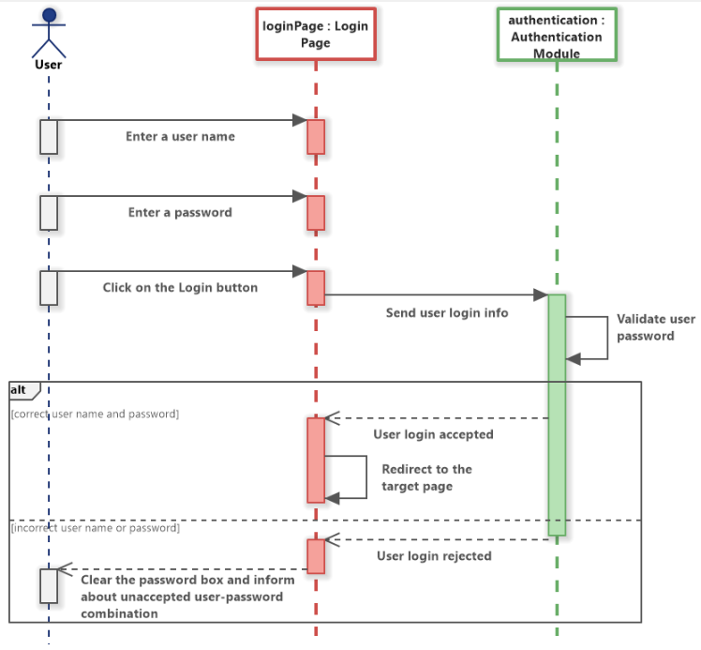
Login Use Case
Login – Sequence diagram

Slide 17
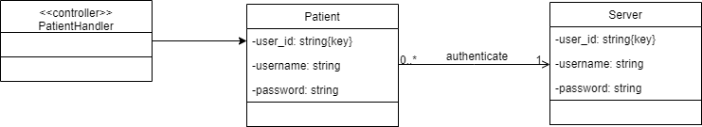
Login Use Case
Login – Domain Design Class diagram

Slide 18
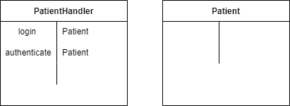
Login Use Case
Login – Controller

Slide 19
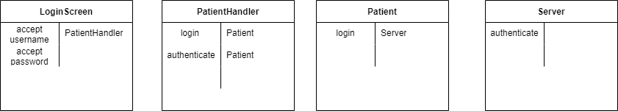
Login Use Case
Login – UI

Slide 20
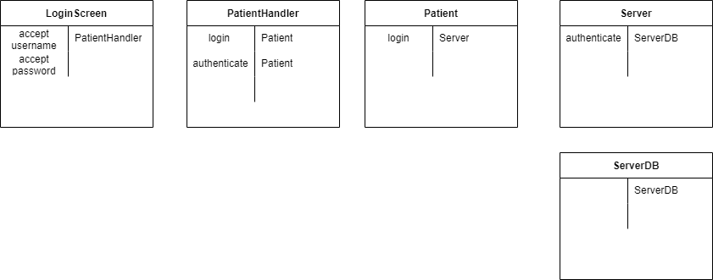
Login Use Case
Login – Data Access

Slide 21
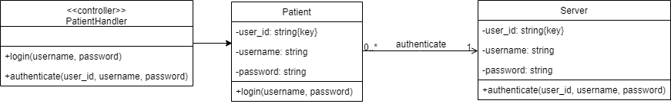
Login Use Case
Login – Design class diagram

Slide 22
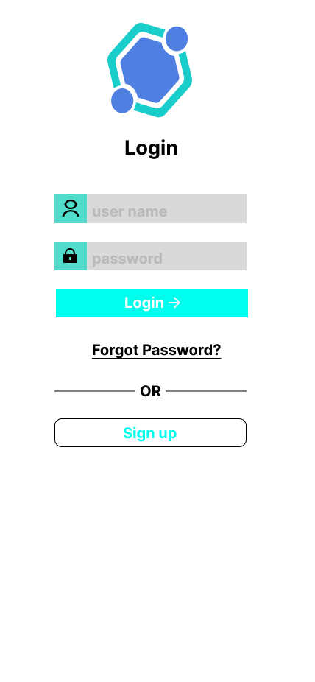
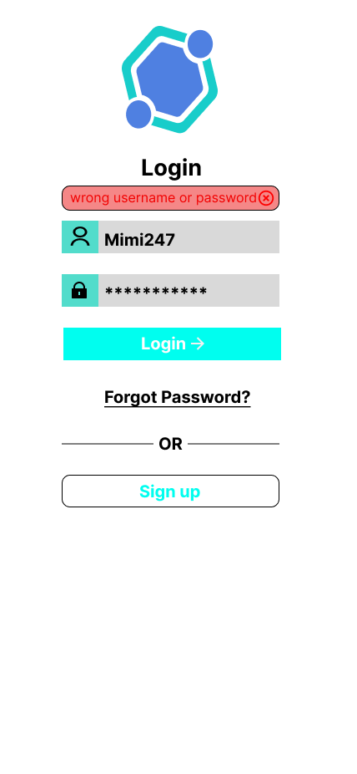
Login User Interface

Slide 23
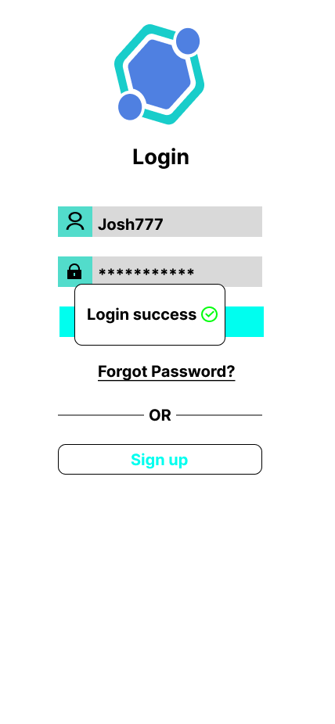
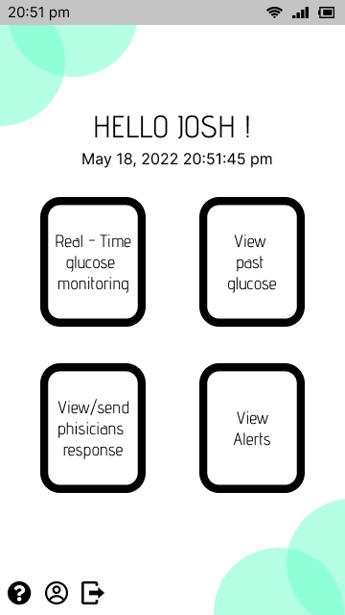
Login User Interface

Slide 24
THE END
Thank you for watching our presentation

