Slide 1

Selenium

Slide 2
WHY SELENIUM?
Selenium is an open-source automation testing tool and it is free of cost to use.
Selenium provides high tester flexibility to write advanced and complex test cases.
Supports test scripts written in any user preferred languages such as C#, Java, Perl, PHP, Python, and Ruby
Supports test case execution on multiple operating systems such as Windows, Linux, Android, Mac, and iOS.
Supports testing on different web browsers such as Chrome, Firefox, Internet Explorer (IE), Opera, and Safari.
Test cases can be executed while the browser window is minimized (headless).
Selenium supports parallel test execution.
Selenium can be integrated with TestNG and JUnit to generate test reports and manage test cases.
Selenium can be integrated with Jenkins, Docker, and Maven to attain continuous testing.

Slide 3
LIMITATIONS OF SELENIUM
Selenium can test only web applications. It cannot test software applications and other desktop applications.
No guaranteed user support is available. We have to depend on customer communities.

Slide 4
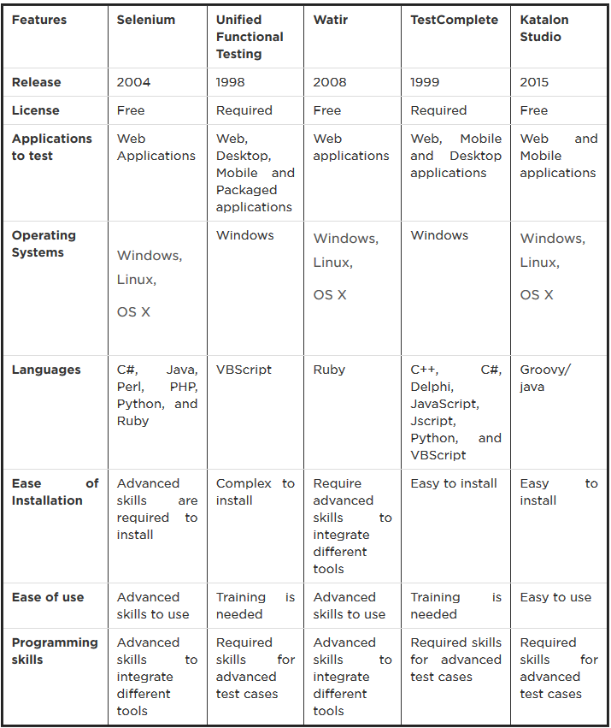
Comparison of Top Five Automation Testing Tools

Slide 5
Web Element
Locate web element
Basic actions on web element
Handling web element best practice

Slide 6
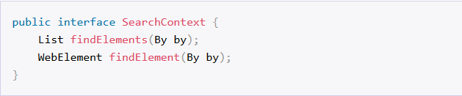
Locate web element – Search context
WebDriver users the SearchContext interface to locate elements on any page.
The first method finds all the elements that match an instance of what is known as a locator
The second method finds the first element that matches or throws a NoSuchElementException if it is not found.

Slide 7
Locate web element – Locator
A locator describes what you want to find on a page. In Java, we create a locator by using the By class.
Examples:
Or

Slide 8
Locate web element – By link text
This method locates elements by the exact text it displays. This method is normally the preferred locator for links on a page.
HTML
Our code
Or

Slide 9
Locate web element – By class attribute
This locates elements by the value of the class attribute. This can be used only for those elements having a class attribute
HTML
Our code

Slide 10
Locate web element – By id attribute
Locates elements by the value of their id attribute.
HTML
Our code
If ID is available, then it should be used as the first preferred choice.

Slide 11

Locate web element – By name
Locates elements by the value of their name attribute. Normally it can only be used to locate form elements built using: <input> , <button> , <select> , and <textarea>
HTML
Our code

Slide 12

Locate web element – By tag name
This locator finds elements by their HTML tag name. Since there are often many repeating uses of most tags, it is not often possible to use this method to locate a single element. But it can be combined with other locators to effectively locate elements
HTML
Our code

Slide 13


Locate web element – By css selectors
Locates elements via the driver’s underlying W3 CSS Selector engine. CSS selector locator is powerful as it can be used to locate any element on a page.
For reference: https://www.w3schools.com/cssref/css_selectors.asp
Examples:

Slide 14
Locate web element – By xpath
XPath locators are the most complex selector to use. It requires knowledge in XPath query language, so if you’re not fluent in that query language, you will find it difficult to find elements using XPath queries.
Xpath syntax: https://www.w3schools.com/xml/xpath_syntax.asp
HTML
Xpath value:
//input[@placeholder="Tôi muốn tìm..."]

Slide 15
Basic actions on web element
getAttribute
sendKeys
clear
click

Slide 16
getAttribute
Get a specific attribute of a web element.

Slide 17
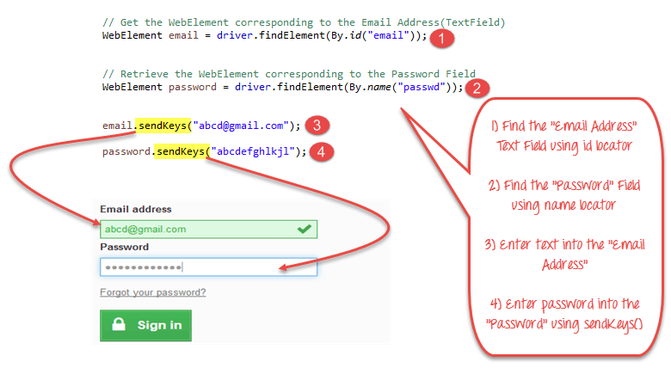
sendKey
Send key as a string to a web element.

Slide 18
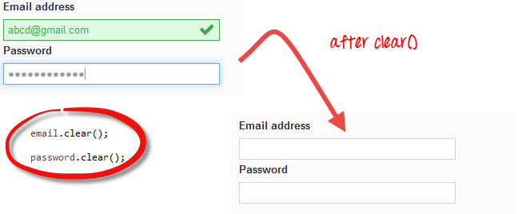
clear
Clear the value on current web element.

Slide 19
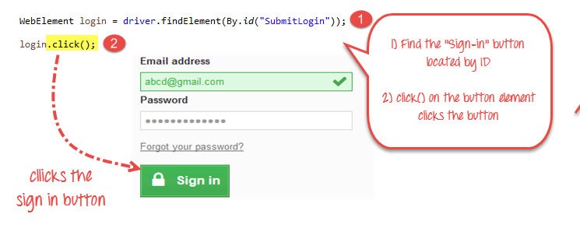
click
Perform a click action on current web element.

Slide 20
Q&A

