Slide 1
model adaptation with ls-svm for adaptive hand prosthetics
F. Orabona¹, C. Castellini², B. Caputo¹, A. E. Fiorilla³ and G. Sandini^{2,3}
¹ idiap research center, switzerland
² advanced robotics laboratory, university of genova, italy
³ italian institute of technology, genova, italy

Slide 2
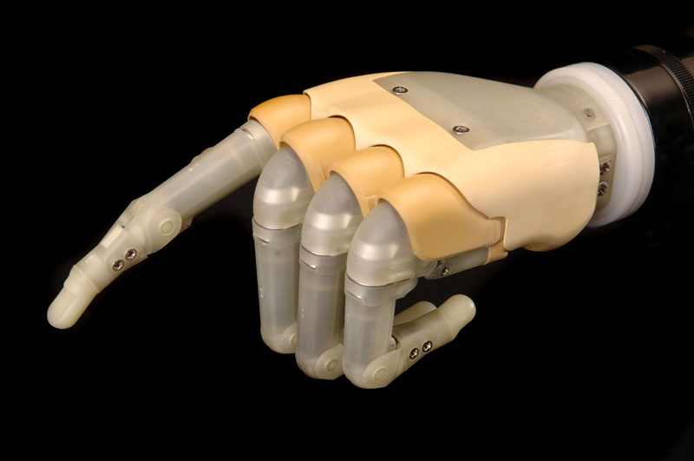
prosthetic hands
wishlist: cheap, cosmetic, lightweight, long-running, dexterous, finely controlled both in position and force
commercial s.o.a.:
touch bionics’s i-Limb
prosthetic hand
(reproduced from www.touchbionics.com)

Slide 3
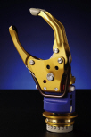
prosthetic hands
soa:
  one dof (otto bock)
  open-loop position control
  no sensing, no biofeedback
  very recent polyarticulate hand by touch bionics has 5 dofs, but
  no known means of accurate control
highly needed: fine control
otto bock’s sensorHand speed
(reproduced from www.ottobock.us)

Slide 4
problem
little possibility of control by the patient: what interface?
focus upon non-invasive interfaces, particularly upon
forearm surface electromyography
can a prosthetic hand be swiftly position- and force-controlled using the emg?

Slide 5
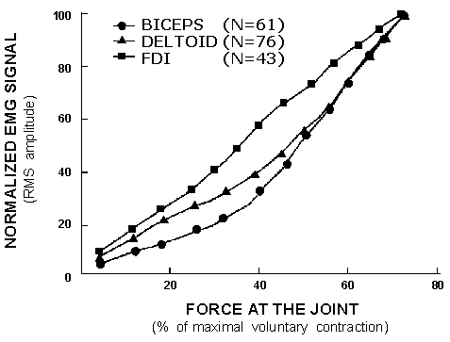
emg (in principle)
RMS non-linearly related to the force applied by a muscle

Slide 6
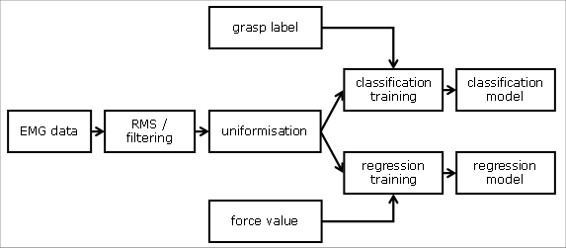
proposed schema

Slide 7
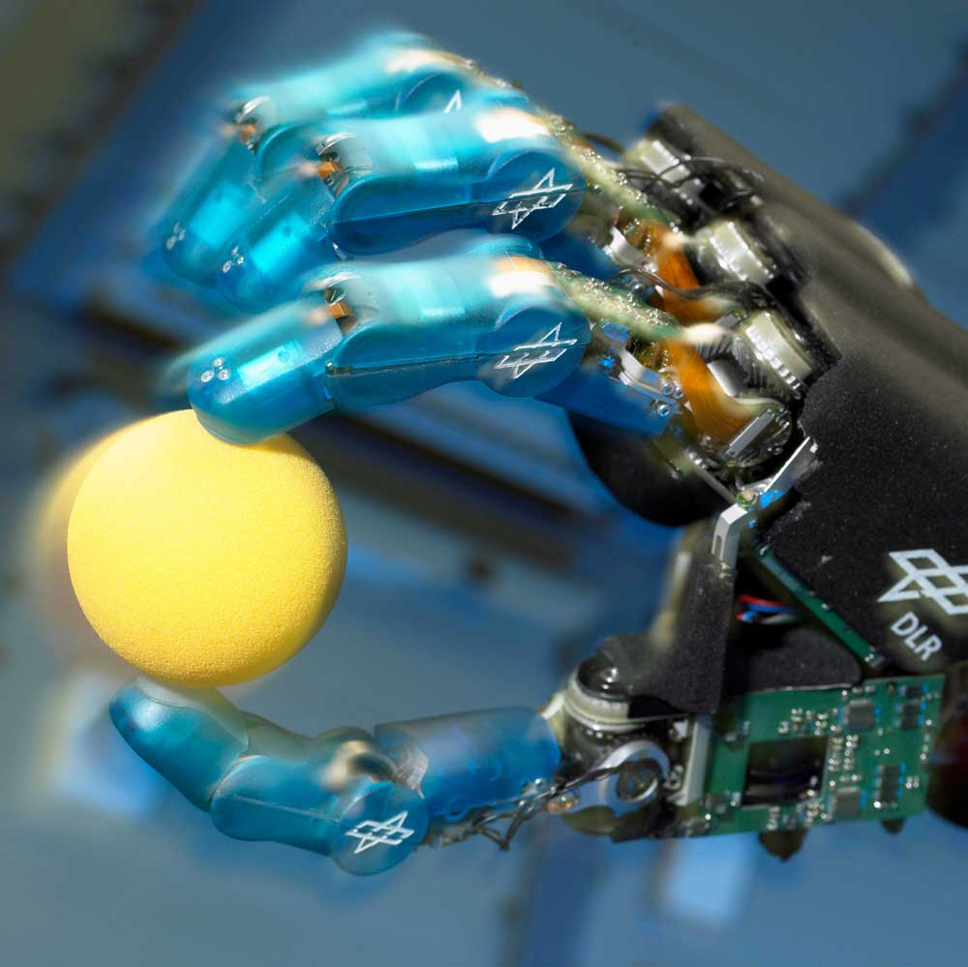
demo
(movie)
[2008] C. Castellini, P. van der Smagt, G. Sandini and G. Hirzinger, Surface EMG for Force Control of Mechanical Hands, ICRA 2008 @ Pasadena, US

Slide 8
the rest of this talk
experiment on multi-subject and non-controlled conditions (daily life activities)
model adaptation, that is: can we use one subject’s models for the others?
discussion

Slide 9
extending the approach to…
any subject (heatlhy, so far)?
what if the forearm / arm / body is moving, as is expected in daily-life activities? can the system learn how to deal with the added noise?

Slide 10
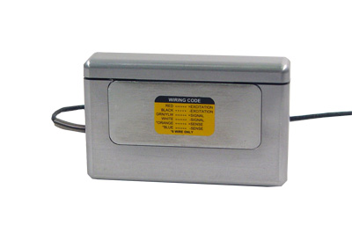
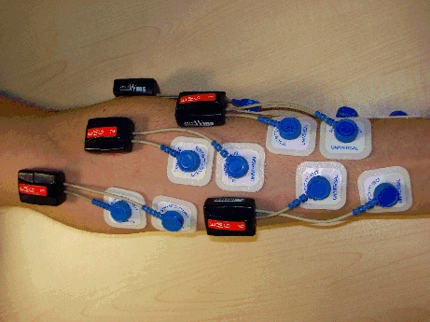
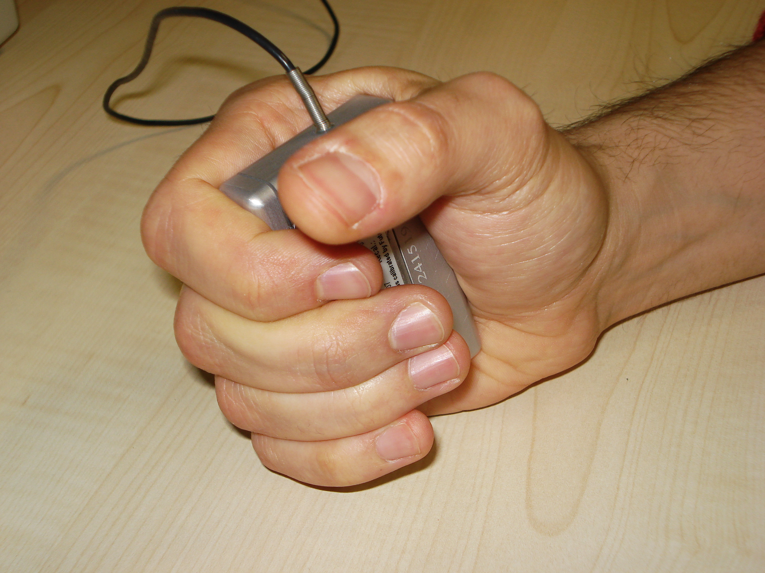
experiment
7 (wireless) emg electrodes
10 healthy subjects
comparing the still-arm condition with a freely moving condition: walking, raising the arms, etc.

Slide 11
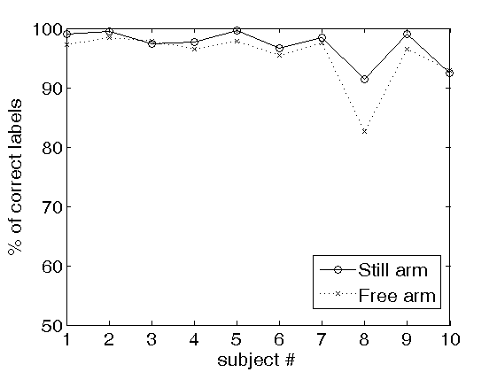
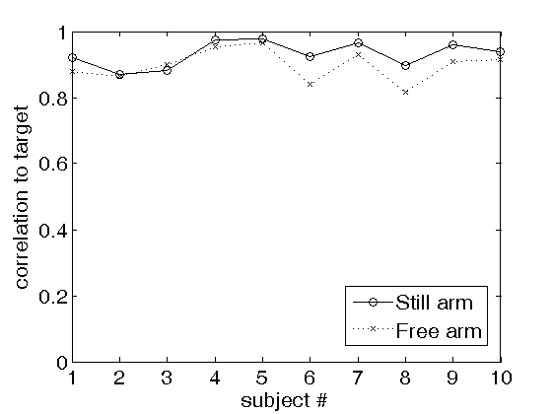
results
classification accuracy (left) and regression correlation (right) per subject. still arm vs. freely moving

Slide 12
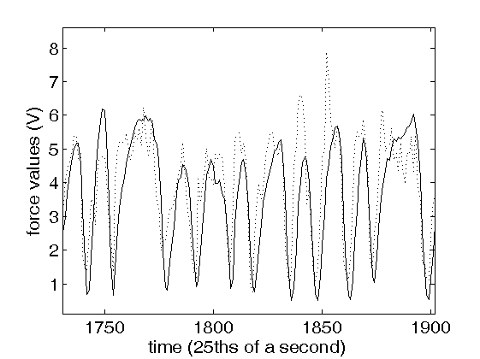
results (cont’d)

Slide 13
model adaptation
further problem:
  training guarantees adaptation (→ accuracy) to the patient, but might be long and uncomfortable
idea: ship the prosthesis with a prior knowledge, automatically exploited by the system
  leading to shorter training time

Slide 14
questions
how to weigh the prior knowledge and the newly acquired one?
computational efficiency?
but most interestingly, what prior knowledge?

Slide 15
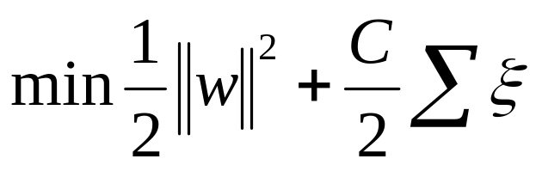
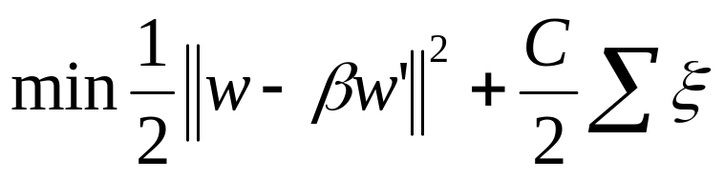
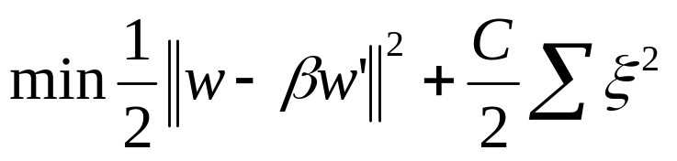
model adaptation
svms are trained by minimising a regularization term plus a loss term
change the regularization so that the new solution is close to the previous one
change the error term in order to evaluate the leave-one-out error in closed form

Slide 16
the leave-one-out error
the average error on each single training sample when it is removed from the training set
  the “best cross-validation” one can have
the leave-one-out error is an almost unbiased estimate of the error on a given set
in general, evaluating the l.o.o. for n samples implies training n models with n-1 samples each…
…but if you can compute it quickly, it also gives you a way to find the optimal ß

Slide 17
prior knowledge
consider nine training subjects and one testing subject
build model_{i} with i=1,…,9
incrementally train model for the testing subject and evaluate error using each training model as prior
output the prediction of the best one

Slide 18
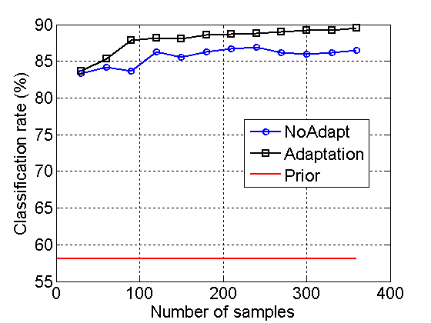
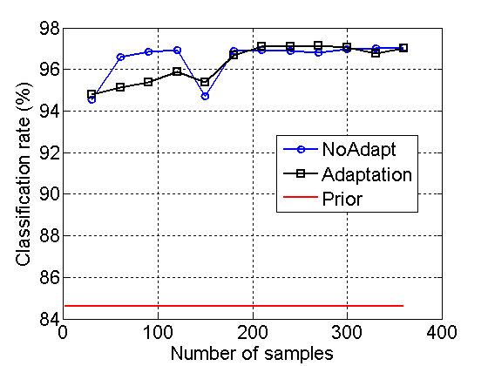
classification
(left) best case, (right) worst case

Slide 19
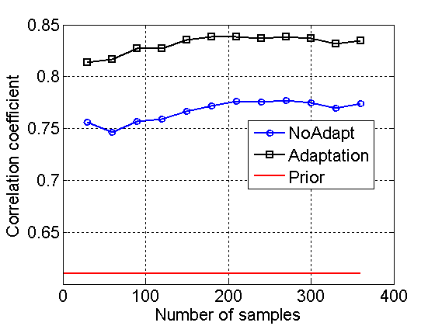
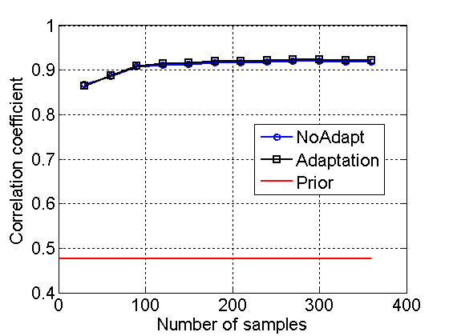
regression
(left) best case, (right) worst case

Slide 20
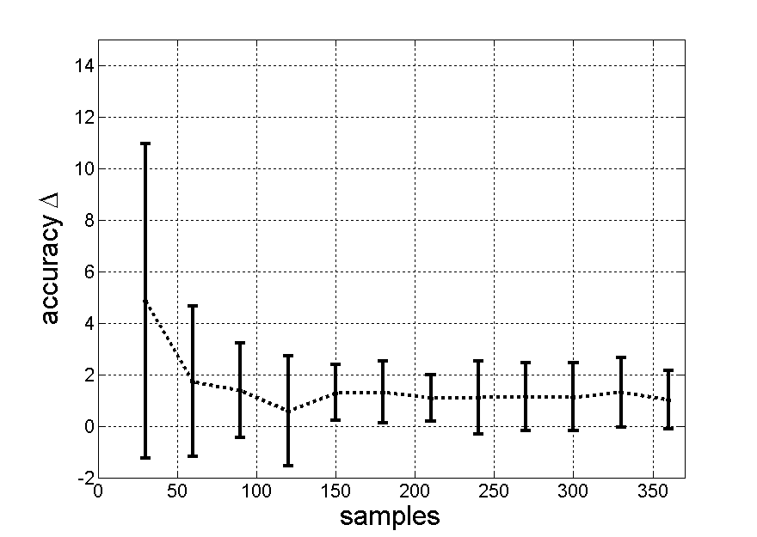
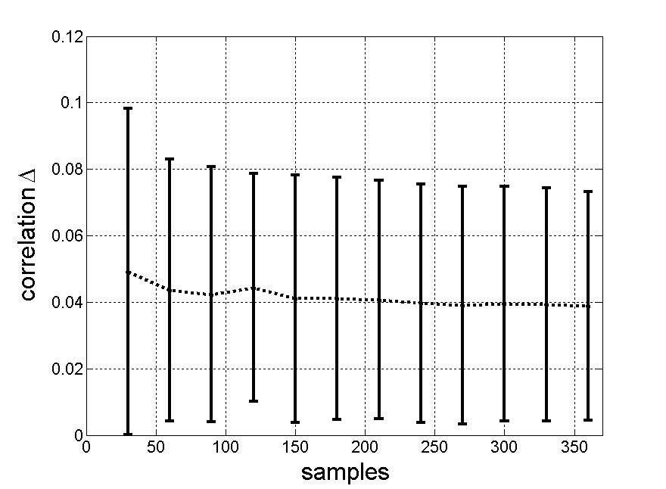
overall comparison
(left) classification, (right) regression

Slide 21
discussion
ls-svm model adaptation consistently and uniformly improves both classification and regression accuracy
pre-trained models give better performance than starting-from-scratch
denoting analogies among models, that is, among subjects

Slide 22
thank you!
[1] C. Castellini and P. van der Smagt, Surface EMG in Advanced Hand Prosthetics, Biological Cybernetics, 100(1)
[2] C. Castellini, E. Fiorilla and G. Sandini, Multi-subject/DLA analysis of surface EMG control of mechanical hands, submitted to the Journal of Neuroengineering and Rehabilitation
[3] C. Castellini, E. Gruppioni, A. Davalli and G. Sandini, Fine detection of grasp force and posture by amputees via surface electromyography, Journal of Physiology (Paris), in press

