Slide 1
eye movements in learning when to grasp
Claudio CASTELLINI
LIRA-Lab, University of Genova, Italy
Giulio SANDINI
Italian Institute of Techmology, Genova, Italy

Slide 2
www.neurobotics.org
robotic artifacts driven by humans (HBS), e.g.
  intelligent prostheses
  intelligent teleoperation platforms
…where by intelligent we mean semi-autonomous and/or adaptive
solution: build internal models of complex actions, e.g., reaching, grasping, etc.

Slide 3
machine learning…
…seems a promising way to achieve that:
  naturally adaptive
  suited for complex tasks, where a model-based approach alone could fail
  sometimes biologically inspired, but anyway essentially example-based

Slide 4
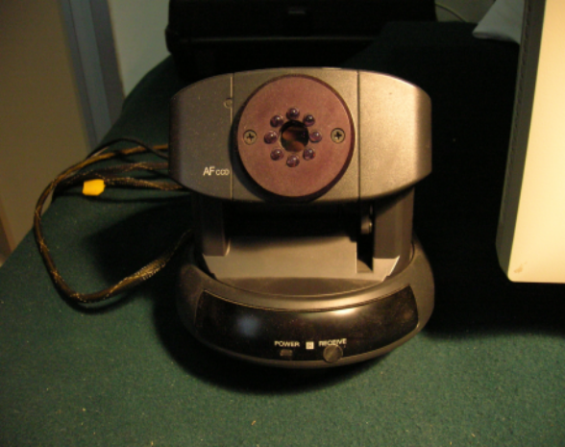
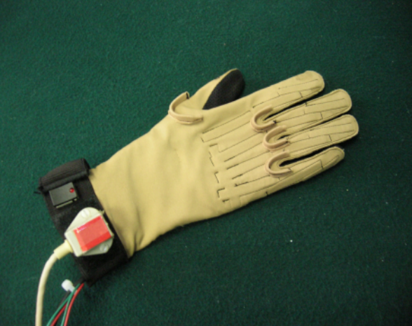
www.neurobotics.org
in teleoperated reaching and grasping:
  guess when the master wants to grasp
  guess how the master wants to grasp
  guess what the master wants to grasp
in intelligent prosthetics:
  guess what the patient wants his prosthesis to do

Slide 5
machine learning
show the machine a set of sport cars, then a set of non-sport-cars
build an approximated classification function (training)
ask the machine to classify new images, according to the approximation built (testing)
hope for high accuracy, expect long computational times, avoid overfitting

Slide 6
support vector machines
excellent theoretical foundation
no local minima during training
able to handle highly-dimensional data:
  map features to an infinite-dimensional space
  solve a linear separation problem over there
will seldom overfit
few parameters to be tuned
poor performance on large datasets

Slide 7
learning when to grasp
human subjects look at objects on a monitor and simulate the act of grasping
by monitoring the user’s gaze and arm motion, guess when he wants to grasp
consider an adequate time window of gaze variance and arm velocity

Slide 8
learning when to grasp
7 human subjects:
  4 women, 3 men
  aged 31-73: wide variance in bodily and eye movements
  some of them slightly visually impaired (short-sighted, pupil spasm, cataract operated)
gaze tracker: ASL E504

Slide 9
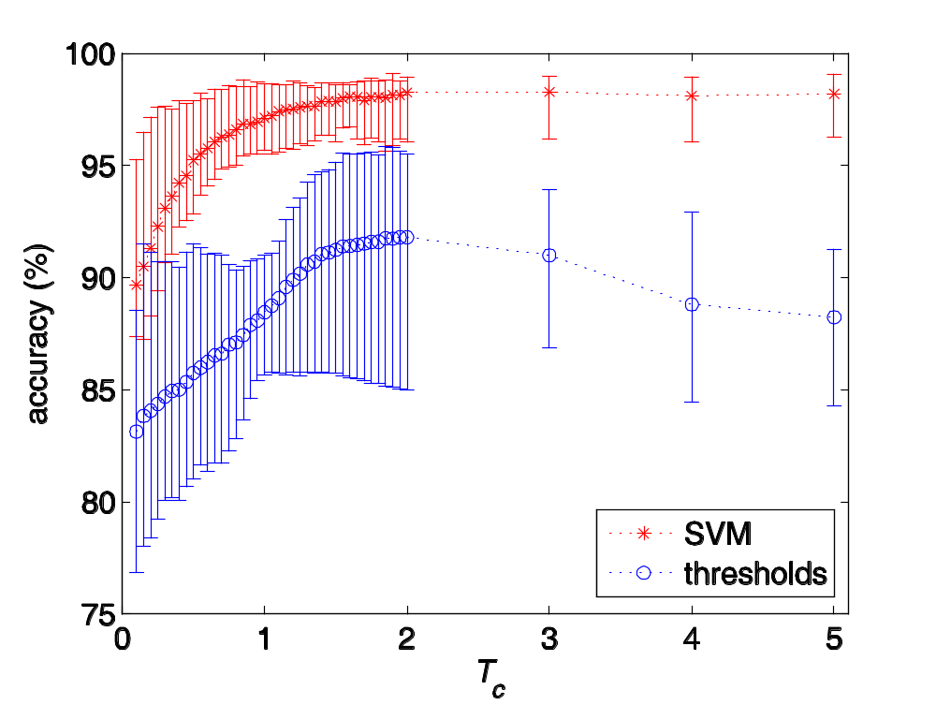
learning when to grasp
comparison: Support Vector Machines vs. a simple decision tree

Slide 10
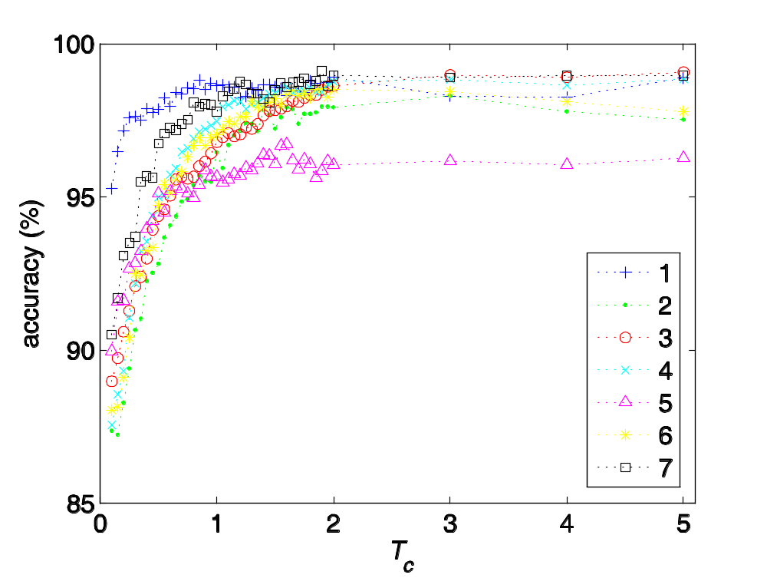
learning when to grasp
accuracy: how well do we guess the subject’s intention?

Slide 11
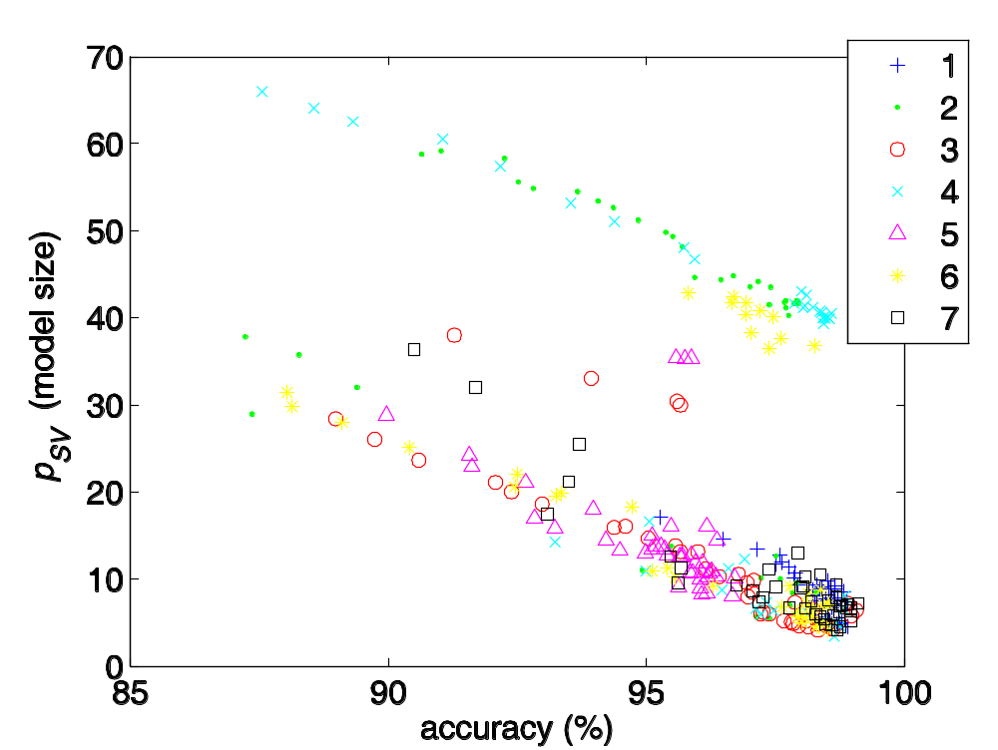
learning when to grasp
compactness: how large are the models obtained?

Slide 12
learning when to grasp
SVMs build excellent models of the user’s intention to grasp:
  accurate
  small (i.e., fast and suitable for online applications)
the problem is easy in the feature space, not necessarily in the input space!
research about (functional) biological plausibility is ongoing

Slide 13
conclusions
SVMs are a viable solution to understand user’s intention by monitoring gaze and arm motion
highly adaptive, regardless of visual impairment and age of the subjects
they can be employed in aiding the disabled

