Slide 1
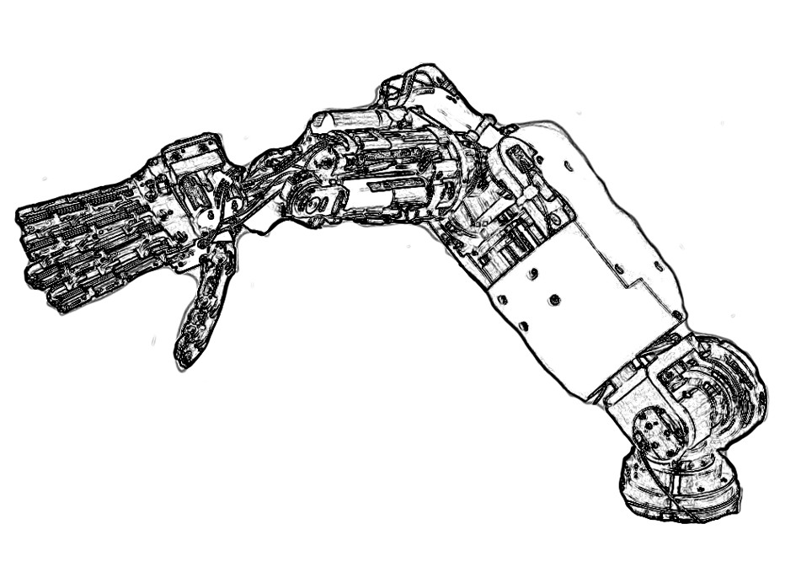
API
VABoard.ini
VBBoard.ini
Name=VABoard
Port=/dev/tty1
Baud=57600
Bits=8
Name=VBBoard
Port=/dev/usb
VABoard
RS232
VA-Wrapper
DeviceDriver
Interface
Reusable
User Code
PositionControl
Interface
API
VBBoard
USB
VB-Wrapper

