Slide 1
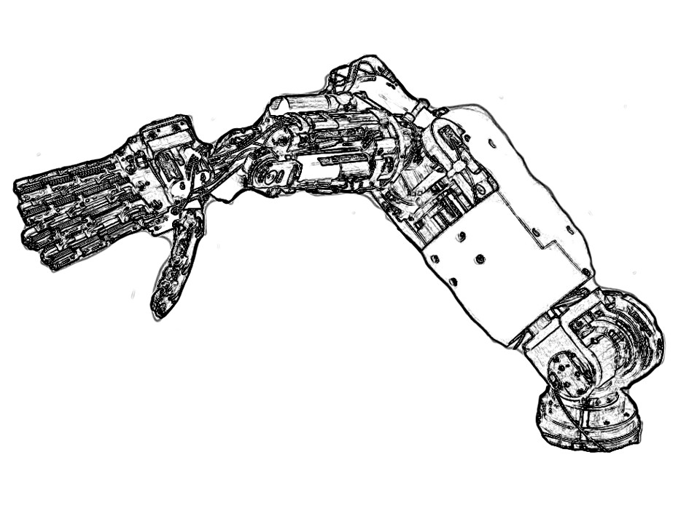
API
Network Wrapper
(Server)
VABoard
VA-Wrapper
YARP Interface
Network
Connection
Network Wrapper
(Client)
Reusable
User Code
YARP Interface

