Slide 1
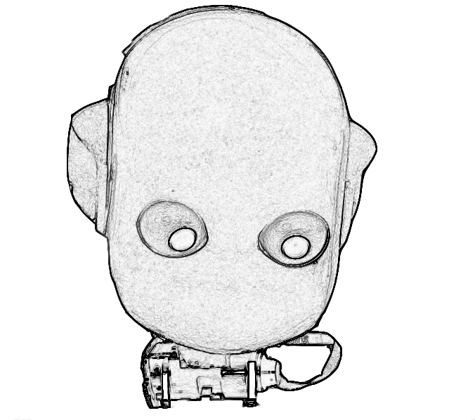
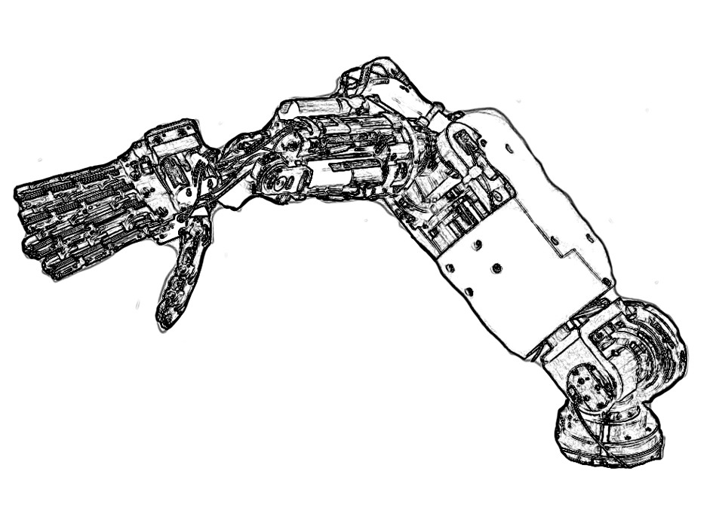
Process1
PolyDriver
dragonfly.ini
open(“dragonfly”)
view(IFramegrabberRgb)
IFramegrabberRgb
dragonfly
mboardA.ini
dragonfly
open(“mboardA”)
PolyDriver
view(IPositionControl)
IPositionControl
mboardA
mboardA
factory
Process2
mboardB.ini
open(“mboardB”)
PolyDriver
view(IPositionControl)
mboardB
IPositionControl
mboardB
view(IVelocityControl)
IVelocityControl

