Slide 1
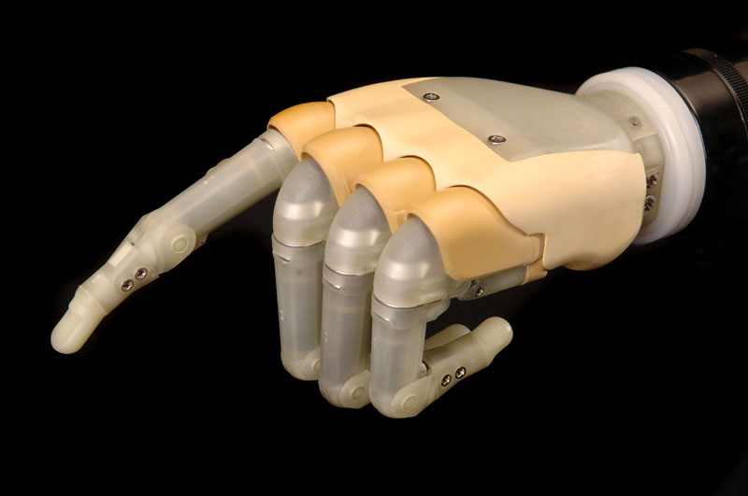
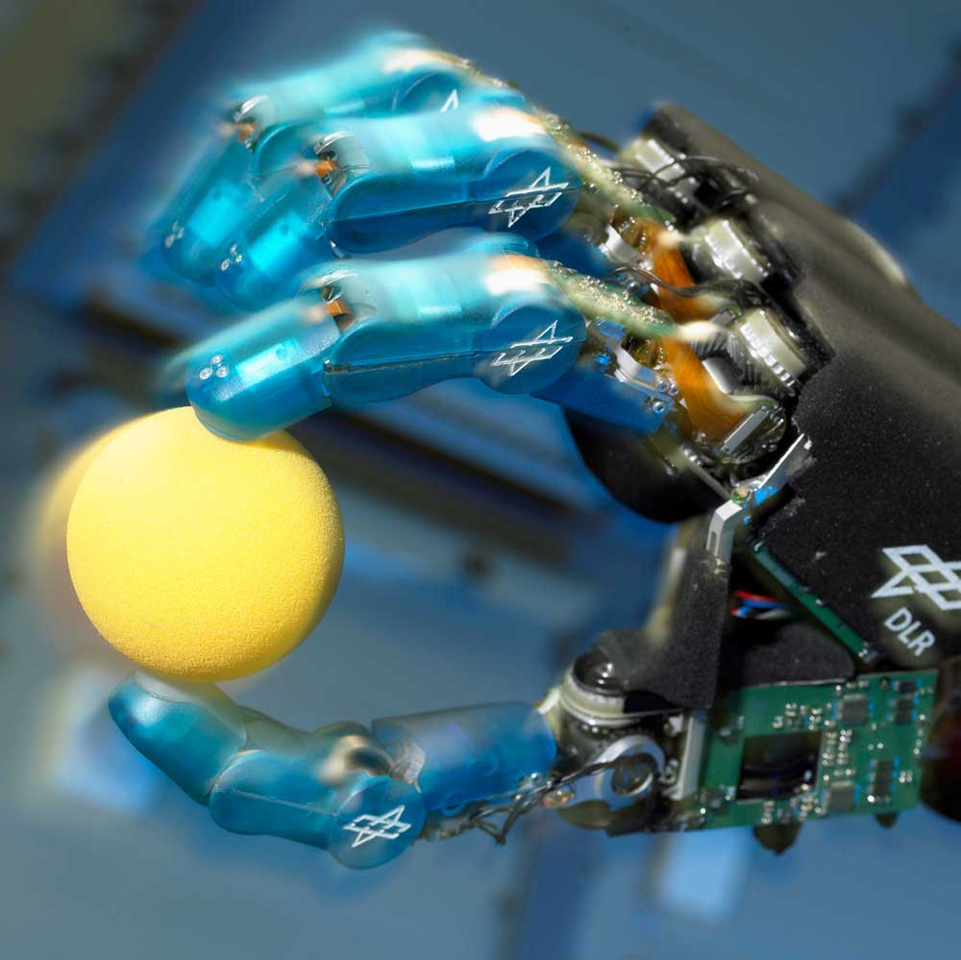
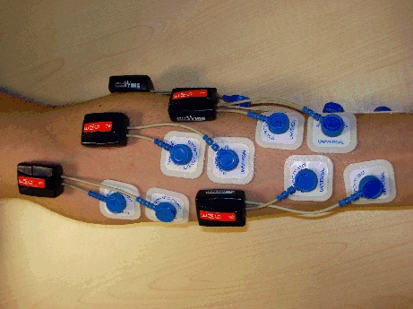
EMG-driven mechanical hand
use forearm surface electromyography to control a mechanical hand (future work: an active hand prosthesis)
  totally non-invasive
  relatively cheap
excellent results both in classification of grasp type and approximation of involved force (UGDIST/DLR)
in controlled and non-controlled conditions, and for a number of healthy subjects (UGDIST/IIT)
and for a trans-radial proximal amputee (UGDIST/IIT/INAIL)

