Slide 1
surface EMG for force control of mechanical hands
claudio CASTELLINI¹, patrick VAN DER SMAGT^{2,} giulio SANDINI^{1,3}, gerd HIRZINGER²
¹ advanced robotics laboratory, university of genova, italy
² german aerospace research center, oberpfaffenhofen, germany
³ italian institute of technology, genova, italy

Slide 2
problem
high dexterity, but
little possibility of control by the patient: what interface?
we focus upon non-invasive interfaces, particularly upon
forearm surface electromyography
can a mechanical hand be swiftly driven using the emg?

Slide 3
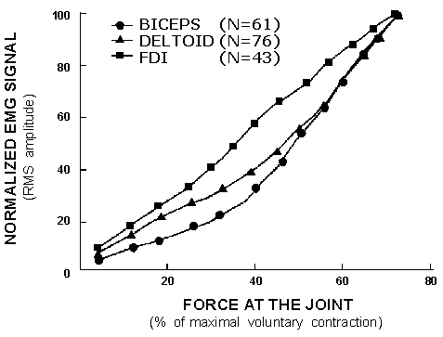
emg (in principle)
RMS non-linearly related to the force applied by a muscle

Slide 4
emg (in practice)
a very badly conditioned signal, affected by a number of factors:
  (long-term) inter-arm differences
  (long-term) arm postures and movements
  (short-term) muscular fatigue, sweat
  (medium-term) electrode displacement, muscle cross-talk
how to take into account all these problems?

Slide 5
emg
how to take into account all these problems?
  (inter-arm differences neglected) one subject only, able-bodied
  (arm postures and movements neglected) relaxed on a table, fixed position
  (muscular fatigue, sweat) three-and-a-half minutes of activity: one session
  (electrode displacement) three sessions form a group; electrodes replaced between groups
30 sessions in 10 groups across 2 days, 25Hz, 153.000 samples

Slide 6
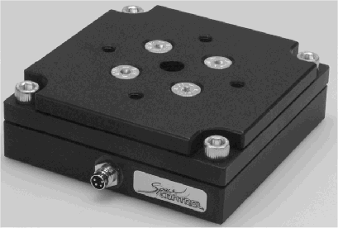
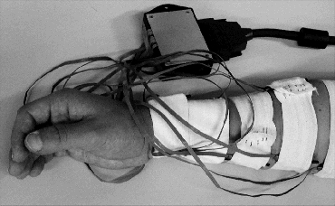
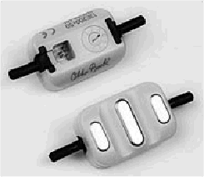
setup
10 Ottobock emg electrodes
1 SpaceControl force/torque sensor
4 fingertip sensors

Slide 7
methodology
the subject freely, repeatedly presses the force sensor
  variable grasping speed
  variable force
  four types of grasp (thumb-index,
  -middle, -ring and power grasp)
classify type of grasps
detect applied force (regression)

Slide 8
methods
feed-forward neural network (classification, regression)
  sigmoidal activation
  one hidden layer w/10 neurons
  backprop
support vector machine (classification, regression)
  gaussian kernel
locally weighted projection regression (regression only)
  online, incremental

Slide 9
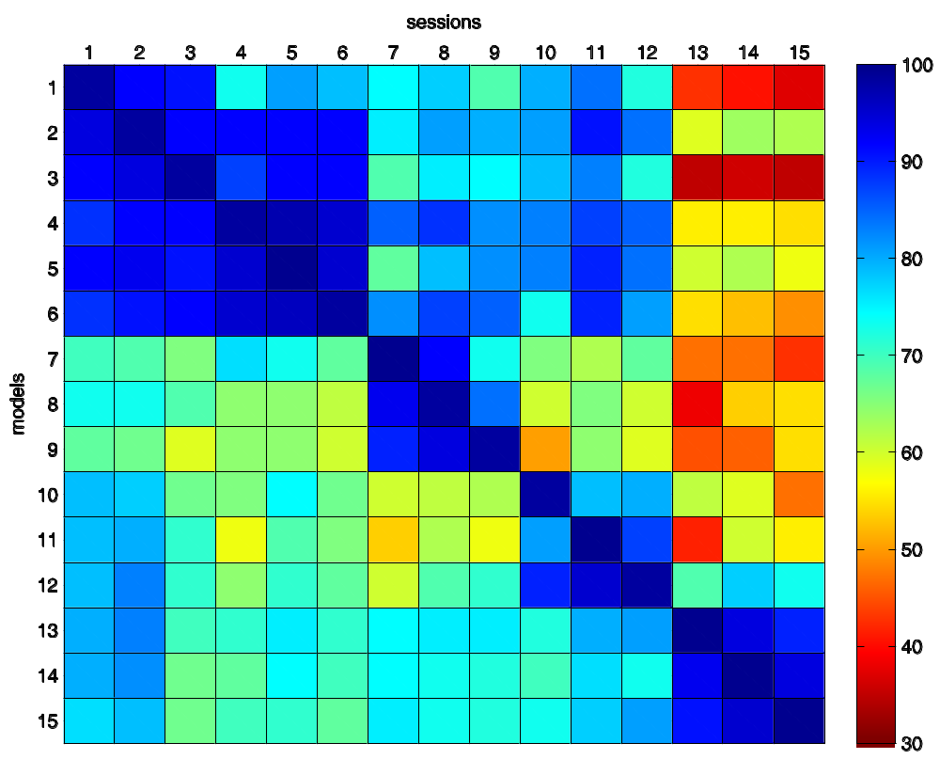
svc cross-session accuracy
A =
A_{ij} classification accuracy, training on session i, testing on session j.

Slide 10
uniformisation
number of samples is unacceptably high, and it is bound to be even larger when we go online!
assumption: the function we are modelling is smooth (human movement)
assumption: displacing the electrodes shifts the samples in the input space
try with uniformisation: avoid samples which are too close to the current training set

Slide 11
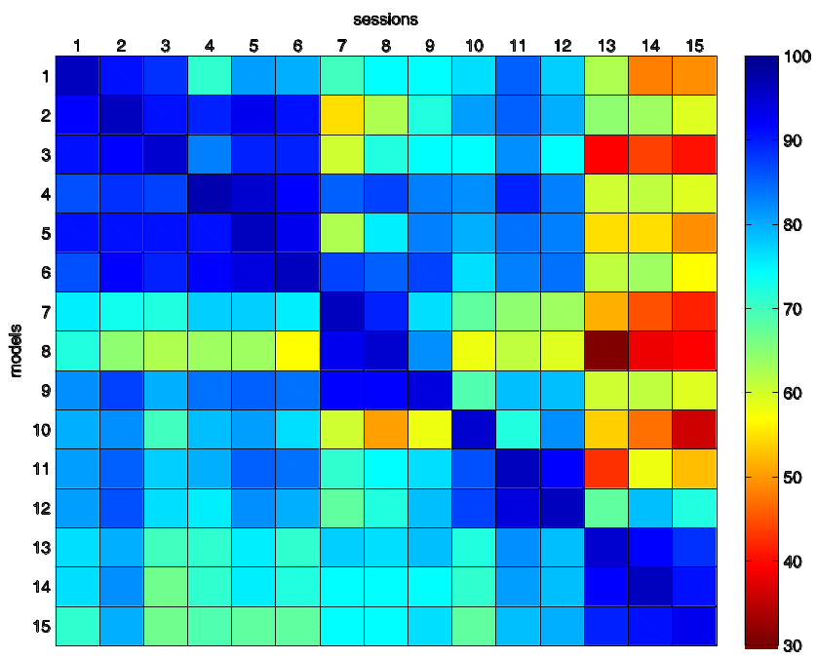
uniformisation
full training sets
diag: 98.73% ± 0.39%
non-diag: 73.23% ± 14.29%
uniform training sets
diag: 95.52% ± 1.21%
non-diag: 74.53% ± 13.70%

Slide 12
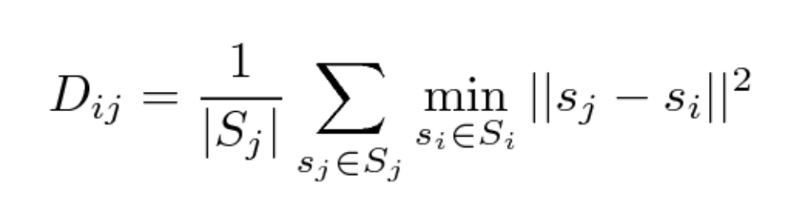
what makes it hard?
average minimum sample set distance:
correlation(A,D) = -0.60
analogous (even stronger) correlation with nn, and all approaches on regression
what if we adjoin good models and then train on this new model?

Slide 13
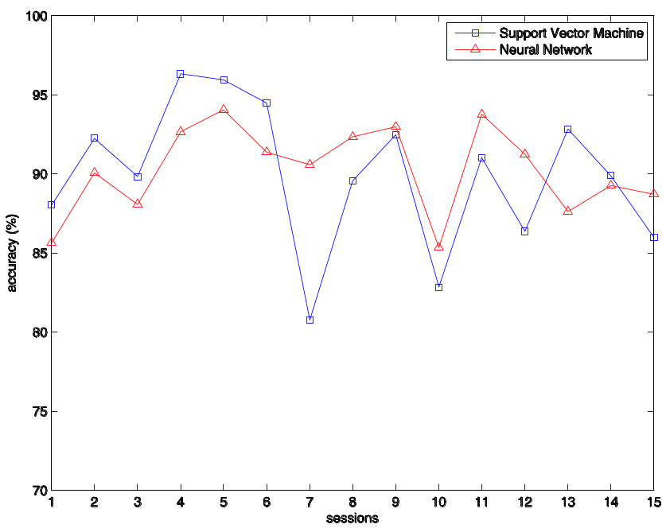
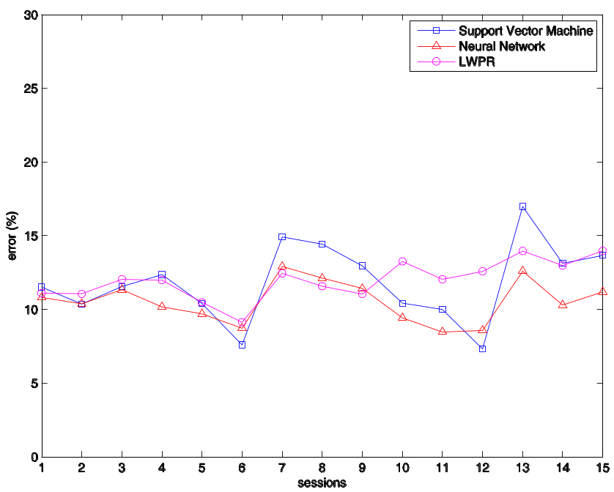
best models
best models on day 1, classification accuracy (left) and regression NRMSE (right)

Slide 14
intermission
information is there, one only has to dig and find it!
distance is the key
need a mechanical way of building good models
on-line version of uniformisation:
  check wheter a new sample is far away from the current training set
  if so, use it
  otherwise, ignore it

Slide 15
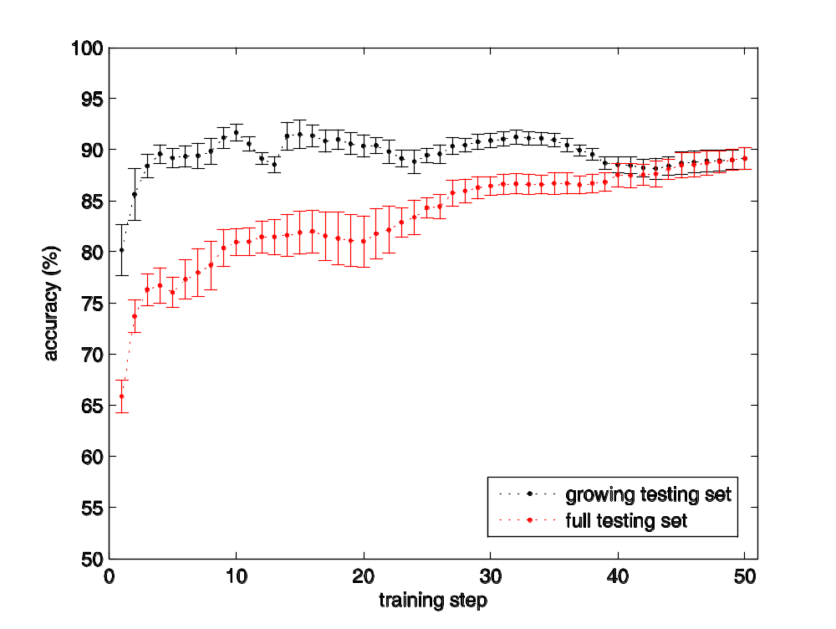
on-line accuracy
red line says: we aren’t going to miss anything: the system learns more and more.
black line says: uniformisation doesn’t waste anything useful.

Slide 16
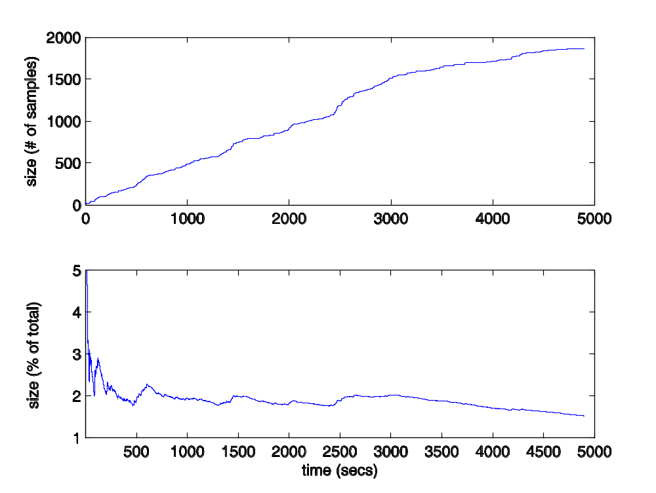
growth of a training set
the training set will eventually stop growing.
imagine you’re stuffing balls in a cube...

Slide 17
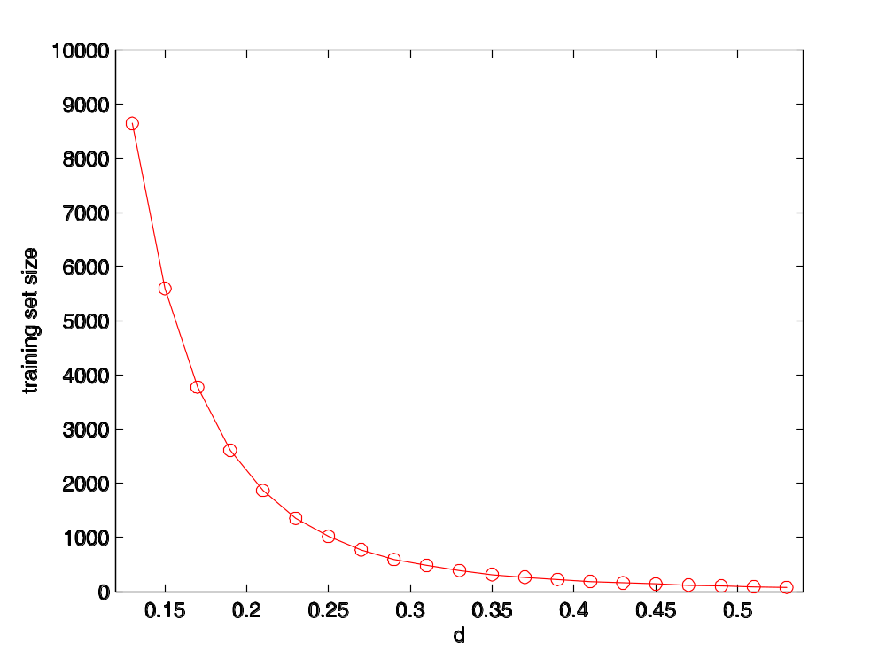
as the distance grows... (1)
how many balls fit in the cube?
training set size decreases as d⁻¹⁰ since we have 10 electrodes.

Slide 18
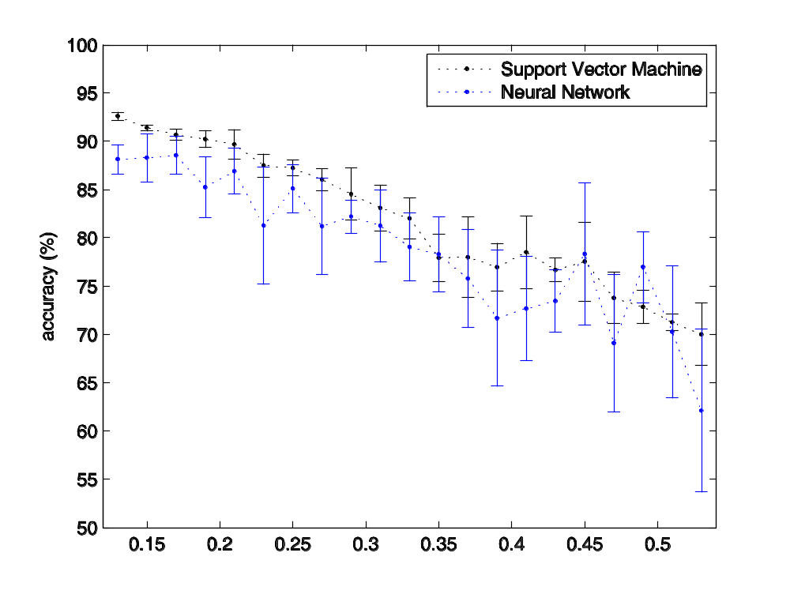
as the distance grows... (2)
accuracy decreases linearly.

Slide 19
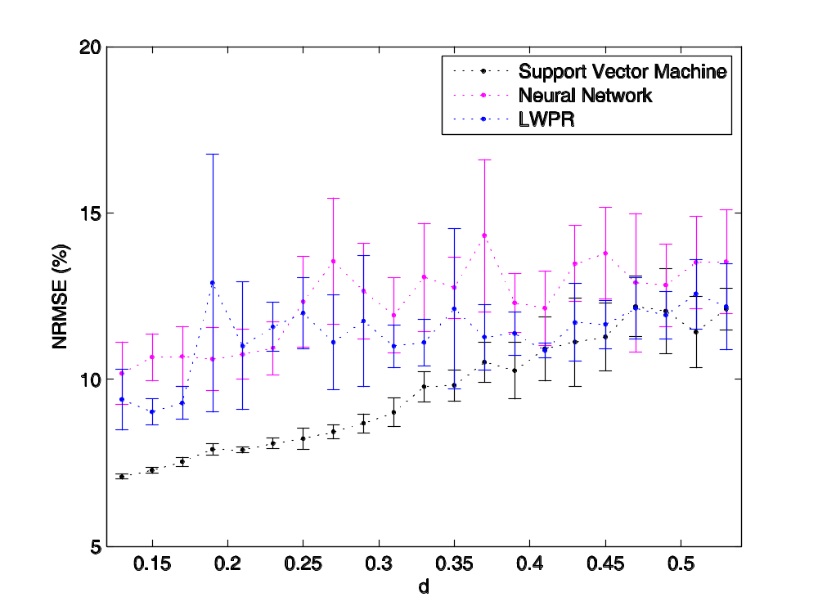
as the distance grows... (3)
error increases linearly.
for d=0.53, error is 12.12%, and the training set has 77 samples over 153.000!

Slide 20
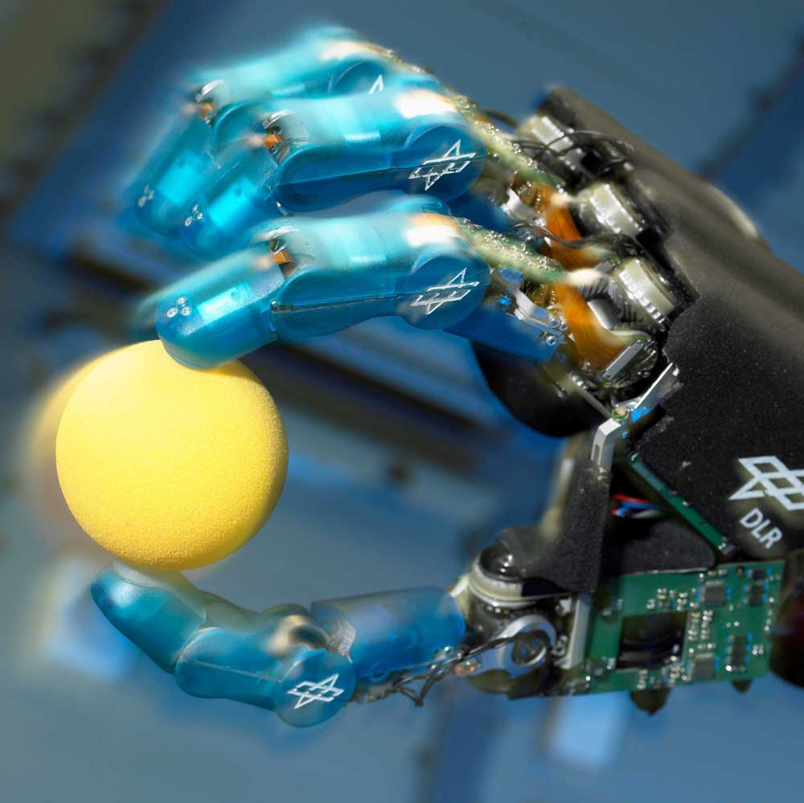
demo
it works!
(movie)

Slide 21
conclusions
problem is solved so far!
now
  gather more data to take arm movement into account
  try on multiple healthy subjects (expect low cross-subject performance)
  online uniformisation seems a promising way to keep training sets small and effective
mechanical hands can be actually controlled this way
go to clinical setting

