Slide 1

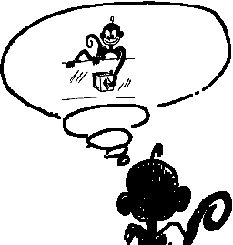
“Canonical neurons”
Active when manipulable objects are presented visually
“Mirror neurons”
Active when another individual is seen performing manipulative gestures

