Slide 1

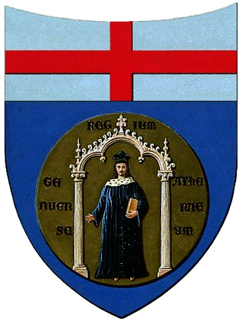

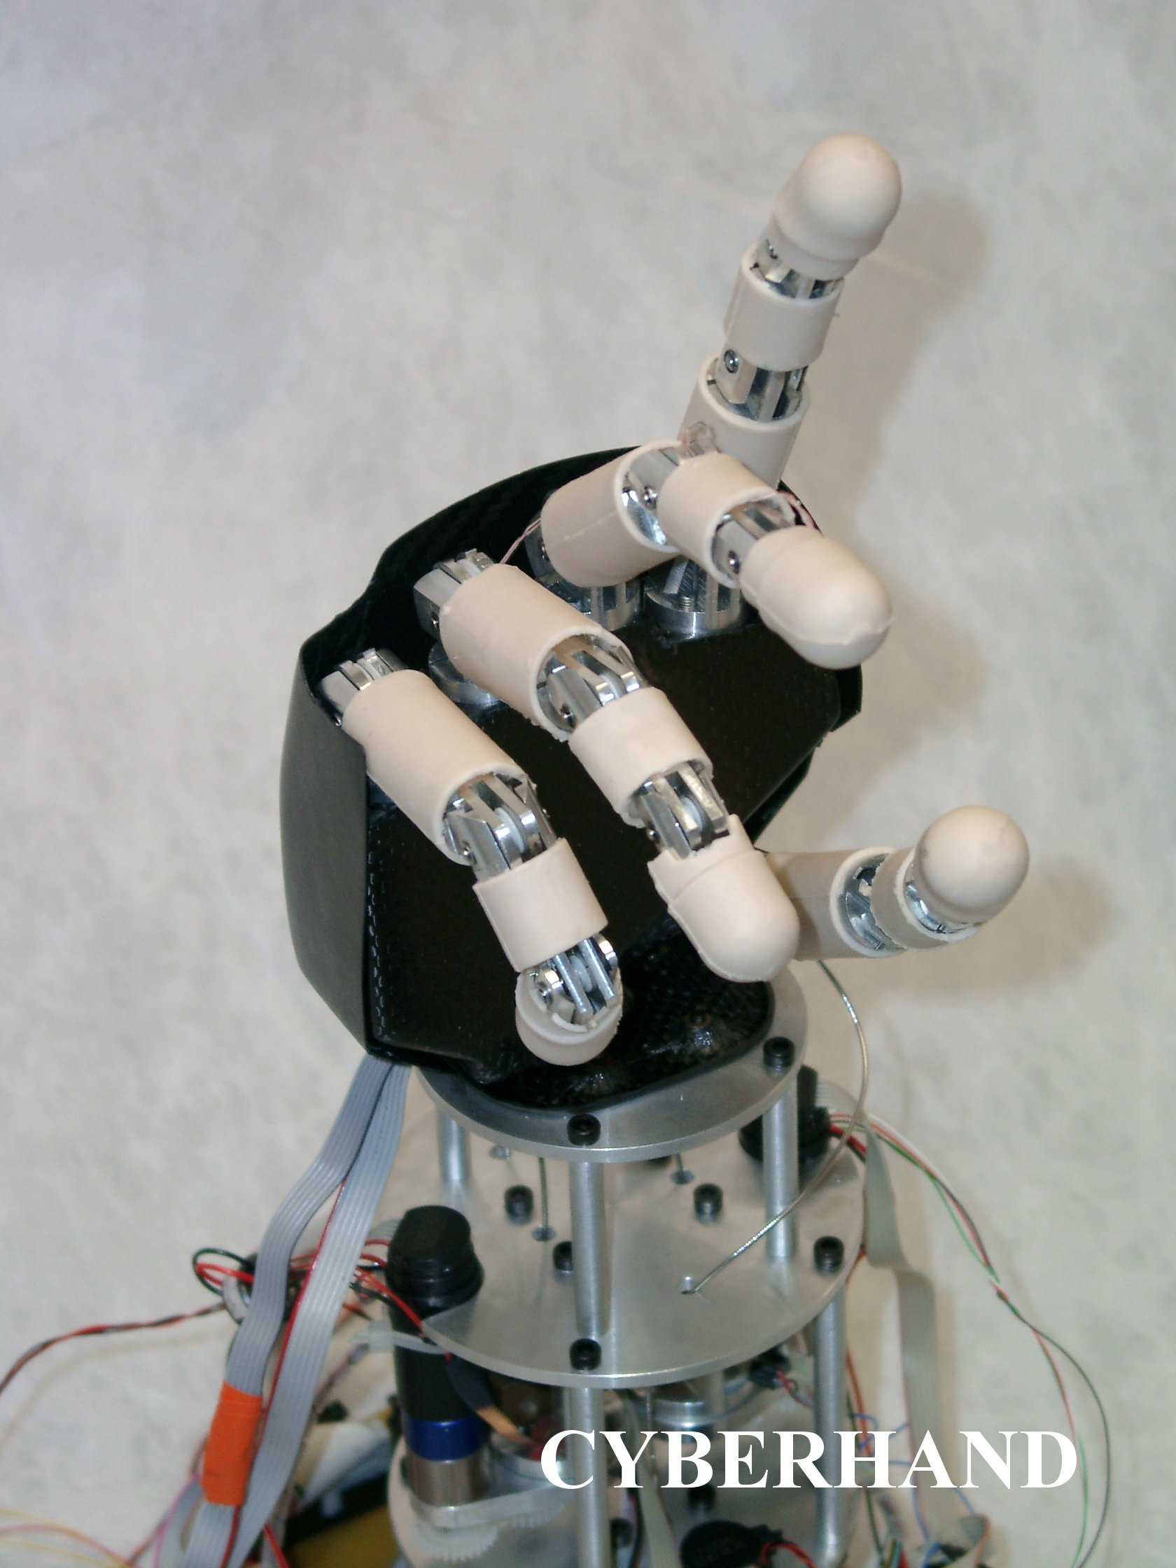
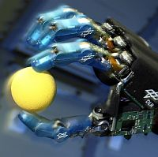
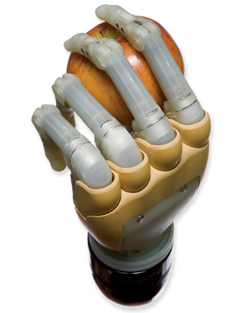
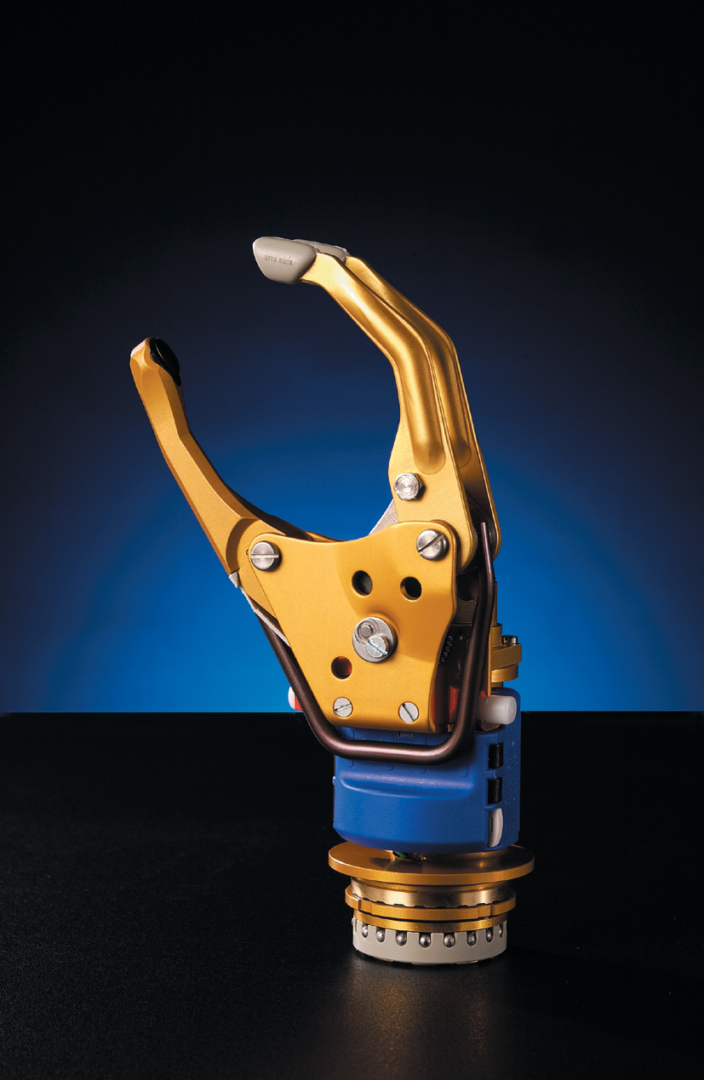
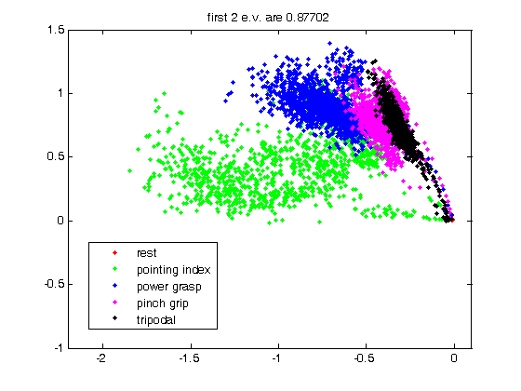
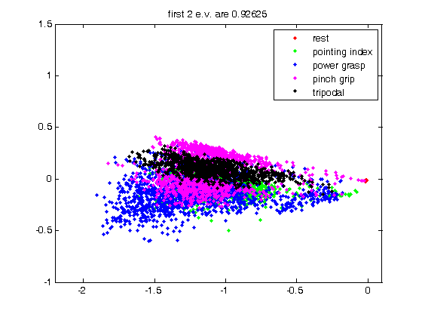
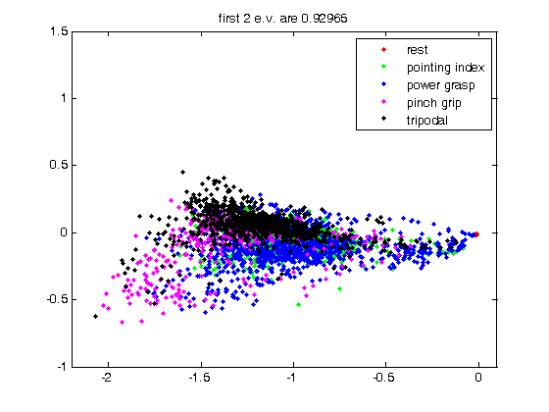
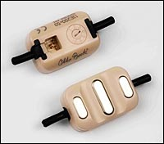
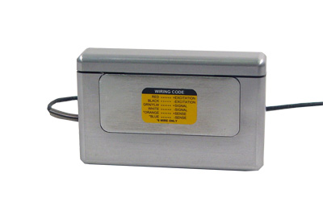
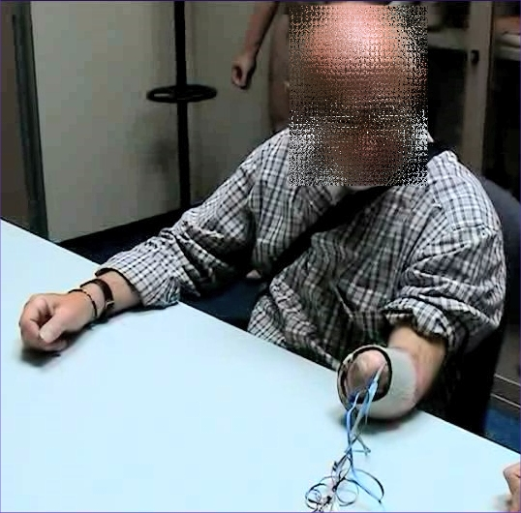
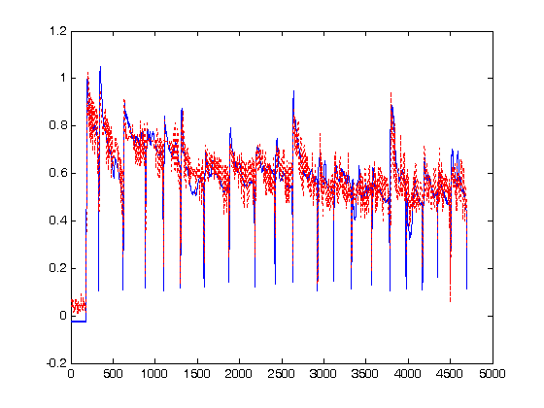
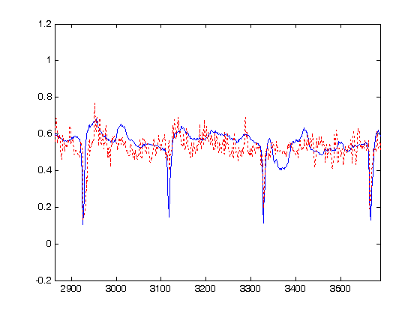
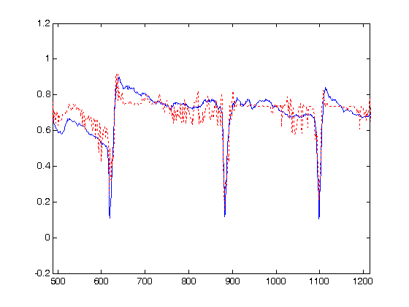
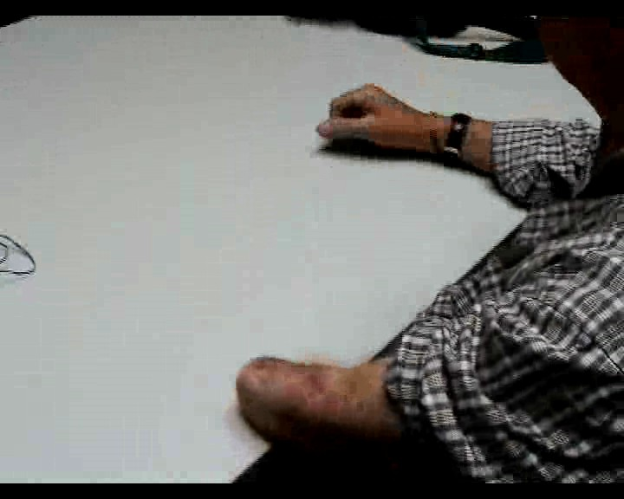
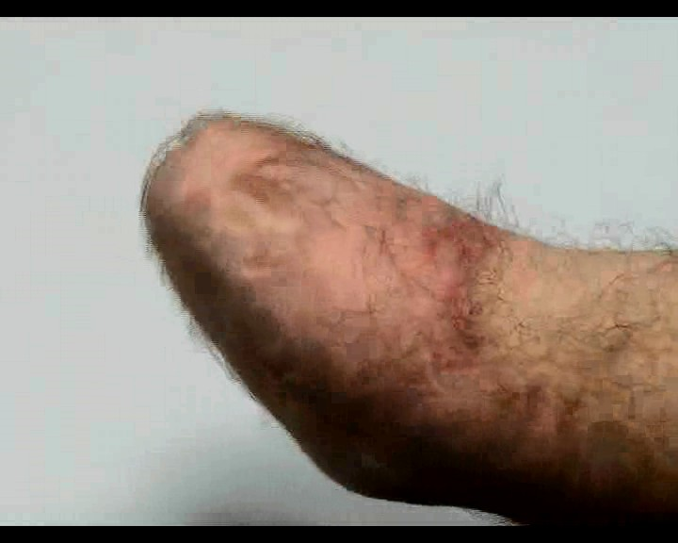
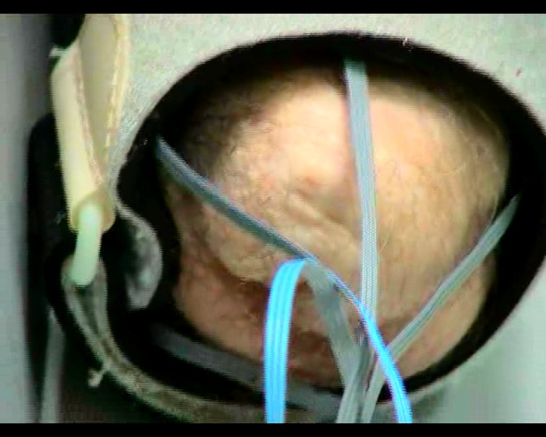
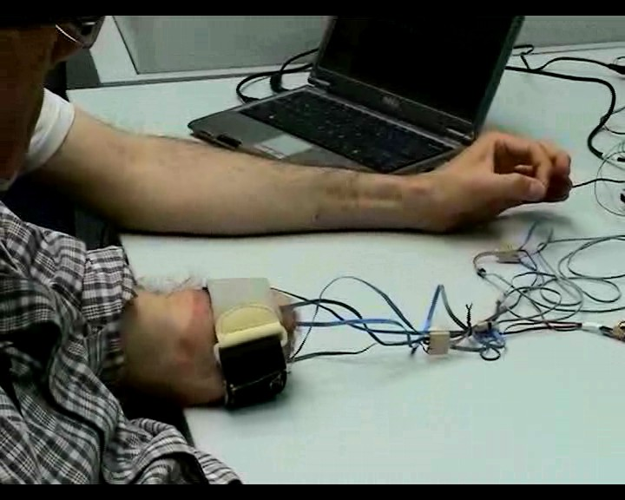
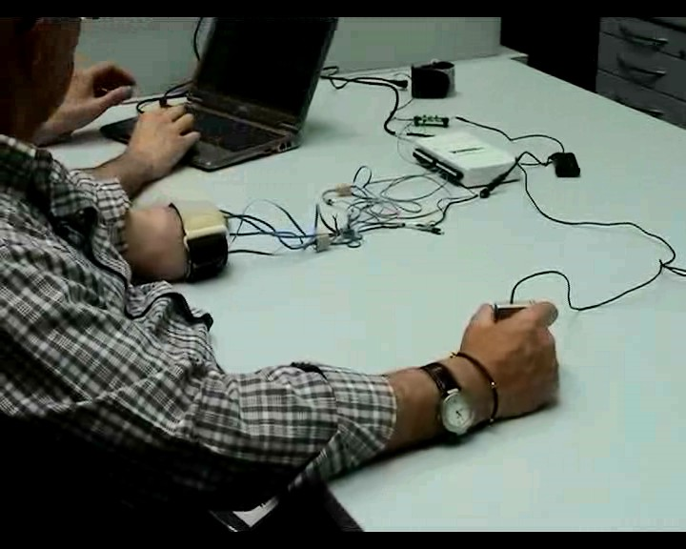
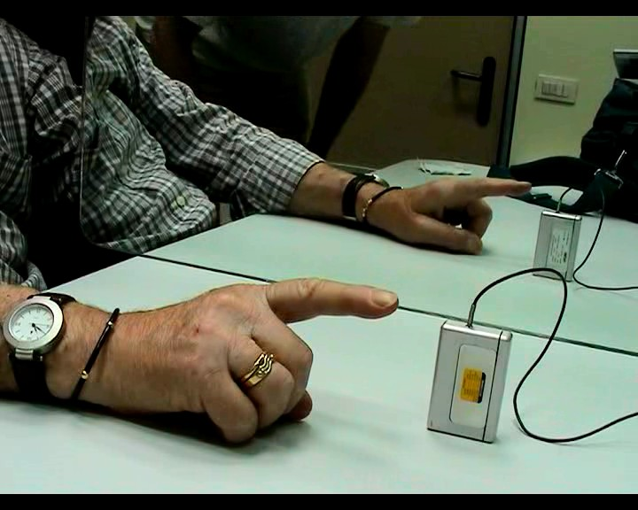
SURFACE EMG FOR HAND PROSTHESES: CAN AN AMPUTEE REALLY DO IT?
C. Castellini^{A}, E. Gruppioni^{B}, A. Davalli^{B}, G. Sandini^{A,C}
^{A} LIRA-Lab, DIST, University of Genova, Italy
^{B} INAIL Centro Protesi, Vigorso di Budrio, Bologna, Italy
^{C} RBCS Department, Italian Institute of Technology, Genova, Italy
INTRODUCTION
This paper shows the first experiment ever, as far as we know, to enable an amputee finely control an Active Hand Prosthesis (AHP) via forearm surface electromyography (EMG). This is going to be needed soon, as the mechatronics of AHPs is getting better and better, and current state-of-the-art (one d.o.f. and scarce control) will be soon out of date^{1,2}.
DATA INSPECTION AND PRE-PROCESSING
Spectral analysis of the EMG signals reveals that, as is well-known⁶, the relevant bandwidth lies below 10-15Hz (the OttoBock electrodes already perform an RMS operation); so the signals were subsampled at 25Hz from the original 100Hz. Categories were assigned to samples according to the type of grasp the subject was asked to perform; the force value was, in the case of modality #1, the maximum possible, and the sensor was pressed by the teacher himself. Samples with low force values were removed from the data set.
First of all, PCA reveals that the 5 signals can be reduced to 2 without losing more than 10-15% variance. So we can see the samples:
s.o.a. dexterous robotic hands and AHPs:
the CyberHand, the DLR II, Touch BIonics’s i-LIMBTM and Otto Bock’s SensorHandTM
1) teacher imitation 2) bilateral symmetric action 3) mirror-box
We hereby show how a machine learning method, namely a Support Vector Machine³ (SVM), can be trained on data gathered from a patient to proficiently control a dexterous AHP. In particular we show that even a patient with a short stump and whose operation dates back to decades ago is potentially able to elicit at least 4 grasp types, and precisely modulate the force involved in each grasp. This opens up a scenario in which surface EMG, a cheap and totally non-invasive technique⁴, can enable amputees perform many more operations with an AHP, than it is nowadays possible.
As is apparent from the Figure above, classes corresponding to grasp types are well separated; and the best modality, as far as separation is concerned, is teacher imitation. It is unclear, so far, whether this can be ascribed to fatigue while progressing in the experiment, or modality 1 is inherently better. All in all, it appears highly surprising that Mr. V., 40+ years after a proximal amputation, is still able to produce very distinct signals even for similar grasp types, e.g., pinch (magenta) and tripodal (black). This lets us hope for the best.
MATERIALS AND METHODS
Subject. Mr. V., a trans-radial proximal left-hand amputee, participated in the experiment. The subject is 64 years old and was operated in 1963; he is left with a stump about 8cm long. He is a pioneer of myoelectric prostheses, as he’s been using OttoBock’s and INAIL’s custom devices since the 60s.
Devices. Five OttoBock MyoBockTM electrodes were placed on V.’s stump without precisely checking for the residual muscles positions. A FUTEK LMD500 force sensor was used to detect the force involved in the grasping. Lastly, a standard DAQ card was employed to acquire the signals (sampling rate: 100Hz).
CLASSIFICATION AND REGRESSION
Data were initially fed to the system as-is, with no filtering whatsoever, in order to check that the approach would be feasible in a real, on-line setting. As a second trial, a 2° order lowpass filter with cutoff frequency at 5Hz was applied to the EMG signals, in order to cut off all possible HF noise.
A SVM with Gaussian kernel was trained on V.’s data in order to map EMG signals to (a) types of grasp (classification) and (b) required force values (regression). The hyperparameters C and σ were found by grid-search over 5-fold cross-validation, with classification accuracy (for classification) and correlation with the target (for regression) as the performance index.
The results are very good, as one can see from the Table and Figure below:
the real force values (black) and the ones guessed by the SVM (red - whole picture and two zooms)
 | imitation | bilateral | mirror
unfiltered | 93.1% / 0.86 | 79.2% / 0.80 | 75.8% / 0.78
filtered | 96.0% / 0.88 | 88.1% / 0.86 | 85.7% / 0.85
the OttoBock EMG sensors the FUTEK force sensor
Mr. V., our subject
elbow
CONCLUSIONS
This paper can be seen as a follow-up to^{6,7}, in which we showed that the approach is on average perfectly feasible on healthy subjects, even in non-controlled conditions. Here we turn to patients. Obviously, no statistical inference can be made with one patient only; but indeed this work proves that an amputee can still have enough muscular plasticity and “body memory” to elicit very precise activation patterns; and that these patterns can actually be used to drive an AHP to a degree of dexterity totally unknown so far.
Tasks. Mr. V. was asked to “perform” 4 different grasps/postures (pointing index, index pinch grip, tripodal grip, power grasp) with free force and speed, while we would record the EMG and force sensor activity. Three ways of training the system (modalities) were employed:
1. teacher imitation. A healthy subject (teacher) would place his left arm besides V.’s stump and ask him to “imitate” the grips. The subject was asked to imagine gripping with his maximum strength.
2. bilateral symmetric action. The subject was asked to grip the force sensor with his healthy hand while “doing” the same things with his stump.
3. mirror-box. Same as modality 2, but a mirror was placed between the subject’s arms, in order to increase the visual feedback⁵.
REFERENCES
[1] M. Zecca, S. Micera, M. C. Carrozza and P. Dario, Control of Multifunctional Prosthetic Hands by Processing the Electromyographic Signal, Critical Reviews in Biomedical Engineering, 30(4–6):459–485, 2002.
[2] H. Huang, L. Jiang, D. Zhao, J. Zhao, H. Cai, H. Liu, P. Meusel, B. Willberg, and G. Hirzinger, The development on a new biomechatronic prosthetic hand based on under-actuated mechanism, in Proceedings of IROS 2006, 2006, pp. 3791—3796.
[3] B. E. Boser, I. M. Guyon, and V. N. Vapnik, A training algorithm for optimal margin classifiers, in Proceedings of the 5th Annual ACM COLT Workshop, ACM press, 1992, pp. 144–152.
[4] C. J. De Luca, The use of surface electromyography in biomechanics, Journal of Applied Biomechanics, 13:135-163, 1997.
[5] V. S. Ramachandran and D. Rogers-Ramachandran. Synaesthesia in phantom limbs induced with mirrors. Proceedings of the Royal Society B: Biological Sciences, 263(1369), 377-386, 1996.
[6] C. Castellini and P. van der Smagt, Surface EMG in Advanced Hand Prosthetics, to appear in Biological Cybernetics, 2008.
[7] C. Castellini, A. E. Fiorilla and G. Sandini, Multi-Subject/DLA Analysis of Surface EMG Control of Mechanical Hands, poster at the I National Bioengineerings Group meeting, Pisa, Italy, 2008, and manuscript in preparation for Biological Cybernetics.
1) teacher imitation 2) bilateral symmetric action 3) mirror-box

