Slide 1
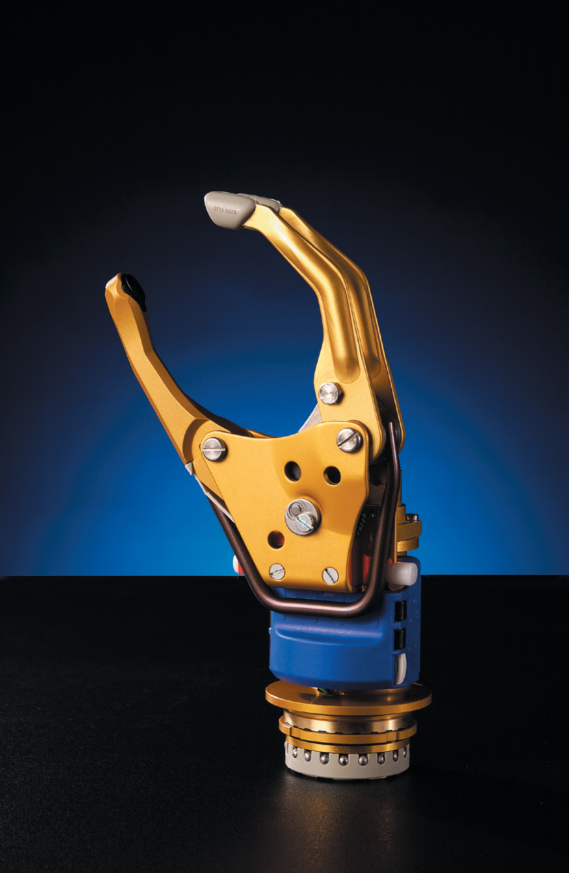
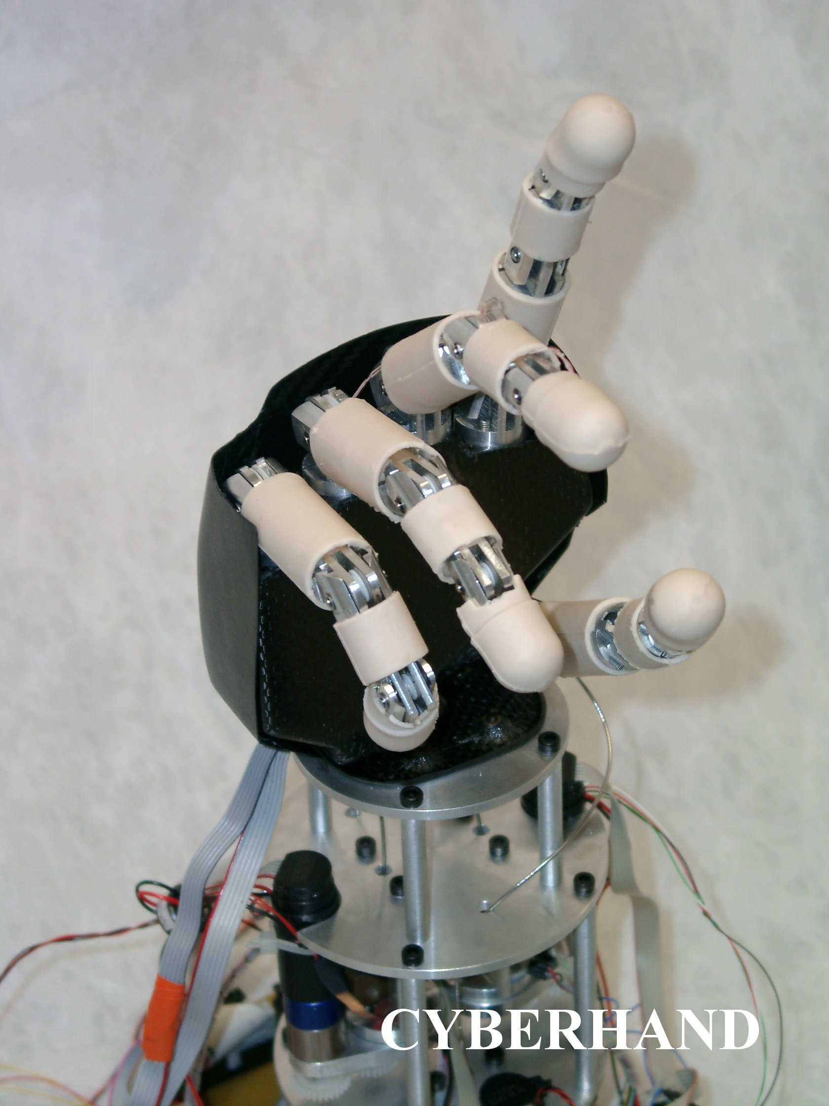
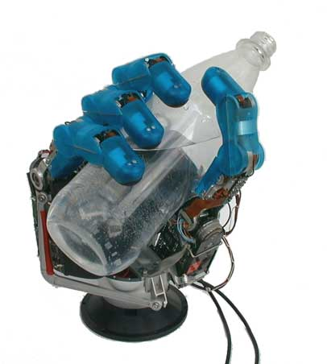
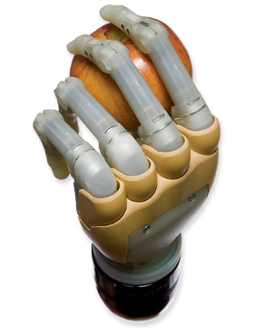
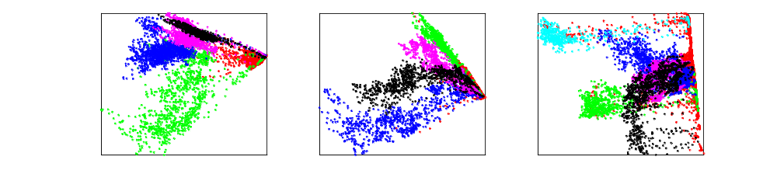
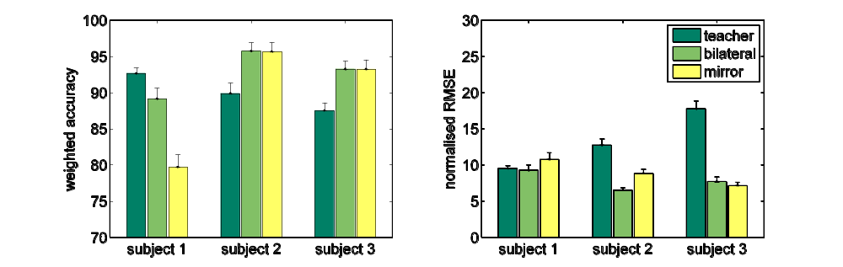
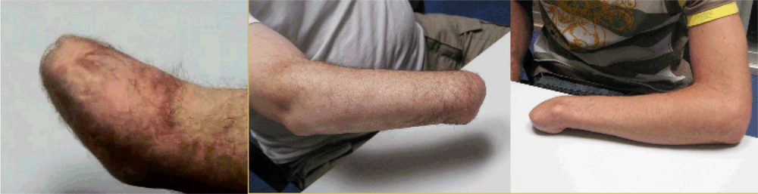
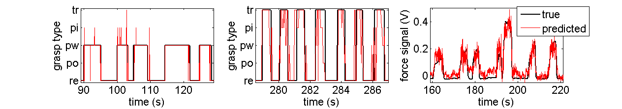
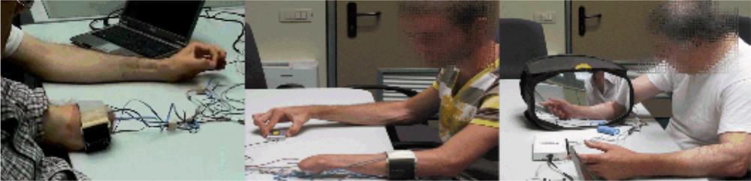
NON-INVASIVE ADAPTIVE HAND PROSTHETICS
C. Castellini^{A}, E. Gruppioni^{B}, A. E. Fiorilla^{C}, P. van der Smagt^{D}, A. Davalli^{B}, G. Sandini^{A,C}
^{A} LIRA-Lab, DIST, University of Genova, Italy – ^{B} INAIL Centro Protesi, Vigorso di Budrio, Bologna, Italy
^{C} RBCS Department, Italian Institute of Technology, Genova, Italy – ^{D} DLR (German Aerospace Center), Oberpfaffenhofen, Germany
INTRODUCTION
Improvements in the control strategies of Active Hand Prostheses (AHPs) appear urgent and mandatory to enable amputees to fully exploit the features of new multi-joint mechatronic AHPs (figure below): one-DOF hand prostheses are already out of date.
In this work we investigate the possibility for trans-radial amputees to perform different grasping postures with feed-forward force control using five commercially available surface EMG sensors.
DATA PRE-PROCESSING AND INSPECTION
Categories were assigned to samples according to the type of grasp the subject was asked to perform; the force value was, in the case of modality #1, the maximum possible, and the sensor was pressed by the teacher himself. Samples with low force values were assimilated to the rest condition, after making sure that the force and EMG values would match.
Principal Component Analysis reveals that the 5 signals can be reduced to 2 without losing more than 10-15% variance, so we can visualise the samples, coloured according to the required phantom limb posture. As is apparent from the examples in the Figure below, EMG samples are rather well separated, e.g., pinch (magenta) and tripodal (black).
s.o.a. dexterous robotic hands and AHPs:
the Otto Bock’s SensorHandTM, the CyberHand, the DLR I and the Touch BIonics’s i-LIMBTM
CLASSIFICATION AND REGRESSION
Data were fed to a Support Vector Machine as read from the force and EMG sensors, with no further processing. The hyperparameters C and σ, as well as the generalisation error, were found by nested cross-validation, with weighted classification accuracy (for classification) and normalised mean squared error wrt the target force values (for regression) as the performance indexes. Analysis of the ratio of Support Vectors and number of samples reveals that the task is, from the point of view of machine learning, an easy one.
PREVIOUS WORK
Surface EMG has already been used to discriminate hand postures in the past. As far as our work is concerned, in [1] we showed that surface EMG could be used to control a dexterous non-prosthetic hand, in poisition and force, by a healthy subject. In [2] the analysis has been extended with equally good results to 10 healthy subjects in non-controlled conditions, i.e., they were free to walk, move, sit down and stand up and raise/lower their arms. Here we show that three amputees obtain results in the same order of precision as the healthy subjects.
MATERIALS AND METHODS
Subjects. Three male subjects have joined the experiment:
Subject 1 is 63, trans-radial one-third proximal, amputated in 1963, 9cm stump; Subject 2 is 56, trans-radial one-third distal, amputated in 1972, 20cm stump; Subject 3 is 25, trans-carpal, amputated in 2007, complete forearm.
Acquisition setup. A standard DAQ card and an entry-level laptop were used to gather at 100Hz sampling rate the signals coming from a FUTEK LMD500 Hand Gripper force sensor, and five Otto Bock MyoBock 13E125=50 surface EMG electrodes. The electrodes were placed around the stump of each subject, a little below the elbow, uniformly spaced and irrespective of the residual muscles. No supervision by a physiatrist was employed. The figure below shows the setup and placement of the electrodes. Later on, after spectral analysis, the signals were low-pass filtered at 5Hz and subsampled at 25Hz.
Experimental task and data gathering. The subjects were asked to perform with their phantom limb various hand postures: (1) the act of pointing the index finger, used when pressing buttons; (2) a power grasp, used, e.g., when holding a heavy cylindrical object such as a hammer; (3) a precision pinch grip, with thumb and index finger closing on an object, usually for lifting small objects such as a pen or an egg; (4) a precision tripodal grip, using the middle finger too, used for spherical objects; (5) the act of stretching one's hand, used when an amputee is trying to put his hand inside a pocket. A rest condition was recorded at the beginning as a baseline condition.
The postures were done with various intended speeds and forces. Each subject performed them sequentially in three different modalities:
teacher imitation. A healthy subject (the teacher) would place his arm besides the subject's stump and ask him to imitate the teacher's postures with his phantom limb.
bilateral action. The subject would grip the force sensor with his healthy hand while doing the same thing with the phantom limb.
mirror-box. Same as modality 2, but a mirror-box was used.
DISCUSSION
Quality of the results. In [1] it was shown that a dexterous mechanical hand such as the DLR-II could be feed-forward force and position controlled in real time by a healthy subject using surface EMG. The results here presented show that our subjects could actually do the same, even possibly a little better. Our subjects obtain good results regardless of the age, age of operation (decades for Subjects 1 and 2) and type of amputation. Uniform electrode positioning works fine for all Subjects.
Perspectives. The problem is easy from the point of view of machine learning, which suggests that the rehabilitation community should stop looking for more and more sophisticated features and machine learning methods. Invasive techniques will not be necessary for a long time to come, at least for trans-radial amputees.
Neurophyisiological considerations. This form of feed-forward control is ”more natural” than the standard since here we use real-time phantom limb movements and forces. We find it amazing that long-term amputees, one of which has had almost no forearm for 45 years, can still produce such distinct signals for anatomically similar phantom movements. Moreover, it is common understanding that, due to cortical plasticity, motor/sensory brain areas devoted to amputated limbs are in the long run reassigned to other functions. The wonderful accuracy we have seen seems to go against this belief. This is in agreement with recent neurological experiments with fMRI and TMS on long-term hand amputees.
OWN REFERENCES
[1] C. Castellini and P. van der Smagt, Surface EMG in Advanced Hand Prosthetics, Biological Cybernetics, 100(1), 2008.
[2] C. Castellini, E. Fiorilla and G. Sandini, Multi-subject/DLA analysis of surface EMG control of mechanical hands, submitted to the Journal of Neuroengineering and Rehabilitation.
[3] C. Castellini, E. Gruppioni, A. Davalli and G. Sandini, Fine detection of grasp force and posture by amputees via surface electromyography, Journal of Physiology (Paris), in press, 2009.

