Slide 1
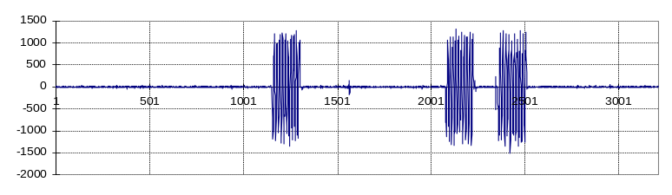
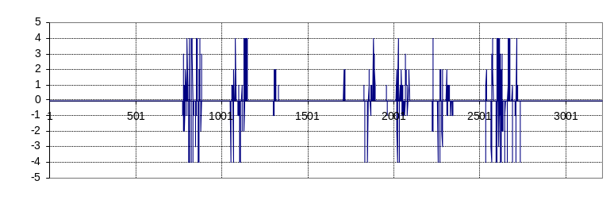
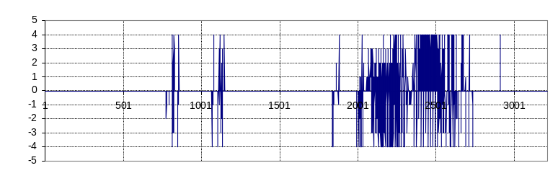
Joint speed (wrist)
Block (12,7)
optic flow (uncorrelated)
Block (10,5)
optic flow (correlated)

Slide 2
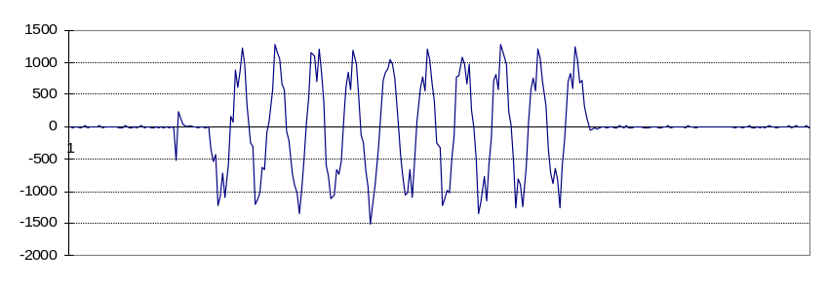
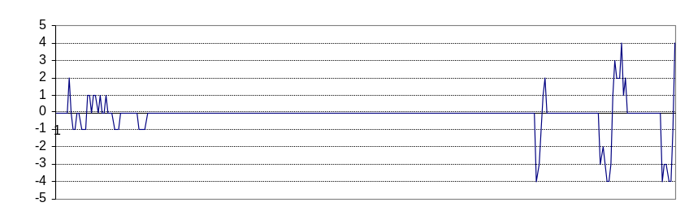
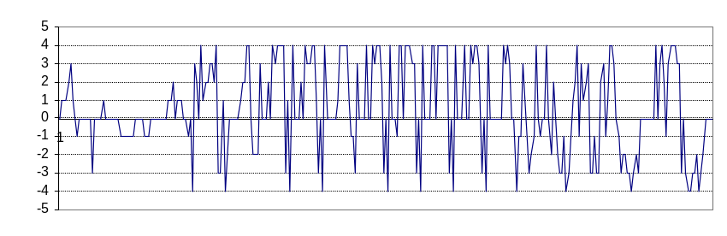
Joint speed (wrist)
Block (12,7)
optic flow (uncorrelated)
Block (10,5)
optic flow (correlated)

Slide 3
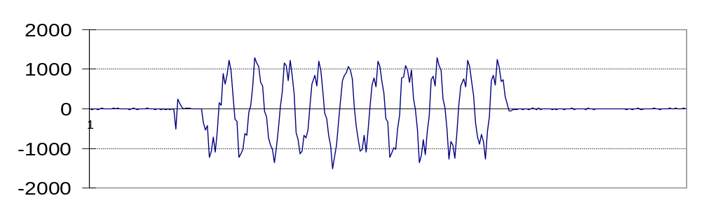
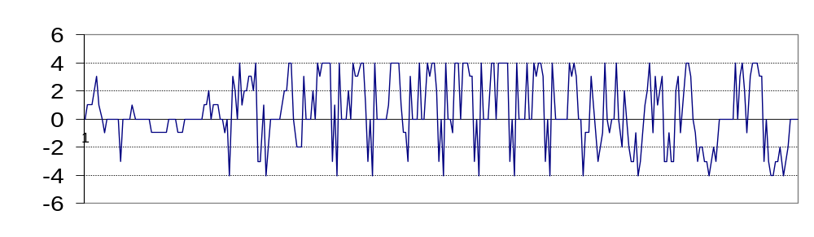
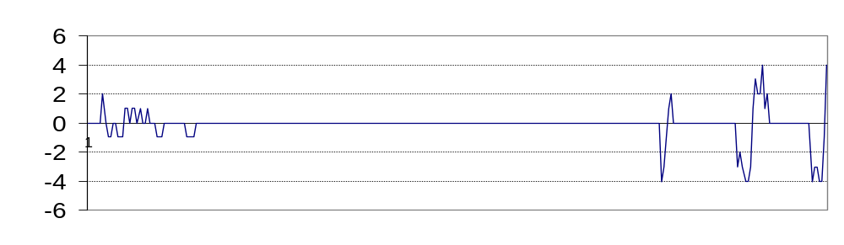
encoder value
pixels/frame
pixels/frame
frame index
start
stop

