Slide 1
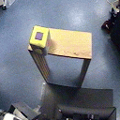
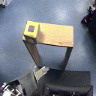
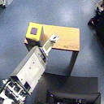
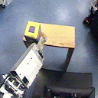
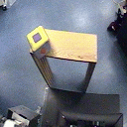
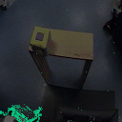
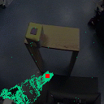
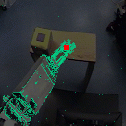
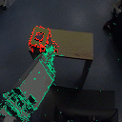
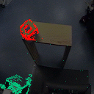

Slide 2
Edges of table and cube overlap
Color of cube and table are poorly separated
Cube has misleading surface pattern

Slide 3
Edges of table and cube overlap
Color of cube and table are poorly separated
Cube has misleading surface pattern

Slide 6

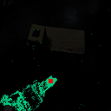
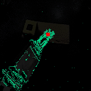
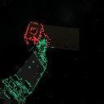
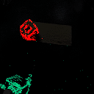
Begin
Find end-effector
Sweep
Contact!
Withdraw

Slide 7
X translation
Y translation
Translation
in depth
In-plane
rotation
Rotations
in depth
4 DOFs are trackable through projected appearance
2 DOFs remain:
point on surface

Slide 10
shoulder (a)
shoulder (b)
elbow (a)
elbow (b)
wrist (a)
wrist (b)

Slide 11
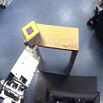
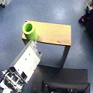
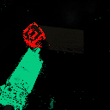
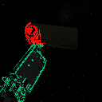

Slide 12
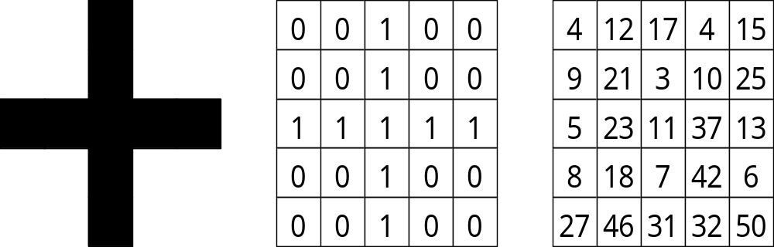
A cross
A binary cross
??

Slide 13
0
0
1
0
0
4
12
17
4
15
0
0
1
0
0
9
21
3
10
25
1
1
1
1
1
5
23
11
37
13
0
0
1
0
0
8
18
7
42
6
0
0
1
0
0
27
46
31
32
50
a cross
a binary cross
?

Slide 14
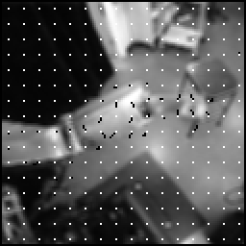
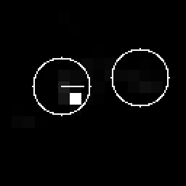
Optical flow
Maximum
Segmented regions

Slide 15
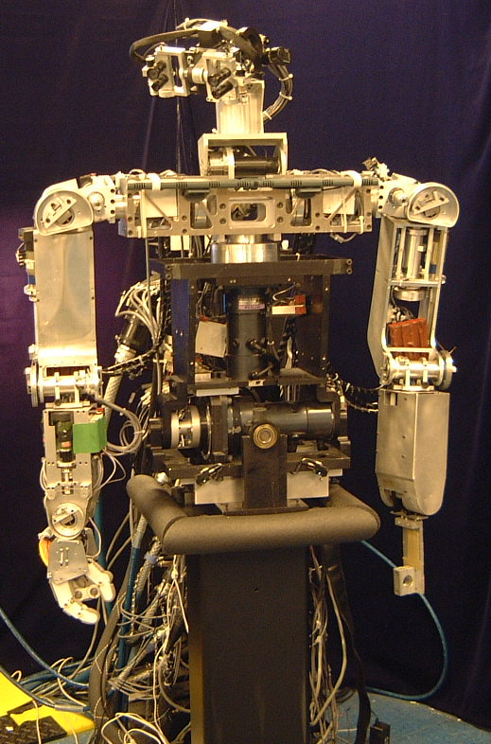
Head
(7 DOFs)
Right arm
(6 DOFs)
Left arm
(6 DOFs)
Torso
(3 DOFs)
Stand
(0 DOFs)

Slide 16
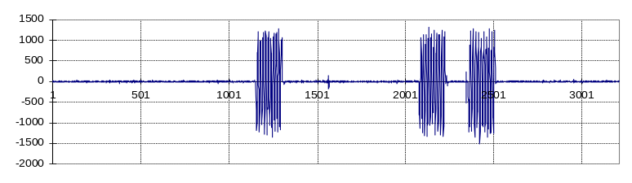
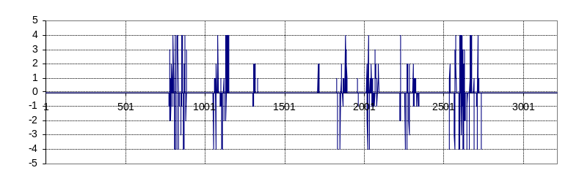
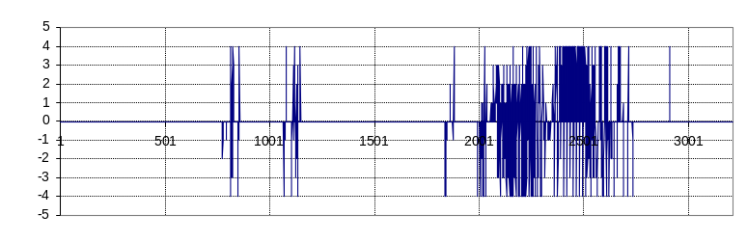
Joint speed (wrist)
Block (12,7)
optic flow (uncorrelated)
Block (10,5)
optic flow (correlated)

Slide 17
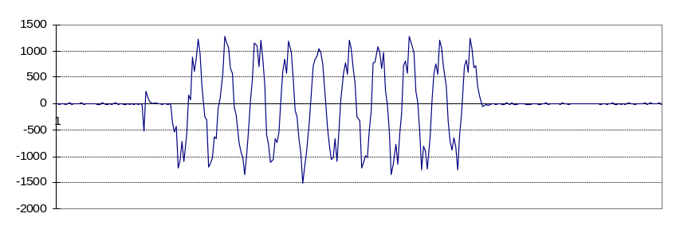
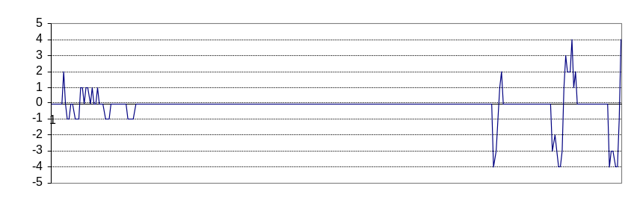
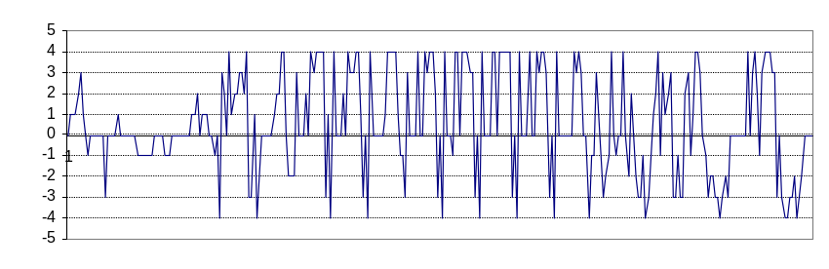
Joint speed (wrist)
Block (12,7)
optic flow (uncorrelated)
Block (10,5)
optic flow (correlated)

Slide 18
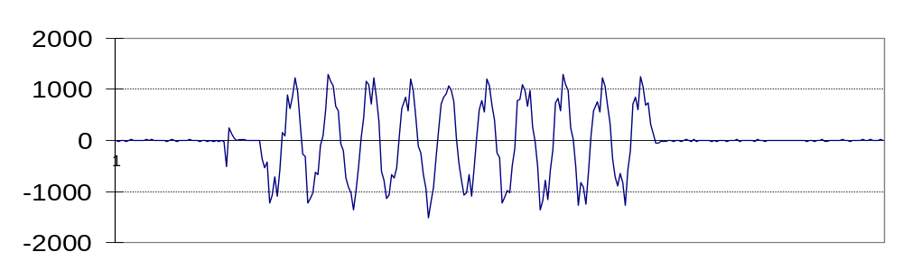
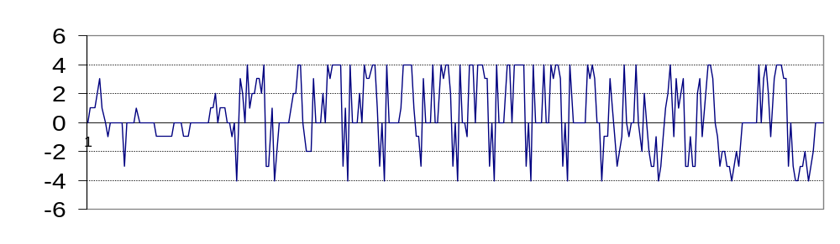
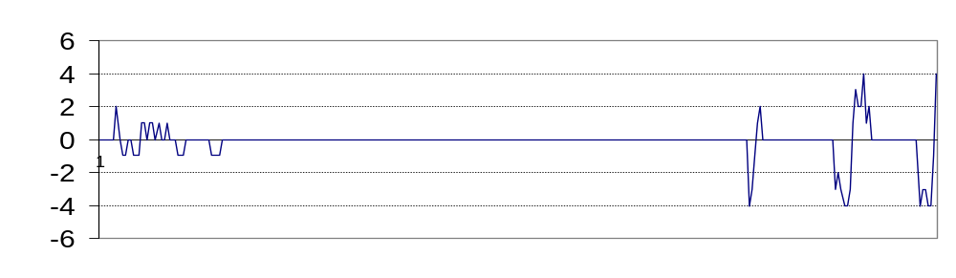
start
stop

Slide 19
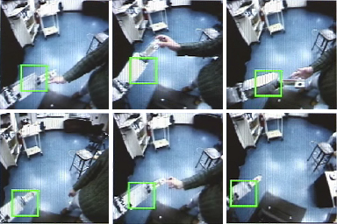

Slide 20
7
redundancy
reduction
gaze direction
head joint
position
2
map
2
image plane
position
4
arm joint
position

Slide 21
gaze
open loop
controller
+
postural
primitives
visual
error
closed loop
controller
low-level
control
oscillatory
movements
arm locator
robot joint position

Slide 22
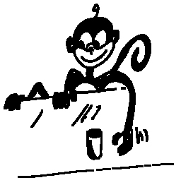
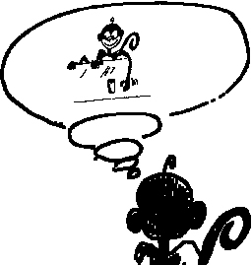

B
within A’s brain…
B doing
object
A
goal
A doing
object
Notes:
Explaining mirror neurons through causality: from the observer point of view (A) understanding B’s action means mapping it into its own motor repertoire. If the causal chain leading to the goal is already in place within (lower branch of the graph) then the acquisition of a mirror neuron for this particular action/object is a matter of building and linking the upper part of the chain to the lower one. There are various chances to reinforce this link either at the object level, at the goal level or both. Developmentally we can explain mirror neurons only if we take into account another class of neurons (called canonical) which in practice describes the lower branch of the graph.

Slide 23
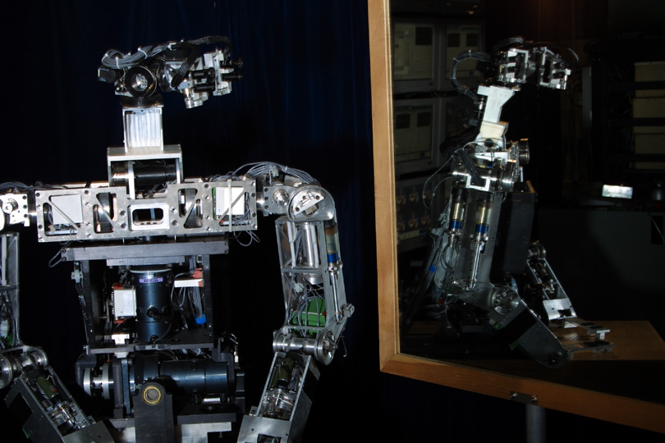

Slide 24
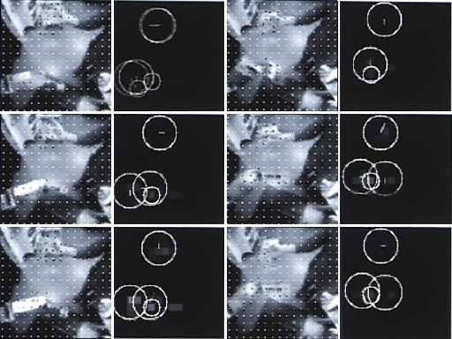

Slide 25
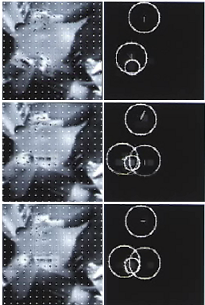

Slide 26
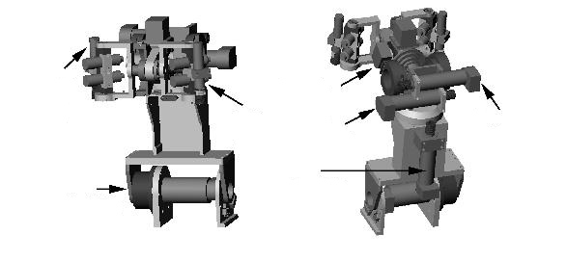
right
eye
pan
left
eye
pan
eye tilt
bottom
differential
top
differential
neck
tilt
neck
pan

Slide 29
X translation
Y translation
Translation
in depth
In-plane
rotation
Tangent region shifts when head rotates in depth

