Slide 1

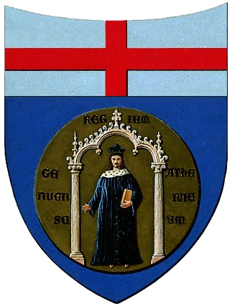

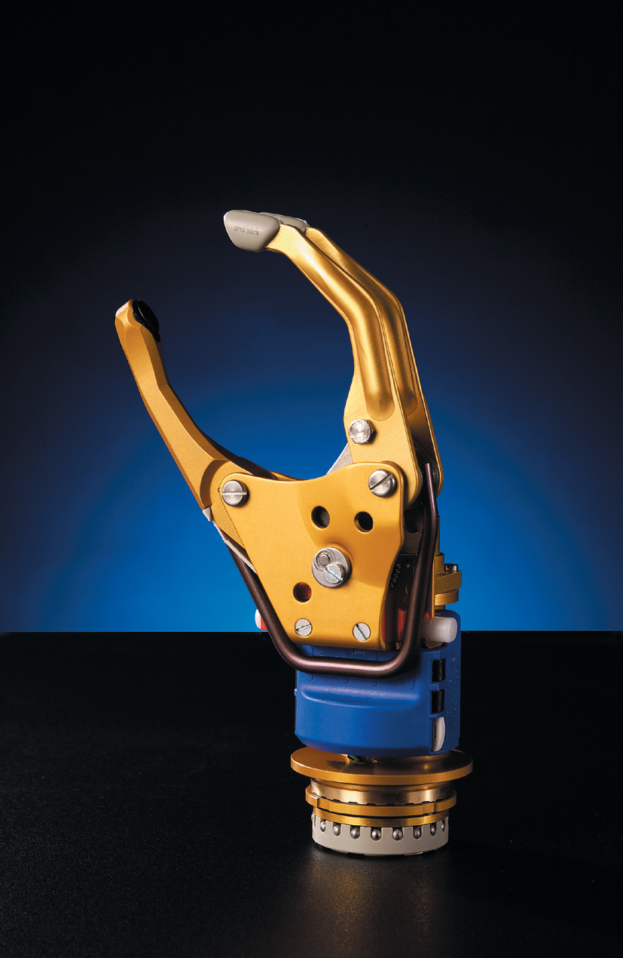
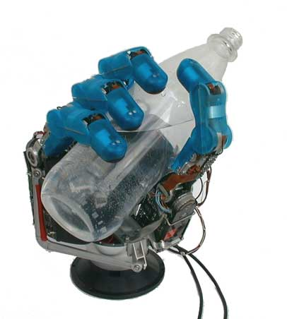
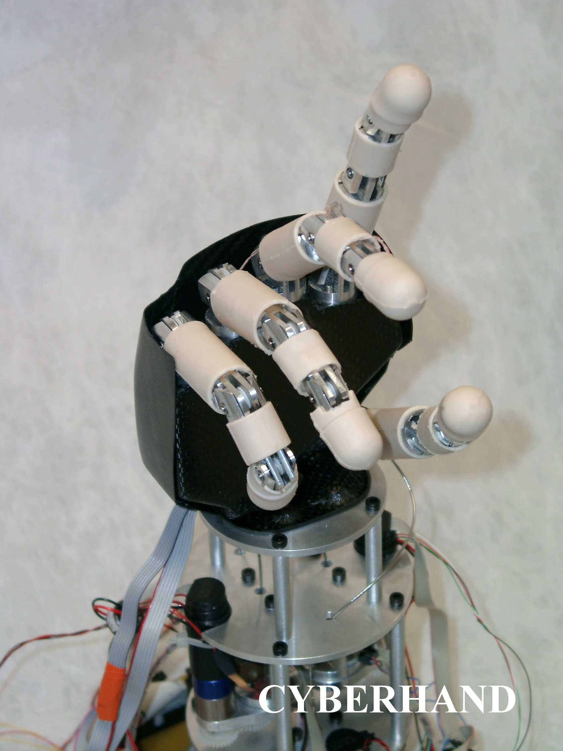
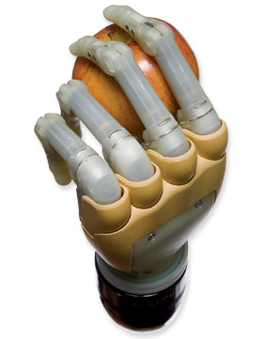
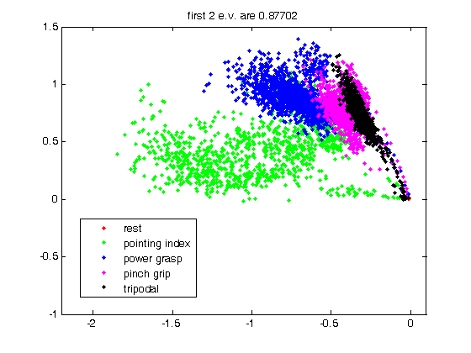
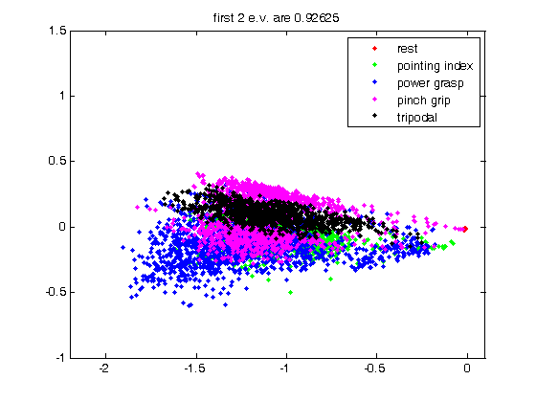
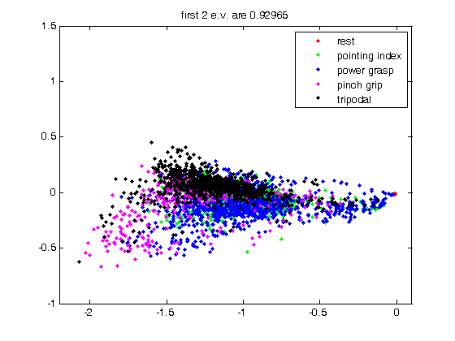
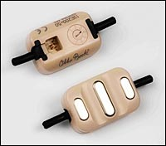
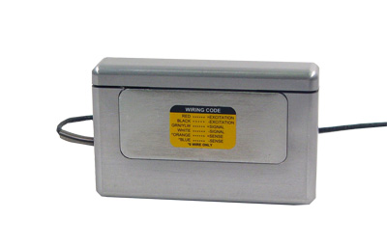
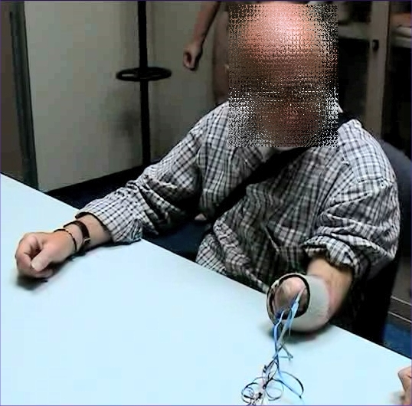
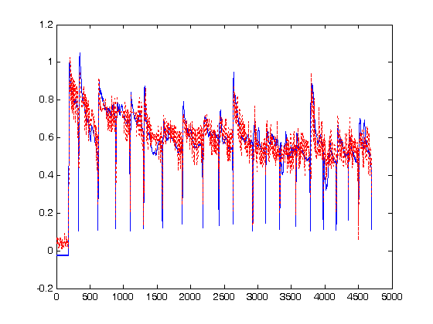
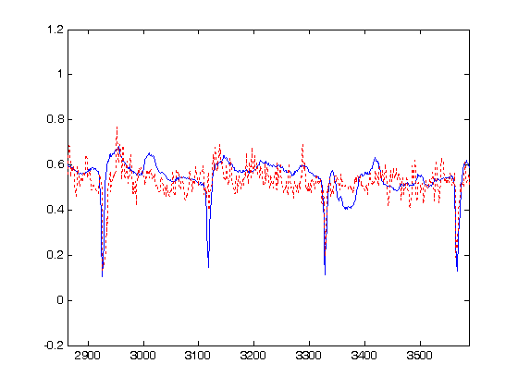
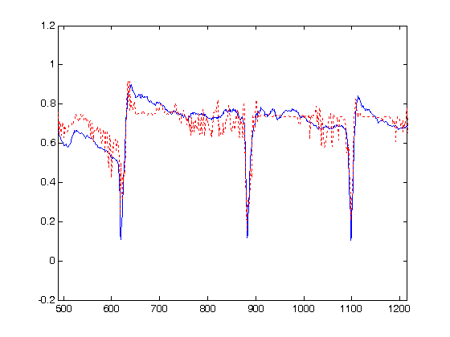
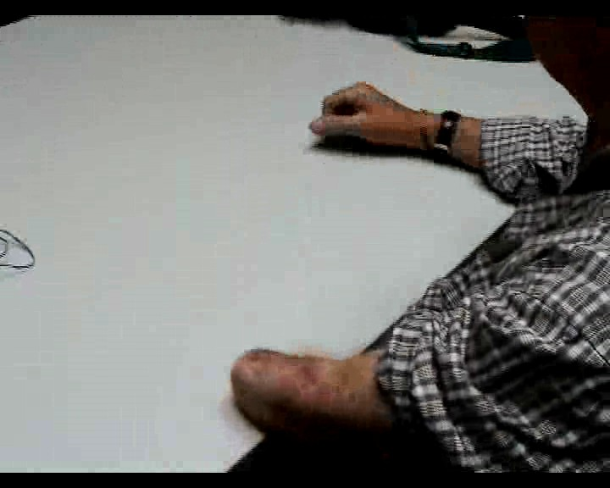
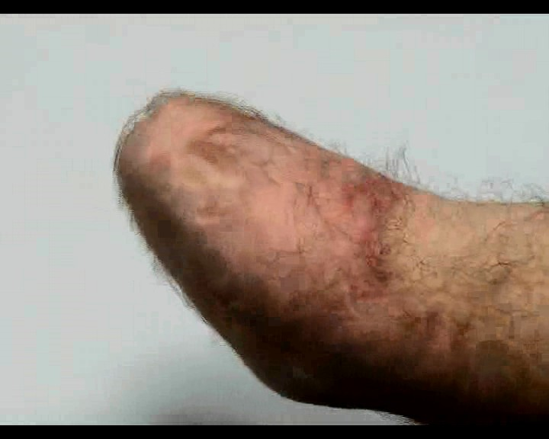
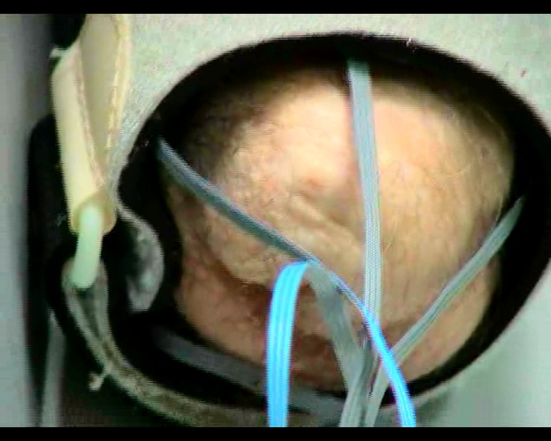
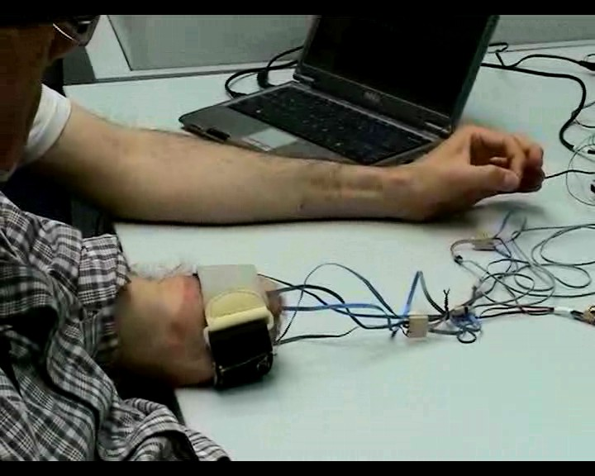
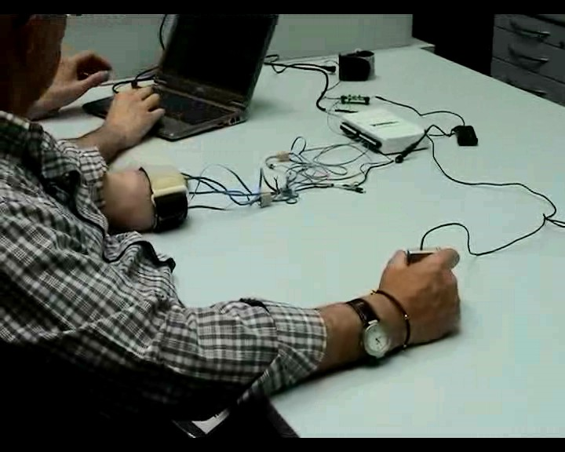
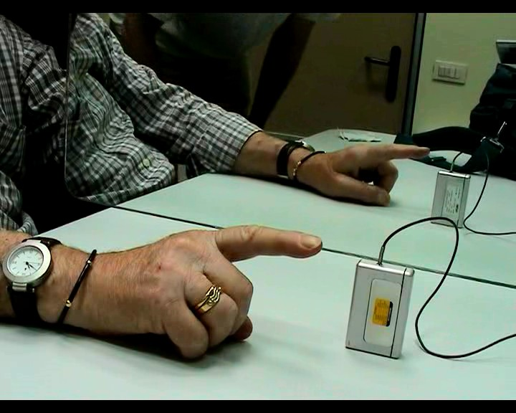
SURFACE EMG FOR Active HAND PROSTHESES: is possible to improve control strategies?
C. Castellini^{A}, E. Gruppioni^{B}, A. Davalli^{B}, G. Sandini^{A,C}
^{A} LIRA-Lab, DIST, University of Genova, Italy
^{B} INAIL Centro Protesi, Vigorso di Budrio, Bologna, Italy
^{C} RBCS Department, Italian Institute of Technology, Genova, Italy
INTRODUCTION
Improvements in the control strategies of Active Hand Prostheses (AHPs) appear urgent and mandatory to enable amputees to fully exploit the features of new multi-joint mechatronic AHPs (figure below). Nowadays the most used AHPs has only one d.o.f. but these will be soon out of date. Therefore the aim of this work was to investigate the possibility for a proximal transradial amputee to perform different type of grasping with force control with a multi-joint AHP through 5 surface EMG sensors positioned over the muscles of the residual stump.
DATA PRE-PROCESSING AND INSPECTION
Spectral analysis of the EMG signals reveals that, as is well-known⁶, the relevant bandwidth lies below 10-15Hz (the OttoBock electrodes already perform an RMS operation); so the signals were subsampled at 25Hz from the original 100Hz.
Categories were assigned to samples according to the type of grasp the subject was asked to perform; the force value was, in the case of modality #1, the maximum possible, and the sensor was pressed by the teacher himself. Samples with low force values were removed from the data set.
First of all, Principal Component Analysis (PCA) reveals that the 5 signals can be reduced to 2 without losing more than 10-15% variance, as we can see:
s.o.a. dexterous robotic hands and AHPs:
the Otto Bock’s SensorHandTM, the CyberHand, the DLR I and the Touch BIonics’s i-LIMBTM
1) teacher imitation 2) bilateral symmetric action 3) mirror-box
We hereby show how a machine learning method, namely Support Vector Machine³ (SVM), can be trained base on data gathered from a patient to proficiently control a dexterous AHP. In particular we show that even a patient with a short stump and whose operation dates back to decades ago is potentially able to elicit at least 4 grasp types, and precisely modulate the force involved in each grasp. This opens up a scenario in which surface EMG, a cheap and totally non-invasive technique⁴, can enable amputees to perform many more operations with new polyarticulate AHPs which are nowadays market available.
As is apparent from the Figure above, classes corresponding to grasp types are well separated and the best modality, as far as separation is concerned, is teacher imitation. It is unclear, so far, whether this can be ascribed to fatigue while progressing in the experiment, or if modality 1 is inherently better. All in all, it appears highly surprising that Mr. V., 40+ years after a proximal forearm amputation, is still able to produce very distinct signals even for similar grasp types, e.g., pinch (magenta) and tripodal (black). This lets us hope for the best.
CLASSIFICATION AND REGRESSION
Data were initially fed to the system as-is, with no filtering whatsoever, in order to check that the approach would be feasible in a real on-line setting. As a second trial, a 2° order lowpass filter with cutoff frequency at 5Hz was applied to the EMG signals, in order to cut off all possible HF noise.
A SVM with Gaussian kernel was trained on V.’s data in order to map EMG signals to (a) types of grasp (classification) and (b) required force values (regression). The hyperparameters C and σ were found by grid-search over 5-fold cross-validation, with classification accuracy (for classification) and correlation with the target (for regression) as the performance index.
The results are very good, as one can see from the Table and Figures below:
MATERIALS AND METHODS
Subject. One male, 64-year-old, first proximal transradial amputee (initials V.C.) participated in the experiment after signing an informed consent. V.C. underwent a left-side traumatic amputation in 1963 and he presented a stump about 8cm long. It could be say that he is a “pioneer” of myoelectric prostheses as he’s using OttoBock’s and INAIL’s customized devices since the 60s.
Devices. Five OttoBock MyoBockTM electrodes were placed on V.’s stump without precisely checking for the residual muscles positions. A FUTEK LMD500 force sensor was used to detect the force involved in the grasping. Lastly, a standard DAQ card was employed to acquire the signals (sampling rate: 100Hz).
the real force values (black) and the ones guessed by the SVM (red - whole picture and two zooms)
unfiltered
imitation
bilateral
mirror
filtered
93.1% / 0.86
79.2% / 0.80
75.8% / 0.78
96.0% / 0.88
88.1% / 0.86
85.7% / 0.85
the OttoBock EMG sensors the FUTEK force sensor
Mr. V., our subject
elbow
CONCLUSIONS
This paper can be seen as a follow-up to^{6,7}, in which we showed that the approach is on average perfectly feasible on healthy subjects, even in non-controlled conditions. Here we turn to amputees. Obviously, no statistical inference can be made with one patient only but indeed this work proves that an amputee can still have enough muscular activity and “body memory” to elicit very different activation patterns so, in the future, to drive an AHP with a degree of dexterity totally unknown so far.
Tasks. Mr. V. was asked to “perform” 4 different grasps/postures (pointing index, index pinch grip, tripodal grip, power grasp) with free force and speed, while we were recording the EMG signals and force sensor activity. Three ways of training the system (modalities) were employed:
teacher imitation. A healthy subject (teacher) has placed his left arm besides V.’s stump asking him to “imitate” the grips and “imagining” to apply his maximum strength.
bilater symmetric action. The subject was asked to grip the force sensor with his healthy hand while “doing” the same things with his stump.
mirror-box. Same as modality 2, but a mirror was placed between the subject’s arms, in order to increase the visual feedback⁵.
REFERENCES
[1] M. Zecca, S. Micera, M. C. Carrozza and P. Dario, Control of Multifunctional Prosthetic Hands by Processing the Electromyographic Signal, Critical Reviews in Biomedical Engineering, 30(4–6):459–485, 2002.
[2] H. Huang, L. Jiang, D. Zhao, J. Zhao, H. Cai, H. Liu, P. Meusel, B. Willberg, and G. Hirzinger, The development on a new biomechatronic prosthetic hand based on under-actuated mechanism, in Proceedings of IROS 2006, 2006, pp. 3791—3796.
[3] B. E. Boser, I. M. Guyon, and V. N. Vapnik, A training algorithm for optimal margin classifiers, in Proceedings of the 5th Annual ACM COLT Workshop, ACM press, 1992, pp. 144–152.
[4] C. J. De Luca, The use of surface electromyography in biomechanics, Journal of Applied Biomechanics, 13:135-163, 1997.
[5] V. S. Ramachandran, E. L. Altschuler and L. Stone, Can mirrors alleviate visual hemineglect?, Medical Hypotheses 52 (4): 303-305, 1999.
[6] C. Castellini and P. van der Smagt, Surface EMG in Advanced Hand Prosthetics, to appear in Biological Cybernetics, 2008.
[7] C. Castellini, A. E. Fiorilla and G. Sandini, Multi-Subject/DLA Analysis of Surface EMG Control of Mechanical Hands, poster at the I National Bioengineerings Group meeting, Pisa, Italy, 2008, and manuscript in preparation for Biological Cybernetics.
1) teacher imitation 2) bilateral symmetric action 3) mirror-box

