Slide 1
0.35
0.35
0.35
backslap
0.35
pull in
0.3
0.3
0.3
0.3
0.25
0.25
0.25
0.25
0.2
0.2
0.2
0.2
0.15
0.15
0.15
0.15
0.1
0.1
0.1
0.1
0.05
0.05
0.05
0.05
Estimated probability
0
0
0
-
0
-
200
200
-
-
150
150
-
-
100
100
-
-
50
50
0
0
50
50
100
100
150
150
200
200
-
-
200
200
-
-
150
150
-
-
100
100
-
-
50
50
0
0
50
50
100
100
150
150
200
200
0.25
0.25
0.25
side tap
0.25
push away
0.2
0.2
0.2
0.2
0.15
0.15
0.15
0.15
0.1
0.1
0.1
0.1
0.05
0.05
0.05
0.05
0
0
0
-
0
-
200
200
-
-
150
150
-
-
100
100
-
-
50
50
0
0
50
50
100
100
150
150
200
200
-
-
200
200
-
-
150
150
-
-
100
100
-
-
50
50
0
0
50
50
100
100
150
150
200
direction of movement [deg]
200

Slide 2
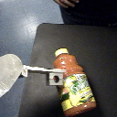
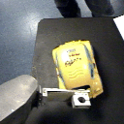
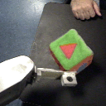
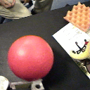
0.5
0.5
0.4
Bottle, “pointiness”=0.13
0.4
Car, “pointiness”=0.07
0.3
0.3
0.2
Rolls at right
angles to
principal axis
0.2
Rolls
along
principal axis
0.1
0.1
estimated probability of occurrence
0
0
10
20
30
40
50
60
70
80
90
0
0
10
20
30
40
50
60
70
80
90
0.5
0.5
0.4
Cube, “pointiness”=0.03
0.4
Ball, “pointiness”=0.02
0.3
0.3
0.2
0.2
0.1
0.1
0
0
10
20
30
40
50
60
70
80
90
0
0
10
20
30
40
50
60
70
80
90
difference between angle of motion and principal axis of object [degrees]
Notes:
100 samples of each object collected.
Poke object, see which direction it ends up moving in.
Greenness of cube.

Slide 3
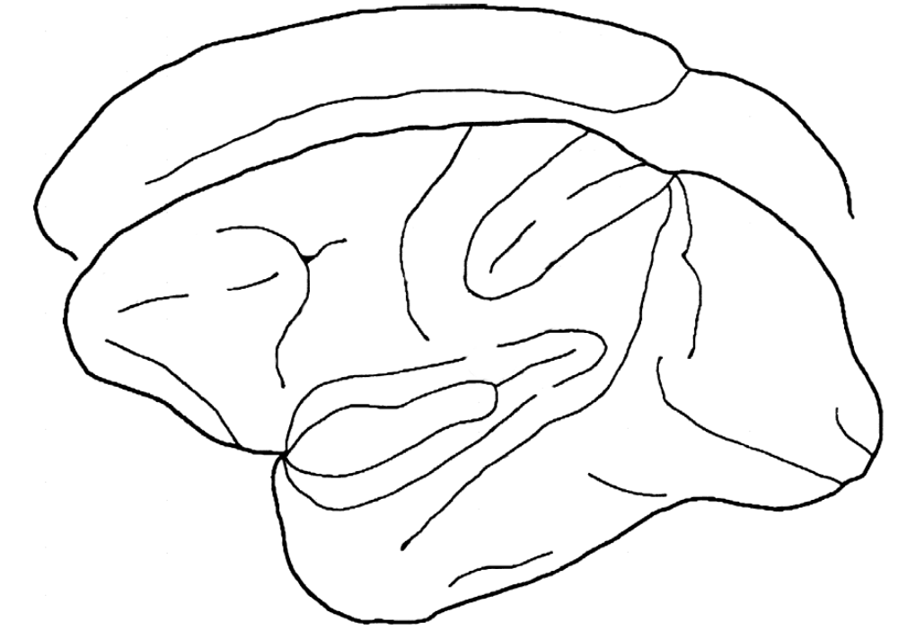
Reaching
F3
F1
F6
5
MIP
F7
F2
SI
VIP
LIP
F1
AIP
7a
PO
46
F4
Visual
cortex
F5
7b
SII
Insula
STs
TEO
Grasping
TE
Object/hand recognition

Slide 4
Reaching
F1
5
MIP
F7
F2
SI
VIP
LIP
F1
AIP
7a
46
F4
Visual
cortex
F5
7b
SII
Insula
STs
TEO
Grasping
TE
Object/hand recognition

Slide 5
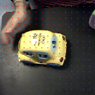
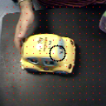
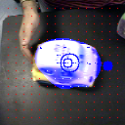
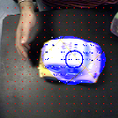
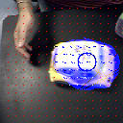
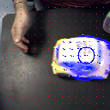
Initial position
Final position

Slide 6
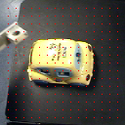
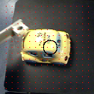
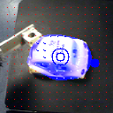
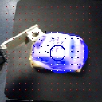
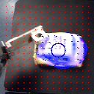
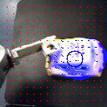
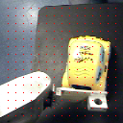
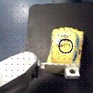
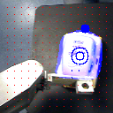
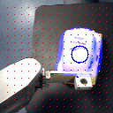
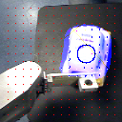
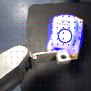
Initial position
Final position
Example 1
Initial position
Final position
Example 2

Slide 7
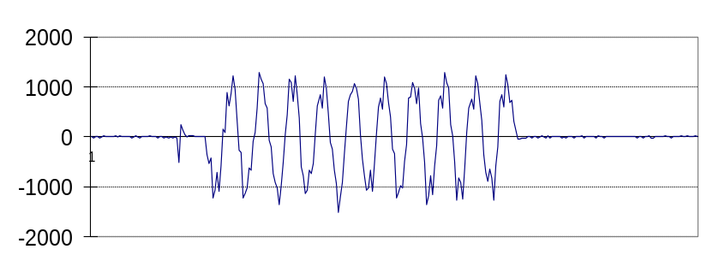
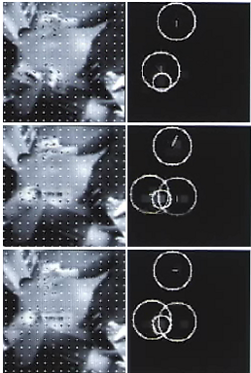
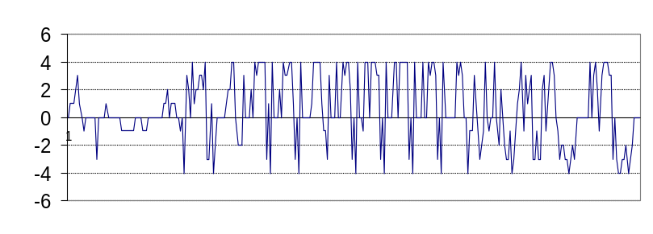
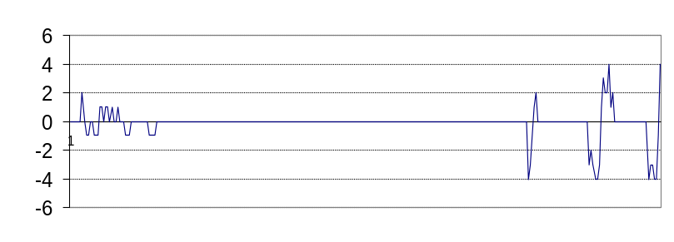
start
stop
a
b

