Slide 1


Machine Learning to identify neuroimaging
biomarkers in psychiatry
Edouard Duchesnay, PhD, HDR
CEA, NeuroSpin – Université Paris-Saclay – France

Slide 2
Outline
Introduction: Machine learning to identify prognostic signature in psychiatry
Fighting over-fitting: Feature selection, regularization and model selection
Spatial regularization to improve interpretability
Applications to psychiatry
Deep learning for supervised task
Transfer learning and representation learning

Slide 3

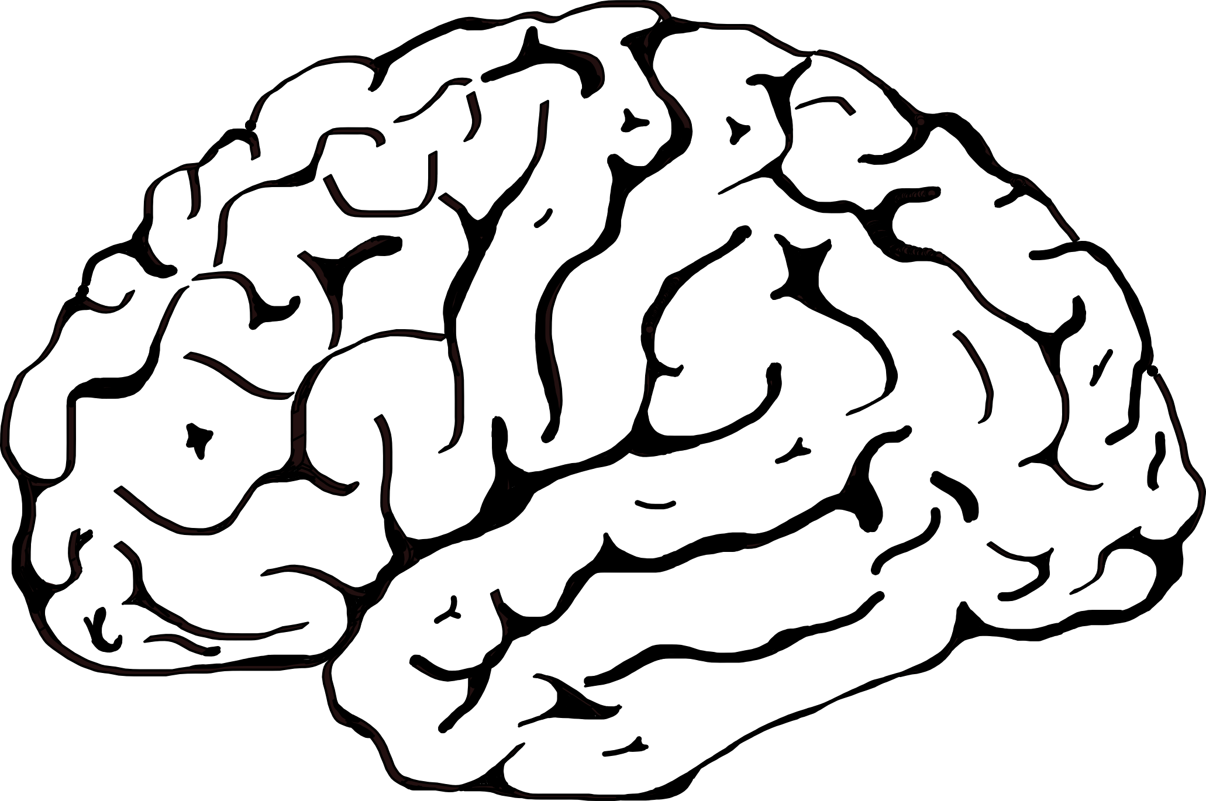



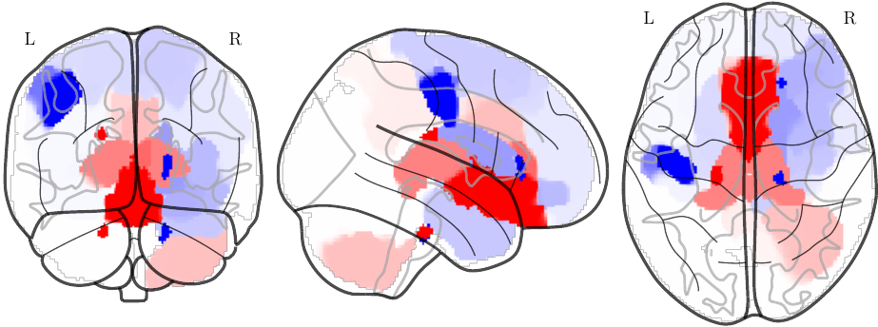
Introduction: Machine learning to identify prognostic signature in psychiatry
Psychiatry lacks objective quantitative measures (such as blood dosage) to guide clinicians in choosing a therapeutic strategy
Psychosis ?
Bipolar ?
I feel like
everyone is staring
at me
Psychosis 90%
Prognostic brain signatures of clinical course or response to treatment for personalized medicine in psychiatry.

Slide 4

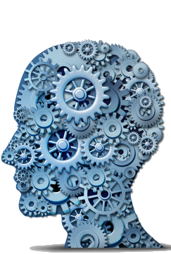


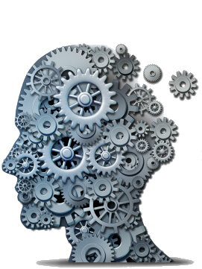
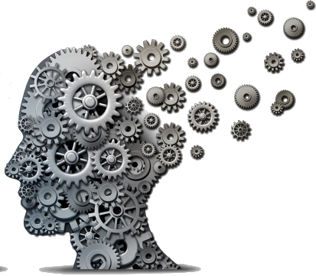

Neuroimaging: biological markers for personalized psychiatry
Rational
Genetic and environment (trauma, stress, toxic, alcohol) modify the trajectory of the brain development.
Subtle differences measurable with neuroimaging
Fetal
Childhood
Adolescence
Adult
genetic
environment
Treatment
or time
Applications
Transition to psychosis in subjects at risk
Response to Lithium in Bipolar Disorder
Goal
Capture those brain patterns with machine learning
Learn to predict the outcome from past brain scans at early stage of the disorder progression

Slide 5
Outline
Introduction: Machine learning to identify prognostic signature in psychiatry
Fighting over-fitting: Feature selection, regularization and model selection
Spatial regularization to improve interpretability
Applications to psychiatry
Deep learning for supervised task
Transfer learning and representation learning

Slide 6
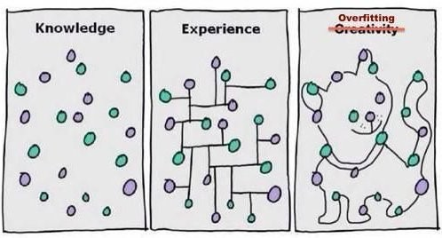
Balance underfitting and overfitting
Too many (300,000) neuroimaging variables
Avoid spurious correlations:“With my red socks I get good results in my exams”
Find true correlations: “By studying I get good results”

Slide 7

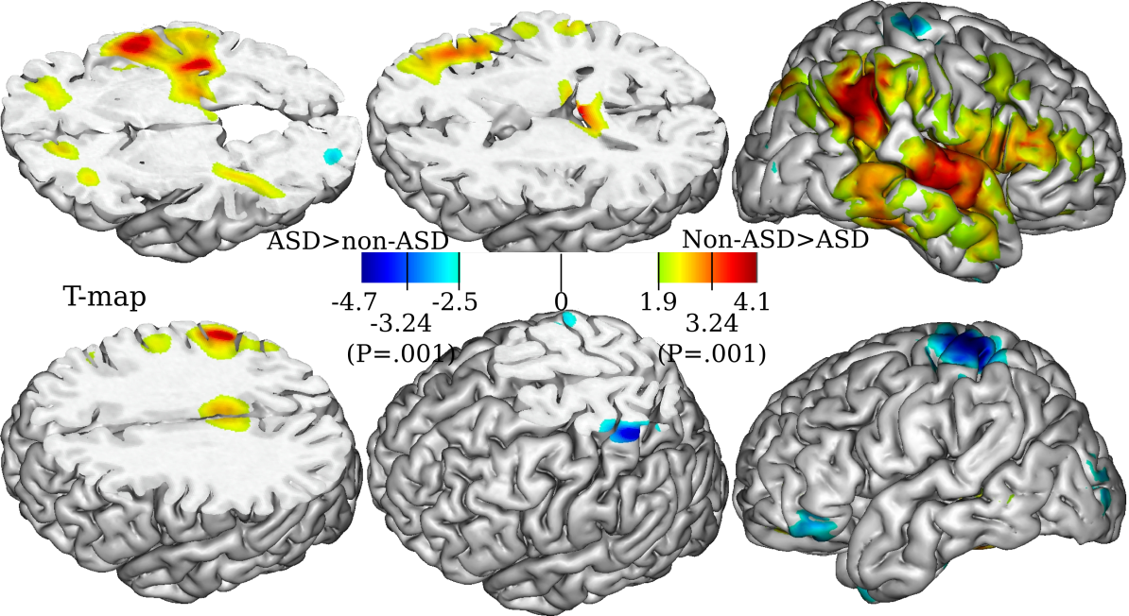
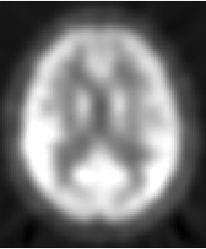
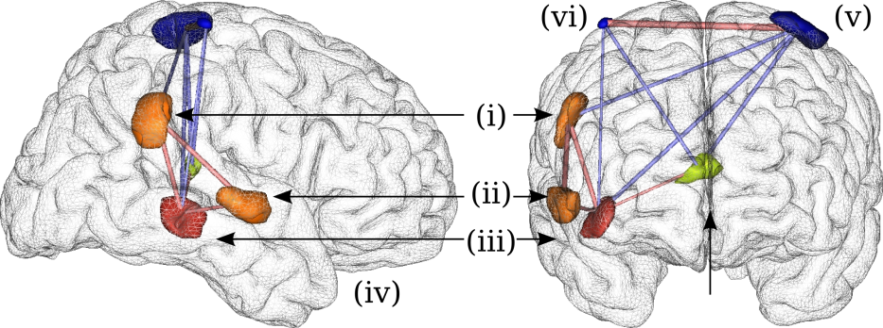
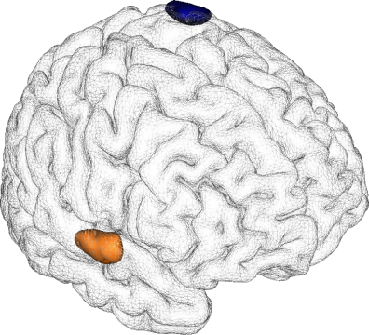
The old good time of ad hoc pipelines: variable selection (filtering) + regions extraction + model selection + classification
Application: Prediction of subjects with autism (ASD) on PET imaging
PET images
1) Univariate filter
Classification
– All: 88%***
– ASD: 91% (41/45)***
– Non-ASD: 77% (10/13)*
Discriminative pattern
– Hyper. in STS
– Hypo. in postcentral
4) Feature subset ranking
5) Model selection
3) Regional feature extraction
[Duchesnay et al. Neuroimage 2011, IEEE TMI 2007]

Slide 8
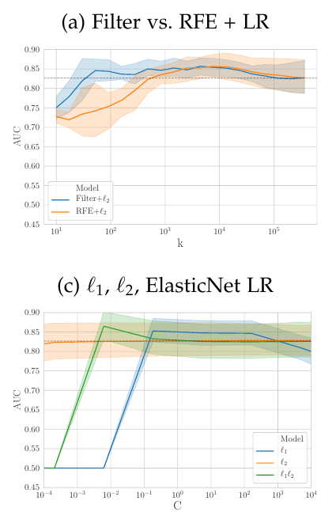
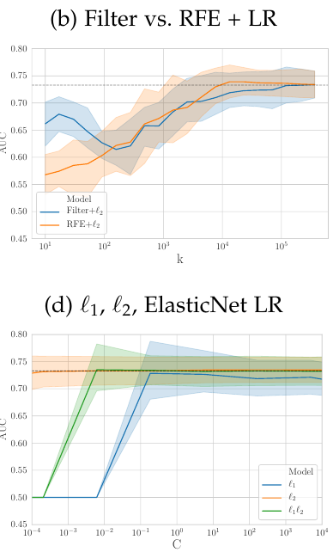
Feature selection with whole brain VBM (Gray Matter maps 360 000 voxels):
Mixed results
N=605 participants: 330 Controls vs 275 with patients with chronic schizophrenia.
N=662 participants: 356 Controls vs 306 patients with Bipolar Disorder (BD).
Improvement +5%(vs L2)
“Detectable” with CV
No improvement (vs L2)

Slide 9
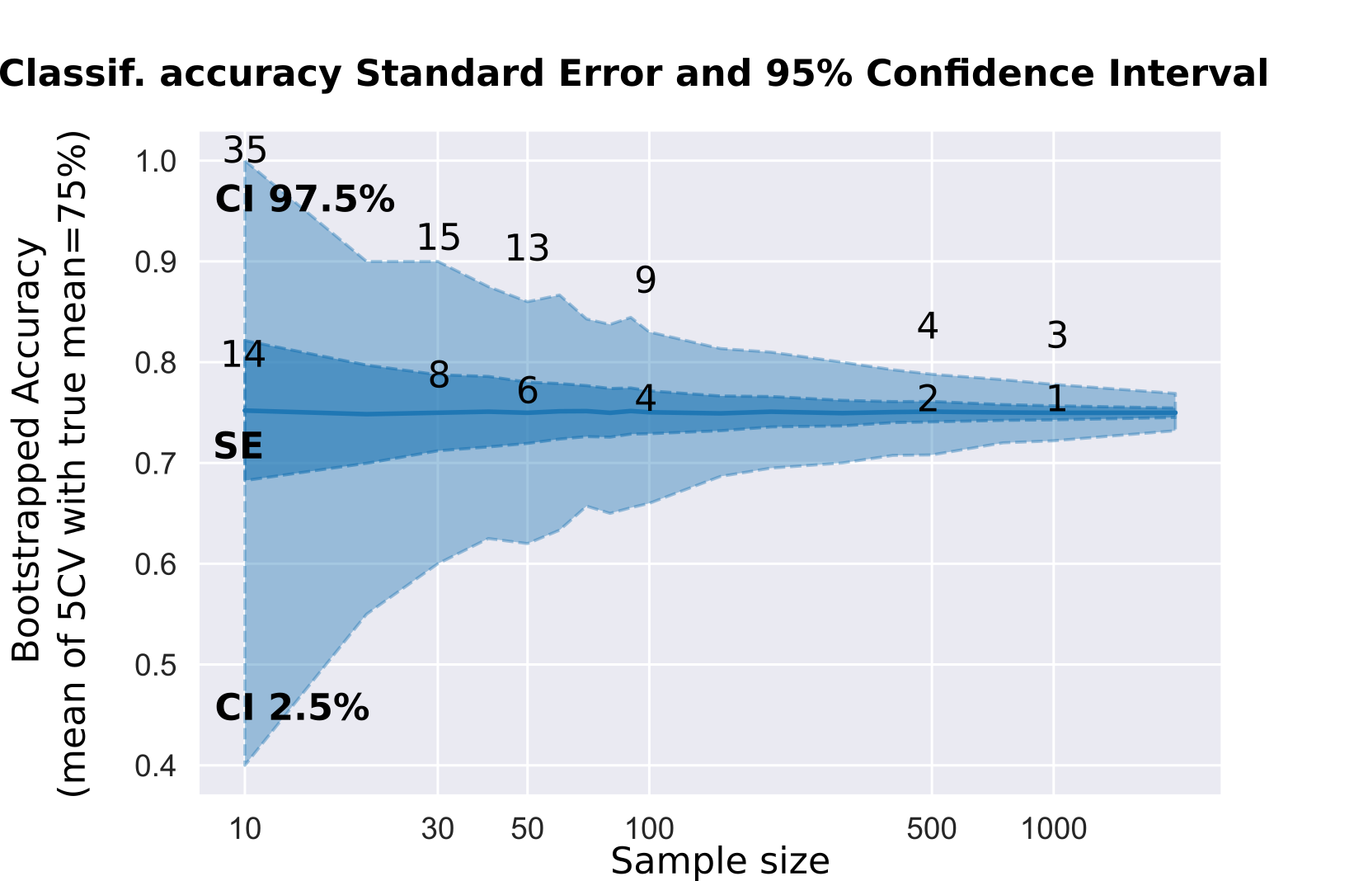
Conclusion on sparse models and feature selection
“Venerable” L2-regularization provides a baseline performances.
Basic univariate Filter/Lasso or ElasticNet can help
Model selection is the main issue
For large dataset N~500, Cross-Validation (CV) is efficient
For small dataset <200
  CV has a large variance
  In-sample estimates provide promising results
N | SE(p)
30 | 10%
100 | 5%
500 | 2%
Theoretical
standard errors of classification rate

Slide 10
Outline
Introduction: Machine learning to identify prognostic signature in psychiatry
Fighting over-fitting: Feature selection, regularization and model selection
Spatial regularization to improve interpretability
Applications to psychiatry
Deep learning for supervised task
Transfer learning and representation learning

Slide 11
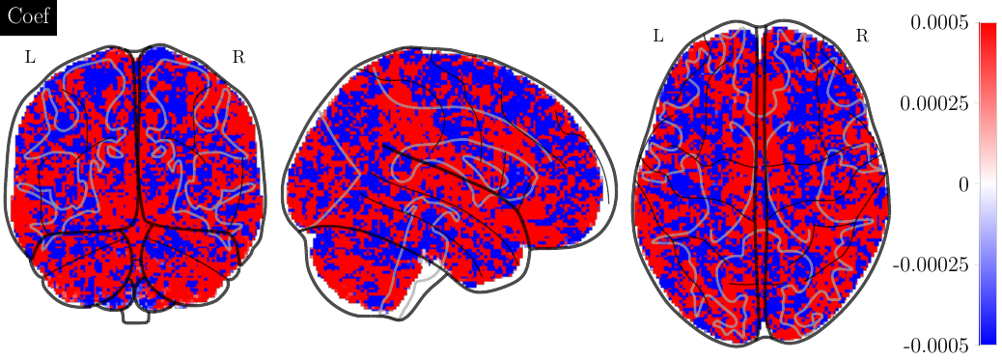
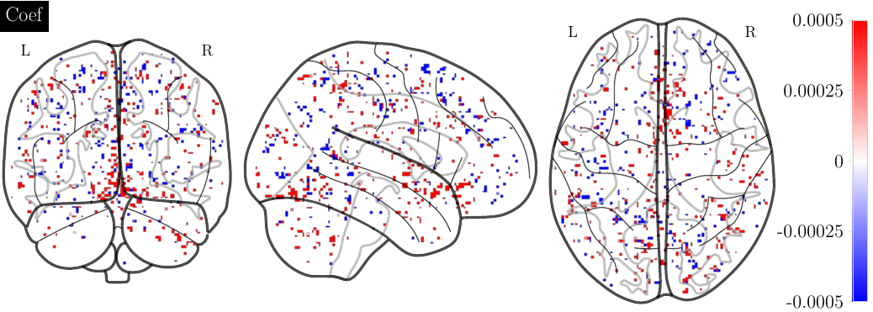
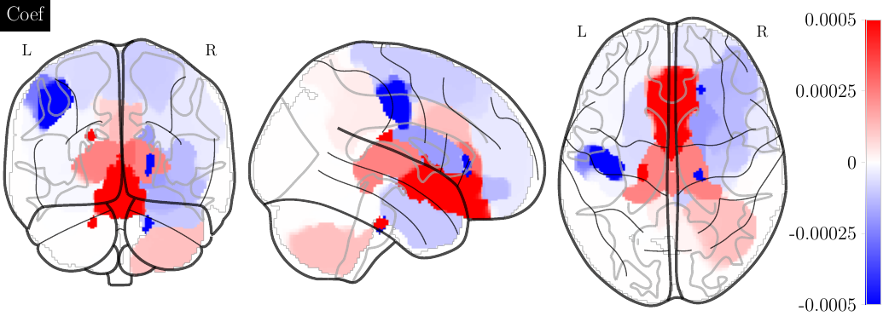
Spatial regularization
Predict transition to psychosis in at-risk adolescents
Collab. with MO Krebs and
A. Iftimovici, Ste-Anne, Hosp. Paris [to be published]
l2-regularization
l1-regularization
Design of a solver for convex
minimization problem with
non-smooth terms:
– [Hadj-Selem 2018 IEEE TMI]
– Python library
Add spatial regularization:
– “spatial smoothness” or
– solution should be organized as regions

Slide 12
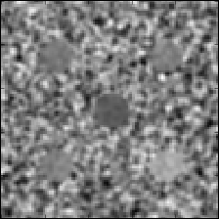
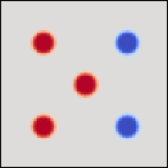
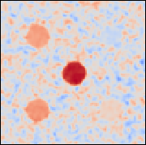
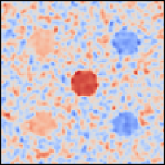

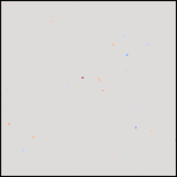

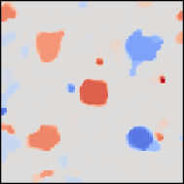
Effect of spatial regularization
Simulated dataset
True
biomarkers
Observed
clinical score
Images
Classical univariate associations
(GWAS, VBM) cor(X^{j}, y) for each locus j
- No prediction
- Overlook
information
Multiple regression with constraint (penalty): shrink coefficients ⇒ Ridge regression (or SVM)
+ Prediction
- Interpretation
(Signal everywhere)
More constraints: many coefficient should be null:
⇒ Elasticnet
+ Prediction
- Interpretation
(Too sparse)
Biological constraints: solution should be smooth
⇒ Total Variation
+ Prediction
+ Interpretation

Slide 13
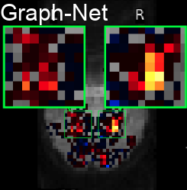
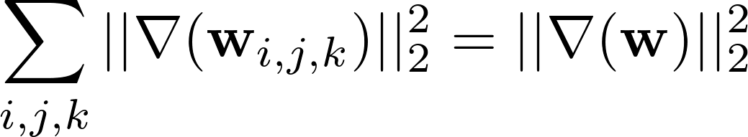
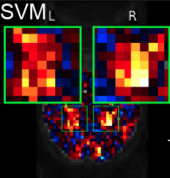
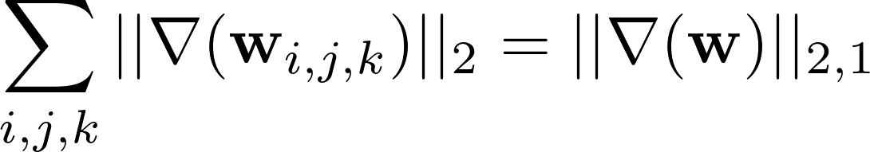
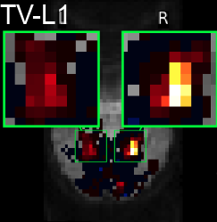
Spatial regularization GraphNet vs Total Variation
GraphNet: GN (Dohmatob 2015; Grosenick 2013)
Squared L2-norm on the gradient of the weight map
Promote smooth continuous change
Differentiable solved with any proximal gradient method
GN: 12=3*2²
TV: 6=3*2
3 steps of size 3
6
Total-Variation: TV
GN: 36=1*6²
TV: 6=1*6
1 step of size 6
L12 -norm norm on the gradient of the weight map
Segmenting the weight map into spatially-contiguous parcels with almost constant values
Image:
Dohmatob 15

Slide 14
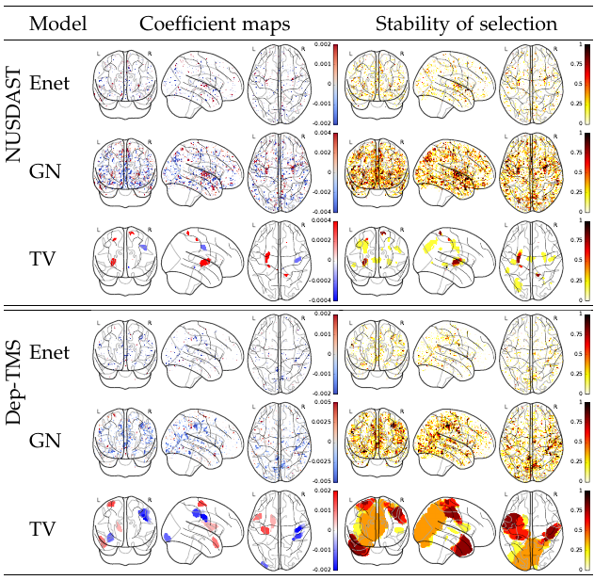
Spatial regularization GraphNet vs Total Variation
Datasets
NUSDAST dataset N = 236
97 patients with schizophrenia vs 139 healthy controls.
Predict clinical status
Dep-TMS dataset N=34
Patients with treatment-resistant depression.
18 responders vs 16 non-responders
Predict response to transcranial magnetic stimulation (TMS).
TV for spatial regularization
Similar performances
More interpretable models: identify regions
Improved stability of predictive support

Slide 15
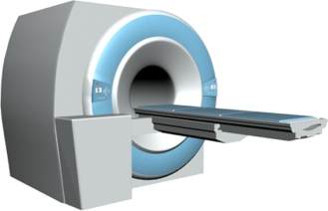


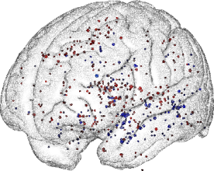
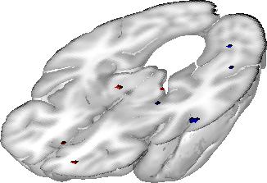
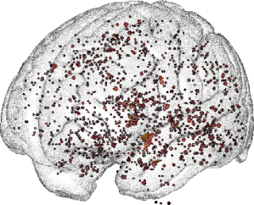
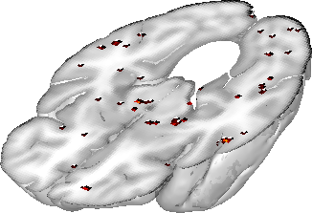
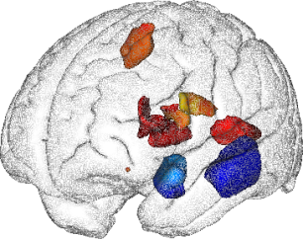
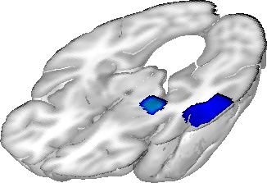
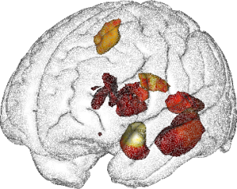
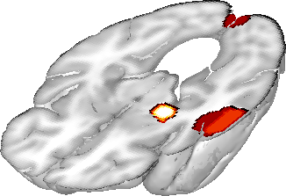
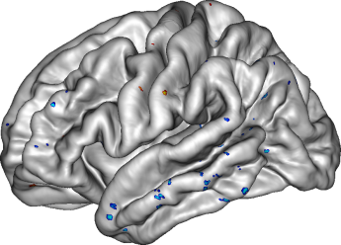
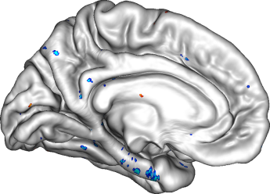
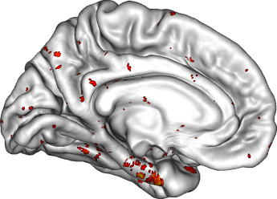
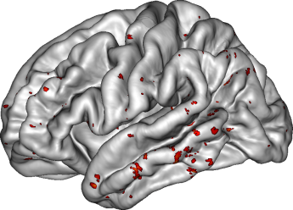
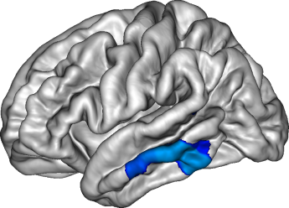
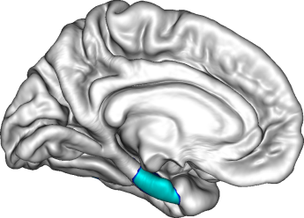
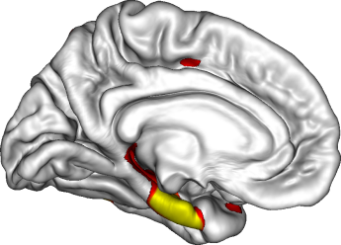
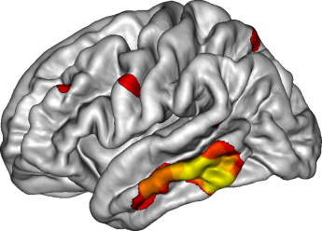
Spatial regularization on 3D images and meshes: improved stability
sMRI
Clinic
ADNI dataset N= 201
81 patients with with mild cognitive Impairments that converted to Alzheimer disease vs 120 healthy controls elderly subjects.
VBM 3D GM maps
Cortical thickness.
Interpretable and stable predictors of brain diseases
Sparse map: moderate perf., low relevance & stability
Add spatial constraints: improve perf., relevance & stability
Predictive map
Stability of the map
Application to
Alzheimer's
Disease
aMRI
Enet
3D images
Spatial(TV)
Perf.:+5%
Stability:+225%
Improved stability of coefficient map
Similar performances
We needed fast solvers for 300 000 features working on meshes of cortical surface
Enet
2D meshes
Spatial(TV)
Perf.: +8%
Stability: +510%

Slide 16
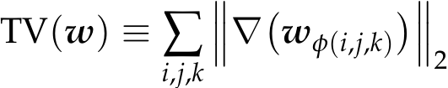
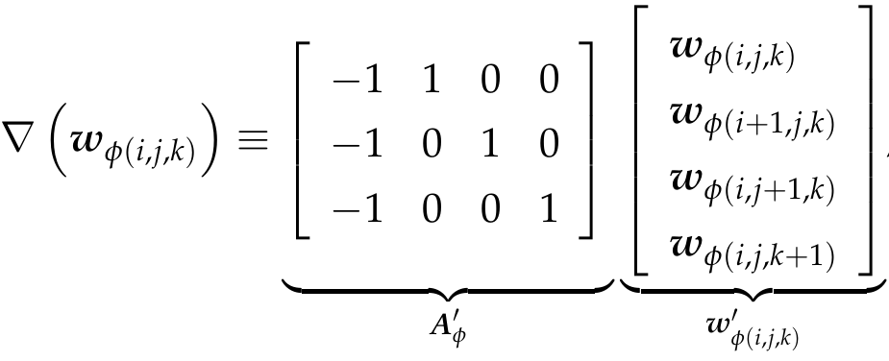

Reformulating TV as a linear operator
Reformulate the structured penalty as a product with a linear operator
A Is a huge 3 x P sparse matrix
General and flexible formulation can be adapted:
– other penalties: group lasso
– other input feature meshes

Slide 17
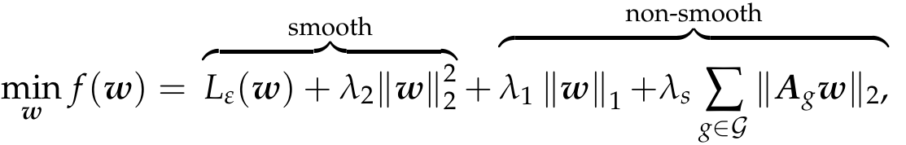
ElasticNet with structured penalty (TV, Group lasso, )
Any differentiable Loss
Any function with known
proximal operator
s(w) structured penalty: TV,
Group lasso, etc.
Unknown proximal operator
Any function formulated as a
norm of product
Problem
The proximal operator of TV (several useful non-smooth penalties) are mostly not known or difficult to compute
Strategies
Approximate the proximal operator of TV [Beck and Teboulle 2009, Schmidt et al., 2011]
Smooth TV [Nesterov, 2005, Chen et al. 2012]

Slide 18
CONESTA solver: Nesterov smoothing with continuation steps guided by the duality gap
Nesterov smoothing of the complex term
We apply Nesterov smoothing technique to approximate s(w), of parameter μ, such that: s_{μ}(w) ≤s(w) ≤ s_{μ}(w) + μP/2, where P is the number of features.
Problem
s_{μ}(w) is smooth, the problem can be minimized with FISTA (Beck and Teboulle, 2009).
Large smoothing fast convergence but low precision
Small smoothing slow convergence with high precision
Contributions
Continuation procedure: Start with large smoothing and decrease while approaching the solution
Duality gap to estimate the distance to the solution
Expression of optimal smoothing parameter given a prescribed precision

Slide 19

CONESTA solver: the algorithm
Principles: smooth touchdown procedure
Solve a smoothed problem with dynamic reduction of the smoothing.
Duality gap to probe the distance to the ground (global optimum).
Dynamically adapts its speed (the smoothing parameter) according to this distance.
Algorithm
(1) duality gap: probe
the distance to solution
(2) Current desired
precision = gap/cte
(3) Optimal smoothing
Parameter to achieve precision
(4) FISTA to solve the smoothed problem
– Use optimal smoothing parameter
– Use duality gap to stop
solution
(5) duality gap > desire precision
continuation
Solve the problem with 300k features in 30 minutes

Slide 20
Outline
Introduction: Machine learning to identify prognostic signature in psychiatry
Fighting over-fitting: Feature selection, regularization and model selection
Spatial regularization to improve interpretability
Applications to psychiatry
Deep learning for supervised task
Transfer learning and representation learning

Slide 21

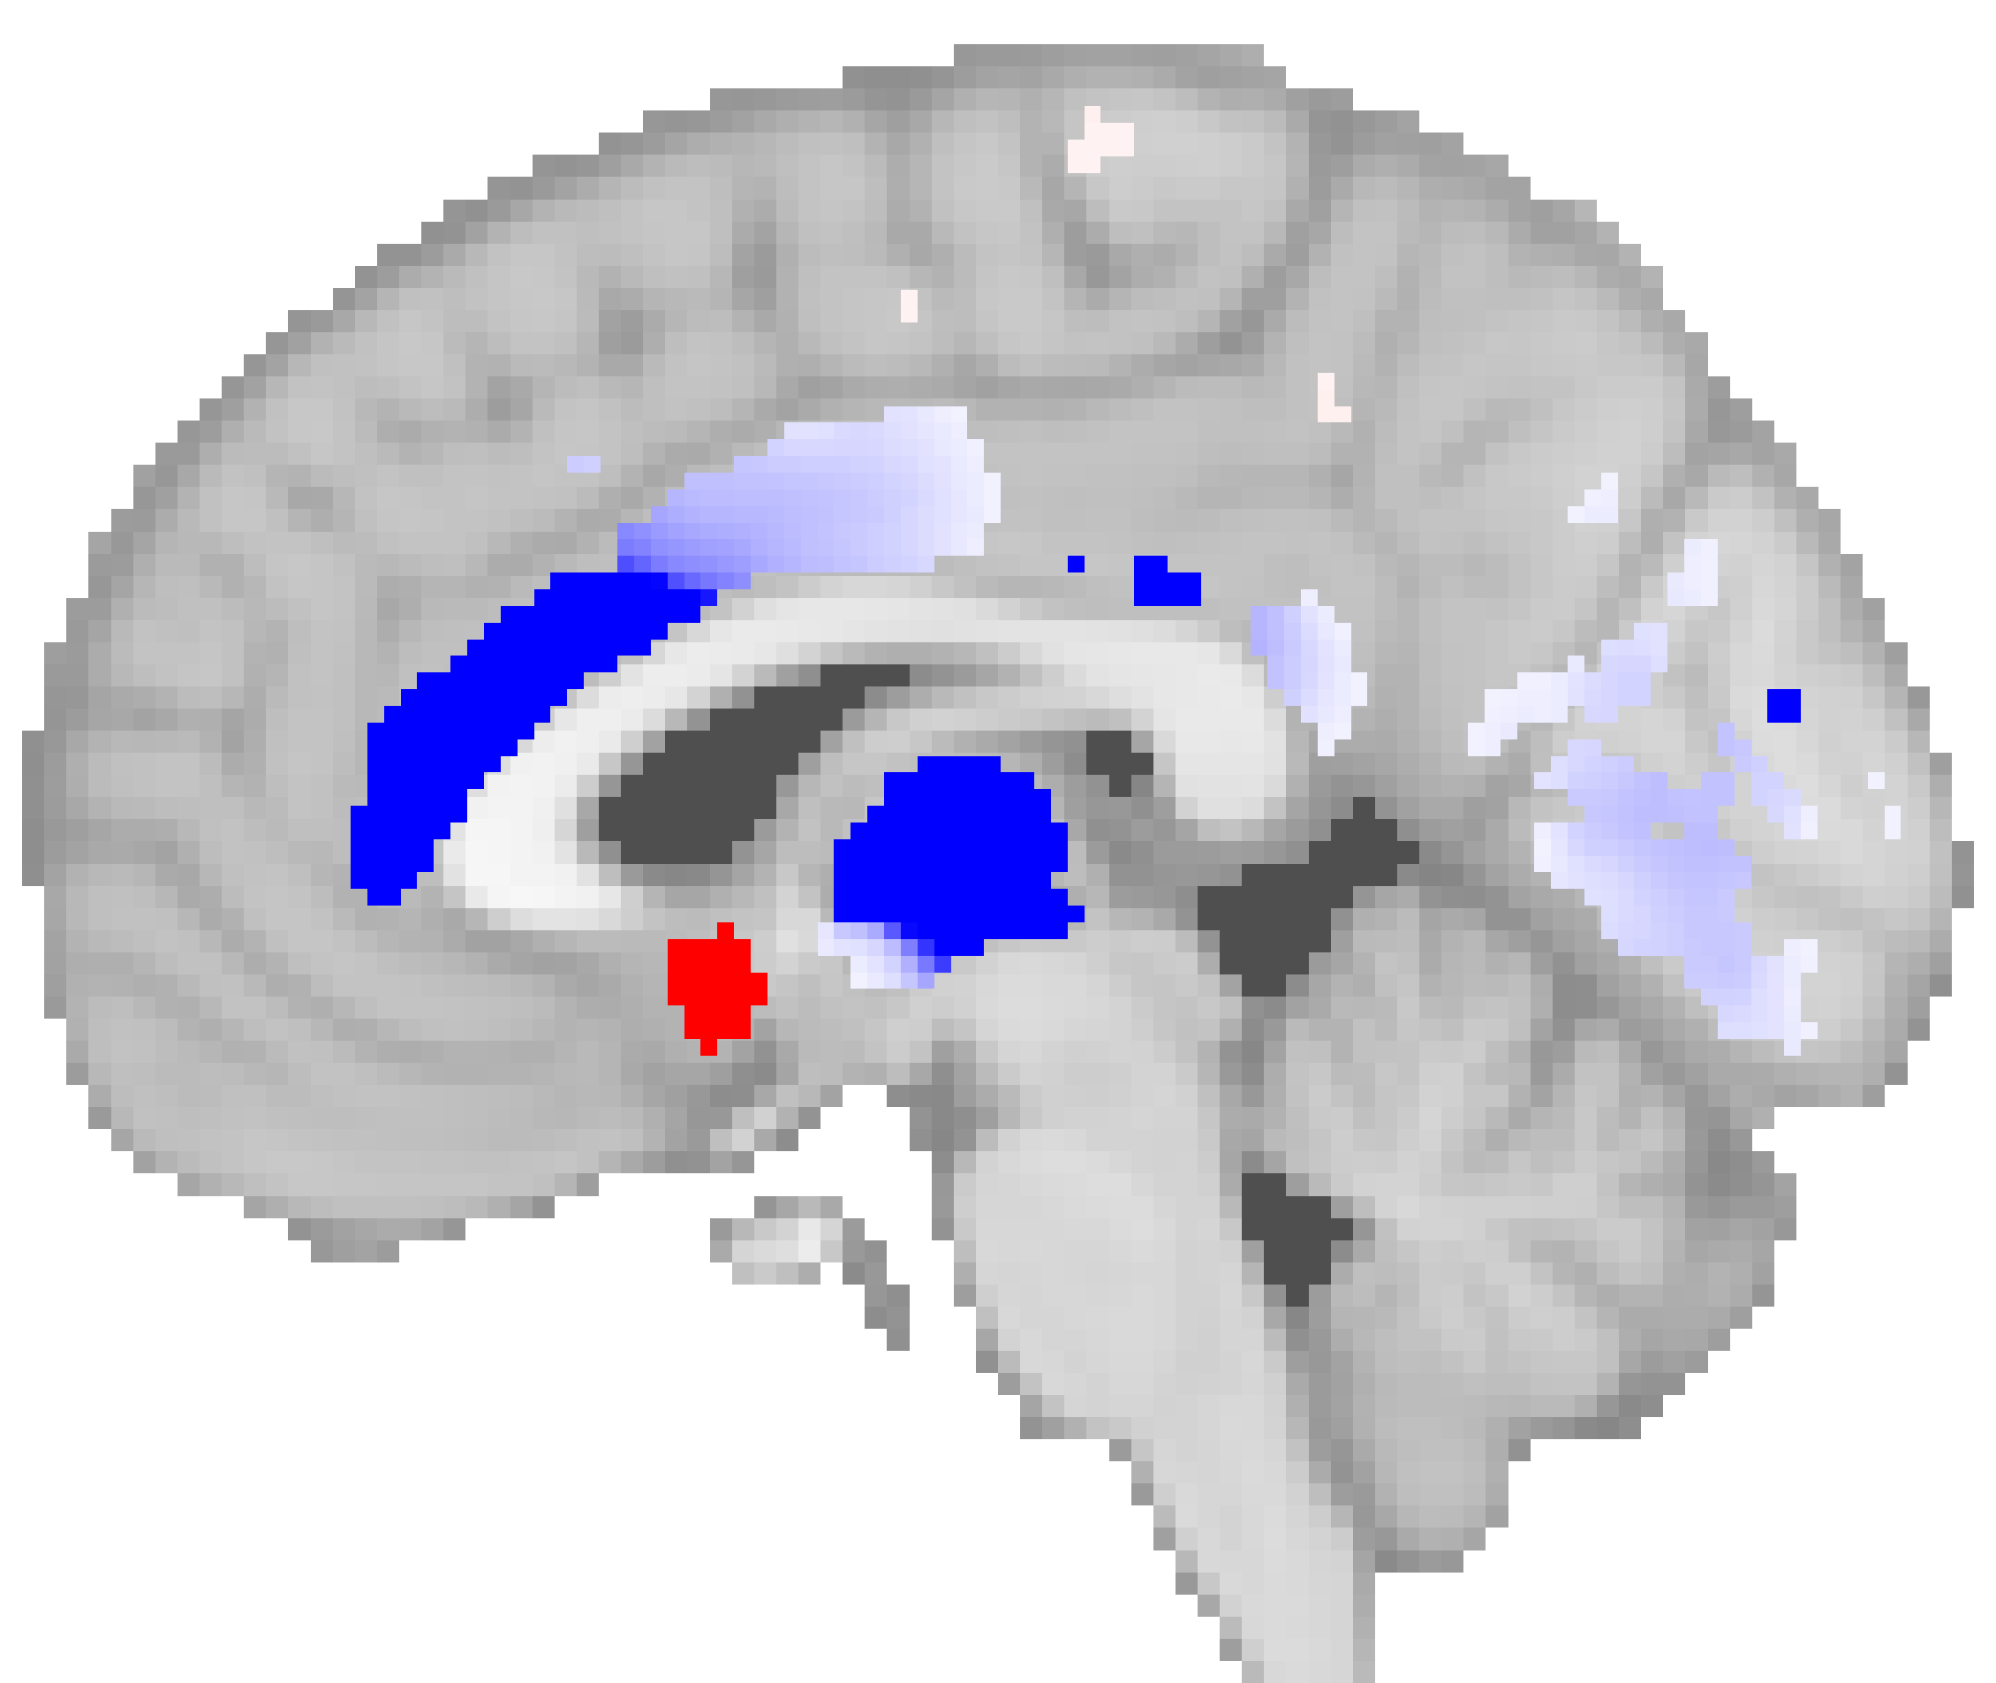


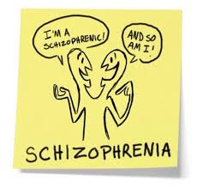
Identifying a Neuroanatomical Signature of Schizophrenia
Learn a predictive signature that generalize across sites and stages of the disorder
[De Pierrefeu Acta Psychiatrica Scandinavica, 2018]
Collab with
- CHU Lille (R. Jardri)
- SHU Ste-Anne Paris (M.O. Krebs)
- CHU Créteil (J. Houenou)
90 Controls
330 Controls
Disorder
progression
43 first episode
of psychosis
272 patients with Chronic SCZ
76% of
prediction
accuracy
68% of inter-site
accuracy
Learn predictive
signature
Predictive signature
Apply to new
patients
Brain score

Slide 22


Identifying a Neuroanatomical Signature of Schizophrenia
Prediction performances on an independent cohort of controls and patients with first-episode psychosis.
VBM outperforms ROI and cortical thickness.
All classifiers provide similar performance.
TV-Enet: sparse and stable solution organized as regions.
Signature of SCZ, shared by a majority of patients across different sites and already present at the early stage of the disorder.
Signature provides a brain score is associated with the symptoms severity and the amount of cognitive deficit.
[De Pierrefeu Acta Psychiatrica Scandinavica, 2018]

Slide 23
Preliminary experiments: Predict psychotic transition using anatomical imaging in prodromal (Ultra High Risk, UHR) subjects
82 UHR participants
NT=53
T=29
Collab. Ste-Anne:
Anton Iftimovici
MO Krebs
TV-L1L2
AUC: 0.79
genetic
environment
environment
CTL
L1
AUC: 0.7
CTL
UHR-NT
UHR-T
FE
L2
AUC: 0.66
Chronic
SCZ
AUC
79%
76%
80%
>70%

Slide 24






Functional MRI activations predict hallucinations in Schizophrenia
1) Rest functional MRI during
hallucination
2) Learn functional
signature of hallucination
Predictive signature:
Broca’s area and its right homologue
3) Decoding
4) Neuro-feedback
Relax
[De Pierrefeu Hum. Brain Map., 2018]
Collab with CHU Lille (R. Jardri)

Slide 25


Functional MRI Activation Patterns to Predict hallucinations in Schizophrenia for neurofeedback
Inter-subject decoding performances
Linear SVM
TV-Enet
Predictive signature: right homologue of Broca’s area
Perspective with near-infrared spectroscopy (NIRS)
[De Pierrefeu Hum. Brain Map., 2018]
Collab with CHU Lille (R. Jardri)

Slide 26

Prediction of Bibolar Disorder on 978 participants (423 BD vs 555 HC) from 13 sites
Collab with J. Houenou
Learning curve: Leave-One-Site-Out CV
DenseNet121
AUC~ 0.7
Performances still increase with sample size
Non-linear and linear models provided similar performances (including DenseNet).
Differences < Standard errors
  Possibility to capture non-linear pattern?
  Possibility to capture subgroups of patients/controls?

Slide 27
Interpretability of predictive models
Interpretability is not always a key issue (see “The Great AI Debate” – NIPS2017). In most situations, one would prefer a complex “black-box” that outperform an interpretable model.
The situation:
Complex models perform like linear models.
Interpretability is essential in the context of clinical (psychiatric) applications:
  Underpinning physiopathological process.
  Drug development (brain region targets).
  Brain stimulation (brain region targets).
  ML aims to guide treatment strategy, this choice must be justified by biological evidence.
Interpretability revisited:
Identify stable predictive regions.
Characterize the function of the regions:
Directly linked (causal or consequence) with the disorder.
Proxy of some important information (treatment, disease duration, etc.)
“Suppressor variable” that adjusts the model for latent variables (ex. Age, sex,).

Slide 28

Interpretability of predictive pattern
1/2: Identify stable regions
Dataset: Prediction of Bipolar disorder with 978 participants in 13 recruitment sites.
Aims: find stable regions
Z-score maps across leave-site-out cross-validation highlight stable regions identified by TV
Spatial (Enet-TV) regularization
l2-regularization

Slide 29

Interpretability of predictive pattern
2/2: Group regions into patterns and feature importances
Aims: group regions into more global patterns and evaluate importance/redundancy/complementary
Ablation study (Loss of ROC-AUC)
Whole pattern Loss of AUC |  | Sum of AUC losses
-0.16 | > | -6
Empowerment among regions: the whole is bigger than the sum of its parts.
-0.03 | = | -0.03
Simple additive effect
-0.07 | < | -0.09
Redundancy
-0.05 | = | -0.05
Explored other tracks, LARS-paths, etc.
Simple additive effect

Slide 30
Interpretability of multivariate models, ie, do methodologists design useful models?
Multivariate models are worth: “the whole is bigger than the sum of its parts”.
Ok but, to be useful (for clinical practice) models should address the “role” of a brain region given multivariate model?
Tools: Feature importance, Bootstrapping, ablation study, GradCam, etc.
Remains an open challenge: Indeed proposed solution have unsatisfactory methodological soundness: a posteriori exploration of solution will introduce bias
Validation on an independent data set (need more data!)
In-depth exploration with clinical conditions (medications, age, disorder severity, dimensions)
In-depth exploration of the role of brain regions:
  Directly (or proxy) associated with the disorder
  “Suppressor variable” that adjusts the model for latent variable (ex. Age)
In conclusion, it is a laborious task, full of potential bias, for which good practices must be defined

Slide 31
Outline
Introduction: Machine learning to identify prognostic signature in psychiatry
Fighting over-fitting: Feature selection, regularization and model selection
Spatial regularization to improve interpretability
Applications to psychiatry
Deep learning for supervised task
Transfer learning and representation learning

Slide 32
Deep learning?
General idea
Deep learning does not require feature extraction: compare minimally processed “quasi-raw” data
traditional feature extraction (here VBM).
Deep learning should outperformed other models.
– Bad arguments: Because it's trendy and I like it… ;). CNN deals with translation, homothety, rotation.
– Good ones: Because world is compositional, ie, multi-scale, non linearity, subgroups of subjects, etc.
Controversial findings
1. DL outperformed linear models.
2. Feature extraction is not necessary.
Abrol... Calhoun (2021). Nature communications.
Cole... Montana, G. (2017) NeuroImage.
...
VS.
1. DL and linear models produce similar performances.
2. Feature extraction is necessary.
Schulz (2020). Nature communications.
Wen ... Colliot (2020). MedIA.
...
Aspects not addressed yet
Choice of an architecture (no need to deal with invariances).
Relevance of data augmentation.
Ensemble learning and dropout.
Dufumier ... Duchesnay (2021) submitted
to NeuroImage.

Slide 33

Our benchmark with 10k training samples from dozens of sites on 3 tasks:
Age, Sex and Schizophrenia prediction
Traditional feature extraction (VBM) outperforms “quasi-raw” data.
Linear models equal DL.
DenseNet is a good default choice.

Slide 34


To generalize to independent sites, traditional feature extraction (VBM) outperformed quasi-raw in generalization to independent sites
5-CV stratified for site
VBM = Quasi-Raw
Leave-One-Site-Out
VBM > Quasi-Raw

Slide 35

Data augmentation?

Slide 36

Data augmentation: no clear improvement
Increase
Decrease

Slide 37
Outline
Introduction: Machine learning to identify prognostic signature in psychiatry
Fighting over-fitting: Feature selection, regularization and model selection
Spatial regularization to improve interpretability
Applications to psychiatry
Deep learning for supervised task
Transfer learning and representation learning

Slide 38








Transfer learning from big “dirty” datasets to small quality datasets:
“learn reference curves”
Learn the general variability on large datasets
1) Learn reference curve
– Large “open” datasets
– Heterogeneous “dirty”
– Cross-sectional
– Transdiagnostic
– 10k subjects
– Psychiatry requires “young” participants (UK-BioBank > 40 years)
Small homogeneous datasets:
<1000 subjects, 10k€/subject.
10k subjects would cost 100M€ !
2) Transfer Learning from Big data to Small Data
Detect deviation from reference curve

Slide 39

Transfer learning from big “dirty” datasets to small quality datasets:
“learn reference curves” details
Large cohorts of general population
N ≥ 10,000, transnosographic heterogeneous
(HBN, ABCD, UK Biobank, other open-datasets)
Learn the general variability
Disorder-specific retrospective and heterogeneous cohorts
N < 10,000, cross-sectional, case-control, “dirty”, limited clinical value
(Schizconnect (SCZ), abide (ASD), BIOBD/BSNIP (BD)
Focus on specific variability
Disorder-specific longitudinal and homogeneous cohorts
N < 2,000, longitudinal and homogeneous cohorts, high clinical value
PsyCARE (RHU), R-LiNK, H2020, EU-AIMS
Learn useful predictive signature

Slide 40

Transfer learning: Self-supervised contrastive learning integrating age
Encoders for representation learning of the general variability
– Learn on large 10k dataset
– Add contrastive learning
– Add prior on age
Dufumier (2021) submitted to MICCAI

Slide 41

Representation learning with age-aware contrastive learning
Representation learning: learn encoder on 10k samples (upstream task).
Validation (downtream task): Learn linear layer on top of the pre-trained frozen encoders
Compare with different strategies and a fully supervised fine-tuned model (gold standard)
Conclusion
Simple cutout transformation is efficient
Age-aware CL pre-training significantly outperformed all other strategies: pre-training on age, classical SimCLR, etc.
Fully fine-tuning of pre-trained age-aware CL significantly outperformed linear...
Dufumier (2021) submitted to MICCAI

Slide 42
Summary
Regularized linear models
Feature selection/sparsity may help but it raises the problem of model selection.
Most models provide similar performances, always try the venerable l2-regularization as baseline.
Interpretability is a key issue to consider a transfer to the clinic.
Deep learning
We found that DL is not better than traditional feature extraction with linear models on supervised task
However, DL opens perspectives for transfer learning from large heterogeneous datasets to small homogeneous datasets
Representation learning of the general variability (remember the reference curve of BMI). This idea is similar to the "normative modeling" of André Marquand.
The data issue
Most of existing (open) datasets are of low value for useful clinical application:
  Either cross-sectional (case/control) or heterogeneous trans-diagnostic (HBN, UKB, ABCD, etc.)
Need for large longitudinal datasets: data → treatment → outcome. Learn(data) → outcome
Problem: cost is 10K€/sample → 100k€ for 10k subjects !!!
The best we will get for next 10 years is ~1000 subjects per clinical problem.
That’s why we are exploring transfer learning, any other idea?

Slide 43










Thanks!
Anton Iftimovici
MD Psychiatrist
PhD@NS
Benoit Dufumier
PhD@NS
Robin Louiset
PhD@NS
Julie Victor
Engineer@NS
Pietro Gori
Researcher
@Télécom
Fouad Hadj-Selem
Researcher
@Vedecom
Tommy Loftstead
Researcher
@UMEA, Sweden
Antoine Grigis
Engineer@NS
Josselin Houenou
Pr in Psychiatry
Amicie de Pierrefeu
Former PhD

