Slide 1

IBC 2018 CHAPTER 10
ORB University
MEANS OF EGRESS
CHAPTER 10 PROVIDES THE GENERAL CRITERIA FOR DESIGNING THE MEANS OF EGRESS ESTABLISHED AS THE PRIMARY METHOD FOR PROTECTION OF PEOPLE IN BUILDINGS BY ALLOWING TIMELY RELOCATION OR EVACUATION OF BUILDING OCCUPANTS.

Slide 2
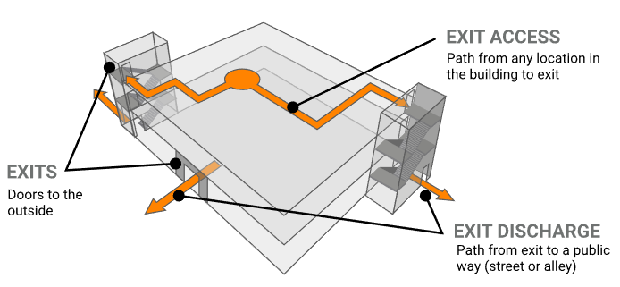
SECTION 1003 – GENERAL MEANS OF EGRESS
MEANS OF EGRESS: A CONTINUOUS AND UNOBSTRUCTED PATH OF VERTICAL AND HORIZONTAL EGRESS TRAVEL FROM ANY OCCUPIED PORTION OF A BUILDING OR STRUCTURE TO A PUBLIC WAY. A MEANS OF EGRESS CONSIST OF THREE SEPARATE AND DISTINCT PARTS: THE EXIT ACCESS, THE EXIT AND THE EXIT DISCHARGE.

Slide 3
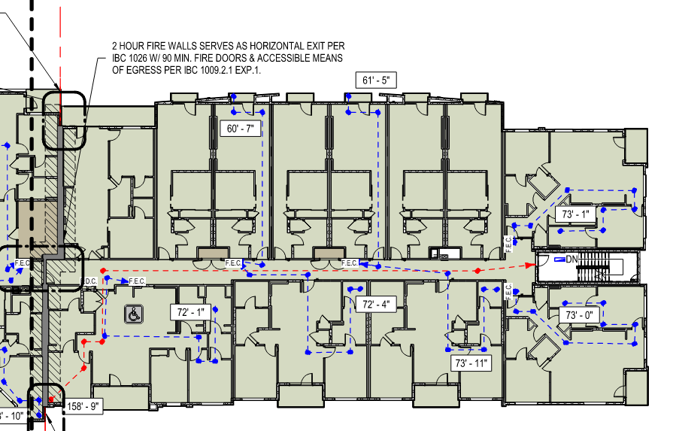
SECTION 1003 – GENERAL MEANS OF EGRESS

Slide 4
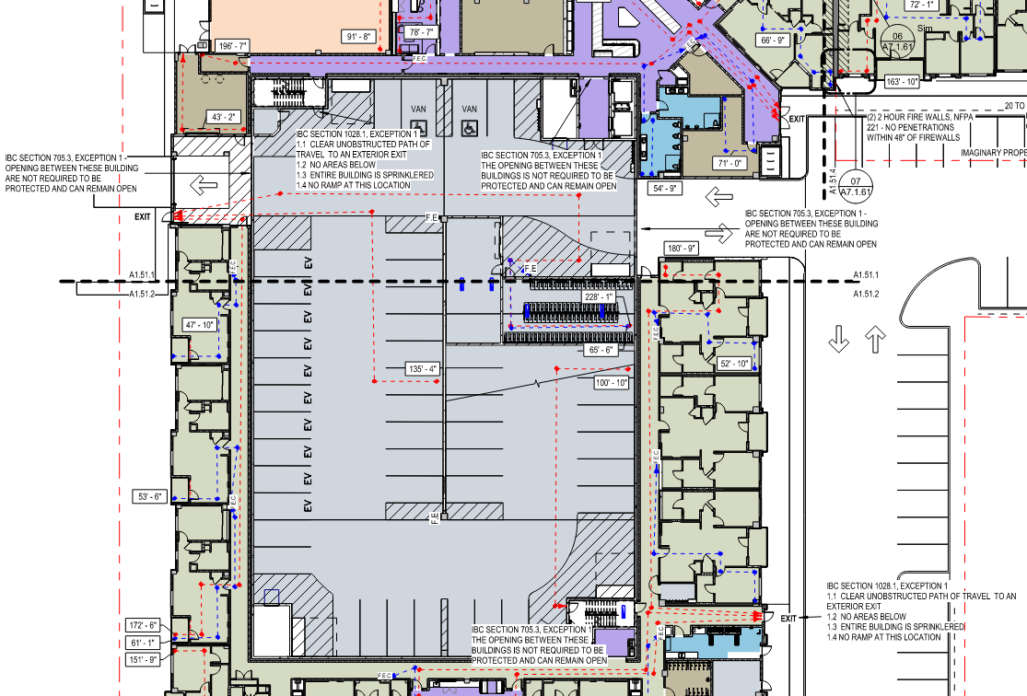
SECTION 1003 – GENERAL MEANS OF EGRESS

Slide 5
SECTION 1003 – GENERAL MEANS OF EGRESS
1003.2 Ceiling height. The means of egress shall have a ceiling height of not less than 7 feet 6 inches above the finished floor.
1003.5 Elevation change. Where changes in elevation of less than 12 inches exist in the means of egress, sloped surfaces shall be used. Where the slope is greater than 5-percent slope, ramps shall be used.
1003.6 Means of egress continuity. The path of egress travel along a means of egress shall not be interrupted by a building element other than a means of egress component as specified in this chapter. Obstructions shall be not be placed in the minimum width or required capacity of a means of egress component except projections permitted by this chapter. The minimum width or required capacity of a means of egress shall not be diminished along the path of egress travel.
1003.7 Elevators, escalators and moving walks. Elevators, escalators and moving walks shall not be used as a component of a required means of egress from any other part of the building.

Slide 6
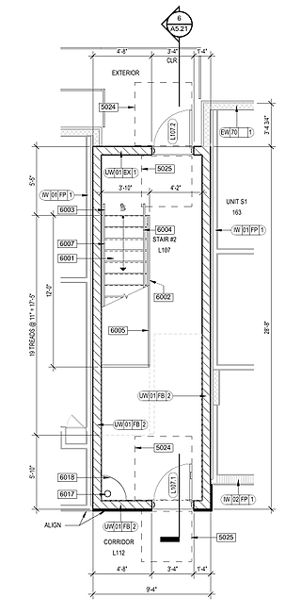
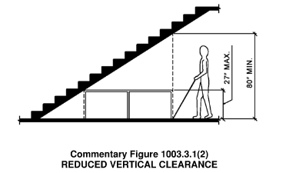
SECTION 1003 – GENERAL MEANS OF EGRESS
1003.3.1 Headroom. Protruding objects are permitted to extend below the minimum ceiling height where a minimum headroom of 80 inches is provided over any circulation paths, including walks, corridors, aisles and passageways. Not more than 50 percent of the ceiling area of a means of egress shall be reduced in height by protruding objects. A barrier shall be provided where the vertical clearance above a circulation path is less than 80 inches high above the finished floor. The lading edge of a such a barrier shall be located 27 inches maximum above the finished floor.

Slide 7
SECTION 1004 – OCCUPANT LOAD
THE DESIGN OCCUPANT LOAD IS THE NUMBER OF PEOPLE INTENDED TO OCCUPY A BUILDING OR PORTION THEREOF AT ANY ONE TIME; ESSENTIALLY, THE NUMBER FOR WHICH THE MEANS OF EGRESS IS TO BE DESIGNED.
THE DESIGN OCCUPANT LOAD IS ALSO UTILIZED TO DETERMINE THE REQUIRED PLUMBING FIXTURE COUNT AND OTHER BUILDING REQUIREMENTS, SUCH AS AUTOMATIC SPRINKLER SYSTEMS AND FIRE ALARM AND DETECTION SYSTEMS.

Slide 8
SECTION 1004 – OCCUPANT LOAD
1004.2 Design occupant load. In determining means of egress requirements, the number of occupants for whom mean of egress facilities are provided shall be determined in accordance with this section.
1004.5 Areas without fixed seating. The number of occupants shall be computed at the rate of one occupant per unit of area as prescribed in table 1004.5 The occupant load shall be not less than that number determined by dividing the floor area under consideration by the occupant load factor assigned to the function of the space.
1004.6 Fixed seating. For areas having fixed seats and aisles, the occupant load shall be determined by the number of fixed seats installed therein.

Slide 9
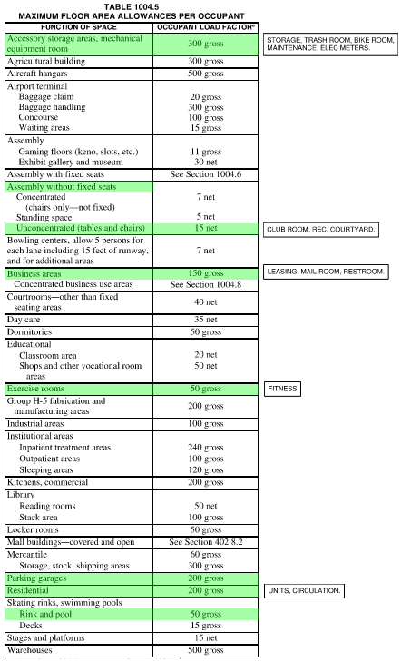
SECTION 1004 – OCCUPANT LOAD

Slide 10
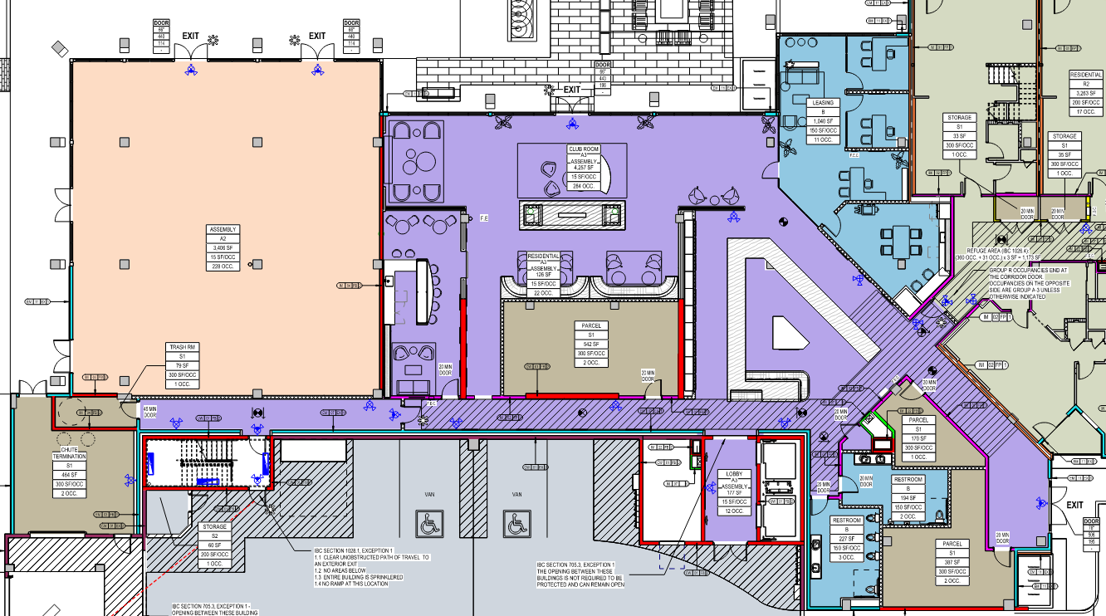
SECTION 1004 – OCCUPANT LOAD

Slide 11
SECTION 1004 – OCCUPANT LOAD
1004.2 Cumulative occupant loads. Where the path of egress travel includes intervening rooms, areas or spaces, cumulative occupant loads shall be determined in accordance with this section.
When occupants from an accessory area move through another area to exit, the combined number of occupants must be utilized to determine the capacity that the egress components must accommodate. For example, the means of egress from a lobby must be sized for the cumulative occupant load of the adjacent office spaces if the occupants must travel through the lobby to reach an exit. Likewise, if an adjacent room has an egress route independent of the lobby, the occupant load of that room would not be combined with the occupant loads of the other rooms that pass through the lobby. If a portion of the adjacent room’s occupant load is to travel through the lobby, only that portion would be combined with the lobby occupant load for determining lobby egress.

Slide 12
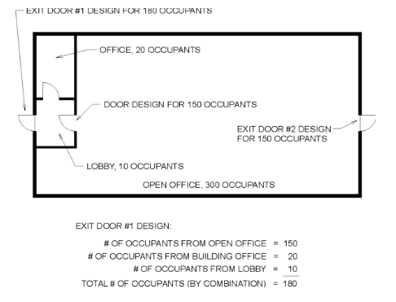
SECTION 1004 – OCCUPANT LOAD

Slide 13
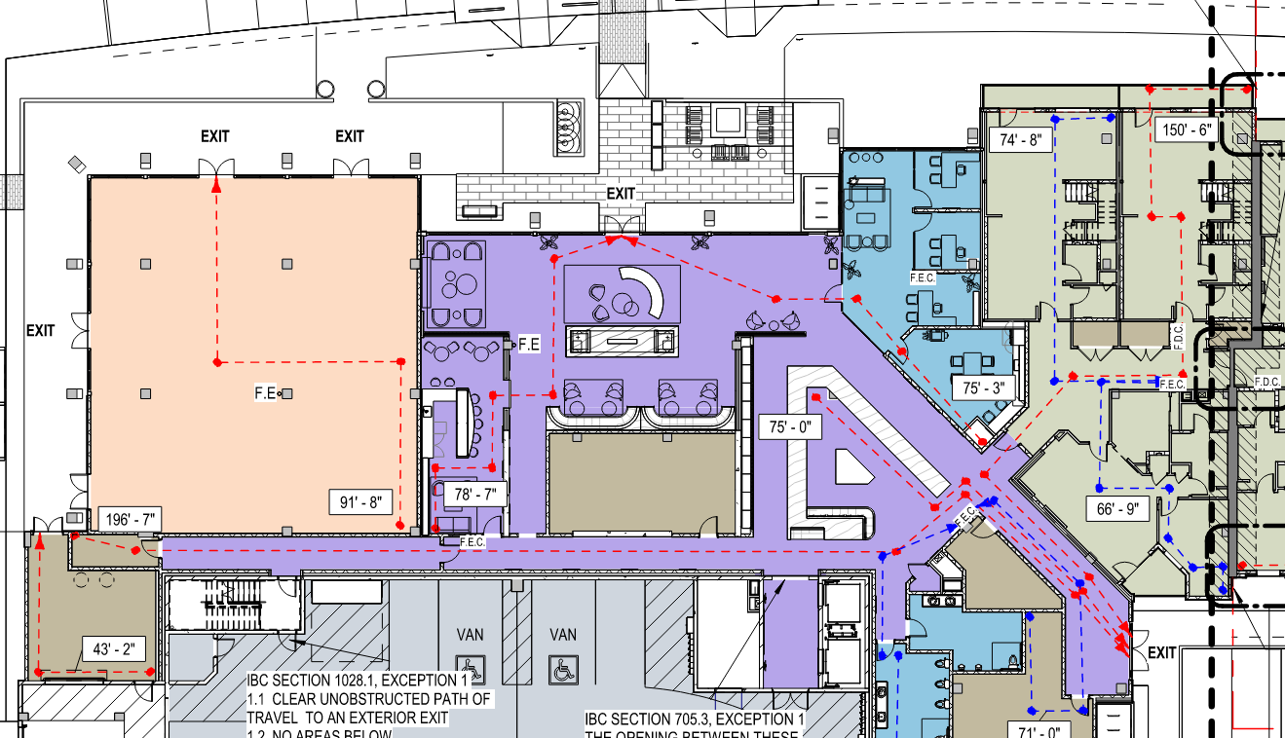
SECTION 1004 – OCCUPANT LOAD

Slide 14
SECTION 1004 – OCCUPANT LOAD
1004.2.3 Adjacent stories. Other than for the egress components designed for convergence in accordance with Section 1005.6, the occupant load from separate stories shall not be added.
1004.3 Multiple function occupant load. Where an area under consideration contains multiple functions having different occupant load factors, the design occupant load for such area shall be based on the floor area of each function calculated independently.
1004.7 Outdoor areas. Yards, patios, occupied roofs, courts and similar outdoor areas accessible to and usable by the building occupants shall be provided with means of egress. Where outdoor areas are to be used by persons in addition to the occupants of the building, and the path of egress travel from the outdoor areas passes through the building, means of egress requirements for the building shall be based on the sum of the occupant loads of the building plus the outdoor area.

Slide 15
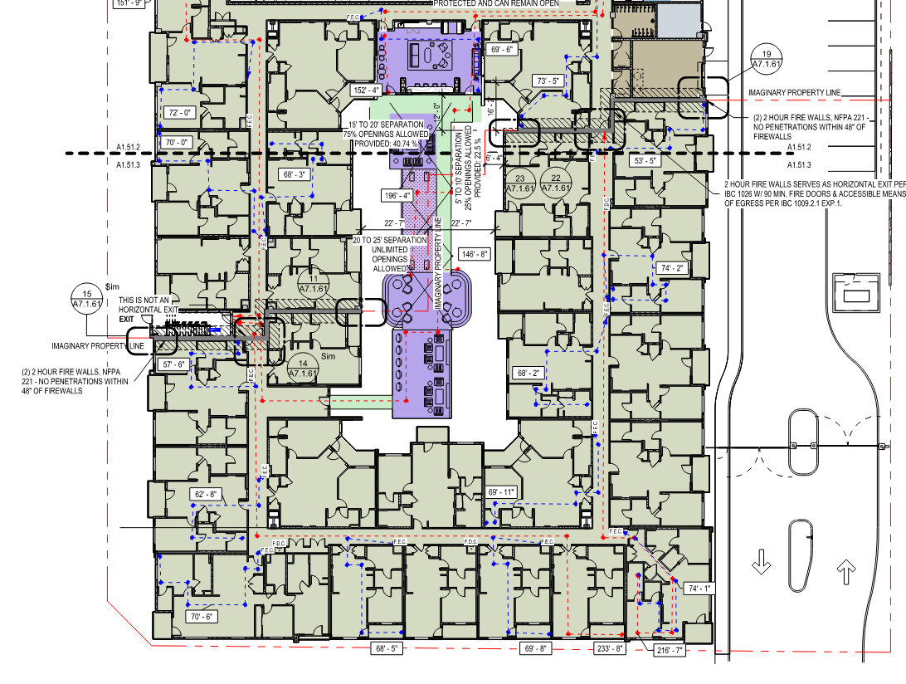
SECTION 1004 – OCCUPANT LOAD

Slide 16
SECTION 1005 – MEANS OF EGRESS SIZING
THIS SECTION IS A CHARGING PARAGRAPH FOR SIZING THE MEANS OF EGRESS SYSTEM IN A TENANT SPACE, FLOOR OR BUILDING.
ALL PORTIONS OF THE MEANS OF EGRESS SYSTEM SHALL BE SIZED IN ACCORDANCE WITH THIS SECTION.

Slide 17
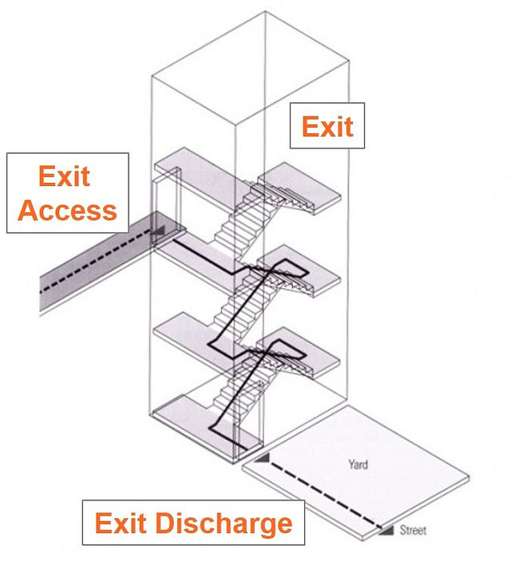
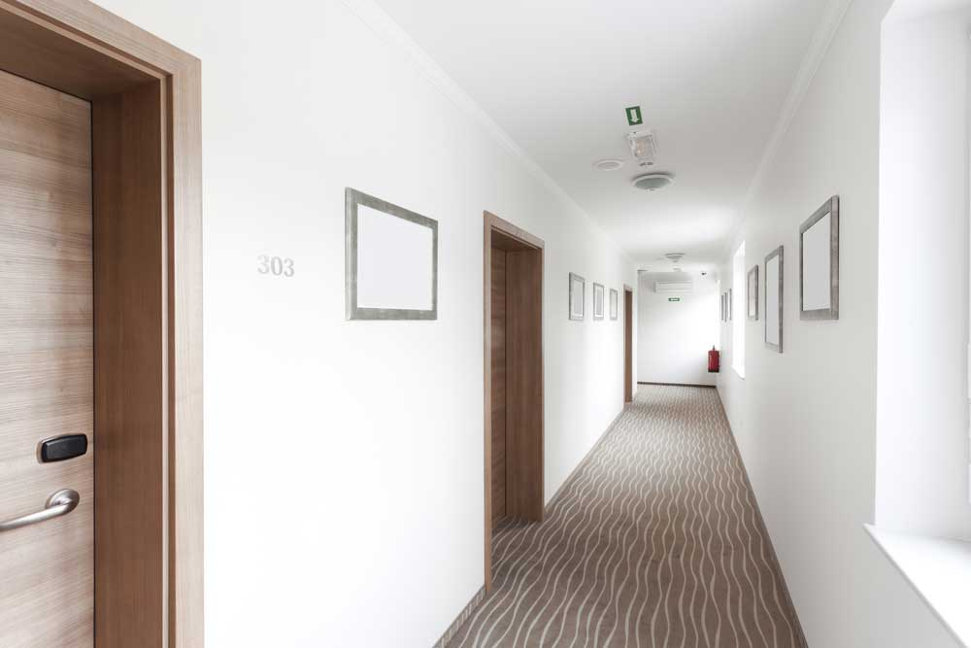
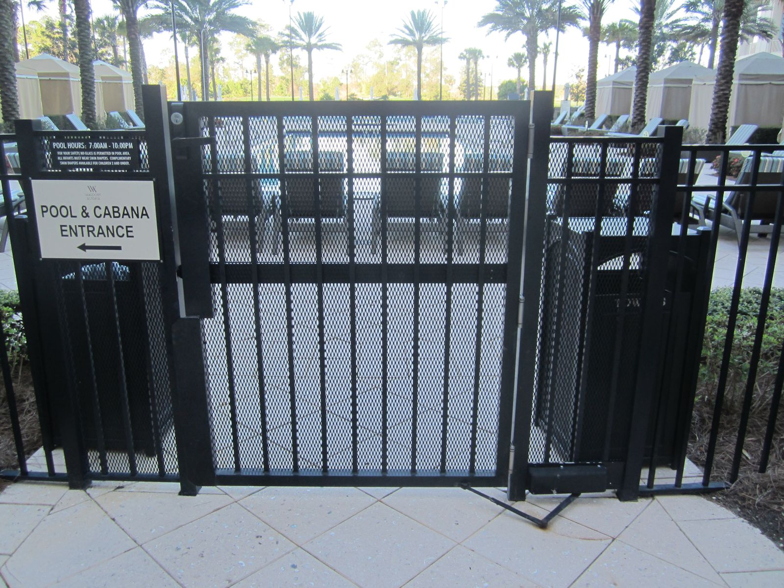
SECTION 1005 – MEANS OF EGRESS SIZING
THIS SECTION IS A CHARGING PARAGRAPH FOR SIZING THE MEANS OF EGRESS SYSTEM IN A TENANT SPACE, FLOOR OR BUILDING.
ALL PORTIONS OF THE MEANS OF EGRESS SYSTEM SHALL BE SIZED IN ACCORDANCE WITH THIS SECTION.

Slide 18
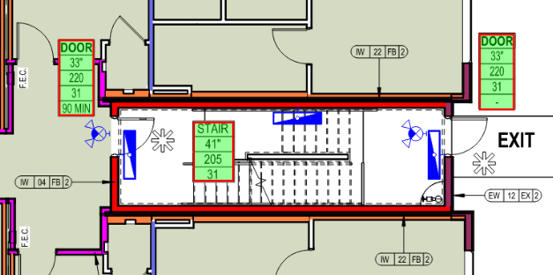
SECTION 1005 – MEANS OF EGRESS SIZING
THIS SECTION IS A CHARGING PARAGRAPH FOR SIZING THE MEANS OF EGRESS SYSTEM IN A TENANT SPACE, FLOOR OR BUILDING.
ALL PORTIONS OF THE MEANS OF EGRESS SYSTEM SHALL BE SIZED IN ACCORDANCE WITH THIS SECTION.

Slide 19
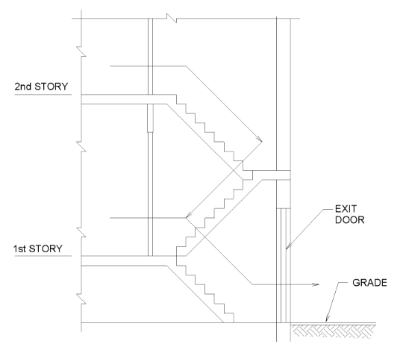
SECTION 1005 – MEANS OF EGRESS SIZING
1005.3.1 Stairways. The capacity, in inches, of means of egress stairways shall be calculated by multiplying the occupant load served by such stairways by a means of egress capacity factor of 0.3 inch per occupant. Where stairways serve more than one story, only the occupant load of each story considered individually shall be used in calculating the required capacity of the stairways serving that story.

Slide 20
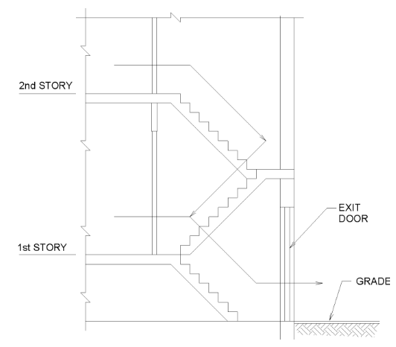
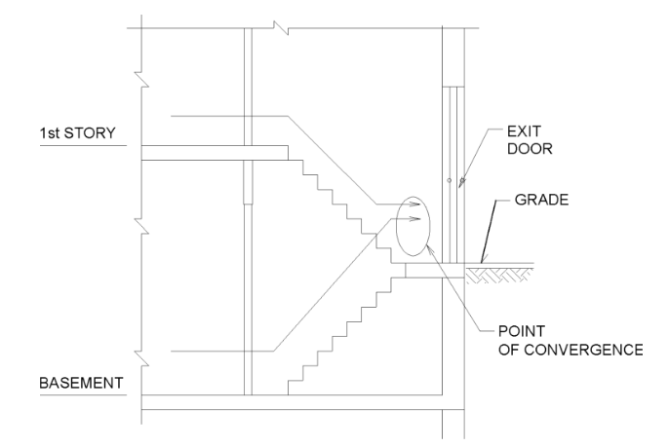
SECTION 1005 – MEANS OF EGRESS SIZING
1005.6 Egress convergence. Where the means of egress from stories above and below converge at an intermediate level, the capacity of the means of egress from the point of convergence shall be not less than the largest minimum width or the sum of the required capacities for the stairways or ramps serving the two adjacent stories, whichever is larger.

Slide 21
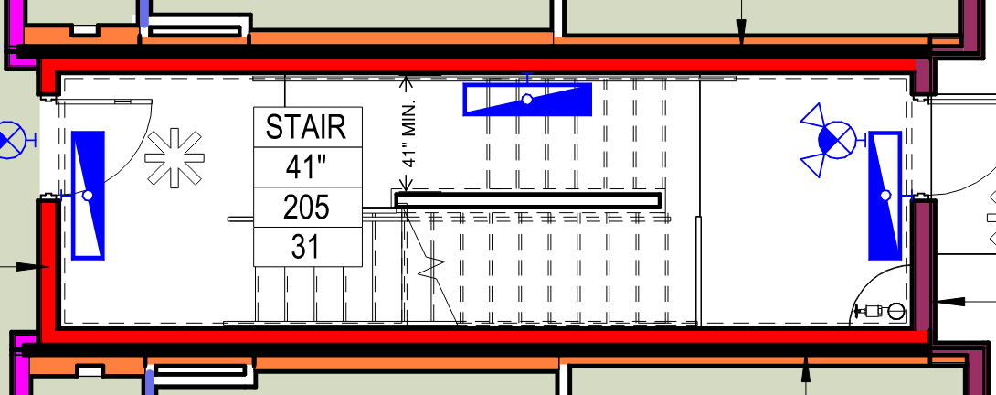
SECTION 1005 – MEANS OF EGRESS SIZING
1005.3.1 Stairways. The capacity, in inches, of means of egress stairways shall be calculated by multiplying the occupant load served by such stairways by a means of egress capacity factor of 0.3 inch per occupant. Where stairways serve more than one story, only the occupant load of each story considered individually shall be used in calculating the required capacity of the stairways serving that story.
Exception: The capacity, in inches, of means of egress stairways shall be calculated by multiplying the occupant load served by such stairways by a means of egress capacity factor of 0.2 inch per occupant in buildings equipped throughout with an automatic sprinkler system installed and an emergency voice/alarm communication system.

Slide 22
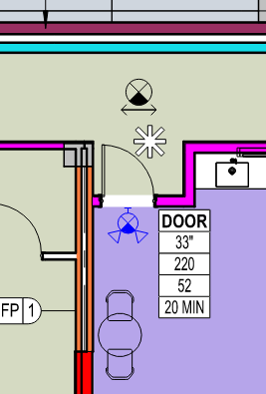
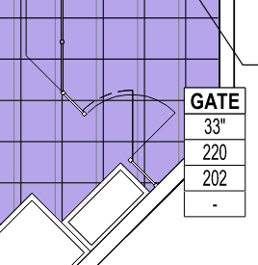
SECTION 1005 – MEANS OF EGRESS SIZING
1005.3.2 Other egress components. The capacity, in inches, of means of egress components other tan stairways (doors, gates, corridors, aisles, ramps) shall be calculated by multiplying the occupant load served by such component by a means of egress capacity factor of 0.2 inch per occupant.
Exception: The capacity, in inches, of means of egress components other than stairways shall be calculated by multiplying the occupant load served by such component by a mans of egress capacity factor of 0.15 inch per occupant in buildings equipped throughout with an automatic sprinkler system and an emergency voice/alarm communication system.

Slide 23
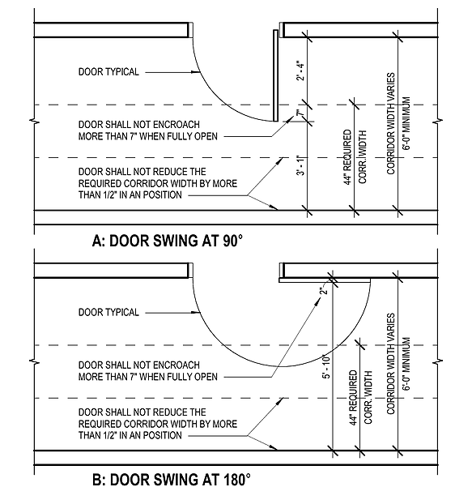
SECTION 1005 – MEANS OF EGRESS SIZING
1005.4 Encroachment. Encroachments into the required means of egress width shall be in accordance with the provisions of this sections.
1005.7.1 Doors. Doors, when fully opened, shall not reduce the required width by more than 7 inches. Doors in any position shall not reduce the required width by more than one-half.

