Slide 1
LRL-WEB
Lawrence C Andrews
larry6640995@gmail.com
Herbert J Bernstein
yayahjb@gmail.com

Slide 2
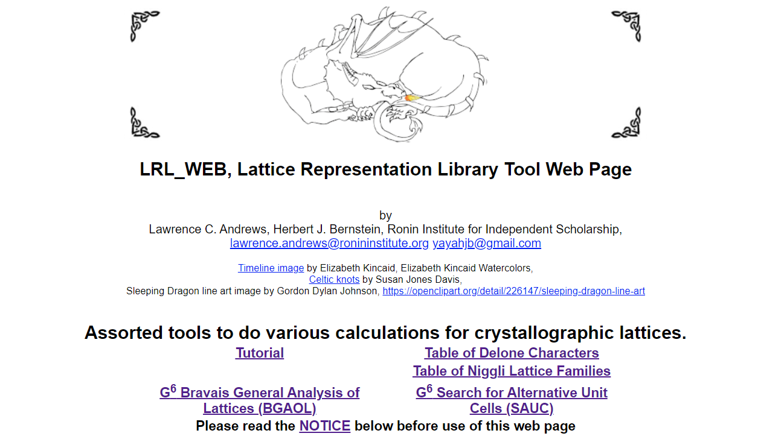
LRL_WEB

Slide 3
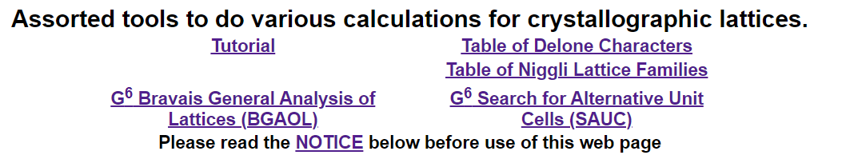
LRL_WEB Resources

Slide 4
Several Classes of Programs
Information
Graphical information
Generate examples
Type conversion
Unit cell reduction
Modify/extend input

Slide 5
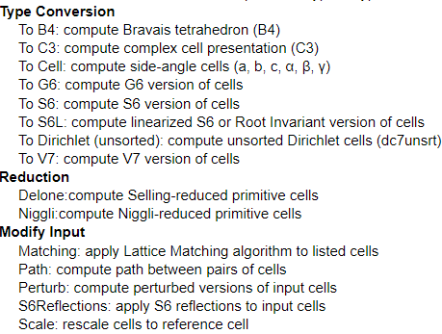
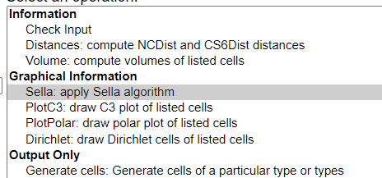
More than 20 Programs Available

Slide 6
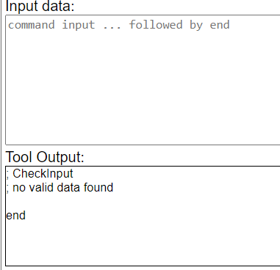
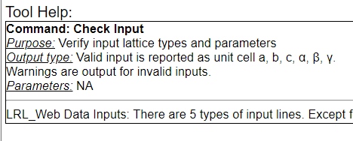
More than 20 Programs Available

Slide 7
NIH/EPA Chemical Information System
LCA Need a decent image here
1978 – Commissioned to create an online database of all known unit cells, searchable for similar unit cells.
Result: the creation of a metric for computing the “distance” between any pair of unit cells.
V⁷ representation of unit cells
1980, Andrews, Bernstein, Pelletier

Slide 8
1978
We were faced with the problem of finding “matching” unit cells within some specified capture radius. An important example was:
F 10 10 10 90 90 90
P 7.071 7.071 7.071 60 60 60 (Niggli reduced)
P 7.071 7.071 7.071 90 120 120
or
10 10 10 90 90 90 F
7.071 7.071 7.071 60 60 60 P
7.071 7.071 7.071 90 120 120 P
When you consider axial rearrangements and small perturbations, there are many possibilities.

Slide 9
Unit Cells as Points in a [Metric} Space
The conventional representation of unit cells is as edge lengths and interaxial angles: a, b, c, α, β, γ.
Or thinking about them as a vector in a space:
u = [a, b, c, α, β, γ]

Slide 10
V⁷ and Bravais Lattices
LCA delete slide
In 1980, Bravais lattice determination was not fully developed
V⁷ uses a vector of the Niggli reduced cell edges, the reduced reciprocal cel, and the cell volume
V⁷ is not easily invertible
V⁷ turned out to not be easy to use for Bravais lattice determination

Slide 11
G⁶ and Bravais Lattices
V⁷
G⁶ is based on the metric tensor, similar to the “Niggli matrix”
g = [a², b², c², 2b·c, 2a·c, 2a·b]

Slide 12
S⁶ and Bravais Lattices
S⁶ is based on the “Selling parameters”, which are used in Delaunay (Delone) reduction
S = [b·c, a·c, a·b, a·d, b·d, c·d]
Where:
d = -(a+b+c)

Slide 13
The same 3 unit cells as [a, b, c, α, β, γ], Gruber G⁶ and Selling S⁶
As [a, b, c, α, β, γ]
10 10 10 90 90 90 F
7.071 7.071 7.071 60 60 60 P
7.071 7.071 7.071 90 120 120 P
As Selling S⁶
S6 0.00000 0.00000 0.00000 -100.00000 -100.00000 -100.00000
S6 24.99952 24.99952 24.99952 -99.99808 -99.99808 -99.99808
S6 0.00000 -24.99952 -24.99952 -0.00000 -24.99952 -24.99952
As Gruber G⁶
G6 100 100 100 0 0 0
G6 50 50 50 50 50 50
G6 50 50 50 0 -50 -50

Slide 14
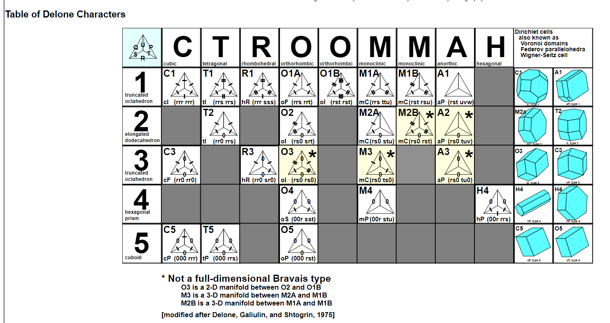

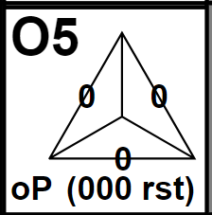
Table of Delaunay Characters

Slide 15
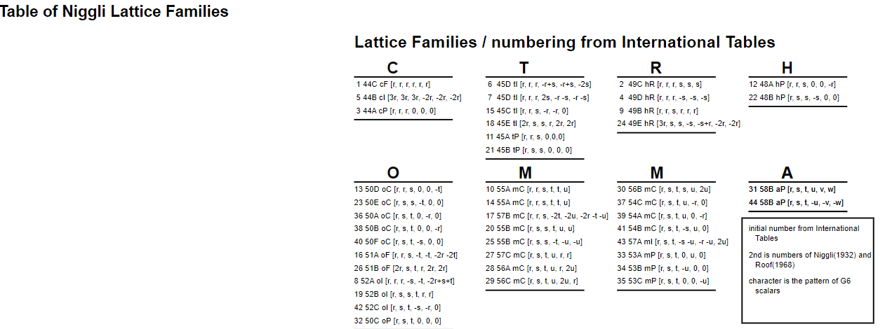
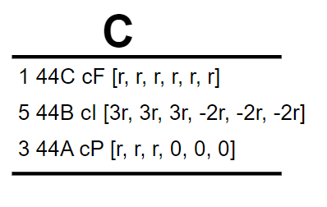
Table of Niggli Characters

Slide 16
ITERATE, 1988
LCA remove slide?
The Niggli matrix was used as a model for a new, vector representation of unit cells. The advantage is that each of the Bravais lattice types is a linear subspace in this space. (Later, this space was named G⁶.)
For a unit cell a, b, c, α, β, γ, a vector in G⁶ is:
v = [a², b², c², 2b·c, 2a·c, 2a·b]

Slide 17
BGAOL, 2014 (Bravais General Analysis of Lattices)
Formal description of the space G⁶ for describing unit cells.
For a unit cell a, b, c, α, β, γ, a vector in G⁶ is:
v = [a², b², c², 2b·c, 2a·c, 2a·b]
BGAOL was found to be quite reliable for aiding Bravais lattice choices

Slide 18
LRL_WEB Resources

Slide 19
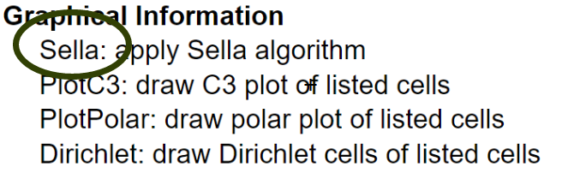
LRL_WEB has SELLA
SELLA is based on Delaunay reduction and uses the S⁶ vector

Slide 20
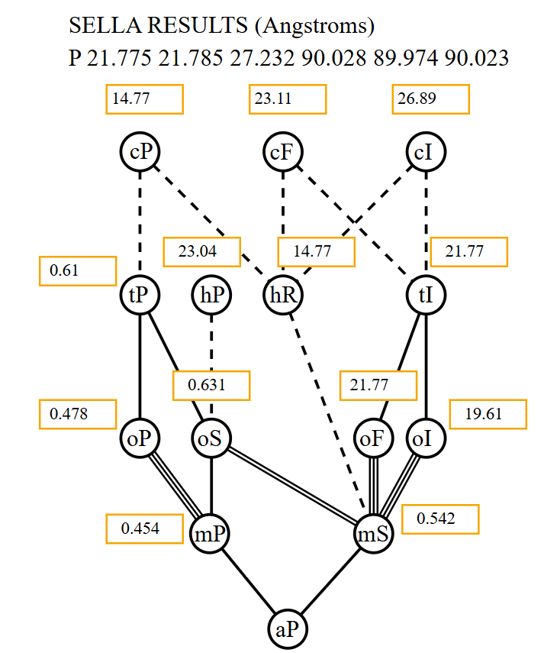
SELLA, 2019
SELLA is still under development, but it is functional.
SELLA produces its results as a graphical presentation of Grimmer’s hierarchal display of Bravais lattices

Slide 21
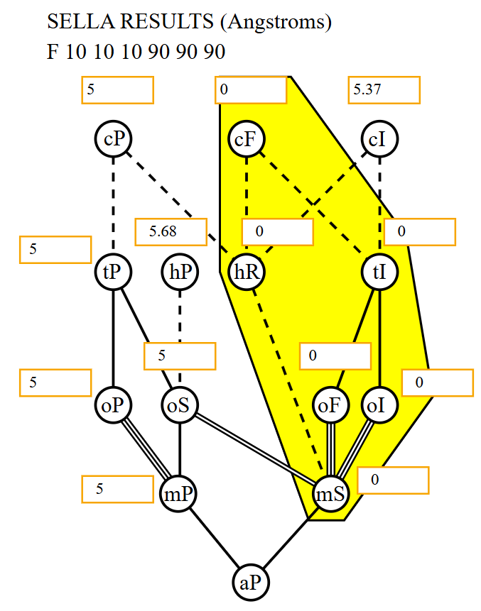
LRL_WEB has SELLA
F 10 10 10 90 90 90

Slide 22
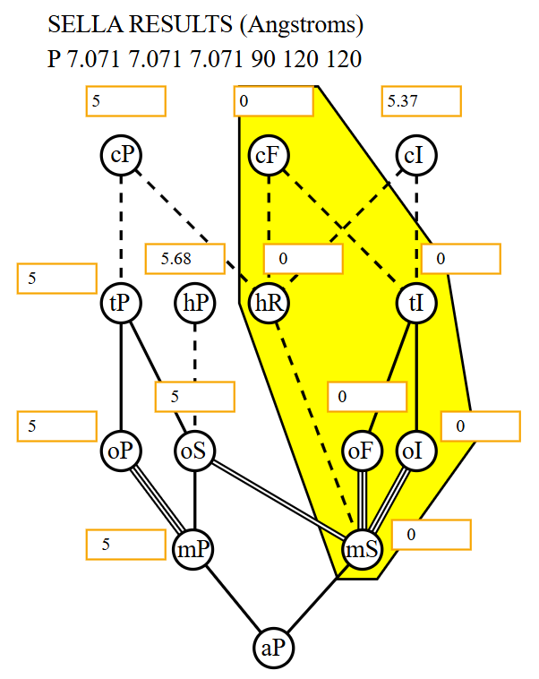
LRL_WEB has SELLA
P 7.071 7.071 7.071 90 120 120

Slide 23
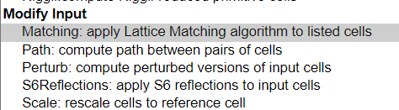
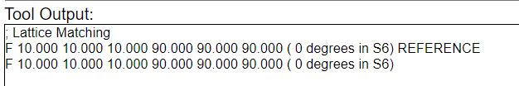
LRL_WEB has Lattice Matching
F 10 10 10 90 90 90
P 7.071 7.071 7.071 90 120 120

Slide 24
Example from Marsh
P 6.558, 12.628, 6.554, 100.43, 107.53, 100.48 (P1)
(Sheldrick & Haeusler, 1988)
C 7.750, 10.576, 12.628, 90.03, 107.88, 89.96 (Cc)
(Kapon, Reisner, & Marsh, 1989)
On the Structure of KAsSe2, Kapon, Reisner,& Marsh, 1989

Slide 25
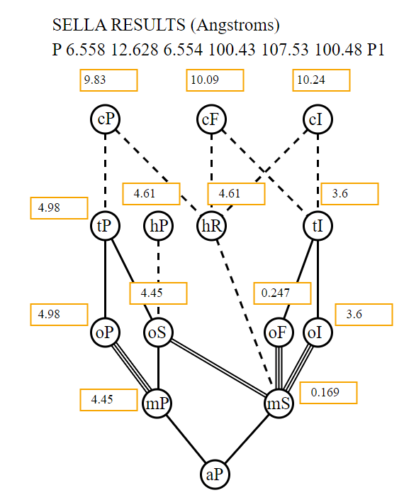
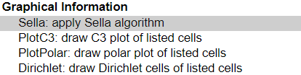

Example from
Marsh (2)

Slide 26

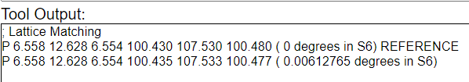
Example from Marsh (3)
Example from Marsh (3)

Slide 27
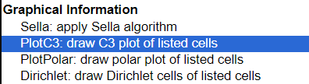
Graphical Programs

Slide 28
C³ and plotting in C³
Delaunay (Delone) pointed out the close association of pairs of scalar in S⁶
Noticing that the pairs were those where an edge vector was associated with its opposite interaxial angle, we create a new space: C³ a 3-D space of 3 complex numbers, where each defines a 2-D complex plane.
C3 = [(|a|,α), (|b|,β), (|c|,γ)]
or
C3 = [(|a|cos(α), |a|sin(α)),
(|b|cos(β), |b|sin(β)),
(|c|cos(γ), |c|sin(γ))]

Slide 29
Expanding shell around P 10 10 10 89 89 89 and plotting in C³
Each frame created by 1000 perturbations, from 0% to 10% in S⁶
animated gif created with "Animated GIF Maker", https://ezgif.com/maker

Slide 30
Expanding shell around P 10 10 10 90 90 90, followed by Delaunay reduction and plotting in C³
Each frame created by 1000 perturbations, from 0% to 10% in S⁶, and Delaunay reduced
animated gif created with "Animated GIF Maker", https://ezgif.com/maker

Slide 31
P³ and plotting in P³
Delaunay (Delone) pointed out the close association of pairs of scalar in S⁶
Noticing that the pairs were those where an edge vector was associated with its opposite interaxial angle, we create a new space: P³,a 3-D space of 3 complex numbers, where each defines a 2-D complex plane.
p3 = [(|a|,α), (|b|,β), (|c|,γ)]
or
p3 = [(|a|cos(α), |a|sin(α)),
(|b|cos(β), |b|sin(β)),
(|c|cos(γ), |c|sin(γ))]

Slide 32
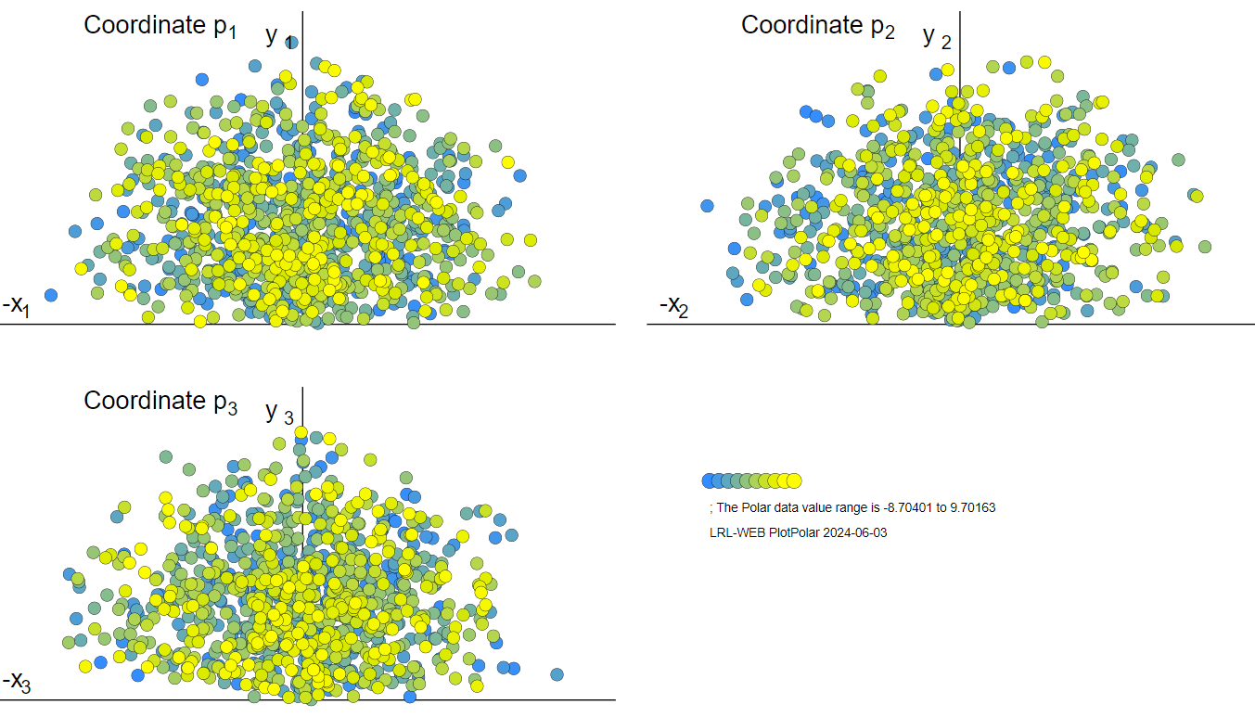
2000 Random Cells in P³

Slide 33
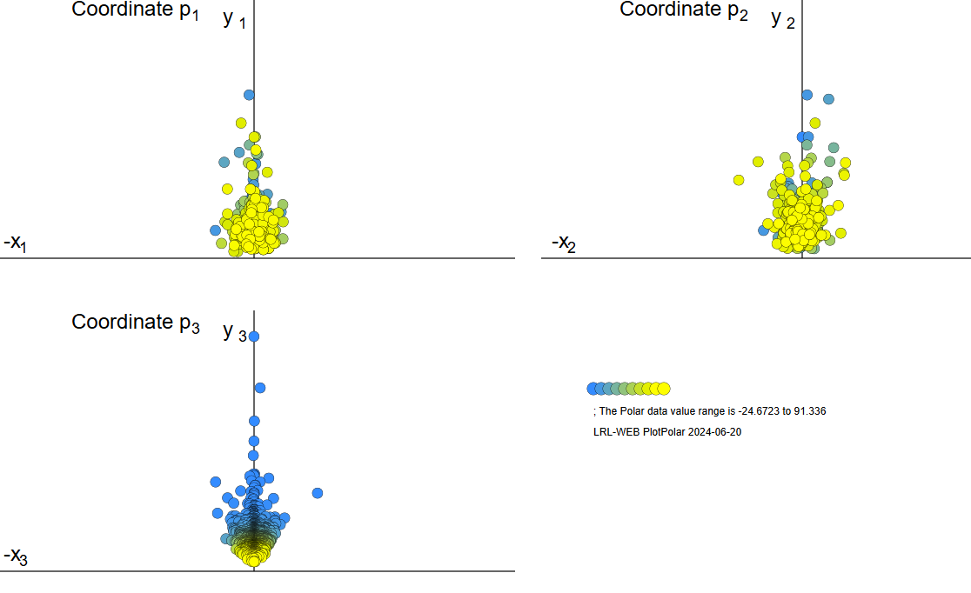
Example from Caroline Brock,
Plotted in P³
1091 cells
Brock, Carolyn Pratt, and Robin Taylor. "Identifying and characterizing translationally modulated molecular crystal structures." Acta Crystallographica Section B: Structural Science, Crystal Engineering and Materials 76.4 (2020): 630-642.

Slide 34
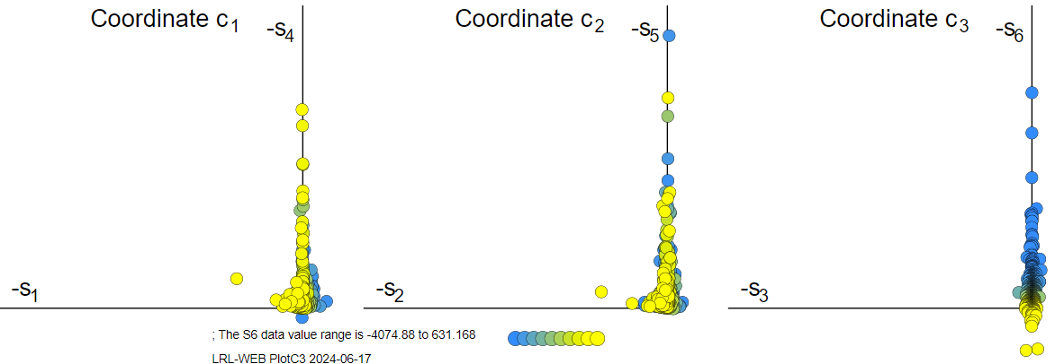
Example from Caroline Brock, Plotted in C³, 1089 cells
Brock, Carolyn Pratt, and Robin Taylor. "Identifying and characterizing translationally modulated molecular crystal structures." Acta Crystallographica Section B: Structural Science, Crystal Engineering and Materials 76.4 (2020): 630-642.

Slide 35
LRL_WEB

Slide 36
SAUC
LeTrong&Stenkamp, 2007, found that krait toxin phospholipase A2 has several PDB structures that might be the same structures. All be one were reported as rhombohedral or hexagonal.
One of the reported cells is:
C 80.949 80.572 57.098 90 90.35 90
Using SAUC with NCDist distance and a spherical search radius of 4.5%, and reporting by protein family, we find:
C 80.949 80.572 57.098 90 90.35 90 Dist: 0.0180898 1G2X
R 57.104 57.104 57.104 89.75 89.75 89.75 Dist: 0.126897 2OSN
H 80.36 80.36 99.44 90 90 120 Dist: 0.554658 1G0Z
R 57.98 57.98 57.98 92.02 92.02 92.02 Dist: 1.75314 1FE5

Slide 37
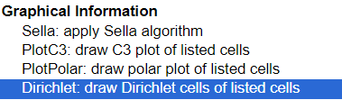
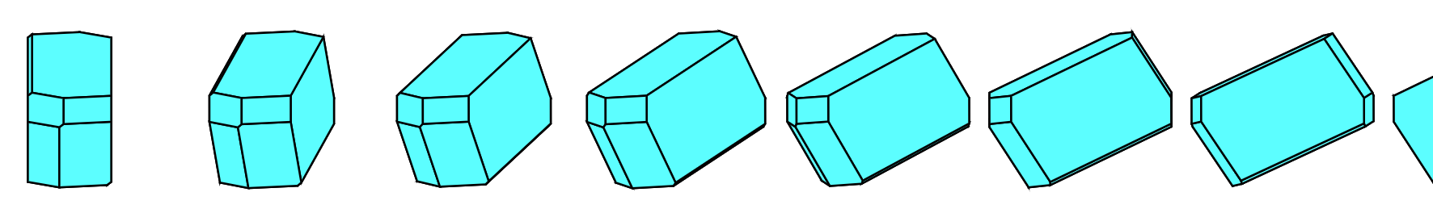
Graphical Programs, Dirichlet
animated gif created with "Animated GIF Maker", https://ezgif.com/maker

Slide 38

Where to Find LRL_WEB
http://blondie.arcib.org:8083/~yaya/cgi-bin/lrl_web.cgi
SOURCE:
http://github.com/duck10/LatticeRepLib

