Slide 1
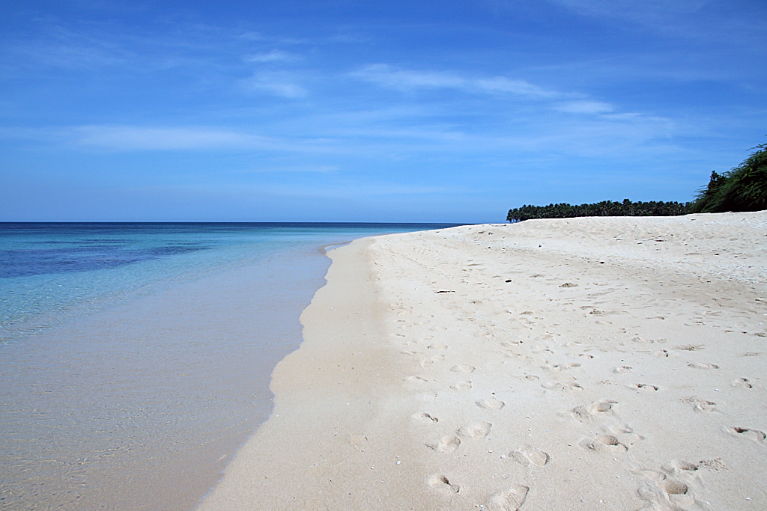
Beach
Waves
Sea
Sky
Sand
Trees
This Photo by Unknown Author is licensed under CC BY-SA

Slide 2
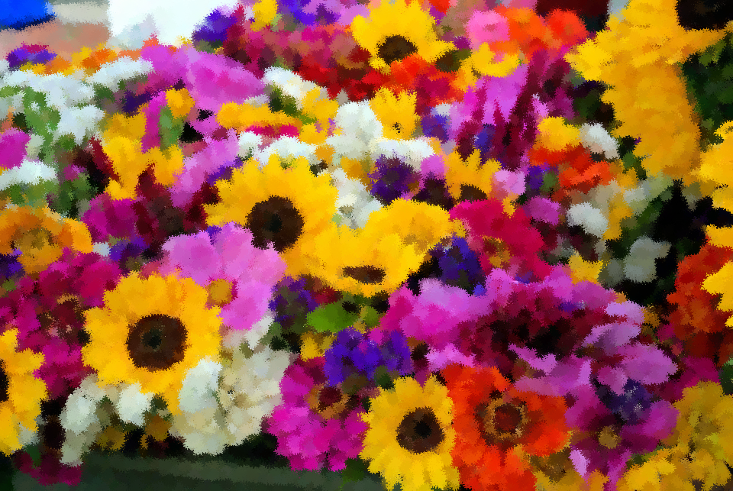
Impressionist Flowers
Lots of flowers
Pink
Yellow
White
Red
Orange

Slide 3
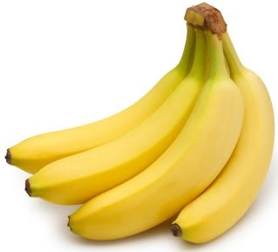
Bananas
Fruit
This Photo by Unknown Author is licensed under CC BY

