Slide 1
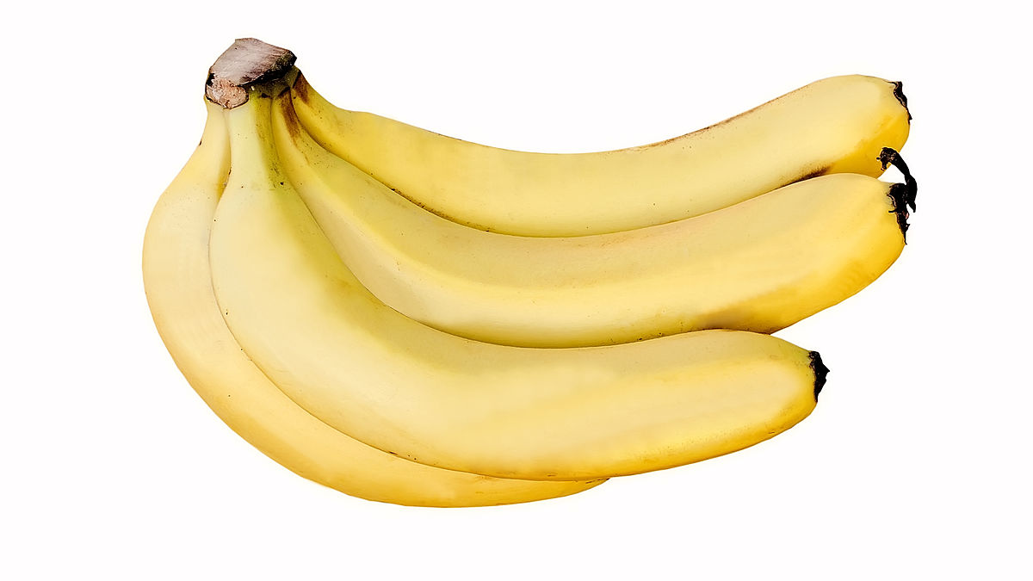
Bananas
Fruit
Is
Good
For
You
This Photo by Unknown Author is licensed under CC BY-SA

Slide 2
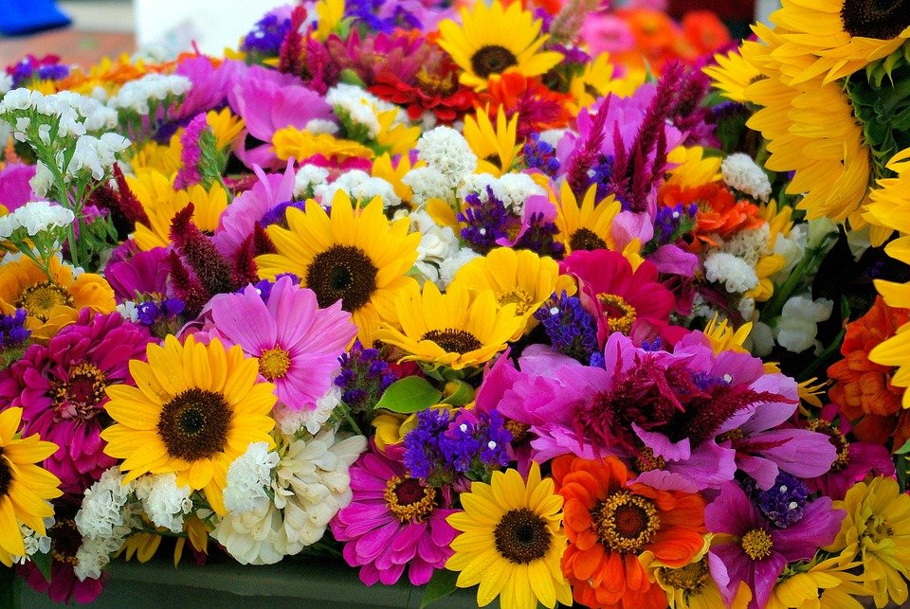
Flowers
Lots of flowers
Pink
Yellow
White
Red
Orange

Slide 3
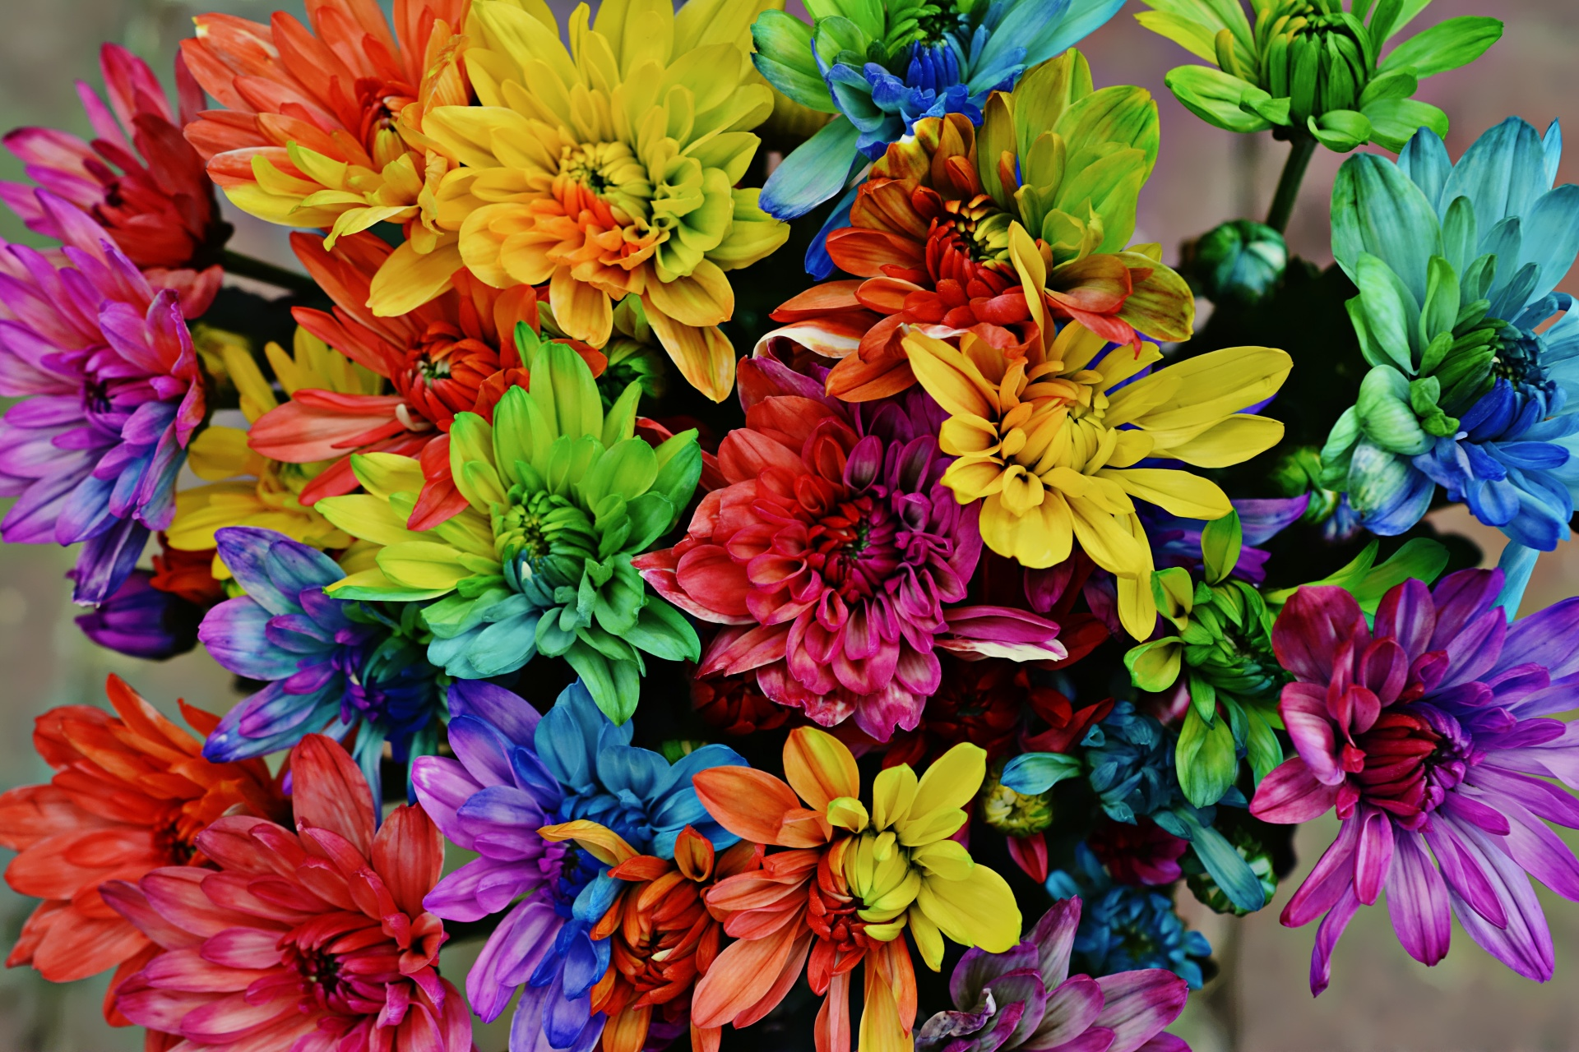
Artificial Flowers
More flowers
Green
Red
Yellow
Blue

Slide 4
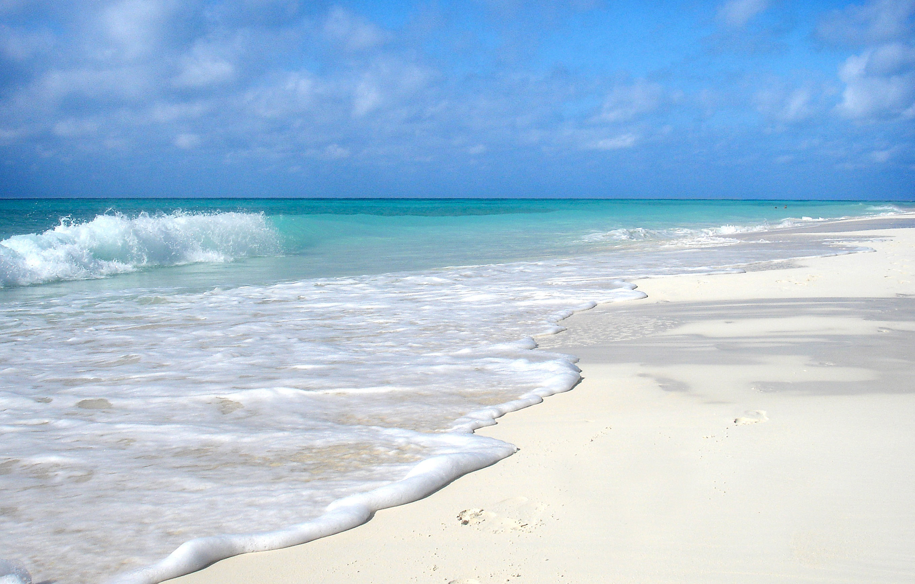
Beach2
Sea
Sky
Sand
Waves

