Slide 1

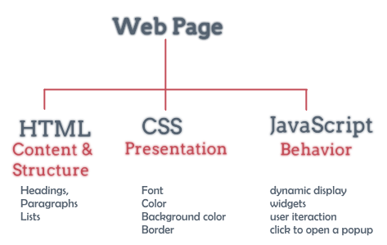
JSon

Slide 2
Lesson Objectives
Know the JSON data structure
Declare and exploit using Json

Slide 3
1. Introducing JSon
JSon concept
Json Object
Json Array

Slide 4
JSon concept
JSON (JavaScript Object Notation) is data defined in the JavaScript language, ECMA-262 standard 1999, the structure is a simple a format text with nested data fields. JSON is used to exchange data between components of a system compatible with most languages C, C++, C#, Java, JavaScript, Perl, Python...

Slide 5
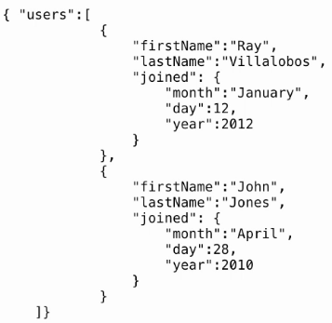
JSon concept
JSON is built on two main structures:
Set of name/value pairs, in many different languages this value pair can be object, record, struct, dictionary, hash table, keyed list...
Collection of a list of values, which can be array, vector, list or sequence.

Slide 6
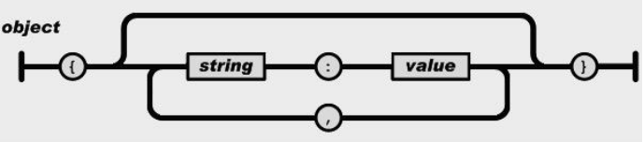
JSonObject
An Object object contains unordered string/value pairs, enclosed in "{}" pairs, the values inside are formatted "string:value" and separated by a ",". Value here can be string, number, true- false, null... You can see the description with the following example:

Slide 7
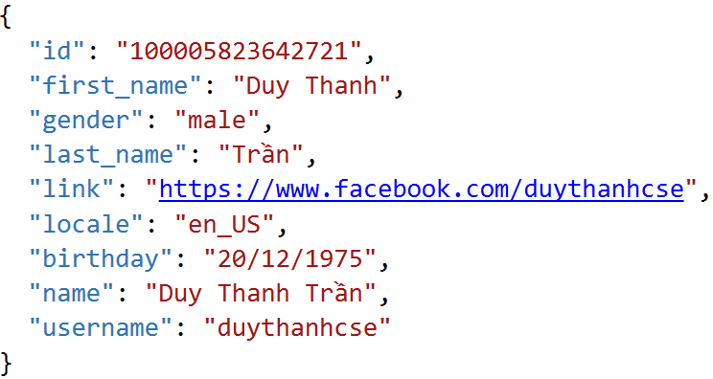
JSonObject

Slide 8
JSonObject
<head>
<meta charset="utf-8" />
<title></title>
<script>
var user = {
"id": "100005823642721",
"first_name": "Duy Thanh",
"gender": "male",
"last_name": "Trần",
"link": "https://www.facebook.com/duythanhcse",
"locale": "en_US",
"birthday": "20/12/1961",
"name": "Duy Thanh Trần",
"username": "duythanhcse"
}
</script>
</head>

Slide 9
JSonObject
<body>
<p id="info"></p>
<script>
var p = document.getElementById("info")
p.innerHTML = user.id + "<br/>" + user.first_name
</script>
</body>
</html>

Slide 10
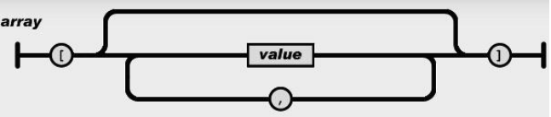
JSonArray
An array object that consists of many ordered children. The subword parts are enclosed in "[]" pairs and separated by ",". Each child element can be a single value like: number, string, true-false, null or another object, maybe even an array.

Slide 11
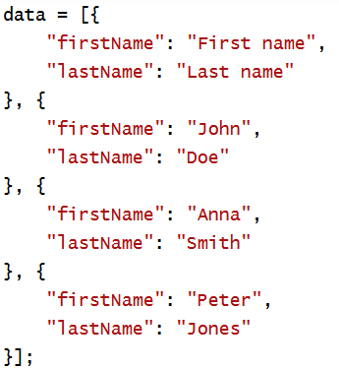
JSonArray

Slide 12
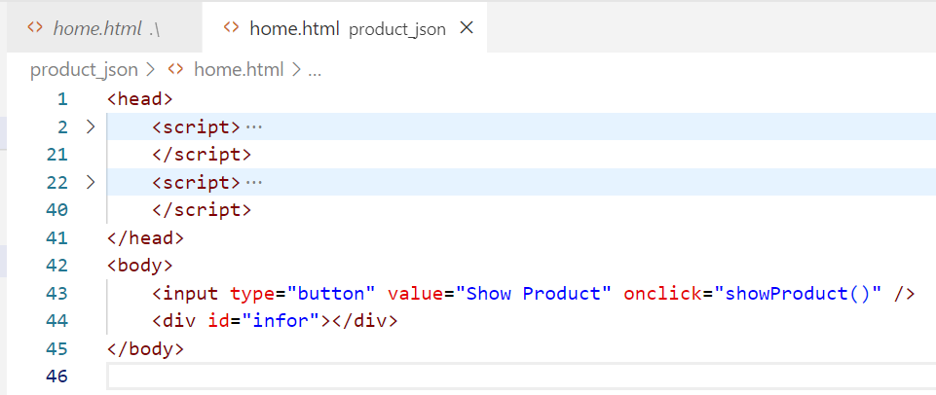
JSonArray

Slide 13
JSonArray
<script>
var data={
"products": [
{
"code": "p1",
"name": "DELL Inspiron 14NR",
"quantity": 100,
"price": 150000
},
{
"code": "p2",
"name": "HP Inspiron 113",
"quantity": 130,
"price": 140000
}
],
"cateid": "cate1",
"catename": "Computer-laptop"
}
</script>

Slide 14
JSonArray
<script>
function showProduct() {
var str = "Cate ID:" + data.cateid + "<br/>"
str += "Cate Name:" + data.catename + "<br/>"
var table = "<table border='1'>"
var header = "<tr><td>Code</td><td>Name</td><td>Quantity</td><td>Price</td></tr>"
table += header
for (var i = 0; i < data.products.length; i++){
var sp = data.products[i]
var tr = "<tr><td>" + sp.code + "</td><td>" + sp.name + "</td><td>"
+ sp.quantity + "</td><td>" + sp.price + "</td></tr>"
table += tr
}
table += "</table>"
var div = document.getElementById("infor")
div.innerHTML = table
}
</script>

Slide 15
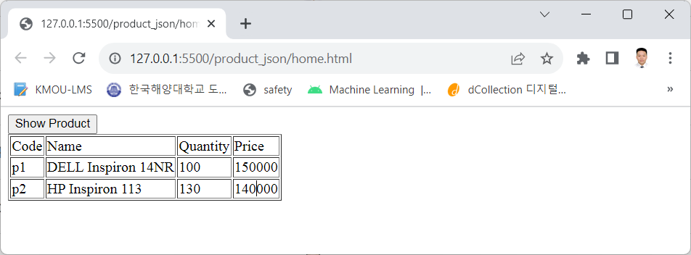
JSonArray
<body>
<input type="button" value="Show Product" onclick="showProduct()" />
<div id="infor"></div>
</body>

Slide 16


Hey! Coding is easy!
END

