Slide 1
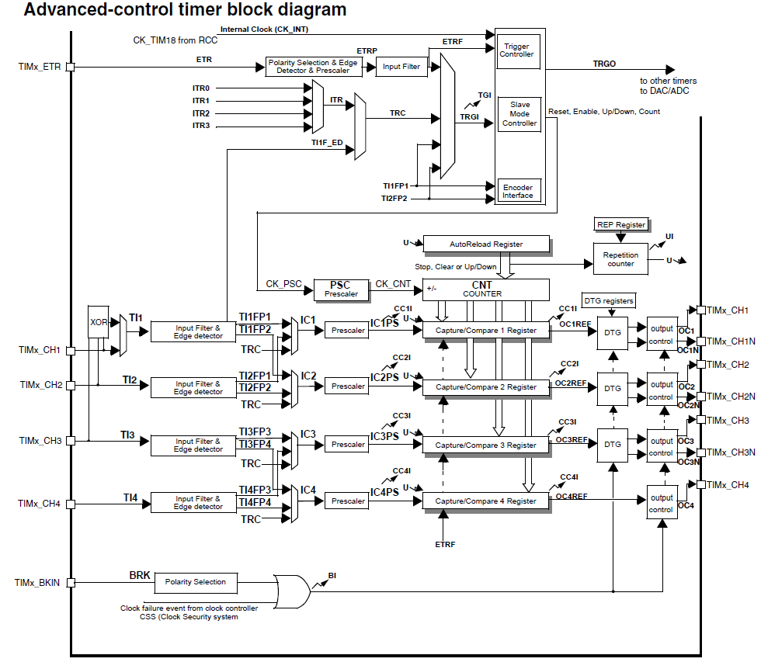
The time-base unit includes:
● Counter register (TIMx_CNT)
● Prescaler register (TIMx_PSC)
● Auto-reload register (TIMx_ARR)
● Repetition counter register (TIMx_RCR)

Slide 2
TIM1&TIM8 timer features include:
● 16-bit up, down, up/down auto-reload counter.
● 16-bit programmable prescaler allowing dividing (also “on the fly”) the counter clock
frequency either by any factor between 1 and 65535.
● Up to 4 independent channels for:
. Input Capture
. Output Compare
. PWM generation (Edge and Center-aligned Mode)
. One-pulse mode output
● Complementary outputs with programmable dead-time
● Synchronization circuit to control the timer with external signals and to interconnect
several timers together.
● Repetition counter to update the timer registers only after a given number of cycles of
the counter.
● Break input to put the timer’s output signals in reset state or in a known state.
● Interrupt/DMA generation on the following events:
. Update: counter overflow/underflow, counter initialization (by software or
internal/external trigger)
. Trigger event (counter start, stop, initialization or count by internal/external trigger)
. Input capture
. Output compare
. Break input
● Supports incremental (quadrature) encoder and hall-sensor circuitry for positioning
purposes
● Trigger input for external clock or cycle-by-cycle current management

