Slide 1
Spring
aspects

Slide 2
aspects (1)
새 프로젝트의 pom.xml
<dependency>
<groupId>org.springframework</groupId>
<artifactId>spring-context</artifactId>
<version>5.2.8.RELEASE</version>
</dependency>
<dependency>
<groupId>org.springframework</groupId>
<artifactId>spring-aspects</artifactId>
<version>5.2.8.RELEASE</version>
</dependency>
public class Comment {
private String text;
private String author;
// Omitted getters and setters
}

Slide 3
aspects (2)
@Service
public class CommentService {
private Logger logger =
Logger.getLogger(CommentService.class.getName());
public void publishComment(Comment comment) {
logger.info("Publishing comment:" + comment.getText());
}
}
@Configuration
@ComponentScan(basePackages = "services")
public class ProjectConfig {
}
public class Main {
public static void main(String[] args) {
var c = new AnnotationConfigApplicationContext(ProjectConfig.class);

Slide 4
aspects (3)
var service = c.getBean(CommentService.class);
Comment comment = new Comment();
comment.setText("Demo comment");
comment.setAuthor("Natasha");
service.publishComment(comment);
}
}
실행 결과 로그
Sep 26, 2020 12:39:53 PM services.CommentService publishComment
INFO: Publishing comment:Demo comment

Slide 5
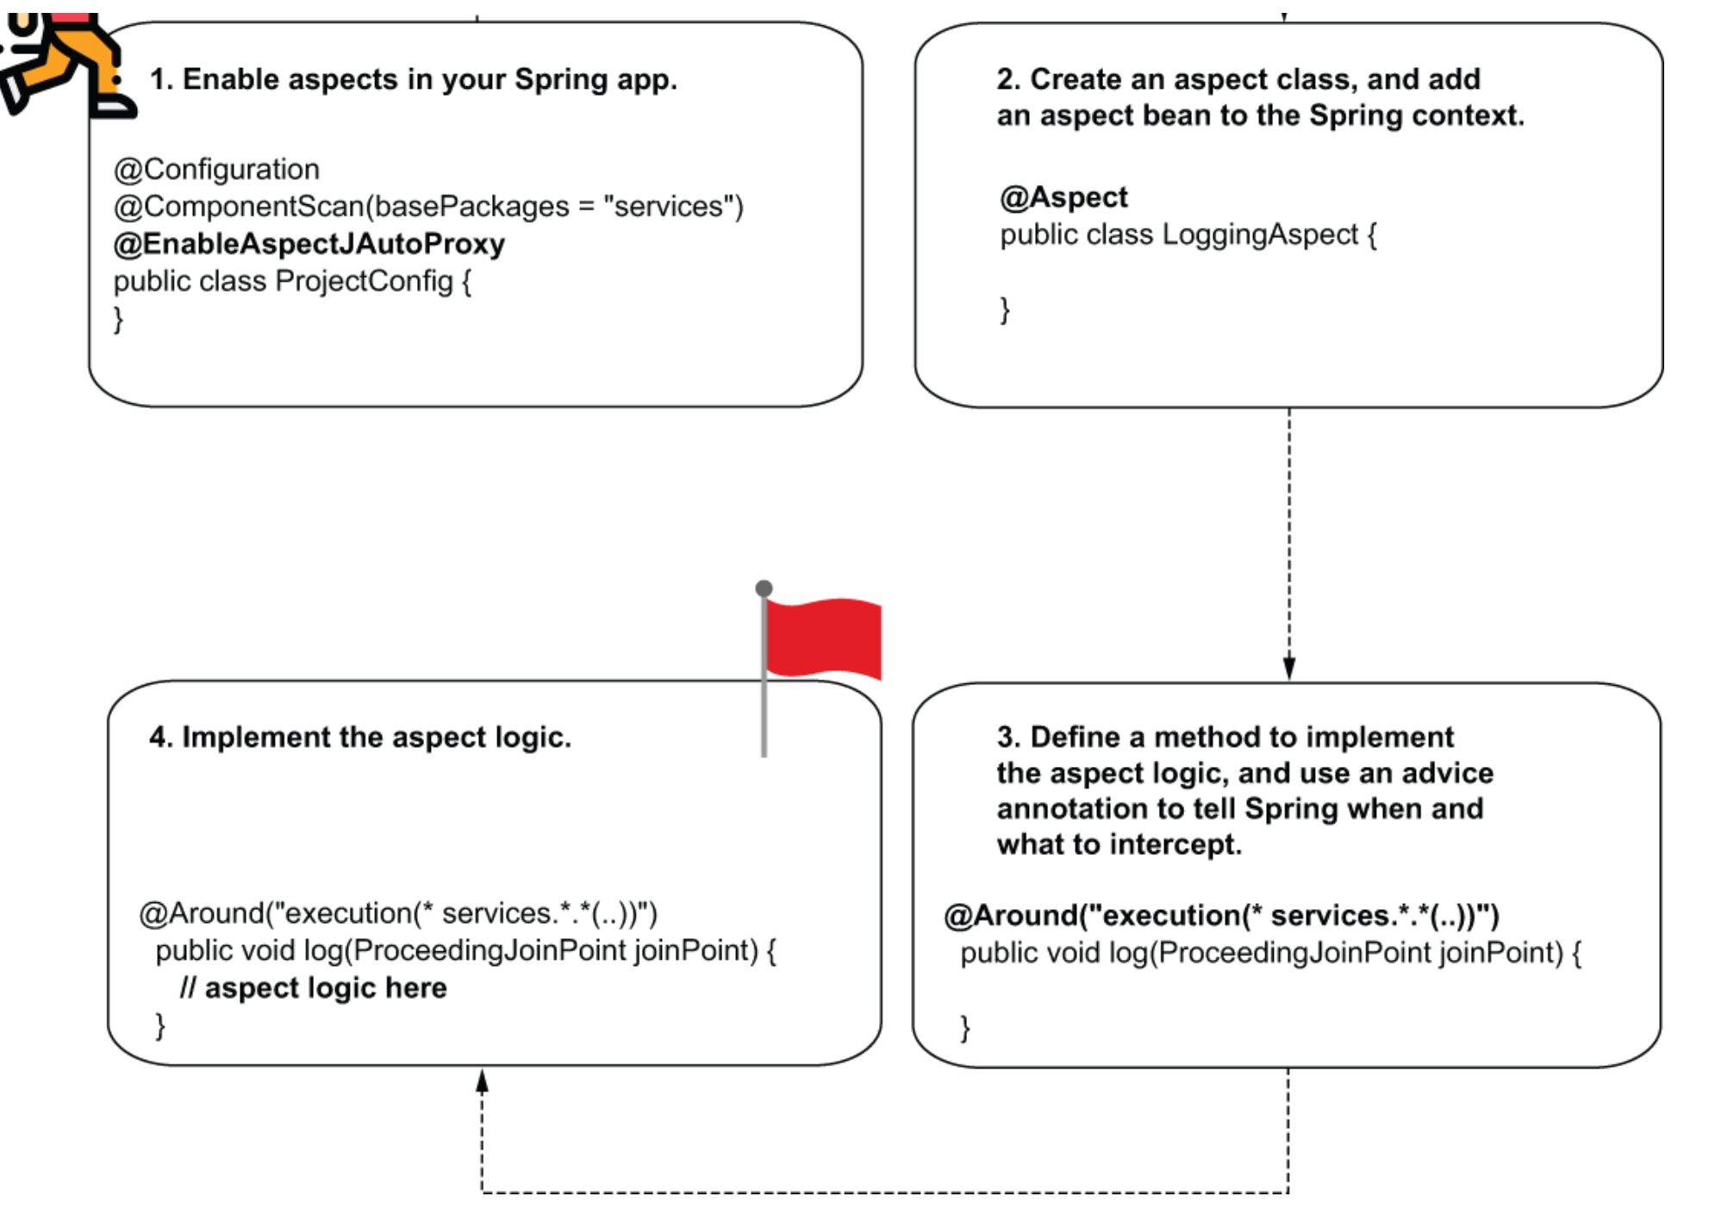
aspects (4)
AspectJ 설정 순서

Slide 6
aspects (5)
@Configuration
@ComponentScan(basePackages = "services")
@EnableAspectJAutoProxy
public class ProjectConfig {
}
@Aspect
public class LoggingAspect {
public void log() {
// To implement later
}
}
@Configuration
@ComponentScan(basePackages = "services")
@EnableAspectJAutoProxy
public class ProjectConfig {
@Bean
public LoggingAspect aspect() {
return new LoggingAspect();
}
}

Slide 7
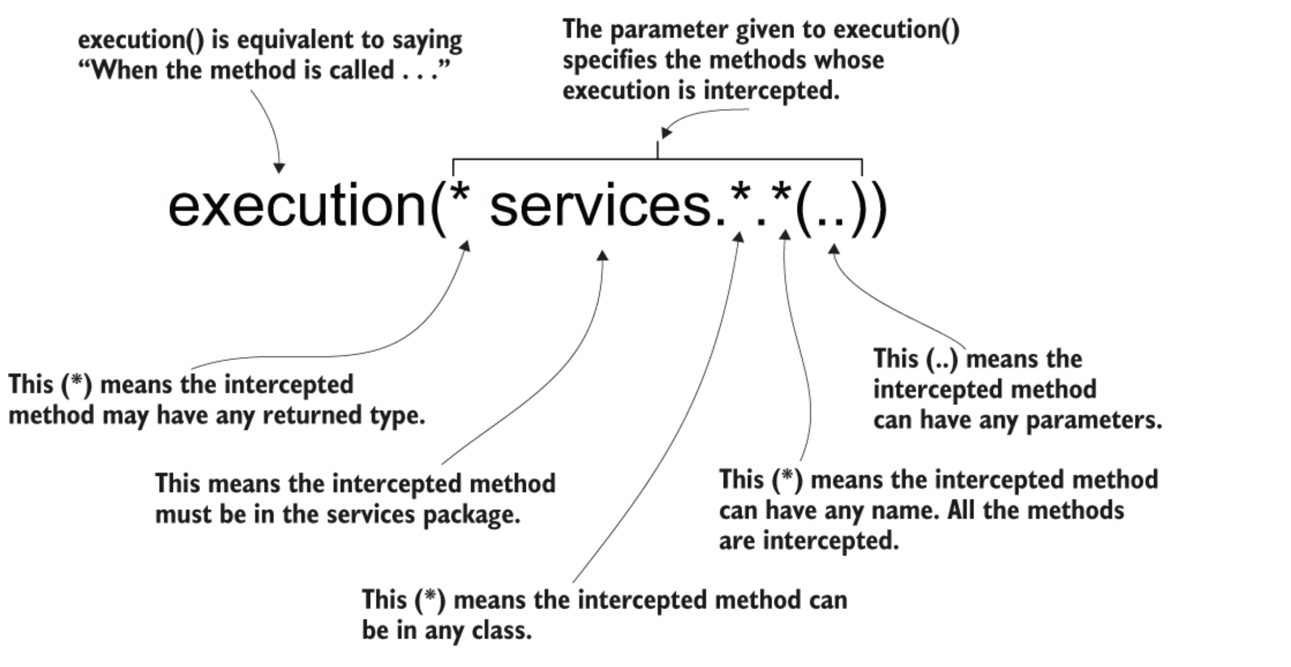
aspects (6)
@Aspect
public class LoggingAspect {
@Around("execution(* services.*.*(..))")
public void log(ProceedingJoinPoint joinPoint) {
joinPoint.proceed();
}
}

Slide 8
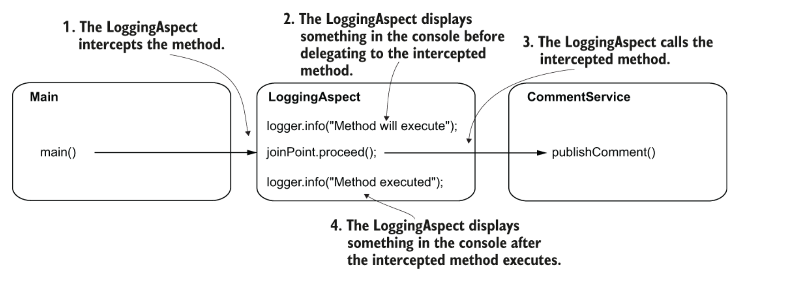
aspects (7)
aspects’ behavior
@Aspect
public class LoggingAspect {
private Logger logger = Logger.getLogger(LoggingAspect.class.getName());
@Around("execution(* services.*.*(..))")
public void log(ProceedingJoinPoint joinPoint) throws Throwable {
logger.info("Method will execute");
joinPoint.proceed();
logger.info("Method executed");
}
}

Slide 9
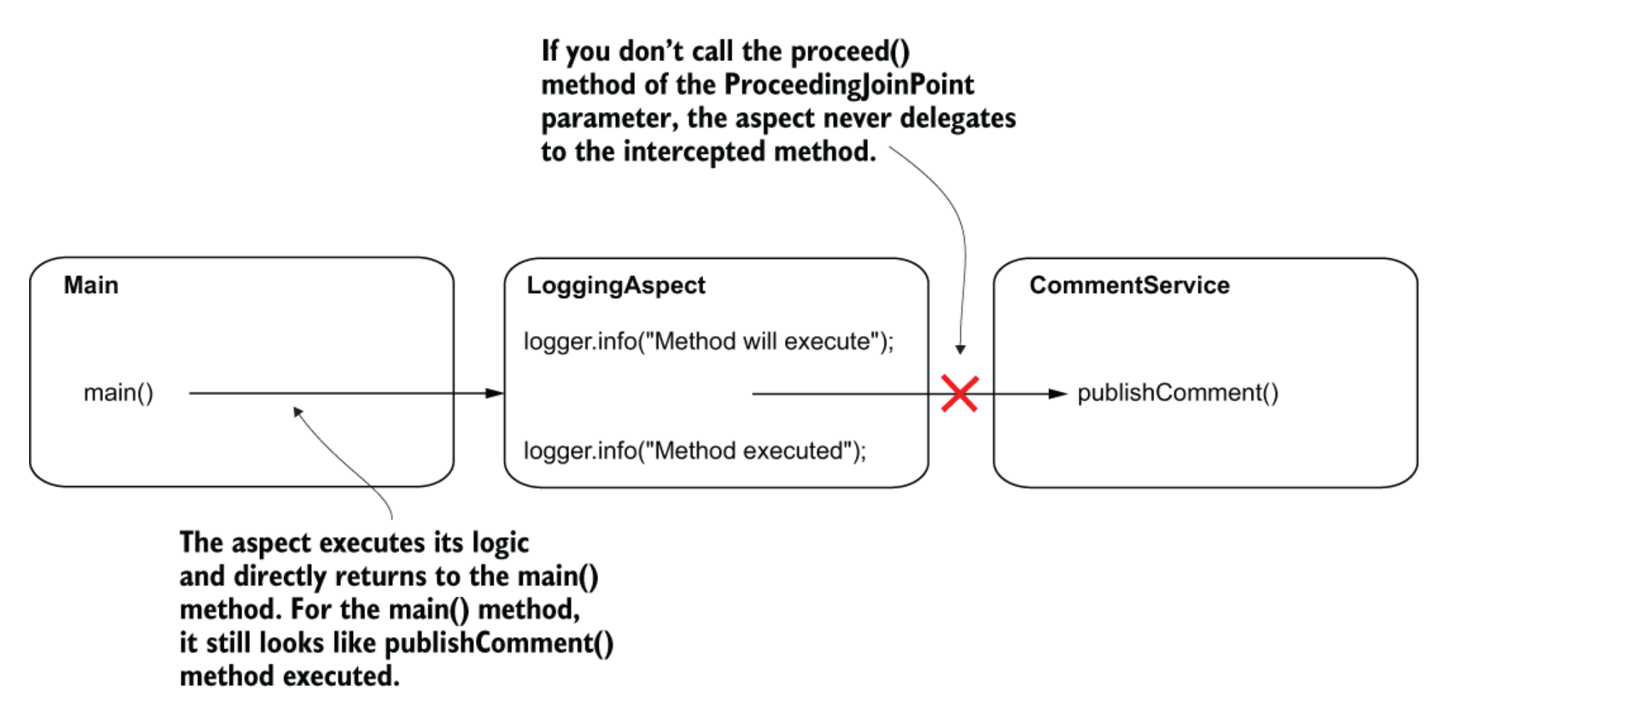
aspects (8)
proceed() call
실행 결과
Sep 27, 2020 1:11:11 PM aspects.LoggingAspect log
INFO: Method will execute
Sep 27, 2020 1:11:11 PM services.CommentService publishComment

Slide 10
aspects (9)
INFO: Publishing comment:Demo comment
Sep 27, 2020 1:11:11 PM aspects.LoggingAspect log
INFO: Method executed
@Service
public class CommentService {
private Logger logger = Logger.getLogger(CommentService.class.getName());
public String publishComment(Comment comment) {
logger.info("Publishing comment:" + comment.getText());
return "SUCCESS";
}
}
메서드 이름과 패러미터 얻기:
String methodName = joinPoint.getSignature().getName();
Object [] arguments = joinPoint.getArgs();

Slide 11
aspects (10)
@Aspect
public class LoggingAspect {
private Logger logger = Logger.getLogger(LoggingAspect.class.getName());
@Around("execution(* services.*.*(..))")
public Object log(ProceedingJoinPoint joinPoint) throws Throwable {
String methodName =
joinPoint.getSignature().getName();
Object [] arguments = joinPoint.getArgs();
logger.info("Method " + methodName +
" with parameters " + Arrays.asList(arguments) +
" will execute");
Object returnedByMethod = joinPoint.proceed();
logger.info("Method executed and returned " + returnedByMethod);
return returnedByMethod;
}
}

Slide 12
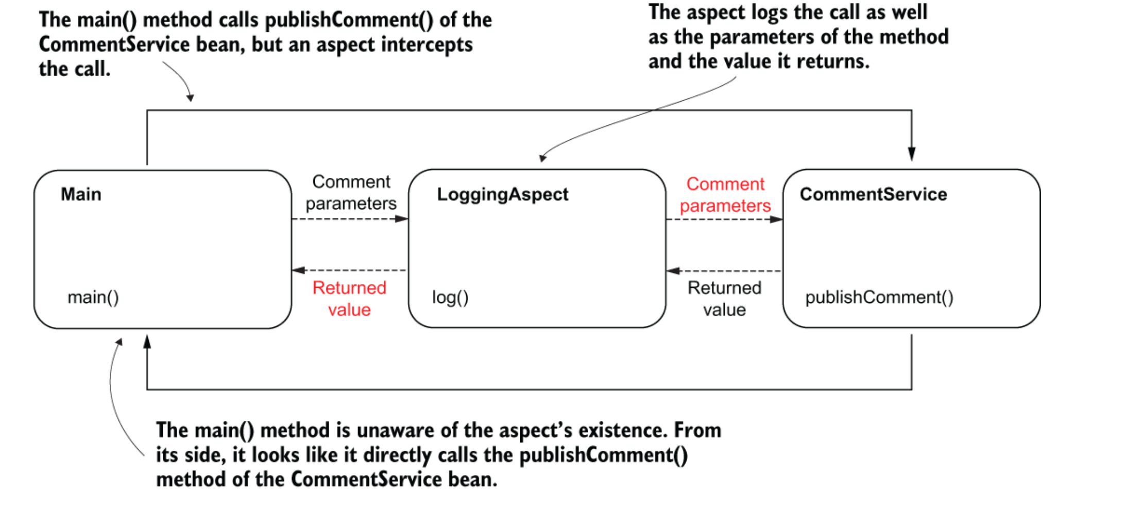
aspects (11)
aspects 흐름

Slide 13
aspects (12)
public class Main {
private static Logger logger = Logger.getLogger(Main.class.getName());
public static void main(String[] args) {
var c = new AnnotationConfigApplicationContext(ProjectConfig.class);
var service = c.getBean(CommentService.class);
Comment comment = new Comment();
comment.setText("Demo comment");
comment.setAuthor("Natasha");
String value = service.publishComment(comment);
logger.info(value);
}
}

Slide 14
aspects (13)
콘솔 화면
Sep 28, 2020 10:49:39 AM aspects.LoggingAspect log
INFO: Method publishComment with parameters [Comment{text='Demo comment',
➥ author='Natasha'}] will execute
Sep 28, 2020 10:49:39 AM services.CommentService publishComment
INFO: Publishing comment:Demo comment
Sep 28, 2020 10:49:39 AM aspects.LoggingAspect log
INFO: Method executed and returned SUCCESS
Sep 28, 2020 10:49:39 AM main.Main main
INFO: SUCCESS

Slide 15
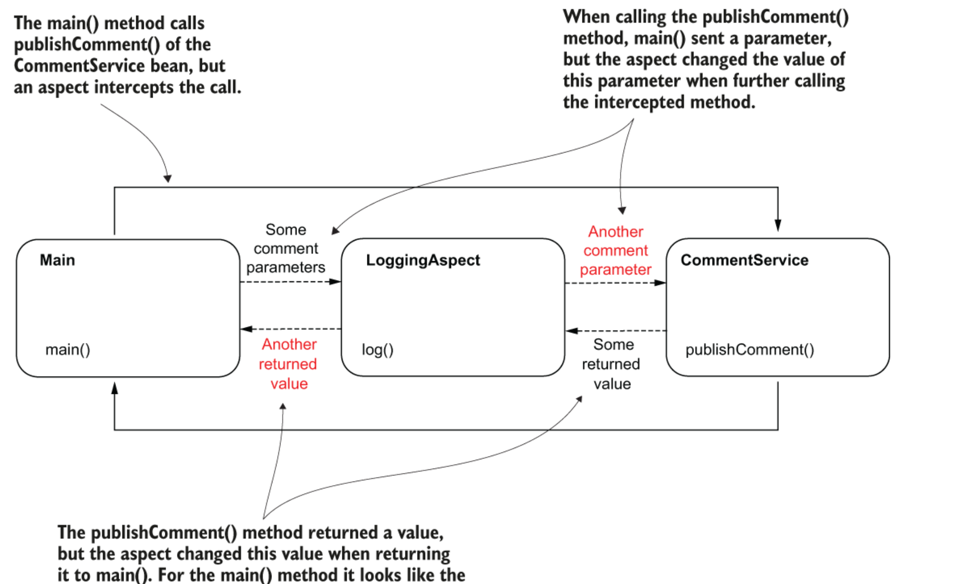
Aspect가 패러미터나 반환 값을 바꿀 수 있다.

Slide 16
aspects (15)
@Aspect
public class LoggingAspect {
private Logger logger =
Logger.getLogger(LoggingAspect.class.getName());
@Around("execution(* services.*.*(..))")
public Object log(ProceedingJoinPoint joinPoint) throws Throwable {
String methodName = joinPoint.getSignature().getName();
Object [] arguments = joinPoint.getArgs();
logger.info("Method " + methodName +
" with parameters " + Arrays.asList(arguments) +
" will execute");
Comment comment = new Comment();
comment.setText("Some other text!");
Object [] newArguments = {comment};

Slide 17
aspects (16)
Object returnedByMethod = joinPoint.proceed(newArguments);
logger.info("Method executed and returned " + returnedByMethod);
return "FAILED";
}
}
결과
Sep 29, 2020 10:43:51 AM aspects.LoggingAspect log
INFO: Method publishComment with parameters [Comment{text='Demo comment',
➥ author='Natasha'}] will execute
Sep 29, 2020 10:43:51 AM services.CommentService publishComment
INFO: Publishing comment:Some other text!
Sep 29, 2020 10:43:51 AM aspects.LoggingAspect log
INFO: Method executed and returned SUCCESS
Sep 29, 2020 10:43:51 AM main.Main main
INFO: FAILED

Slide 18
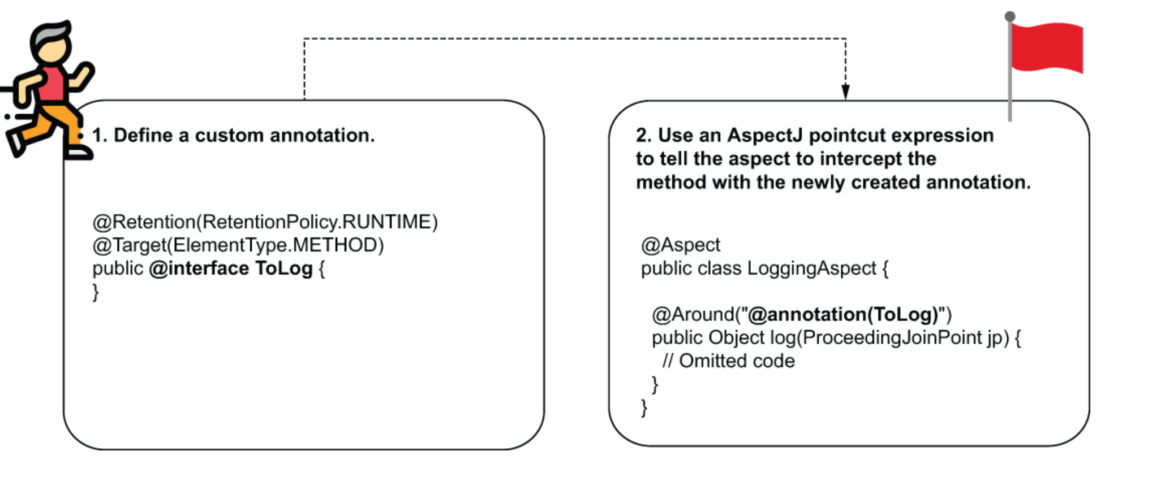
aspects (17)
Custom aspect
@Retention(RetentionPolicy.RUNTIME)
@Target(ElementType.METHOD)
public @interface ToLog {
}

Slide 19
aspects (18)
@Service
public class CommentService {
private Logger logger = Logger.getLogger(CommentService.class.getName());
public void publishComment(Comment comment) {
logger.info("Publishing comment:" + comment.getText());
}
@ToLog
public void deleteComment(Comment comment) {
logger.info("Deleting comment:" + comment.getText());
}
public void editComment(Comment comment) {
logger.info("Editing comment:" + comment.getText());
}
}

Slide 20
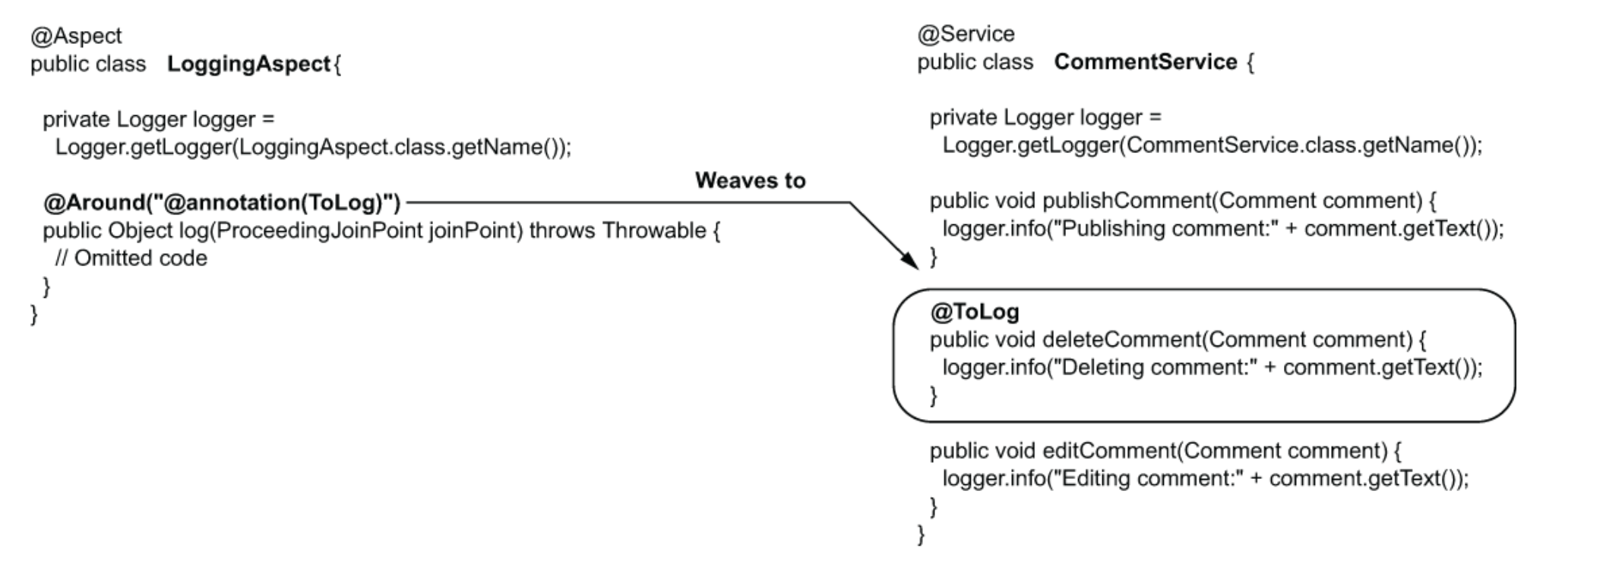
aspects (19)
AspectJ pointcut 연산식
@Aspect
public class LoggingAspect {
private Logger logger = Logger.getLogger(LoggingAspect.class.getName());

Slide 21
aspects (20)
@Around("@annotation(ToLog)")
public Object log(ProceedingJoinPoint joinPoint) throws Throwable {
// Omitted code
}
}
결과
Sep 29, 2020 2:22:42 PM services.CommentService publishComment
INFO: Publishing comment:Demo comment
Sep 29, 2020 2:22:42 PM aspects.LoggingAspect log
INFO: Method deleteComment with parameters [Comment{text='Demo comment',
➥ author='Natasha'}] will execute
Sep 29, 2020 2:22:42 PM services.CommentService deleteComment
INFO: Deleting comment:Demo comment
Sep 29, 2020 2:22:42 PM aspects.LoggingAspect log
INFO: Method executed and returned null
Sep 29, 2020 2:22:42 PM services.CommentService editComment
INFO: Editing comment:Demo comment

Slide 22
aspects (21)
@Aspect
public class LoggingAspect {
private Logger logger = Logger.getLogger(LoggingAspect.class.getName());
@AfterReturning(value = "@annotation(ToLog)", ❶
returning = "returnedValue") ❷
public void log(Object returnedValue) { ❸
logger.info("Method executed and returned " + returnedValue);
}
}
Aspect 실행 순서

Slide 23
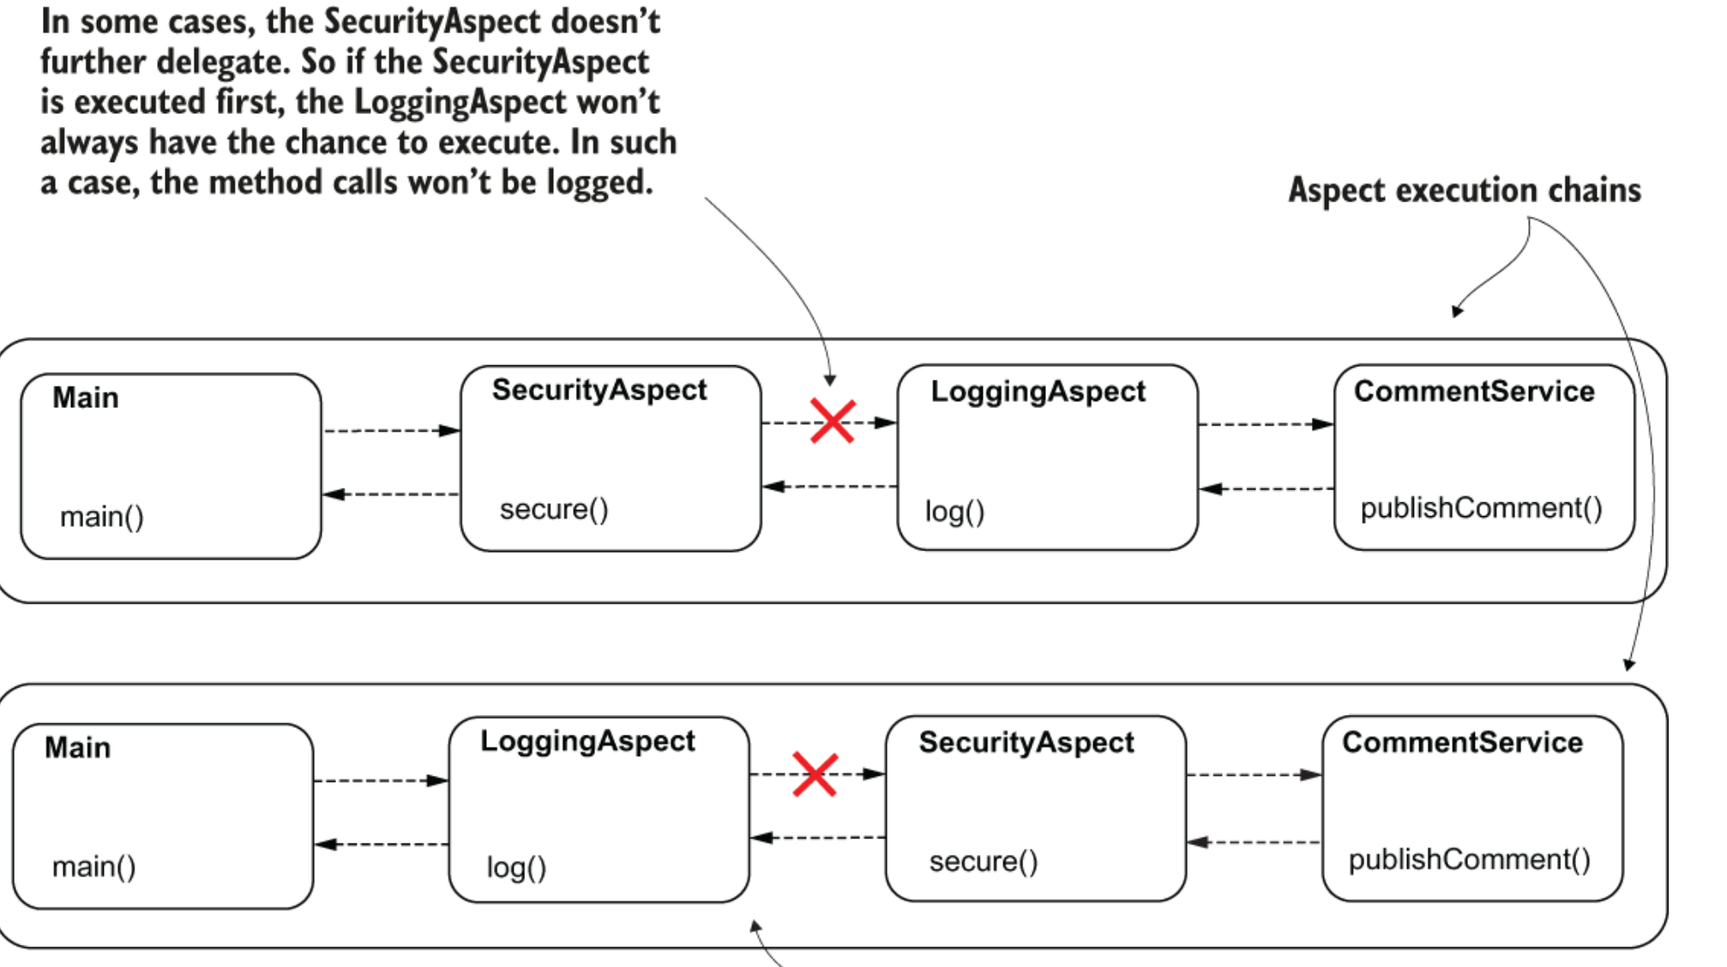
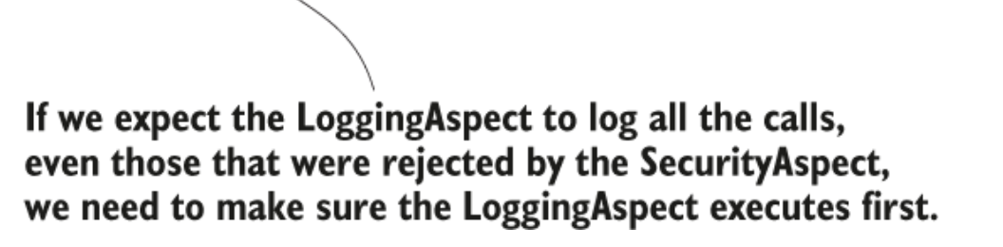
aspects (22)
순서

Slide 24
aspects (23)
@Aspect
public class LoggingAspect {
private Logger logger =
Logger.getLogger(LoggingAspect.class.getName());
@Around(value = "@annotation(ToLog)")
public Object log(ProceedingJoinPoint joinPoint) throws Throwable {
logger.info("Logging Aspect: Calling the intercepted method");
Object returnedValue = joinPoint.proceed();
logger.info("Logging Aspect: Method executed and returned " +
returnedValue);
return returnedValue;
}
}

Slide 25
aspects (24)
@Aspect
public class SecurityAspect {
private Logger logger =
Logger.getLogger(SecurityAspect.class.getName());
@Around(value = "@annotation(ToLog)")
public Object secure(ProceedingJoinPoint joinPoint) throws Throwable {
logger.info("Security Aspect: Calling the intercepted method");
Object returnedValue = joinPoint.proceed();
logger.info("Security Aspect: Method executed and returned " +
returnedValue);
return returnedValue;
}
}

Slide 26
aspects (25)
@Service
public class CommentService {
private Logger logger =
Logger.getLogger(CommentService.class.getName());
@ToLog
public String publishComment(Comment comment) {
logger.info("Publishing comment:" + comment.getText());
return "SUCCESS";
}
}
@Configuration
@ComponentScan(basePackages = "services")
@EnableAspectJAutoProxy
public class ProjectConfig {

Slide 27
aspects (26)
@Bean
public LoggingAspect loggingAspect() {
return new LoggingAspect();
}
@Bean
public SecurityAspect securityAspect() {
return new SecurityAspect();
}
}
Sep 29, 2020 6:04:22 PM aspects.LoggingAspect log
INFO: Logging Aspect: Calling the intercepted method
Sep 29, 2020 6:04:22 PM aspects.SecurityAspect secure
INFO: Security Aspect: Calling the intercepted method
Sep 29, 2020 6:04:22 PM services.CommentService publishComment
INFO: Publishing comment:Demo comment
Sep 29, 2020 6:04:22 PM aspects.SecurityAspect secure
INFO: Security Aspect: Method executed and returned SUCCESS
Sep 29, 2020 6:04:22 PM aspects.LoggingAspect log
INFO: Logging Aspect: Method executed and returned SUCCESS

Slide 28
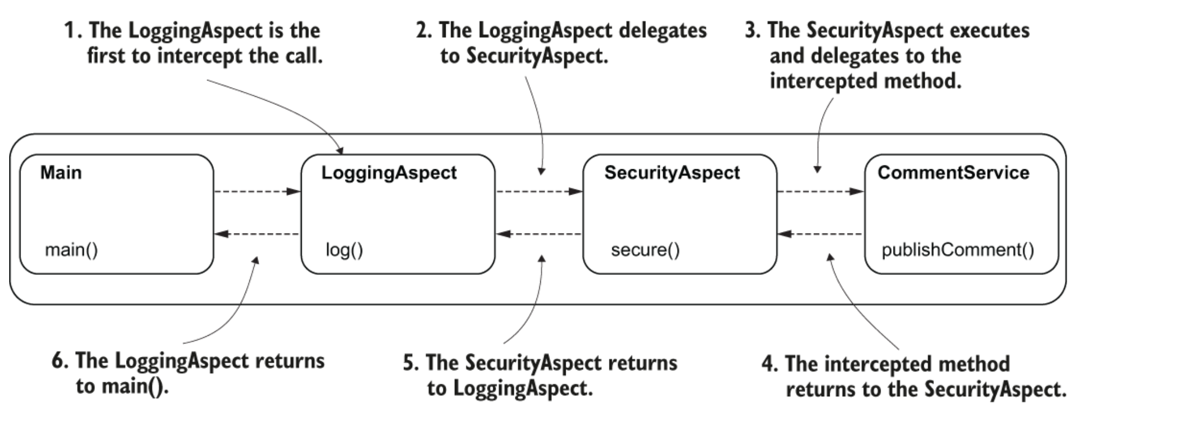
aspects (27)
실행 고리
@Aspect
@Order(1)
public class SecurityAspect {
// Omitted code
}

Slide 29
aspects (28)
@Aspect
@Order(2)
public class LoggingAspect {
// Omitted code
}
Sep 29, 2020 6:38:20 PM aspects.SecurityAspect secure
INFO: Security Aspect: Calling the intercepted method
Sep 29, 2020 6:38:20 PM aspects.LoggingAspect log
INFO: Logging Aspect: Calling the intercepted method
Sep 29, 2020 6:38:20 PM services.CommentService publishComment
INFO: Publishing comment:Demo comment
Sep 29, 2020 6:38:20 PM aspects.LoggingAspect log
INFO: Logging Aspect: Method executed and returned SUCCESS
Sep 29, 2020 6:38:20 PM aspects.SecurityAspect secure
INFO: Security Aspect: Method executed and returned SUCCESS

Slide 30
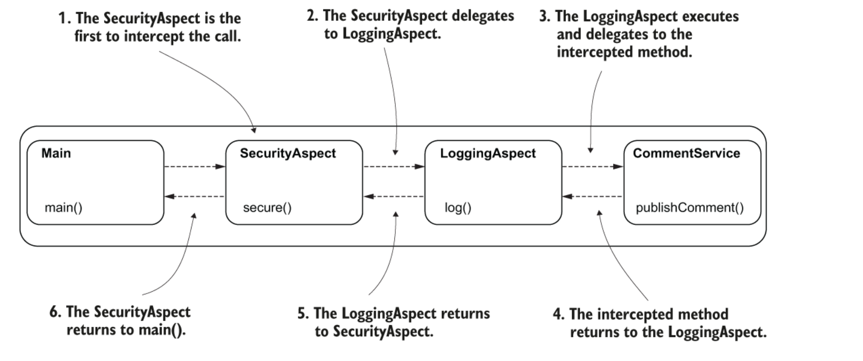
aspects (29)
실행 고리

