Slide 1
views & templating
IT 328
Tina Ostrander

Slide 2
About Templating in F3
Variables are passed to templates in key/value pairs
Content is displayed using handlebars notation {{ @name }}
This is called a template token
Templates can be used to:
Display variables
Evaluate expressions
Loop through arrays
Execute conditionals
Display object properties

Slide 3
Passing Variables to a Template
index.php
$f3->route('GET /', function($f3) {
//save variables
$f3->set('username', 'jshmo');
$f3->set('password', sha1('Password01'));
$f3->set('title', 'Working with Templates');
//load a template
$template = new Template(); echo $template->render('views/info.html');
//alternate syntax
echo Template::instance()->render('views/info.html');
});

Slide 4
Passing Variables to a Template
info.html
<!doctype html>
<html>
<head>
<meta charset="utf-8">
<title>{{ @title }}</title>
</head>
<body>
<h1>{{ @title }}</h1>
<p>User logged in as {{ @username }} using {{ @password }}</p>
</body>
</html>
These are called "handlebars"

Slide 5
Using Expressions in a Template
index.php
$f3->route('GET /', function($f3) {
//save variables
$f3->set('temp', 67);
//load a template
echo Template::instance()->render('views/info.html');
});

Slide 6
Using Expressions in a Template
info.html
<body>
...
<!-- working with expressions -->
<h3>Temperature</h3>
<p>Fahrenheit: {{ @temp }} degrees</p>
<p>Celsius: {{ round((@temp-32) * (5.0/9.0), 2) }} degrees</p>
</body>
</html>

Slide 7
Try It
Add a variable 'color' with a value of 'purple' to your index page
Display 'I like purple' in your template
Add a variable 'radius' with a value of 10 to your index page
Display the circumference of a circle with the given radius in your template
C = 2 π r

Slide 8

Repeating Segments
Given an array variable
Fat-Free can handle repetitive HTML blocks
https://fatfreeframework.com/3.6/views-and-templates

Slide 9
Try It
In the index page, define an array of bookmarks
Create and load a template called info.html
In the template, display an unordered list of bookmarks
index.php
$f3->route('GET /', function($f3) {
...
//bookmark array
$f3->set('bookmarks', array('http://www.cnet.com',
'http://www.reddit.com/r/news',
'http://edition.cnn.com/sport'));
//load a template
echo Template::instance()->render('views/info.html');
});

Slide 10
info.html
<body>
...
<!-- looping over arrays -->
<h3>Bookmarks</h3>
<p>My first bookmark is {{ @bookmarks[0] }}</p>
<ul>
<repeat group="{{ @bookmarks }}" value="{{ @bookmark }}">
<li><a href="{{ @bookmark }}"> {{ str_replace('http://', '', @bookmark) }}</a></li>
</repeat>
</ul>
</body>
</html>
We can access a single array element
Or loop through the array

Slide 11
Passing an Associative Array to a Template
index.php
$f3->route('GET /', function($f3) {
...
$f3->set('addresses', array('primary' =>
'1000 Apple Ln. Seattle, Wa 98999',
'secondary' =>
'2510 100th Court Tac, Wa 90000'));
//load a template
echo Template::instance()->render('pages/info.html');
});

Slide 12
Passing an Associative Array to a Template
info.html
<body>
...
<!– displaying elements of an associative array -->
<h3>Addresses</h3>
<p>{{ @addresses['primary'] }}</p>
<p>{{ @addresses['secondary'] }}</p>
</body>
</html>

Slide 13
Passing an Associative Array to a Template
info.html
<body>
...
<!-- looping over associative arrays -->
<repeat group="{{ @addresses }}"
key="{{ @key }}"
value="{{ @value }}">
<p>{{ @key }} - {{ @value }}</p>
</repeat>
</body>
</html>

Slide 14
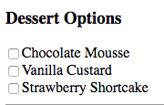
Try It
Define an associative array called desserts with the following key/value pairs
"chocolate", "Chocolate Mousse"
"vanilla", "Vanilla Custard"
"strawberry", "Strawberry Shortcake"
In your template, display a list of checkboxes with the value set to the key (e.g. "strawberry", and the display text set to the value (e.g. "Strawberry Shortcake")

Slide 15
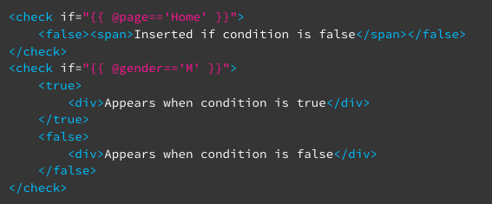
Using Conditions in Templates
The <check> directive allows you to embed an HTML fragment depending on the value of a condition.
https://fatfreeframework.com/3.6/views-and-templates

Slide 16
Using Conditions in Templates
If you have no false, then the true tags are optional
You can have just a false...
<check if="{{ @number >= 10 }}">
<p>You are perfect!</p>
</check>
<check if="{{ @number == 10 }}">
<false><p>You are NOT perfect</p></false>
</check>

Slide 17
Using Conditional Content in a Template
index.php
$f3->route('GET /', function($f3) {
...
//conditional content
$f3->set('preferredCustomer', true);
$f3->set('lastLogin', strtotime('-1 week'));
//load a template
echo Template::instance()->render('views/info.html');
});

Slide 18
Using Conditional Content in a Template
info.html
<body>
...
<!-- conditional content -->
<h3>Message</h3>
<check if="{{ @preferredCustomer }}">
<strong>Thank you for being a preferred customer!</strong><br>
</check>
<check if="{{ @lastLogin > strtotime('-1 month') }}">
<true>Welcome back!</true>
<false>It's been a while!</false>
</check>
</body>
</html>

Slide 19
Using Objects in a Template
index.php
$f3->route('GET /', function($f3) {
...
//objects
$pet = new Pet('Fido', 'pink');
$f3->set('myPet', $pet);
//load a template
echo Template::instance()->render('pages/info.html');
});

Slide 20
Using Objects in a Template
info.html
<body>
...
<!-- printing objects -->
<h3>My Pet</h3>
<p>{{ @myPet->getName() }}</p>
<p>{{ @myPet->getColor() }}</p>
</body>
</html>

Slide 21
Try It
Create a purple pet named Henrietta your index page.
In your template, if the value of your color variable (created in the first Try-It exercise) matches the color of the pet, then display an image of a pet. If the colors don't match, then display some text.
Be sure to test both branches of your decision by changing the value of your color variable.

Slide 22
Using Includes in a Template
<body>
...
<!-- include a file-->
<h3>Include</h3>
<include href="footer.html" />
<include if="{{ @page == 'home' }}" href="{{ @content }}" />
</body>
</html>

Slide 23
Accessing Session Variables in a Template
<body>
...
<!-- access a session variable ->
<h3>Session Variable</h3>
<p>Session ID: {{ @SESSION['id'] }} </p>
</body>
</html>

Slide 24
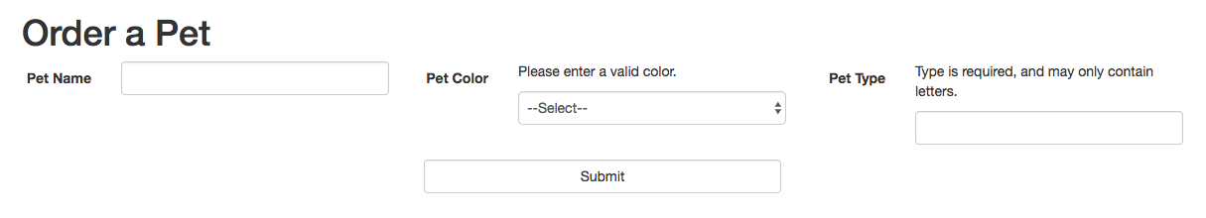
Data Validation Example

Slide 25
Learn More
https://fatfreeframework.com/3.6/views-and-templates
https://fatfreeframework.com/3.6/quick-reference#TemplateDirectives
VIDEO: https://www.youtube.com/watch?v=DQT5sDO1_Ck

