Slide 1
Getting Started with Fat-Free
IT 328: Web Development frameworks
tina ostrander

Slide 2
Getting Started
Access a terminal window
Review basic Linux commands
Create a config file
Install Composer
Create an index page

Slide 3
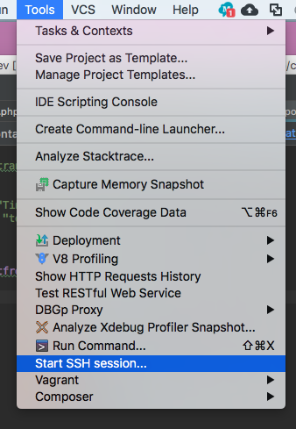
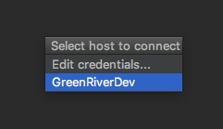
Open a Terminal Window
Access a terminal window
Review basic Linux commands
Create a config file
Install Composer
Create an index page
In PHP Storm, select Tools → Start SSH session
Select GreenRiverDev
You should see a terminal window at the bottom of the screen

Slide 4
Open a Terminal Window: Mac
Access a terminal window
Review basic Linux commands
Create a config file
Install Composer
Create an index page
Launch a Terminal window
Type: $ ssh username@domain.greenriverdev.com -p 18765
Enter your greenriverdev password

Slide 5
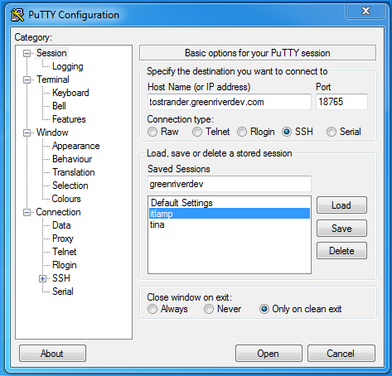
Open a Terminal Window: PC
Download Putty
Launch Putty
Connect to your domain on port 18765, type a name under Saved Sessions, and click Save

Slide 6
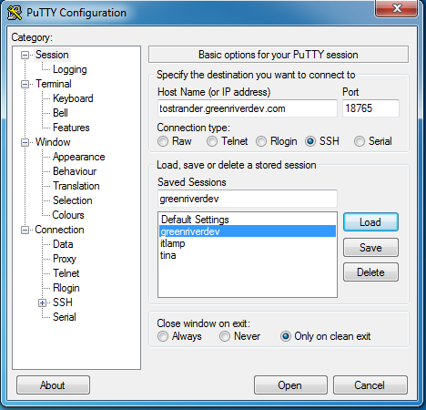
Open a Terminal Window: PC
Select your Saved Session, and click Load, and then Open
If you get a message about the Server Host Key, click Yes
Enter your username and password

Slide 7
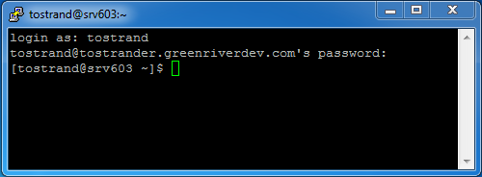
Open a Terminal Window: PC
Access a terminal window
Review basic Linux commands
Create a config file
Install Composer
Create an index page
Log in using your greenriverdev username and password

Slide 8
Basic Linux Commands
pwd displays your current directory
# pwd
ls displays your directory contents
# ls
cd changes your directory
# cd public_html/328
cd .. goes up a directory
# cd ..
cd ~ goes to your home directory (/home/username)
# cd ~
Access a terminal window
Review basic Linux commands
Create a config file
Install Composer
Create an index page

Slide 9
Basic Linux Commands
mkdir creates a directory
# mkdir myfolder
rm removes a file or directory
# rm filename
# rm -rf myfolder
cp copies a file or directory
# cp filename somefolder
Access a terminal window
Review basic Linux commands
Create a config file
Install Composer
Create an index page

Slide 10
Create a JSON Config File
In your editor, create a new folder in 328 called hello
In the hello folder, create a new file called composer.json
Type the following (substitute your own info)
Save the file
Access a terminal window
Review basic Linux commands
Create a config file
Install Composer
Create an index page
{
"name": "tostrand/hello",
"authors": [
{
"name": "Tina Ostrander",
"email": "tostrander@greenriver.edu"
}
],
"require": {
"bcosca/fatfree-core": "dev-master"
}
}

Slide 11
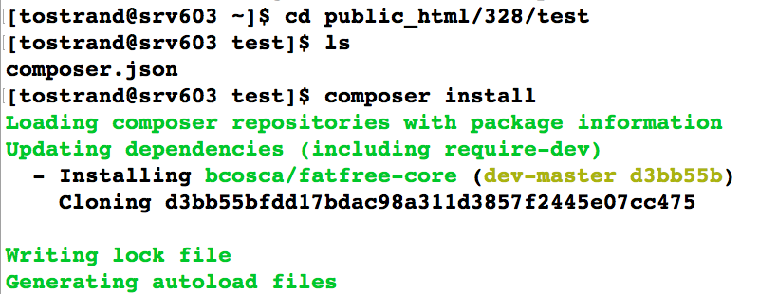
Install Composer for the Project
Composer is a dependency manager for PHP
Composer will pull in all the required libraries and dependencies for a project, and manage them all in one place.
In the terminal window, navigate to your project directory
Make sure the directory contains composer.json
Access a terminal window
Review basic Linux commands
Create a config file
Install Composer
Create an index page

Slide 12
Install Composer for the Project
Install Composer for your project using:
# composer install
Create a config file
Install Composer
Create an index page

Slide 13
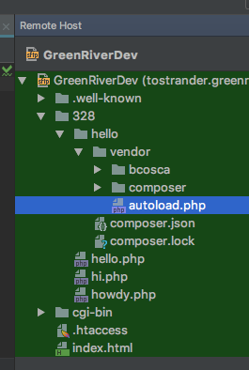
View the Project Directory
View your hello directory in the editor (Remote Host)
vendor/autoload.php –will automatically load whatever 3rd party libraries you have in your json file
e.g. "fat-free"
This file must be included in your PHP code
require_once('vendor/autoload.php');
Only one require is needed, and it takes care of the rest!
Access a terminal window
Review basic Linux commands
Create a config file
Install Composer
Create an index page

Slide 14
When Your Config File Changes…
Every time your config file changes, you need to update Composer
Navigate to your project directory
Update composer:
# composer update
Access a terminal window
Review basic Linux commands
Create a config file
Install Composer
Create an index page

Slide 15
Create an Index Page
Create an index page in your project directory
Access a terminal window
Review basic Linux commands
Create a config file
Install Composer
Create an index page
<?php
//Require the autoload file require_once('vendor/autoload.php');
//Create an instance of the Base class
$f3 = Base::instance();
//Run fat free
$f3->run();

Slide 16
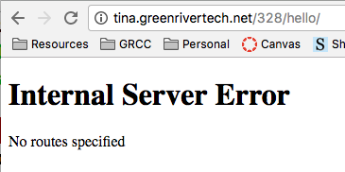
View Your Index Page
Load the page in a browser
http://username.greenrivertech.net/328/hello
You should see this:
Fat Free is running, but we haven't created any routes yet
Access a terminal window
Review basic Linux commands
Create a config file
Install Composer
Create an index page

Slide 17
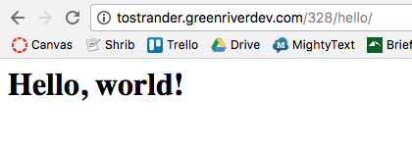
Add a Route
Add a route to your index page, before calling run()
Save your changes
Refresh the page in the browser
Access a terminal window
Review basic Linux commands
Create a config file
Install Composer
Create an index page
…
//Define a default route
$f3->route('GET /', function() {
echo '<h1>Hello, world!</h1>';
}
);
//Run fat free
$f3->run();

Slide 18
Try It
Create a 328/hello/views directory
Create a file in the views directory called home.html
Add some content to home.html
Display home.html as shown here:
(This will replace the Hello World you had previously)
…
//Define a default route
$f3->route('GET /', function() {
$view = new View;
echo $view->render
('views/home.html');
}
);
//Run fat free
$f3->run();

Slide 19
Practice: Do It Again!
Create a hello2 directory in 328
Create a composer.json file inside hello2
Navigate to your hello2 directory in the terminal window
Install composer
Add an index page to your hello2 directory
Define a view for your hello2 project

