Slide 1

Getting Started with GIT
IT 328: Web Development Frameworks
Tina Ostrander

Slide 2
What is Git?
Git is a version control system
Also called a source control management (SCM) tool
Allows you to keep versions of your work so you can always revert to a previous version
Can be used individually or in teams
Free and open source
Learn more: https://git-scm.com/video/what-is-git

Slide 3
Create a GitHub Account
Working Directory
Remote Repository
(GitHub)
Stage
Local Repository

Slide 4
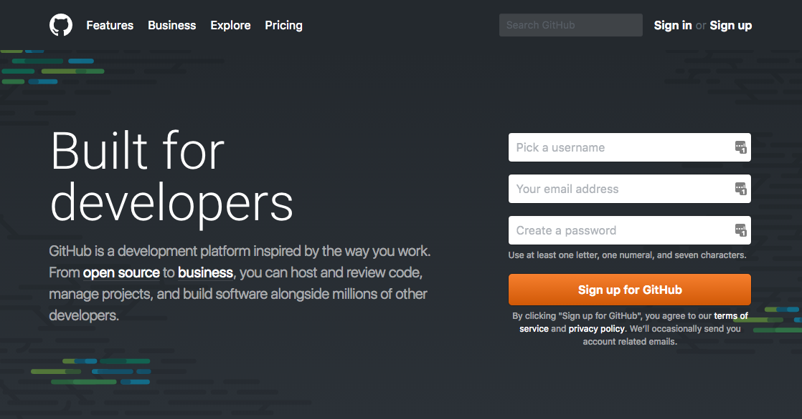
Create a GitHub Account
GitHub is the Web "hub" for sharing git repositories
You can use Git without GitHub

Slide 5
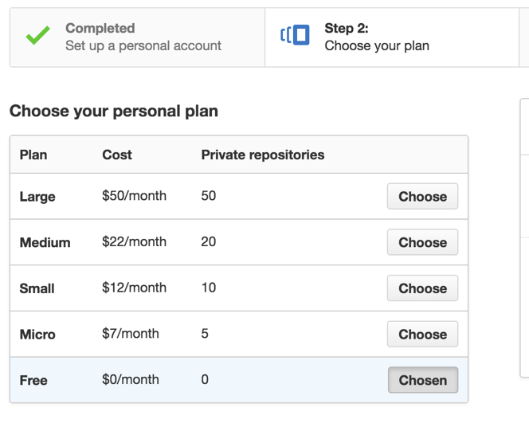

Pick a Plan
With a free account, all repos are public.
As a student, you can also get a free private repo.

Slide 6
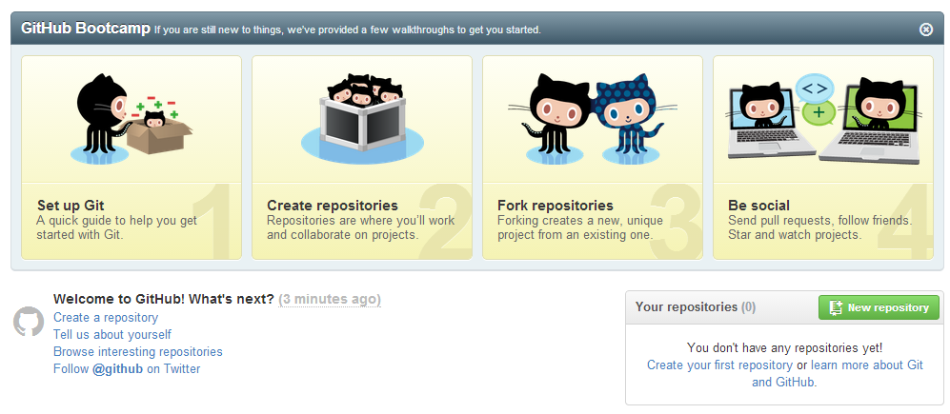
Create a Repository on GitHub

Slide 7
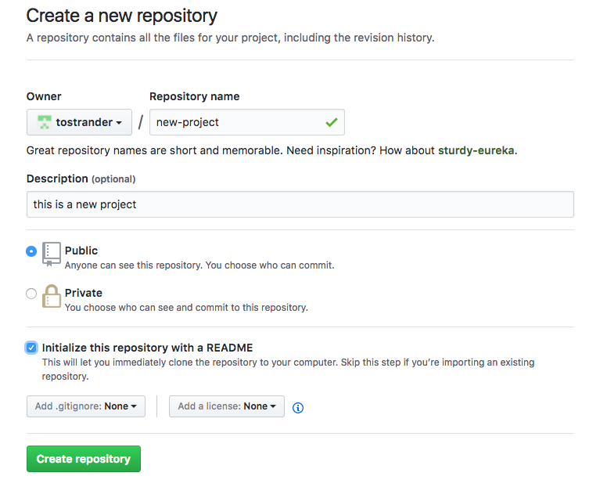
Create a Repository on GitHub

Slide 8
Set Up Your Local Repository
Working Directory
Remote Repository
(GitHub)
Stage
Local Repository

Slide 9
Configure Git
Each commit is associated with a username and email
git config is used to set the values
SSH into greenriverdev
ssh username@domainname.greenriverdev.com -p 18765
Configure your username and email
This is used in tracking your commits
git config --global user.name "John Doe"
git config --global user.email "johndoe@example.com"

Slide 10
Create a New Project
clone
Working Directory
Remote Repository
(GitHub)
Stage
Local Repository

Slide 11
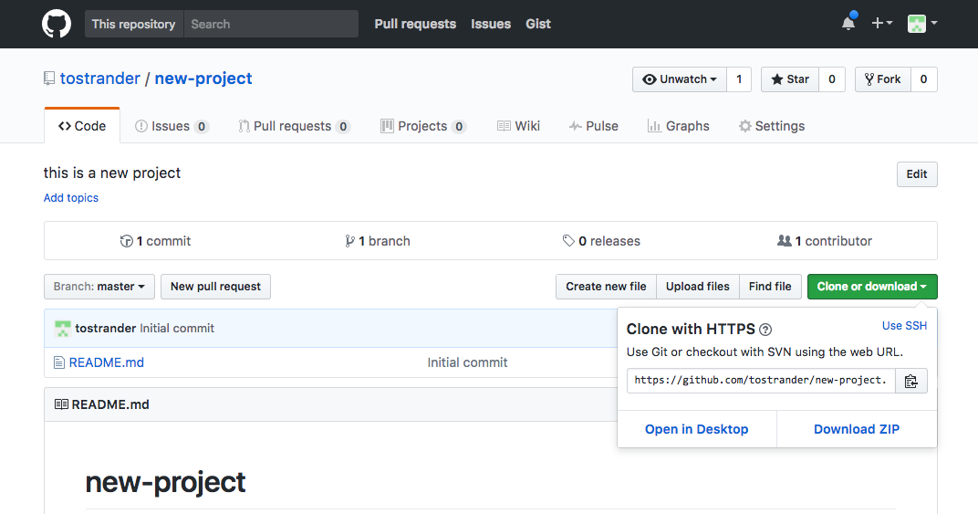
1. Get the URL of your GitHub Repo
Copy this to the Clipboard

Slide 12
2. Clone your GitHub Repo
Navigate to your 328 directory in the console window
Clone the repo
View a directory listing; you should see a new-project directory
# git clone url

Slide 13
2. Clone your GitHub Repo
Navigate to your 328 directory in the console window
Clone the repo
View a directory listing; you should see a new-project directory
tina@tina.greenrivertech.net [~]# cd public_html/328
tina@tina.greenrivertech.net [~/public_html/328]# git clone https://github.com/tostrander/new-project.git
Cloning into 'new-project'...
remote: Counting objects: 3, done.
remote: Total 3 (delta 0), reused 0 (delta 0), pack-reused 0
Unpacking objects: 100% (3/3), done.
tina@tina.greenrivertech.net [~/public_html/328]# ls
./ beehive/ dating/ hello/ is-number.php
../ blogs/ examples/ index.php new-project/

Slide 14

3. Check your Status
git status displays the status of the repo
$ git status
On branch master
nothing to commit, working directory clean
Change to the new-project directory
View your git status

Slide 15
Making Changes
Working Directory
clone
Remote Repository
(GitHub)
Stage
Local Repository
add
commit
push

Slide 16
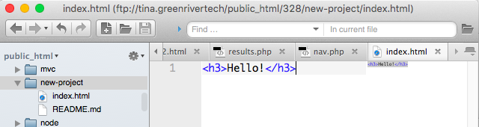

Create an index.html page in your new-project directory

Slide 17
Working Directory
clone
Remote Repository
(GitHub)
Stage
Local Repository
add
commit
push
git add
adds files to a staging area
git add <filename>
git add . → adds everything in the current directory

Slide 18
Add index.html to your repo
Check the status
# cd new-project
# ls
./ ../ .git/ README.md index.html
# git add index.html
# git status
# On branch master
# Changes to be committed:
# (use "git reset HEAD <file>..." to unstage)
#
# new file: index.html
#

Slide 19
Working Directory
clone
Remote Repository
(GitHub)
Stage
Local Repository
add
commit
push
git commit –m "message"
commits the changes to the local repository

Slide 20
Commit your changes
Check the status
Look at your GitHub repo online
Is the file there?
# git commit -m "first commit"
[master f1d4c7a] first commit
1 file changed, 1 insertion(+)
create mode 100644 index.html
# git status
# On branch master
# Your branch is ahead of 'origin/master' by 1 commit.
#
nothing to commit (working directory clean)

Slide 21
Working Directory
clone
Remote Repository
(GitHub)
Stage
Local Repository
add
commit
push
git push
sends the changes to the remote repository, i.e. GitHub
# git push

Slide 22
Push the changes
Check the status
Look at your GitHub repo online
Is the file there?
# git push
Username for 'https://github.com': tostrander
Password for 'https://tostrander@github.com':
To https://github.com/tostrander/test.git
48fe638..9af3e8c master -> master
#
# git status
# On branch master
nothing to commit (working directory clean)

Slide 23

Try It
In the editor, add an <h2> to index.html
Check the status
Add to the Staging area
git add index.html
Check the status
Commit the changes
git commit –m "subheader added"
Check the status
Push to master
git push
Check the status

Slide 24
1. Add
# git add index.html
# git status
# On branch master
# Changes to be committed:
# (use "git reset HEAD <file>..." to unstage)
#
# modified: index.html
#
# git commit -m "added subtitle"
[master a75e89b] added subtitle
1 file changed, 2 insertions(+), 1 deletion(-)
# git status
# On branch master
# Your branch is ahead of 'origin/master' by 1 commit.
#
nothing to commit (working directory clean)
# git push
Username for 'https://github.com': tostrander
Password for 'https://tostrander@github.com':
To https://github.com/tostrander/test.git
9af3e8c..a75e89b master -> master
# git status
# On branch master
nothing to commit (working directory clean)
modified file
2. Commit
3. Push

Slide 25
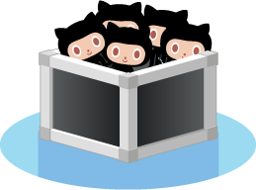
View your Commit Logs
git log displays your log history
$ git log
commit 3f8dd37fefc25e32ba748d766100ecd3da631670
Author: Tina Ostrander <tostrander@greenriver.edu>
Date: Wed Mar 9 08:23:26 2016 -0800
Creating new project

Slide 26
In Summary…

Slide 27
Important Git Commands
Initialize a project
git init projectName
git init .
Add a file
git add fileName
git add *
Commit changes
git commit -m "remark"
View the log
git log
Get a "clean" copy from GitHub
git checkout -- filename
git checkout -- .
Check status
git status
Add a remote location to upload files
git remote add origin url
Push changes from local to remote
git push
Pull changes from remote to local
git pull url
git pull

Slide 28

Git Isn't Just for Code
You can commit anything to a Git repository
Pictures
Word docs
PowerPoint presentations
Videos
Music
etc.

Slide 29

Learn More
GitGuys
Git Documentation
Git Cheat Sheet

