Slide 1

Chapter 13: Software Project Management

Slide 2
Project Management “Process”
Why do we need project management?
Why can’t we just follow one of the software development processes and be left alone?
All projects – small and large – need project management
because all projects need some degree of POMA:
– Planning
– Organizing
– Monitoring of status
– Adjustment

Slide 3
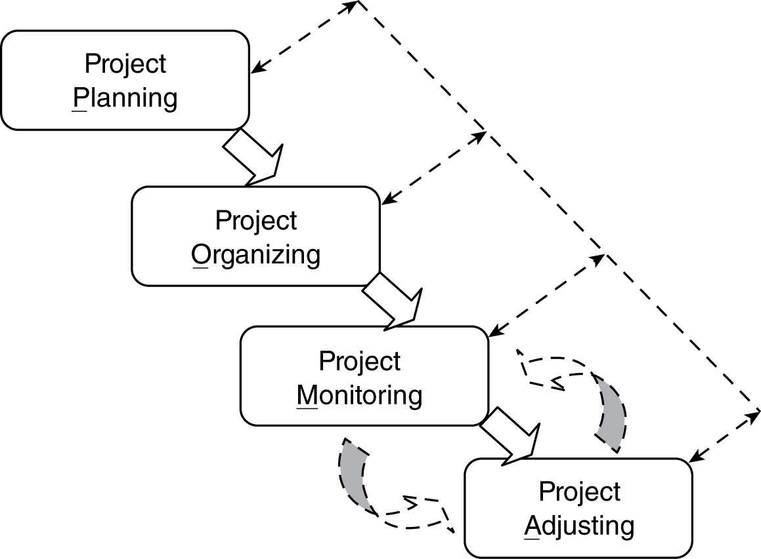
Software Project Management (POMA) Process
This process looks
sequential at the macro
level, but may be very
iterative at the micro
level

Slide 4
Goals of Software Project Management
End results of the project satisfy the customer’s needs.
All the desired and the needed product/project attributes (quality, security, productivity, cost, schedule, etc.) are met.
Team members are operating effectively and at a high level of morale.
Required tools and other resources are made available and are effectively utilized.

Slide 5
Planning (POMA)
The 1st step of project planning is to understand the requirements of the project.
This step itself may be a mini-project.
Then the following four steps are included in the rest of project planning:
Perform estimation of
The work effort
The schedule
The needed resources
Clearly define and establish measurable “goals” for the project.
Determine the project resource allocations of
People
Process
Tools and Facilities
Identify and analyze the project risks.

Slide 6
Organizing (POMA)
Once a project plan is formulated or partially formulated, organizing may start.
Organization structure needs to be designed.
Human resource hiring needs to start and be completed along with acquisition of other resources.
Any required education and training have to be completed.
Mechanisms for tracking must be established.
Risk tracking and mitigation
Project goals (schedule, cost, market place, etc.)

Slide 7
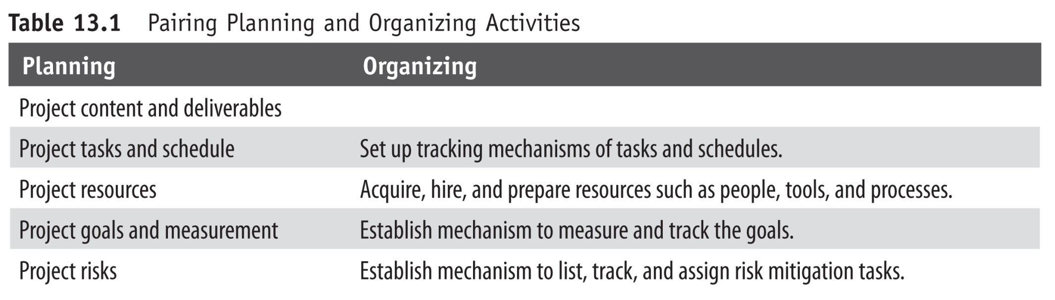
Comparing and Pairing Planning and Organizing Activities

Slide 8
Monitoring (POMA)
Once the project is organized and set into motion, there still needs to be regular tracking to ensure that it is headed in the right direction. (Projects cannot be left to coast along by itself.)
Three main components of project monitoring:
Project status information collection
Analysis and evaluation of collected information
Presentation and communication of the project status

Slide 9
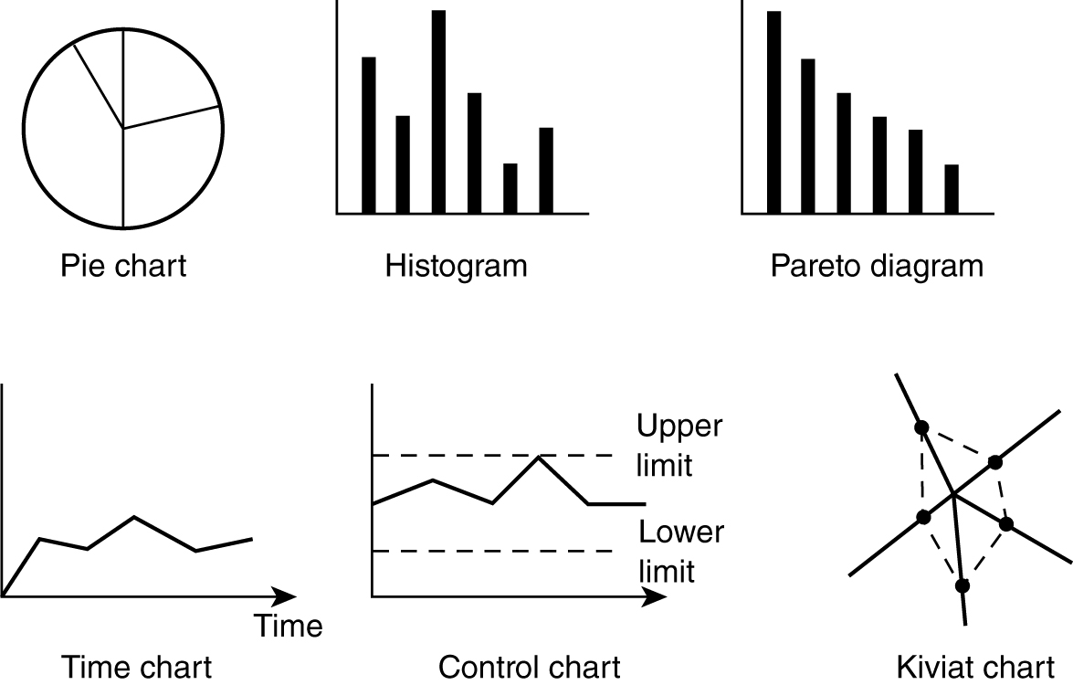
Different Ways of Visualization/Reporting of Information and Project Status

Slide 10
Adjusting (POMA)
It is highly unlikely that a software project progresses with no problem. As soon as the project status suggests potential problem, we must not be afraid to make changes.
Three main areas of adjustments are (or are combinations of):
Resources
Schedule
Project content

Slide 11
Software project management process
is not the same as
− Software development process or
− Software life cycle

Slide 12
Some Project Management Techniques
Planning: project effort estimation
General view:
Units of effort = a + b (size)^{c} + Σ(factors)
where a, b, and c is set of estimated constants,
size is the estimated size of the project,
and factors are additional factors of concern
Most of the estimating techniques use some form of this general “formula.”
COCOMO I and COCOMO II models
Function Point model
pages 354−364 of your
textbook

Slide 13
Some Project Management Techniques (cont.)
Planning and organizing: work breakdown structure
Estimation of the complete project by
Deliverables
Tasks required to develop the deliverables
Resources required to perform the tasks

Slide 14
Work Breakdown Structure (WBS) Steps
Examine and determine the external deliverables of the project.
Identify the steps and tasks required to produce each of the deliverables, including the tasks that are required to produce any intermediate internal deliverables.
Sequence the tasks, showing any potential for parallelism.
Provide an estimate size of each of the tasks.
Provide an estimate of the productivity of the personnel that is most likely to be assigned to each of the tasks.
Calculate the time required to accomplish each task.
For each of the external deliverable, lay out the timeline of all the tasks needed to produce that deliverable and label the resources that will be assigned to the tasks.

Slide 15
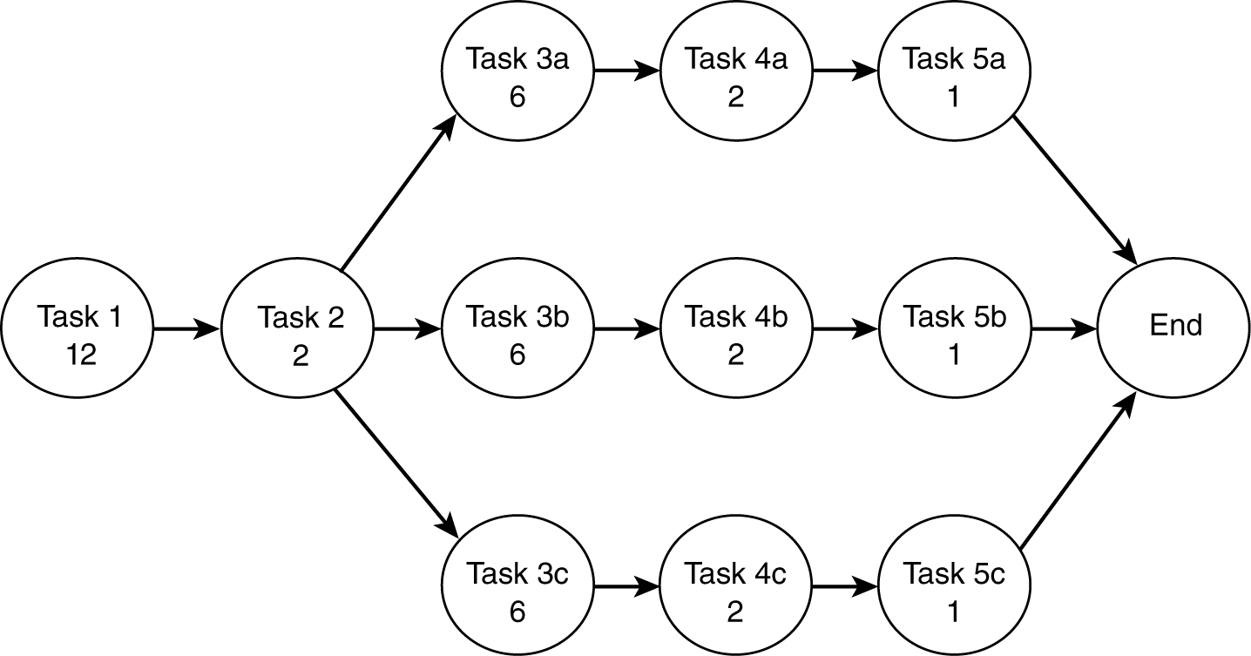
Example of: Task Network with Estimated Time Units

Slide 16
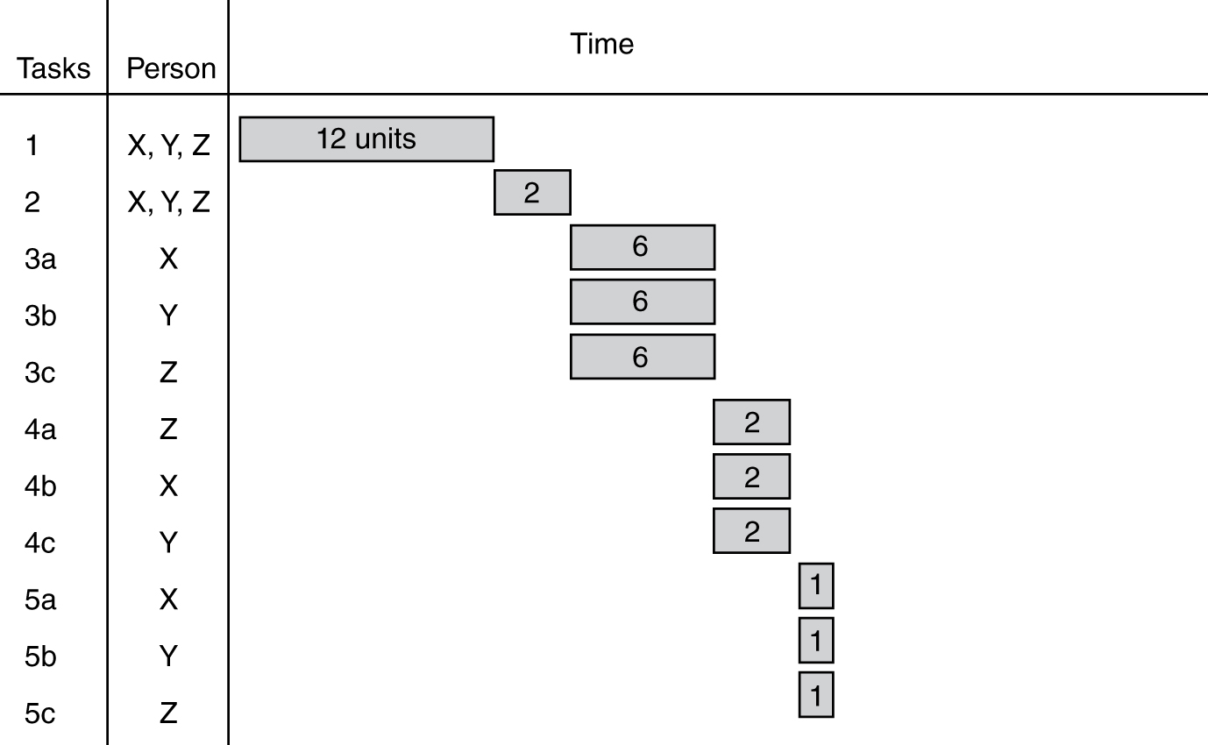
End Result of WBS = Initial Schedule Estimate

Slide 17
Some Project Management Techniques (cont.)
Monitoring: earned value
A technique to track the project status by comparing (at some specific time):
How much effort has been expended
versus
How much effort was planned to have been expended

Slide 18
Definitions for Earned Value
Budgeted cost of work (BCW): estimated effort for each of the work tasks.
Budgeted cost of work scheduled (BCWS): sum of estimated effort of all the tasks that were planned to be completed (by a specific date).
Budget at completion (BAC): estimate of the total project effort or sum of all the BCWs.
Budgeted cost of work performed (BCWP): The sum of the estimated efforts of all the tasks that have been completed (by a specific date).
Actual cost of work performed (ACWP): The sum of the actual efforts of all the tasks that have been completed (by a specific date).
Earned value (EV) indicates how much of the estimated work is completed on a specific date.
EV = BCWP / BAC

Slide 19
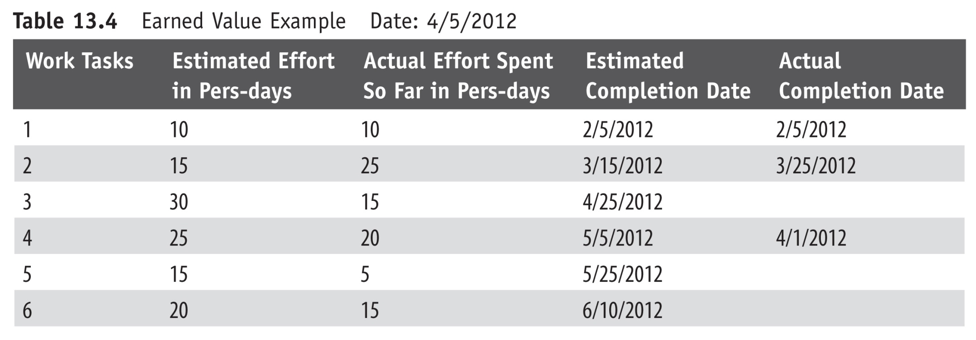
Earned Value Example
Note the status
checking date.

Slide 20
Earned Value Example
For work task 4, BCW is 25 person-days; for task 6, BCW is 20 person-days.
BAC is the sum of the estimated efforts for all the tasks or
BAC = (10 + 15 + 30 + 25 + 15 + 20 = 115 person-days)
BCWS for the date 4/5/06 is the sum of the estimated effort of all the tasks that were schedule to be completed on or before 4/5/06 or
BCWS = (10 + 15 = 25 person-days)
BCWP for the date 4/5/06 is the sum of the estimated effort of all the tasks which were actually completed on or before 4/5/06 or
BCWP = (10 + 15 + 25 = 50 person-days)
ACWP for the date 4/5/06 is the sum of the actual efforts expended for all the tasks that have been completed on or before 4/5/06 or
ACWP = (10 + 25 + 20 = 55 person-days)
EV = BCWP / BAC = 50/115 = .434 or
the project is estimated to be 43% complete as of 4/5/06

Slide 21
Earned Value Example (cont.)
There are two more measurements we look at:
Cost variance = BCWP – ACWP = 50 – 55 = – 5
Schedule variance = BCWP – BCWS = 50 – 25 = 25

