Slide 1
Code Design
Classes
It 426

Slide 2
Order of class elements
Keep the contents of your class in recognizable locations
MyClass
Fields
Constructors
Methods

Slide 3
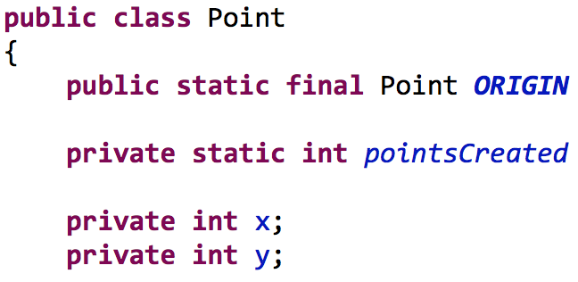
Order of class elements
Order of fields
Public static constants
Static fields
Private fields
Protected fields (avoid)
They break encapsulation
They introduce opportunities to create bugs
Do you really trust another class, built by a different developer, with the internal details of your class?!?!
Public fields
Never use these

Slide 4
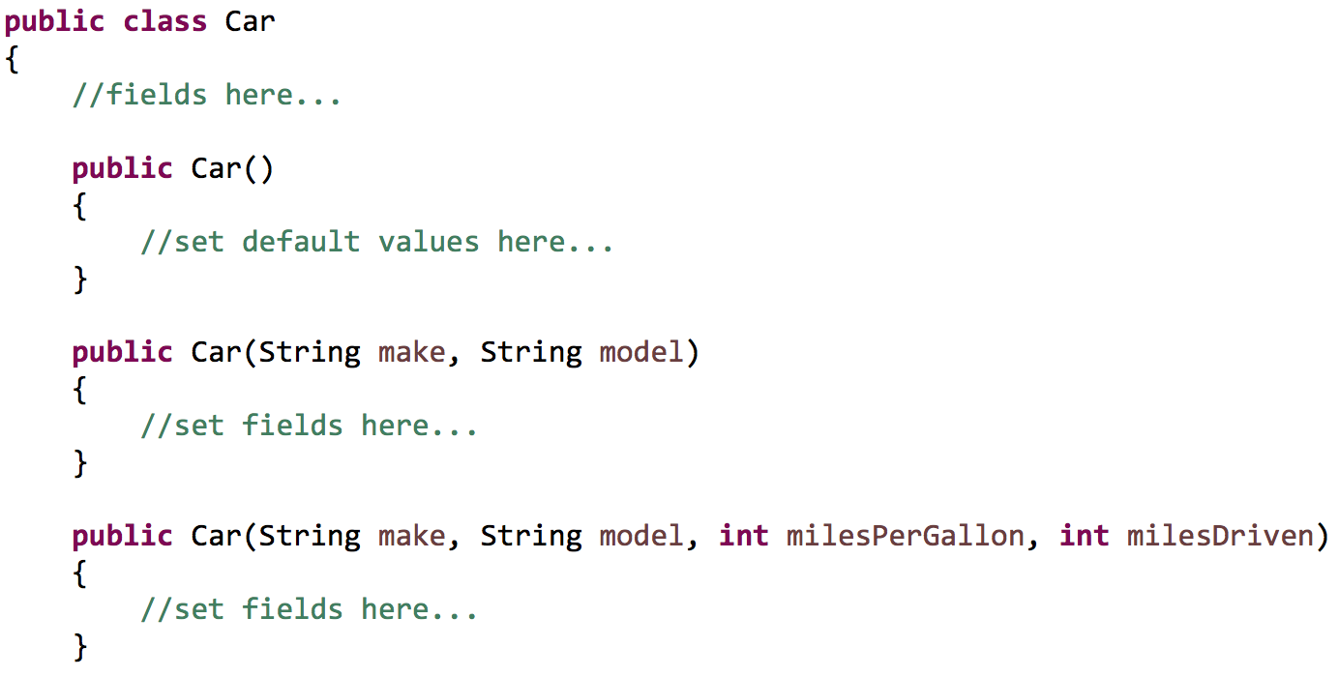
Order of class elements - Constructors
Keep the number of constructors to a minimum
Only ones that will likely be used
Reduces the complexity of the class
Reduces the size of the public API of the class

Slide 5
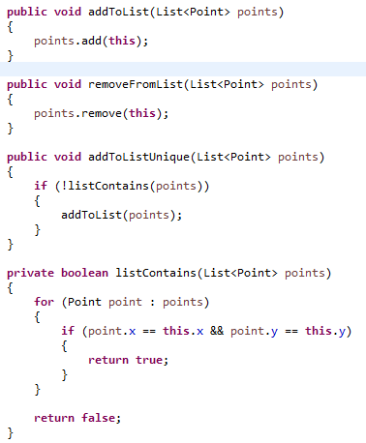
Organize you methods sensibly
Technique 1:
Step-down approach!

Slide 6
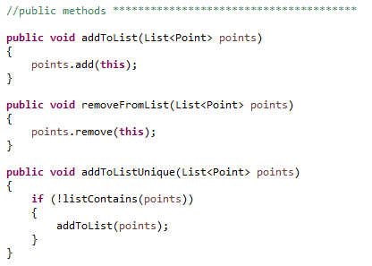
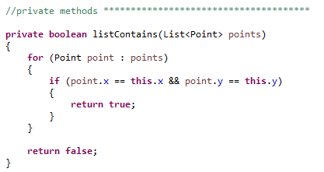
Organize you methods sensibly
Technique 2:
public functions first, private functions last
This makes the public API of a class crystal clear

Slide 7
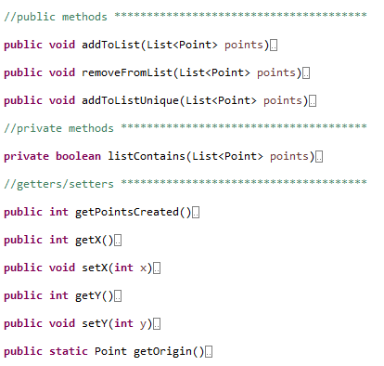
Organize you methods sensibly
Other techniques
Keep your getters/setters grouped together
(Only write getters/setters that you or others will use)

Slide 8
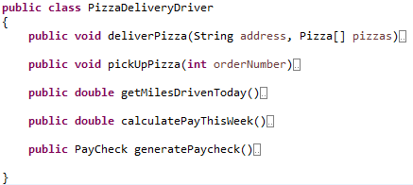
Classes should be small
Things that affect class size
The number of responsibilities
The size of the public API
The lines of code
Avoiding god(zilla) classes

Slide 9
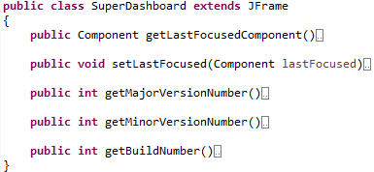
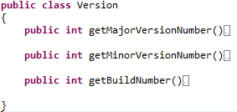
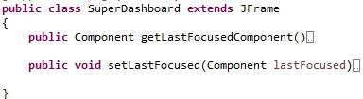
Single responsibility principle
There should only be one reason for an object to change
If there is more than one reason, we need to split the responsibilities into separate classes

Slide 10
Class cohesion
The functions in a class should be directly using the fields in a class
The more these fields are used in each function, the higher the cohesions
Previous goals:
Keep functions small
Keep function parameter lists small
This often results in proliferation of fields
The fields are often only used in one function (low cohesion)
Extract any fields you can to another class that is more cohesive

Slide 11
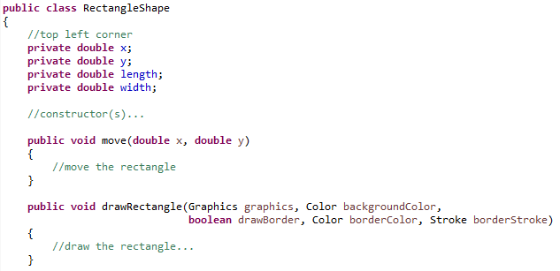
Class cohesion example

Slide 12
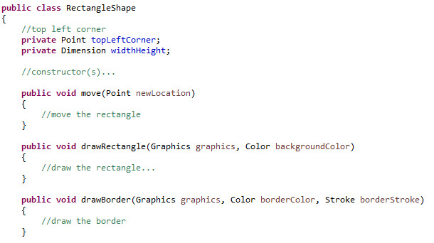
Refactoring

Slide 13
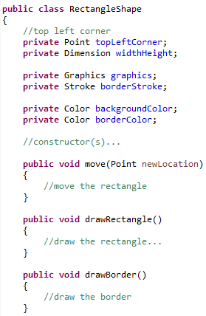
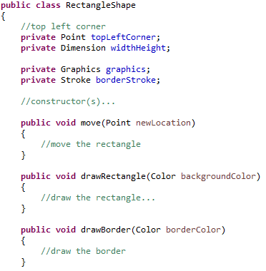
Refactoring

Slide 14
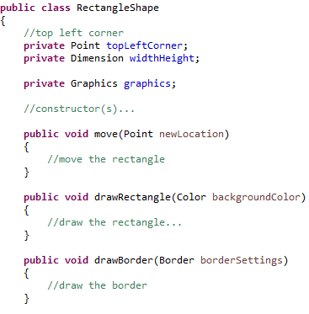
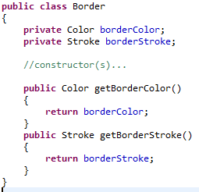
Refactoring
Both these classes will have high cohesion

Slide 15
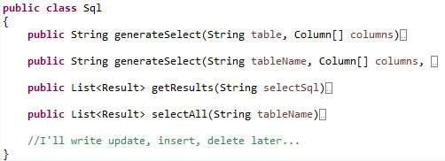
Organizing for change
Would it be easy to alter this class to support later features (insert, update delete)?
Open-closed principle

Slide 16
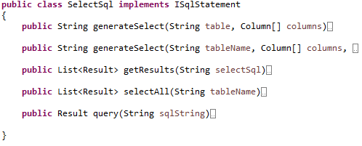

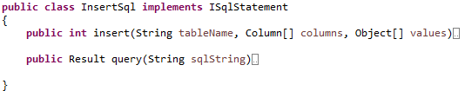
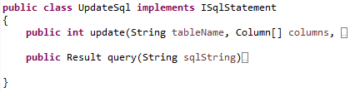
Organizing for change
Here is a redesign that supports change and the O.C.P.

Slide 17
Isolating for change
Dependency inversion principle:
Our classes should depend on abstractions (interfaces, abstract classes), not concrete details
Benefits?
Decouples classes
Makes unit tests easier to write
Promotes code reuse

Slide 18
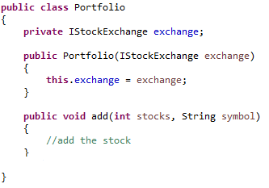


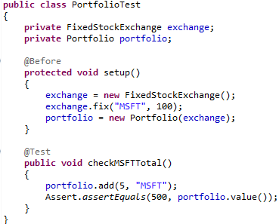
Dependency inversion principle

Slide 19
Sources
Martin, Robert C. Clean Code. New Jersey: Pearson Education Inc, 2009.

Slide 20
Code Design
Classes
It 426

