Slide 1
Code Design
Comments
IT 426

Slide 2

Are comments always a good thing?
Are comments a good thing?
Well placed, descriptive comments help us understand what the author of a code segment was trying to accomplish
Comments can lose their meaning over time
Do you update your comments as your code changes? Seriously, be honest here
“The older a comment is, and the farther away it is from the code it describes, the more likely it is to be just plain wrong.”

Slide 3

Are comments always a good thing?
Some view comments as a failure to express ourselves with
the syntax of a language
names
control flow
But we are taught to leave comments
as breadcrumbs in our programs
nearby tricky code segments
for the next reader of your code
because that is what developers do!

Slide 4
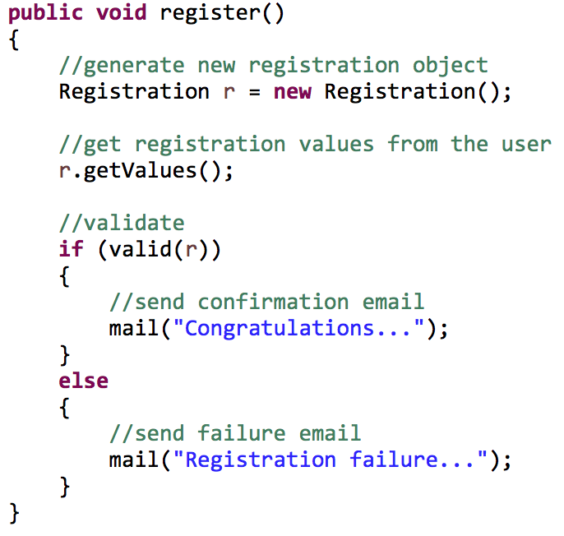
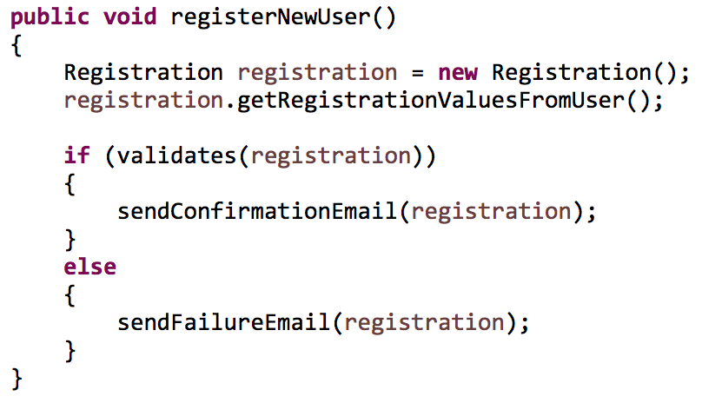
Which is more readable?

Slide 5

Comments don’t make up for bad code
Have you ever written
a complex code segment?
a segment of code that you knew was a mess?
confusing code?
Your response to this should not be
“I’ll write some comments to explain what I did!”
Your response should be
“I need to clean up my code!”

Slide 6
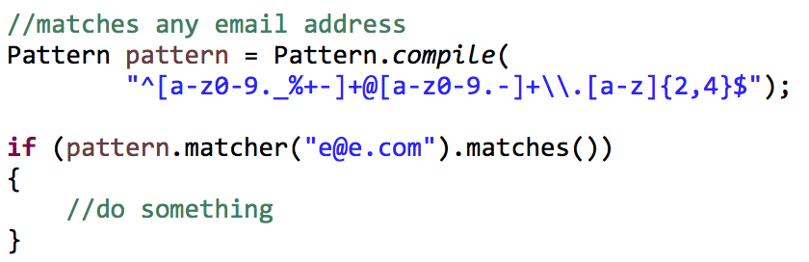
Good comments - Informative
It is good to use these types of comments where
code can be misunderstood
you can save the reader time when viewing your code

Slide 7
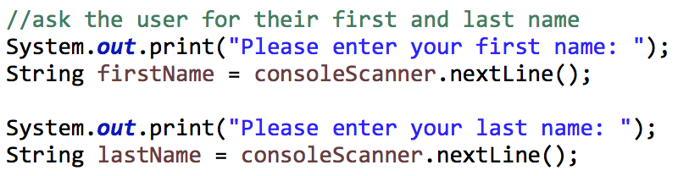
Good comments - Informative
Try to avoid redundantly stating the obvious

Slide 8
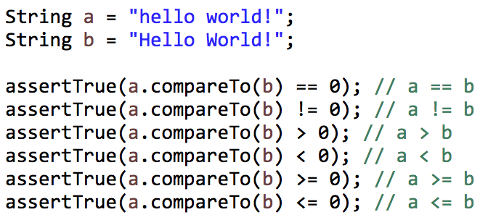
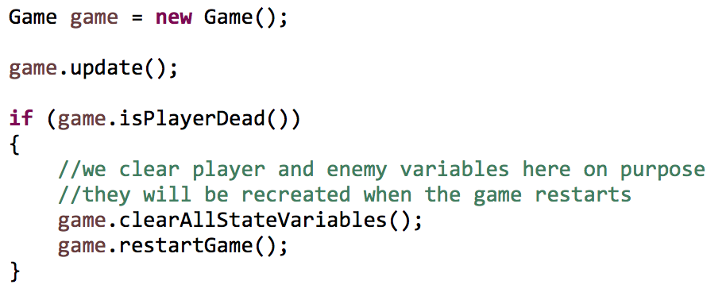
Good comments
Can we be more clear here?
Clarification
Explaining intent
What was our reasoning here?

Slide 9
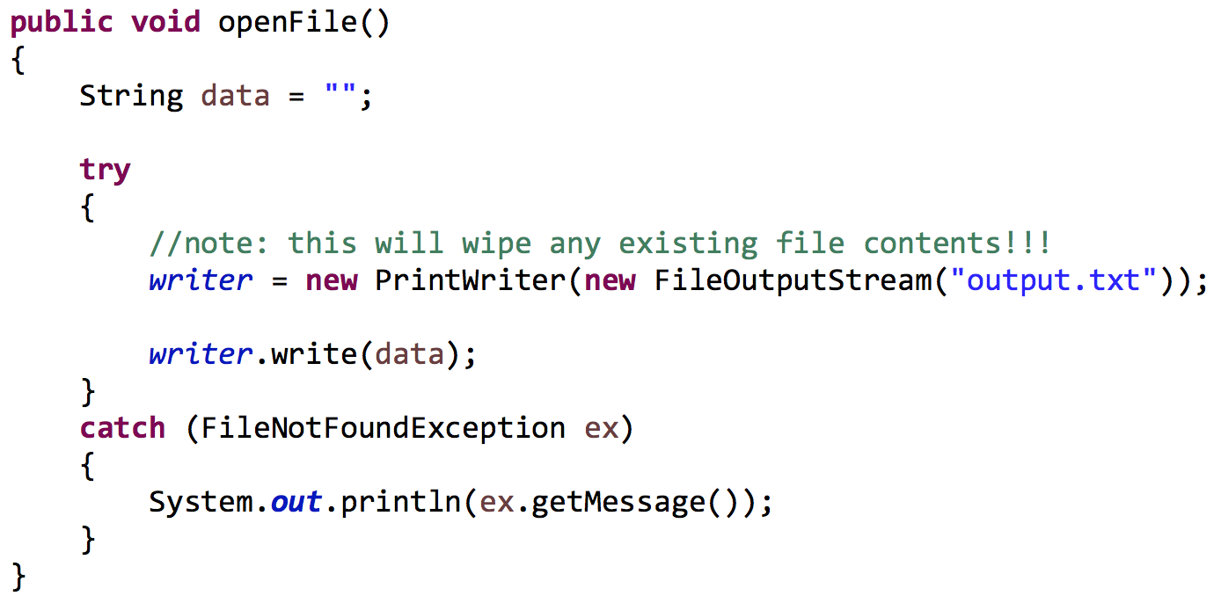
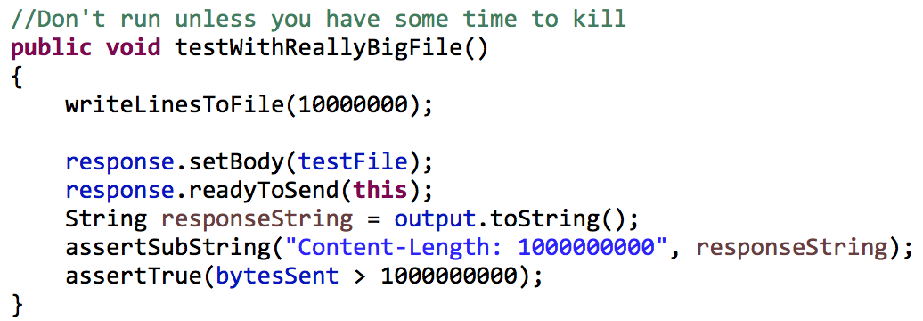
Good comments
Warning of consequences

Slide 10
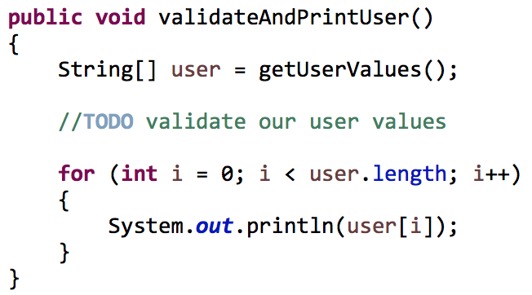
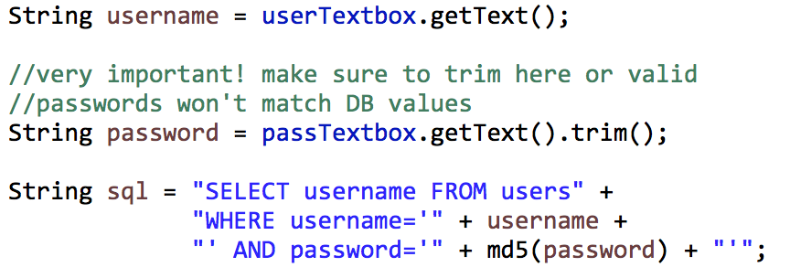
Good comments
Todo comments
Amplification

Slide 11
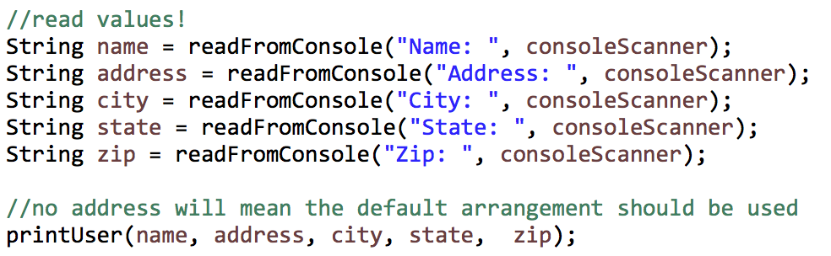
Bad comments - mumbling
Don’t write a comment just for the sake of writing a comment
Questions unanswered?
What is the default arrangement?
Do we use the default if part of our address is missing?
Is a missing address an empty string value?

Slide 12
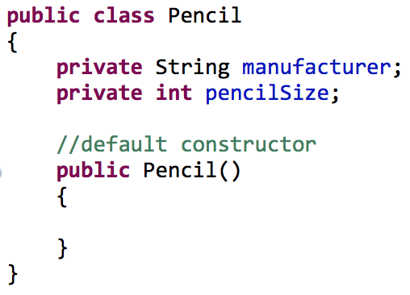
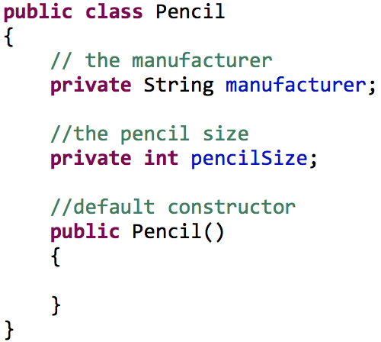
Bad comments - noise
Bad!
Even worse!

Slide 13
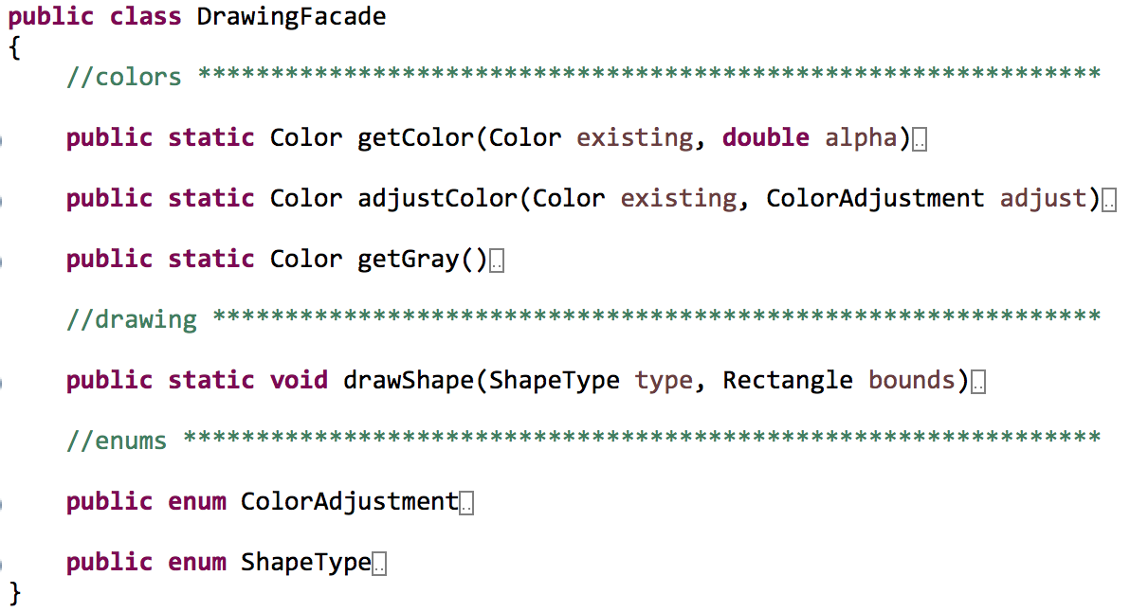
Bad comments – position markers

Slide 14
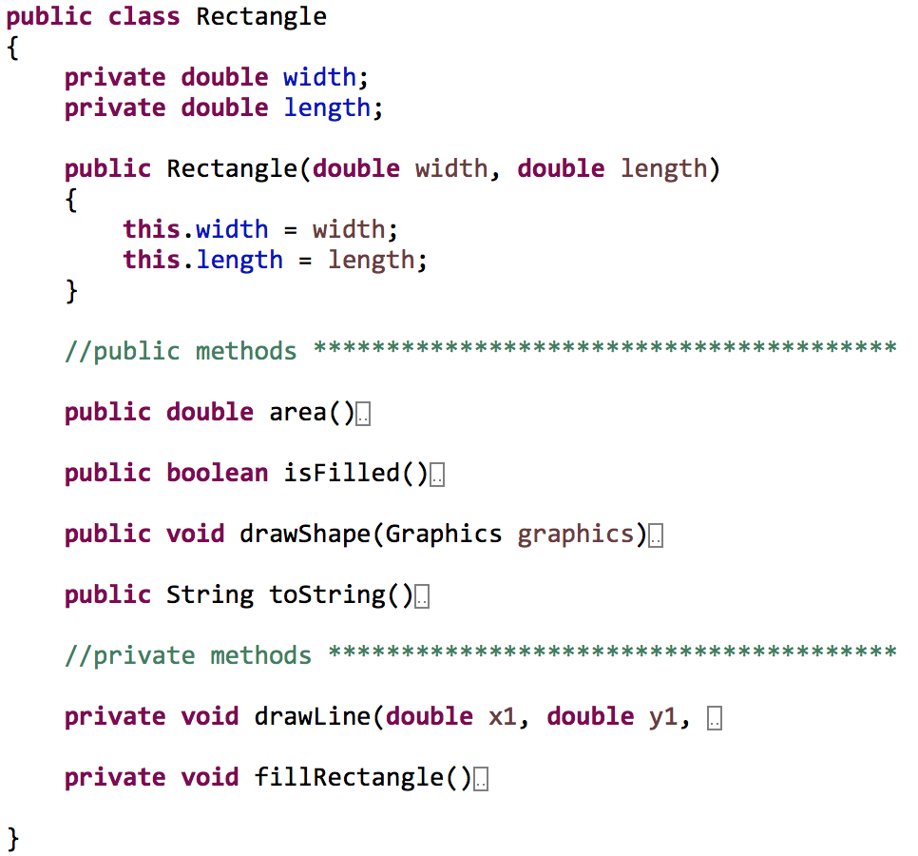
Bad comments – position markers

Slide 15
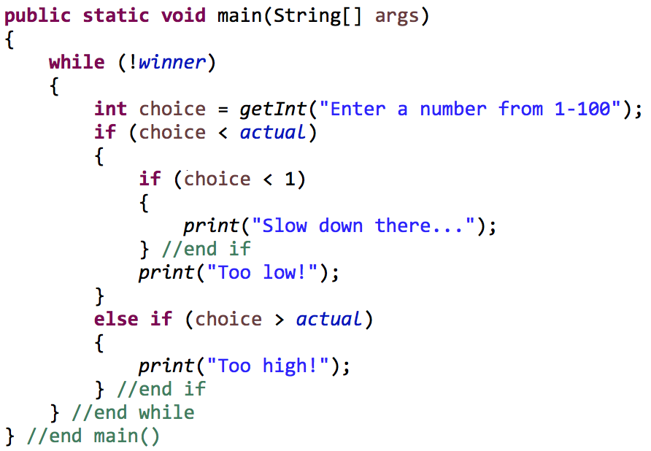
Bad comments – brace comments
These create clutter
If you can’t see your entire method on one screen, what is really your problem?

Slide 16
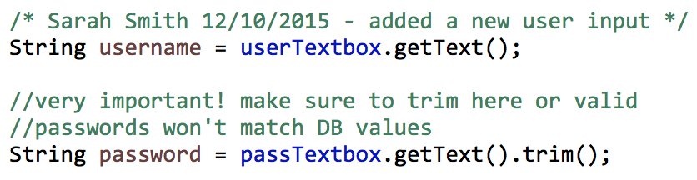
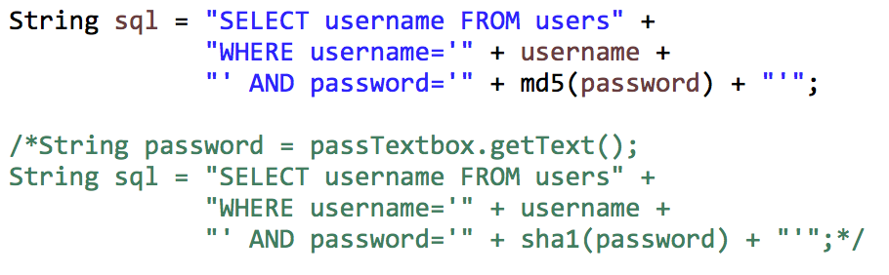
Bad comments
Source control can be used to track all of these details
Attribution
Commented code

Slide 17

Final comments
There are good and bad comments
In general, comments are a good thing
Comments should be placed throughout your code
Keep your comments relevant and updated as code changes

Slide 18
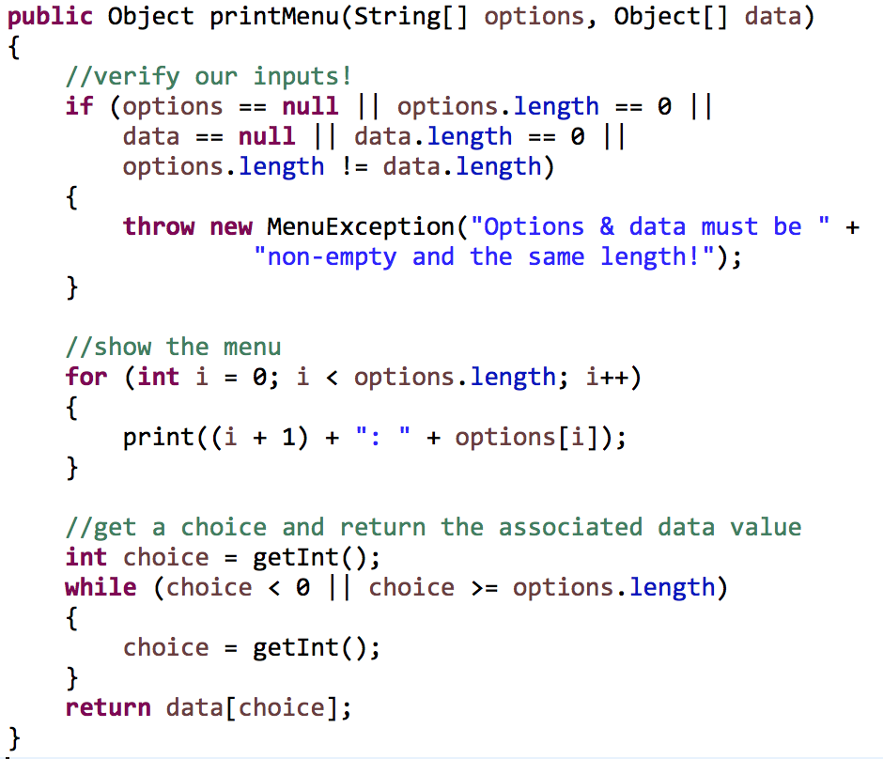
Final comments – comments as breadcrumbs
A user should be able to scan the comments in your document to get a gist of what the file is doing
Group common elements and leave a digest above each group

Slide 19
Sources
Martin, Robert C. Clean Code. New Jersey: Pearson Education Inc, 2009.

Slide 20
Code Design
Comments
IT 426

