Slide 1
Code Design
Formatting
IT 426

Slide 2
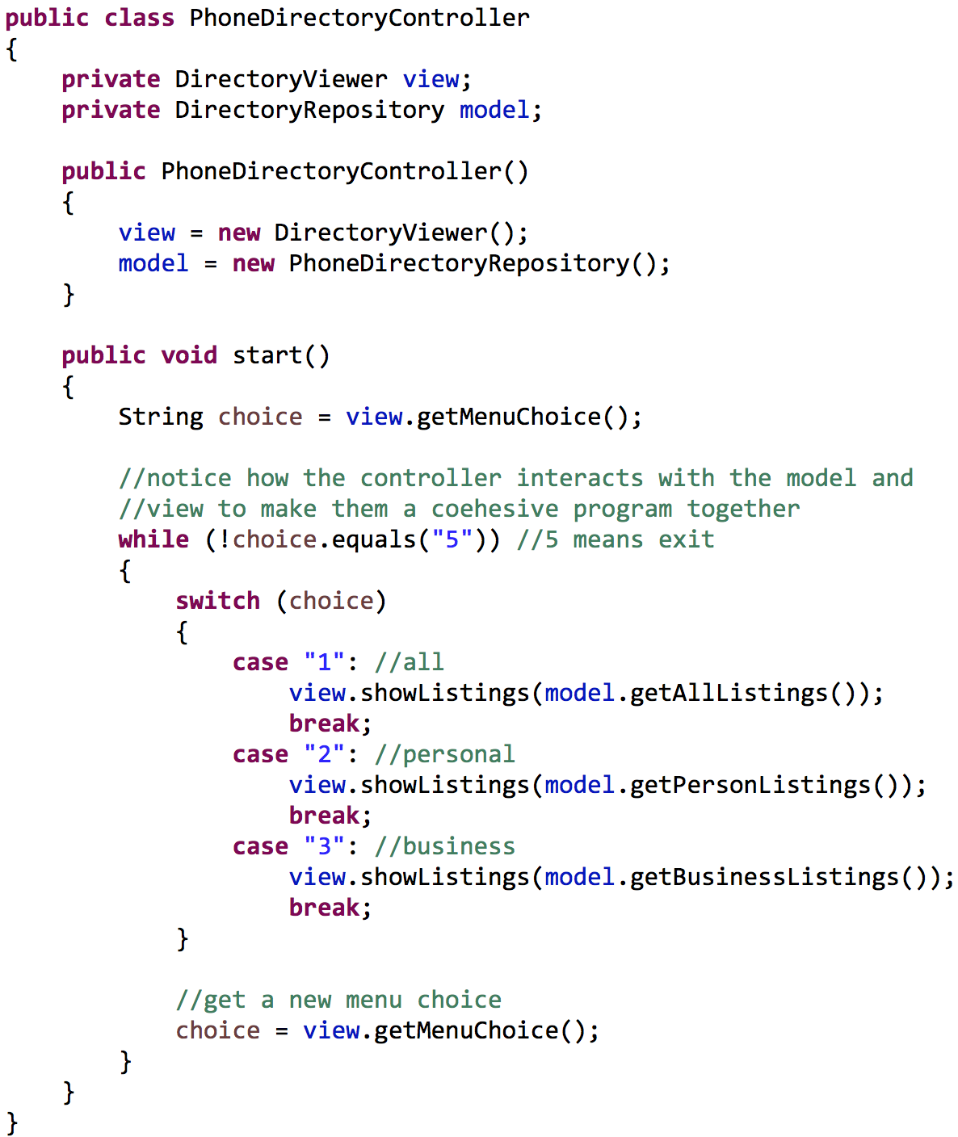
Code formatting
Key to readability
Key to communication

Slide 3

Source Files
Size
The size of any source file should be minimized
Avoid god(zilla) file syndrome
Name
Should be simple
Should describe their contents

Slide 4

Vertical Layout
Newspaper analogy
We read newspapers vertically
Main story
Synopsis
Supporting paragraphs
Sub-story
Synopsis
Supporting paragraphs
Source files
High-level concepts/algorithms near the top
Low-level functions near the bottom

Slide 5
Visual Layout
Space between entities in a file
packages
imports
class
fields
Methods
Let your code breathe!
This provides visual cues

Slide 6
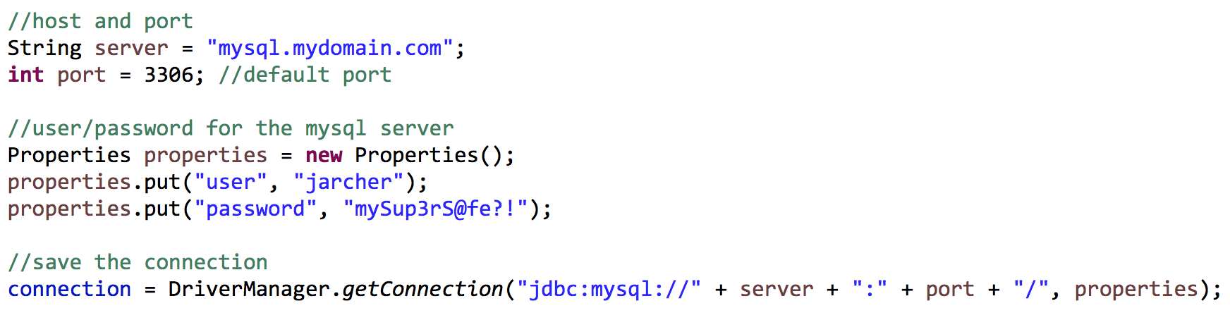
Vertical Density
Group related statements together
“Vertical separation is a measurement of how important each is to the understandability of the other”
Avoid forcing users to scan vertically in the page to find related concepts
Leave comment digests above the group

Slide 7
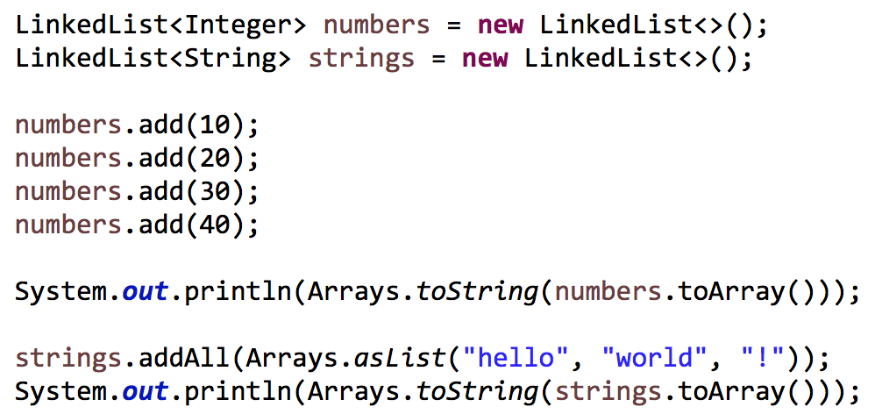
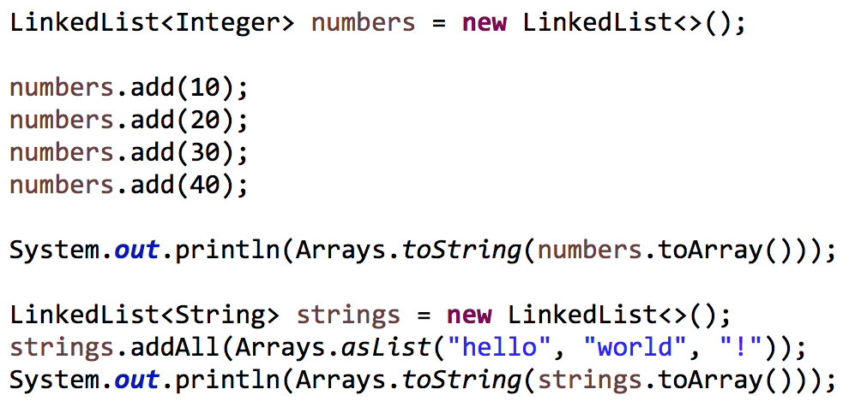
Vertical distance
Declared variables should be as close as possible to their first use

Slide 8
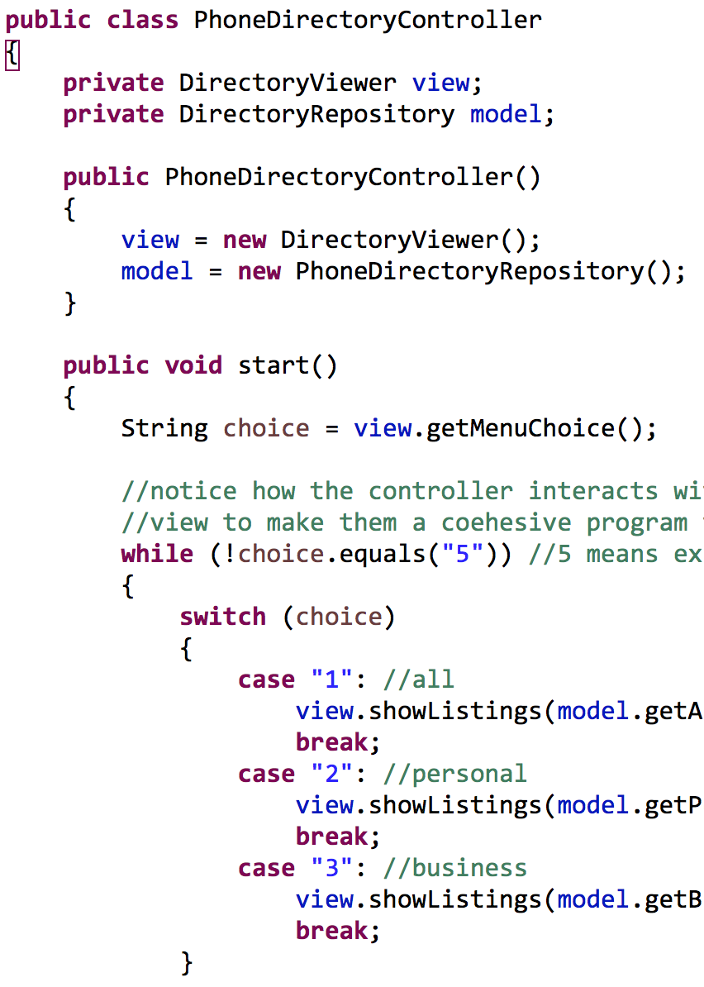
Instance variables
Located at the top of a file
C++: bottom by convention
Java: top by convention
Only in one location!
Should be used by many if not all methods
Or it shouldn’t be a field

Slide 9
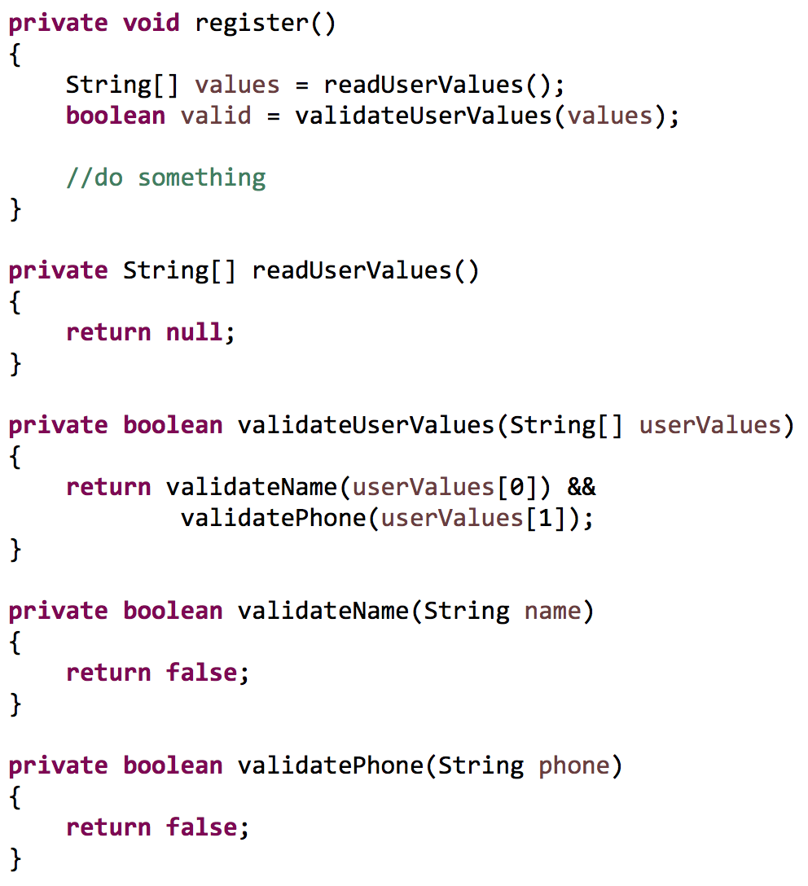
Dependent functions
A method that calls another should be vertically close to it
Caller above callee
This creates a vertical, readable and natural flow

Slide 10
Horizontal Line Length
Try to stay around 80
Never off screen!
Space around operators, method parameters
Always for readability!
Examples:
a + b == c % d
if (a.compareTo(b) != 0)
public void move(Point p, int dx, int dy)

Slide 11
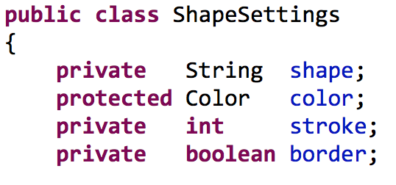
Horizontal column alignment
Don’t align access modifiers, types, names, assignments
Can be distracting from associating names and types
Becomes more unreadable with larger type names
Auto-formatters will not follow this rule

Slide 12
Indentation
Programmers rely heavily on indentation
Quickly and visually hop over code blocks that are not pertinent/relevant
You should be able to instantly notice elements of a file
Fields
Constructors
Methods
Class

Slide 13

Indentation
Don’t break indentation for short blocks of code
if (flag == true) System.out.println(“Hello”);
while (file.read(buff, size) != null);
public int getX() { return x; }

Slide 14
Team formatting
We have our own formatting rules
Follow the rules of your development team
Team should have a stated style
Software should have a consistent look
Use your IDE formatter tool!
“The last thing we want to do is add more complexity to the source code by writing in a jumble of different individual styles”

Slide 15
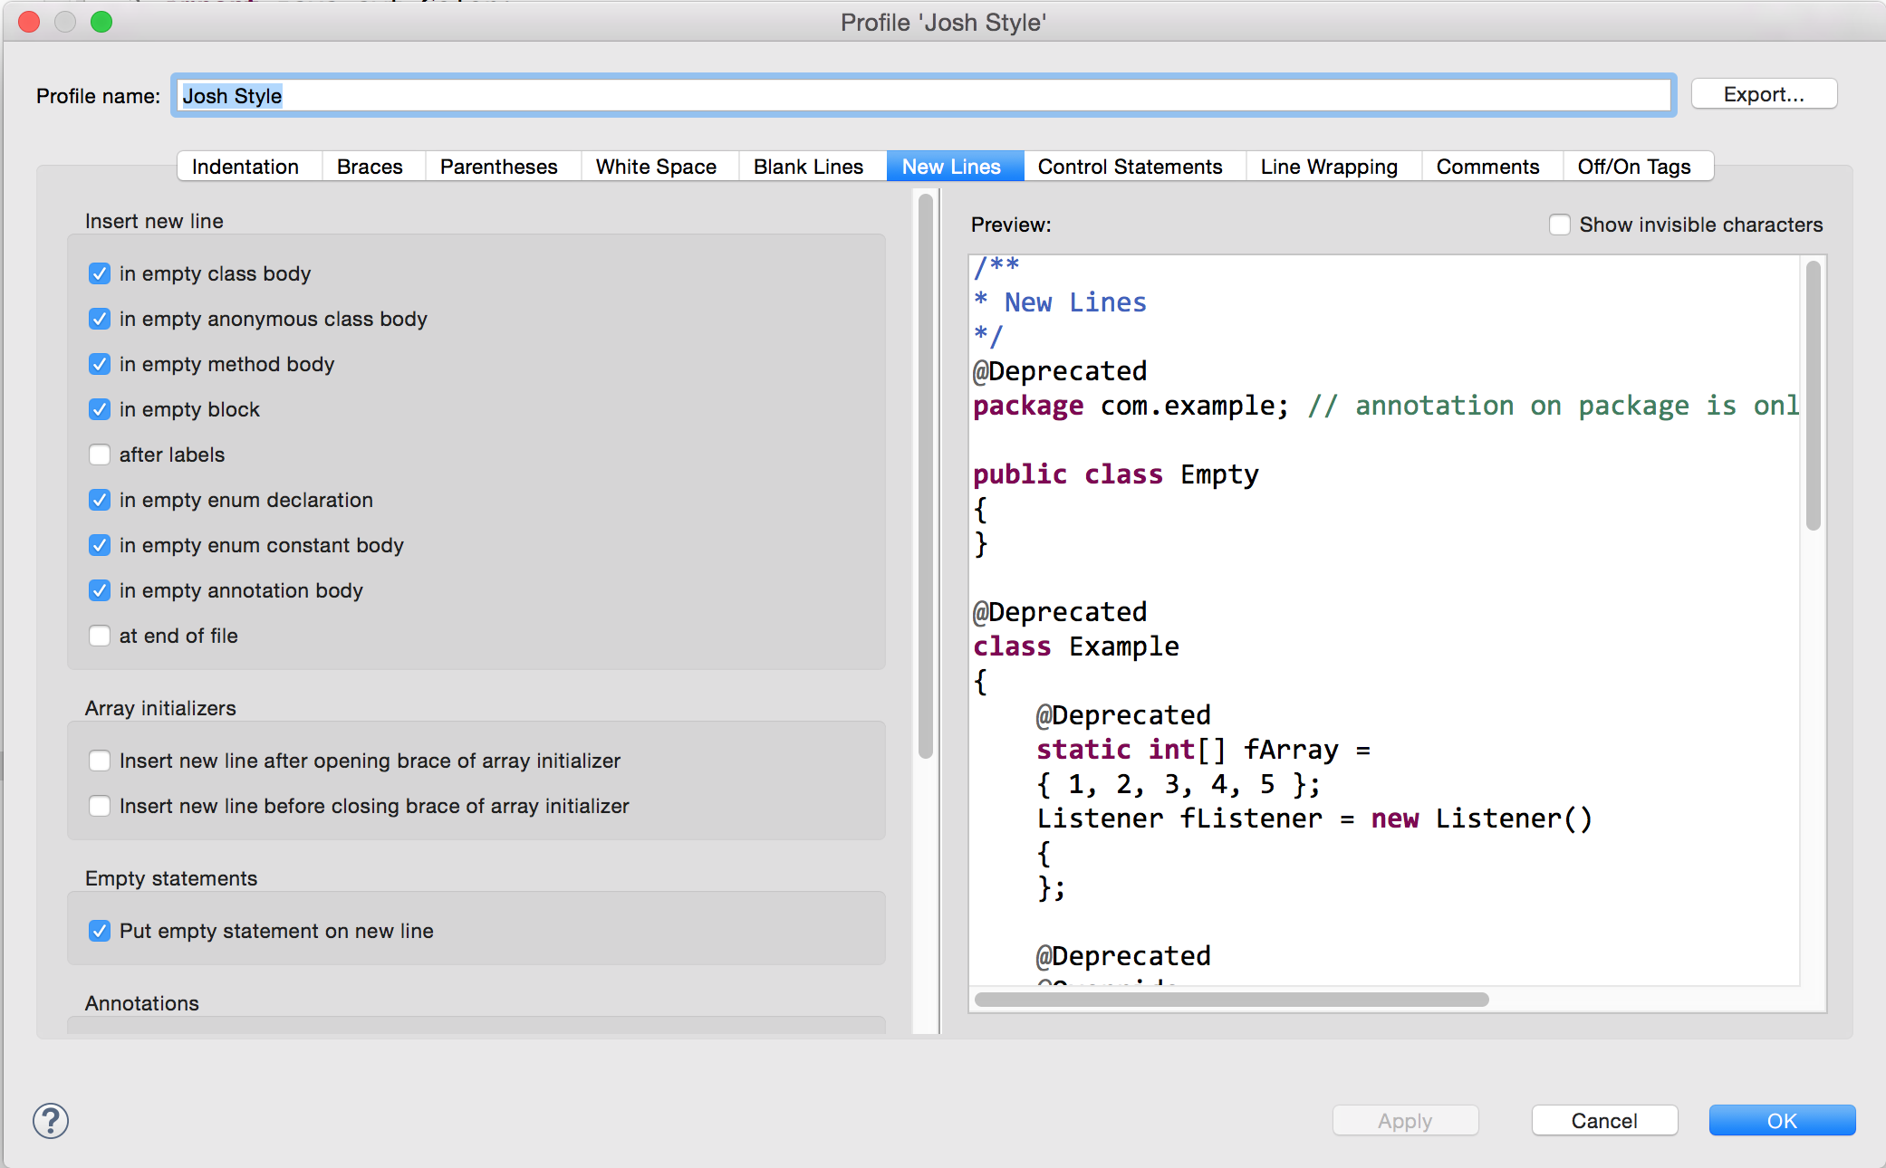
Eclipse formatter!

Slide 16
Sources
Martin, Robert C. Clean Code. New Jersey: Pearson Education Inc, 2009.

Slide 17
Code Design
Formatting
IT 426

