Slide 1
Code Design
Functions (Methods)
IT 426

Slide 2
Keep functions small!
Functions should be
Limited to as few lines as possible
Never stretch off screen
If you function reaches beyond 20 lines of code, you should ask yourself whether it is trying to do too much
“The first rule of functions is that they should be small. The second rule of functions is that they should be smaller than that.”

Slide 3

Keep functions small!
Benefits
Easy to understand
Easy to debug
Easy to unit test
Difficult to introduce side effects (more on this later)

Slide 4
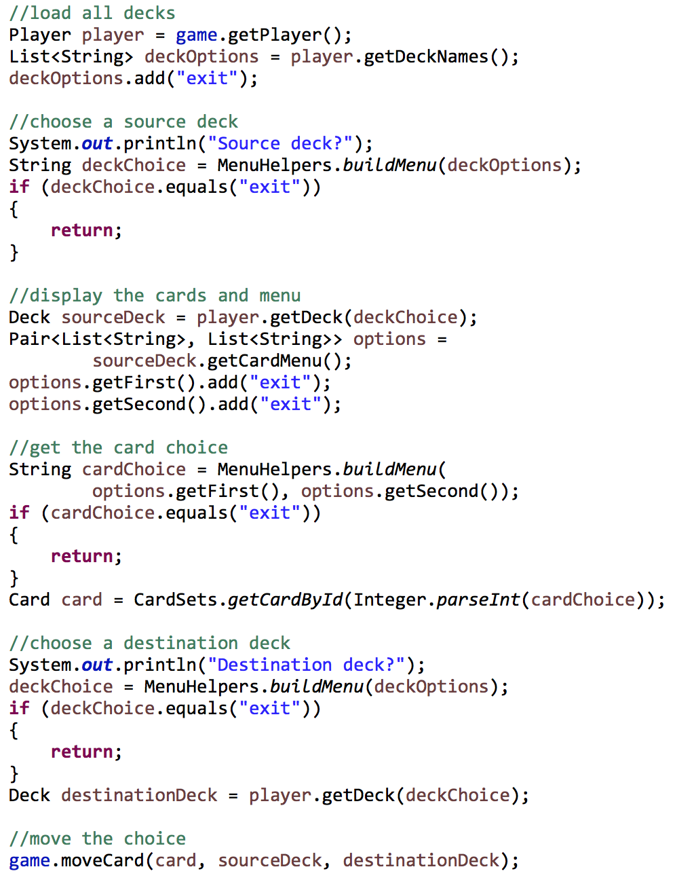
Keep functions small!
God object: an object that does too much
God function: a function that does too much

Slide 5
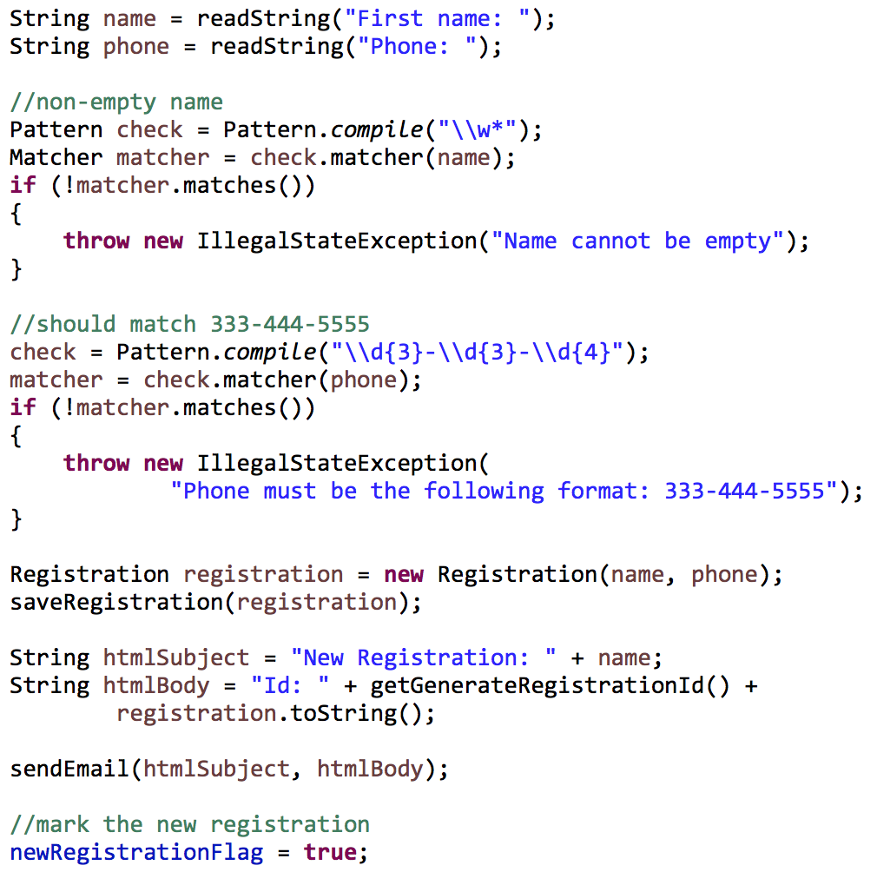
Functions should do one thing!
One goal, one problem solved
How many problems am I solving in the following code segment?

Slide 6

Functions should do one thing!
Goal: register a new user
Read in registration values
Validation
Saving a new registration object
Sending an email
“Functions should do one thing. They should do it well. They should do it only.”

Slide 7
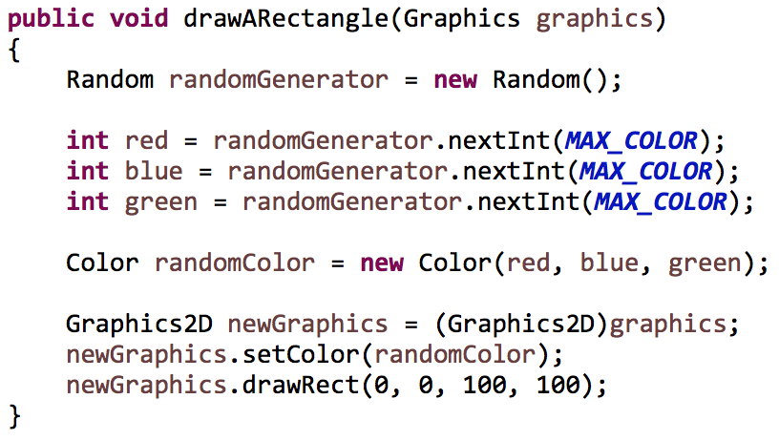
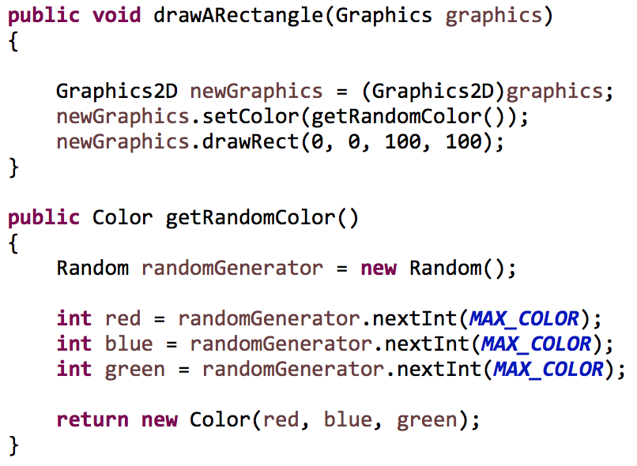
Extracting functions
If you can extract a function from another function and give it a name that is not a restatement of the original implementation, then the function is doing more than one thing.

Slide 8
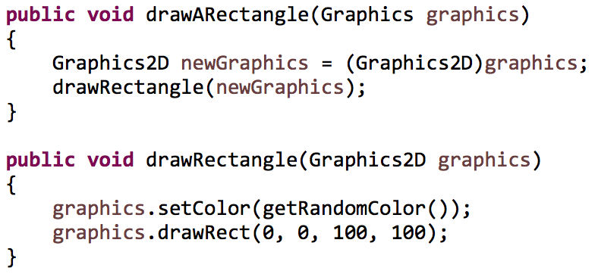
Extracting functions
This does not work

Slide 9
One level of abstraction per function
registration
get user values
read name
read phone number
validate user values
Save registration object
validate name
validate phone number
generate object
save it
Send email
header
body

Slide 10
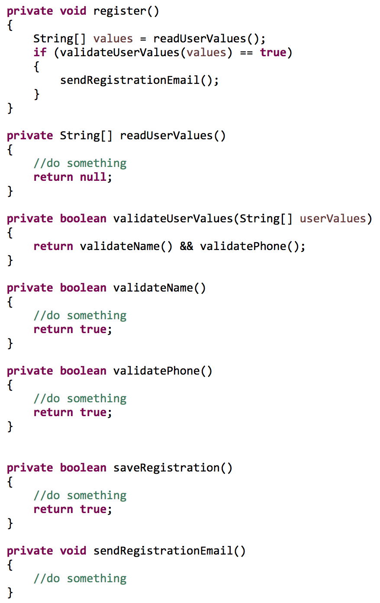
The stepdown approach
A code file should read from top-to-bottom
It should include higher level abstractions above lower level abstractions

Slide 11
The stepdown approach
A code file should read from top-to-bottom
It should include higher level abstractions above lower level abstractions

Slide 12
Use descriptive names!
A function name should describe what it does
Be pithy
Don’t be afraid of longer names!
Give the same effort to private methods as public
Examples
sendRegistrationEmail() is better than email()
isRetirementAge() is better than checkFlag()
validateAndSaveEmployee() is better than employeeStart()
What might be wrong with this function?
Notes:
Is it possible to misunderstand the names on the left?

Slide 13
Be consistent
Include similar names for similar concepts
Java’s inconsistency
Array.length
String.length()
ArrayList.size()
Examples
Bad: addHeader(), includeLogo(), generateBody()
Good: includeHeader(), includeLogo(), includeBody()

Slide 14
Number of function arguments
Niladic (0)
The ideal number
Monadic (1)
Acceptable
Dyadic (2)
Acceptable
Triadic (3)
Avoid this many arguments if possible
Polyadic
Use a new type (class) to wrap your arguments

Slide 15
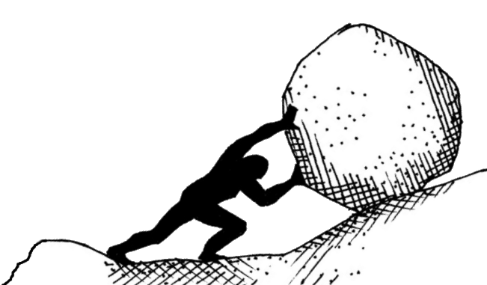
Niladic form
Examples
void buildGui()
boolean isHealthy()
double calculateTotal()
Less is more!
“The ideal number of arguments for a function is zero”
A function with less arguments is
easier to understand
easier to test

Slide 16
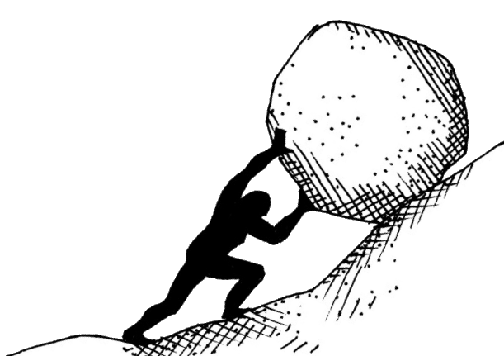
Monadic form
Examples
void saveEmployee(Employee newEmp)
void mouseClicked(MouseEvent event)
boolean fileExists(String fileName)
String readFile(File theFile)
Always be clear about intent
Asking a question about the input (query)
Operating on the input (command)

Slide 17
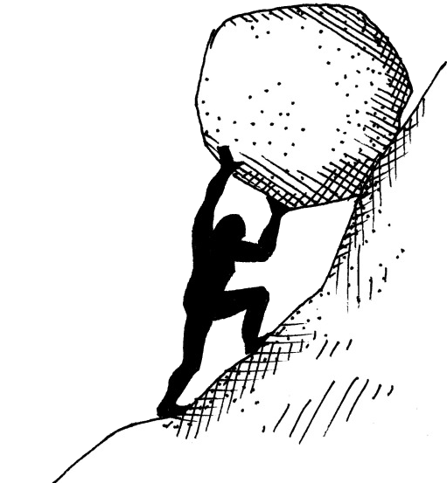
Dyadic and triadic form
Examples:
Point createPoint(int x, int y)
boolean isUser(String fName, String lName)
void draw(Graphics g, Color c, BasicStroke s)
void move(Shape s, boolean relative, Point p)
We begin to
Pause to consider inputs
Ignore inputs
Ordering of arguments becomes important

Slide 18
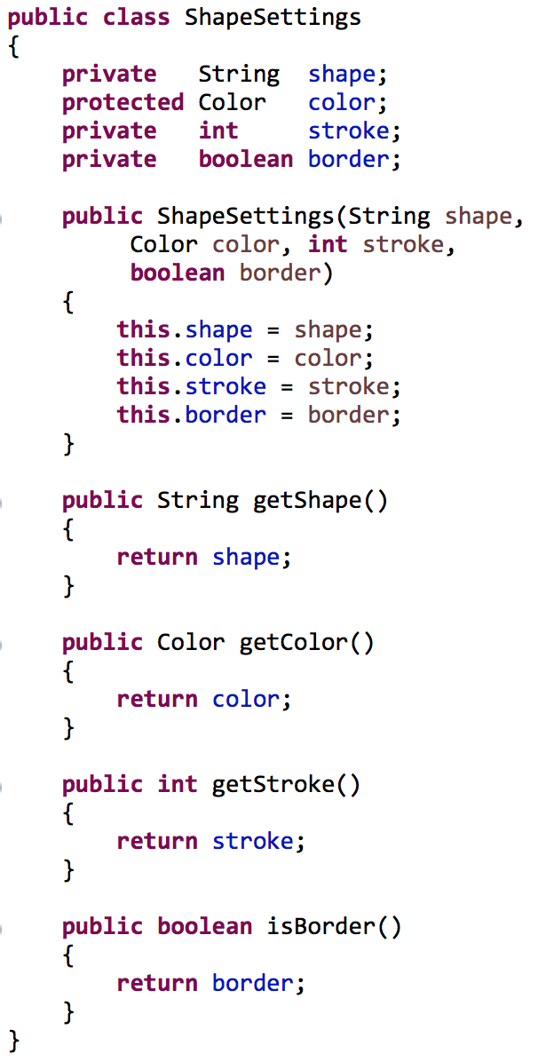
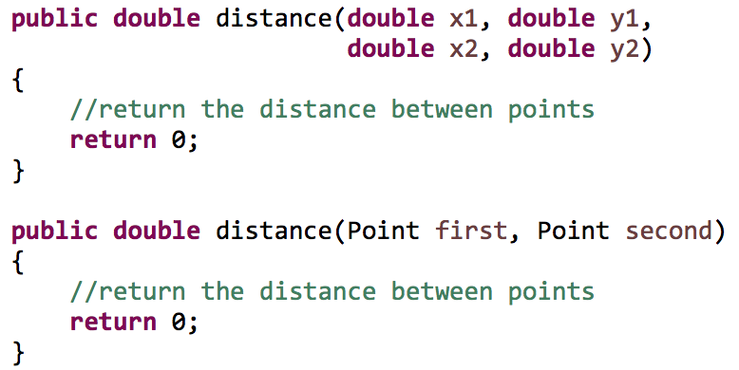
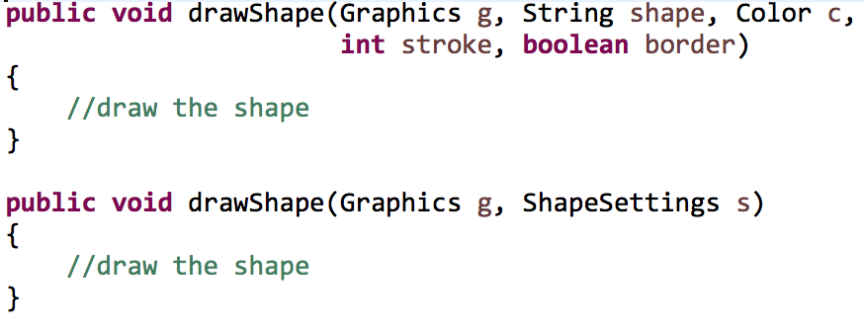
Reducing arguments

Slide 19
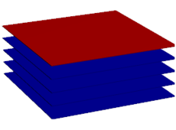
Command query separation
A function should
Do something (command)
Ask something (query)
Not both!
Stack ADT example
push() – does something
Adds an element to the stack
peek() – asks something
Returns the top element of the stack
pop() – does something and asks something
Removes the top element from the stack (does something)
Returns the top element from the stack (asks something)

Slide 20

Command query separation
Command examples (change of state?)
employee.update(newName);
ball.bounce();
order.send(address, phoneNumber);
creditCard.charge(amount);
Query examples (change of state?)
pen.getStrokeWidth();
bankAccount.isInOverdraft();
Notes:
What state is changing with the command examples? What types of side effects could be part of the queries?

Slide 21

Command query separation
Anticipation of the behavior of a function
You can reorder calls to query functions easily
If we follow this separation then we can clearly see when the state of an object changes (commands)

Slide 22

Flags and null arguments
Avoid boolean arguments and arguments that accept null if possible
What are the following arguments?
shapeLine.draw(null, color, 10, 10, 20,
20, false);
Why null? What does false signify?
These types of arguments will always send you the API
Does the false signify that the method is doing more than one thing?

Slide 23
Flags and null arguments
Improvement?
shapeLine.draw(null, color, X1, Y1,
X2, Y2, Border.FALSE);
Notice the required constants
I still don’t know what null represents unless I look at the API!

Slide 24
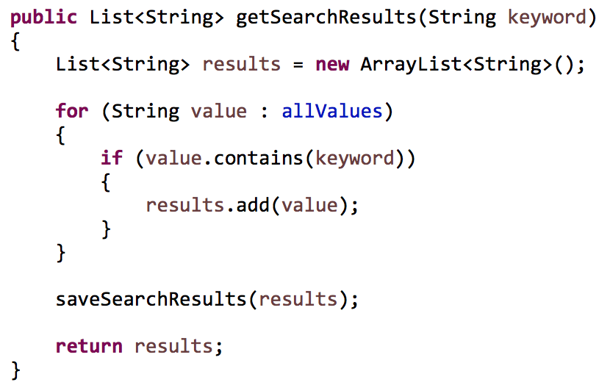
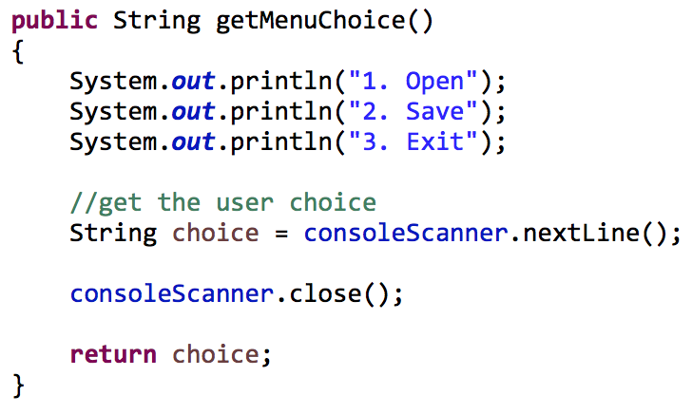
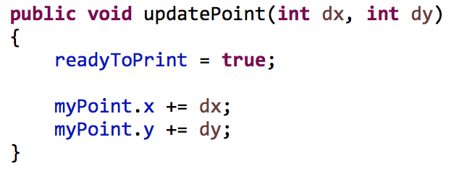
Function side-effects
Your function should not have side effects!
Your function should do only one thing
Can you see the side effects below?

Slide 25
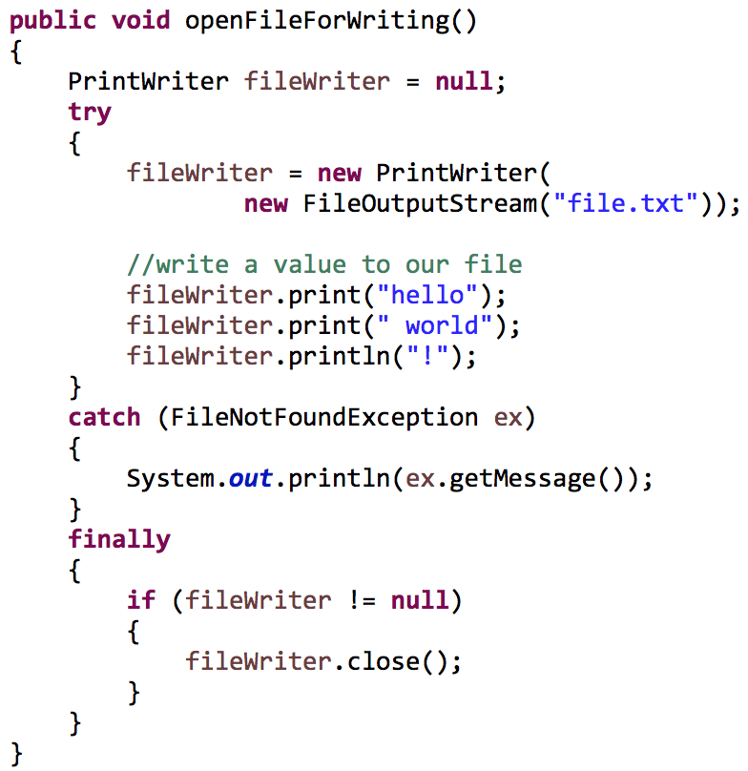
Extract try-catch blocks
They obscure meaning in functions
They force a function to do more than one thing!

Slide 26
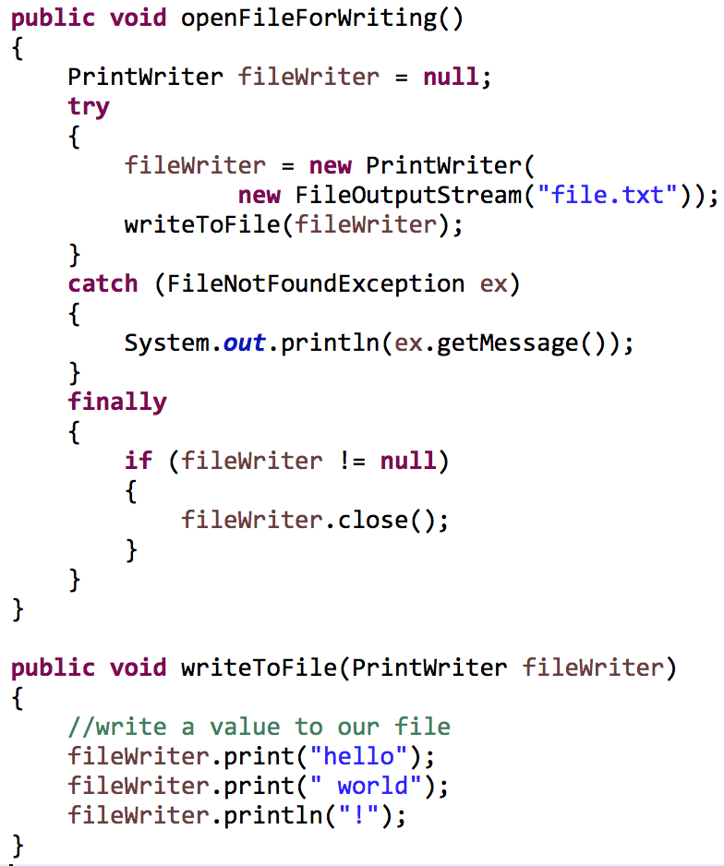
Extract try-catch blocks
They obscure meaning in functions
They force a function to do more than one thing!

Slide 27

Don’t repeat yourself!
Two major themes in Software Engineering
Never repeat yourself in code - DRY
How to write efficient code – runtime analysis

Slide 28
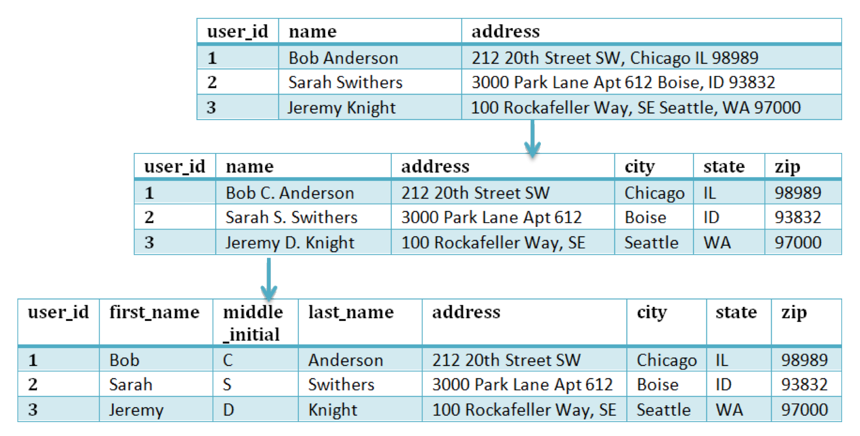
Ways to apply DRY
Database normal forms

Slide 29
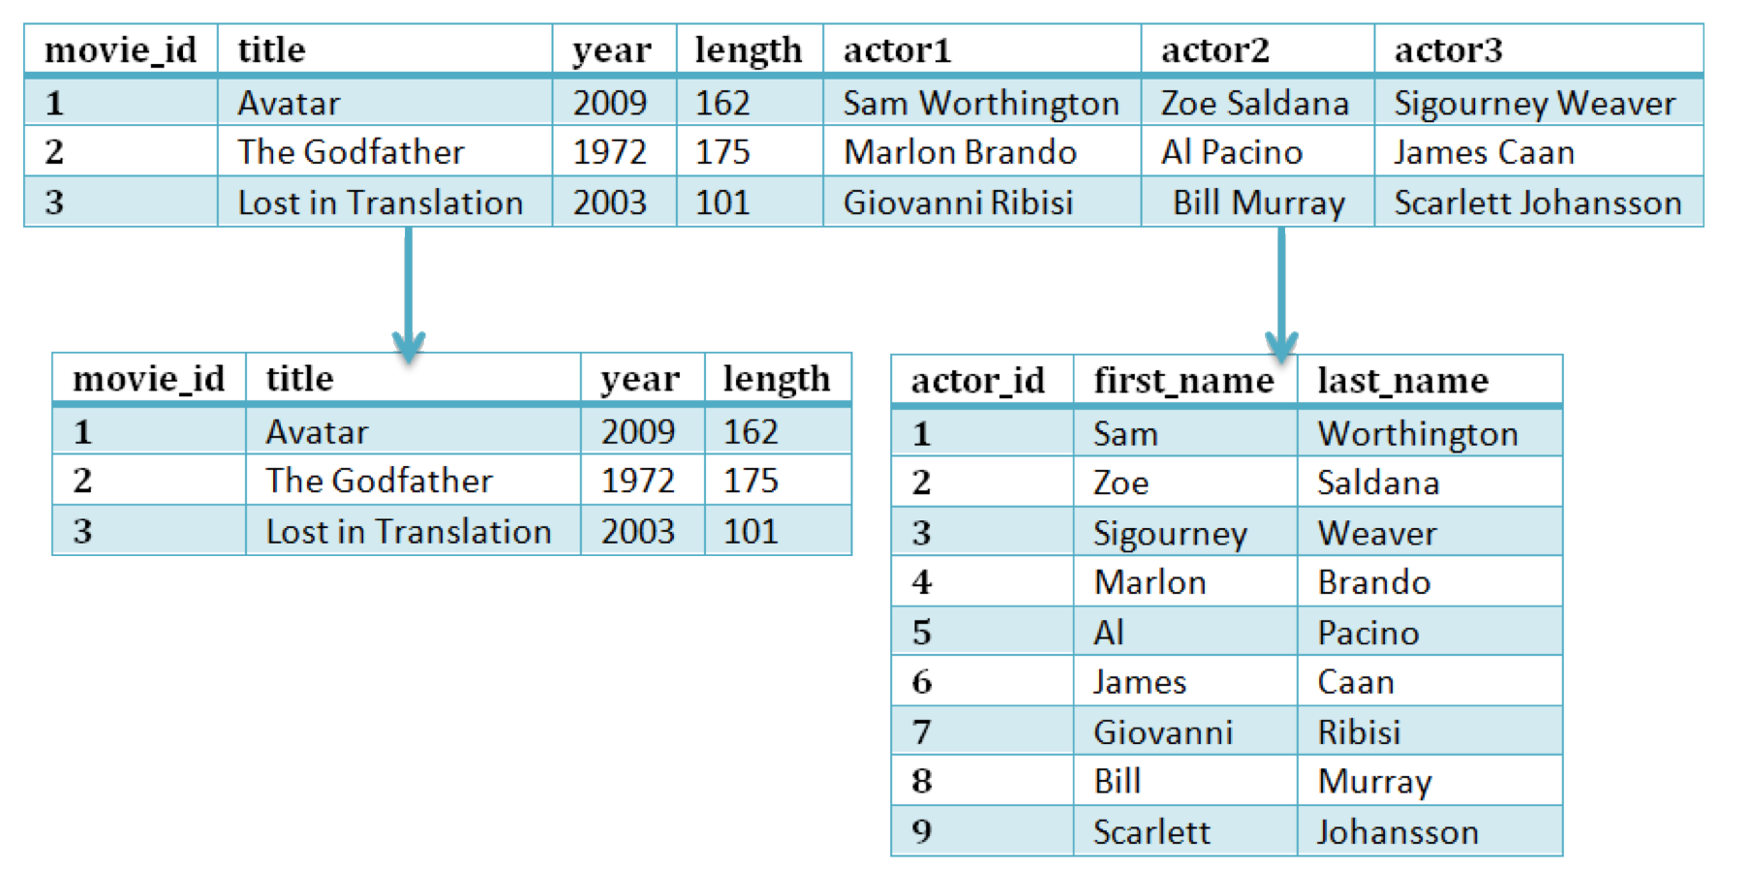
Ways to apply DRY
Database normal forms

Slide 30
Ways to apply DRY
Structural decomposition
place Order()
choose Billing()
choose Shipping()
verify Payment()
verify Account()
shipItems()
validation()
holdFunds()
pullItems()
package()
quality Control()
ship()

Slide 31
Ways to apply DRY
Inheritance
HardCoverBook
Author, Title, Publish Date, Publisher, Page Count
Ebook
Author, Title, Publish Date, Publisher, Format

Slide 32
Ways to apply DRY
Inheritance
Book
Author, Title, Publish Date, Publisher
HardCoverBook
Page Count
Ebook
Format

Slide 33
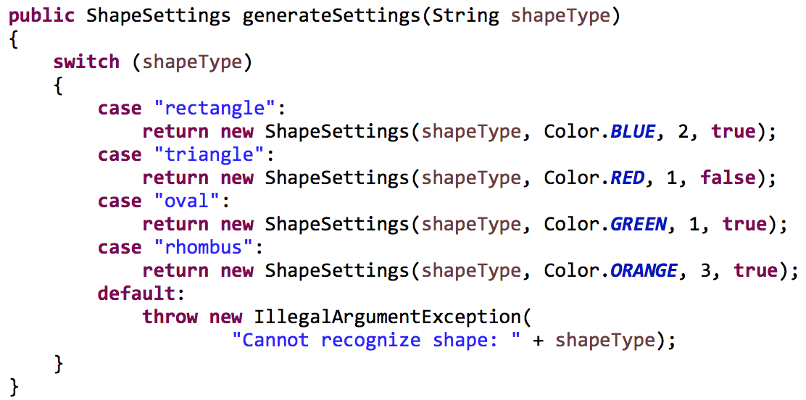
Structured programming
Every function should have one entry point and one exit point
One return statement!
Well, try to minimize the number of return statements

Slide 34
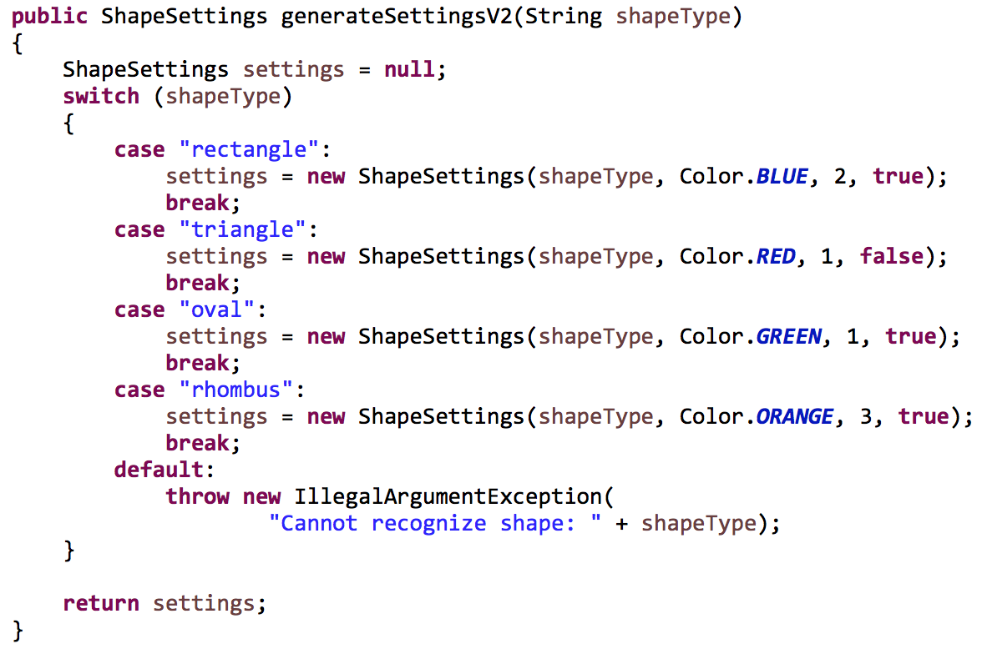
Structured programming
One return statement!

Slide 35
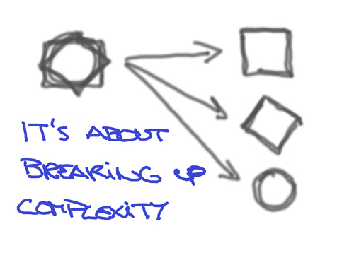
Cyclomatic complexity
Definition: The number of execution paths through a program
Adding more { decisions, loops, return statements } increases the complexity of a function
This in turn increases the difficulty of unit testing a function

Slide 36
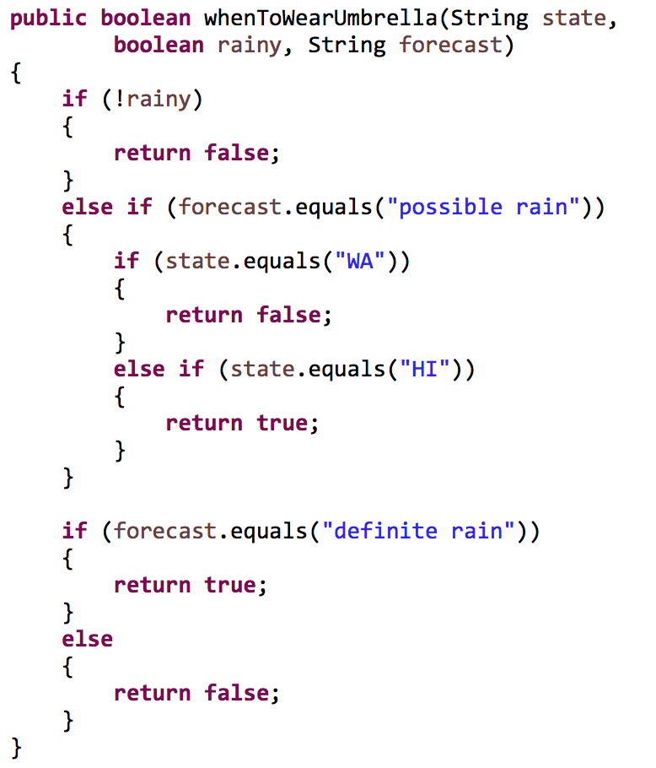
Cyclomatic complexity
How many linear paths are there in the program below?

Slide 37
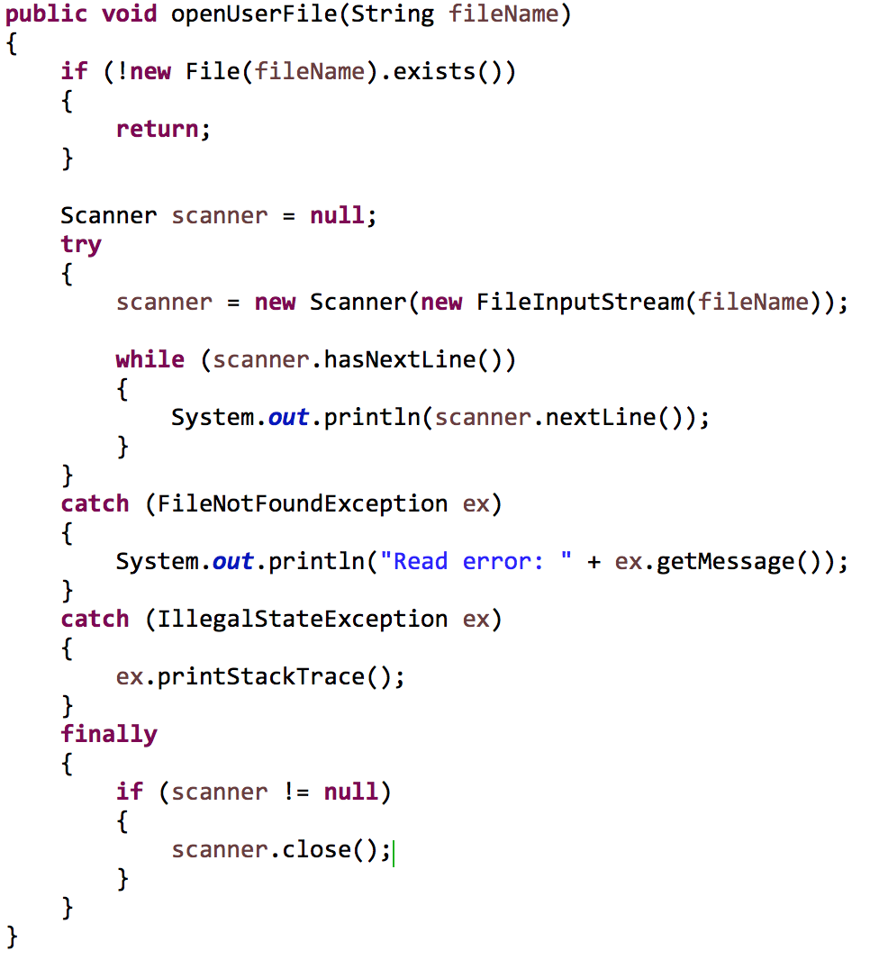
Cyclomatic complexity
How many linear paths are there in the program below?

Slide 38
Sources
Martin, Robert C. Clean Code. New Jersey: Pearson Education Inc, 2009.

Slide 39
Code Design
Functions (Methods)
IT 426

