Slide 1
Code Design
General
IT 426

Slide 2
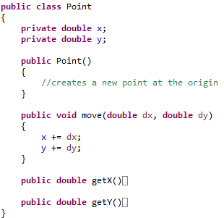
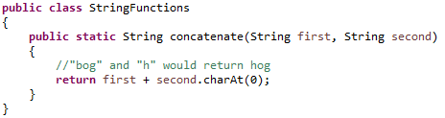
Principle of least surprise
A function or class should do what a programmer would reasonable expect from looking at its name
Some obvious behavior is expected in any library
I assume I would get (first + second)
I can’t create a Point object with an (x, y)?

Slide 3
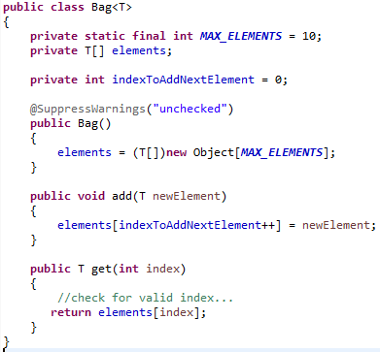
Principle of least surprise
Where is the size() method?
Where is the iterator() method?

Slide 4
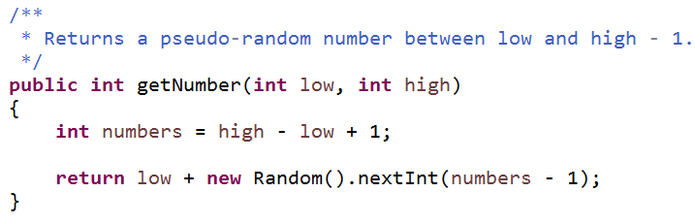
Principle of least surprise
Why, oh, why?!?!

Slide 5

Minimize your interfaces
Keep the public API of a class small
This reduces coupling with
sub-classes
collaborator classes
Reduce the number of public functions
Simplify their behavior

Slide 6

Avoid style inconsistencies
Commit to your conventions
I might not like your conventional style
But I’m glad you have a style
This includes:
Names
Naming conventions
Brackets
Indentation

Slide 7
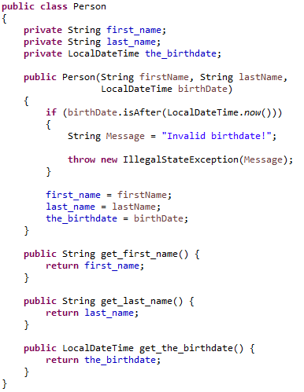
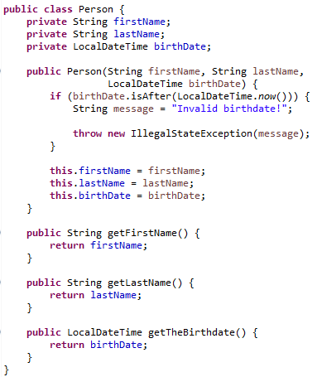
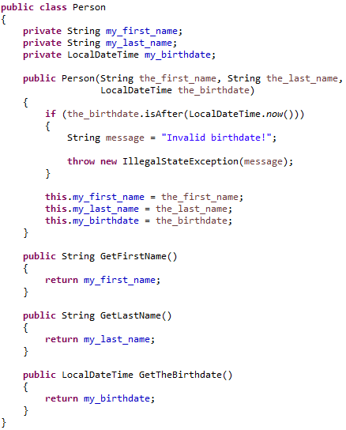


Avoid inconsistency

Slide 8
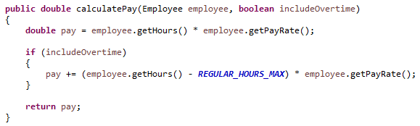
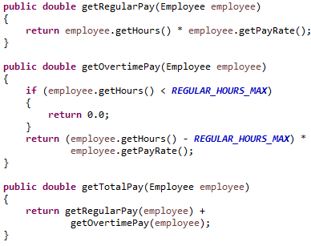
Avoid selector arguments
What does the following invocation imply?
calculatePay(myEmployee, true);
What does true stand for?
Off to the API I go!

Slide 9

Function names should say what they do
What do we know about the following invocation?
Date newDate = date.add(5);
Does this add hours, minutes or days?
Does the object in the “date” variable change?
Better choices:
If this adds hours and changes the object then
Date newDate = date.addHoursTo(5); //still bad design!
If this adds hours but does not change the object then
Date newDate = date.hoursLater(5);

Slide 10

Replace magic numbers with constants
You should never have numeric literals littered across your code
Replace numeric literals with meaningful constant names
86400 => SECONDS_PER_DAY
40 => CHARACTERS_PER_LINE
16 => HEX_BASE
The numeric literals 0, 1 and 2 are usually exempt from this rule

Slide 11
Encapsulate conditionals
Write functions to encapsulate complex logic
Example
if (rounds > 0 && player.getLife() > 0 &&
!game.isPaused()) { … }
if (isGameOver(player)) { … }
Example
if (point.getX() >= rect.getX() &&
point.getY() >= rect.getY() &&
point.getX() <= (rect.getX() + rect.getWidth()) &&
point.getY() <= (rect.getY() + rect.getHeight())) { … }
if (rect.contains(point)) { … }

Slide 12
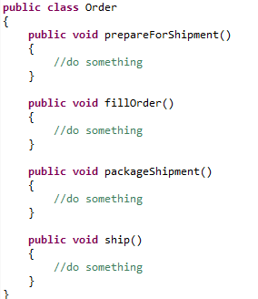
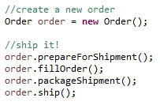
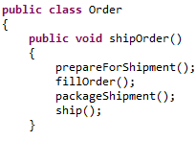
Beware of temporal couplings
Is the ordering of function calls important here?
What if a client calls these functions out of order?
Encapsulated for security and predictability.

Slide 13
Avoid transitive navigation
We should limit what we know about collaborator classes
employeeManager.getEmployee(10).getPayCheck().getTotal()
The EmployeeManager should not interact with the PayCheck class
employeeManager.getEmployee(10).getPayCheck().getTotal()
How would you fix this?
getEmployee()
getPayCheck()
getTotal()
EmployeeManager
Employee
PayCheck

Slide 14
Law of Demeter
Law of Demeter
We trust (interact with) our friends
But not friends of friends
Also called the Principle of Least Knowledge
This promotes loose coupling (why?)
getEmployee()
getPayCheck()
getTotal()
EmployeeManager
Employee
PayCheck
friends
friend of friends

Slide 15
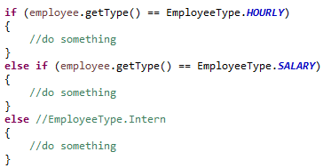

Use Enums!
Enums provide a structured way to group constants
They are easy to define
They increase code readability
They can prevent errors with “string markers”

Slide 16
Sources
Martin, Robert C. Clean Code. New Jersey: Pearson Education Inc, 2009.

Slide 17
Code Design
General
IT 426

