Slide 1
Code Design
Meaningful Names
IT 426

Slide 2

Creating “Readable” Code
Why is naming such a big deal?
Classes
Fields
Methods
Files
How do we choose meaningful names?
Names should be:
Self evident
Never ambiguous, disinformative, inconsistent or misleading
Follow conventions!
So other developers can follow your meaning (and quickly at that)

Slide 3
Intention Revealing Names
“Names should reveal intent”
int daisy = 100;
File f = new File(“my_file.txt”);
“If a name requires a comment, then the name does not reveal intent”
int tid = 10; //time in days since our last pay period

Slide 4
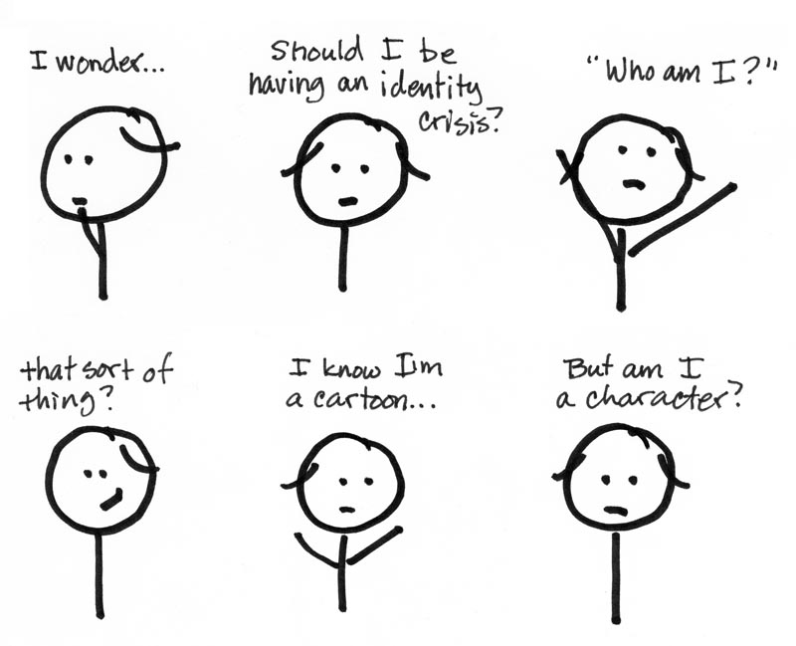
Intention Revealing Names
Variable names should tell you:
Why a variable exists!
What a variable does!
How to use the variable!

Slide 5
Intention Revealing Names
Better choices (from the previous slide)
int daisysAge = 100;
File recentTaxRecords = new File(“tax_records_2015.dat”);
int daysFromLastPayPeriod = 10; //is this name too long?!
Which is better?
int daysSinceLastPayPeriod = 10;
int daysElapsedFromLastPayPeriod = 10;
int daysElapsed = 10;
Don’t be afraid of longer names!

Slide 6
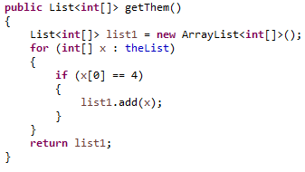
Code Review
What does this code do?

Slide 7
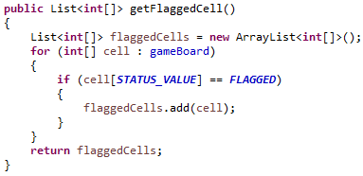
Code Review (Minesweeper)
After some refactoring

Slide 8
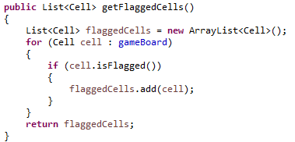
Code Review (Minesweeper)
Encapsulating some of our functionality in a class

Slide 9
Disinformation
Avoid false meaning in your names
Don’t call a variable “emailList” unless it is actually a list
Better choices: emails, emailGroup, bunchOfEmails
How about the name “gameMap”
Does this describe a geographical map in a game, or a HashMap?
What about the term “dictionary” in a name?
Avoid names with multiple meanings
What does the name “hp” stand for?
Hewlett Packard?
Hypotenuse?
Hit points?
HP – Unix?

Slide 10
Meaningful Distinctions
Avoid series
int a1, a2, a3;
Point point1; Point point2;
Customer customerA; Customer customerB;
Avoid names with indistinguishable differences
getCustomer(), getCustomers(), getCustomerInfo()
quit(), destroy(), dispose()

Slide 11

Avoid Noise Words
Noise words are the terms we add to names that don’t add meaning (or intent)
Can you spot the noise words in the following names?
EmployeeInfo
theProduct
emailString
customerObject
moneyAmount
PointClass

Slide 12
Avoid Noise Words
What is the difference before and after?
EmployeeInfo
theProduct
emailString
customerObject
moneyAmount
PointClass

Slide 13
Use Pronounceable Names
What do these names represent? | Can we misunderstand these names?
private DateTime mdyhms; | private DateTime timeStamp;
private Date modmdy; | private Date modificationDate;
String keymac = “ctrl-c”; | String copyKeybind = “ctrl-c”;
int cid = 10012; | int customerId = 10012;
String cistzip; | String cityStateAndZip;

Slide 14
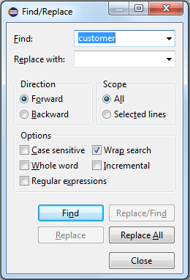

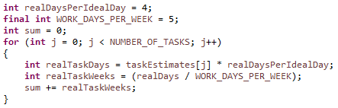
Searchable Names
Avoid single letter names or abbreviations
(except by convention – see below)
Avoid numeric literals (magic numbers)

Slide 15
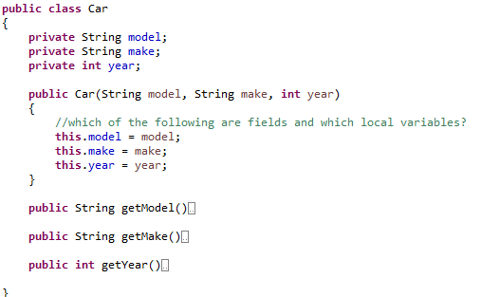
Avoid Encodings
Hungarian notation
btnPrimary
txtEntry
cmbStates
Member prefixes
mFirstName
theCustomerId
aPayPeriod

Slide 16
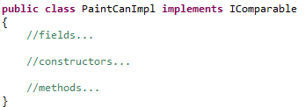
Avoid Encodings
Avoid emphasizing your interfaces and implementations
“A distraction at best and too much information at worst”
Interfaces
IComparable
IPrintable
Idrawable
Implementations
ShapeImpl
CPaintTool

Slide 17

Class Names and Method Names
Classes
Nouns
Noun phrases
Avoid plural names
Methods
Verbs
Verb phrases

Slide 18

Avoid Silly Names
holyHandGrenade() → deleteItems()
whack() → killProgram()
eatMyShorts() → abort()

Slide 19
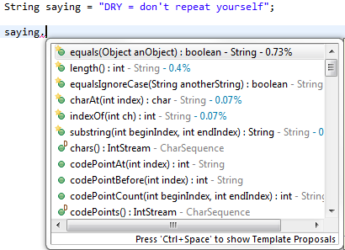
Pick One Word Per Concept
Will these be easy to find with intellisense?
fetchCustomers()
retrieveOrders()
getEmployees()
In Java:
myArray.length
myString.length()
myList.size()
In C#:
theList.Count()
theDictionary.Count()
theSet.Count()

Slide 20
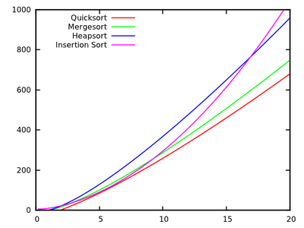

Solution Domain and Problem Domain
Solution domain names
Programmers will be reading your code
It’s fair game to use
Algorithm names
Pattern names
Math terms
Problem domain names
Use concepts from your problem domain as names
Film making: anamorphic, blockingAShot, chiaroscuro
College: studentRegistration, yearQuarter

Slide 21


Add Meaningful Context
What is the following code segment trying to do?
Are we referring to
states (ie. WA, OR, CA…)
states (ie. ON, OFF, BROKEN…)

Slide 22
Final Suggestions
“Clarity is king”
“Change [your names] when you find better ones”
Refactoring!
Use singular names for class names, plural names for data structures
List<Car> cars = new ArrayList<Car>();
There is a happy medium with name length (find it!)
int counter = 0;
int countOnTuesday = 0;
int negativeNumsOnTuesday = 0;
int countNegativeValuesButOnlyOnTuesday = 0;

Slide 23
Sources
Martin, Robert C. Clean Code. New Jersey: Pearson Education Inc, 2009.

Slide 24
Code Design
Meaningful Names
IT 426

