Slide 1
Inclusive development for web accessibility
Devon Persing
Green River College
14 February 2018

Slide 2
What we’ll do today
What is accessibility?
How does accessibility affect users?
Design and development considerations
Introduction to developer testing tools
Exercise
Q&A

Slide 3
Accessibility is building for every person on every device.

Slide 4
1 in 5 people in the US have a disability.

Slide 5

Hearing
Vestibular disorders
Learning difficulties
Photoepileptic seizures
Acquired brain injuries
Getting older
Noise-induced hearing loss
Anomalous trichromacy
Situational disabilities
Muscle slowness
Dyscalculia
Photosensitive epilepsy
Stroke
Tritanomaly
And many, many, many more…
Achromatopsia
Dysgraphia
Illiteracy
Visual impairments
Cerebral palsy
Loss of fine muscle control
Cataracts
Parkinson’s disease
Cognitive
Blindness
Chemo brain
Glaucoma
Protanopia
Lazy-Eyes
Cystic fibrosis
Muscular dystrophy
Vertigo
Astigmatism
Amputation
Deuteranomaly
Dichromacy
Deafness
Directionally challenged
Gamer’s thumb
Neurodegenerative diseases
Language barriers
Tritanopia
Dementia
Age-related macular degeneration
Tremors
Developmental disabilities
Dyslexia
Post-concussion syndrome
Color blindness
Sleep deprivation
Attention deficit disorder
Protanomaly
Monochromacy
Multiple sclerosis
Deuteranopia
Hard of hearing
Motor
Difficulty concentrating
Autism
Diabetic retinopathy
Visual
Aphasia
Reading disorders
Low vision

Slide 6
Disability experiences
Motor, mobility, and dexterity issues
Vision issues
Hearing issues
Seizure and vestibular disorders
Neurodiversity
Speech issues
Combinations of the above

Slide 7


Slide 8
What do users need to be able to do?
No mouse or touch
No vision or low vision
No hearing or low hearing
No seizures or motion issues
Few distractions, a clear path, and understandable language
Combinations of the above

Slide 9
Accessible, usable experiences in practice
Where am I?
What is this?
What will happen if…?
Did that work?

Slide 10
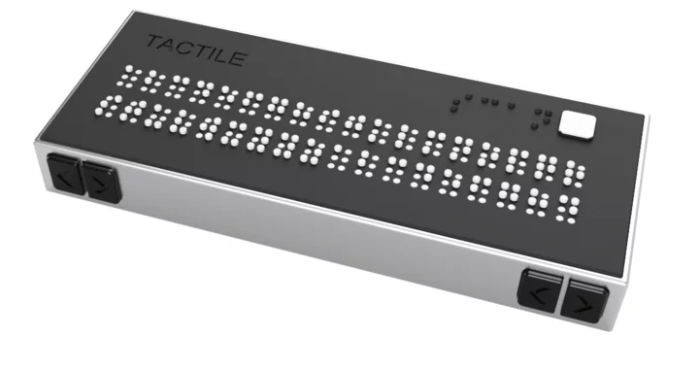
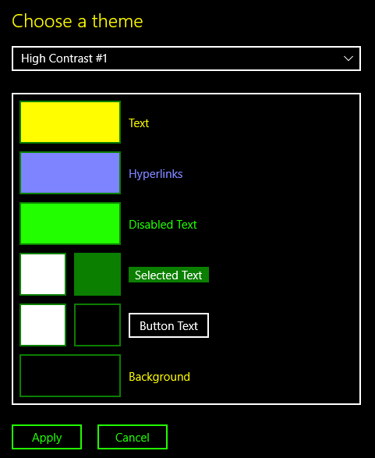
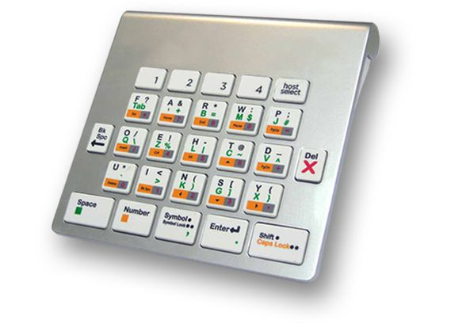




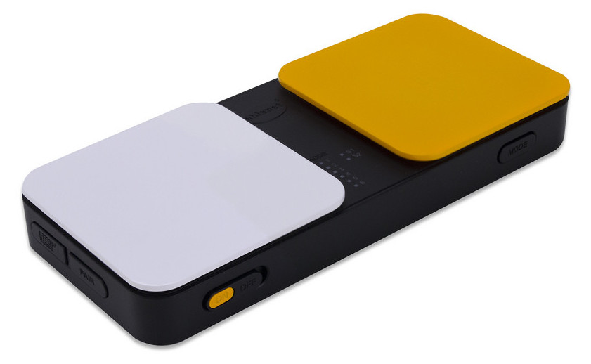
Assistive technology examples

Slide 11
Evaluating accessibility
Web Content Accessibility Guidelines (WCAG)
WCAG 2.0
WCAG 2.1 (draft)
Most organizations target Level AA success criteria
User research and usability studies with people who have disabilities

Slide 12
Content and Information Architecture
Design and UX
Development

Slide 13
Design and content
Color: Color contrast and not relying on color alone
Proximity: Put related stuff together
Labels: Make clear, logical labels for all controls
Micro-interactions: Individual steps are clear
Motion: Reduce motion to the minimum
Responsive: Allow for text resizing and user settings

Slide 14
Development stack
HTML: Semantic structure and content order
CSS: Look and feel
JavaScript: Interaction
Accessible Rich Internet Applications (ARIA): Extra semantic info for some assistive technology users

Slide 15
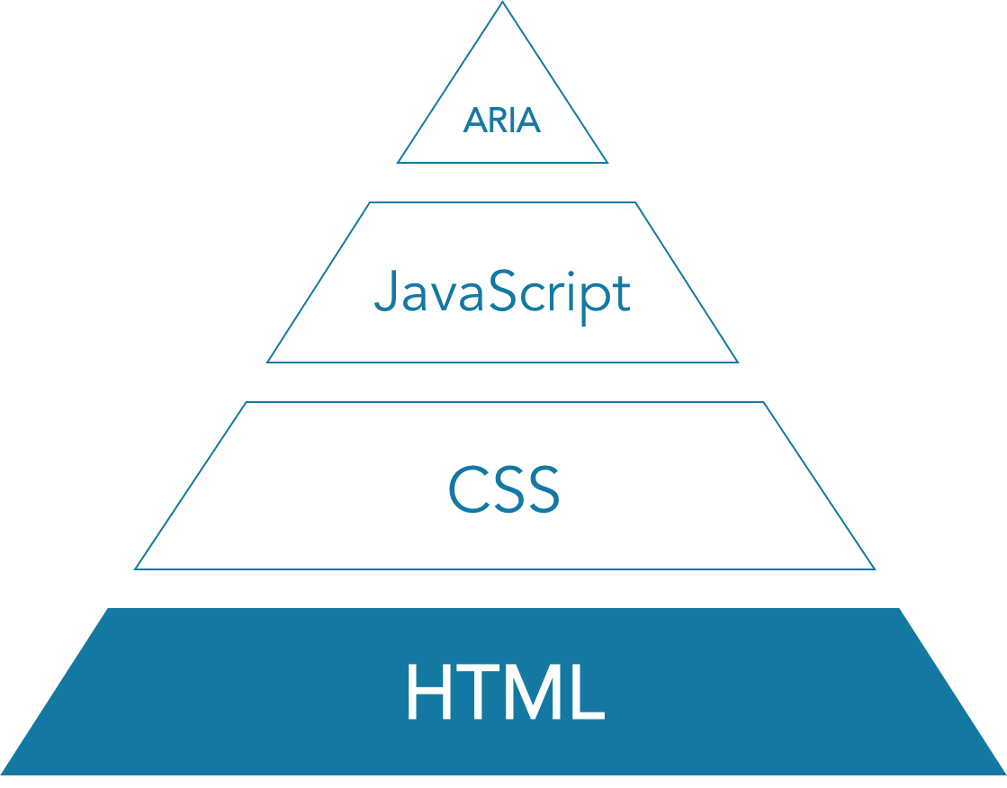
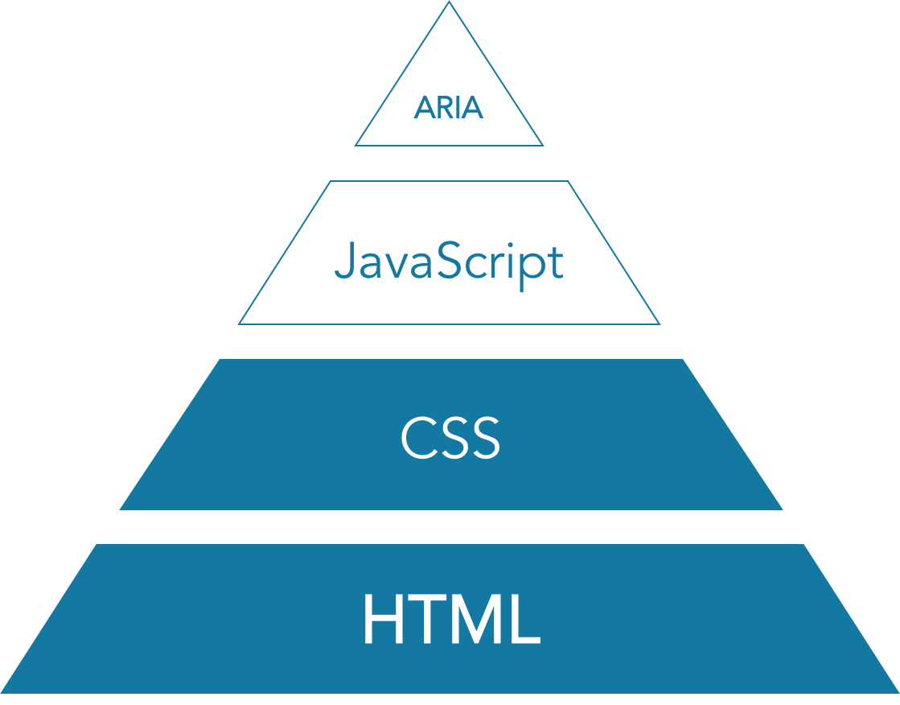
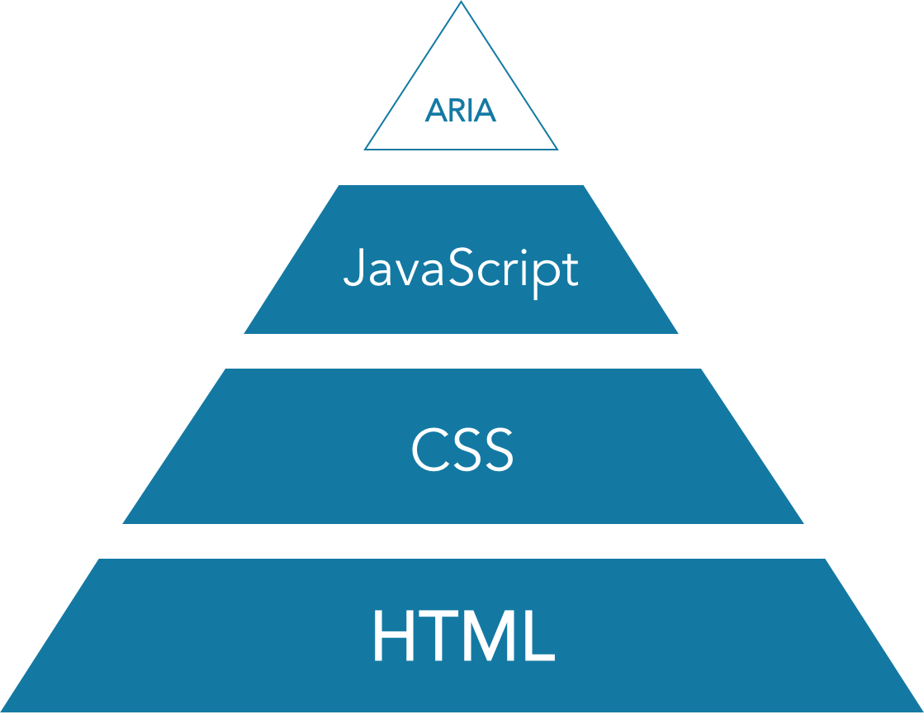
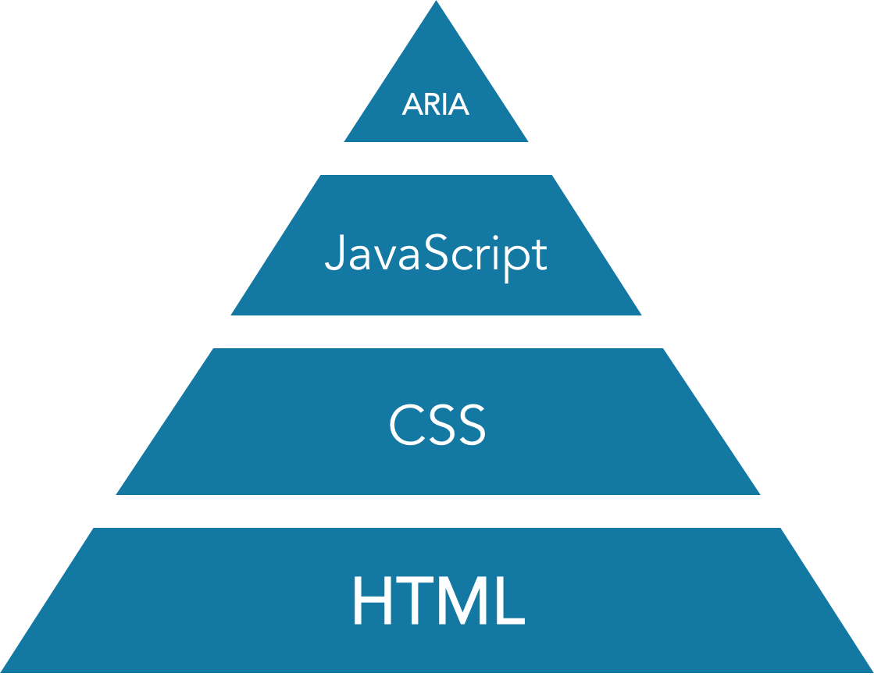
Notes:
Here’s a look at how progressive enhancement should pan out for your code with regard to accessibility. You should lean on HTML and CSS, use JavaScript when you need to, and use ARIA when the other three don’t cut it.

Slide 16
Introduction to testing tools
W3C Markup Validation Service
Keyboard
WAVE extension
Chrome accessibility audit
Chrome Accessibility Tools extension
Contrast Ratio

Slide 17
Minimum viable testing for development
Valid code
Logical content and heading order
Keyboard support
Use of color and contrast
Text equivalents for media

Slide 18
1. Validation
Unclosed tags?
Invalid or missing attributes?
Duplicated id values?
Nested controls?
Deprecated code?

Slide 19
2. Logical content order and structure
Is the page content presented in a meaningful order in the DOM?
Does the page have a logical heading structure (<h1>, <h2>, <h3>, etc.)?

Slide 20




Headings
Heading 1
Heading 2
Heading 3

Slide 21
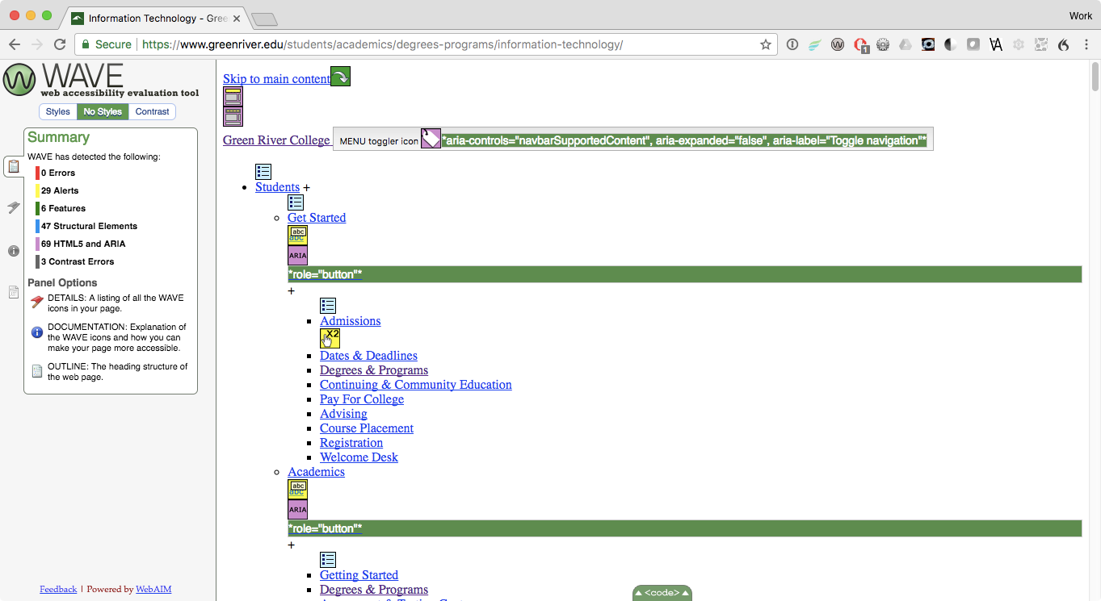

Slide 22
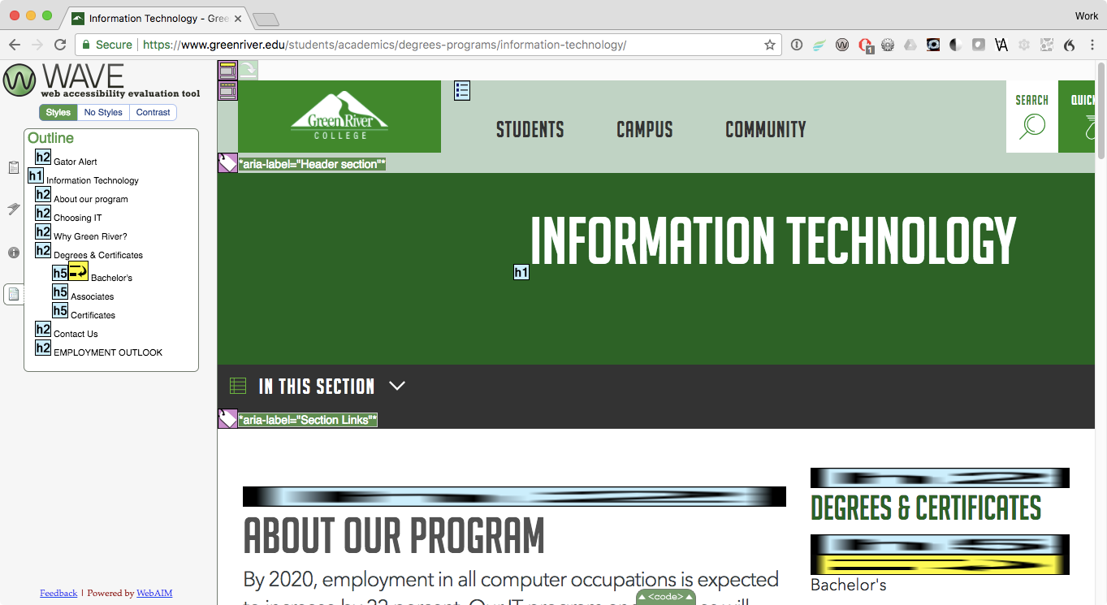

Slide 23
3. Keyboard support
Can you access and use interactive features with the keyboard?
Is focus visible?
Is the focus order logical?
Do changes only happen on activation?
If tabindex is used, are all values -1 or 0?
Does this work in every supported browser?

Slide 24
Keyboard cheatsheet
Action | Keystroke
Move focus to the next focusable element | Tab
Move focus to the previous focusable element | Shift + Tab
Fire a link | Enter
Fire a button | Enter or Space
Check or uncheck a checkbox | Space
Change a radio button selection | Up and down arrow keys
Change a select option selection | Up and down arrow keys

Slide 25
4. Color
Does normal text have a contrast of at least 4.5:1?
Does large text (18pt or 14pt and bold) have a contrast of at least 3:1?
Does color used to convey information have a text equivalent and/or another style as well?
Convert px to pt

Slide 26
5. Text equivalents for media
Are content images in HTML and not CSS?
Do all images have an alt (alt="some text" or alt="")?
If the image conveys information, does the text equivalent provide it?
Do videos have captions? A transcript?
Does audio have a transcript?

Slide 27
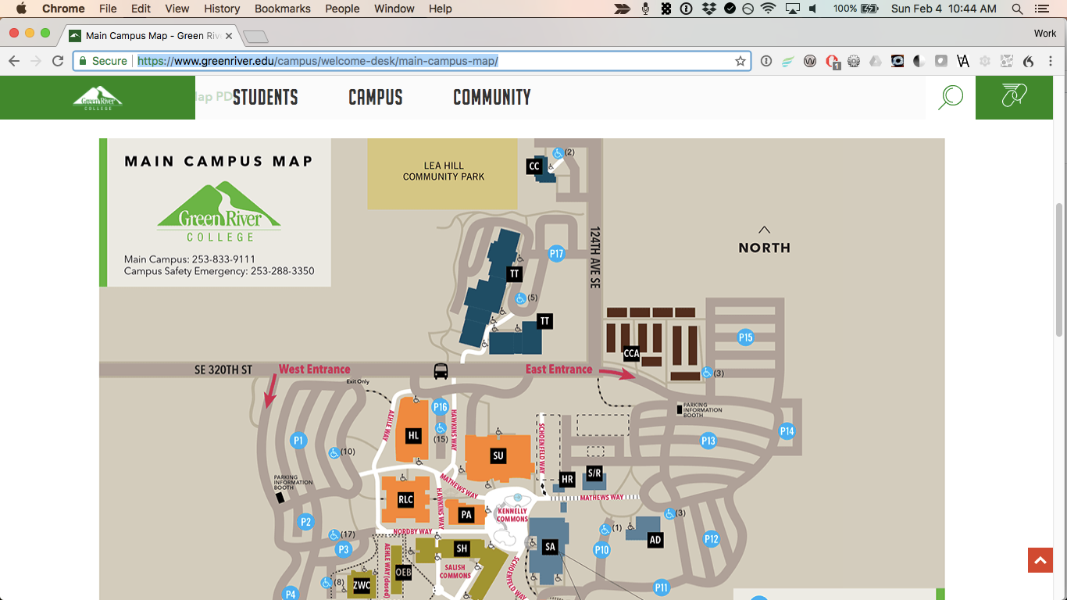

Slide 28
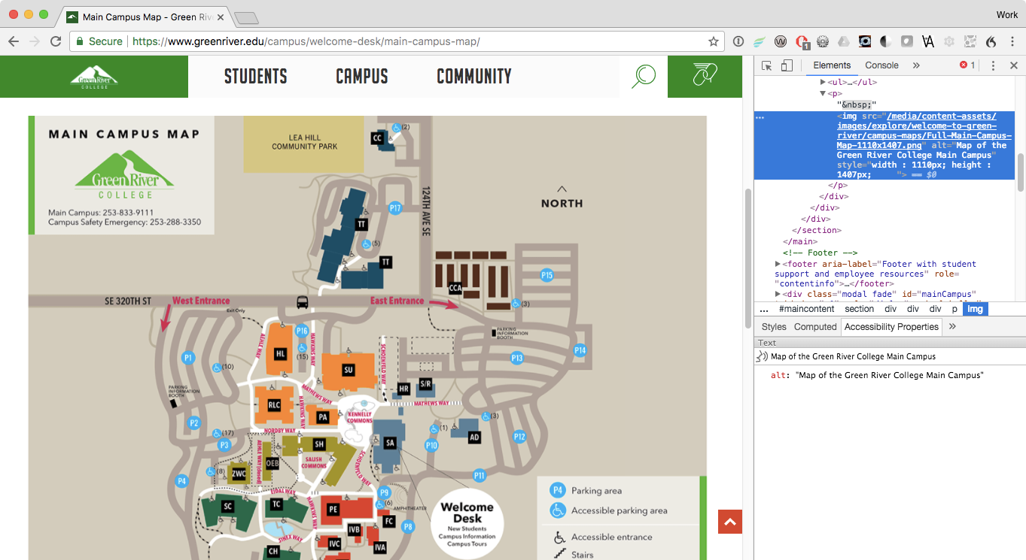

Slide 29
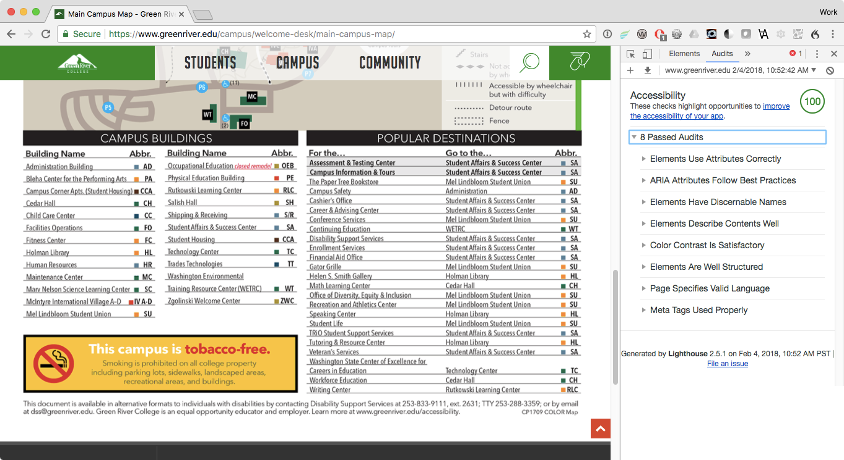

Slide 30
All automated tests require human verification.

Slide 31
Exercise
Choose one page from your current project and verify:
Valid code
Logical content and heading order
Keyboard support
Sufficient color contrast and use of color
Text equivalents for media

Slide 32
Accessibility ≠ compliance
While some accessibility issues can be found with automated testing, accessibility is a usability problem, so it requires hands-on care.
You’ll never be able to design, develop, and test for every single use case, but you can work to address the most common ones and get a feel for how they overlap.

Slide 33
Low vision tools from discussion
I want to see like the color blind
NoCoffee vision simulator

Slide 34
Advanced accessible examples
Keyboard focus management for modals
Form labels and validation
Image carousel
Google map
Drag and drop
Date picker

Slide 35
Safely hide content visually only, for screen reader users
.visuallyhidden {
border: 0;
clip: rect(0 0 0 0);
-webkit-clip-path: inset(50%);
clip-path: inset(50%);
height: 1px;
margin: -1px;
overflow: hidden;
padding: 0;
position: absolute;
width: 1px;
white-space: nowrap;
}

Slide 36
Q & A

Slide 37
Thank you!
Site: dpersing.github.io
Twitter: twitter.com/devonpersing
LinkedIn: linkedin.com/in/devonpersing/
Articles: simplyaccessible.com/article/author/devon/

