Slide 1
IGRAD
JEFF – DUCK - KEVIN

Slide 2

IGRAD WEB APPLICATION
BY TEAM EXPLOSIVE SALSA

Slide 3

DESIGNED AND BUILT FOR

Slide 4
WHY ARE WE HERE?
To significantly improve the manual process of populating a 40 page application with applicant information through automation.
Build software to make it easier for people to apply
to iGrad and pursue their GED

Slide 5
ELEVATOR PITCH
This product will be built for iGrad, a partnership company between Kent School District and Green River College. The program is designed for students who have dropped out of highschool or are behind on credits. The product will significantly reduce the application time for potential iGrad students as well as provide a straightforward and efficient workflow for the application process while still capturing the information necessary.

Slide 6
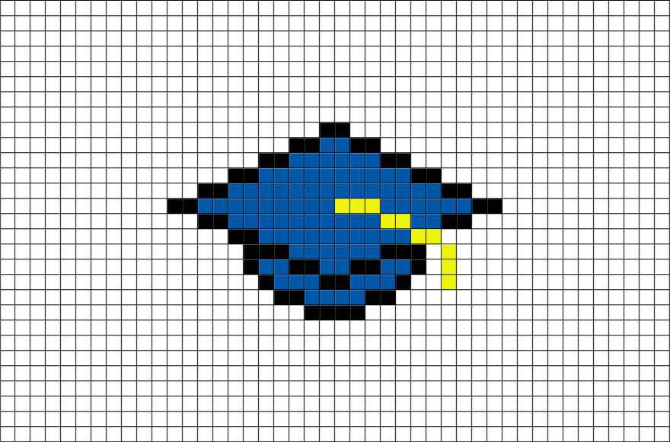
PRODUCT BOX
iGrad
Behind on Credits?
Want your G.E.D?
Students age 16-21
Apply In Under 5 Minutes!

Slide 7
THE NOT LIST
Discovering hosting solutions for our client.
Focusing on a mobile friendly (responsive) environment.
We will not be enabling the pdf to be editable; PDFs are generated with content that are not able to be changed without re-generating a pdf.

Slide 8




PROJECT COMMUNITY
Ken
Dorothy Smedsrud
Jeff, Kevin, Duck
IGRAD students
Carol Cleveland
Everyone else !
Notes:
List everyone you are going to have to interact with at some point during the course of your project.
Goal is to start building relationships with these people and let them know we are coming down the tracks (before we actually get there).

Slide 9

TECHNICAL SOLUTION
MySQL
/SQL
iGrad
Website / App Form
.NET or LAMP
User
Analytics Engine

Slide 10
WHAT KEEPS US UP AT NIGHT
PDF Conversions
Scaling 40 pages of content into something manageable
Formatting of PDF
Unknown current infrastructure
Duck doing the Explosion Salsa logo

Slide 11
OUR TEAM
Jeff Pratt
Duck Nguyen
Kevin Locke

Slide 12
HOW BIG IS THIS PROJECT?
12 weeks
Construction
Last Rev.
UAT
Training/
Configuration
9 weeks
1 wk
1 wk
1 wk
Thorough Customer Feedback every 2 weeks

Slide 13
TRADE-OFF SLIDERS
 | The classic four
 | Feature completeness (scope)
 | Stay within budget (budget)
 | Deliver project on time (time)
 | High quality, low defects (quality)
ON
OFF
ON
OFF
ON
OFF
ON
OFF
 | Other important things
 | Ease of use
 | Don’t make me think!
 | Detailed audits (log everything)
 | All In One Embedded Functionality
ON
OFF
ON
OFF
ON
OFF
ON
OFF
Notes:
When push comes to shove, something has to give. Here we want to be clear on what that is.
On agile projects we flex on scope. But there could be others factors at play here so get ready to listen as you customer tells you which forces can bend (scope) and which are written in stone (usually budget).
Slider rules:
1. No two sliders can occupy the same level.
2. List other important project factors down below.

Slide 14
WORKING AGREEMENT
Sprint Material to be complete and submitted to repo by 9:00 PM the day before review (at the latest)
24 Hour turnaround time on team questions in GLIP chat / email.
Reasonable notice if there are struggles with dev material so other members can help solve them. (LET THE TEAM HELP!)
Unanimous agreement on distribution of work items.

Slide 15
VISION STATEMENT
Build an efficient and inviting application form for potential iGrad students. Collect all necessary information in as short amount of time as possible. Collect user information and perform data analysis on captured data.

Slide 16
DEFINITION OF DONE
A Sprint is done when:
The Team has completed all user stories.
All completed user stories for sprint have been committed to repo.
All user stories have been tested for functionality.
The completed user stories have been presented to product owner.

Slide 17
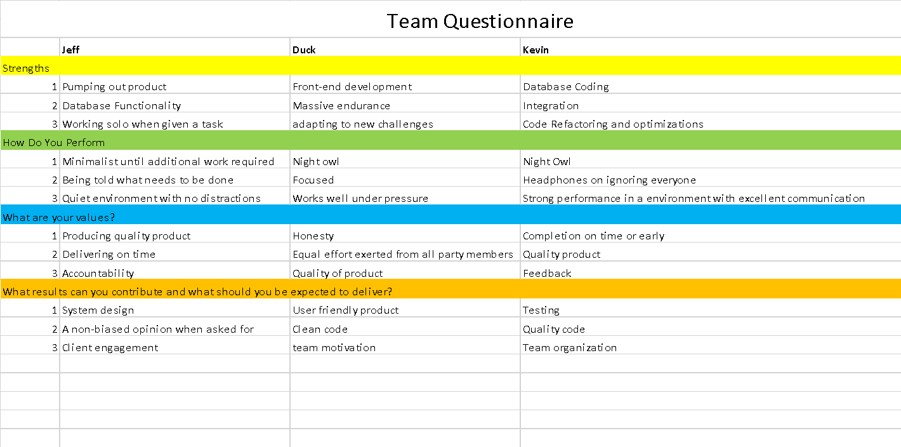
DRUCKER EXERCISE

Slide 18
MINIMUM VIABLE PRODUCT (MVP)
Hosted website that has its’ own domain. Website contains an application form for iGrad. User can fill out the form with relevant information. Form can be submitted, formatted to required state and saved as a .pdf file.

Slide 19
PAPER PROTOTYPE
Form main categories:
Student information
Education information
Household information
Supplemental questions/ others
Review/ Summary

Slide 20
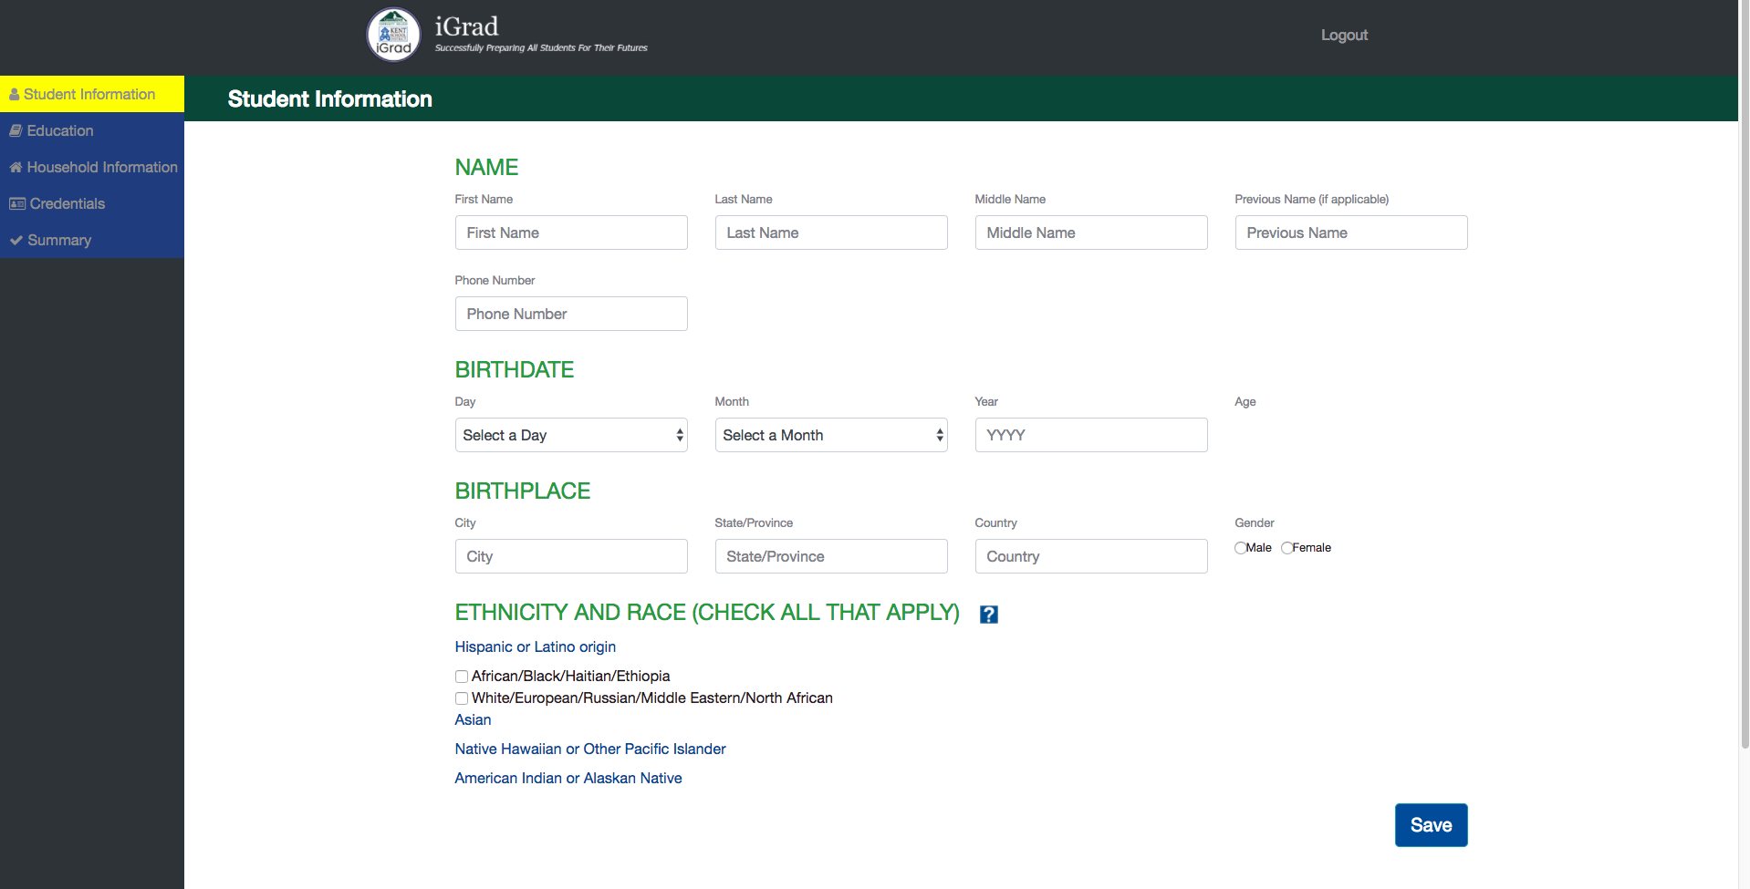
PAPER PROTOTYPE

Slide 21
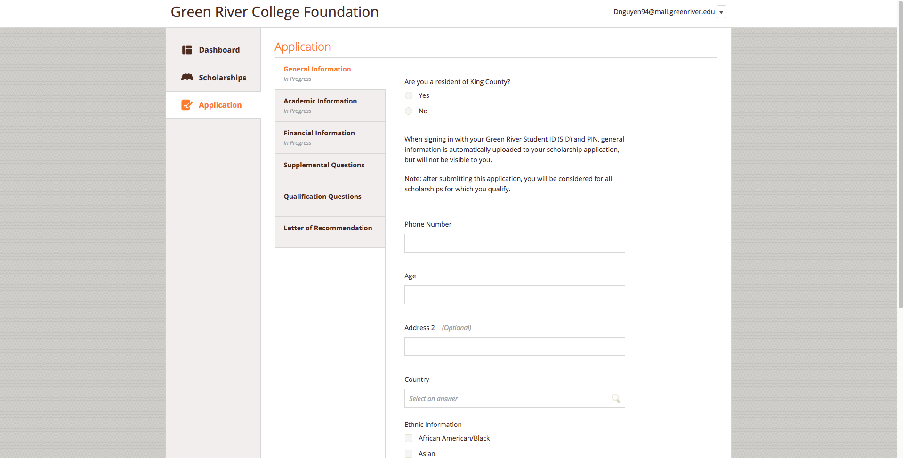

Slide 22
SIZE
3(devs) * 50$/Hr * 20Hrs/Week * 10 Weeks (project life) = $30,000
Cloud Hosting : TBD
Total Cost ~ $42,000

