Slide 1
ENGLISH WRITING & PRESENTATION SKILLS — FINAL ORAL DEFENSE
PasswordGuard: An Experimental Analysis of
Password Strength and Authentication Security
Student Researchers: Nguyen Duc Nhat (22001594) • Hoang Minh Duc (22002598) • Pham Tuan Phong (22002621)
Course: English Writing and Presentation Skills • Framework: React 19 / TypeScript / Client-Side Web Crypto
⚡ Opening Question for the Audience
Before we begin, which password do you believe offers stronger mathematical resistance?
Option A: "P@ssw0rd123" (Traditional complexity: uppercase, number, symbol, 11 chars)
Option B: "correct-horse-battery-staple" (Passphrase: 4 common lowercase words, 28 chars)
Today, we demonstrate why intuitive human perceptions often diverge from combinatorial mathematics.
Notes:
Hello everyone, and welcome to our presentation on PasswordGuard: An Experimental Analysis of Password Strength and Authentication Security. Before we start, let me ask our audience a quick question: Which of these two passwords do you think is stronger? Option A: P@ssw0rd123, with symbols and numbers, or Option B: correct-horse-battery-staple, four simple lowercase words? Many people instinctively choose Option A because of the special characters. However, as we will explore today, Option B has a vastly larger mathematical search space. Let us examine why password security remains such a critical challenge.

Slide 2
PROBLEM & MOTIVATION
The Problem: Human Memory vs. Combinatorial Search Spaces
1. Human Cognitive Limits
2. Modern Threat Landscape
3. The Complexity Fallacy
• Account Overload: Users manage 50 to 100 online accounts across personal and academic services.
• Memory Constraints: Random, high-entropy character strings are cognitively difficult for humans to retain.
• Predictable Shortcuts: Users predictably fall back on simple dictionary roots, birthdays, and repeated substitutions (e.g., 'a' -> '@').
• Credential Reuse: The same root password is frequently reused across multiple websites, creating cascading breach risks.
• Leaked Wordlists: Attackers exploit precomputed wordlists (e.g., RockYou with 32M+ entries) and pattern mutation rules.
• High-Rate Offline Guessing: Unsalted or fast cryptographic hashes allow specialized GPU rigs to evaluate billions of guesses per second.
• Credential Stuffing: Automated botnets test dumped credential pairs across unrelated platforms with zero manual effort.
• Phishing & Interception: Social engineering bypasses password complexity entirely by intercepting plaintext directly.
• Superficial Rules: Legacy policies demanding 1 uppercase, 1 digit, and 1 symbol produce predictable templates like 'Spring2024!'.
• NIST SP 800-63B Shift: Modern standards discourage arbitrary character composition rules and frequent periodic expiration.
• The Education Gap: Most users have never seen how password length mathematically dominates character alphabet expansion.
• PasswordGuard Purpose: An interactive educational platform to demonstrate password heuristics, theoretical entropy, and salting.
Notes:
Why is password security such an enduring problem? Modern users manage dozens of accounts. Because truly random strings are hard to memorize, users predictably take cognitive shortcuts—reusing passwords or adding simple substitutions like an exclamation mark at the end. Meanwhile, attackers exploit leaked wordlists and automated botnets. Even worse, traditional complexity rules produced an illusion of security: people wrote passwords like 'Summer2024!', which modern attack tools crack almost instantly. PasswordGuard was created to make these mathematical realities transparent and accessible through hands-on interaction.

Slide 3
AUTHENTICATION FOUNDATIONS
Mathematical Foundations: Search Spaces & the Prover-Verifier Model
1. Prover-Verifier & Formula
2. Search Space Comparison
The Prover-Verifier Principle:
In client-server authentication, the user (prover) proves knowledge of a secret without the server storing plaintext. The server validates against a stored cryptographic verifier.
Combinatorial Search Space Formula:
Total Combinations (S) = R^L
Theoretical Entropy (E) = L × log₂(R) bits
• R = Active character pool size (e.g., 26 letters, 62 alphanumeric, 95 printable ASCII).
• L = Password length in characters.
Critical Takeaway: Length (L) is in the exponent! Increasing length expands the theoretical search space exponentially, while expanding character pool (R) only increases the base.
Example 1: Short Simple (8 chars, lowercase only)
R = 26, L = 8 | Total: 26⁸ ≈ 2.09 × 10¹¹ combinations
Theoretical Entropy ≈ 37.6 bits | At 10¹¹ guesses/s: ≈ 1.05 seconds!
Example 2: Complex Short (8 chars, all ASCII sets)
R = 95, L = 8 | Total: 95⁸ ≈ 6.63 × 10¹⁵ combinations
Theoretical Entropy ≈ 52.6 bits | At 10¹¹ guesses/s: ≈ 9.2 hours
Example 3: Long Passphrase (28 chars, lowercase + hyphens)
R = 27, L = 28 | Total: 27²⁸ ≈ 1.20 × 10⁴⁰ combinations
Theoretical Entropy ≈ 133.2 bits | At 10¹¹ guesses/s: ≈ 1.9 × 10²¹ years!
Notes:
How do passwords work mathematically? In the prover-verifier model, the server stores a cryptographic verifier, not plaintext. If an attacker performs brute-force guessing, the theoretical search space equals R to the power of L, where R is the character pool and L is length. Notice that length is the exponent! Look at the comparison on the right: an 8-character password using all 95 printable characters yields about 6.6 times 10 to the 15th combinations. At an assumed rate of 10 to the 11th guesses per second, that could be tested in roughly 9 hours. In contrast, a 28-character passphrase using only lowercase letters and hyphens yields 1.2 times 10 to the 40th combinations—taking over 10 to the 21st years. Length dominates character variety.

Slide 4
ATTACK VECTORS & MITIGATIONS
Common Password Threats & Defense in Depth
Threat Vectors
Defense in Depth Layers
⚠️ Dictionary & Rule-Based Attacks
Attackers rarely guess uniformly. They prioritize human wordlists (e.g. RockYou) and apply automated mutation rules (leetspeak, appending years).
⚠️ Credential Stuffing Botnets
Automated replay of stolen username-password dumps against thousands of unrelated login portals, capitalizing on widespread user credential reuse.
⚠️ Offline Fast Hash Cracking
When unsalted or fast hashes (MD5, SHA-1, SHA-256) leak from backend databases, attackers perform unthrottled GPU recovery without server lockouts.
⚠️ Phishing & Social Engineering
Adversaries manipulate human trust through deceptive sites, harvesting raw credentials directly regardless of password complexity.
🛡️ Password Managers (Vaults)
Generate, store, and autofill cryptographically random, 20+ character passwords unique to every site—neutralizing credential stuffing.
🛡️ Multi-Factor Authentication (MFA)
Enforce independent factors (TOTP apps or FIDO2/WebAuthn hardware keys). Even if a password leaks, unauthorized access is denied.
🛡️ Slow Memory-Hard Hashing
Use dedicated Key Derivation Functions (Argon2id, bcrypt, scrypt) with unique salts to impose severe computational costs on offline attackers.
🛡️ Rate Limiting & Account Lockouts
Throttling login endpoints at the network perimeter neutralizes online automated guessing and credential stuffing botnets.
Notes:
Let us examine how passwords are attacked and defended. In the real world, attackers rarely try every character uniformly. Instead, they run dictionary words through mutation rules, replay breached passwords in automated credential-stuffing attacks, and crack leaked database dumps offline on GPU clusters. Phishing bypasses password complexity entirely. This proves that password security is not the same as authentication security. A resilient defense requires defense in depth: users must adopt password managers to keep credentials unique, enable Multi-Factor Authentication so stolen passwords alone are insufficient, and servers must employ slow memory-hard hashing like Argon2id alongside strict rate limiting.

Slide 5
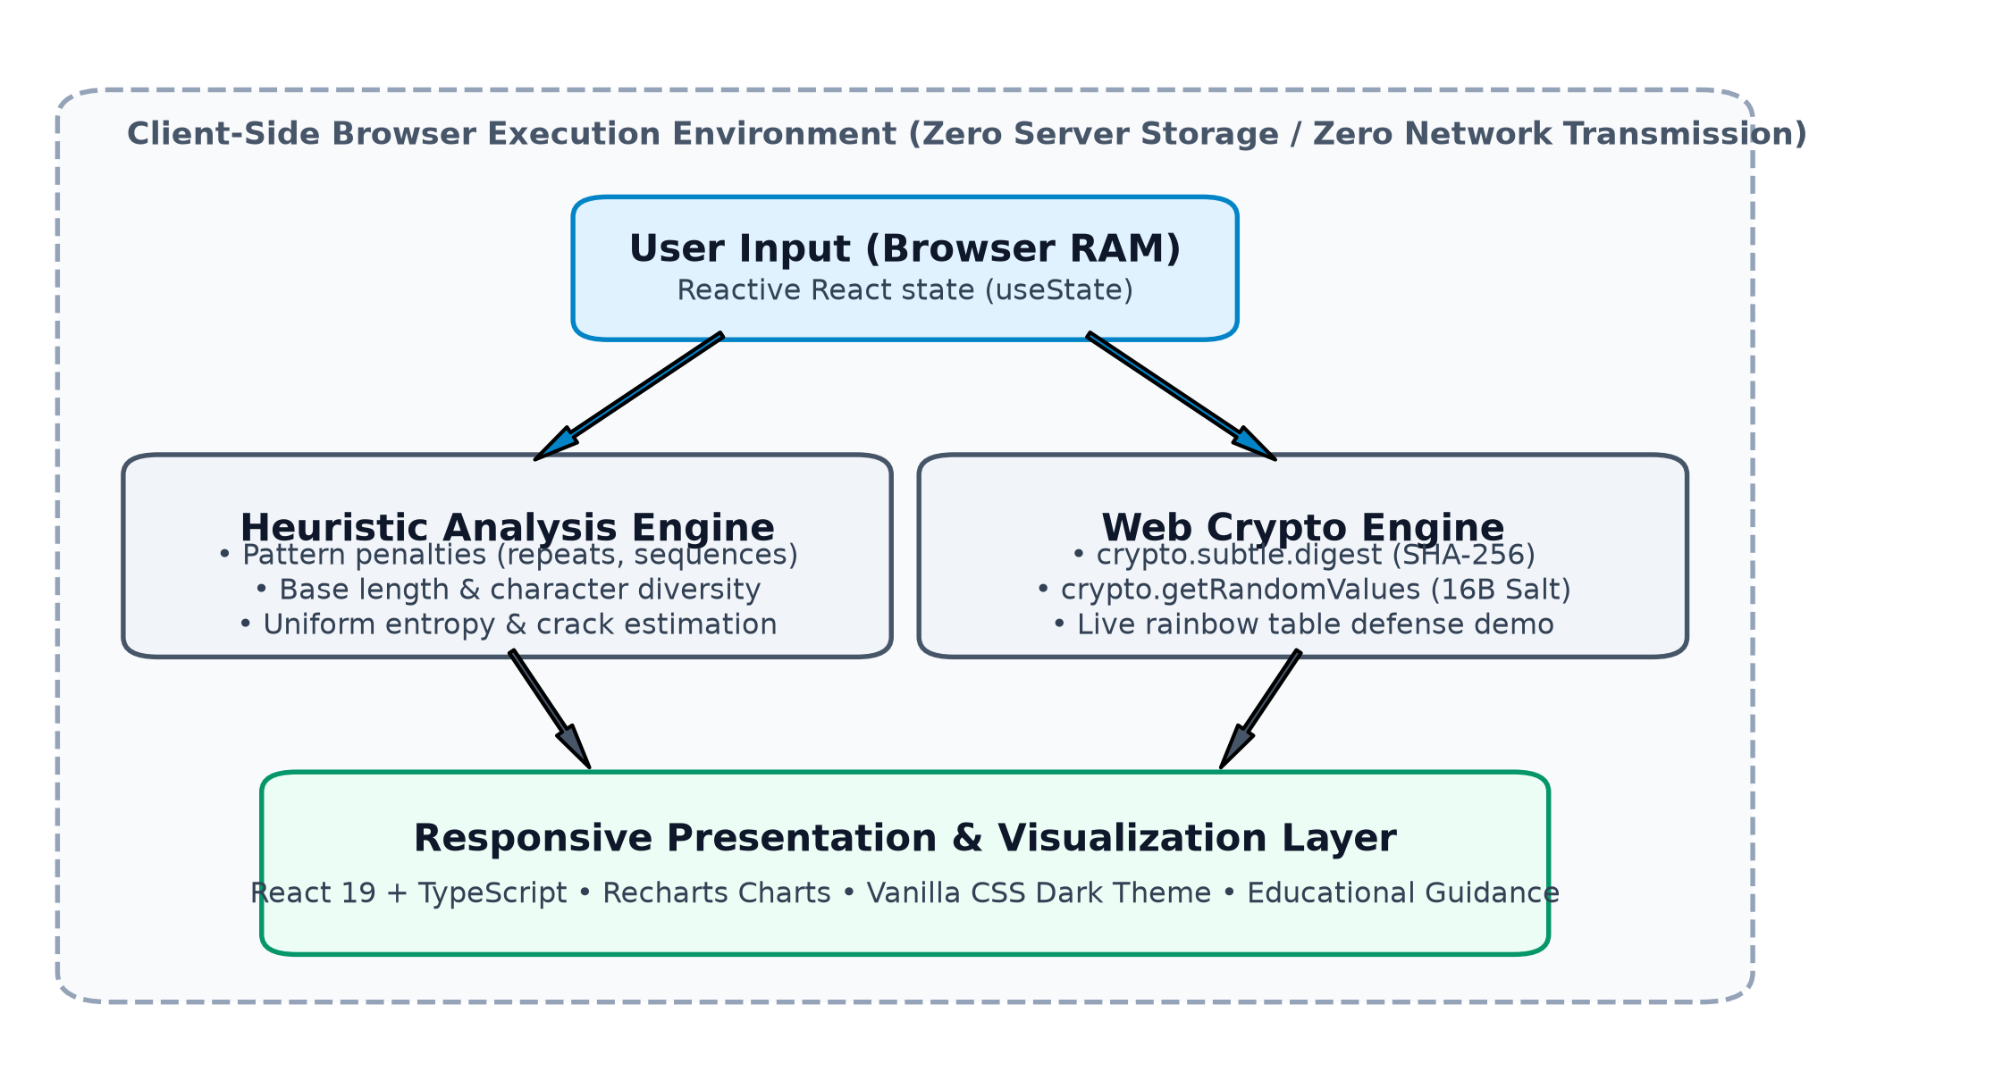
SYSTEM DESIGN
PasswordGuard: Application Architecture & Privacy Design
Client-Side Processing Model
System Architecture Flow
• Modern Frontend Stack:
Built with React 19, TypeScript, and Vite for fast, type-safe interactive evaluation.
• Strict Browser Execution Context:
All analysis logic, scoring calculations, and hashing routines execute entirely inside the user's browser runtime.
• Zero Server Transmission:
PasswordGuard operates with no application backend, no remote database, and no tracking telemetry. Entered credentials are not sent over any network.
• Native Web Crypto API:
Utilizes window.crypto.subtle for cryptographic hashing and crypto.getRandomValues for 16-byte random salt generation.
• Modular Component Architecture:
Clean separation of concerns: Password Input, Strength Meter, Security Checklist, Cracking Time Estimator, and Hashing Lab.
Notes:
To explore these concepts practically, we designed and built PasswordGuard. PasswordGuard is a single-page web application built with React, TypeScript, and Vite. A critical design choice was our client-side processing model: all password evaluation, entropy estimation, and hashing occur locally in the browser memory context. There is no application backend, no external database, and no network logging. Users can safely test example passwords without third-party exposure. For cryptographic operations, we interface directly with the browser's native Web Crypto API.

Slide 6
SCORING METHODOLOGY
How PasswordGuard Evaluates Passwords: Heuristic & Entropy
1. Transparent Heuristic (0–100)
2. Theoretical Entropy & Guessing Models
Scoring Mechanics:
• Base Length Score: Up to 40 points (+4 pts/char up to 6; +2.5 pts/char up to 10; +1 pt/char beyond 10).
• Character Variety: Up to 35 points (Lowercase +5, Uppercase +10, Digits +10, Symbols +10).
• Structural Diversity: Up to 15 bonus points (2 types: +5, 3 types: +10, all 4 types: +15).
• Passphrase Bonus: +10 bonus points for strings ≥16 chars with whitespace/hyphen word boundaries.
• Subtractive Penalties: Sequential characters (-15), repeated runs (-15), known dictionary patterns (-25).
• Final Classification: Weak (0–39) • Medium (40–69) • Strong (70–100).
Theoretical Character-Space Entropy Estimate:
E = L × log₂(R) bits
(Upper bound estimate under uniform-character assumption)
Illustrative Assumed Guessing Rates (T = S / (2 × V)):
• 100 guesses/sec: Simulates an online authentication endpoint with aggressive network rate-limiting and lockout.
• 10,000,000 guesses/sec (10⁷): Simulates standard multi-threaded CPU offline guessing against a moderately fast hash.
• 100,000,000,000 guesses/sec (10¹¹): Simulates high-end parallel GPU clusters targeting unsalted fast hashes (e.g. SHA-256).
• Educational Qualification: These rates are illustrative mathematical projections, NOT physical cracking benchmarks.
Notes:
How does PasswordGuard evaluate password strength? We implement two distinct metrics. First, a transparent heuristic score from 0 to 100. It awards points for length and character sets, adds bonuses for diversity and multi-word passphrases, and deducts targeted penalties for sequential runs, repetitions, and dictionary roots. The score classifies passwords into Weak, Medium, or Strong. Second, we calculate a theoretical character-space entropy estimate in bits, assuming uniform random selection. To make this intuitive, we project illustrative search times across three assumed guessing scenarios: 100 guesses per second for rate-limited online logins, 10 million per second for offline CPU attacks, and 100 billion per second for GPU rigs targeting fast hashes. We emphasize that these are educational mathematical projections, not hardware benchmarks.

Slide 7
HASHING & SALTING DEMONSTRATION
Password Hashing, Cryptographic Salts, and Production Security
1. One-Way Hashing
2. The Role of Salt
3. Production Standards
• Deterministic & Irreversible:
Input maps to a fixed-size 256-bit hexadecimal digest. Inverting the digest back to plaintext is computationally infeasible.
• Avalanche Effect:
Changing a single character flips over 50% of output bits pseudorandomly, preventing incremental clues.
• The Fast Hash Flaw:
General-purpose hashes (SHA-256, MD5) are engineered for maximum throughput, allowing attackers to test billions of guesses per second if a database leaks.
• 16-Byte Cryptographic Salt:
A unique, cryptographically random salt generated per user via crypto.getRandomValues().
• Digest Uniqueness:
Even if 1,000 users share the exact same password, each user gets a completely distinct stored hash.
• Rainbow Table Invalidation:
Precomputed plaintext-to-hash lookup tables become useless because the table cannot predict random per-user salts.
• Forced Individual Cracking:
Attackers must spend full computing budget attacking each account individually.
• Educational Notice:
SHA-256 is used in PasswordGuard strictly for browser demonstration and educational clarity.
• Why Fast Hashes Fail:
SHA-256 uses simple arithmetic logic and minimal memory, making it vulnerable to massive GPU/ASIC acceleration.
• Memory-Hard KDFs Required:
Production credential stores MUST use slow Key Derivation Functions: Argon2id (IETF RFC 9106), bcrypt, or scrypt.
• Work Factor Tuning:
KDFs intentionally consume high RAM and CPU time, rendering large-scale offline brute force economically infeasible.
Notes:
Next, let us examine how servers protect passwords during storage. Passwords should never be stored in plain text. A cryptographic hash is a one-way transformation that maps arbitrary input to a fixed-length digest. We also demonstrate the necessity of cryptographic salts. By appending a unique 16-byte random salt to each password, two identical passwords produce completely different digests. This completely neutralizes precomputed rainbow table lookups. However, we must state an important security distinction: SHA-256 is used in PasswordGuard solely for educational clarity. Because SHA-256 is designed to be fast, production authentication backends should never use raw SHA-256. Production systems must use slow, memory-hard key derivation functions like Argon2id or bcrypt.

Slide 8
EVALUATION METHODOLOGY
Experimental Design: Controlled Evaluation of Heuristic Behavior
Experimental Protocol & Ethics
The 5 Synthetic Password Categories (n = 30 each)
• Synthetic Dataset (N = 150):
Evaluates internal scoring consistency across five controlled structural categories (n = 30 samples each).
• Research Ethics Compliance:
Strictly zero real user credentials and zero breached databases used, complying with Menlo Report ethics guidelines.
• Controlled Heuristic Evaluation:
The experiment evaluates how consistently the scoring rules respond to structural variations. It is NOT an external cracking benchmark.
• Automated Test Harness:
Node.js batch runner processes all 150 samples deterministically, exporting full score breakdowns and entropy estimates.
Category A — Short Simple (3–5 chars)
Examples: 'cat', 'red2', 'sky9'
Design: Minimal length, single pool, tiny combinatorial space.
Category B — Common Pattern (8–12 chars)
Examples: 'password123', 'admin2024!', 'Summer2023!'
Design: Dictionary roots, sequential digits, leetspeak, punctuation.
Category C — Medium Complexity (11–15 chars)
Examples: 'BlueSky#49', 'Silver!Fox82', 'GreenForest*21'
Design: Traditional enterprise complexity rules (mixed case, numbers, symbols).
Category D — Long Passphrases (25–36 chars)
Examples: 'correct-horse-battery-staple', 'apple-mountain-river-winter'
Design: Multi-word sequences with hyphens; large length, low alphabet diversity.
Category E — Long Random (16 chars)
Examples: '7$zW#9!kLp&2Qx@m', 'k9#mP$2vL&8xQ!zR'
Design: Pseudo-random selection across all 95 printable ASCII characters.
Notes:
To test our scoring heuristic systematically, we conducted a controlled experiment. In accordance with research ethics principles, we did not use real user credentials or breached password dumps. Instead, we constructed a synthetic dataset of 150 passwords partitioned into five distinct structural categories of 30 samples each. Category A represents short simple words. Category B reflects common human patterns with dictionary roots and appended numbers. Category C represents enterprise complexity guidelines. Category D contains long multi-word passphrases. And Category E consists of 16-character pseudo-random strings across all character sets. We evaluated all 150 samples to observe how consistently our heuristic behaves across these structures.

Slide 9
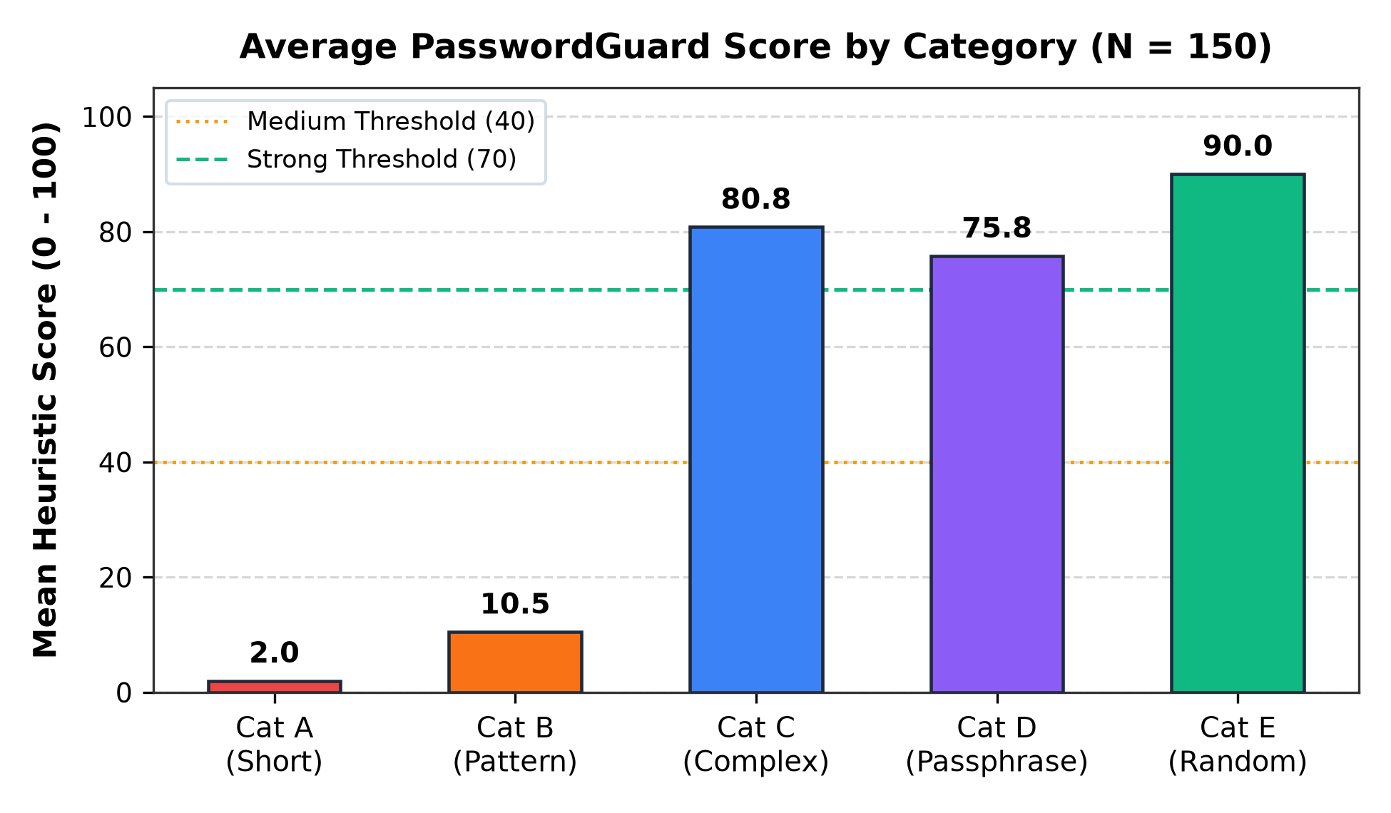
EMPIRICAL FINDINGS
Experimental Results: Quantitative Observations Across Categories
Score Distribution by Category
Frozen Results Summary (N = 150)
Overall Tier Distribution:
• Weak (0–39): 59 / 150 (39.3%)
• Medium (40–69): 12 / 150 (8.0%)
• Strong (70–100): 79 / 150 (52.7%)
Key Category Observations:
• Cat E (Long Random): Achieved highest average score: 90.0 / 100. 100% classified as Strong.
• Cat D (Long Passphrases): Highest theoretical entropy estimate: 182.9 bits (avg len 29.5 chars). 70.0% Strong, 30.0% Medium.
• Cat C (Medium Complexity): Average score 80.8 / 100; 93.3% Strong, 6.7% Medium.
• Cat B (Common Pattern): Average score collapsed to 10.5 / 100 (96.7% Weak) due to pattern penalties despite containing symbols.
• Cat A (Short Simple): Lowest score: 2.0 / 100 (100% Weak).
Notes:
Here are the quantitative results from our frozen experiment. Across the 150 synthetic samples, 59 were classified as Weak, 12 as Medium, and 79 as Strong by our heuristic. As seen in the chart, Category E achieved the highest average score of 90.0, with 100% rated Strong. Category D, the long passphrases, achieved the highest theoretical entropy estimate of 182.9 bits, with 70% Strong and 30% Medium. In contrast, look at Category B: even though these passwords contained uppercase letters, digits, and exclamation marks, their average score plummeted to 10.5, with 96.7% rated Weak. This confirms that our heuristic successfully penalizes predictable patterns rather than relying on superficial character checks. Category A averaged only 2.0, correctly reflecting tiny search spaces.

Slide 10
SUMMARY & CONCLUSION
Academic Limitations, Core Takeaways, and Conclusion
Academic & Methodological Limitations
Core Security Takeaways
• Circularity Constraint: The experiment demonstrates internal behavioral consistency of the heuristic, NOT an independent real-world cracking proof.
• Synthetic Dataset Scope: A controlled synthetic sample (N=150) isolates structural variables but does not replicate the full behavioral distribution of real user passwords.
• Theoretical Entropy Bounds: The metric E = L × log₂(R) assumes ideal uniform random selection, whereas human passwords exhibit significant natural language bias.
• Illustrative Guessing Rates: The 100, 10⁷, and 10¹¹ guesses/sec models are assumed illustrative scenarios, not physical hardware benchmarks.
• Length Dominates Exponent: Password length expands the theoretical search space exponentially (R^L). Passphrases provide an effective, memorable defense.
• Superficial Complexity Fails: Appending '123!' or capitalizing the first letter does not deceive modern attack tools.
• Password ≠ Authentication Security: Strong passwords alone cannot stop phishing or credential stuffing; authentication requires defense in depth.
• Essential Defense Triad: 1. Password managers for unique credentials. 2. Slow memory-hard hashing (Argon2id). 3. Universal Multi-Factor Authentication (MFA).
Thank You for Your Attention! • Questions & Answers Welcome
Repository: ducknhat/password-pro | PasswordGuard: Client-Side Educational Security
Notes:
In conclusion, we must emphasize our project's academic limitations. Because the scoring rules and evaluation engine share the same heuristic, our experiment evaluates internal rule consistency rather than real-world cracking immunity. Our synthetic dataset and uniform entropy calculations are educational models. Nonetheless, the core takeaways are clear: first, password length dominates character variety through exponential growth. Second, superficial complexity like 'Password123!' fails against modern attack tools. And third, authentic authentication security requires defense in depth—combining memorable passphrases with password managers, slow memory-hard hashing like Argon2id, and universal Multi-Factor Authentication. Thank you very much for your time and attention. We are now ready to answer any questions!

