Slide 1


R Е F L E C T O R

Slide 2

Who we are
Alexandr Shvetsov (@shvetsovalex007) Web security researcher at Positive Technologies
Egor Dimitrenko (@elk0kc) Web security researcher at Positive Technologies

Slide 3
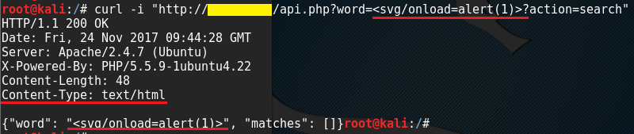
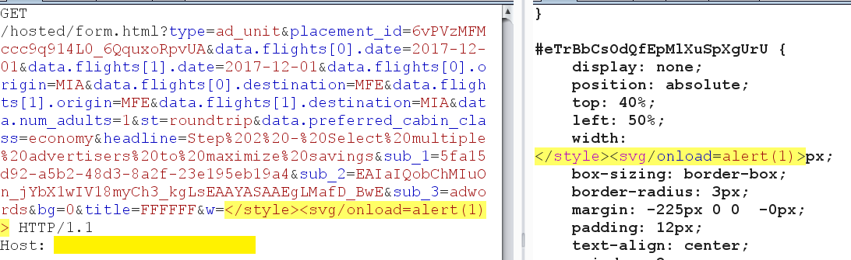
What we need

Slide 4
What we need
Finding reflected XSS
Running in passive scan
Testing a lot of parameters automatically
Using less queries for testing
Simple to use

Slide 5
About
Burp Suite extension is able to find reflected XSS on page in real-time while browsing on web-site and includes some features:
Highlighting reflection in the response tab
Test which symbols are allowed in this reflection
Analyse of reflection context
Content-Type whitelist

Slide 6
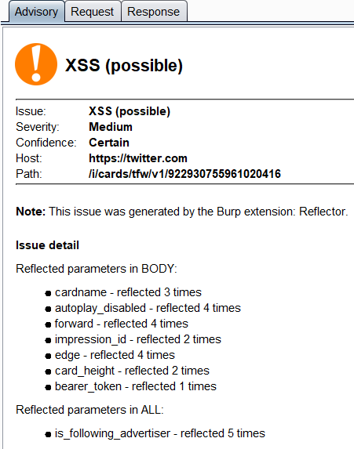
About
Workflow:
Find which request arguments were reflected in the response
Check where the reflection occurred (Body, Headers, All).
Generate Burp Issue

Slide 7
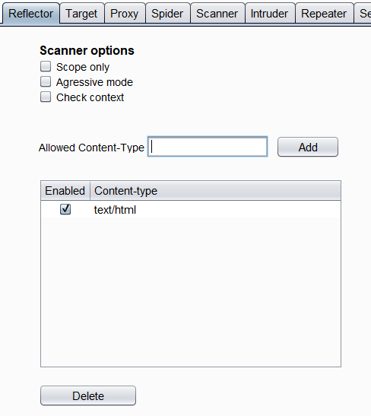
Settings
Available features:
Scope only
Aggressive mode
Check context
Flexible Content-Type settings

Slide 8
Aggressive mode
Testing parameters were only reflected in response body:
Make additional requests inserting special symbols in request parameters: “, ‘, <
Figure out which of these symbols were reflected in the response without escaping
One request for one parameter
Generate High severity issue if any of these symbols was reflected

Slide 9
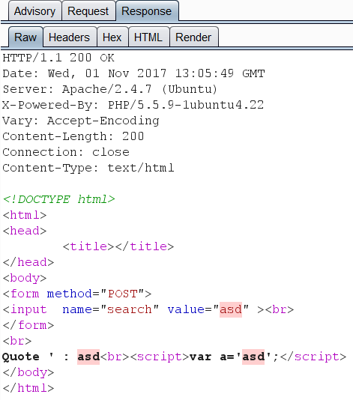
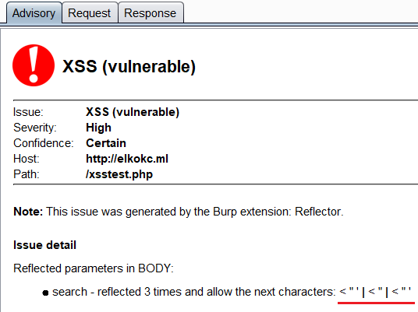
Aggressive mode

Slide 10
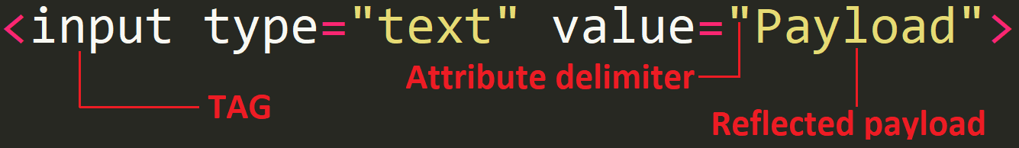
Context Analysis
In this mode reflector tries to figure out a character that allows breaking the syntax in the page code. After the analysis it gives detailed information about the context of the reflected parameters, which simplifies the understanding of the vulnerability.
Notes:
Double quote allow to exit from this context and write HTML code.
Bracket allow to inject HTML-tags.
Single quote allow to exit from JS variable context and write malicious code.
Есть идея разбить текст на подпункты, типа воркфлоу.
А примеры расписать на каждом слайде со скрином!

Slide 11

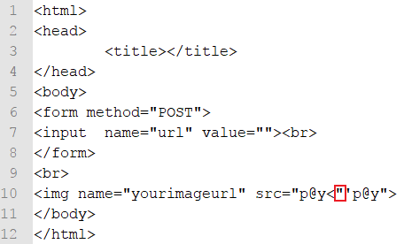
Context Analysis
Double quote allows escaping from attribute context
Issue contains:
Information about character that allows breaking the syntax
Information about other chars that are reflected without context

Slide 12
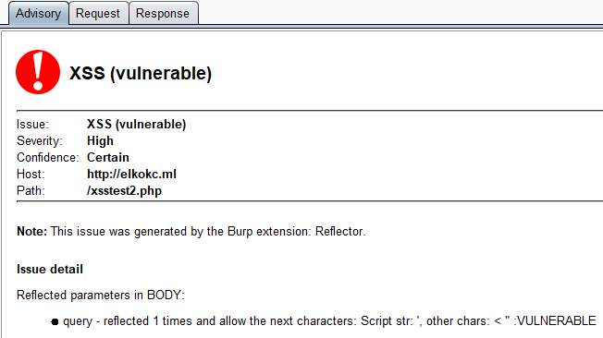
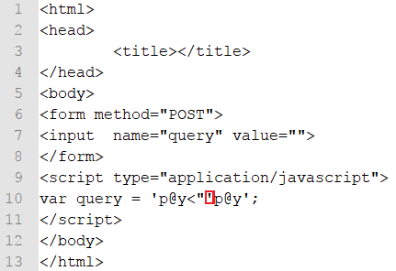
Context Analysis
Single quote allows escaping from JS variable context and writing malicious code.

Slide 13
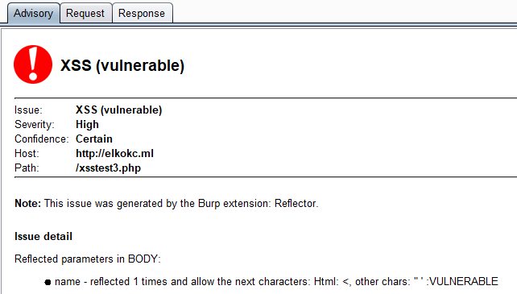
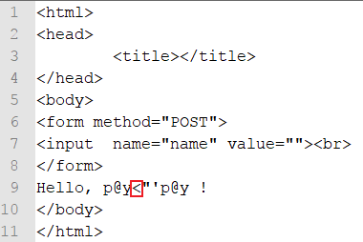
Context Analysis
Bracket character allows injecting HTML-tags.

Slide 14
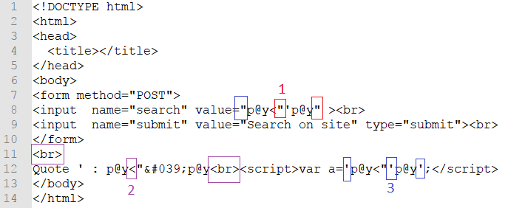
Context Analysis

Slide 15
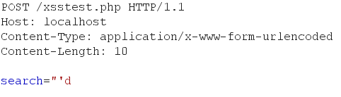
Context Analysis: non-aggressive
Analyse context of requests parameters
Generate Issue the same as context mode with additional query
Analyse payload from user request parameters

Slide 16
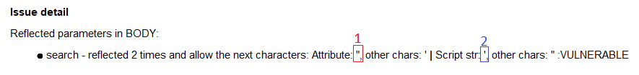
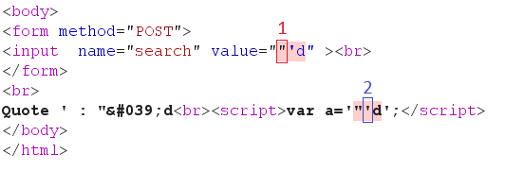
Context Analysis: non-aggressive

Slide 17
Thanks
Github: https://github.com/elkokc/reflector
Releases: https://github.com/elkokc/reflector/releases

