Slide 1
6 Sigma Assignment
Contents
1. Define
2. Measure
3. Analyze
4. Improve
5. Control
2026.Sep.23
6 Sigma GB assignment
IVI LD – Nguyen Duc Long
Notes:
Tôi là Nguyen Duc Long, team IVI LD. Bài Six Sigma Green Belt của tôi là cải thiện Luminance value cho model Porsche CID J1 Dual, đi theo 5 pha DMAIC.
1

Slide 2
Six Sigma Project Register
Team | IVI LD
Leader | Nguyen Dinh Huong TL
Owner | Nguyen Duc Long
Task category
□ HW □ SW
□ Mecha ■ Current job
Theme | Reduce defect rate of Model Porsche CID J1 Dual Luminance |  |  |  | Period | 2026.Mar.09 ~ 2026.Sep.20 |  |  | Task team name | Inspection Engineering Project
Six Sigma Project |  | Improvement Goal (Stretch Goal) |  |  |  |  |  |  | Idea of breaking the limit
 |  | Improvement index |  | Current |  | World Best | World Best | Goal
Improve Luminance value |  | KPI | Defect rate (ppm) | 226,624ppm |  | N/A | N/A | 0 ppm | Teaching robot and change camera angle for detecting the central of PID Make check sheet to control camera equipment
 |  | ProjectY | Luminance (800-2000Cd/m²) | Cpk ≈ 0.25 (Z ≈ 0.75) |  | N/A | N/A | Cpk ≥ 1.33 (Z ≥ 4.0)
Management Issue (Biz. Issue) |  | Implement Plan (Fast & Strong) |  |  |  |  |  |  | Task Member
- The Luminance issue affects the line UPH and causes loss time. - NG LCDs after retest are returned to the supplier (HEESUNG) for scrap, leading to IF cost, so an action is needed to eliminate this issue and improve factory performance.
 |  |  |  |  |  |  |  |  | Location
 |  |  |  |  |  |  |  |  | LG Electronics Viet Nam-Hai Phong
Qualitative Performance |  | Quantitative Performance |  |  |  |  |  |  | Neck Point
Improving smoothly testing process for sets Reducing cost |  | 1 LCD part =118.72$ The scrap cost of Luminance issue on March: 19*118.72 = 2255.68$ → Result: 0 NG / 420 sets after improvement |  |  |  |  |  |  | Because improvement action related to equipment, So need support from PE team
❑ Schedule
3/9
4/1
5/1
5/19
6/15
Team | Name | Role
IVI LD | Nguyen Duc Long | Task leader
 | Hoang Nhan Quoc | Member
IVI PE | Pham Van Hung | Member
IVI PM | Ta Van Cong | Member
D
M
A
I
C
Key activity / Output
D : Define issue, define defect rate, collect defective sample and issue information
M : Gage R&R (Type 1, Type 3) to evaluate equipment
A : Use logic tree and 5 Why to find root cause. Test samples with different CANSIM, camera and camera angle
I : Meeting with HQ IE to discuss improvement action. Correct camera angle to 90° and verify the result
C : Control by daily Master sample check; defect rate via GMES
Notes:
Đây là tóm tắt dự án: mục tiêu giảm lỗi Luminance của J1 Dual từ 226.624 ppm xuống 0 ppm, Project Y là Luminance value với spec 800–2000, nhóm 4 người, thực hiện tại LGEVH.
2

Slide 3

1.1 Define issue
Project name
- Improve Luminance value
Purpose
- Reduce the Luminance NG rate of Porsche CID J1 Dual from 226,624 ppm to 0 ppm (stretch goal) by making the Luminance measurement reliable: Luminance value inside spec 800-2000 Cd/m² with Cpk ≥ 1.33.
Outline
- If the Luminance measurement problem keeps happening, sets are held and retested at the Luminance station, which leads to line loss time and failure to meet the line UPH.
- Delayed checking leaves unfinished production on line IVI5. NG LCDs are also sent back to the supplier (HEESUNG) for retest and scrap, which leads to extra scrap cost (1 LCD = 118.72$; March: 19 pcs = 2,255.68$).
→ To prevent this in advance, we selected this topic as a Six Sigma GB task: improve the luminance measurement performance from the mass production stage and reduce the cost for the factory to the minimum.
Problem statement
- From Nov.2025 to Mar.2026, 143 of 631 J1 Dual sets failed the Luminance test (226,624 ppm = 22.7%), i.e. 87.2% of all Porsche CID defects (164 / 631 sets = 260,000 ppm).
- The luminance measured on the PID screen was lower than the average of the other measurements, so many sets fell below the lower spec limit of 800 Cd/m² (spec 800-2000 Cd/m²).
Scope
- In scope: Porsche CID J1 Dual, Luminance station 1 & 2 (camera CS2000), IVI 5 line, LG Electronics Vietnam Hai Phong.
- Out of scope: the other defect items in 1.2 (Contrast value, Haptic/Touch, Hardware 6.0%, Software 3.5%), handled by HW members and HQ R&D.
Notes:
Vấn đề là 22,7% bộ J1 Dual bị NG Luminance, gây mất UPH và scrap. Bài này chỉ tập trung vào lỗi Luminance của trạm đo; lỗi phần cứng và phần mềm do bộ phận khác xử lý.

Slide 4

1.2 Y-y breakdown
Big Y
Little y1
Little y2
Little y3
Activity
PIC
Reduce Porsche CID Defect rate
Machine defect
Luminance Function
Luminance value
6 Sigma assignment
IVI LD IE
260,000 PPM
(164/631EA
Nov.2025~Mar.2026)
90.5% 235,300 PPM
89.5% 232,700 PPM
87.2% 226,624 PPM
Haptic/Touch
Function
Calculate contrast value
Real defect _ Material
Return to supplier
HEESUNG vendor
1.0% 2,600 PPM
2.3% 6,076 PPM
Hardware defect
Power Function
Initial/ Booting
Broken pin connector _ check PCBA
Mr. Hai HW
6.0% 15,600 PPM
Software defect
Uniformity Function
Black Uniformity value
Improve software
HQ R&D
Before
3.5% 9,100 PPM
260,000 PPM
After
33,376 PPM
Decrease defect rate of Porsche CID
Hardware issues (6.0%, 15,600 PPM) are mainly broken pin connector (check PCBA), foreign material inside the set after assembly, SQA circuit and LCD from supplier; they will be improved by HW members.
Software issues (3.5%, 9,100 PPM) will be solved by HQ software members.
Machine defect accounts for 90.5% (235,300 PPM), where Luminance value is the overwhelming root issue causing 226,624 PPM (87.2% of all defects), causing severe UPH loss and scrap cost. That is why Luminance value is selected as Project Y for this Six Sigma assignment.
Notes:
Trong 260.000 ppm lỗi, nhóm Machine chiếm 90,5% và riêng Luminance value chiếm 87,2%. Tôi chọn Luminance value làm Project Y vì lớn nhất và đo được. Nếu xử lý hết lỗi này thì tổng lỗi giảm còn 33.376 ppm.

Slide 5

1.3 Define Project Y
To reduce the Luminance test NG, Project Y is defined as “Luminance value”.
What is Luminance ?
Project Y
Luminance is a photometric quantity used for light sources and displays such as LCDs.
Luminance is the luminous intensity per unit area emitted by a surface in a given direction (unit: cd/m², also called nit)
It quantifies the brightness level of the display.
Project Y: “Luminance value” of the Porsche CID J1 Dual model.
Luminance formula:
L = d²Φ / (dA · dω · cos θ)
Spec: 800-2000 (cd/m²)
d²Φ stands for the luminous flux in lumens (lm)
θ stands for the angle between the surface normal of the display and the sight line of the detector, in this case θ = 0°
dA stands for the differential area in square meters (m²)
dω stands for the differential solid angle in steradians (sr)
PID
CID
+
J1 Dual PPR RHD set
Camera
CS2000
The sensor inside the detector receives the light from the center of the LCD, calculates the luminance value and returns the measurement result to the program.
Measurement method:
The set is connected to the test bench; when the program sends the request, the display shows the highest brightness level.
The J1 display shows a white screen at maximum brightness.
The CS2000 detector moves to the center of the PID LCD, recognizes the center of the display and measures the luminance.
Because the center always has higher brightness than the corner and edges, the detector must be placed exactly at the center.
The result is recorded and sent back to the program.
Issue: The luminance measured on the PID screen is lower than the average of the compared values, so the luminance test result falls below the spec.
Project Y= Luminance value = f(x1, x2, …, xn) + ε
Notes:
bộ J1 Dual PPR RHD set gồm PID và CID; camera CS2000 nằm dưới PID, mũi tên đỏ hướng vào tâm màn PID; mũi tên hai đầu cho thấy camera di chuyển ngang giữa hai màn.
Issue (vấn đề): luminance đo ở màn PID thấp hơn trung bình các giá trị so sánh, nên kết quả test rơi dưới spec.
Luminance là độ sáng màn hình, đo bằng cd/m², spec 800 đến 2000. Camera CS2000 đo ở tâm màn PID. Project Y của tôi là chính giá trị luminance đo được.

Slide 6



2.1 Gage R&R outline
Measure
Define
Analyze
Improve
Control
Equipment information:
Equipment:
- Power supply, Pallet
- CID bench
- CANSIM
- Camera CS2000 (spectroradiometer)
- Resolution: 0.01 Cd/m²
Program: LG Moohantech
Function test Luminance station
Checking brightness level
Detect and measure Luminance value
Test set without CAN mode
Checking CID black / white patterns
Calculate contrast ratio
Luminance station diagram
Camera CS2000 (spectroradiometer)
Notes:
Output level resolution: 0.01 Cd/m²
Trạm đo gồm máy tính chạy chương trình, bench điều khiển set, CANSIM mô phỏng tín hiệu xe và camera CS2000 đo luminance. Kết quả được gửi lên GMES.

Slide 7
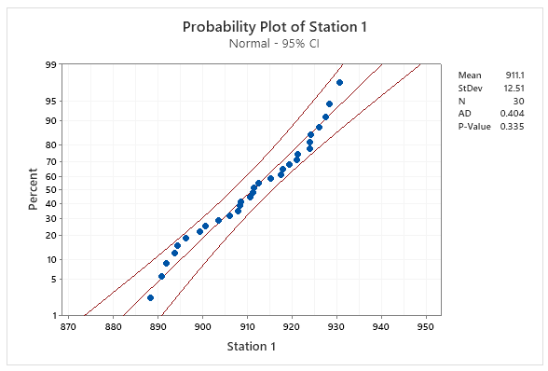
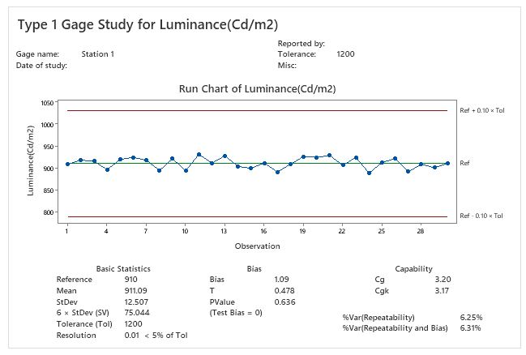
2.2 Type 1 Study
Measure
Define
Analyze
Improve
Control
Station 1 Luminance
I chose the Type 1 gage study to assess the measurement capability of the gage, based on its repeatability and bias.
In this case, one sample (golden sample, 910 Cd/m²) is measured 30 times.
H0: Bias = 0 in measurement system.
H1: Bias ≠ 0 in measurement system.
No | Luminance(Cd/m²) | No | Luminance(Cd/m²)
1 | 908.00 | 16 | 911.46
2 | 917.93 | 17 | 890.79
3 | 915.27 | 18 | 908.47
4 | 896.15 | 19 | 926.02
5 | 919.40 | 20 | 924.05
6 | 924.00 | 21 | 928.50
7 | 917.44 | 22 | 906.05
8 | 894.39 | 23 | 924.20
9 | 921.04 | 24 | 888.30
10 | 893.60 | 25 | 912.50
11 | 930.70 | 26 | 921.38
12 | 911.27 | 27 | 891.90
13 | 927.62 | 28 | 908.25
14 | 903.52 | 29 | 900.60
15 | 899.24 | 30 | 910.68
Spec: 800.00 ~ 2000.00
Reference value: 910 (golden sample)
Resolution of Instrument: 0.01
Conclusion
• P value = 0.636 > 0.05 Fail to reject H0 -> No significant bias (PASS)
• Cg = 3.20 (Std ≥ 1.33) PASS | Cgk = 3.17 (Std ≥ 1.33) PASS
• %Var(Repeatability) = 6.25% (< 10%) PASS
• %Var(Repeatability & Bias) = 6.31% (< 10%) PASS
• Resolution = 0.01 < 5% of Tolerance
✔ Equipment is OK. Camera CS2000 of Station 1 can be used to measure Luminance value.
Notes:
Mục đích. Kiểm tra Station 1 có đo đúng (bias) và đo lặp lại tốt (repeatability) trên cùng một mẫu chuẩn hay không.
Nội dung trên slide.
Cách làm: chọn Type 1, dùng 1 mẫu (golden sample, giá trị tham chiếu 910 Cd/m²) đo lặp 30 lần. H0: Bias = 0; H1: Bias ≠ 0.
Bảng 30 giá trị đo (No 1–30). Spec 800–2000; Reference 910; Resolution 0,01.
Probability Plot: Mean 911,1; SD 12,51; N 30; AD 0,404; p = 0,335 > 0,05 nên dữ liệu xấp xỉ phân phối chuẩn (điều kiện của t-test).
Báo cáo Type 1 Gage Study: Run Chart cùng các đường Ref (910) và Ref ± 0,10 × Tol (790 và 1030); bảng thống kê: Mean 911,09; StDev 12,507; 6 × StDev = 75,044; Tolerance 1200; Bias 1,09; T 0,478; p 0,636; Cg 3,20; Cgk 3,17; %Var (Repeatability) 6,25%; %Var (Repeatability and Bias) 6,31%.
Conclusion: p = 0,636 > 0,05, không bác bỏ H0, tức là không có bias đáng kể (PASS); Cg 3,20 và Cgk 3,17 lớn hơn 1,33 (PASS); %Var 6,25% và 6,31% nhỏ hơn 10% (PASS); resolution 0,01 nhỏ hơn 5% tolerance. Kết luận: Station 1 đo được Luminance.
Nên nói. Tôi đo 30 lần trên mẫu chuẩn 910. Trung bình 911,09, bias chỉ 1,09 và không có ý nghĩa thống kê (p 0,636). Cg 3,20 và Cgk 3,17 đều trên 1,33 nên Station 1 đạt.
Cách tính (kiểm chứng).
Bias = 911,09 − 910 = 1,09. T = 1,09 / (12,507 / √30) = 0,478.
Cg = 0,2 × 1200 / (6 × 12,507) = 240 / 75,04 = 3,20.
Cgk = (0,1 × 1200 − 1,09) / (3 × 12,507) = 118,91 / 37,52 = 3,17.
%Var (Repeatability) = 6 × 12,507 / 1200 = 6,25%. %Var (Repeatability and Bias) = 20 / 3,17 = 6,31%.

Slide 8
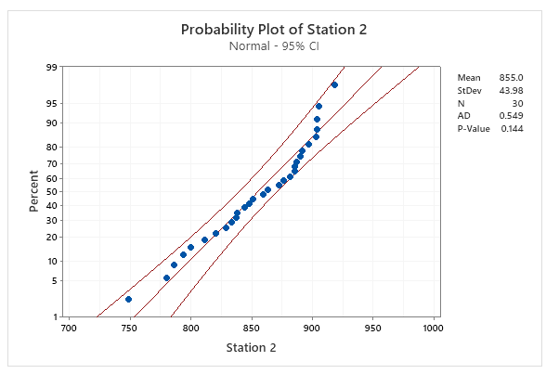

2.2 Type 1 Study
Measure
Define
Analyze
Improve
Control
Station 2 Luminance
I chose the Type 1 gage study to assess the measurement capability of the gage, based on its repeatability and bias.
In this case, one sample (golden sample, 910 Cd/m²) is measured 30 times.
H0: Bias = 0 in measurement system.
H1: Bias ≠ 0 in measurement system.
No | Luminance(Cd/m²) | No | Luminance(Cd/m²)
1 | 779.90 | 16 | 872.50
2 | 811.25 | 17 | 881.38
3 | 794.00 | 18 | 820.60
4 | 829.24 | 19 | 905.68
5 | 887.44 | 20 | 897.04
6 | 844.39 | 21 | 833.60
7 | 851.46 | 22 | 885.70
8 | 799.79 | 23 | 838.27
9 | 903.47 | 24 | 837.62
10 | 876.02 | 25 | 863.52
11 | 904.05 | 26 | 892.00
12 | 918.50 | 27 | 847.93
13 | 890.05 | 28 | 885.27
14 | 904.20 | 29 | 786.15
15 | 748.30 | 30 | 859.40
Spec: 800.00 ~ 2000.00
Reference value: 910 (golden sample)
Resolution of Instrument: 0.01
Conclusion
• P value < 0.001 (≤ 0.05) Reject H0 -> Bias ≠ 0 (FAIL)
• Cg = 0.91 (Std ≥ 1.33) FAIL | Cgk = 0.49 (Std ≥ 1.33) FAIL
• %Var(Repeatability) = 21.99% (> 10%) FAIL
• %Var(Repeatability & Bias) = 40.63% (> 10%) FAIL
✖ Equipment has problem. Cannot measure consistently (large repeatability error and significant bias). Need to improve measurement system.
08 / 33
Notes:
Conclusion: p < 0,05 bác bỏ H0, tức là có bias (FAIL); Cg 0,91 và Cgk 0,49 nhỏ hơn 1,33 (FAIL); %Var 21,99% và 40,63% lớn hơn 10% (FAIL). Thiết bị có vấn đề, đo không nhất quán (lặp lại kém và lệch thấp), cần cải tiến hệ thống đo.
Cách tính.
Bias = 854,96 − 910 = −55,04, tức đọc thấp hơn thật khoảng 6%.
Cg = 240 / (6 × 43,982) = 0,91. Cgk = (120 − 55,04) / (3 × 43,982) = 0,49.
So với Station 1: SD của Station 2 (43,98) lớn gấp khoảng 3,5 lần (12,51), tức là cùng một mẫu mà đọc dao động rất lớn.
Nên nói. Cùng mẫu chuẩn 910 nhưng Station 2 đọc trung bình 855, thấp hơn 55, và dao động lớn (SD 44). Cg 0,91 và Cgk 0,49 đều dưới 1,33 nên hệ thống đo Station 2 không đạt. Vì vậy phải tìm nguyên nhân ở thiết bị đo chứ chưa vội kết luận sản phẩm lỗi.

Slide 9
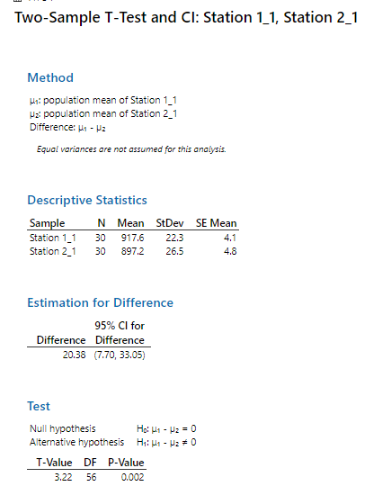
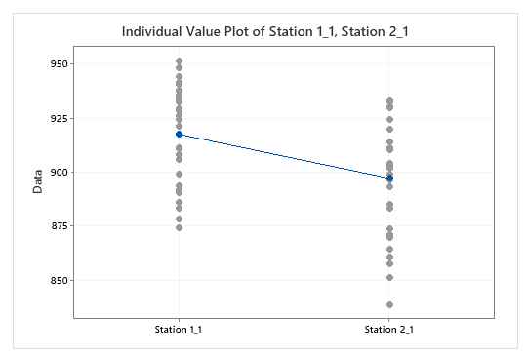
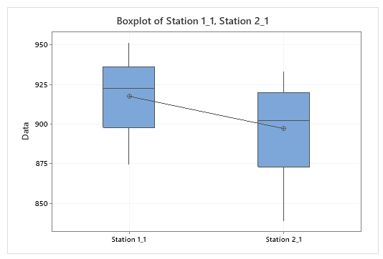
2.3 2 sample T-test for station 1 and 2
Measure
Define
Analyze
Improve
Control
After the Type 1 study, compare the 2 Luminance stations.
Spec: 800- 2000 Cd/m²
Station 1 | Station 2
891.90 | 864.43
908.25 | 902.75
940.60 | 924.61
910.68 | 893.10
921.04 | 910.28
893.60 | 885.34
935.70 | 896.79
951.27 | 911.49
937.62 | 930.12
883.52 | 873.72
908.00 | 933.11
937.93 | 899.03
935.27 | 929.61
886.15 | 857.73
929.40 | 919.88
934.00 | 913.82
899.24 | 871.07
917.44 | 903.96
874.39 | 851.55
911.46 | 883.16
890.79 | 860.89
948.47 | 903.74
926.02 | 896.62
944.05 | 932.64
928.50 | 933.35
906.05 | 901.82
924.20 | 838.91
878.30 | 869.70
932.50 | 903.21
941.38 | 919.98
Conclusion : we chose 30 samples and tested at 2 stations.
H0: there is no significant difference between station 1 and station 2
H1: there is a significant difference between station 1 and station 2
P value = 0.002 ≤ 0.05 → reject H0,
→ The charts also show that the measured values differ between station 1 and station 2. The same 30 samples were tested at both stations, so a paired t-test is also appropriate: mean difference = 20.38, t = 5.81, DF = 29, p < 0.001 (same conclusion). So we need to check why there is a difference.
Notes:
Mục đích. So sánh hai trạm trên cùng 30 mẫu để xem chúng có đo giống nhau không.
Nội dung trên slide.
Bảng 30 cặp giá trị (cột Station 1, cột Station 2); spec 800–2000.
Kết quả Two-Sample T-Test (Minitab): Station 1 N 30, Mean 917,6, SD 22,3, SE 4,1; Station 2 N 30, Mean 897,2, SD 26,5, SE 4,8. Chênh lệch μ1 − μ2 = 20,38; 95% CI (7,70; 33,05). H0: μ1 − μ2 = 0; H1: khác 0. T = 3,22; DF = 56; p = 0,002. Phương pháp Welch (không giả định hai phương sai bằng nhau).
Hai hình: Individual Value Plot và Boxplot cho thấy Station 2 thấp hơn và rộng hơn.
Conclusion: p = 0,002 nhỏ hơn 0,05 nên bác bỏ H0: hai trạm đo khác nhau. Kiểm tra bằng paired t (cùng 30 mẫu đo ở cả hai trạm): chênh trung bình 20,38; SD chênh 19,21; SE 3,51; t = 5,81; DF = 29; p < 0,001, cùng kết luận.
Cách tính.
Welch: T = 20,38 / √(22,3² / 30 + 26,5² / 30) = 20,38 / 6,33 = 3,22.
Paired: t = 20,38 / (19,21 / √30) = 5,81. Hai cột có tương quan khoảng 0,70, nên paired t nhạy hơn vì loại bỏ được sự khác nhau giữa các mẫu.
Hai trạm lệch nhau 20,4 Cd/m² (khoảng 2,2%).
Nên nói. Cùng 30 mẫu nhưng Station 2 đọc thấp hơn Station 1 trung bình 20,4 Cd/m², khác biệt có ý nghĩa thống kê (p 0,002; paired t p dưới 0,001). Điều này khớp với kết quả Type 1 và cho thấy cần tìm nguyên nhân làm Station 2 đo sai.

Slide 10


2.4 Type 3 Study
Measure
Define
Analyze
Improve
Control
Station 2 Luminance
Need to evaluate the repeatability of the measurement system.
Because the Luminance station is fully automated with no operator influence, Type 3 Gage Study is used to evaluate equipment repeatability.
In type 3 study, use 25 samples to verify station, each sample is measured repeat 2 times.
Spec: 800- 2000 (Cd/m2)
No | Data | No | Data
1 | 796.95 | 13 | 837.73
1 | 786.61 | 14 | 811.78
2 | 794.73 | 14 | 833.46
2 | 796.58 | 15 | 836.42
3 | 838.61 | 15 | 837.85
3 | 839.58 | 16 | 817.70
4 | 810.76 | 16 | 857.90
4 | 830.05 | 17 | 837.17
5 | 815.12 | 17 | 838.29
5 | 835.75 | 18 | 828.88
6 | 823.98 | 18 | 826.94
6 | 834.57 | 19 | 840.14
7 | 827.40 | 19 | 839.72
7 | 827.69 | 20 | 830.75
8 | 839.12 | 20 | 830.78
8 | 835.42 | 21 | 823.24
9 | 839.73 | 21 | 826.32
9 | 842.06 | 22 | 825.35
10 | 834.01 | 22 | 827.79
10 | 834.48 | 23 | 838.87
11 | 834.67 | 23 | 837.29
11 | 836.61 | 24 | 850.33
12 | 786.15 | 24 | 819.42
12 | 780.77 | 25 | 755.89
13 | 827.29 | 25 | 853.94
% Contribution of Gage R&R = 71.56% > 9% (std < 1%) →NG
% Study Var = 84.59% > 10% → NG
% Tolerance = 8.33% < 10% → OK
NDC: 1 < 5 → NG
Conclusion: %Contribution = 71.56% (> 9% NG), %Study Var = 84.59% (NG), %Tolerance = 8.33% (OK), NDC = 1 (< 5 NG). The repeatability error (SD ≈ 16.7) is large vs. the part variation (SD ≈ 10.5) and Type 1 also failed, so the system is NOT acceptable: improve.
Notes:
H0 (ANOVA, part effect): all part means are equal
H1: at least one part mean is different
Follow AIAG guidelines: %Study Var and %Tolerance < 10% = acceptable, 10-30% = conditionally acceptable, > 30% = unacceptable; %Contribution < 1% = acceptable, > 9% = unacceptable. Here %Contribution (71.56%) and %Study Var (84.59%) are far above the limits and NDC = 1 < 5, so the measurement system is NOT acceptable (only %Tolerance = 8.33% is below 10%). The ANOVA p-value (0.077 > 0.05) also shows that the 25 selected parts cannot be distinguished from the repeatability error.
NDC (number of distinct categories): the number of groups of parts the measurement system can reliably distinguish; NDC ≥ 5 is required.

Slide 11


3.1 Root cause of measurement system problem
Analyze
Define
Measure
Improve
Control
After the Type 1 study, we see that the measurement system of Station 2 has problems, so a logic tree is used to find the root cause
Power supply
Power supply is stable
Power supply is not affected
Machine
Pallet
All model used same kind of pallet
Changing pallet no different
Camera equipment (CS2000)
Measure incorrectly

Change new camera
Logic tree analysis
Camera Angle is changed
Change angle of camera

Luminance at Station 2
CANSIM
CANSIM send weak signal for LCD recognize
Change new CANSIM

Material
Set
Return LCD and check on vendor → result is OK
LCD is not affected
Method
Sequence test, timing
Sequence is used for all model, but only this model have issue
Sequence is not affected
Plug in set to pallet not fully
Other function is OK, only Luminance is NG
Not relate to set plugging in
Man
Working skill
Automatic process
Man is not related

: Potential factor

Slide 12
3.1 Root cause of measurement system problem
Analyze
Define
Measure
Improve
Control
2 Samples T
No | Potential Factors | List checking | Station | Tool to identify
1 | CANSIM send weak signal to LCD recognized | Checking luminance value before /after change to new CANSIM | Station 2 | 2 sample T
2 | Measure incorrectly | Checking luminance value before /after change to new camera | Station 2 | 2 sample T
3 | Camera angle changed | Checking luminance value before /after changing angle of detector | Station 2 | 2 sample T

: Potential factor

Slide 13



3.1 Root cause of measurement system problem
Analyze
Define
Measure
Improve
Control
2 Samples T _ Analysis
Detection Luminance from CANSIM of Station 2_Change to the new CANSIM
H0: The changing CANSIM does not affect in the luminance in station 2
H1: Changing the CANSIM affects the luminance in station 2
Both samples fail the normality test (Anderson-Darling P < 0.005); with n = 30 per group the 2-sample t-test (Welch) is robust.
P-value = 0.695 > 0.05 -> Fail to reject H0 (No significant difference before/after changing CANSIM).
Changing CANSIM has no significant effect on luminance (Factor eliminated).

Slide 14



3.1 Root cause of measurement system problem
Analyze
Define
Measure
Improve
Control
2 Samples T _ Analysis
Detection Luminance from Camera of Station 2_Change to the new camera
H0: The changing new camera does not affect in the luminance in station 2
H1: Changing the new camera affects luminance in station 2
Both samples fail the normality test (Anderson-Darling P < 0.005). With n = 30 per group the 2-sample t-test (Welch) is robust: P = 0.950 > 0.05, so changing the camera has no significant effect.
P-value = 0.950 > 0.05 -> Fail to reject H0 (No significant difference before/after changing camera).
Changing camera has no significant effect on luminance (Factor eliminated).

Slide 15



3.1 Root cause of measurement system problem
Analyze
Define
Measure
Improve
Control
2 Samples T _ Analysis
Detection Luminance from Camera of Station 2_Change to the angle of Camera
H0: The changing angle does not affect in the luminance in station 2
H1: Changing angle affects the luminance in station 2
The before-fix sample (C1) fails the normality test (Anderson-Darling P < 0.005); with n = 30 per group the 2-sample t-test (Welch) is robust. After the angle correction the mean is 48.99 Cd/m² higher (95% CI 32.93 to 65.05).
P-value < 0.001 (< 0.05) -> Reject H0 (Significant difference before/after angle adjustment).
Changing camera angle significantly affects luminance → Root Cause verified!

: Potential factor

Slide 16
3.1 Root cause of measurement system problem
Analyze
Define
Measure
Improve
Control
2 Samples T
No | Potential Factors | List checking | Station | Tool to identify | P value | Conclusion
1 | CANSIM send weak signal to LCD recognized | Checking luminance value before /after change to new CANSIM | Station 2 | 2 sample T | 0.695 | Not root cause (P > 0.05)
2 | Measure incorrectly | Checking luminance value before /after change to new camera | Station 2 | 2 sample T | 0.950 | Not root cause (P > 0.05)
3 | Camera angle changed | Checking luminance value before /after changing angle of detector | Station 2 | 2 sample T | < 0.001 | Root Cause (Significant effect, P < 0.05)


: Potential factor

Slide 17



3.1 Root cause of measurement system problem
Analyze
Define
Measure
Improve
Control
Problem
Cause
Improvement
Progress Monitoring
• Issue: Luminance NG ppm (Model: J1 Dual)
• Defect date: Feb-2026 | Station: Luminance
• Q’ty: 92 ea / 383,333 ppm (Total before: 143 ea / 631 = 226,624 ppm)
Root Cause: 5-Why Analysis
1. Why occur? Luminance value measured under spec (800~2000 Cd/m²).
2. Why under spec? Camera axis not perpendicular (90°) to the LCD surface.
3. Why angle changed? Long production time caused angle drift from 90° standard.
4. Why did angle drift? Dual display (PID/CID) requires camera motion; vibration loosened fixture.
5. Why no prevention? No daily Master sample check sheet to verify angle before production.
Improvement
Progress Status
1. Teaching robot & adjust angle of CS2000 Camera (Std: 90.0°)
Remark
Schedule
Owner
Jun
Verify
1. Adjust angle
of CS2000
Camera
14- Jun
Mr. Hung PE
2. Monitoring
result
14- Jun
Mr. Hung PE
2. Add check sheet to measure Master sample and verify Camera angle
[Luminance NG]
3. Inform supplier (Heesung): LCD is not a cause (returned LCD OK at vendor), no process change needed
Field Checking
Field Workability
Field Interview
Date: Feb-2026
Line: IVI 5
Area: FA production line
Detail Checking: Visual check the cable of LCD with PCBA to check set OK or not
Easy Working: ✔ (automatic test, no operator action)
Difficulty Working: –
Impossible Working: –
Working Feeling: Can detect by program
With who: Mr. Chien LQC
Field request: when issues happen, the repair member uses repair station to check if NTF, PE member check the camera status.

Slide 18







4.1 Improvement activity of measurement system
Define
Measure
Analyze
Improve
Control
Changing Camera angle
Before measurement
XZ: 89.075º ; YZ: 88.806º
After measurement
XZ: 89.889º ; YZ: 89.889º
PID
CID
PID
CID
X
Y
Y
Z
X
Z
After adjusting the detector camera angle to the 90.0° target (measured 89.889°) and re-testing samples, no Luminance NG was observed in the re-test. Correcting CS2000 camera angle is confirmed as the effective solution.

Slide 19




4.1 Improvement activity of measurement system
Define
Measure
Analyze
Improve
Control
Changing Camera angle
1. Camera position is correct after checking.
→ Camera center coincides with the SET center
PID
CID
+
Center
J1 Dual PPR RHD
Camera
CS2000
2. LHD and RHD use the same servo positions (48, 49) but mirrored screens. → If the position is not correct, J1 PPR LHD will be NG.
(Servo positions 48 and 49: see the diagrams below)

Slide 20





4.1 Improvement activity of measurement system
Define
Measure
Analyze
Improve
Control
Changing Camera angle
→ Correcting the CS2000 camera angle from the existing 89° to 90° raises the measured luminance of the RHD Privacy (PID) displays by about 13%, whereas Public (CID) models change by less than 0.5%, so only the RHD Privacy models need luminance compensation (13%).
No | IVI 5 LINE |  |  | CS2000 Apply luminance compensation
 | Model |  | BLU Type
1 | Bentayga (Bentley) | CID | Public(Normal) | -
2 | Macan LZV | CID | Public(Normal) | -
3 | 992 | CID | Public(Normal) | -
4 | J1 CID | CID | Public(Normal) | -
5 | G3 CID | CID | Public(Normal) | -
6 | E3PA CID | CID | Public(Normal) | -
7* | J1 Dual LHD | PID | Public(Normal) | -
 |  | CID | Public(Normal) | -
 | J1 Dual RHD | PID | Public(Normal) | -
 |  | CID | Public(Normal) | -
8 | Lamborghini | CID | Public(Normal) | -
9 | E3PA Dual LHD | PID | Privacy | -
 |  | CID | Public(Normal) | -
 | E3PA Dual RHD | PID | Privacy | 13%↑
 |  | CID | Public(Normal) | -
10 | G3 Dual LHD | PID | Privacy | -
 |  | CID | Public(Normal) | -
 | G3 Dual RHD | PID | Privacy | 13%↑
 |  | CID | Public(Normal) | -
11 | J1 Dual PPR LHD | PID | Privacy | -
 |  | CID | Public(Normal) | -
 | J1 Dual PPR RHD | PID | Privacy | 13%↑
 |  | CID | Public(Normal) | -
12 | G2 | CID | Public(Normal) | -
13 | E3 | CID | Public(Normal) | -
Privacy & Public Brightness changes depending on viewing angle
89°
90°
➔
Public
Privacy
89°
➔
90°
Privacy View Angle (PID)
Public View Angle (CID)
Difference between Privacy and Public: whether or not an LCF (louver) film is applied
for the privacy display function within the BLU module
* Discontinued model (J1 Dual LHD / RHD)

Slide 21
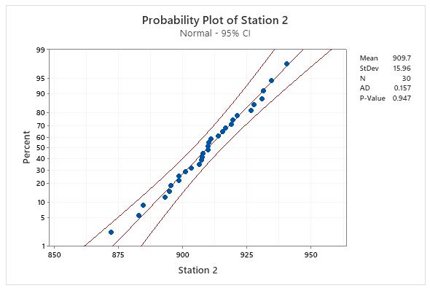
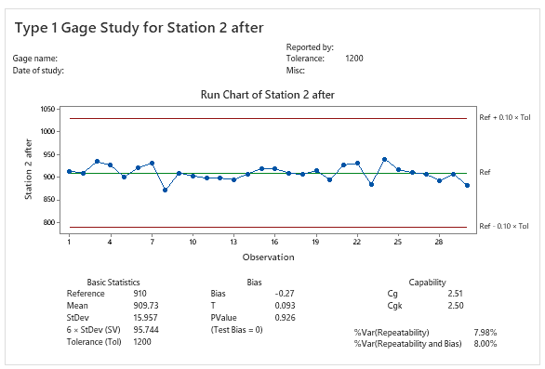
4.2 Type 1 Study again after improvement
Define
Measure
Analyze
Improve
Control
Station 2 Luminance
Use the Type 1 gage study to assess the measurement capability of the gage, based on its repeatability and bias after improvement.
In this case, one sample (golden sample, 910 Cd/m²) is measured 30 times.
H0: Bias = 0 in measurement system.
H1: Bias ≠ 0 in measurement system.
No | Luminance(Cd/m²) | No | Luminance(Cd/m²)
1 | 913.97 | 16 | 919.07
2 | 910.09 | 17 | 909.74
3 | 934.62 | 18 | 906.54
4 | 926.63 | 19 | 915.48
5 | 901.07 | 20 | 894.75
6 | 921.35 | 21 | 927.84
7 | 931.37 | 22 | 930.79
8 | 872.12 | 23 | 884.59
9 | 909.81 | 24 | 940.66
10 | 903.27 | 25 | 916.63
11 | 898.65 | 26 | 910.92
12 | 898.47 | 27 | 907.23
13 | 895.41 | 28 | 893.01
14 | 907.88 | 29 | 907.52
15 | 919.56 | 30 | 883.01
Spec: 800.00 ~ 2000.00
Reference value: 910 (golden sample)
Conclusion
• P value = 0.926 > 0.05 Fail to reject H0 -> No significant bias (PASS)
• Cg = 2.51 (Std ≥ 1.33) PASS | Cgk = 2.50 (Std ≥ 1.33) PASS
• %Var(Repeatability) = 7.98% (< 10%) PASS
• %Var(Repeatability & Bias) = 8.00% (< 10%) PASS
✔ Equipment is OK. Camera CS2000 of Station 2 can be used to measure Luminance value.
21 / 33

Slide 22
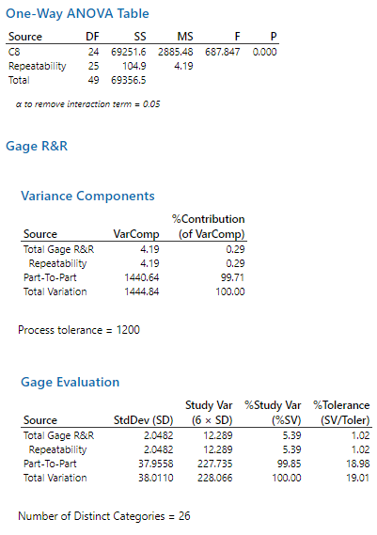
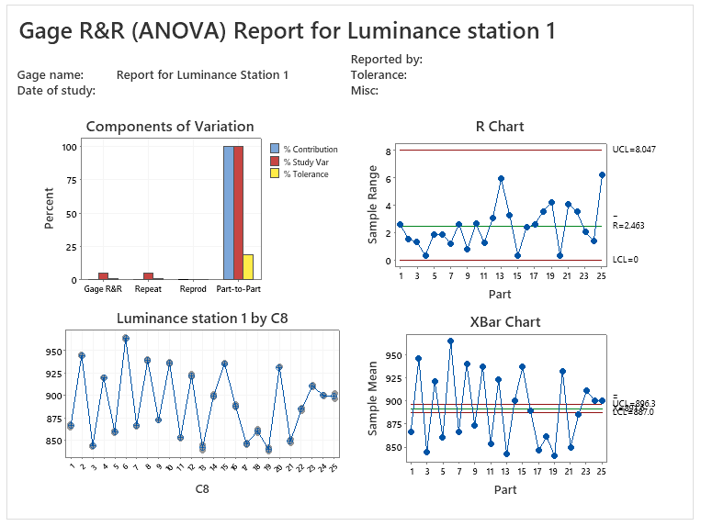
4.2 Check type 3 study again after improvement
Define
Measure
Analyze
Improve
Control
Station 1 Luminance
Only the Type 1 study has been done so far; the Gage R&R (repeatability on 25 parts) still has to be evaluated at both stations.
Because Luminance stations are fully automated with no operator variation, Type 3 Gage Study is conducted (25 samples measured twice per station).
Each station: 25 samples x 2 repeats = 50 measurements (reproducibility does not apply: no operator influence).
No | Luminance(Cd/m²) | No | Luminance(Cd/m²)
1 | 867.90 | 13 | 839.46
1 | 865.27 | 14 | 901.79
2 | 944.79 | 14 | 898.47
2 | 946.33 | 15 | 936.63
3 | 843.90 | 15 | 936.27
3 | 845.25 | 16 | 890.28
4 | 920.68 | 16 | 887.88
4 | 921.04 | 17 | 845.39
5 | 859.34 | 17 | 848.02
5 | 861.23 | 18 | 862.92
6 | 963.60 | 18 | 859.34
6 | 965.47 | 19 | 838.59
7 | 866.30 | 19 | 842.81
7 | 867.55 | 20 | 932.33
8 | 941.27 | 20 | 931.95
8 | 938.62 | 21 | 847.79
9 | 873.52 | 21 | 851.88
9 | 872.70 | 22 | 886.95
10 | 937.93 | 22 | 883.41
10 | 935.27 | 23 | 910.18
11 | 853.15 | 23 | 912.26
11 | 854.44 | 24 | 901.24
12 | 921.24 | 24 | 899.79
12 | 924.31 | 25 | 903.05
13 | 845.39 | 25 | 896.84
% Contribution of Gage R&R = 0.29% < 1% → OK
% Study Var = 5.39% < 10% → OK
% Tolerance = 1.02% < 10% → Can use to judge OK/NG
NDC: 26 > 5 → OK
Spec: 800- 2000 (Cd/m²)
Gage R&R conclusion: The measurement system in station 1 is Good
Notes:
Assess the variation of each source and of any additional factor that affects the measurement system.
H0 (ANOVA, part effect): all part means are equal
H1: at least one part mean is different
VarComp %Contribution: almost all of the variation comes from part-to-part, so the measurement system can reliably distinguish between parts
%Study var: compare the measurement system variation to the total variation
Follow AIAG guidelines: if %Study Var and %Tolerance are below 10% (and %Contribution below 1%), the measurement system is acceptable. Here all three are below the limits and NDC ≥ 5, so the measurement system is Good.

Slide 23


4.2 Check type 3 study again after improvement
Define
Measure
Analyze
Improve
Control
Station 2 Luminance
After adjusting camera angle to 90.0°, Type 3 Gage Study was repeated for Station 2 to verify measurement repeatability.
No | Data | No | Data
1 | 946.86 | 13 | 928.45
1 | 949.24 | 14 | 919.77
2 | 871.49 | 14 | 918.29
2 | 871.89 | 15 | 919.34
3 | 846.49 | 15 | 918.22
3 | 847.85 | 16 | 903.63
4 | 901.35 | 16 | 900.43
4 | 898.05 | 17 | 847.94
5 | 951.03 | 17 | 850.22
5 | 950.78 | 18 | 872.57
6 | 890.56 | 18 | 869.91
6 | 892.16 | 19 | 948.43
7 | 855.23 | 19 | 950.59
7 | 851.36 | 20 | 918.35
8 | 889.44 | 20 | 920.88
8 | 886.99 | 21 | 846.80
9 | 882.94 | 21 | 847.89
9 | 882.16 | 22 | 870.83
10 | 933.20 | 22 | 871.74
10 | 937.61 | 23 | 961.99
11 | 861.69 | 23 | 963.88
11 | 859.00 | 24 | 931.05
12 | 854.84 | 24 | 936.46
12 | 856.49 | 25 | 877.87
13 | 926.83 | 25 | 877.12
% Contribution of Gage R&R = 0.22% < 1% → OK
% Study Var = 4.64% < 10% → OK
% Tolerance = 0.86% < 10% → Can use to judge OK/NG
NDC: 30 > 5 → OK
Conclusion : Measurement system of station 2 is Good after improving measurement system
Notes:
Assess the variation of each source and of any additional factor that affects the measurement system.
H0 (ANOVA, part effect): all part means are equal
H1: at least one part mean is different
VarComp %Contribution: almost all of the variation comes from part-to-part, so the measurement system can reliably distinguish between parts
%Study var: compare the measurement system variation to the total variation
Follow AIAG guidelines: if %Study Var and %Tolerance are below 10% (and %Contribution below 1%), the measurement system is acceptable. Here all three are below the limits and NDC ≥ 5, so the measurement system is Good.

Slide 24
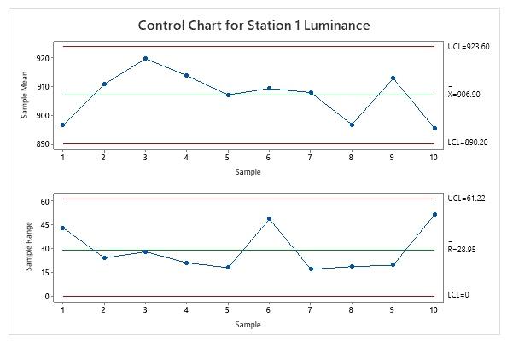
D
I
C
M
A
4.3 Xbar-R Chart Review after improving the measurement system
Define
Measure
Analyze
Improve
Control
Station 1 Luminance
To monitor the mean and the variation of process after applying improvement and use control chart to monitor process stability over time.
- Sampling method: rational subgroups of the first 5 sets per day at the production line, for 10 days (1-Jul to 10-Jul-2026).
Date | Sample 1 | Sample 2 | Sample 3 | Sample 4 | Sample 5
1-Jul | 879.90 | 878.25 | 891.17 | 921.47 | 911.97
2-Jul | 918.79 | 908.47 | 897.79 | 906.27 | 921.88
3-Jul | 920.61 | 929.42 | 914.50 | 930.37 | 902.39
4-Jul | 913.69 | 907.88 | 921.66 | 901.92 | 922.89
5-Jul | 901.04 | 902.26 | 916.63 | 898.68 | 916.27
6-Jul | 903.05 | 920.08 | 880.62 | 929.37 | 912.76
7-Jul | 911.27 | 914.57 | 897.62 | 907.43 | 907.96
8-Jul | 892.92 | 896.84 | 890.74 | 893.58 | 909.34
9-Jul | 919.62 | 915.27 | 905.33 | 921.51 | 901.95
10-Jul | 893.52 | 888.02 | 875.39 | 893.15 | 926.85
Conclusion:
No out-of-control point and no abnormal pattern (run tests) was found in the Xbar and R control charts. Therefore the process is stable over time.
Notes:
Examine the R chart to determine whether the process variation is in control
Examine the Xbar chart to determine whether the process mean is in control

Slide 25
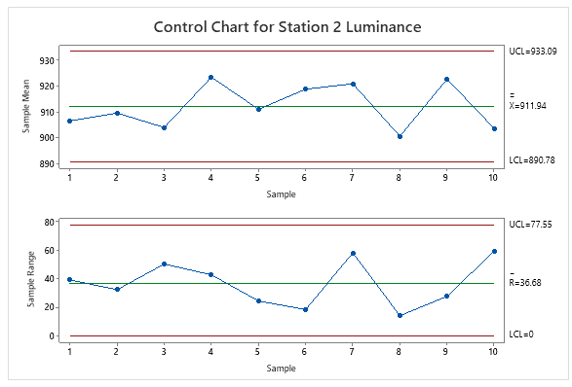
D
I
C
M
A
4.3 Xbar-R Chart Review after improving the measurement system
Define
Measure
Analyze
Improve
Control
Station 2 Luminance
To monitor the mean and the variation of process after applying improvement and use control chart to monitor process stability over time.
- Sampling method: rational subgroups of the first 5 sets per day at the production line, for 10 days (1-Jul to 10-Jul-2026).
Date | Sample 1 | Sample 2 | Sample 3 | Sample 4 | Sample 5
1-Jul | 903.99 | 888.65 | 927.84 | 910.28 | 901.09
2-Jul | 910.09 | 898.47 | 930.79 | 906.56 | 901.04
3-Jul | 934.62 | 905.74 | 884.21 | 897.26 | 897.52
4-Jul | 926.69 | 897.88 | 940.66 | 917.92 | 932.89
5-Jul | 901.07 | 919.56 | 916.63 | 920.68 | 896.27
6-Jul | 921.35 | 919.07 | 910.92 | 929.27 | 912.16
7-Jul | 931.37 | 899.74 | 907.23 | 957.93 | 907.04
8-Jul | 902.12 | 906.54 | 893.01 | 893.85 | 907.01
9-Jul | 909.81 | 925.48 | 937.52 | 920.73 | 918.64
10-Jul | 893.27 | 904.75 | 873.01 | 914.26 | 932.42
Conclusion:
No out-of-control point and no abnormal pattern (run tests) was found in the Xbar and R control charts. Therefore the process is stable over time.

Slide 26
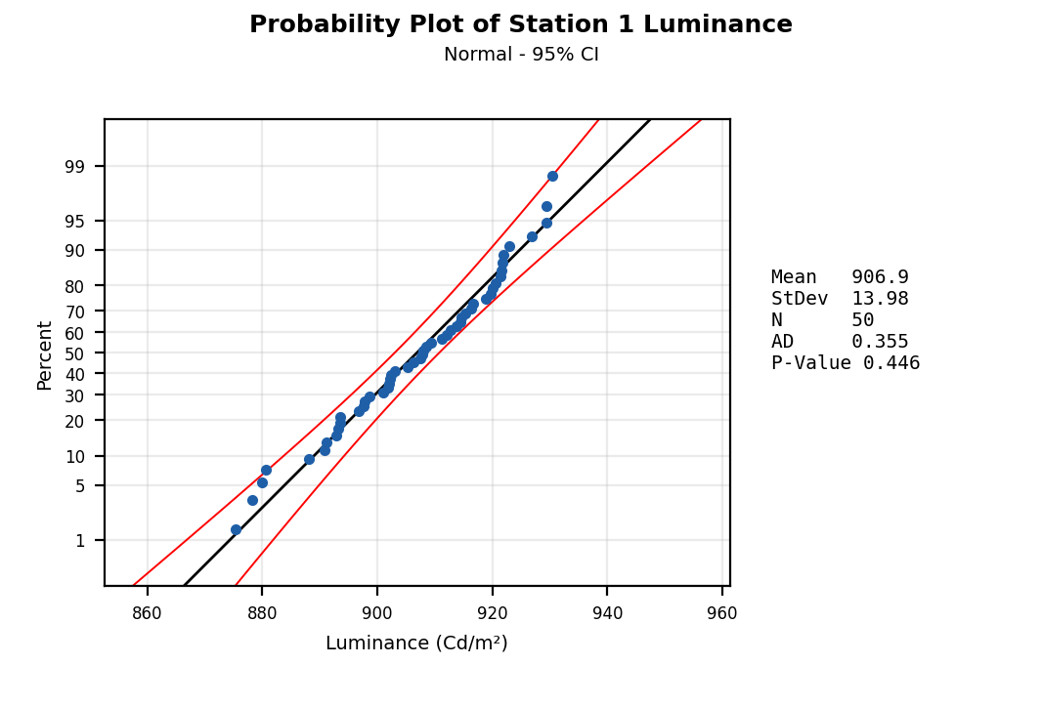
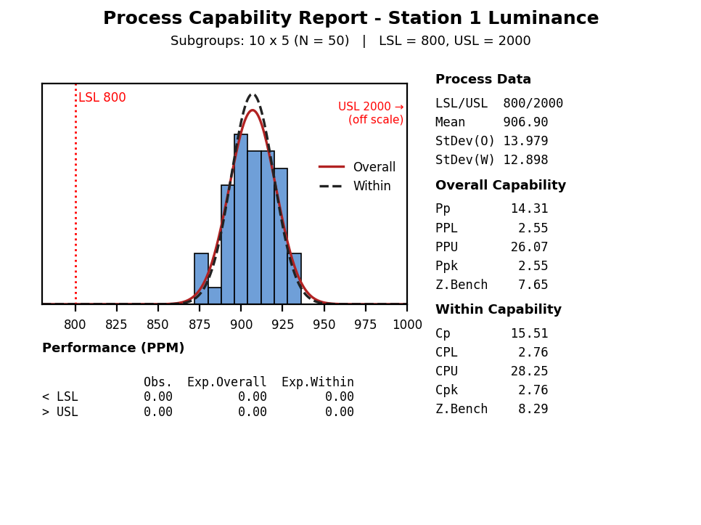
D
I
C
M
A
4.4 Check Process Capability after improving the measurement system
Define
Measure
Analyze
Improve
Control
Station 1 Luminance
Use the normality test (Anderson-Darling) to determine whether the data follow a normal distribution
H0: Data follows Normal Distribution
H1: Data does NOT follow Normal Distribution
P-value = 0.446 > 0.05 -> Fail to reject H0 -> No evidence against normality (PASS)
Then check the probability plot: the closer the points are to the fitted line, the better the normal fit.
After that, evaluate process capability:
P-Value = 0.446 > 0.05 → Pass
(Data can be treated as normally distributed)
Cpk = 2.76 (= CPL; USL 2000 is far from the process) (Goal ≥ 1.33; target ≥ 1.67) → Process capability is sufficient.
Focus effort on maintenance and shared management measures
Notes:
To evaluate process capability:
Check that the data fit the (normal) distribution.
Check whether the solid (overall) curve fits closely with the dashed (within) curve.
Evaluate the capability from the performance indices (Pp, Ppk) and the potential capability indices (Cp, Cpk); compare Cpk with a benchmark value that is acceptable for the process.
Dash: within curve
Solid: overall curve

Slide 27
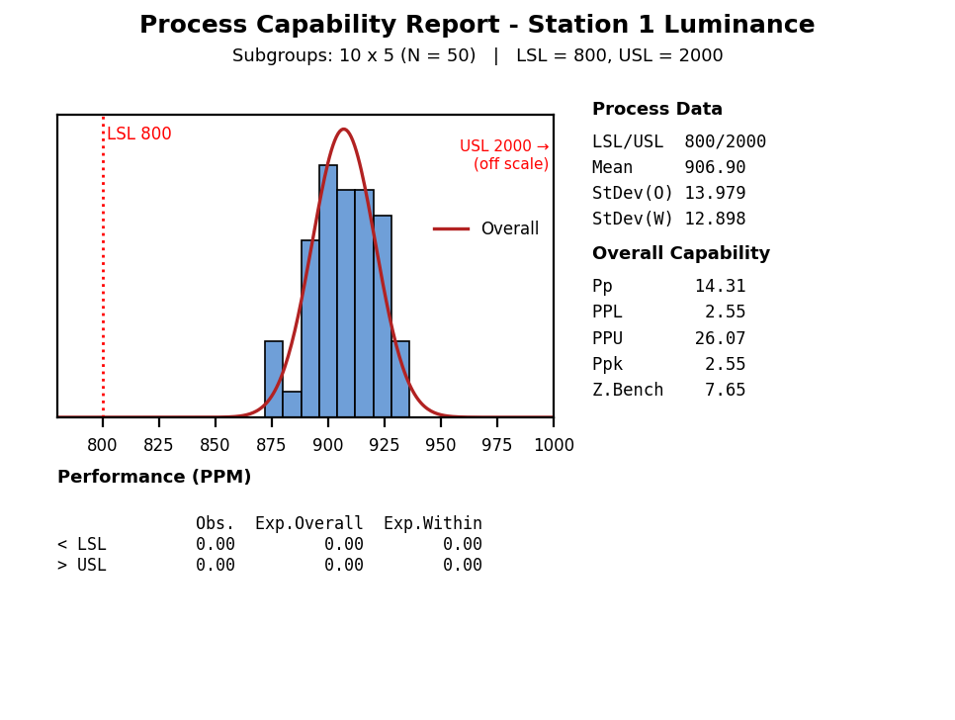
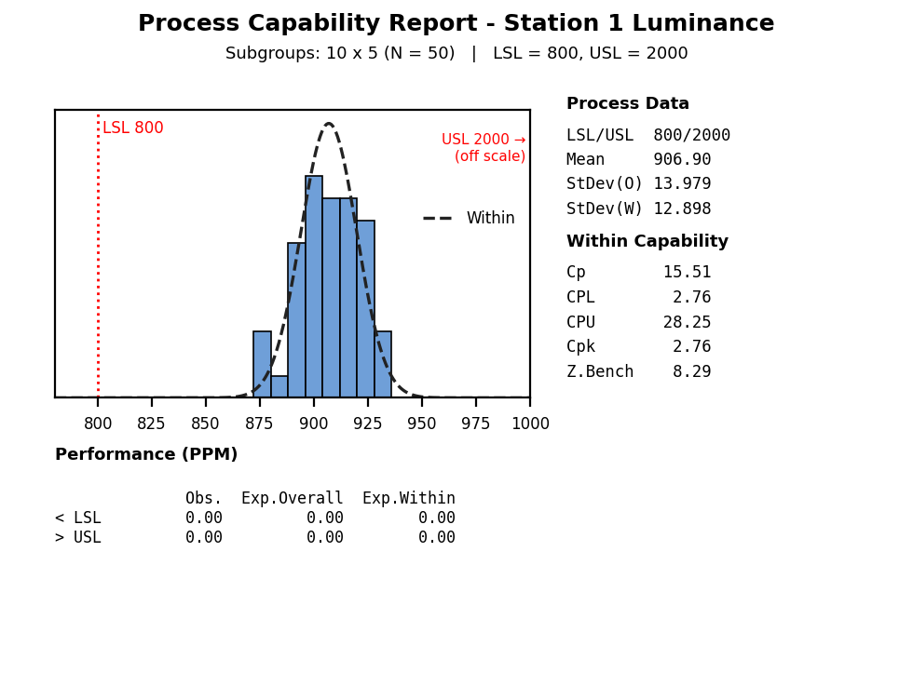
4.4 Check Process Capability after improving the measurement system
Define
Measure
Analyze
Improve
Control
Station 1 Luminance
Z Long term = 7.65 Standard ≥ 4.5
→ OK
Z Short term = 8.29 Standard ≥ 6
→ OK
Z _{shift}
Check the Z short term (best capability of process) and the Z long term (customer’s perspective):
Zshift = Zst – Zlt = 8.29 – 7.65= 0.64 → Z shift < 1.5
→ Proper process control management
Z long term : 7.65 ≥ 4.5, Z short term: 8.29 ≥6
→ Technology is OK
Lack of management
Lack of skill
Lack of management
Proper skills
A
B
1.5
Control
C
D
Proper management
Lack of skills
Proper management
Proper skills
(The matrix boundary Zst = 4.5 is the minimum for good technology; the Six Sigma level Zst ≥ 6 / Zlt ≥ 4.5 is also reached.)
4.5
Z_{ST} Or Z_{ST}(Bench)
Poor
Technology
Good
Notes:
Zst: within (short-term), Zlt: overall (long-term). The short-term process capability (Zst) represents the best capability of the current process. Zlt represents the process capability from the customer’s perspective.
Over time the quality deteriorates because of tool and equipment wear, variation between workers and changes of environment. Zshift = Zst − Zlt indicates the degree of deterioration; a shift of about 1.0 to 1.5 is typical. If Zshift is greater than 1.5, management (control) is judged not good; if Zshift is less than 1.5, management is judged good.
Cpk is a measure of the potential capability of the process and equals the minimum of CPU and CPL. Cpk is a ratio that compares two values:
The distance from the process mean to the closest specification limit (USL or LSL)
The one-sided spread of the process (the 3-σ variation) based on the within-subgroup standard deviation
Cpk considers both the location and the variation (within subgroups) of the process.

Slide 28

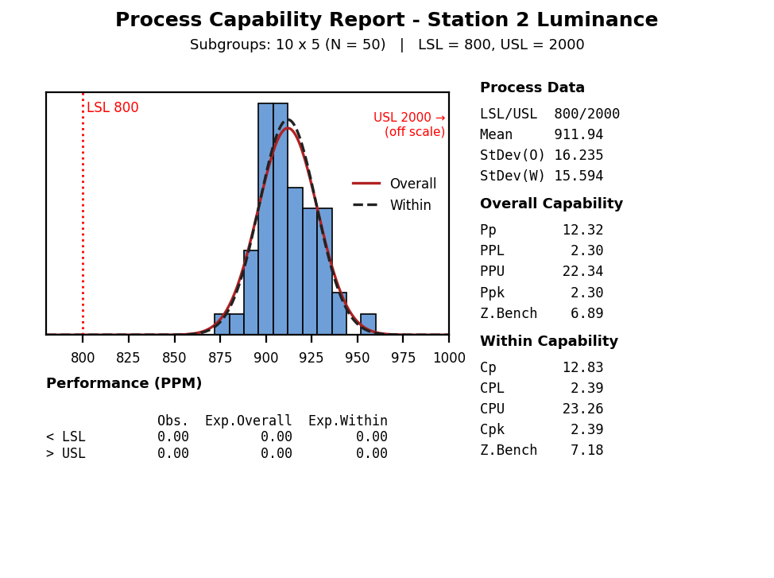
D
I
C
M
A
4.4 Check Process Capability after improving the measurement system
Define
Measure
Analyze
Improve
Control
Station 2 Luminance
To evaluate process capability of station 2:
Normality test (Anderson-Darling): H0: data follow a normal distribution; H1: data do NOT follow a normal distribution.
P-value = 0.503 > 0.05 -> Fail to reject H0 -> No evidence against normality (PASS)
(Data can be treated as normally distributed)
Cpk = 2.39 (= CPL; USL 2000 is far from the process) (Goal ≥ 1.33; target ≥ 1.67) → Pass

Slide 29
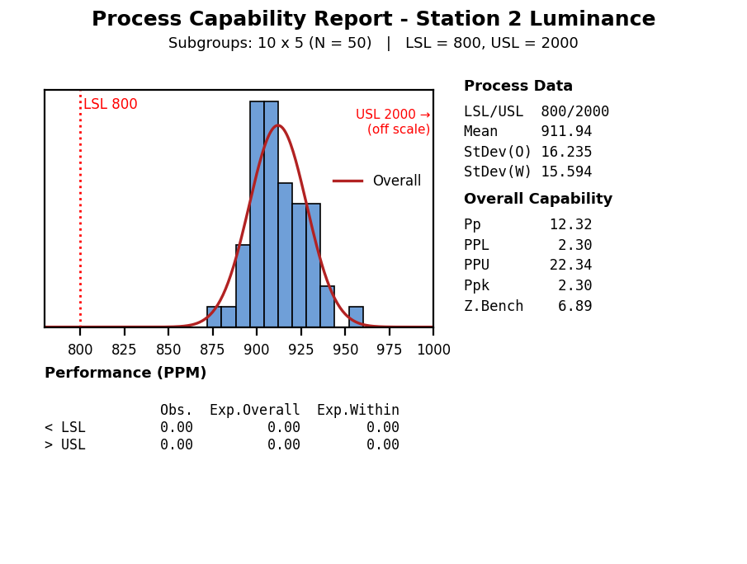
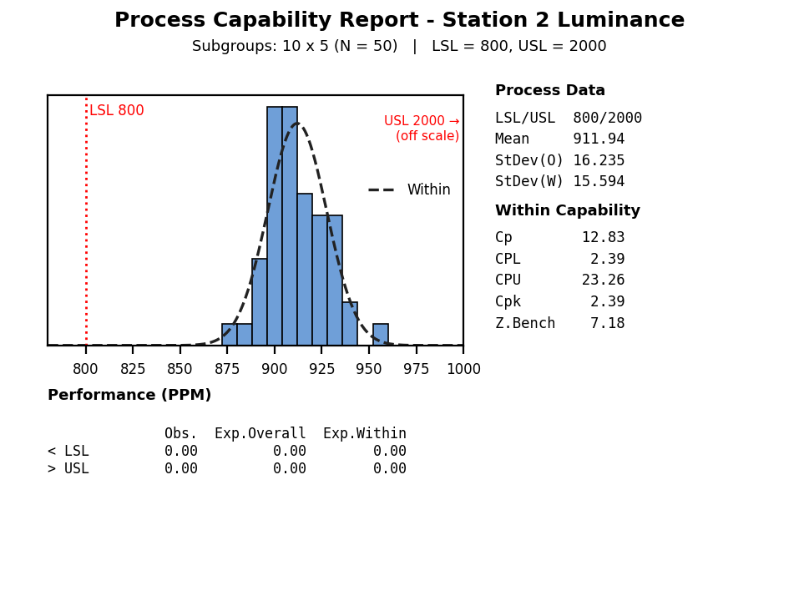
D
I
C
M
A
4.4 Check Process Capability after improving the measurement system
Define
Measure
Analyze
Improve
Control
Station 2 Luminance
Z Long term = 6.89
Standard ≥ 4.5
→ OK
Z Short term = 7.18 Standard ≥ 6
→ OK
Z _{shift}
Lack of management
Lack of skill
Lack of management
Proper skills
Zshift = Zst – Zlt = 7.18 – 6.89 = 0.29 → Z shift < 1.5
→ Proper process control management
Z short term: 7.18 ≥ 6 , Z long term: 6.89 ≥ 4.5
→ Technology is OK
A
B
1.5
Control
C
D
Proper management
Lack of skills
Proper management
Proper skills
(The matrix boundary Zst = 4.5 is the minimum for good technology; the Six Sigma level Zst ≥ 6 / Zlt ≥ 4.5 is also reached.)
4.5
Z_{ST} Or Z_{ST}(Bench)
Poor
Technology
Good
Notes:
Zst: within (short-term), Zlt: overall (long-term). The short-term process capability (Zst) represents the best capability of the current process. Zlt represents the process capability from the customer’s perspective.
Over time the quality deteriorates because of tool and equipment wear, variation between workers and changes of environment. Zshift = Zst − Zlt indicates the degree of deterioration; a shift of about 1.0 to 1.5 is typical. If Zshift is greater than 1.5, management (control) is judged not good; if Zshift is less than 1.5, management is judged good.
Cpk is a measure of the potential capability of the process and equals the minimum of CPU and CPL. Cpk is a ratio that compares two values:
The distance from the process mean to the closest specification limit (USL or LSL)
The one-sided spread of the process (the 3-σ variation) based on the within-subgroup standard deviation
Cpk considers both the location and the variation (within subgroups) of the process.

Slide 30
4.5 Conclusion
Define
Measure
Analyze
Improve
Control
After evaluation, we confirmed that the measurement system at Station 2 had significant problems during testing (while Station 1 was normal). We proved that camera angle misalignment was the root cause of the Luminance NG defect.
We improved the measurement system by correcting the camera angle to 90.0°. We then verified stability and capability using Type 1 Study, Type 3 Gage R&R, Xbar-R control charts, and Process Capability analysis for both stations.
The results demonstrate that both measurement systems achieve high repeatability and no significant bias (Type 1: Cg/Cgk ≥ 1.33; Type 3: %Study Var < 10% and %Contribution < 1%), and the process measured at both stations shows excellent capability (Cpk > 2.0). Result vs goal: Luminance defect rate 226,624 ppm → 0 ppm (0 NG / 420 units after improvement; 95% upper confidence bound ≈ 7,100 ppm, still > 96% below the baseline).

Slide 31
5.1 Result of project
Define
Measure
Analyze
Improve
Control
Summary: Luminance defect rate of J1 Dual model before / after improvement
 | Before |  |  |  | After
Date | 16.Nov.2025 | 2.Jan.2026 | 23.Feb.2026 | 1.Mar.2026 | 15.Jul.2026 | 21.Aug.2026 | 20.Sep.2026
Total NG | 13 | 8 | 92 | 30 | 0 | 0 | 0
Prod Q'ty | 200 | 120 | 240 | 71 | 240 | 120 | 60
Defect rate (ppm) | 65000 | 66666.67 | 383333.33 | 422535.21 | 0 | 0 | 0
After improvement: 0 NG / 420 sets → 95% upper confidence bound ≈ 7,100 ppm (3/420), still > 96% below the 226,624 ppm baseline. Fisher's exact test, 143/631 before vs 0/420 after: p < 0.001.

Slide 32



5.2 Control plan (Future plan)
Define
Measure
Analyze
Improve
Control
Management plan
Make checksheet to control equipment with master sample
Actual DID check sheet in production line
DID check sheet format
A daily check sheet is established to monitor equipment status using a Master sample. Because the J1 Dual model features dual displays requiring camera movement, camera angle status must be verified during pre-production setup to prevent angle deviation.

Slide 33
5.2 Control plan (Future plan)
Define
Measure
Analyze
Improve
Control
Management plan
Master Sample Management Procedure:
• Inspection Timing: Daily at shift start (08:00~10:00 for day shift, 20:00~22:00 for night shift).
• Responsible: PM Technician & Line Leader.
• Procedure:
1. Test the Master Sample (reference 910 Cd/m²) at the Luminance station; the reading must be inside the control limits 910 ± 48 Cd/m² (±3s of the Type 1 study after improvement, s = 15.96) and inside spec (800~2000 Cd/m²).
2. If a reading is out of the limits, stop judging OK/NG and report immediately to Line Leader; PE & PM teams will inspect the camera angle (target 90.0°) and confirm with the Master Sample again before restarting.
3. GMES version checking (SW/HW) is skipped during Master Sample testing to focus strictly on hardware measurement stability.
Standardization & horizontal deployment (planned):
• Add the camera-angle check (target 90.0°) to the pre-production setup standard (SOP) of the Luminance station.
• Apply the same Master sample check to the other dual-display models measured with the CS2000 (E3PA Dual, G3 Dual, J1 Dual PPR); the RHD Privacy models also need the 13% luminance compensation (slide 20).
• Keep monitoring with the Xbar-R chart; if a point goes out of control, apply the reaction plan above (step 2).

