Slide 1


GM Gen 11 Rattle Noise Improvement
Background of Project Selection, clarification of “Y”
Measurement System Analysis, Process Capability and define Current Level
Selection of factor and Selection of Main Factors
Verification of Optimal Value
Improvement status and increase control in the future
2025.11.12
VS IVI SQA

Slide 2
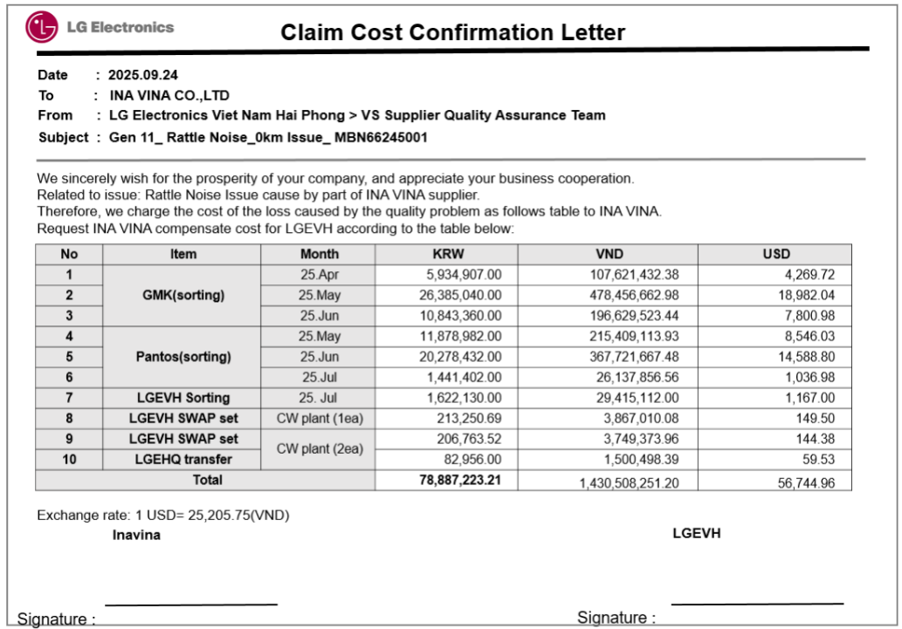
Task category
□ HW □ SW
■ Mecha □ Current job
Belong | VS IVI SQA
Learder | Vu Van Hai Team Learder
Reviewer | Mr. Ken Park
Six Sigma Assignment registration Form
Theme | GM Gen 11 _ Rattle Noise Improvement |  |  |  | Period | 25.01.07 ~ 25.30.09 |  | Task team name | VS IVI SQA
Six Sigma Challenges |  | Improvement goal (Stretch Goal) |  |  |  |  |  | Idea of breaking the time
 |  | Improvement Index |  | Current |  | World Best | Goal
GM Gen 11 Rattle Noise Improvement |  | KPI | Total Defect Rate | 457ppm |  | - | 0 ppm (100%↓) | Analysis Gage R&R study Define little “Y” Measurement data and process capability Optimize specification
 |  | Project Y | Embo height (Case Bottom) | Out min *Z bench = 0.21 |  | - | 7.4 mm *Z bench = 4.5
Management Issue (Biz. Issue) |  | Implement Plan |  |  |  |  |  | Task member
Improvement Rattl Noise issue at 0km Decrease scrap cost at supplier Continuous order through customer satisfaction and Qualitu, failure, cost need to be improves
 |  |  |  |  |  |  |  | Location
 |  |  |  |  |  |  |  | LGE FA line and Supplier
Qualitative Performance |  | Quantitative Performance |  |  |  |  |  | Neck Point
Customer Department & Buyer Quality Satisfaction |  | Rattle Noise Defectve Rate: 457.1ppm (Apr) and Isssue at Customer site (3ea) Claim cost: 56.7K$ Defect Scrap (Supplier): 60.000ea ~ 19k$ |  |  |  |  |  | Smooth business consultation with related departments is necessary
11st, Nov. Ken Park
You’d better to make clear what KPI is and what Project Y is.
Improvement Index
KPI | Ex) Total system defect
Project Y | Ex) Certain Characteristic or dimension
Schedule
Category | Name | Role
VS IVI SQA | Trinh Duc Hieu | Owner
 | Pham Thi Cuc | Supplier control
 | Pham Ngoc Hung | Line quality control
 | Le Hoang Long | Local development
INA VINA | Nguyen Van Luc | Supplier
D
M
A
I
C
※ Claim cost ‘25. Sep: 56.7k$
※ Scrap cost at supplier ‘25. Sep: 19k$
07/10
07/20
08/08
08.30
09/30
24th, Nov. Ken Park Well done to make clear KPI and Project Y. ++ Additionally, you’d better add the current Z and Target Z of Project Y as a footnote.
Key Activity and Out Put
D : Define scrap cost Project Y by deriving Big Y and Little y
M : Verify Measurement System and identify current level to select main Factor
A : Selection of Main Factor affect to Issue
I : Improvement Main Factor
C : Identify Improvement Level and Establish Management Plan
Notes:
2
MBB 후보 과제는 고객의 요구사항과 경영성과 측면에서도 개선 및 기여도가 분명하고, 당해 년도 중요한 과제를 선정해야 한다고 들었습니다.
하지만, MBB후보 모두가 그와 같이 막중하고 규모 있는 과제를 하기란 사실상 어려운 부분도 많습니다. 한 편으로는 MBB가 모든 영역에 대한
전문가도 아니기에 전공 외의 영역에서는 문제해결 전문가로서 업무를 리드해 가기가 힘든 것도 사실입니다.
MBB 후보 생활을 하면서 전, MBB로서의 역량은 물론 자질도 개발해 나가는 과정이라고 생각하고, 휴대전화에는 여태껏 적용하지 않았던
G2의 OIS Camera 부분에 대해 과제를 하기로 결정하였습니다. 주변에서는 휴대폰에 적용할지 어떨지도 잘 모르는 상황이고, 성공할 수 있는지에
대한 의구심으로 인해 기피하던 과제라 반신반의 했지만, 역량을 개발하고 도전적인 목표 달성을 위해 최선을 다해보자는 마음가짐으로 시작했습니다.
‘제대로 한 번 해보자.’
당시 CMR지표 중 Camera 부분은 애플과 SS에 비해 다른 부분보다 현저히 떨어지는 수준이었습니다. 실제 필드불량은 0.32%인데, 고객의 불만지수는
밧데리 사용시간 다음으로 Camera가 컸습니다. FFR지표는 낮은데, 실제 불량은 적은데, 고객들의 느끼는 Imapct는 매우 큰 Item이 Camera라는 사실을
새삼 실감하며, 반드시 성공시켜보겠다는 의지를 갖게 했습니다.
과제등록서는 과제를 진행하면서 상당 부분이 변경되었습니다. 사실 OIS기능에 대한 개발 경험도 없었기에 이것을 어떻게 측정할지.. 또 무엇을 측정할지
결정할 게 한 두가지가 아니었습니다. 개발 기간은 정해져 있는데, 측정 지표를 정하고, Spec을 정하고, 그 수준에 Meet하게끔 만들어 내야 하는 것이었습니다.
Suppression ratio라는 지표 명은 새롭게 정한 것입니다. 그대로 번역하자면 억제력, 보정력입니다. Camera lens가 떨리는 걸 억제해 내는 능력을
Project Y로 정했습니다. 비율 데이터로서 정보의 양도 많고, KPI를 대표할 만한 과제라고 판단했습니다.
2

Slide 3
I. DEFINE
Background of Theme Selection
Big Y – Little y
Select for project Y

Slide 4
Background for Project Selection_Environmental Analysis / Product Issue
D
M
A
I
C
For the GM Gen 11 model, a premium model of our major client General Motor Group, customer complaints and quality issues immediately during to SOP have created risks of stop line in Customer and lead to cost waste. Furthermore, GM model currently account for a large proportion of the plant’s total production volume. Therefore, any issue occurring at these customers could have a serious impact on damage to the company's credibility and future plans.
The GM Gen 11 model is one of the three key models, and LG is responsible for mass production for the customer GM (Gen 11, Gen 12, and GVM). During mass production, the customer identified a noise issue in the Gen 11 model. The customer received feedback from end users regarding unpleasant noise.
The Gen 11 model has been in mass production for two years, and no similar issues have occured. Due to these concerns from the customer, LGEVH must immediately review the production process, identify the root cause of the defect, and implement improvement actions to ensure customer satisfaction.

Slide 5
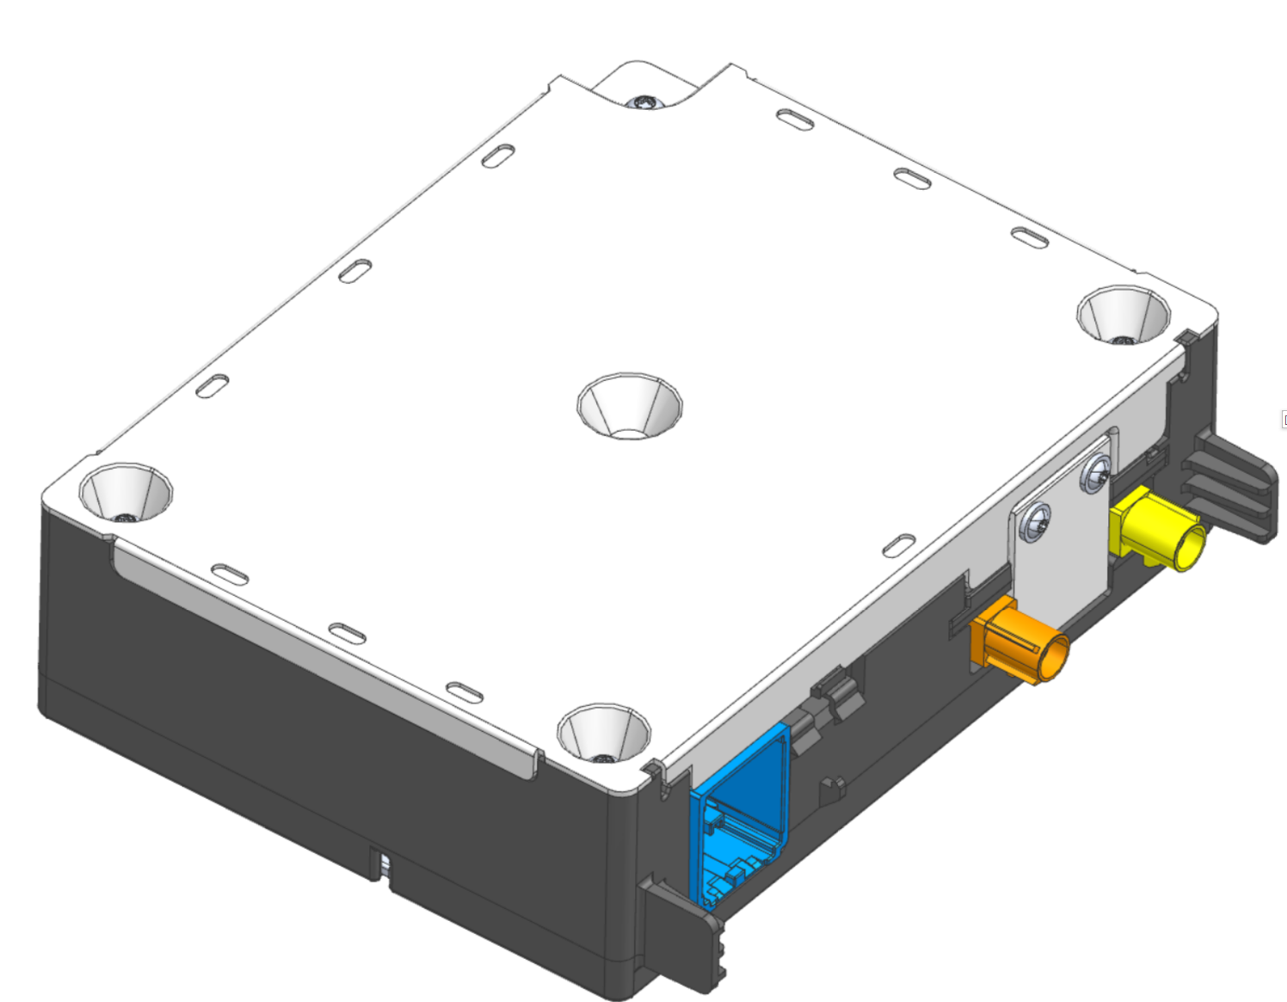
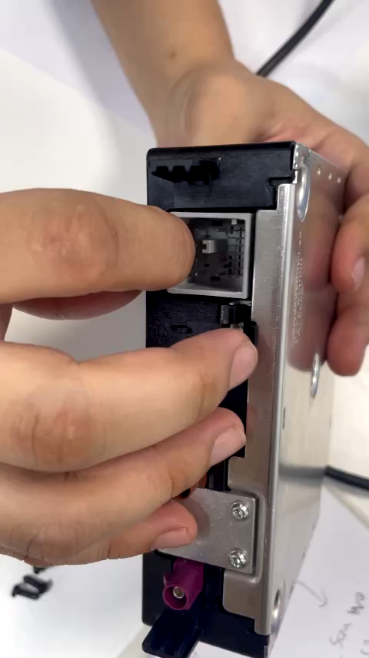
Analyze to select Project Y
D
M
A
I
C
※ Phenomenon:The screws have been fixed fully and there is no gap between Main Case and Bottom Case but when force is applied to the PCB, it is not fixed lead to In the assembly process on passenger car, there is abnormal noise happened.
11st, Nov. Ken Park
Oh, there’s a reason why you select a certain dimension which I commented at page 4.
I think that this page 10 ~ 12 can go to define phase.
24th, Nov. Ken Park Well done to make good story to explain Project Y
Noise

Slide 6
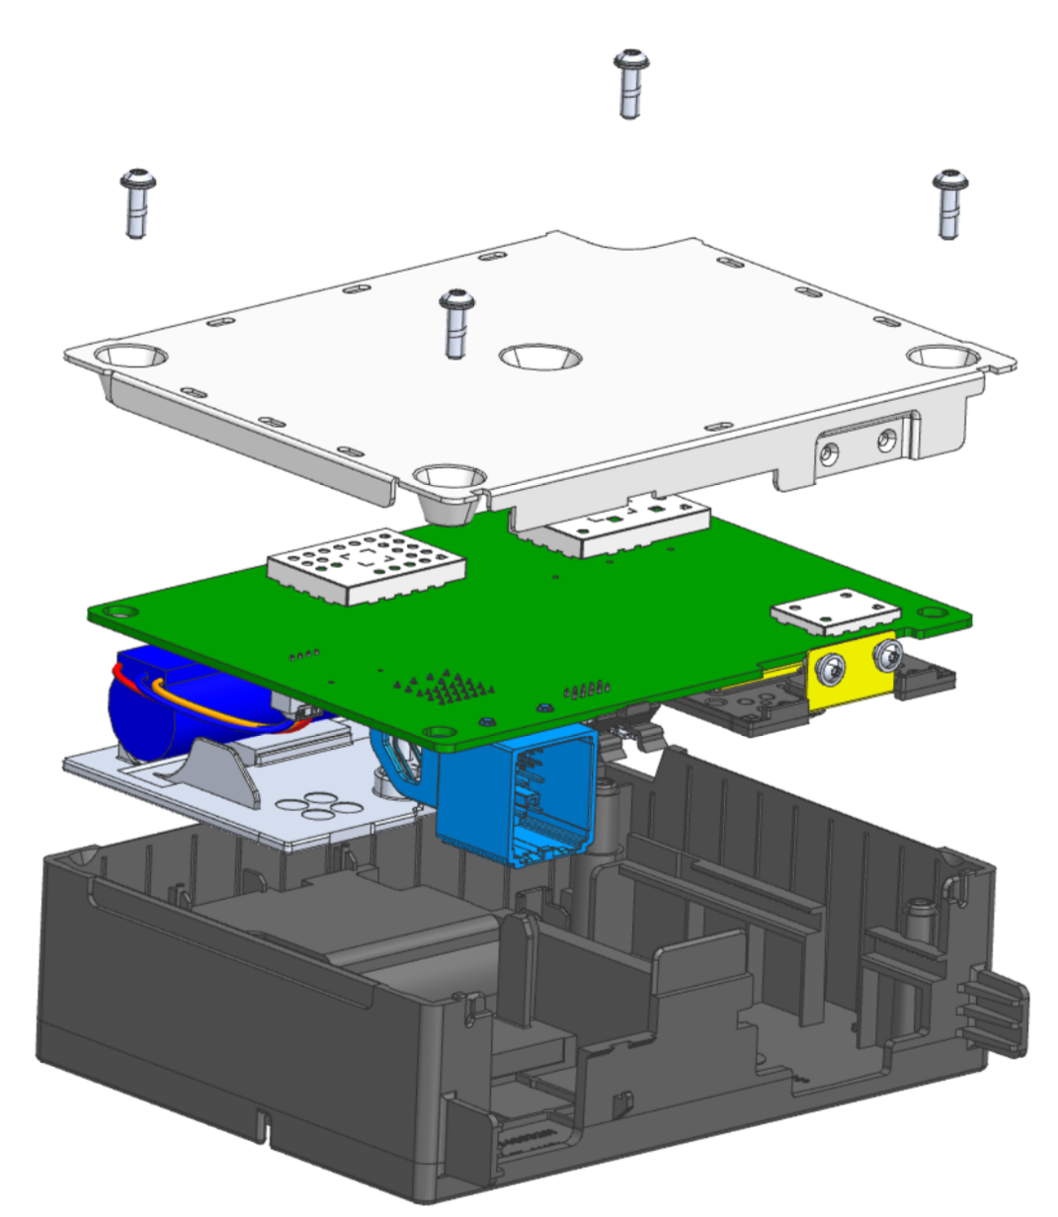
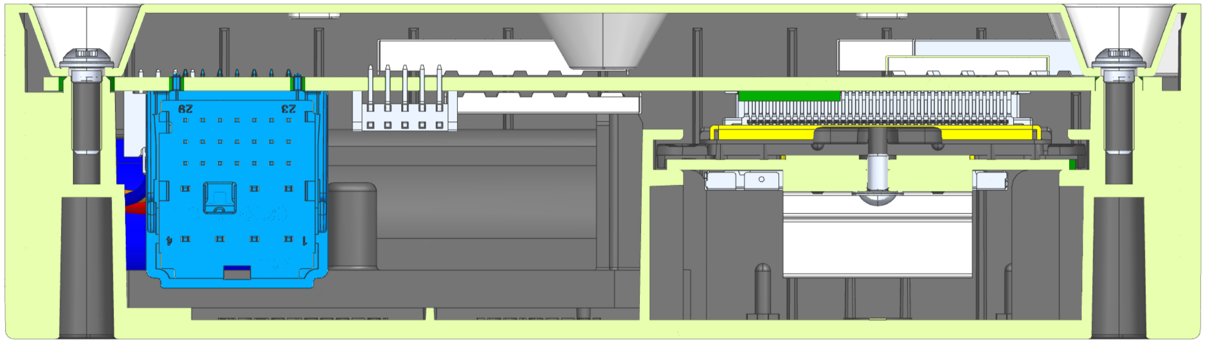
Analyze to select Project Y
D
M
A
I
C
Conduct disassembly to identify the related factors
Create a cross-section through the hold position

Slide 7
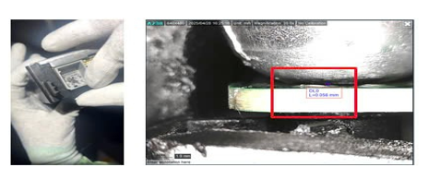
Analyze to select Project Y
D
M
A
I
C
Create a cross-section through the hold position
※ Structure
The Noise location consists of three components: the case bottom, case top, PCB, Screw.
※ Cross Section by Actual Set by Dino
A cross-sectional analysis was performed on the actual production unit, and it was found that after screw fastening, there was a gap between the case bottom and the PCB at the noise location.

Slide 8
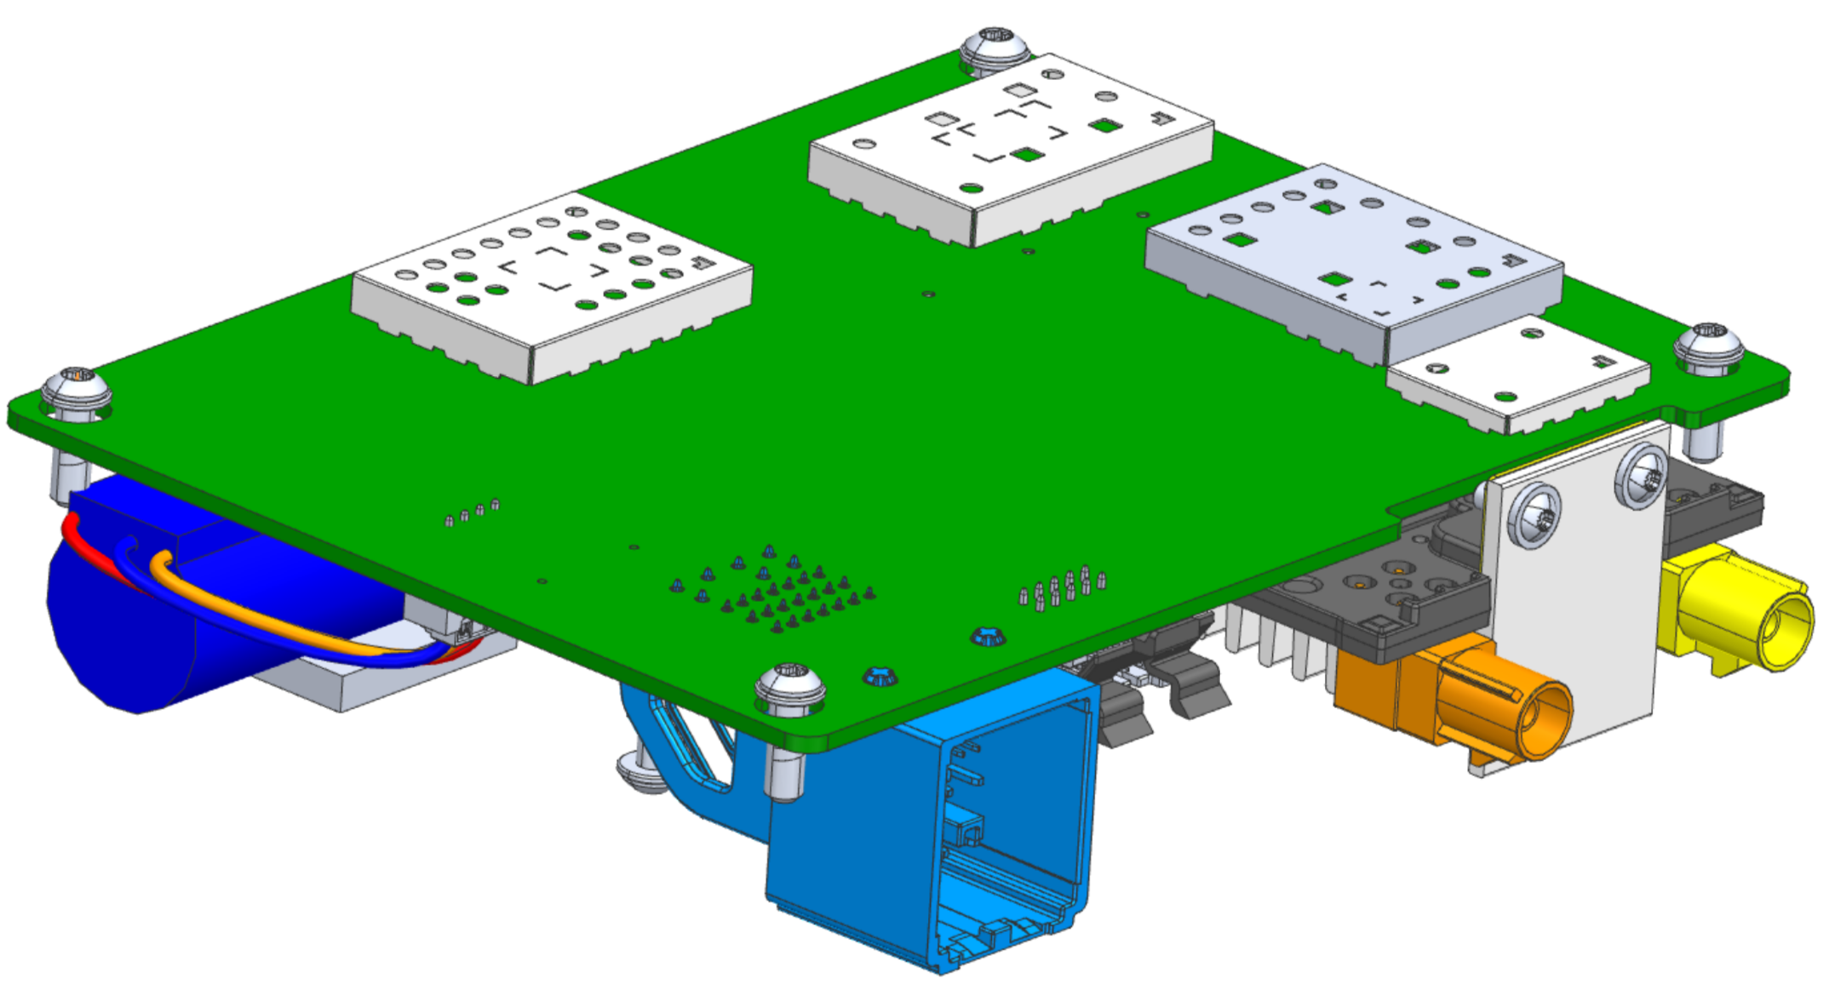
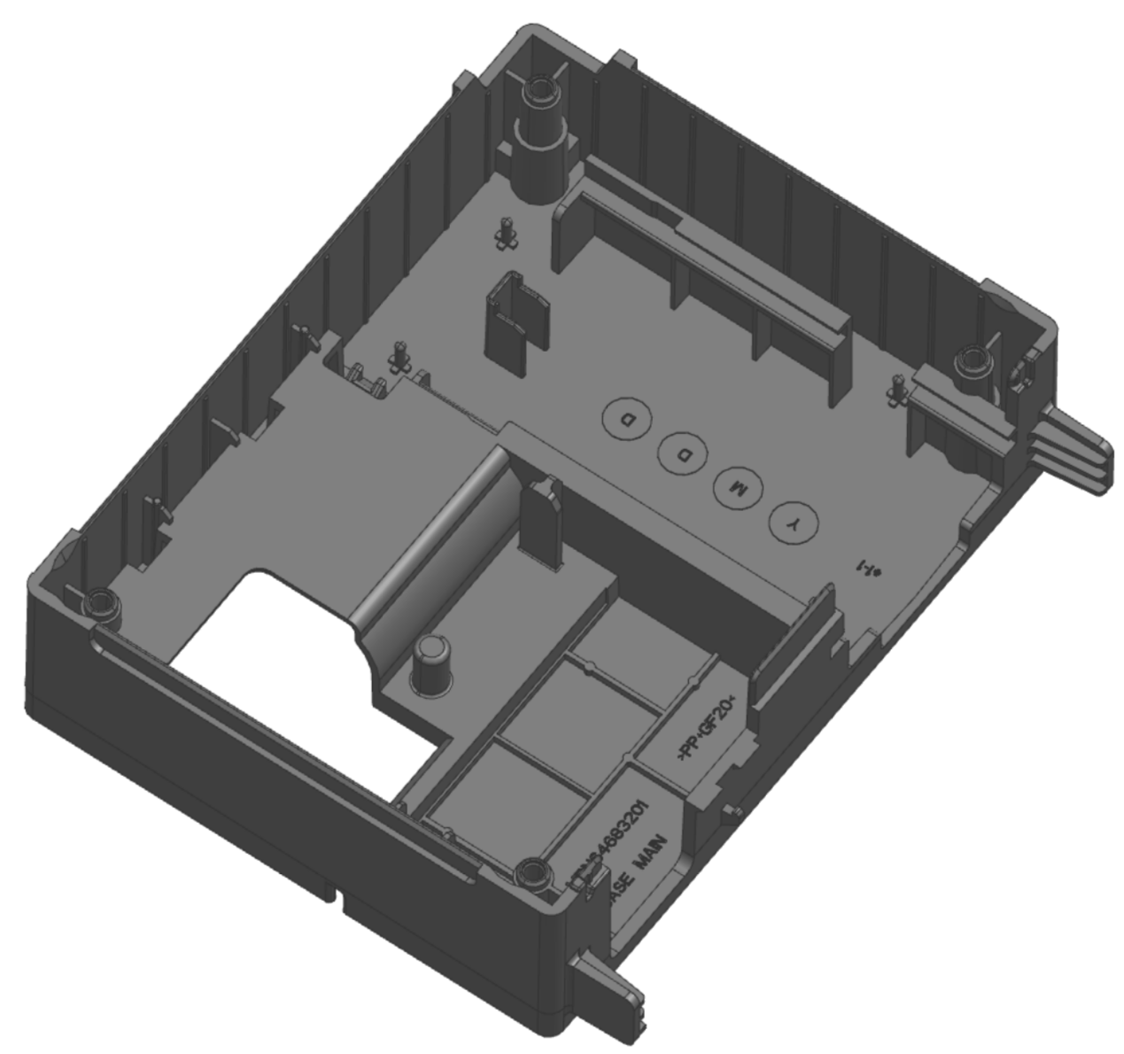
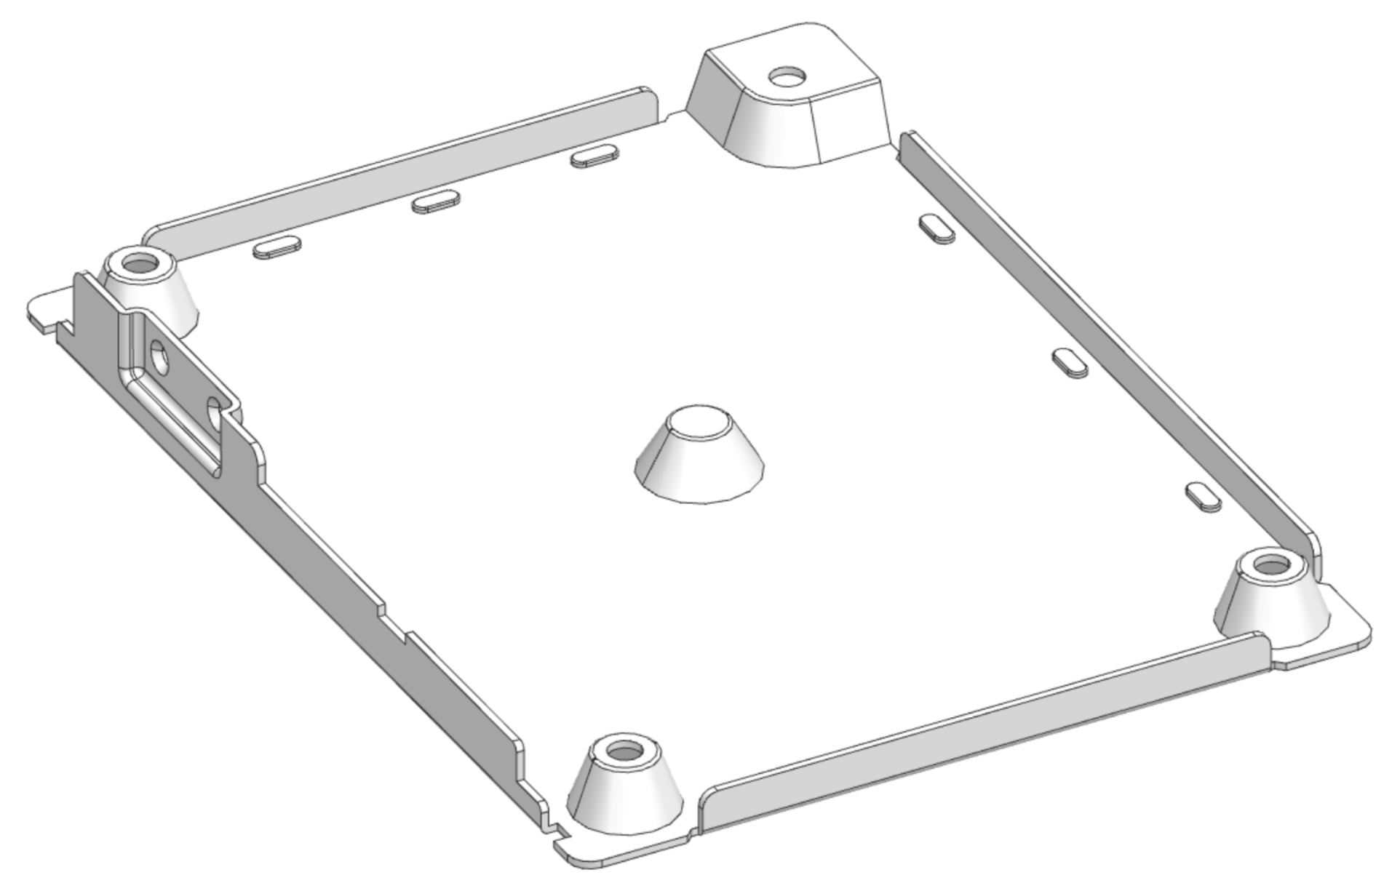
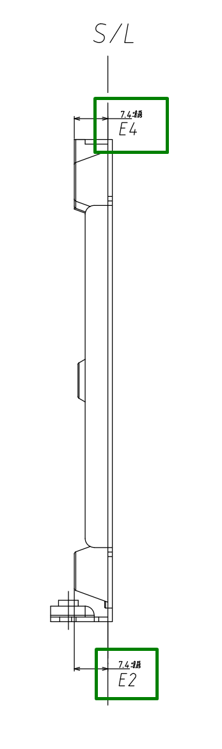
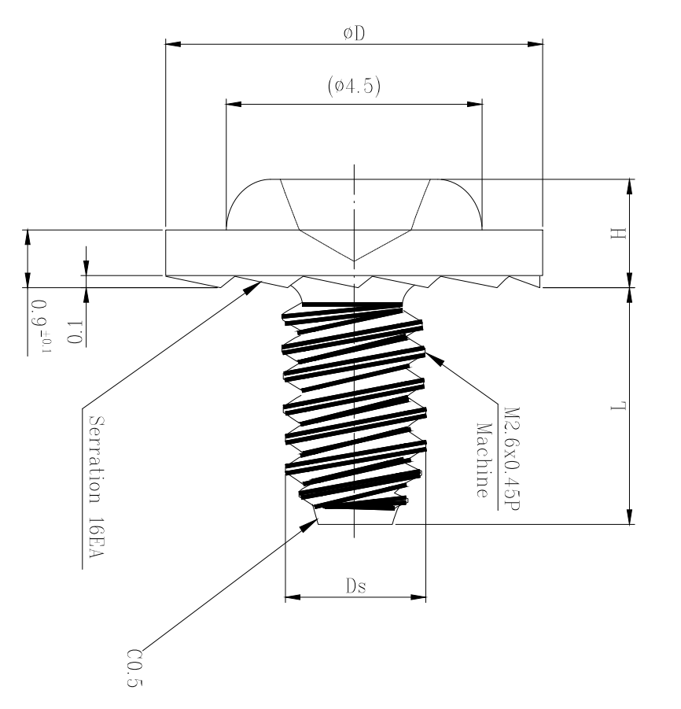
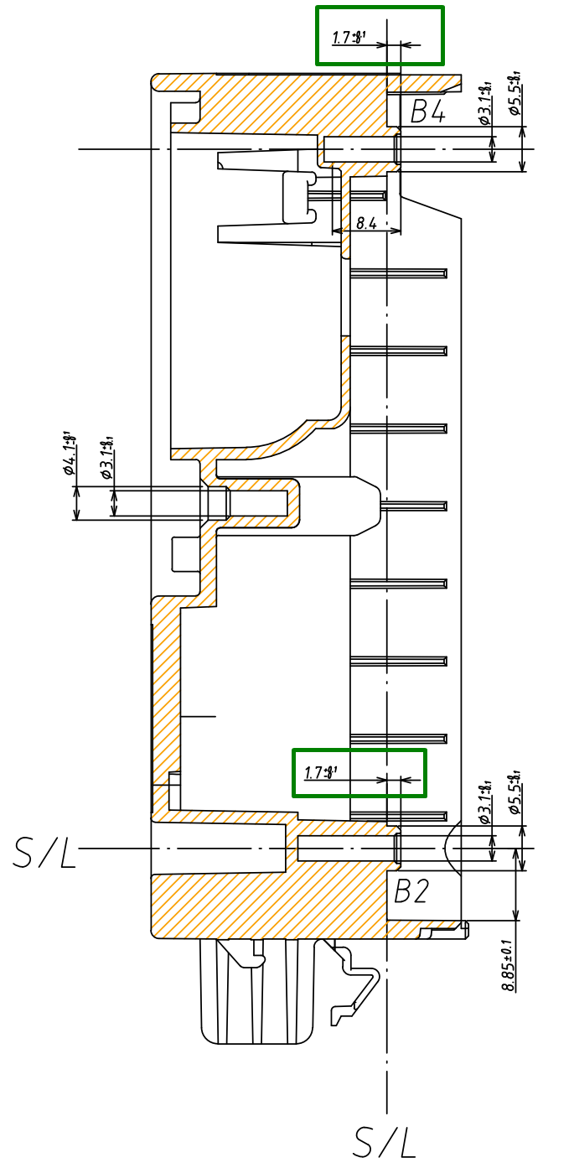
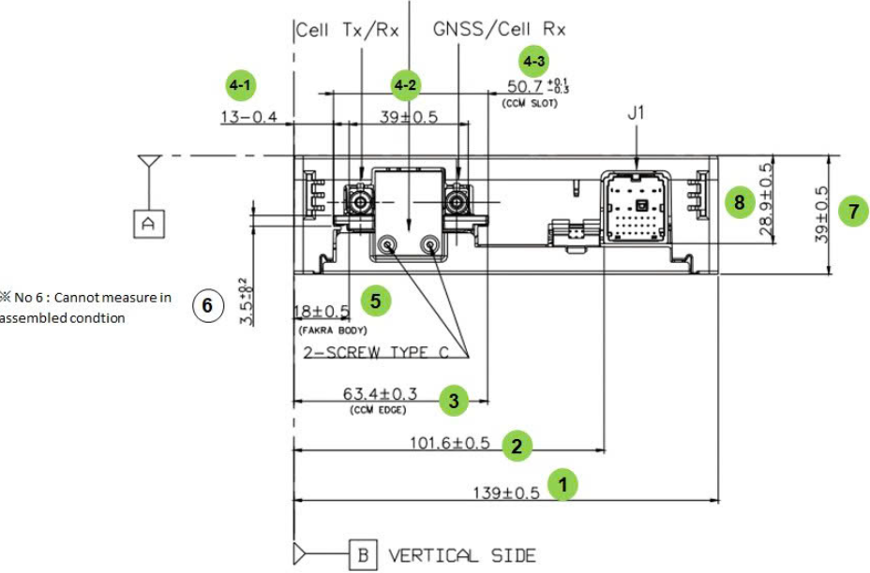
Analyze to select Project Y
D
M
A
I
C
Hole 2
Embo 2
Embo 1
Hole 1
Hole 3
Thinkness
Embo 3
Embo 4
Hole 4
Screw Height
※ Take 5 sample NG noise and inspect
※ Conslution
No | Spec |  |  | Position | Sample 1 | Sample 2 | Sample 3 | Sample 4 | Sample 5 | Judgement
 | Target | +Tol | -Tol
1 | 1 | +0.05 | -0.05 | PCB thinkness | 1.007 | 1.009 | 1.005 | 1.004 | 1.005 | OK
2 | 7.4 | +0.15 | -0.05 | Embo 1 | 7.399 | 7.404 | 7.398 | 7.408 | 7.401 | OK
3 | 7.4 | +0.15 | -0.05 | Embo 2 | 7.402 | 7.401 | 7.398 | 7.407 | 7.406 | OK
4 | 7.4 | +0.15 | -0.05 | Embo 3 | 7.386 | 7.392 | 7.397 | 7.399 | 7.394 | NG
5 | 7.4 | +0.15 | -0.05 | Embo 4 | 7.346 | 7.352 | 7.347 | 7.349 | 7.354 | OK
6 | 1.7 | +0.1 | 0 | Edge to top hole 1 | 1.745 | 1.748 | 1.747 | 1.745 | 1.749 | OK
7 | 1.7 | +0.1 | 0 | Edge to top hole 2 | 1.743 | 1.744 | 1.742 | 1.745 | 1.744 | OK
8 | 1.7 | +0.1 | 0 | Edge to top hole 3 | 1.748 | 1.749 | 1.747 | 1.749 | 1.748 | OK
9 | 1.7 | +0.1 | 0 | Edge to top hole 4 | 1.751 | 1.748 | 1.749 | 1.753 | 1.749 | OK
10 | 39 | +0.5 | -0.5 | Assy part height | 39.018 | 39.013 | 39.015 | 39.019 | 39.017 | OK
11 | 6 | 0 | -0.3 | Screw height | 6.003 | 6.005 | 6.002 | 6.003 | 6.001 | OK
→ Based on the data, we can conclude that
Model: GM Gen 11
Part name: Bottom case MBN64683301
Issue: Rattle Noise
Reason: Gap between Bottom case and PCBA
Root Cause: Embo 3 height is NG

Slide 9
Yy break down
D
M
A
I
C
In order to improve the quality of the GM Gen 11 process, the Rattle Noise defect improvement of the process defect was Selectd as a project.
Production Division Big Y
Little y1
little y 2
little y 3
Action / Project
PIC
Model: GM Gen 11
Issue at 0km
Process defect
Supplier issue
Mechanic issue
Screw
Screw missing
Continuous Improvement by Q-bank task 29
LQC
Defect rate ~ 13%
83ea/127,152ea
(653ppm)
Appearance issue
Scratch
Continuous Improvement by Q-bank task 29
11st, Nov. Ken Park
According to this page, improvement mechanic part to reduce rattle noise defect is very important thing. And then, you have to define what Project Y is and why you select this at the next page.
What do you think that which characteristic is the most important one in this model? Such as length dimension or height of the screw boss dimension? Or strength of the part? Or mass of the part??
And you have to share why you think that this dimension is important with technical or statistical approach.
Apr.2025
114ea/127,152ea
(897 ppm)
Defect rate ~ 17%

Rattle Noise
Part
Improvement Embo height number 3 of
Case Bottom
SQA/
Supplier
11st, Nov. Ken Park
At the first page, I recommend you that Just Background of Project such as how big volumes this project is, how high-quality brand of this GM has, how critical quality of this product is, etc. before Y – y break down.
I’m sharing the reference project with you and please check the overall story.
Highest defect rate ~ 70%
Customer issue
Hardware issue
Main PCBA
NG Main PCBA
ETT claim to supplier
ETT
15ea/127,152ea
(117ppm)
Battery
NG Battery
ETT claim to supplier
Software issue
RF
NG function
LGEDV, IE handle this issue
IE, HQ, LGEDV
24th, Nov. Ken Park Well done to make good story to explain Project Y
Key Writing
Key writing fail
LGEDV, IE handle this issue
16ea/127,152ea
(118ppm)
GPS
NG function
LGEDV, IE handle this issue
Power
Power off
LGEDV, IE handle this issue

Slide 10
II. MEASURE
Measurement System Analysis
Measuring Equipment
Gage R&R
Verify by measurement the factors that may affect the issue on each part
Case Main
Bottom Case
PCB

Slide 11
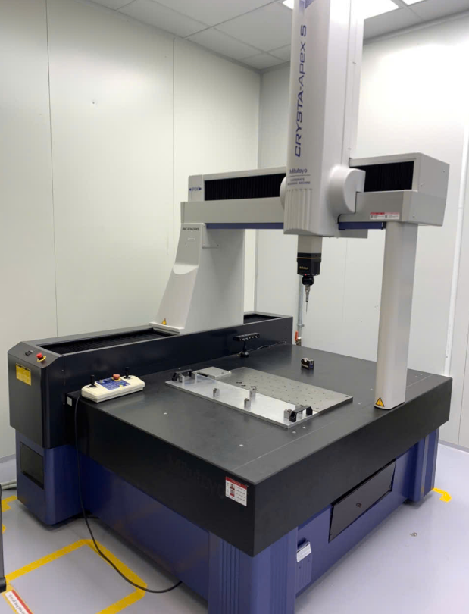
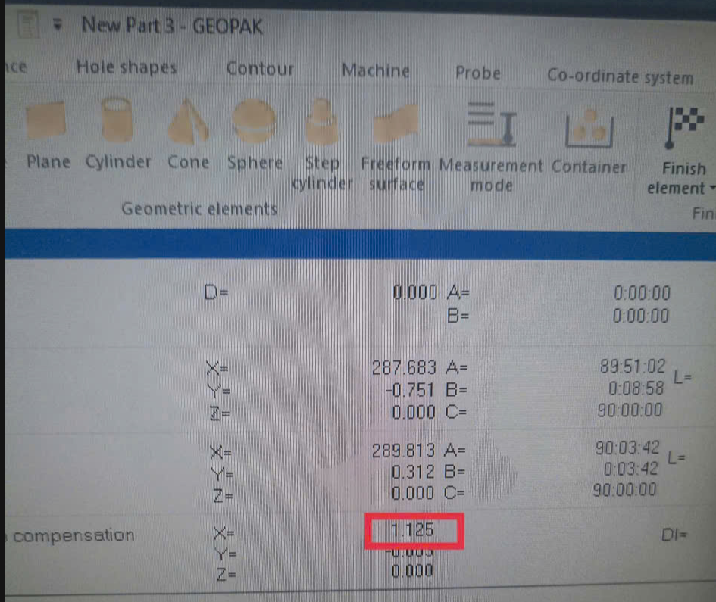
Prepare for Gage R&R
D
M
A
I
C
Measure System
How to Gage R&R
Equipment: CMM (coordinate measurement machine) Mitoyoto
Resolution: 0.001 mm
Type 1: Repeatability and bias of the measuring instrument
Method: 1 people measure a sample, measure repeat 30 times
Judgement: Cg, Cgk ≥ 1.33 (According to VDA 5, GM, Bosch)
Type 2: Calculating the repeatability and reproducibility of the measurement.
Method: 3 people measure 10 sample and repeat 3 times / people
Judgement:
% Study Var ≤ 10% (Pass)
% Tolearance ≤ 10% (Pass)
% Contribution on Total Gage ≤ 1% (Pass)
NDC ≥ 5 (Pass)
Type 3: Calculating the repeatability of the auto measurement.
Method: r * p ≥ 50 (r : sample (min 5 sample), p: repeat time)
Judgement:
% Study Var ≤ 10% (Pass)
% Tolearance ≤ 10% (Pass)
NDC ≥ 5 (Pass)

Resolution
Blind test: The measurer should not know the information of the sample to be measured, including the specifications.
Random: The measuring sequence of the measurer and the sample to be measured and the repetition are determined randomly
These dimensions were measured using a CMM machine by manual method, so this method will affect by operator also.
Type 2 Study is usually called Gage R&R. It is a method of evaluating the accuracy of a measurement system in consideration of reproducibility, which is not only the repeatability of the instrument itself, but also the dispersion among the measurement operators.
How to get sample (sampling)
11st, Nov. Ken Park
What kind of MSA do you implement? Such as MSA Type 1? 2?
You have to select one with the certain reason.
I think that dimension is Project Y, you’d better use type 2 because operator can affect the measurement result. (You have to use type 1 in operator can’t affect the measurement result only. Such as mass, or auto measurement system)
A sample which contains the entire spec or the dispersion of the process should be selected.
- Normally ± 10 to 20% is recommended, but it should be selected considering the current state of the goods in stock!
- The choice of sample should reflect the state of the process
- Pick NG/OK samples, including sample near spec.
*** According to VDA 2: Measurement System Analysis
24th, Nov. Ken Park Well done to make good story to explain Project Y
We will carry out
Gage R&R Type 2 (Repeatability and Reproducibility) study.

Slide 12
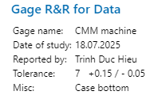
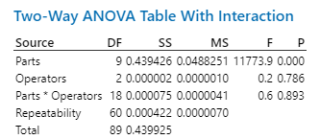
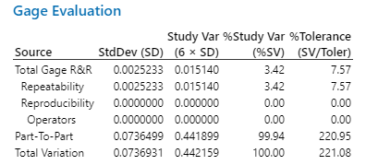

11st, Nov. Ken Park
You measure the 139 dimension for MSA. Does it mean that is this dimension is Project Y?
You have to implement MSA with Project Y
Result for Gage R&R
D
M
A
I
C
Date | 18.Jul.2025 | Equip | CMM | Target | 7.4
Part no | MBN64683301 | ID | IVI - SQA | +TOL | +0.15
Part name | Bottom Case | Resolution | 0.001mm | -TOL | -0.05
Instrument Resolution |  | 0.001
Tolerance | T = USL - LSL | 0.6
Decomposition performance | %RE = (RE / T) * 100% | ( 0.001 / 0.6 ) * 100% = 0.167% < 5 %
 | Tung |  |  | Trung |  |  | Hoang
 | Time 1 | Time 2 | Time 3 | Time 1 | Time 2 | Time 3 | Time 1 | Time 2 | Time 3
1 | 7.418 | 7.423 | 7.420 | 7.422 | 7.419 | 7.419 | 7.420 | 7.418 | 7.421
2 | 7.418 | 7.422 | 7.421 | 7.418 | 7.421 | 7.420 | 7.418 | 7.421 | 7.421
3 | 7.317 | 7.313 | 7.313 | 7.320 | 7.317 | 7.313 | 7.320 | 7.310 | 7.317
4 | 7.419 | 7.425 | 7.419 | 7.420 | 7.423 | 7.419 | 7.415 | 7.420 | 7.418
5 | 7.526 | 7.528 | 7.525 | 7.526 | 7.528 | 7.525 | 7.521 | 7.527 | 7.525
6 | 7.557 | 7.555 | 7.551 | 7.557 | 7.553 | 7.551 | 7.558 | 7.555 | 7.555
7 | 7.417 | 7.419 | 7.417 | 7.417 | 7.421 | 7.417 | 7.415 | 7.422 | 7.418
8 | 7.513 | 7.510 | 7.512 | 7.511 | 7.510 | 7.511 | 7.519 | 7.513 | 7.510
9 | 7.410 | 7.412 | 7.413 | 7.412 | 7.410 | 7.411 | 7.410 | 7.412 | 7.411
10 | 7.519 | 7.520 | 7.527 | 7.518 | 7.520 | 7.525 | 7.516 | 7.521 | 7.521
11st, Nov. Ken Park
I think that you should randomize runs within operators
P part = 0.000 < 0.05 OK → The different between parts is significant
→ The P-value of 0.000 indicates a significant difference between Parts at
the 5% significance level
P operator = 0.786 > 0.05
→ The P-value of 0.786 for the Operator variable indicates that the inter-rater difference
is not significant at the 5% significance level.
P part * operator = 0.893 > 0.05
→ P-value for the interaction between Part and Measurer is 0.893, indicating no
interaction at the 5% significance level.
※ Conclusion:
*3 people measure 10 samples, measure repeat 3 times (Blind and random)
% Study Var (SV) : 3.42 < 10% → OK
→ At 7.72% of total variation, it is below the recommended level of 10%.
% Tolerance (SV / Toler) : 7.57 % < 10% → OK
→ At 19.90% relative to the specification limit, it is somewhat high but conditionally
acceptable for pass/fail determination.
NDC: 41 > 5
→ As NDC 18, it is above the benchmark value of 5 and is considered appropriate from
the NDC perspective.

Slide 13
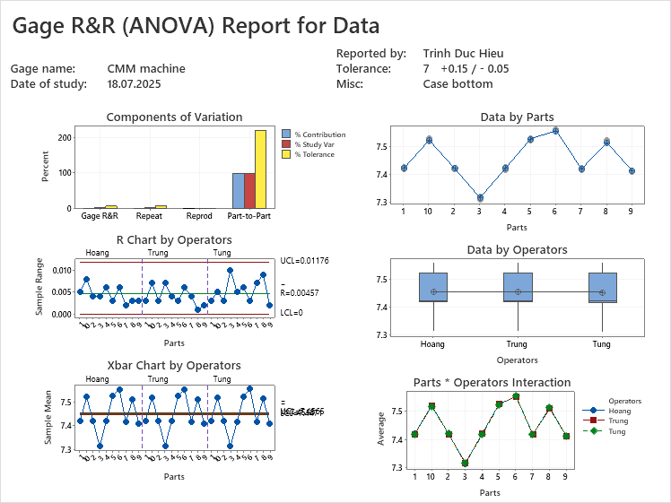
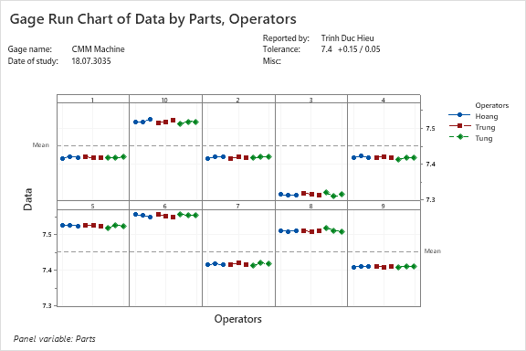
Result for Gage R&R
D
M
A
I
C
Date | 18.Jul.2025 | Equip | CMM | Target | 139
Part no | MBN64683301 | ID | IVI - SQA | +TOL | +0.3
Part name | Bottom Case | Resolution | 0.001mm | -TOL | -0.3
Instrument Resolution |  | 0.001
Tolerance | T = USL - LSL | 0.6
Decomposition performance | %RE = (RE / T) * 100% | ( 0.001 / 0.6 ) * 100% = 0.167% < 5 %
※ Conclusion:
Based on interaction between samples and inspector, we cannot see significant differences between 10 samples.
Inspector’s skill is acceptable. There is no significant differences between 3 operators during each measurement time.

Slide 14
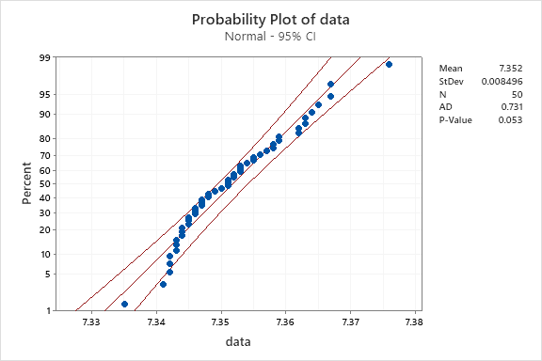
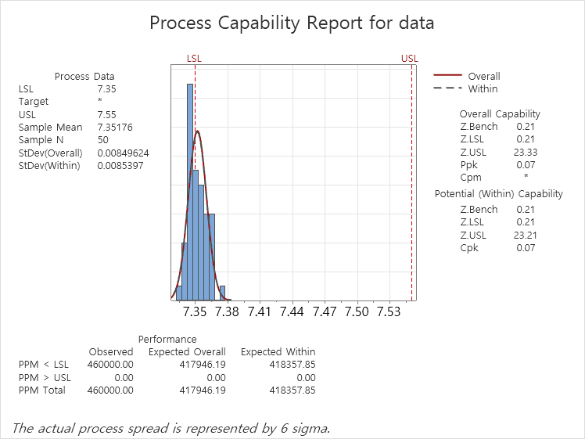
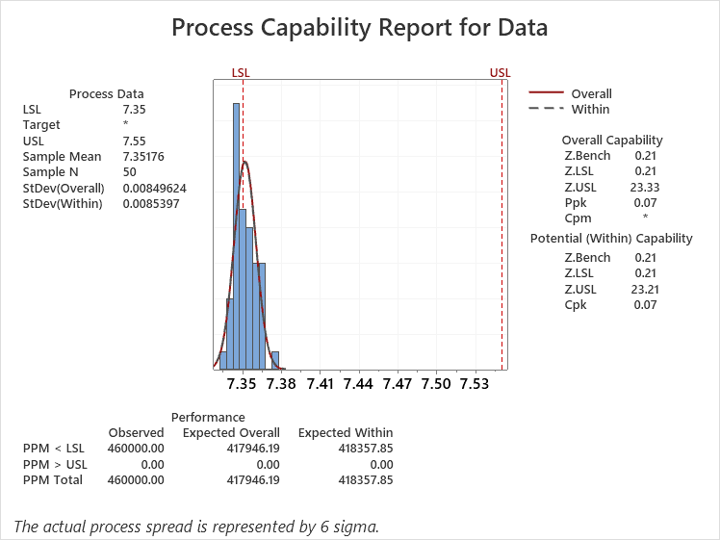
11st, Nov. Ken Park
① Oh…. You check current sigma level with 7 dimension.
Is it a Project Y?? You use 139 dimension in MSA at page 7, 8.
You have to define what dimension is Project Y and you have to implement MSA and check current sigma level with this Project Y dimension.
11st, Nov. Ken Park
② P value is bigger than 0.05 but it’s not that big number..
Current sigma level
D
M
A
I
C
Information
Lot Name: Current Level Inspection Sample
Production Date: September 11, 2025
Sampling method: Random Sampling
11st, Nov. Ken Park
③ Oh, you try to implement RSP(rational sub-grouping). It’s a very nice try but it’s not a clear RSP… I think that you can regard this as Systematic Sampling or Stratified Random Sampling, but not Rational sub-grouping
How do you get 5 samples a day? Is it random? Or first / middle / last 5 samples ?
11st, Nov. Ken Park
⑤ It’s my minitab result and it’s different with yours because I don’t think that it’s RSP so, I use 50 as sub-group size.
I already run again, maybe mistake a few data but P value correct
Sample | Data | Sample | Data | Sample | Data | Sample | Data | Sample | Data
#1 | 7.347 | #11 | 7.363 | #21 | 7.376 | #31 | 7.355 | #41 | 7.359
#2 | 7.359 | #12 | 7.347 | #22 | 7.358 | #32 | 7.353 | #42 | 7.344
#3 | 7.349 | #13 | 7.343 | #23 | 7.362 | #33 | 7.348 | #43 | 7.345
#4 | 7.348 | #14 | 7.351 | #24 | 7.342 | #34 | 7.344 | #44 | 7.342
#5 | 7.346 | #15 | 7.35 | #25 | 7.357 | #35 | 7.352 | #45 | 7.346
#6 | 7.345 | #16 | 7.353 | #26 | 7.365 | #36 | 7.363 | #46 | 7.351
#7 | 7.354 | #17 | 7.355 | #27 | 7.367 | #37 | 7.344 | #47 | 7.335
#8 | 7.345 | #18 | 7.358 | #28 | 7.342 | #38 | 7.367 | #48 | 7.353
#9 | 7.351 | #19 | 7.352 | #29 | 7.356 | #39 | 7.364 | #49 | 7.343
#10 | 7.347 | #20 | 7.343 | #30 | 7.341 | #40 | 7.346 | #50 | 7.362
Data
P value = 0.053 > 0.05
Normal Distribution
*** Setup Improvement Goals (Project Y)
Specification: 7.4 + 0.15 / - 0.05
Z Bench = 0.21 to 4.5 (Target Sigmal Level = 6 Sigma)
Mean: 7.35176 to 7.4
Current status
Sample mean: 7.35176
Z Bench Overall Value = 0.21 confirmed as level
6
Z bench + 1.5
1.71
Z bench + 1.5
Current sigma Level
Target sigma level
11st, Nov. Ken Park
④ As I mentioned at ③ in this page, it’s not a clear RSP and you’d better to use overall capability
11st, Nov. Ken Park
As I mentioned at ③ in this page, it’s not a clear RSP and you’d better to use overall capability

Slide 15
III. ANALYZE
Extract latent Factors
- Fishbone
Logic tree
Selection of Main Factor

Slide 16
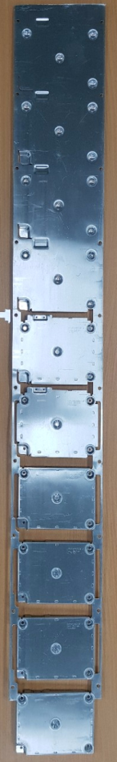
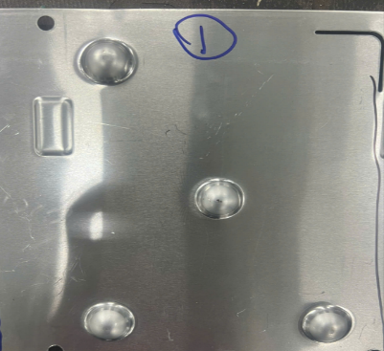
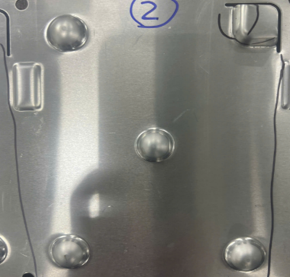
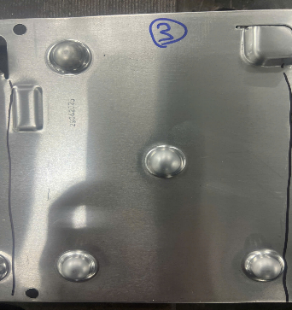
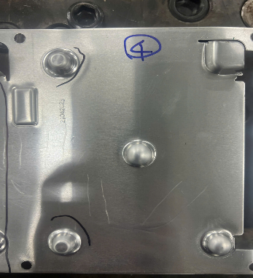
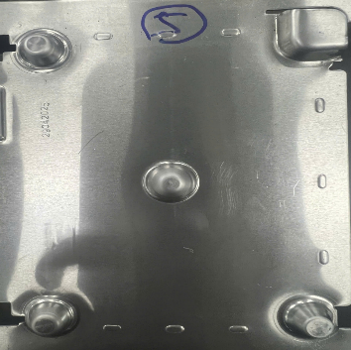
Find out the Factor
D
M
A
I
C
Step #2
Make Embo Remain position
Step #7
Bending rear
Step #8
Cutting bur
Around edge
Step #9
Cutting bur
Around hold
Step #10
Cutting
Final
Step #4
Make flat embo head for 2 positions
Step #5
Make flat embo head for 2 positions
remain
Step #6
Make hole and cutting rear around
Section #10
Section #1
Section #2
Step #3
Make
Embo Depth and
Shrink Diameter
Section #6
Section #7
Section #8
Section #9
Section #3
Section #4
Section #5
Step #1
Make Embo Shape 4 position
Punch
Raw material
Upper
Base

Slide 17
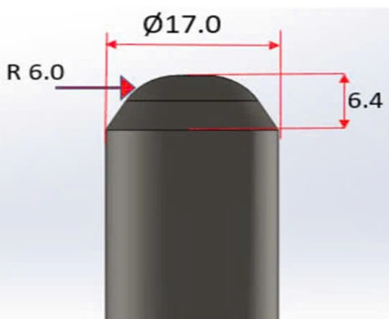
Find out the Factor
D
M
A
I
C
※ In order to define root cause and improvement action, I use logic tree (4M + 1E) to find the root cause.
Material
Material thinkness
Mold
Punch
Punch height

Punch Radius

Punch Diameter
※ Punch Diameter can not change due to affect assembly punch onto mold
Logic tree analysis
Emboss Height
Machine
Press Machine
Pressure Condition
Adjust pressure

Method
Assembly method
Manual Assemble to input jig
Method is not related
Input set to jig not fully
Other function is OK, only Flush is NG
Not relate to part input
Man
Working skill
Automatic process
Man is not related

: Potential factor

Slide 18
Find out the Factor
D
M
A
I
C
※ After use logic tree to Identify influencing factors, we will use screening DOE to identify critical factor and improve
No | Potential Factors | What is looking for? | Tool to identify
1 | Punch Height | Emboss Height change when change height of punch on mold (Punch change from 6.8mm to 6.4 mm) Note: When the punch height is increased to 7.2, a tearing phenomenon appears at the head of the emboss after finhsh stamping | Screening DOE
2 | Punch Radius | Emboss Radius change when change height of punch on mold (Punch change from Ø6 to Ø5.5) Note: When the punch radius is increased to 6.5, a tearing phenomenon appears at the head of the emboss after finhsh stamping | Screening DOE
3 | Press Machine | Emboss Height change when adjust pressure (Pressure from 220 kgf.cm to 320 kgf.cm) | Screening DOE
24th, Nov. Ken Park Good result to find out the factor. You tried two one-way ANOVA and one 2-sample T test. You don’t have to change the project but, in six sigma training, we recommend that screening DOE to find out the factor because it needs much less sample than this 3 times test (2 times one-way ANOVA and 1 time 2-sample T test.) I suggest that you prepare the explanation when six sigma interview asks about this. Why do you test 3 times, but not 1 time screening DOE? If you have a certain reason, you can explain it. But if you don’t have one, I think that you can just answer that you don’t know that you can use screening DOE and it needs much less sample at first. But after the test, you got it but you have already done the test so you didn’t change it.
26th, Nov. Updateed i will request supplier trial run accoring to Screening DOE table
I will delete test by ANOVA, 2 sample T and summarize data by Sceening factor as below (Slide 19~21)

Slide 19
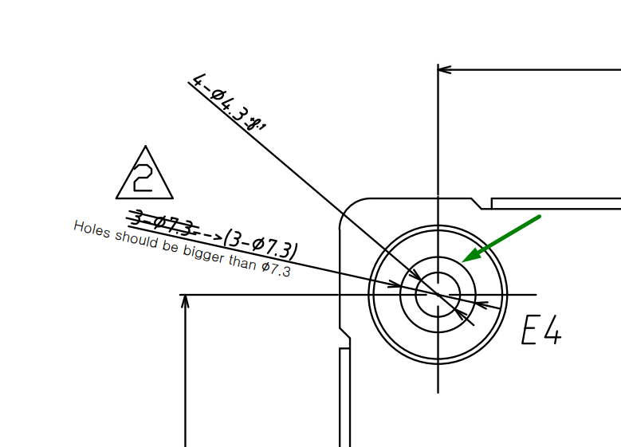
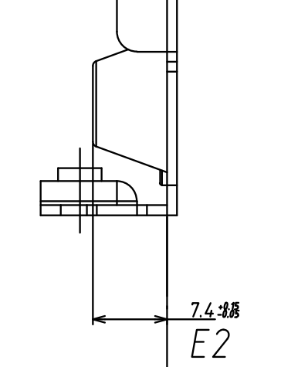
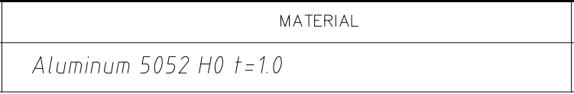
11st, Nov. Ken Park
According to Page 28, Punch height 6.4 and Punch Radius 6 is current process parameter, isn’t it?
And you’d better the DOE as big and small as possible.
With Punch height 7.2 , a tearing phenomenon appears and it’s big enough, but you have to try with lower parameter with punch height. (If you or supplier engineer think that it’s minimum value, you don’t have to try the lower value but and then, you can add comments that if it’s lower than 6.4. XXX phenomenon is expected and you select 6.4 as minimum value.)
Same with Punch Raidus.
Find out the Factor
D
M
A
I
C
※ In the drawing, There are 2 requirements related to embo: Height embo 7.4mm, make flat in embo head.
Hypothesis:
Decrease punch height 6.4 to 6.2
➔ Embo height (estimate) = 6.2 + 1.0 (Material thickness) = 7.2 < 7.4 (NG with Embo height Spec in the drawing & cannot make flat in Embo head)
➔Testing with increase Punch height
24th, Nov. Ken Park Good result to find out the factor. You tried two one-way ANOVA and one 2-sample T test. You don’t have to change the project but, in six sigma training, we recommend that screening DOE to find out the factor because it needs much less sample than this 3 times test (2 times one-way ANOVA and 1 time 2-sample T test.) I suggest that you prepare the explanation when six sigma interview asks about this. Why do you test 3 times, but not 1 time screening DOE? If you have a certain reason, you can explain it. But if you don’t have one, I think that you can just answer that you don’t know that you can use screening DOE and it needs much less sample at first. But after the test, you got it but you have already done the test so you didn’t change it.
Flat in Embo head
26th, Nov. Updateed i will request supplier trial run accoring to Screening DOE table
I will delete test by ANOVA, 2 sample T and summarize data by Sceening factor as below (Slide 19~21)
No | Potential Factors | What is looking for? | Tool to identify
1 | Punch Height | When the punch height is increased to 7.2, a tearing phenomenon appears at the head of the emboss after finhsh stamping | Judgement by spec in the drawing
2 | Punch Radius | When the punch radius is increased to 6.5, a tearing phenomenon appears at the head of the emboss after finhsh stamping | Jundgement by trial run

Slide 20
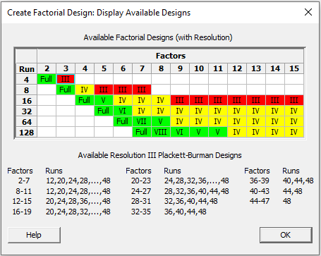
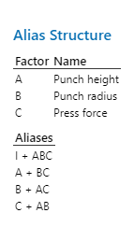

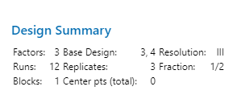
Find out the Factor
D
M
A
I
C
Experimental Design for Critical Factor Selection
- Conducted a two-level experiment for 3 factors.
- A fractional factorial design without replication was conducted to identify main effects and interactions while minimizing
the number of experiments (resolution IV).
- Punch Height / Punch Radius / Press Force
Factor | Low | High
Punch height | 6.4 | 6.8
Punch Radius | 5.5 | 6
Press Force | 220 | 320
24th, Nov. Ken Park Good result to find out the factor. You tried two one-way ANOVA and one 2-sample T test. You don’t have to change the project but, in six sigma training, we recommend that screening DOE to find out the factor because it needs much less sample than this 3 times test (2 times one-way ANOVA and 1 time 2-sample T test.) I suggest that you prepare the explanation when six sigma interview asks about this. Why do you test 3 times, but not 1 time screening DOE? If you have a certain reason, you can explain it. But if you don’t have one, I think that you can just answer that you don’t know that you can use screening DOE and it needs much less sample at first. But after the test, you got it but you have already done the test so you didn’t change it.
StdOrder | RunOrder | CenterPt | Blocks | Punch height | Punch radius | Press force | Respond
2 | 1 | 1 | 1 | 6.8 | 5.5 | 220 | 7.402
1 | 2 | 1 | 1 | 6.4 | 5.5 | 320 | 7.378
5 | 3 | 1 | 1 | 6.4 | 5.5 | 320 | 7.382
9 | 4 | 1 | 1 | 6.4 | 5.5 | 320 | 7.379
12 | 5 | 1 | 1 | 6.8 | 6 | 320 | 7.407
6 | 6 | 1 | 1 | 6.8 | 5.5 | 220 | 7.405
10 | 7 | 1 | 1 | 6.8 | 5.5 | 220 | 7.402
3 | 8 | 1 | 1 | 6.4 | 6 | 220 | 7.387
7 | 9 | 1 | 1 | 6.4 | 6 | 220 | 7.389
4 | 10 | 1 | 1 | 6.8 | 6 | 320 | 7.409
8 | 11 | 1 | 1 | 6.8 | 6 | 320 | 7.408
11 | 12 | 1 | 1 | 6.4 | 6 | 220 | 7.389
26th, Nov. Updateed i will request supplier trial run accoring to Screening DOE table
I will delete test by ANOVA, 2 sample T and summarize data by Sceening factor as below

Slide 21
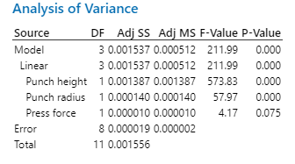
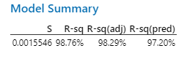
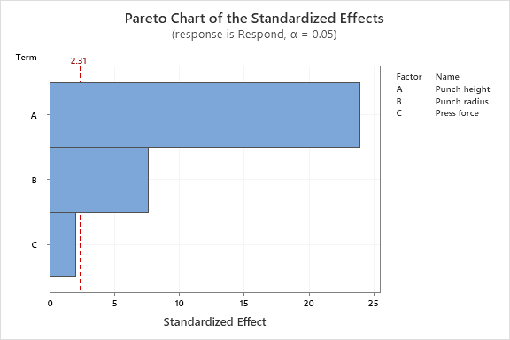
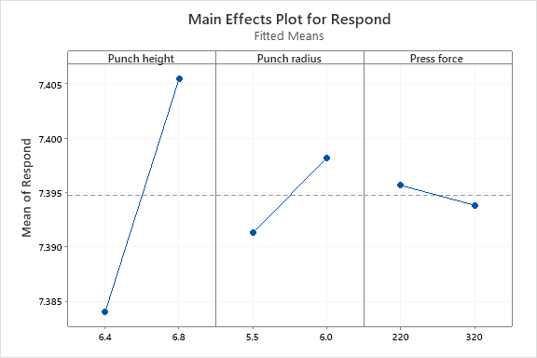
Find out the Factor
D
M
A
I
C
Screening DOE Analysis
- Factor regression analysis: Punch Height, Punch Radius, Press Force
24th, Nov. Ken Park Good result to find out the factor. You tried two one-way ANOVA and one 2-sample T test. You don’t have to change the project but, in six sigma training, we recommend that screening DOE to find out the factor because it needs much less sample than this 3 times test (2 times one-way ANOVA and 1 time 2-sample T test.) I suggest that you prepare the explanation when six sigma interview asks about this. Why do you test 3 times, but not 1 time screening DOE? If you have a certain reason, you can explain it. But if you don’t have one, I think that you can just answer that you don’t know that you can use screening DOE and it needs much less sample at first. But after the test, you got it but you have already done the test so you didn’t change it.
26th, Nov. Updateed i will request supplier trial run accoring to Screening DOE table
I will delete test by ANOVA, 2 sample T and summarize data by Sceening factor as below (Slide 19~21)
The final model review results indicate that the contribution of Punch height and Punch radius are significantly higher than that of other factors.
The Force press with P value = 0.075 > 0.05 is lower than other factor.

Slide 22
11st, Nov. Ken Park
According to Page 28, Punch height 6.4 and Punch Radius 6 is current process parameter, isn’t it?
And you’d better the DOE as big and small as possible.
With Punch height 7.2 , a tearing phenomenon appears and it’s big enough, but you have to try with lower parameter with punch height. (If you or supplier engineer think that it’s minimum value, you don’t have to try the lower value but and then, you can add comments that if it’s lower than 6.4. XXX phenomenon is expected and you select 6.4 as minimum value.)
Same with Punch Raidus.
Please see slide 18
Find out the Factor
D
M
A
I
C
Select Critical Potential
11st, Nov. Ken Park
Very good approach and analysis from Page 15 ~ Page 22
CTQ | Potential |  | Analysis Method | Analysis Result | Conslution | Remark
Emboss height number 3 of Case Bottom | Punch Height | 6.4 (Current) | Screening DOE Analysis | P-Value = 0.000 | Critical Factor | When the punch height is increased to 7.2, a tearing phenomenon appears at the head of the emboss after finhsh stamping
 |  | 6.8 (Increase)
 |  | 7.2 (Increase)
 | Punch Radius | 6.5 (Increase) | Screening DOE Analysis | P-Value = 0.000 | Critical Factor | When the punch radius is increased to 6.5, a tearing phenomenon appears at the head of the emboss after finhsh stamping
 |  | 6 (Current)
 |  | 5.5 (Decrease)
11st, Nov. Ken Park
OH….. Finally I can find that CTQ at this page. I recommend that you can change CTQ to Project Y.
And is it the Project Y, right? You have to align with Y – y break down, MSA, current study with this Project Y(emboss height, 7 dimension)

Slide 23
IV. IMPROVEMENT
Establish optimal conditions (DOE)
Select the best condition by DOE
Design and analysis of experiments

Slide 24
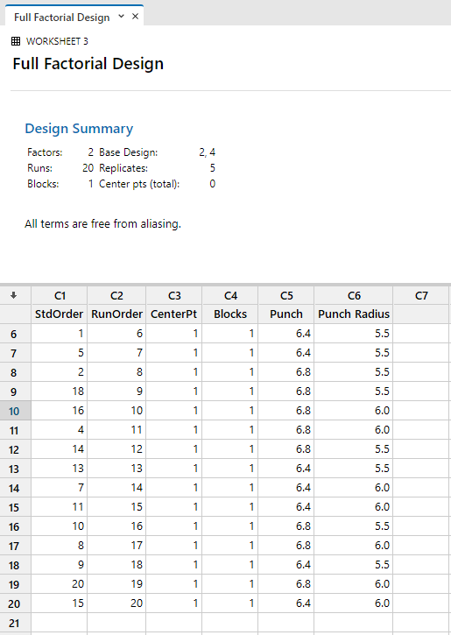
Establish optimal conditions (DOE)
D
M
A
I
C
※ Select two major factors and use a full factorial design with 2 factors and 2 levels to confirm the optimal conditions.
Factor
StdOrder | RunOrder | CenterPt | Blocks | Punch | Punch Radius | Respone
17 | 1 | 1 | 1 | 6.4 | 5.5 | 7.373
12 | 2 | 1 | 1 | 6.8 | 6 | 7.405
19 | 3 | 1 | 1 | 6.4 | 6 | 7.563
6 | 4 | 1 | 1 | 6.8 | 5.5 | 7.394
3 | 5 | 1 | 1 | 6.4 | 6 | 7.564
1 | 6 | 1 | 1 | 6.4 | 5.5 | 7.374
5 | 7 | 1 | 1 | 6.4 | 5.5 | 7.372
2 | 8 | 1 | 1 | 6.8 | 5.5 | 7.396
18 | 9 | 1 | 1 | 6.8 | 5.5 | 7.391
16 | 10 | 1 | 1 | 6.8 | 6 | 7.404
4 | 11 | 1 | 1 | 6.8 | 6 | 7.405
14 | 12 | 1 | 1 | 6.8 | 5.5 | 7.393
13 | 13 | 1 | 1 | 6.4 | 5.5 | 7.373
7 | 14 | 1 | 1 | 6.4 | 6 | 7.562
11 | 15 | 1 | 1 | 6.4 | 6 | 7.565
10 | 16 | 1 | 1 | 6.8 | 5.5 | 7.394
8 | 17 | 1 | 1 | 6.8 | 6 | 7.403
9 | 18 | 1 | 1 | 6.4 | 5.5 | 7.371
20 | 19 | 1 | 1 | 6.8 | 6 | 7.403
15 | 20 | 1 | 1 | 6.4 | 6 | 7.564
Level
Punch Height
Level 1 : 6.4
Level 2 : 6.8
Punch Radius
Level 1 : 5.5
Level 2 : 6
24th, Nov. Ken Park Good result with ramdomized run sequence.
11st, Nov. Ken Park
I recommend you that you can randomize the run sequence.
You don’t have to measure or experiment again. Here’s data and you can just fill with randomized run with this data.

Slide 25
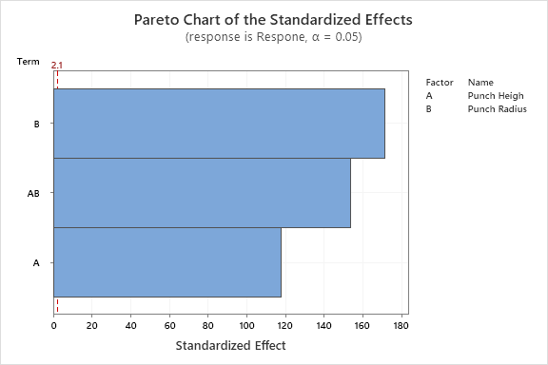
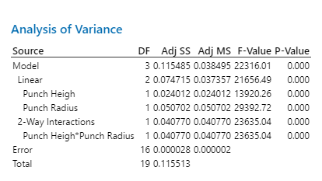
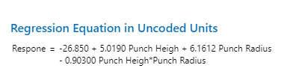
Establish optimal conditions (DOE)
D
M
A
I
C
※ Factorial Regression: Respone versus Punch Heigh, Punch Radius
Conslution:
In the pareto chart, α = 0.05 ~ 2.1.
Punch Radius is the main factor.
The interaction AB also has a significant effect.
Punch Height alone has little influence, but when combined with Punch Radius, it shows a clear impact.

Slide 26
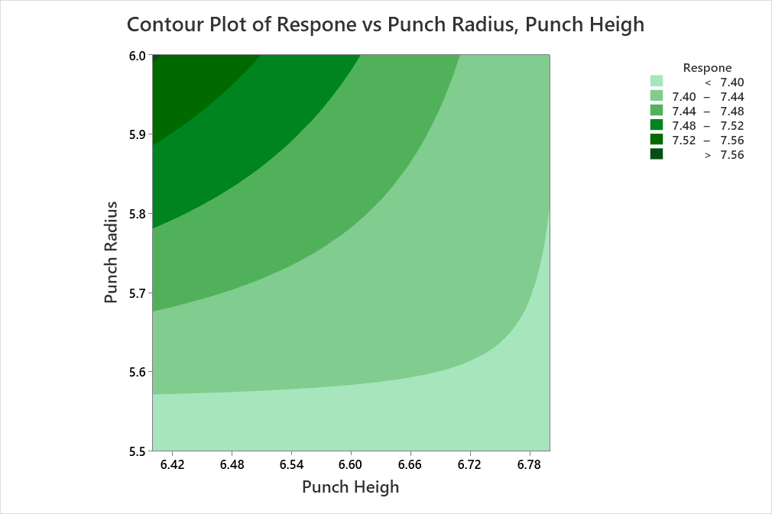
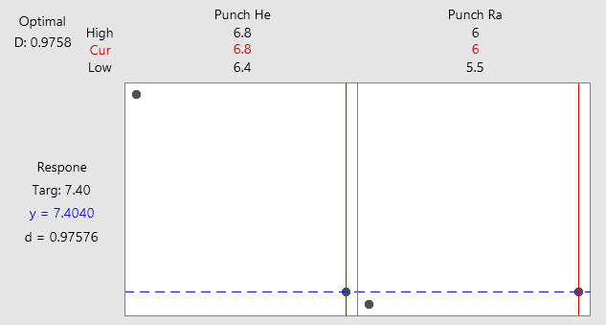
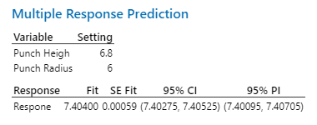
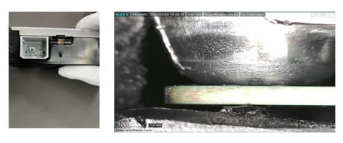
Establish optimal conditions (DOE)
D
M
A
I
C
※ Contour plot
※ Response Optimization
6.8
5.8
6.0
6.6
11st, Nov. Ken Park
Can you share the minitab file with me? I want to compare the real data In Page 28 with this expectation…. I have little concern that it’s quite different with expectation..
StdOrder | RunOrder | CenterPt | Blocks | Punch | Punch Radius | Respone
17 | 1 | 1 | 1 | 6.4 | 5.5 | 7.373
12 | 2 | 1 | 1 | 6.8 | 6 | 7.405
19 | 3 | 1 | 1 | 6.4 | 6 | 7.563
6 | 4 | 1 | 1 | 6.8 | 5.5 | 7.394
3 | 5 | 1 | 1 | 6.4 | 6 | 7.564
1 | 6 | 1 | 1 | 6.4 | 5.5 | 7.374
5 | 7 | 1 | 1 | 6.4 | 5.5 | 7.372
2 | 8 | 1 | 1 | 6.8 | 5.5 | 7.396
18 | 9 | 1 | 1 | 6.8 | 5.5 | 7.391
16 | 10 | 1 | 1 | 6.8 | 6 | 7.404
4 | 11 | 1 | 1 | 6.8 | 6 | 7.405
14 | 12 | 1 | 1 | 6.8 | 5.5 | 7.393
13 | 13 | 1 | 1 | 6.4 | 5.5 | 7.373
7 | 14 | 1 | 1 | 6.4 | 6 | 7.562
11 | 15 | 1 | 1 | 6.4 | 6 | 7.565
10 | 16 | 1 | 1 | 6.8 | 5.5 | 7.394
8 | 17 | 1 | 1 | 6.8 | 6 | 7.403
9 | 18 | 1 | 1 | 6.4 | 5.5 | 7.371
20 | 19 | 1 | 1 | 6.8 | 6 | 7.403
15 | 20 | 1 | 1 | 6.4 | 6 | 7.564
Conslution:
Select A (Punch Height , Punch Radius) =(6.8, 6)
Punch Heigh =(6.6 , 6.8)
Punch Radius = (5.8 , 6.0)

Slide 27
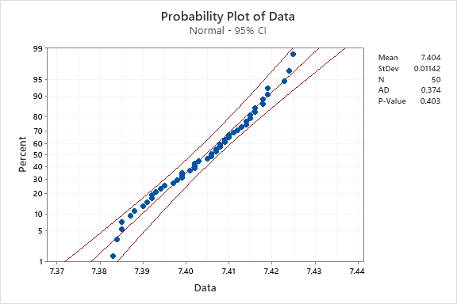
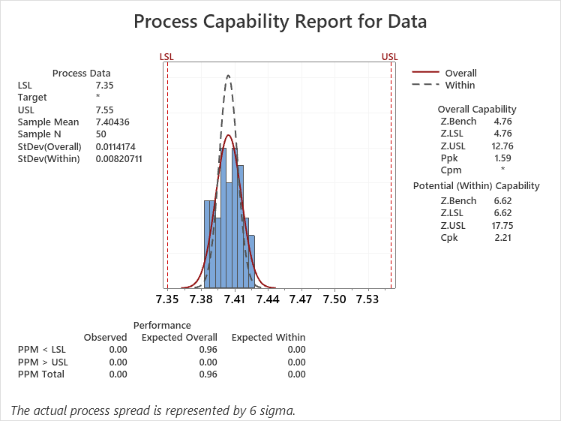
D
M
A
I
C
Punch Height 6.4 mm Punch Radius 6
Punch Height 6.7 mm Punch Radius 5.9
Data
P value = 0.053 > 0.05
Normal Distribution
Data
P value = 0.403 > 0.05
Normal Distribution
Current status
Sample mean: 7.35176
Sample mean: 7.40436
Achieve Target
Z Bench Overall Value = 0.21 confirmed as level
Z Bench Overall Value = 4.76 Achieve Target

Slide 28
V. CONTROL
Maintenance mold process
Apply new method check punch

Slide 29

Use X bar Chart to control after improvement
D
M
A
I
C
※ After Maintenance Punch of the mold, LGEVH requests Supplier control this NG dimension by X Bar R Chart
Method:
Time: Control 15 Days with NG point
Sample: 6ea at Out-Going Quality (OQC) (2ea per First, middle, Last / Day)
No | Time | Day
 |  | First |  | Middle |  | Last
 | Date | # 1 | # 2 | # 3 | # 4 | # 5 | # 6
1 | 15-Sep | 7.429 | 7.431 | 7.438 | 7.432 | 7.433 | 7.430
2 | 16-Sep | 7.431 | 7.439 | 7.435 | 7.415 | 7.416 | 7.438
3 | 17-Sep | 7.434 | 7.439 | 7.437 | 7.433 | 7.409 | 7.405
4 | 18-Sep | 7.434 | 7.433 | 7.434 | 7.425 | 7.427 | 7.431
5 | 19-Sep | 7.429 | 7.432 | 7.434 | 7.435 | 7.427 | 7.439
6 | 20-Sep | 7.435 | 7.437 | 7.432 | 7.441 | 7.442 | 7.435
7 | 22-Sep | 7.441 | 7.442 | 7.449 | 7.447 | 7.438 | 7.445
8 | 23-Sep | 7.431 | 7.426 | 7.433 | 7.435 | 7.433 | 7.437
9 | 24-Sep | 7.442 | 7.445 | 7.441 | 7.448 | 7.444 | 7.438
10 | 25-Sep | 7.434 | 7.435 | 7.431 | 7.427 | 7.435 | 7.438
11 | 26-Sep | 7.435 | 7.431 | 7.432 | 7.429 | 7.428 | 7.437
12 | 27-Sep | 7.438 | 7.434 | 7.439 | 7.432 | 7.433 | 7.429
13 | 28-Sep | 7.429 | 7.432 | 7.429 | 7.434 | 7.438 | 7.435
14 | 29-Sep | 7.432 | 7.431 | 7.432 | 7.434 | 7.437 | 7.432
15 | 30-Sep | 7.434 | 7.436 | 7.438 | 7.434 | 7.429 | 7.428
11st, Nov. Ken Park
You’d better add X bar – R Chart at this control phase for Project Y dimension.
==➔ Add control by X bar R

Slide 30
Increase inspection after Maintenance Mold
D
M
A
I
C
※ Maintenance mold process
BEFORE
AFTER
Mold reaper finish
Setting trial
LQC check sample
Confirm MP
Mold reaper finish
Setting trial
LQC check sample
OQC check
Confirm MP
Check 5 sample if OK confirm MP if NG continues repair Mold
Check 5 sample if OK confirm MP if NG continues repair Mold
OQC check Ok confirm, if structure different inform to SQA LG confirm Ok or Not
After repair Mold only LQC check 5ea sample
(Only DR dimension and appearance)
After repair Mold, LQC and OQC check 5ea sample
(All dimension and appearance)

Slide 31

Apply new method check punch
D
M
A
I
C
※ Make new tool to check punch shape
6.8
6

