Slide 1
Luminance value NG of
Porsche CID J1 Dual
Contents
1. Define
2. Measure
3. Analyze
4. Improve
5. Control
6 Sigma GB Assignment
IVI LD Nguyen Duc Long
Notes:
1

Slide 2
Six Sigma Project Register
Team | IVI LD
Leader | Nguyen Dinh Huong TL
Owner | Nguyen Duc Long
Task category
□ HW □ SW
□ Mecha ■ Current job
Theme | Reduce defect rate of Model Porsche CID J1 Dual Luminance |  |  |  | Period | 2026.Mar.09 ~ 2026.Sep.20 |  |  | Task team name | Inspection Engineering Project
Six Sigma Project |  | Improvement Goal (Stretch Goal) |  |  |  |  |  |  | Idea of breaking the limit
 |  | Improvement index |  | Current |  | World Best | World Best | Goal
Improve Luminance value |  | KPI | Defect rate (ppm) | 226,624ppm |  | N/A | N/A | 0 ppm | Teaching robot and change camera angle for detecting the center of the PID screen Make check sheet to control camera equipment
 |  | ProjectY | Luminance (800-2000Cd/m²) | Cpk = 0.47 Z = 1.41 |  | N/A | N/A | Cpk ≥ 1.33 Z = 4.5
Management Issue (Biz. Issue) |  | Implement Plan (Fast & Strong) |  |  |  |  |  |  | Task Member
- The Luminance issue affects the line UPH and causes loss time. - NG LCDs after retest are returned to the supplier (HEESUNG) for scrap, leading to IF cost, so an action is needed to eliminate this issue and improve factory performance.
 |  |  |  |  |  |  |  |  | Location
 |  |  |  |  |  |  |  |  | LG Electronics Viet Nam-Hai Phong
Qualitative Performance |  | Quantitative Performance |  |  |  |  |  |  | Neck Point
Improving smoothly testing process for sets Reducing cost |  | 1 LCD part =118.72$ The scrap cost of Luminance issue on March: 19*118.72 = 2255.68$ → Result: 0 NG / 420 sets after improvement |  |  |  |  |  |  | Because improvement action related to equipment, So need support from PE team
❑ Schedule
3/9
4/1
5/1
5/19
6/15
Team | Name | Role
IVI LD | Nguyen Duc Long | Task leader
 | Hoang Nhan Quoc | Member
IVI PE | Pham Van Hung | Member
IVI PM | Ta Van Cong | Member
D
M
A
I
C
Key activity / Output
D : Define issue, define defect rate, collect defective sample and issue information
M : Gage R&R (Type 1, Type 3) to evaluate equipment
A : Use logic tree and 5 Why to find root cause. Test samples with different CANSIM, camera and camera angle
I : Meeting with HQ IE to discuss improvement action. Correct camera angle to 90° and verify the result
C : Control by daily Master sample check; defect rate via GMES
Notes:
Define: 3/9~3/31 (about 3 weeks)
Measure: 4/1~4/30 (4 weeks)
Analyze: 5/1~5/18 (about 3 weeks)
Improve: 5/19~6/14 (4 weeks)
Control: 6/15~9/20 (monitoring)
2

Slide 3


1.1 Y-y breakdown
Big Y
Little y1
Little y2
Little y3
Activity
PIC
Reduce Porsche CID Defect rate
Machine defect
Luminance Function
Luminance value
6 Sigma assignment
IVI LD IE
259,905 PPM
(164/631EA
Nov.2025~Mar.2026)
90.2% 234,548 PPM
89.6% 232,964 PPM
87.2% 226,624 PPM
Haptic/Touch
Function
Calculate contrast value
Real defect _ Material
Return to supplier
HEESUNG vendor
0.6% 1,585 PPM
2.4% 6,339 PPM
Hardware defect
Power Function
Initial/ Booting
Broken pin connector _ check PCBA
Mr. Hai HW
6.1% 15,848 PPM
Software defect
Uniformity Function
Black Uniformity value
Improve software
HQ R&D
Before
3.7% 9,509 PPM
259,905 PPM
After
33,281 PPM
Decrease defect rate of Porsche CID
Hardware issues (10 EA, 6.1%, 15,848 PPM) are mainly broken pin connector (check PCBA), foreign material inside the set after assembly, SQA circuit and LCD from supplier; they will be improved by HW members.
Software issues (6 EA, 3.7%, 9,509 PPM) will be solved by HQ software members.
Machine defect accounts for 90.2% (148 EA, 234,548 PPM), where Luminance value is the overwhelming root issue causing 226,624 PPM (143 EA, 87.2% of all defects), causing severe UPH loss and scrap cost. That is why Luminance value is selected as Project Y for this Six Sigma assignment.

Slide 4
1.2 Pareto
80:20 rule
About 80% of the defects come from about 20% of the items (the vital few). Solve the vital few first.
Result
Luminance value = 226,624 ppm = 87.2% of all defects (> 80%): it is the vital few.
The other 4 items together are only 12.8% (Hardware 6.1%, Software 3.7%, Contrast value 2.4%, Haptic/Touch 0.6%).
So Luminance value is selected as Project Y for this 6 Sigma assignment.
Data: 164 NG / 631 EA = 259,905 ppm (Nov.2025~Mar.2026): Luminance value 143, Hardware 10, Software 6, Contrast value 4, Haptic/Touch 1 NG.
Item (80%): Luminance value PIC: IVI LD (this 6 Sigma assignment) MFG: Line IVI 5, FA production line
Other items: Hardware (broken pin connector) → Mr. Hai HW; Software → HQ R&D; Contrast value (real defect) → HEESUNG vendor.

Slide 5

1.3 Define Project Y
To reduce the Luminance test NG, Project Y is defined as “Luminance value”.
What is Luminance ?
Project Y
Luminance is a photometric quantity used for light sources and displays such as LCDs.
Luminance is the luminous intensity per unit area emitted by a surface in a given direction (unit: cd/m², also called nit)
It quantifies the brightness level of the display.
Project Y: “Luminance value” of the Porsche CID J1 Dual model.
Luminance formula:
L = d²Φ / (dA · dω · cos θ)
Spec: 800-2000 (cd/m²)
d²Φ stands for the luminous flux in lumens (lm)
θ stands for the angle between the surface normal of the display and the sight line of the detector, in this case θ = 0°
dA stands for the differential area in square meters (m²)
dω stands for the differential solid angle in steradians (sr)
PID
CID
+
J1 Dual PPR RHD set
Camera
CS2000
The sensor inside the detector receives the light from the center of the LCD, calculates the luminance value and returns the measurement result to the program.
Measurement method:
The set is connected to the test bench; when the program sends the request, the display shows the highest brightness level.
The J1 display shows a white screen at maximum brightness.
The CS2000 detector moves to the center of the PID LCD, recognizes the center of the display and measures the luminance.
Because the center always has higher brightness than the corner and edges, the detector must be placed exactly at the center.
The result is recorded and sent back to the program.
Issue: The luminance measured on the PID (Privacy) screen is lower than the real luminance of the panel (the same LCD is OK when re-checked at the vendor), so the test result falls below the spec (NG).
Project Y= Luminance value = f(x1, x2, …, xn) + ε

Slide 6



1 Preparation of Gage R&R
Measure
Define
Analyze
Improve
Control
Model: Porsche CID J1 Dual PPR (PID / CID display set)
Station: Luminance station (camera CS2000), the station where the Luminance NG occurs
Equipment information:
Equipment:
- Power supply, Pallet
- CID bench
- CANSIM
- Camera CS2000 (spectroradiometer)
- Resolution: 0.01 Cd/m²
Program: LG Moohantech
Function test Luminance station
Checking brightness level
Detect and measure Luminance value
Test set without CAN mode
Checking CID black / white patterns
Calculate contrast ratio
Luminance station diagram
How to get sample (sampling)
Type 1: 1 golden sample (reference 910 Cd/m²), measured 30 times.
Type 3: 25 samples, each measured 2 times (the station is automatic, no operator influence).
Guideline: the samples should cover the spec and the dispersion of the process (include NG / OK samples and samples near the spec).
Camera CS2000 (spectroradiometer)
Notes:
Output level resolution: 0.01 Cd/m²

Slide 7
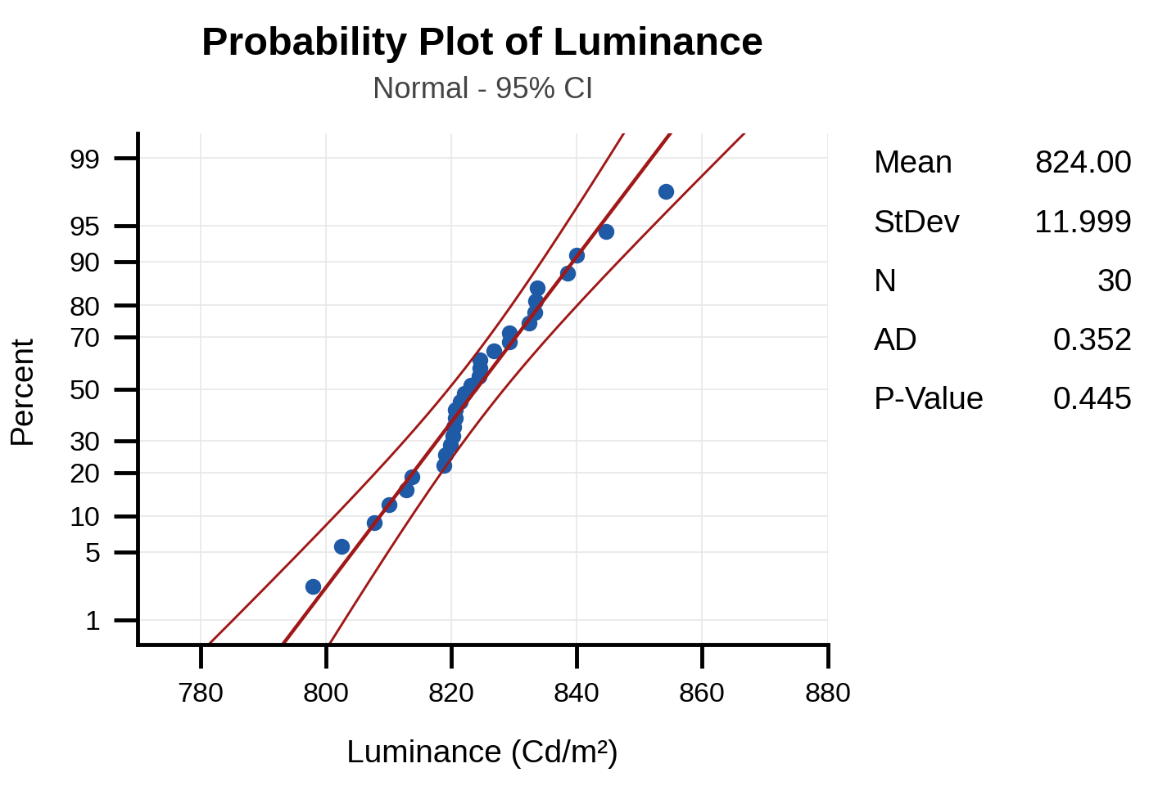
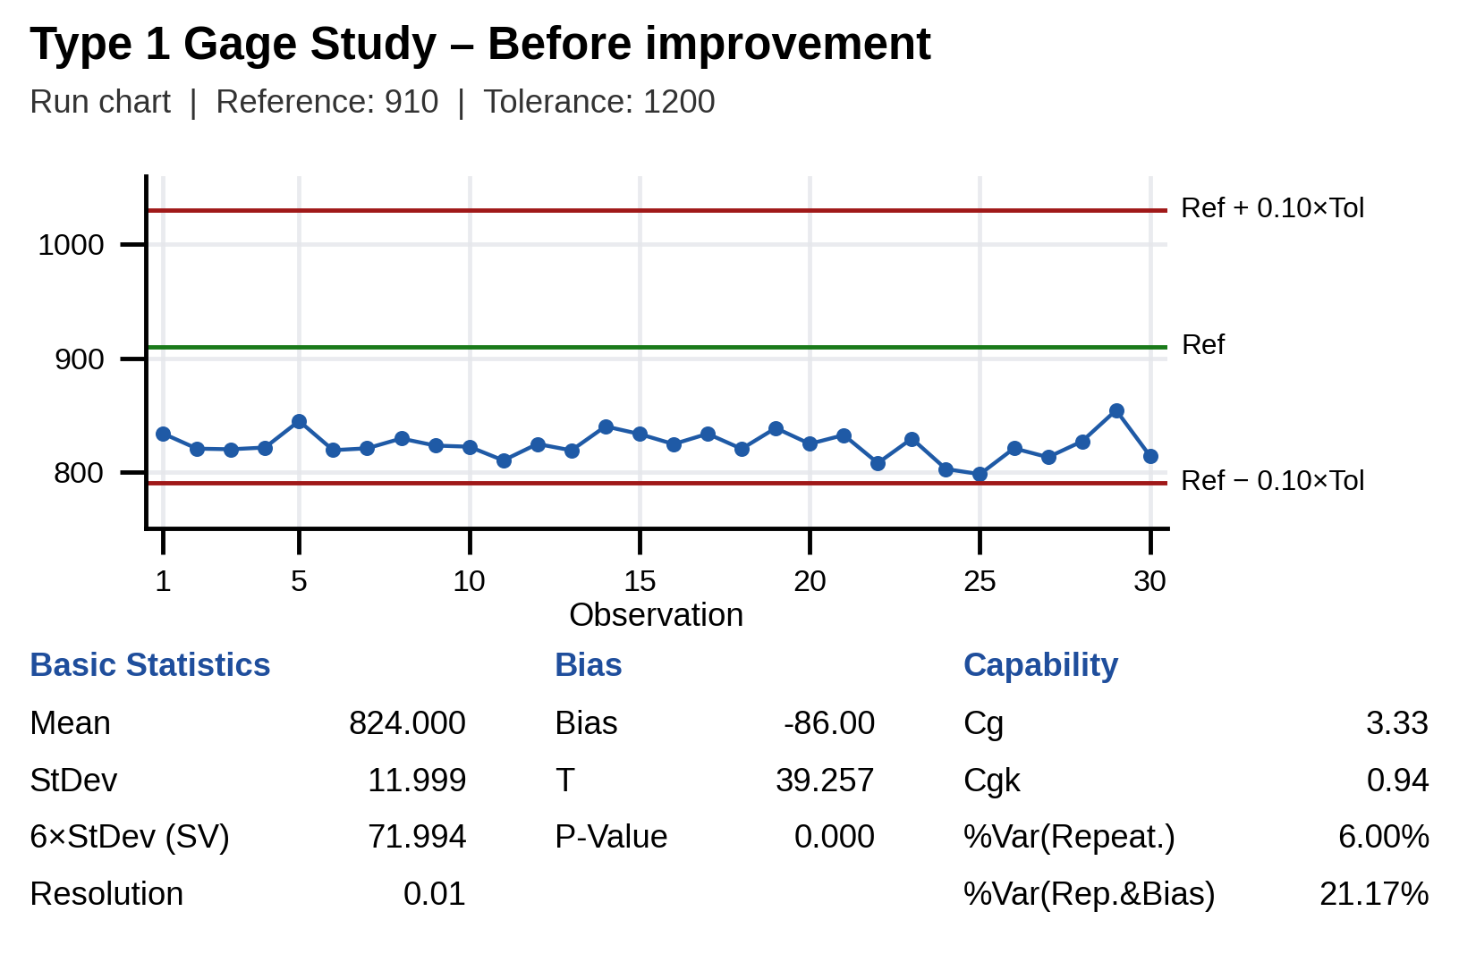
2.1 Type 1 Study
Measure
Define
Analyze
Improve
Control
Luminance station
I chose the Type 1 gage study to assess the measurement capability of the gage, based on its repeatability and bias.
In this case, one sample (golden sample, 910 Cd/m²) is measured 30 times.
H0: Bias = 0 in measurement system.
H1: Bias ≠ 0 in measurement system.
No | Luminance(Cd/m²) | No | Luminance(Cd/m²)
1 | 833.74 | 16 | 824.36
2 | 820.37 | 17 | 833.47
3 | 819.83 | 18 | 820.21
4 | 821.39 | 19 | 838.51
5 | 844.71 | 20 | 824.60
6 | 819.05 | 21 | 832.35
7 | 820.68 | 22 | 807.70
8 | 829.31 | 23 | 829.23
9 | 823.09 | 24 | 802.48
10 | 822.08 | 25 | 797.91
11 | 810.03 | 26 | 820.67
12 | 824.52 | 27 | 812.84
13 | 818.84 | 28 | 826.83
14 | 840.01 | 29 | 854.19
15 | 833.25 | 30 | 813.74
Spec: 800.00 ~ 2000.00
Reference value: 910 (golden sample)
Resolution of Instrument: 0.01
Conclusion
• P value < 0.001 (≤ 0.05) Reject H0 -> Bias ≠ 0 (FAIL)
• Cg = 3.33 (Std ≥ 1.33) PASS | Cgk = 0.94 (Std ≥ 1.33) FAIL
• %Var(Repeatability) = 6.00% (≤ 15%) PASS
• %Var(Repeatability & Bias) = 21.17% (> 15%) FAIL | Bias = −86.00 Cd/m² (all 30 readings far below Ref 910)
✖ Equipment has problem: repeatability alone is acceptable (Cg = 3.33), but there is a large, significant bias: the station reads the 910 golden sample as 824 (−86 Cd/m²). Need to improve the accuracy of the measurement system.
07 / 29
Notes:
Step 1: Run chart: all measurements should stay inside Reference ± 10% of the tolerance (910 ± 120 = 790 ~ 1030 Cd/m²).
Step 2: Check the p-value to assess the bias (p-value vs. α = 0.05).
Step 3: Check Cg and Cgk to assess the capability of the measurement system (benchmark: ≥ 1.33).
Cg (potential gage capability): compares 20% of the tolerance with the spread (6 x s) of the repeated measurements, i.e. repeatability only. Criterion: Cg ≥ 1.33.
Cgk (gage capability index): like Cg but also takes the bias into account (distance between the mean of the measurements and the reference value). Criterion: Cgk ≥ 1.33. Note: %Var(Repeatability) = 20%/Cg and %Var(Repeatability & Bias) = 20%/Cgk, so Cg, Cgk ≥ 1.33 is the same as %Var ≤ 15%.

Slide 8
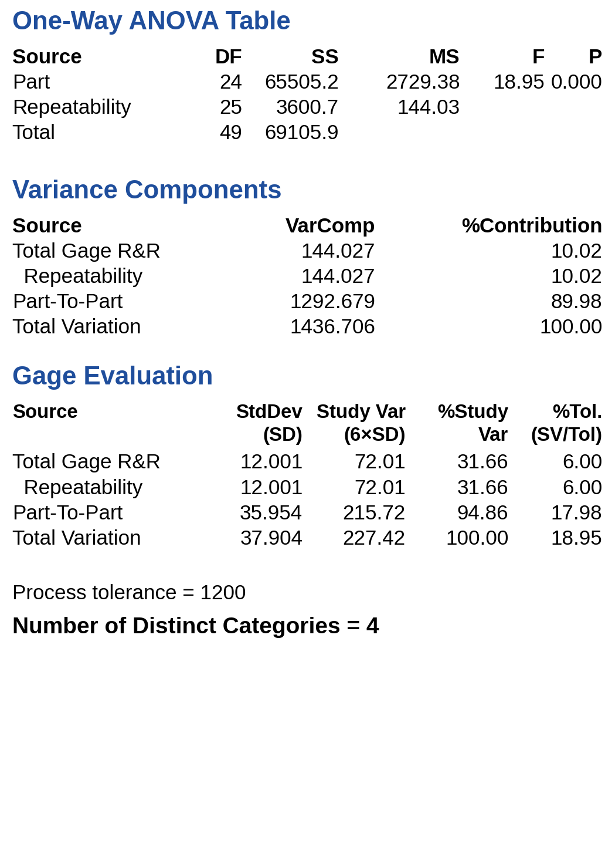
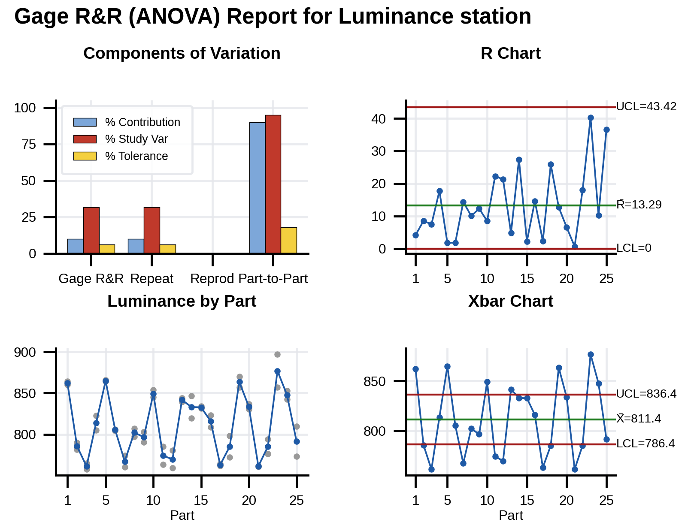
2.2 Type 3 Study
Measure
Define
Analyze
Improve
Control
Luminance station
Need to evaluate the repeatability of the measurement system.
Because the Luminance station is fully automated with no operator influence, Type 3 Gage Study is used to evaluate equipment repeatability.
In type 3 study, use 25 samples to verify station, each sample is measured repeat 2 times.
Spec: 800- 2000 (Cd/m2)
No | Data | No | Data
1 | 859.99 | 13 | 839.26
1 | 864.11 | 14 | 819.33
2 | 789.96 | 14 | 846.73
2 | 781.42 | 15 | 831.66
3 | 764.89 | 15 | 833.90
3 | 757.45 | 16 | 808.74
4 | 804.84 | 16 | 823.32
4 | 822.56 | 17 | 761.91
5 | 865.79 | 17 | 764.25
5 | 864.02 | 18 | 798.18
6 | 806.28 | 18 | 772.30
6 | 804.44 | 19 | 857.16
7 | 774.47 | 19 | 869.86
7 | 760.12 | 20 | 830.35
8 | 797.20 | 20 | 836.88
8 | 807.23 | 21 | 761.67
9 | 790.41 | 21 | 761.02
9 | 802.69 | 22 | 776.28
10 | 845.17 | 22 | 794.29
10 | 853.64 | 23 | 897.05
11 | 763.22 | 23 | 856.82
11 | 785.47 | 24 | 852.88
12 | 759.01 | 24 | 842.63
12 | 780.32 | 25 | 773.20
13 | 844.02 | 25 | 809.79
% Contribution of Gage R&R = 10.02% > 9% (std < 1%) →NG
% Study Var = 31.66% > 30% → NG
% Tolerance = 6.00% < 10% → OK
NDC: 4 < 5 → NG
Conclusion: %Contribution = 10.02% (> 9% NG), %Study Var = 31.66% (> 30% NG), %Tolerance = 6.00% (OK), NDC = 4 (< 5 NG). The repeatability error (SD = 12.0) is too large vs. the part variation (SD = 36.0), and Type 1 shows a large bias (−86 Cd/m²), so the system is NOT acceptable: improve.
Notes:
H0 (ANOVA, part effect): all part means are equal
H1: at least one part mean is different
Follow AIAG guidelines: %Study Var and %Tolerance < 10% = acceptable, 10-30% = conditionally acceptable, > 30% = unacceptable; %Contribution < 1% = acceptable, > 9% = unacceptable. Here %Contribution (10.02%) is above 9%, %Study Var (31.66%) is above 30% and NDC = 4 < 5, so the measurement system is NOT acceptable (only %Tolerance = 6.00% is below 10%). The ANOVA p-value (< 0.001) shows the 25 parts are different (as expected), but the repeatability error (SD 12.0) is still too large to separate them into ≥ 5 groups.
NDC (number of distinct categories): the number of groups of parts the measurement system can reliably distinguish; NDC ≥ 5 is required.

Slide 9
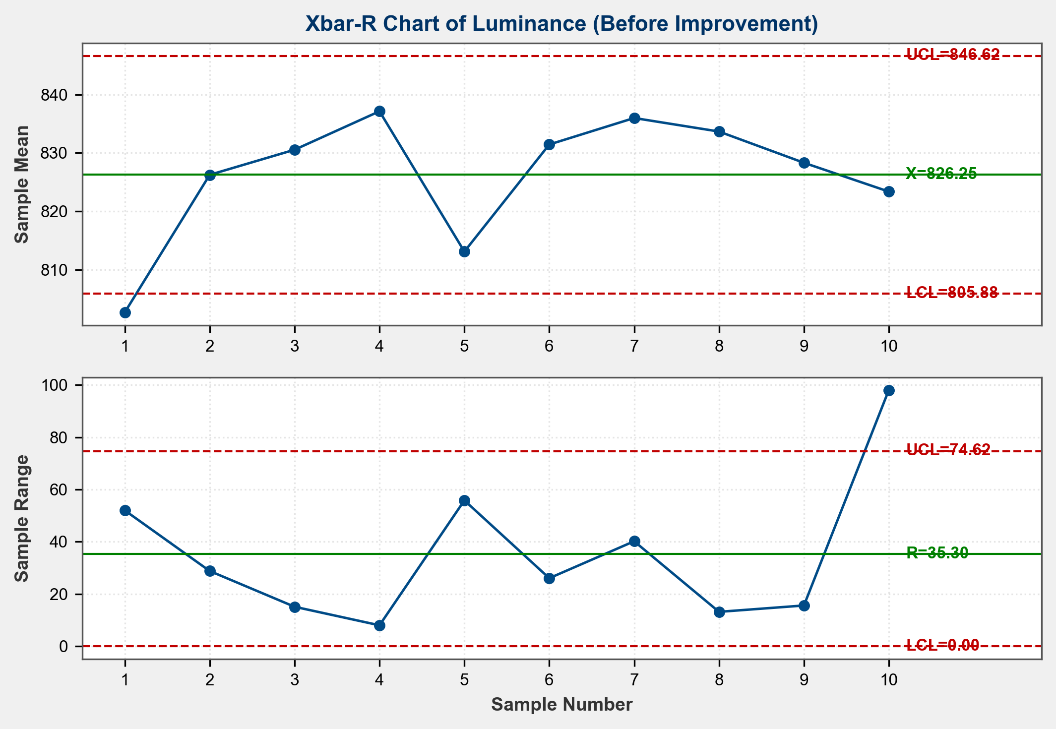
2.3 Xbar-R Chart Review
Measure
Define
Analyze
Improve
Control
Luminance station
Issue Name: Luminance value NG | Spec: 800.00 ~ 2000.00 Cd/m² | Period: 20-Feb-2026 ~ 01-Mar-2026
- Sampling method: Rational subgroup sampling, first 5 sets per day at FA line (Line IVI 5), for 10 days.
Date | Sample 1 | Sample 2 | Sample 3 | Sample 4 | Sample 5
20-Feb | 796.95 | 786.61 | 794.73 | 796.58 | 838.61
21-Feb | 839.58 | 810.76 | 830.05 | 815.12 | 835.75
22-Feb | 823.98 | 834.57 | 827.40 | 827.69 | 839.12
23-Feb | 835.42 | 839.73 | 842.06 | 834.01 | 834.48
24-Feb | 834.67 | 836.61 | 786.15 | 780.77 | 827.29
25-Feb | 837.73 | 811.78 | 833.46 | 836.42 | 837.85
26-Feb | 817.70 | 857.90 | 837.17 | 838.29 | 828.88
27-Feb | 826.94 | 840.14 | 839.72 | 830.75 | 830.78
28-Feb | 823.24 | 826.32 | 825.35 | 827.79 | 838.87
01-Mar | 837.29 | 850.33 | 819.42 | 755.89 | 853.94
Conclusion:
• 2 out-of-control points: 20-Feb X̄ = 802.70 < LCL 805.88 and 01-Mar R = 98.05 > UCL 74.62 → the process is NOT in statistical control (special cause present).
• Process mean (X̄ = 826.25 Cd/m²) is only 26 Cd/m² above the Lower Spec Limit (LSL = 800 Cd/m²).
• 14.0% of baseline readings (7 of 50) fall below LSL, consistent with the high defect rate of 226,624 ppm.
→ Key Insight: Process is NOT STABLE and NOT CAPABLE (Cpk = 0.47 < 1.33). Proceed to Analyze phase to find the special cause.

Slide 10
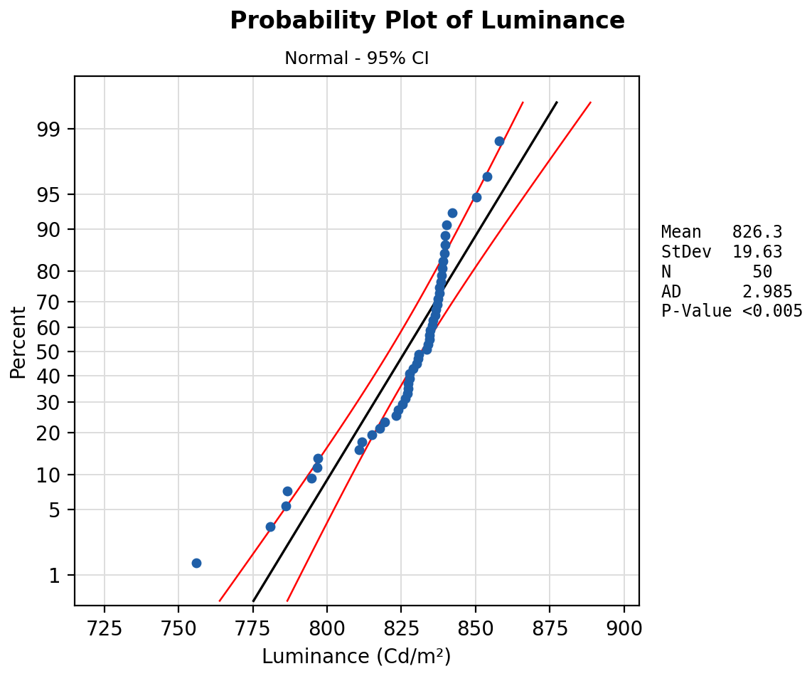
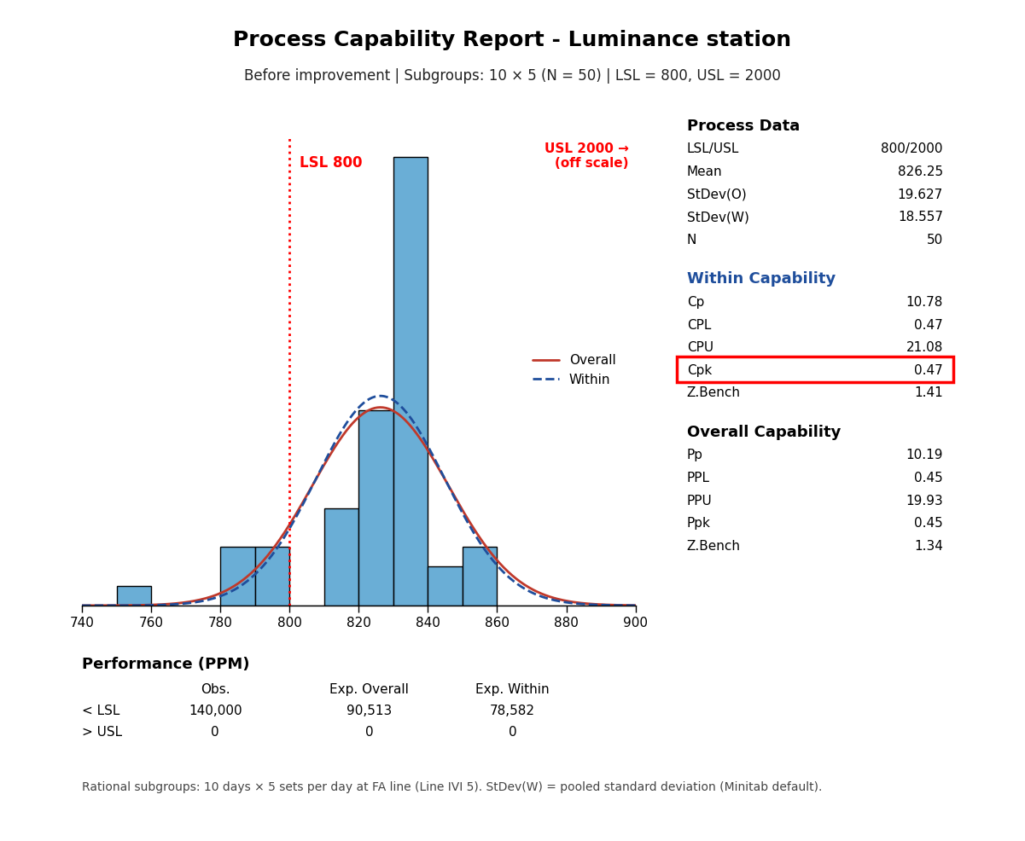
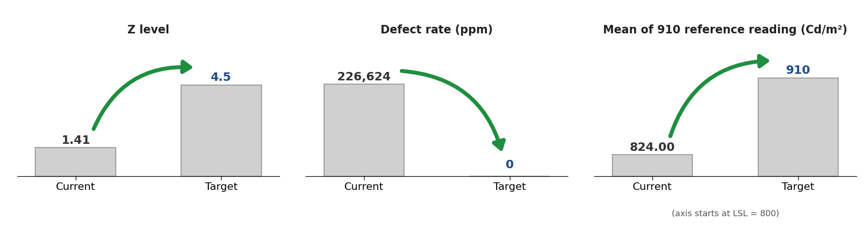
2.4 Result of current Cpk
Measure
Define
Analyze
Improve
Control
Current Cpk
P-value < 0.005 < 0.05 → NG
(Data do not follow a normal distribution: low readings caused by the special cause, see 2.3. Cpk is used as an indicator; the observed 14% below LSL confirms it.)
Current process capability: Cpk = 0.47 < 1.33 (Ppk = 0.45) → NG
Lack of process capability
The process mean 826.25 is close to the LSL 800; about 14% of the readings (7 of 50) are below the LSL.
Baseline sample: 50 subgroup readings measured at FA production line (Line IVI 5), see 2.3. StDev(W) = 18.557 (pooled), StDev(O) = 19.627.
Target of improvement
Improvement goal (practical): measure the luminance correctly, i.e. the reference sample reads 910 Cd/m² (bias → 0).
(Before improvement) Cpk = 0.47, Z = 1.41 → (After improvement) Cpk ≥ 1.33, Z ≥ 4.5
Defect rate 226,624 ppm → 0 ppm; target mean ≥ LSL + 4.5σ = 800 + 4.5 × 18.56 ≈ 884 Cd/m²

Slide 11


3.1 Root cause of measurement system problem
Analyze
Define
Measure
Improve
Control
After the Type 1 study, we see that the measurement system of the Luminance station has problems, so a logic tree is used to find the root cause
Power supply
Power supply is stable
Power supply is not affected
Machine
Pallet
All model used same kind of pallet
Changing pallet no different
Camera equipment (CS2000)
Measure incorrectly

Change new camera
Logic tree analysis
Camera Angle is changed
Change angle of camera

Luminance at the station
CANSIM
CANSIM send weak signal for LCD recognize
Change new CANSIM

Material
Set
Return LCD and check on vendor → result is OK
LCD is not affected
Method
Sequence test, timing
Sequence is used for all model, but only this model have issue
Sequence is not affected
Plug in set to pallet not fully
Other function is OK, only Luminance is NG
Not relate to set plugging in
Man
Working skill
Automatic process
Man is not related

: Potential factor

Slide 12
3.1 Root cause of measurement system problem
Analyze
Define
Measure
Improve
Control
2 Samples T
No | Potential Factors | List checking | Tool to identify
1 | CANSIM send weak signal to LCD recognized | Checking luminance value before /after change to new CANSIM | 2 sample T
2 | Measure incorrectly | Checking luminance value before /after change to new camera | 2 sample T
3 | Camera angle changed | Checking luminance value before /after changing angle of detector | 2 sample T

: Potential factor

Slide 13
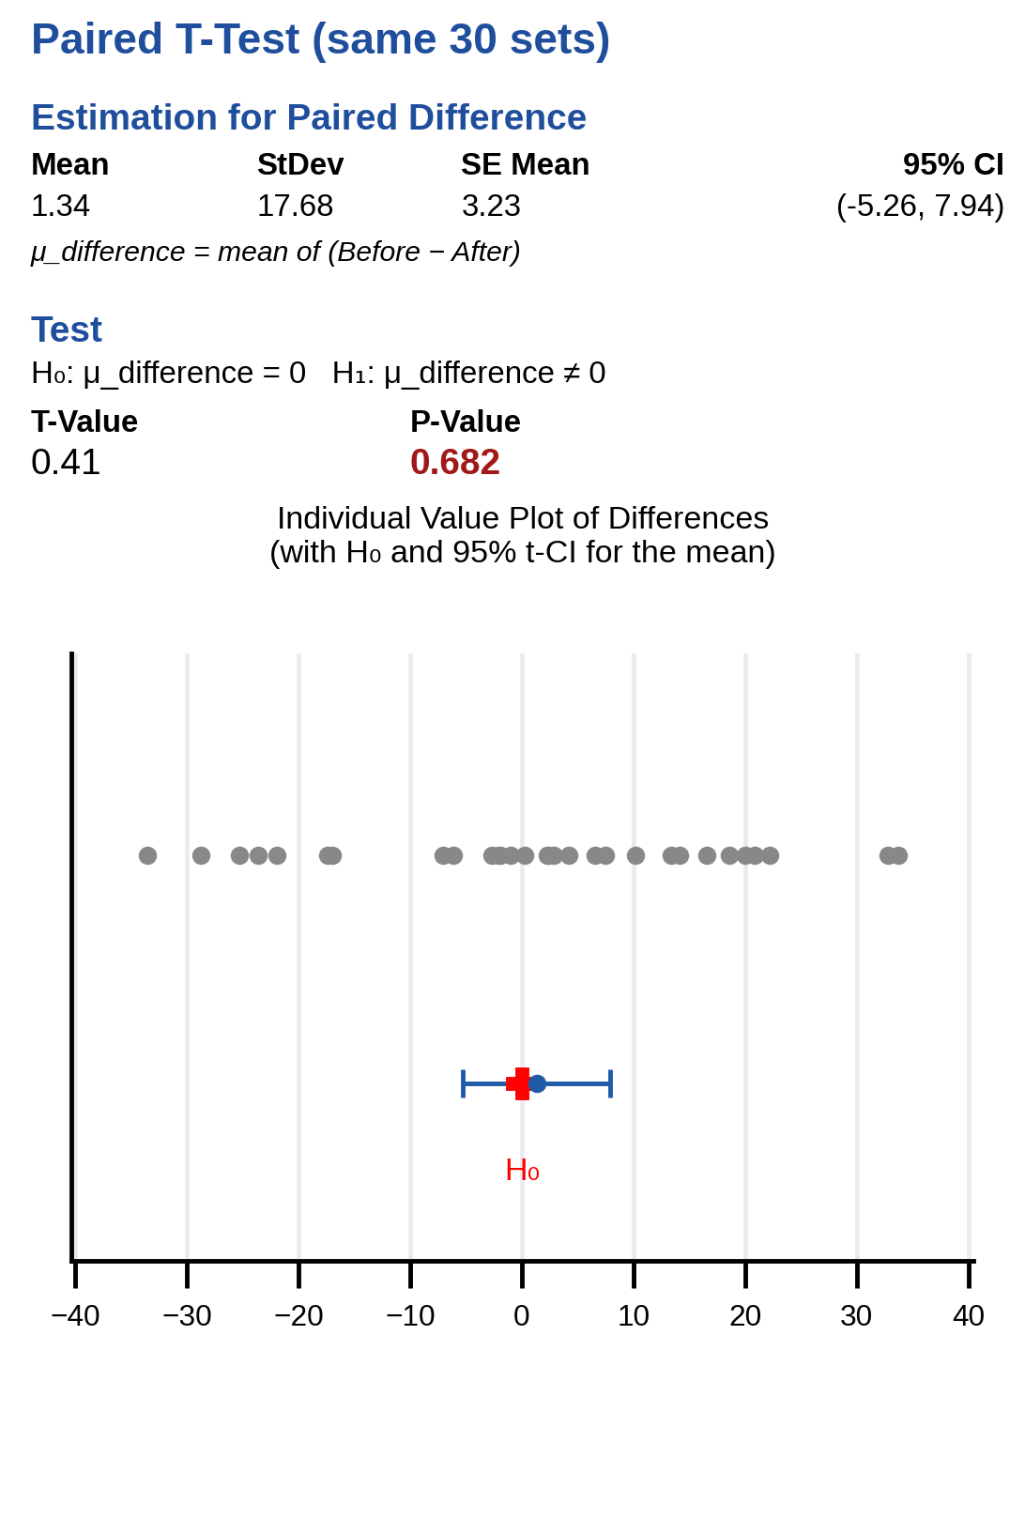
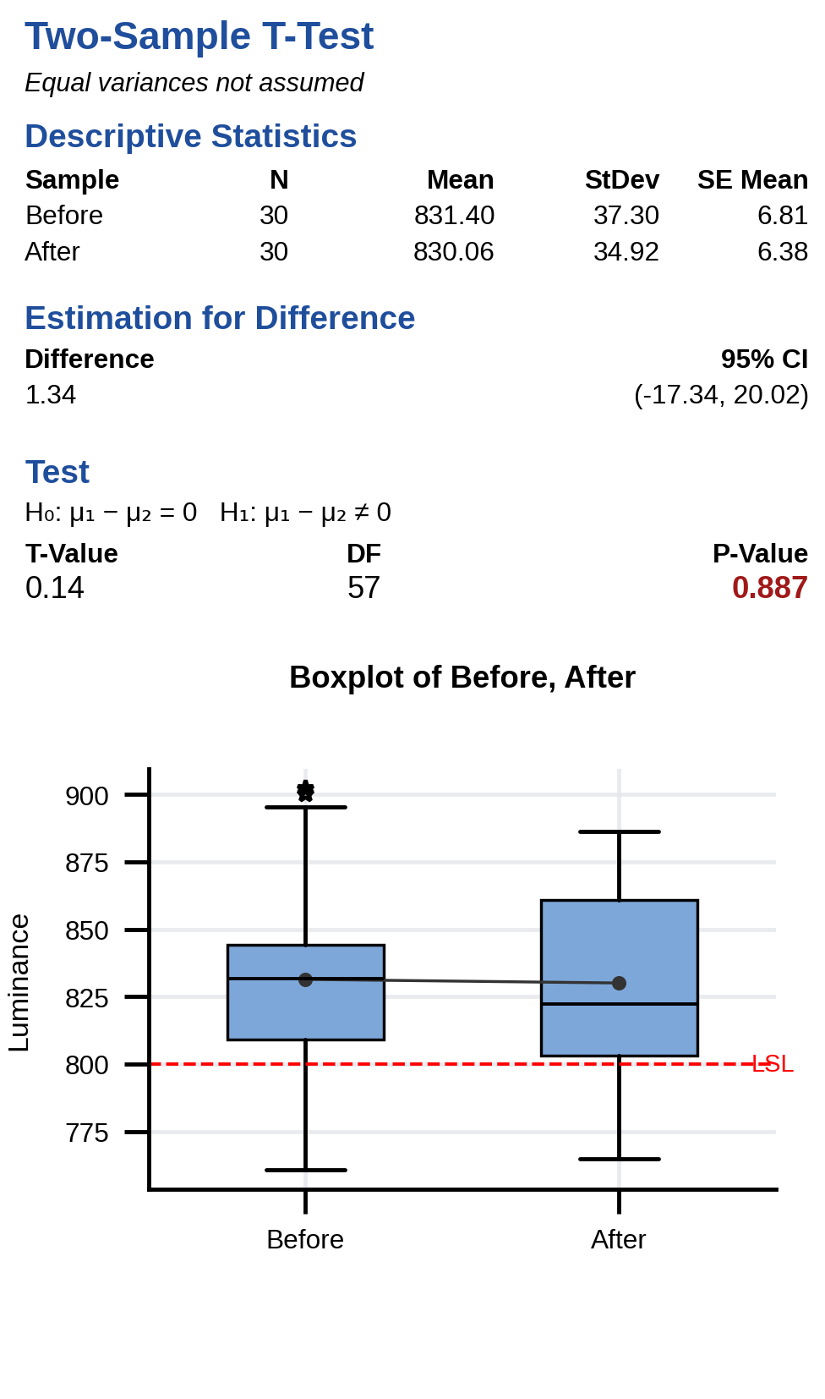
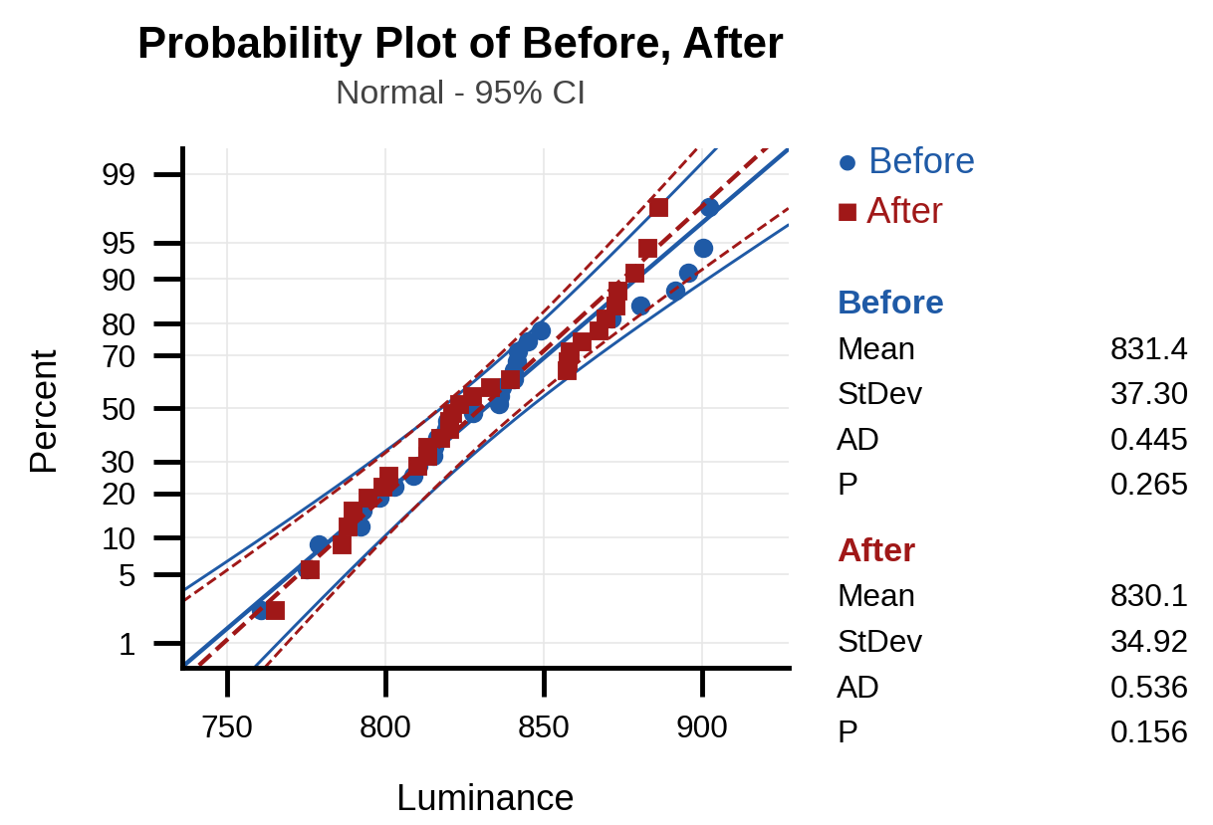
3.1 Root cause of measurement system problem
Analyze
Define
Measure
Improve
Control
2 Samples T _ Analysis
Detection Luminance from CANSIM of the Luminance station_Change to the new CANSIM
H0: Changing the CANSIM does not affect the luminance at the Luminance station
H1: Changing the CANSIM affects the luminance at the Luminance station
Normality OK for both samples (Anderson-Darling P = 0.265 / 0.156 > 0.05) → t-test can be used. Mean 831.4 → 830.1 Cd/m² (difference 1.3, inside the measurement noise).
Paired t (same 30 sets): P-value = 0.682 > 0.05 -> Fail to reject H0 (No significant difference before/after changing CANSIM).
2-sample t: P = 0.887 > 0.05 → both tests agree: CANSIM factor eliminated.

Slide 14
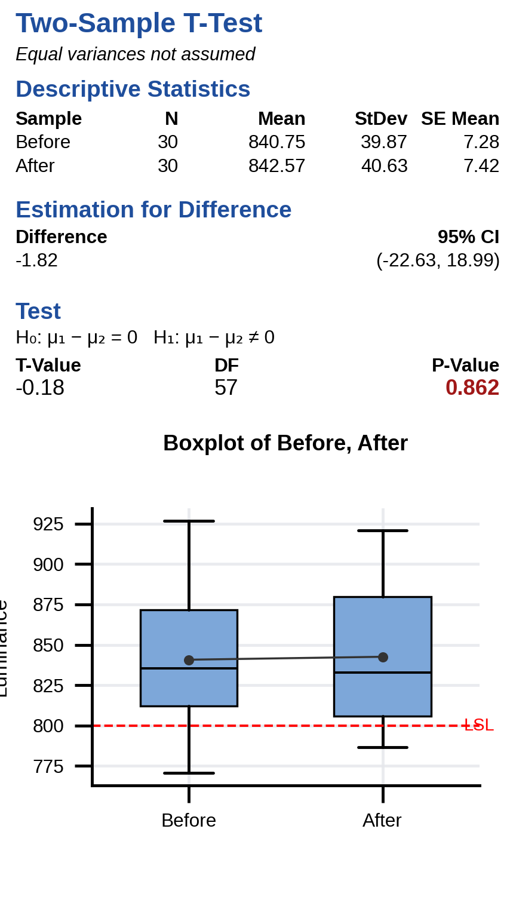
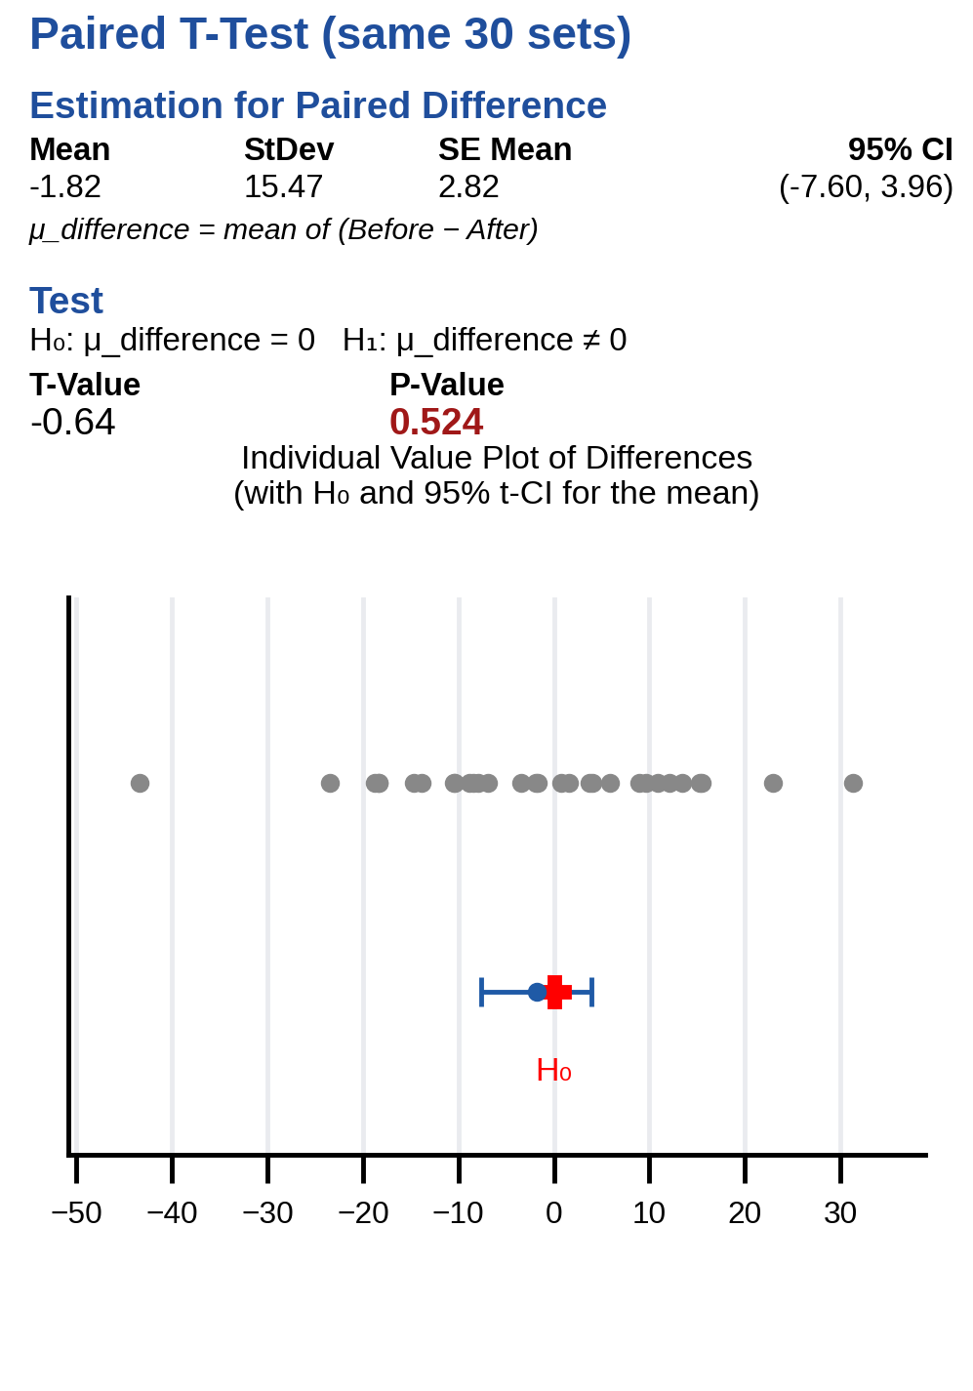
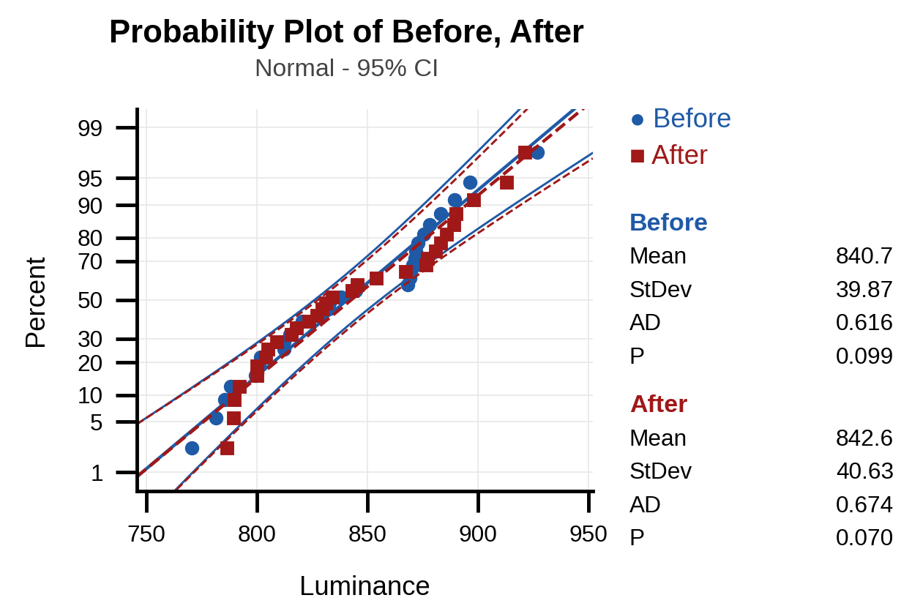
3.1 Root cause of measurement system problem
Analyze
Define
Measure
Improve
Control
2 Samples T _ Analysis
Detection Luminance from Camera of the Luminance station_Change to the new camera
H0: Changing to the new camera does not affect the luminance at the Luminance station
H1: Changing to the new camera affects the luminance at the Luminance station
Normality OK for both samples (Anderson-Darling P = 0.099 / 0.070 > 0.05) → t-test can be used. Mean 840.7 → 842.6 Cd/m²: a new camera at the same (wrong) angle gives the same low reading.
Paired t (same 30 sets): P-value = 0.524 > 0.05 -> Fail to reject H0 (No significant difference before/after changing camera).
2-sample t: P = 0.862 > 0.05. Both tests agree: the camera has no significant effect (Factor eliminated).

Slide 15
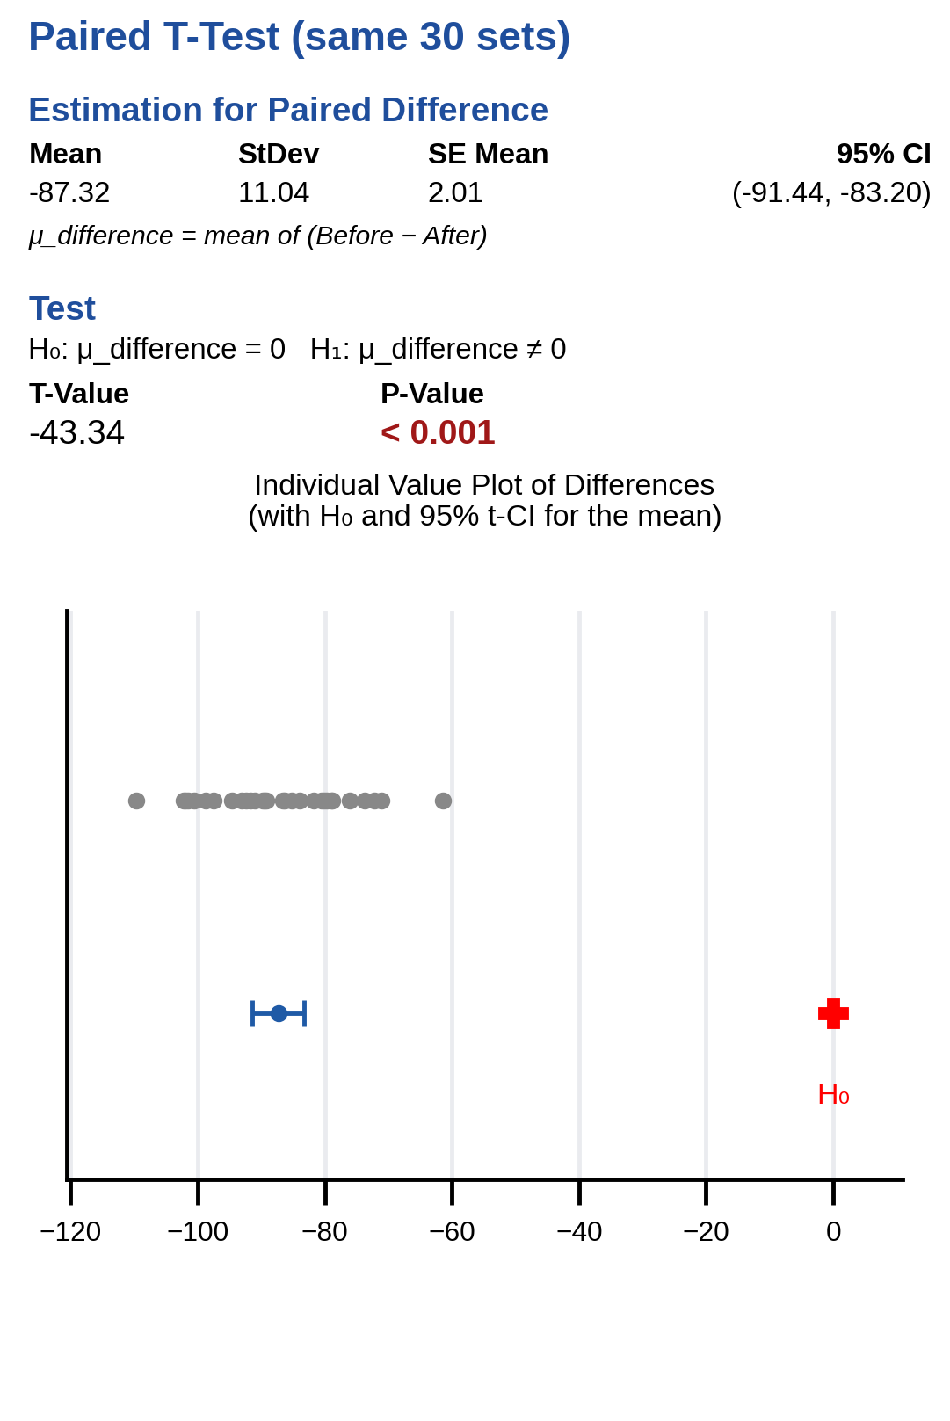
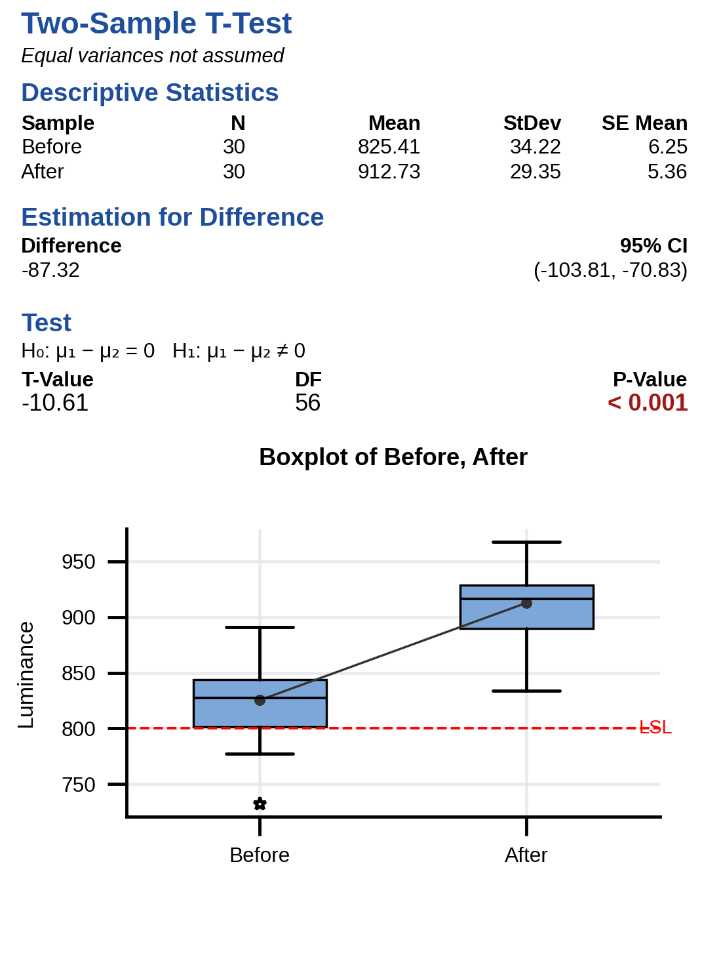
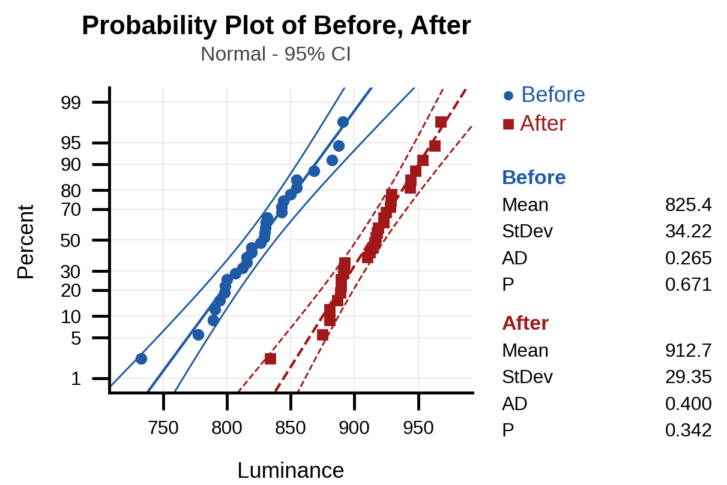
3.1 Root cause of measurement system problem
Analyze
Define
Measure
Improve
Control
2 Samples T _ Analysis
Detection Luminance from Camera of the Luminance station_Change to the angle of Camera
H0: Changing the camera angle does not affect the luminance at the Luminance station
H1: Changing the camera angle affects the luminance at the Luminance station
Normality OK for both samples (Anderson-Darling P = 0.671 / 0.342). After the angle correction the same 30 sets read 87.32 Cd/m² higher (825.4 → 912.7; 95% CI 83.20 to 91.44), the same size as the −86 Cd/m² bias found in the Type 1 study.
Paired t (same 30 sets): T = −43.34, P-value < 0.001 (< 0.05) -> Reject H0 (Significant difference before/after angle adjustment).
2-sample t (Welch): T = −10.61, P < 0.001. Changing camera angle significantly affects luminance → Root Cause verified!

: Potential factor

Slide 16
3.1 Root cause of measurement system problem
Analyze
Define
Measure
Improve
Control
2 Samples T
No | Potential Factors | List checking | Tool to identify | P value | Conclusion
1 | CANSIM send weak signal to LCD recognized | Checking luminance value before /after change to new CANSIM | 2 sample T | 0.682 | Not root cause (P > 0.05)
2 | Measure incorrectly | Checking luminance value before /after change to new camera | 2 sample T | 0.524 | Not root cause (P > 0.05)
3 | Camera angle changed | Checking luminance value before /after changing angle of detector | 2 sample T | < 0.001 | Root Cause (Significant effect, P < 0.05)


: Potential factor

Slide 17



3.1 Root cause of measurement system problem
Analyze
Define
Measure
Improve
Control
Problem
Cause
Improvement
Progress Monitoring
• Issue: Luminance NG ppm (Model: J1 Dual)
• Defect date: Feb-2026 | Station: Luminance
• Q’ty: 92 ea / 383,333 ppm (Total before: 143 ea / 631 = 226,624 ppm)
Root Cause: 5-Why Analysis
1. Why occur? Luminance value measured under spec (800~2000 Cd/m²).
2. Why under spec? Camera axis not perpendicular (90°) to the LCD surface.
3. Why angle changed? Long production time caused angle drift from 90° standard.
4. Why did angle drift? Dual display (PID/CID) requires camera motion; vibration loosened fixture.
5. Why no prevention? No daily Master sample check sheet to verify angle before production.
Improvement
Progress Status
1. Teaching robot & adjust angle of CS2000 Camera (Std: 90.0°)
Remark
Schedule
Owner
Jun
Verify
1. Adjust angle
of CS2000
Camera
14- Jun
Mr. Hung PE
2. Monitoring
result
14- Jun
Mr. Hung PE
2. Add check sheet to measure Master sample and verify Camera angle
[Luminance NG]
3. Inform supplier (Heesung): LCD is not a cause (returned LCD OK at vendor), no process change needed
Field Checking
Field Workability
Field Interview
Date: Feb-2026
Line: IVI 5
Area: FA production line
Detail Checking: Visual check the cable of LCD with PCBA to check set OK or not
Easy Working: ✔ (automatic test, no operator action)
Difficulty Working: –
Impossible Working: –
Working Feeling: Can detect by program
With who: Mr. Chien LQC
Field request: when issues happen, the repair member uses repair station to check if NTF, PE member check the camera status.

Slide 18







4. Improvement (short term)
Define
Measure
Analyze
Improve
Control
4.1 Correct the camera angle (before / after)
Before measurement
XZ: 89.075º ; YZ: 88.806º
After measurement
XZ: 89.889º ; YZ: 89.889º
PID
CID
PID
CID
X
Y
Y
Z
X
Z
After adjusting the detector camera angle to the 90.0° target (measured 89.889°), 5 J1 Dual PPR RHD sets were re-tested (PE data): before 853.95 / 1052.40 / 850.68 / 870.22 / 796.79 Cd/m² (1 NG) → after 954.01 / 1094.30 / 952.56 / 971.34 / 901.94 Cd/m² (0 NG), average +90 Cd/m². Correcting the CS2000 camera angle is confirmed as the effective solution.

Slide 19




4. Improvement (short term)
Define
Measure
Analyze
Improve
Control
4.1 Correct the camera angle: camera position and servo position
1. Camera position is correct after checking.
→ Camera center coincides with the SET center
PID
CID
+
Center
J1 Dual PPR RHD
Camera
CS2000
2. LHD and RHD use the same servo positions (48, 49) but mirrored screens. → If the position is not correct, J1 PPR LHD will be NG.
(Servo positions 48 and 49: see the diagrams below)

Slide 20





4. Improvement (short term)
Define
Measure
Analyze
Improve
Control
4.2 Why only Privacy (PID) screens failed: angle sensitivity
→ A 1° tilt (89° → 90°) changes the measured luminance of a Privacy (LCF) screen by ≈ 13% (722.2 → 816.7 cd/m²) but a Public screen by < 0.5% (1255 → 1259 cd/m²). This explains why only the RHD Privacy (PID) screens failed while all Public models on the same station passed; these angle-sensitive positions (highlighted) are given priority in the daily Master sample check (slide 21, 28).
No | IVI 5 LINE |  |  | CS2000 Luminance change per 1° tilt
 | Model |  | BLU Type
1 | Bentayga (Bentley) | CID | Public(Normal) | -
2 | Macan LZV | CID | Public(Normal) | -
3 | 992 | CID | Public(Normal) | -
4 | J1 CID | CID | Public(Normal) | -
5 | G3 CID | CID | Public(Normal) | -
6 | E3PA CID | CID | Public(Normal) | -
7* | J1 Dual LHD | PID | Public(Normal) | -
 |  | CID | Public(Normal) | -
 | J1 Dual RHD | PID | Public(Normal) | -
 |  | CID | Public(Normal) | -
8 | Lamborghini | CID | Public(Normal) | -
9 | E3PA Dual LHD | PID | Privacy | -
 |  | CID | Public(Normal) | -
 | E3PA Dual RHD | PID | Privacy | 13%↑
 |  | CID | Public(Normal) | -
10 | G3 Dual LHD | PID | Privacy | -
 |  | CID | Public(Normal) | -
 | G3 Dual RHD | PID | Privacy | 13%↑
 |  | CID | Public(Normal) | -
11 | J1 Dual PPR LHD | PID | Privacy | -
 |  | CID | Public(Normal) | -
 | J1 Dual PPR RHD | PID | Privacy | 13%↑
 |  | CID | Public(Normal) | -
12 | G2 | CID | Public(Normal) | -
13 | E3 | CID | Public(Normal) | -
Privacy & Public Brightness changes depending on viewing angle
89°
90°
➔
Public
Privacy
89°
➔
90°
Privacy View Angle (PID)
Public View Angle (CID)
Difference between Privacy and Public: whether or not an LCF (louver) film is applied
for the privacy display function within the BLU module
* Discontinued model (J1 Dual LHD / RHD)

Slide 21



4. Improvement (long term)
Define
Measure
Analyze
Improve
Control
4.3 Add Master sample check sheet to control the camera angle
Before: no daily check of the camera angle, so an angle drift is not detected until NG sets appear.
After: a daily check sheet with the Master sample (reference 910 Cd/m²) at shift start to verify the camera angle.
Actual DID check sheet in production line
DID check sheet format
A daily check sheet is established to monitor equipment status using a Master sample. Because the J1 Dual model features dual displays requiring camera movement, camera angle status must be verified during pre-production setup to prevent angle deviation.

Slide 22
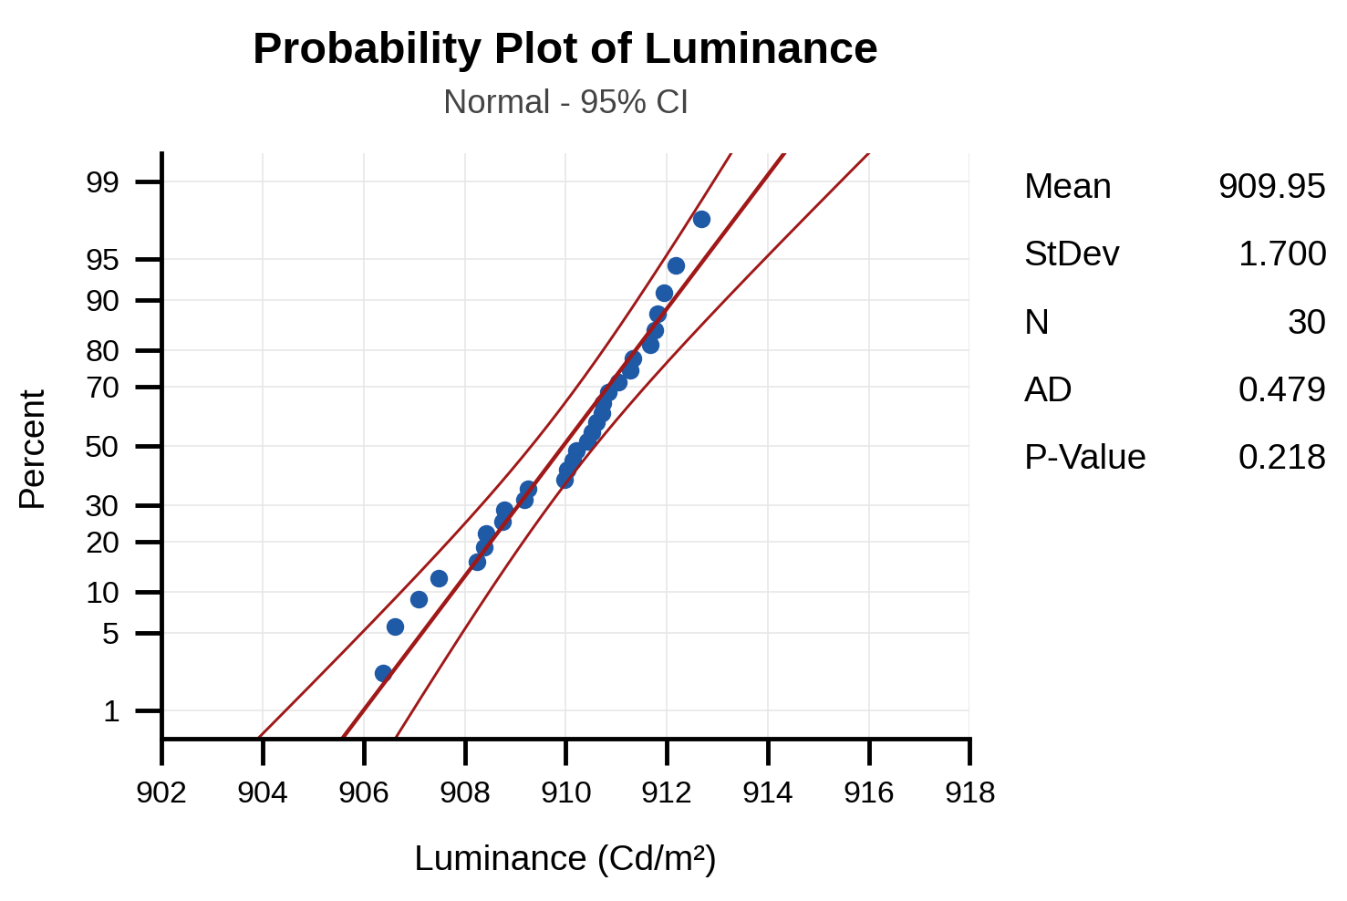
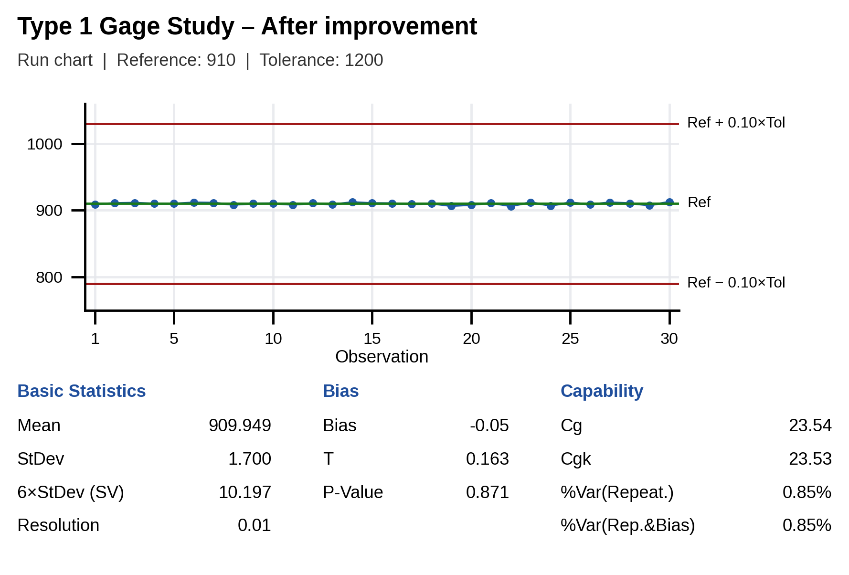
4.4 Type 1 Study again after improvement
Define
Measure
Analyze
Improve
Control
Luminance station
Use the Type 1 gage study to assess the measurement capability of the gage, based on its repeatability and bias after improvement.
In this case, one sample (golden sample, 910 Cd/m²) is measured 30 times.
H0: Bias = 0 in measurement system.
H1: Bias ≠ 0 in measurement system.
No | Luminance(Cd/m²) | No | Luminance(Cd/m²)
1 | 909.19 | 16 | 910.52
2 | 910.74 | 17 | 909.25
3 | 911.28 | 18 | 910.14
4 | 910.03 | 19 | 906.62
5 | 909.97 | 20 | 908.24
6 | 911.67 | 21 | 911.04
7 | 911.33 | 22 | 906.38
8 | 908.42 | 23 | 911.94
9 | 910.21 | 24 | 907.09
10 | 910.42 | 25 | 911.77
11 | 908.39 | 26 | 908.78
12 | 910.84 | 27 | 911.81
13 | 908.75 | 28 | 910.60
14 | 912.17 | 29 | 907.48
15 | 910.72 | 30 | 912.69
Spec: 800.00 ~ 2000.00
Reference value: 910 (golden sample)
Conclusion
• P value = 0.871 > 0.05 Fail to reject H0 -> No significant bias (PASS)
• Cg = 23.54 (Std ≥ 1.33) PASS | Cgk = 23.53 (Std ≥ 1.33) PASS
• %Var(Repeatability) = 0.85% (≤ 15%) PASS
• %Var(Repeatability & Bias) = 0.85% (≤ 15%) PASS | Bias −86.00 → −0.05 Cd/m²
✔ Equipment is OK. Camera CS2000 of the Luminance station can be used to measure Luminance value.
22 / 29

Slide 23


4.4 Type 3 Study again after improvement
Define
Measure
Analyze
Improve
Control
Luminance station
After adjusting camera angle to 90.0°, Type 3 Gage Study was repeated for the Luminance station to verify measurement repeatability.
No | Data | No | Data
1 | 946.86 | 13 | 928.45
1 | 949.24 | 14 | 919.77
2 | 871.49 | 14 | 918.29
2 | 871.89 | 15 | 919.34
3 | 846.49 | 15 | 918.22
3 | 847.85 | 16 | 903.63
4 | 901.35 | 16 | 900.43
4 | 898.05 | 17 | 847.94
5 | 951.03 | 17 | 850.22
5 | 950.78 | 18 | 872.57
6 | 890.56 | 18 | 869.91
6 | 892.16 | 19 | 948.43
7 | 855.23 | 19 | 950.59
7 | 851.36 | 20 | 918.35
8 | 889.44 | 20 | 920.88
8 | 886.99 | 21 | 846.80
9 | 882.94 | 21 | 847.89
9 | 882.16 | 22 | 870.83
10 | 933.20 | 22 | 871.74
10 | 937.61 | 23 | 961.99
11 | 861.69 | 23 | 963.88
11 | 859.00 | 24 | 931.05
12 | 854.84 | 24 | 936.46
12 | 856.49 | 25 | 877.87
13 | 926.83 | 25 | 877.12
% Contribution of Gage R&R = 0.22% < 1% → OK
% Study Var = 4.64% < 10% → OK
% Tolerance = 0.86% < 10% → Can use to judge OK/NG
NDC: 30 > 5 → OK
Conclusion : Measurement system of the Luminance station is Good after improving measurement system
Notes:
Assess the variation of each source and of any additional factor that affects the measurement system.
H0 (ANOVA, part effect): all part means are equal
H1: at least one part mean is different
VarComp %Contribution: almost all of the variation comes from part-to-part, so the measurement system can reliably distinguish between parts
%Study var: compare the measurement system variation to the total variation
Follow AIAG guidelines: if %Study Var and %Tolerance are below 10% (and %Contribution below 1%), the measurement system is acceptable. Here all three are below the limits and NDC ≥ 5, so the measurement system is Good.

Slide 24

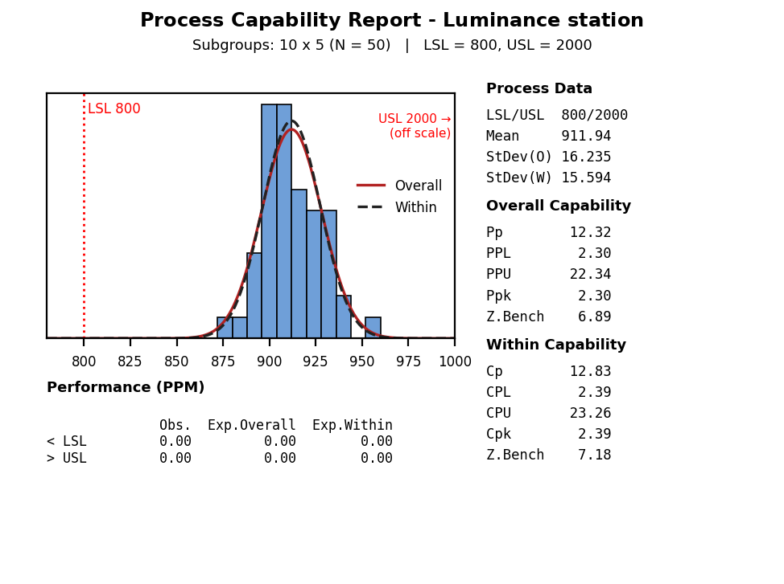
D
I
C
M
A
4.5 Process Capability review
Define
Measure
Analyze
Improve
Control
Luminance station
Before (2.4): Cpk = 0.47 (Z = 1.41) → Standard ≥ 1.33 → NG, lack of process capability
After: Cpk = 2.39 (Z = 7.18) → Standard ≥ 1.33 → OK, good process capability
To evaluate process capability of the Luminance station:
Normality test (Anderson-Darling): H0: data follow a normal distribution; H1: data do NOT follow a normal distribution.
P-value = 0.503 > 0.05 -> Fail to reject H0 -> No evidence against normality (PASS)
(Data can be treated as normally distributed)
Cpk = 2.39 (= CPL; USL 2000 is far from the process) (Goal ≥ 1.33; target ≥ 1.67) → Pass

Slide 25
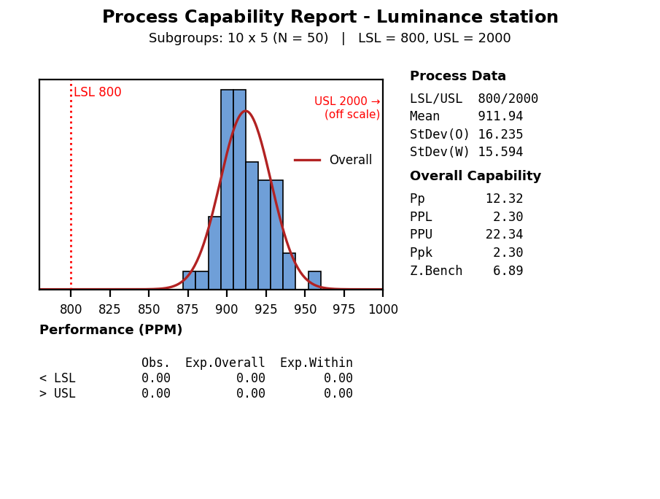
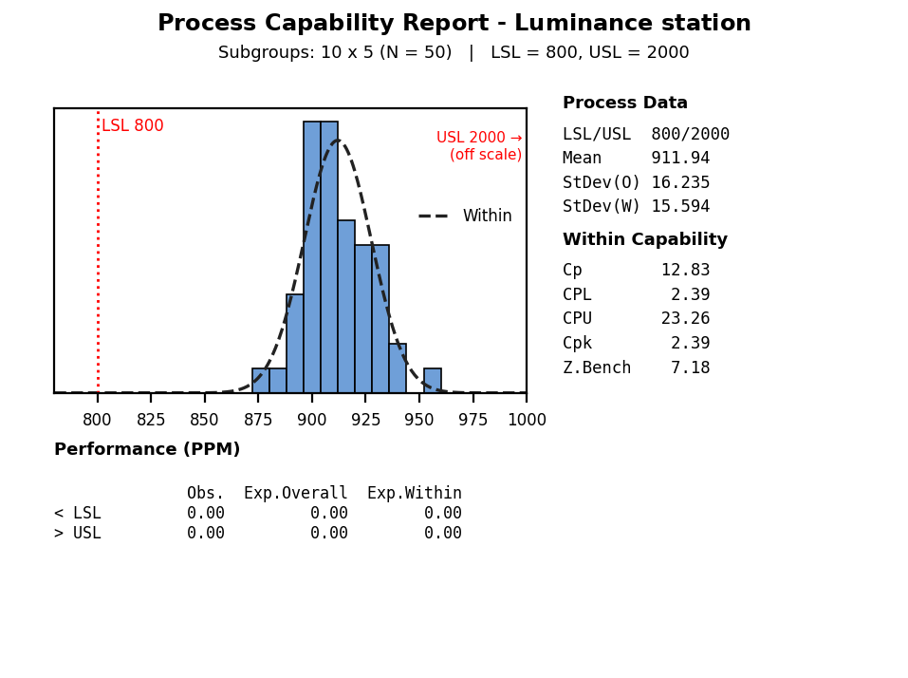
D
I
C
M
A
4.5 Process Capability review (Z value)
Define
Measure
Analyze
Improve
Control
Luminance station
Z Long term = 6.89
Standard ≥ 4.5
→ OK
Z Short term = 7.18 Standard ≥ 4.5
→ OK
Z _{shift}
Lack of management
Lack of skill
Lack of management
Proper skills
Zshift = Zst – Zlt = 7.18 – 6.89 = 0.29 → Z shift < 1.5
→ Proper process control management
Z short term: 7.18 ≥ 4.5 , Z long term: 6.89 ≥ 4.5
→ Technology is OK
A
B
1.5
Control
C
D
Proper management
Lack of skills
Proper management
Proper skills
4.5
Z_{ST} Or Z_{ST}(Bench)
Poor
Technology
Good
Notes:
Zst: within (short-term), Zlt: overall (long-term). The short-term process capability (Zst) represents the best capability of the current process. Zlt represents the process capability from the customer’s perspective.
Over time the quality deteriorates because of tool and equipment wear, variation between workers and changes of environment. Zshift = Zst − Zlt indicates the degree of deterioration; a shift of about 1.0 to 1.5 is typical. If Zshift is greater than 1.5, management (control) is judged not good; if Zshift is less than 1.5, management is judged good.
Cpk is a measure of the potential capability of the process and equals the minimum of CPU and CPL. Cpk is a ratio that compares two values:
The distance from the process mean to the closest specification limit (USL or LSL)
The one-sided spread of the process (the 3-σ variation) based on the within-subgroup standard deviation
Cpk considers both the location and the variation (within subgroups) of the process.

Slide 26
4.6 Conclusion
Define
Measure
Analyze
Improve
Control
After evaluation, we confirmed that the measurement system at the Luminance station had significant problems during testing. We proved that camera angle misalignment was the root cause of the Luminance NG defect.
We improved the measurement system by correcting the camera angle to 90.0°. We then verified stability and capability using Type 1 Study, Type 3 Gage R&R, Xbar-R control chart, and Process Capability analysis at the Luminance station.
The results demonstrate that the measurement system now achieves high repeatability and no significant bias (Type 1: Cg/Cgk ≥ 1.33; Type 3: %Study Var < 10% and %Contribution < 1%), and the process measured at the Luminance station shows excellent capability (Cpk 0.47 → 2.39; Z 1.41 → 7.18). Result vs goal: Luminance defect rate 226,624 ppm → 0 ppm (0 NG / 420 units after improvement; 95% upper confidence bound ≈ 7,100 ppm, still > 96% below the baseline).

Slide 27
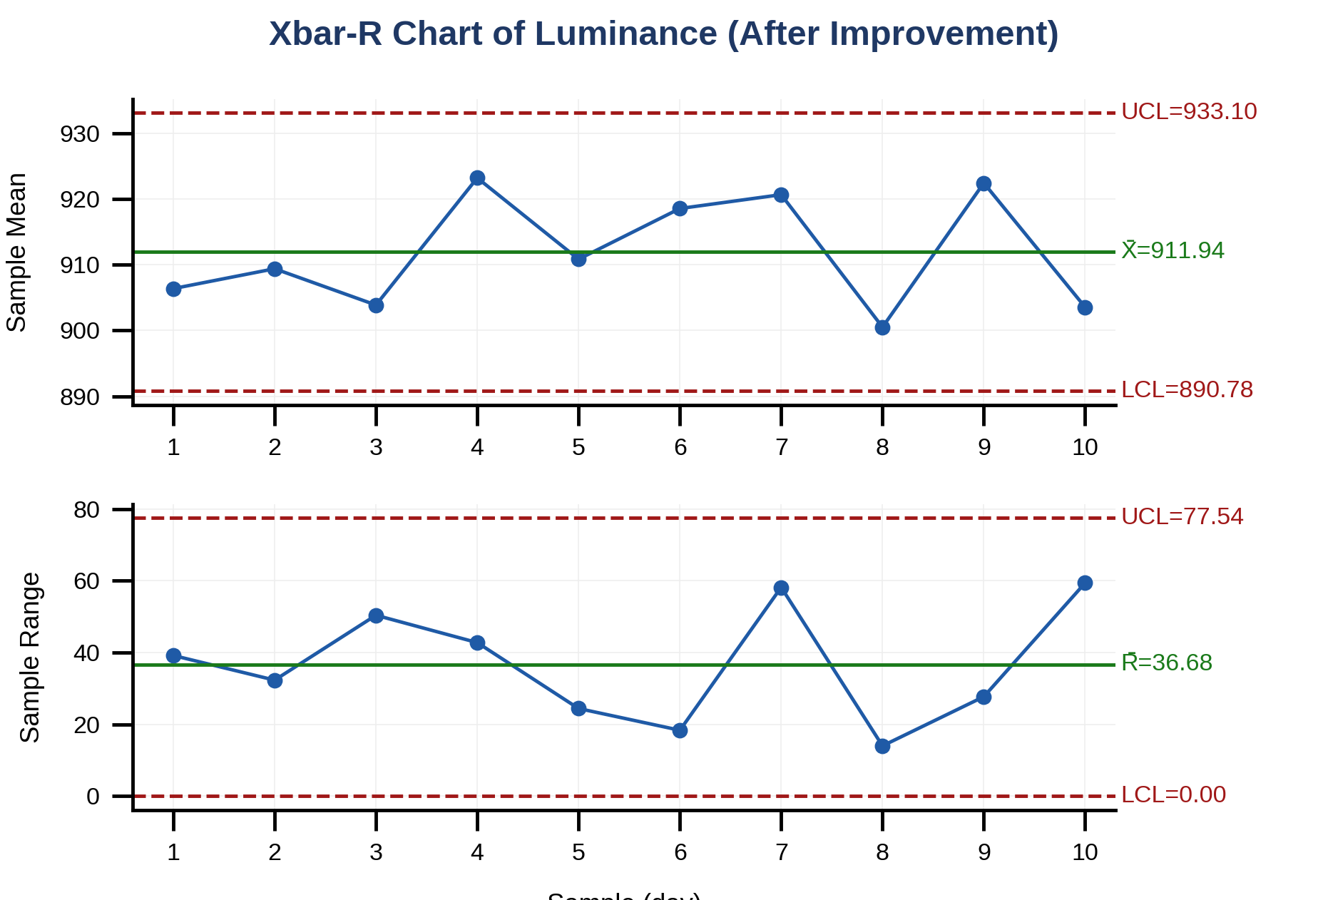
D
I
C
M
A
5.1 Xbar-R Chart Review after improvement
Define
Measure
Analyze
Improve
Control
Luminance station
To monitor the mean and the variation of process after applying improvement and use control chart to monitor process stability over time.
- Sampling method: rational subgroups of the first 5 sets per day at the production line, for 10 days (1-Jul to 10-Jul-2026).
Date | Sample 1 | Sample 2 | Sample 3 | Sample 4 | Sample 5
1-Jul | 903.99 | 888.65 | 927.84 | 910.28 | 901.09
2-Jul | 910.09 | 898.47 | 930.79 | 906.56 | 901.04
3-Jul | 934.62 | 905.74 | 884.21 | 897.26 | 897.52
4-Jul | 926.69 | 897.88 | 940.66 | 917.92 | 932.89
5-Jul | 901.07 | 919.56 | 916.63 | 920.68 | 896.27
6-Jul | 921.35 | 919.07 | 910.92 | 929.27 | 912.16
7-Jul | 931.37 | 899.74 | 907.23 | 957.93 | 907.04
8-Jul | 902.12 | 906.54 | 893.01 | 893.85 | 907.01
9-Jul | 909.81 | 925.48 | 937.52 | 920.73 | 918.64
10-Jul | 893.27 | 904.75 | 873.01 | 914.26 | 932.42
Conclusion:
No out-of-control point and no abnormal pattern (run tests) was found in the Xbar and R control charts. Therefore the process is stable over time.

Slide 28
5.2 Future plan (Management plan)
Define
Measure
Analyze
Improve
Control
Management plan
Master Sample Management Procedure:
• Inspection Timing: Daily at shift start (08:00~10:00 for day shift, 20:00~22:00 for night shift).
• Responsible: PM Technician & Line Leader.
• Procedure:
1. Test the Master Sample (reference 910 Cd/m²) at the Luminance station; the reading must be inside the control limits 910 ± 5 Cd/m² (≈ ±3s of the Type 1 study after improvement, s = 1.70) and inside spec (800~2000 Cd/m²).
2. If a reading is out of the limits, stop judging OK/NG and report immediately to Line Leader; PE & PM teams will inspect the camera angle (target 90.0°) and confirm with the Master Sample again before restarting.
3. GMES version checking (SW/HW) is skipped during Master Sample testing to focus strictly on hardware measurement stability.
Standardization & horizontal deployment (planned):
• Add the camera-angle check (target 90.0°) to the pre-production setup standard (SOP) of the Luminance station.
• Apply the same Master sample check to the other dual-display models measured with the CS2000 (E3PA Dual, G3 Dual, J1 Dual PPR); the RHD Privacy (PID) screens are the most angle-sensitive (≈ 13% per 1°, slide 20), so on a Privacy PID master a 1° tilt (≈ −12% ≈ −105 Cd/m²) is far outside the ±5 limit and is detected at once.
• Keep monitoring with the Xbar-R chart; if a point goes out of control, apply the reaction plan above (step 2).

Slide 29
5.3 Result of project
Define
Measure
Analyze
Improve
Control
Summary: Luminance defect rate of J1 Dual model before / after improvement
Quantitative performance (vs goal)
Defect rate: 226,624 ppm → 0 ppm (0 NG / 420 sets). Goal 0 ppm: achieved
Cpk: 0.47 → 2.39 (goal ≥ 1.33). Z: 1.41 → 7.18 (goal ≥ 4.5)
MSA: Type 1 bias −86.00 → −0.05 Cd/m², Cgk 0.94 → 23.53; Type 3 %Study Var 31.66% → 4.64%, NDC 4 → 30
Cost: scrap of NG LCD avoided: 19 LCD × 118.72 $ = 2,255.68 $ per month at the March-2026 level (≈ 27,068 $/year if that level had continued)
Qualitative performance
Root cause of a long-standing issue (since Nov.2025) found by data (2-sample t) and fixed at the source (camera angle).
Measurement system made reliable and controlled daily (Master sample check sheet, SOP).
Lesson learned shared to the other dual-display / Privacy models (E3PA Dual, G3 Dual, J1 Dual PPR).
 | Before |  |  |  | After
Date | 16.Nov.2025 | 2.Jan.2026 | 23.Feb.2026 | 1.Mar.2026 | 15.Jul.2026 | 21.Aug.2026 | 20.Sep.2026
Total NG | 13 | 8 | 92 | 30 | 0 | 0 | 0
Prod Q'ty | 200 | 120 | 240 | 71 | 240 | 120 | 60
Defect rate (ppm) | 65,000 | 66,667 | 383,333 | 422,535 | 0 | 0 | 0
After improvement: 0 NG / 420 sets → 95% upper confidence bound ≈ 7,100 ppm (3/420), still > 96% below the 226,624 ppm baseline. Fisher's exact test, 143/631 before vs 0/420 after: p < 0.001.

