Slide 1

Modern Approaches for Heuristic Algorithms in Network Architecture Searches (NAS) and tinyML
Daniel Duclos-Cavalcanti
Advisor:
M.Sc. and M.Eng. Alex Hoffman
Wissenschaftliches Seminar VLSI Entwurfsverfahren
TUM SoSe 2022

Slide 2
Contents
Introduction
  Historical Context and Motivation
Background
  Neural Architecture Search (NAS)
  Search Space
  Search Strategies
  Performance Estimation
State of The Art
  Evolutionary Neural Architecture Search (ENAS)
  TinyML and NAS
Conclusion

Slide 3
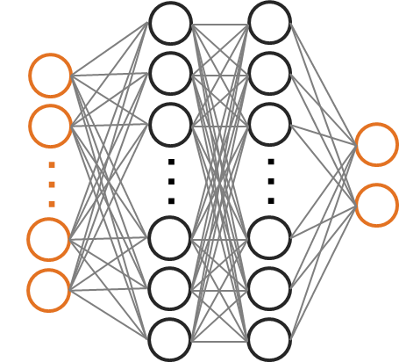
Introduction
  Deep Learning
    Groundbreaking technology
    Algorithms complexity increase
    Architecture engineering and domain expertise
  Neural Architecture Search (NAS)

Slide 4
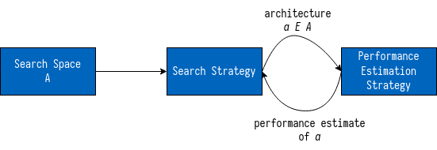
Background – Neural Architecture Search (NAS)
  NAS methods categorized by three dimensions:
    Search Space
    Search Strategy
    Performance Estimation Strategy

Slide 5
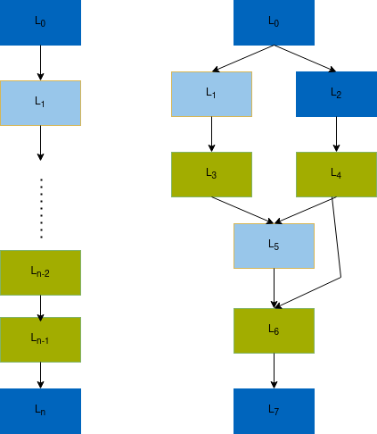
NAS – Search Space
  Optimization problem
  Exploration x Exploitation trade-off
  Chain-Structured NN (a) x Multi-Branch NN (b)
  (a)
  (b)

Slide 6
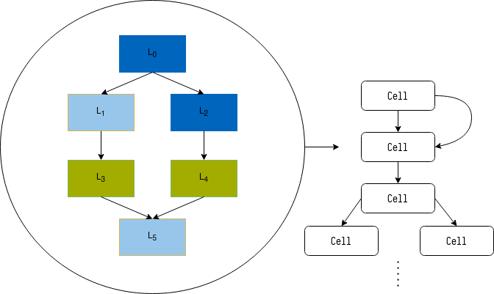
NAS – Search Space
  Optimization problem
  Exploration x Exploitation trade-off
  Cells x Blocks
  Macro x Micro architectures

Slide 7
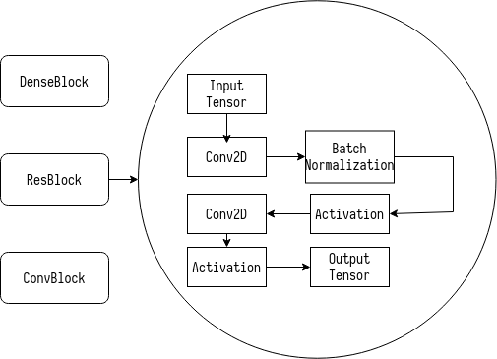
NAS – Search Space
  Optimization problem
  Exploration x Exploitation trade-off
  Cells x Blocks
  Macro x Micro architectures

Slide 8
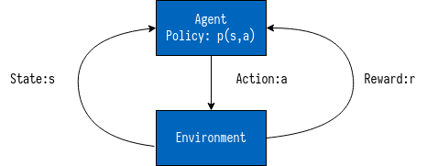
NAS – Search Strategy
  Reinforcement Learning (RL) - Based
    Agent’s action – generation of a neural architecture
    Action space – search space
    Agent’s reward – performance estimation
  Evolutionary Computation (EC) - Based
  Gradient-Based

Slide 9
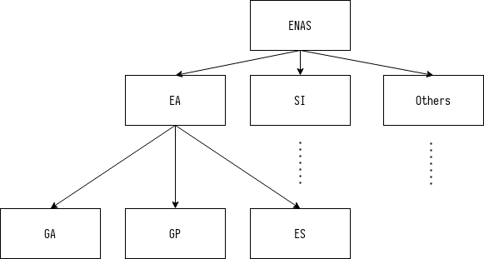
NAS – Search Strategy
  Reinforcement Learning (RL) - Based
    Agent’s action – generation of a neural architecture
    Action space – search space
    Agent’s reward – performance estimation
  Evolutionary Computation (EC) - Based
  Gradient-Based

Slide 10
NAS – Performance Estimation Strategy
  Bias vs Speed trade-off
Speed-up Method | How?
Lower Fidelity Estimates | Shorter training time, training on subset of the data, training on downscaled data or with downscaled models.
Learning Curve Extrapolation | Performance is extrapolated after just a small number of epochs and then decided upon directly. Hyperparameters to predict promising architectures after partial learning. Extrapolate partial learning curves to predict and eliminate sub-optimal architectures.
Weight Inheritance | Weights from previously trained models passed down to new ones.
Weight Sharing or One-Shot Models | All architectures as subgraphs of a supergraph (one-shot model). Weights are shared between specific architectures. Only one-shot is trained.

Slide 11
State-of-the-Art – NAS Overview
  Reinforcement Learning (RL) - Based
    Costly, hundreds even thousands of GPU days
  Gradiant Descent - Based
    Faster and efficient
    NAS and gradient-based not completely compatible
  Evolutionary Computation (EC) - Based
    Easily applicable to non-convex optimization problems
    Competetive models from trivial initial conditions
    No human interaction

Slide 12
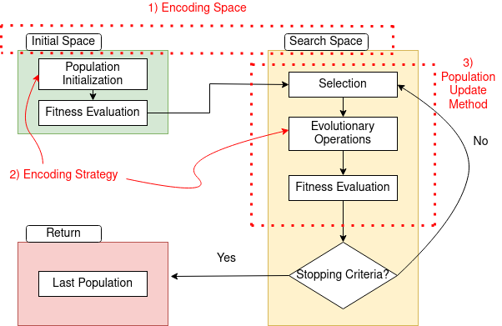
Evolutionary NAS (ENAS)
  Encoding Space
  Encoding Strategy
  Population Update
  ENAS Algorithm Flowchart

Slide 13
ENAS – Encoding Space
  Initial Space + Search Space
  Initialization
    Trivial Conditions
    Rich Initialization
    Random Initialization
  Bias vs Speed

Slide 14
ENAS – Encoding Strategy
  How network architectures are encoded into individuals
  Fixed-length vs variable length
  Easier implementation vs greater discovery freedom

Slide 15
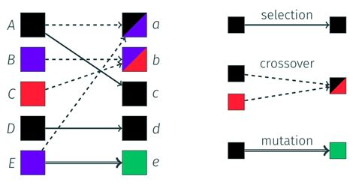
ENAS – Population Update Method
  Selection
    Elitism
    Discard worst or oldest
    Roulette
    Tournament Selection
  Evolutionary Operators
    Mutation
    Crossover
Source: https://minapecheux.com/website/2018/09/15/a-peek-at-genetic-algorithms/

Slide 16
State-of-the-Art – tinyML and NAS
  TinyML
    Port AI algorithms to constrained devices
    Training, pruning, quantizing and hardware design
    Not optimal, mutual influence of HW and algorithm
  McuNET
    TinyEngine and TinyNAS
    Optimizes search space according to memory, energy consumption, storage and latency
  MicroNETs
    Tailored differentiable NAS based on DARTS
    Regularization term, balance between eFlash memory x SRAM x accuracy

Slide 17
Conclusions
  NAS is a complex optimization problem with great promise.
  NAS can be used to optimize architecture search for multi-objective goals.
  This proves useful within the tinyML paradigm:
    Energy consumption
    Latency
    Memory Usage
    Storage

Slide 18
Questions

